Slide 1
CHALLENGE 4
Cloud-Based Data
Collection and Visualization
GROUP 3
AOSHUANG WANG, LAN YAO, YIXUAN HUANG, LAN LUO

Slide 2

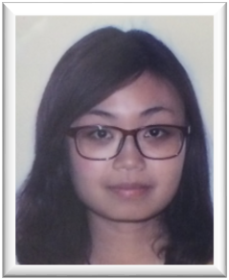


 | Lan Yao | Aoshuang Wang | Yixuan Huang | Lan Luo
Challenge 1 | Presenter
Challenge 2 |  |  | Presenter
Challenge 3 |  | Presenter
Challenge 4 |  |  |  | Presenter
Challenge 5
Challenge 6
Challenge 7
Challenge 8

Slide 3
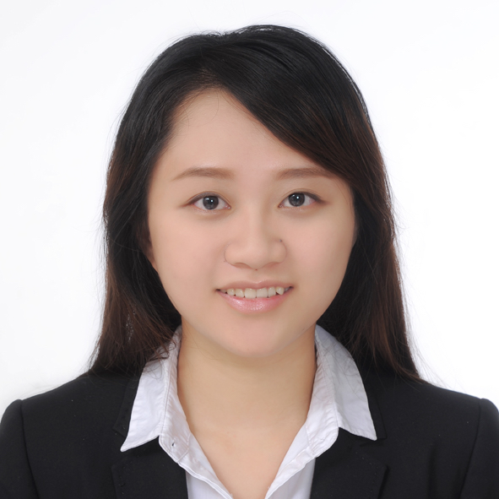
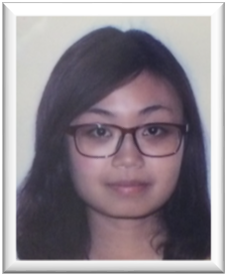
 | Lan Yao | Aoshuang Wang | Yixuan Huang | Lan Luo
 | Program Writing (unidirectional/ bidirectional) Webpage Control | Program Writing (unidirectional/ bidirectional) Webpage Control | Webpage Design Program Writing (bidirectional) Remote Access | Remote Access IOS App Design & Control

Slide 4
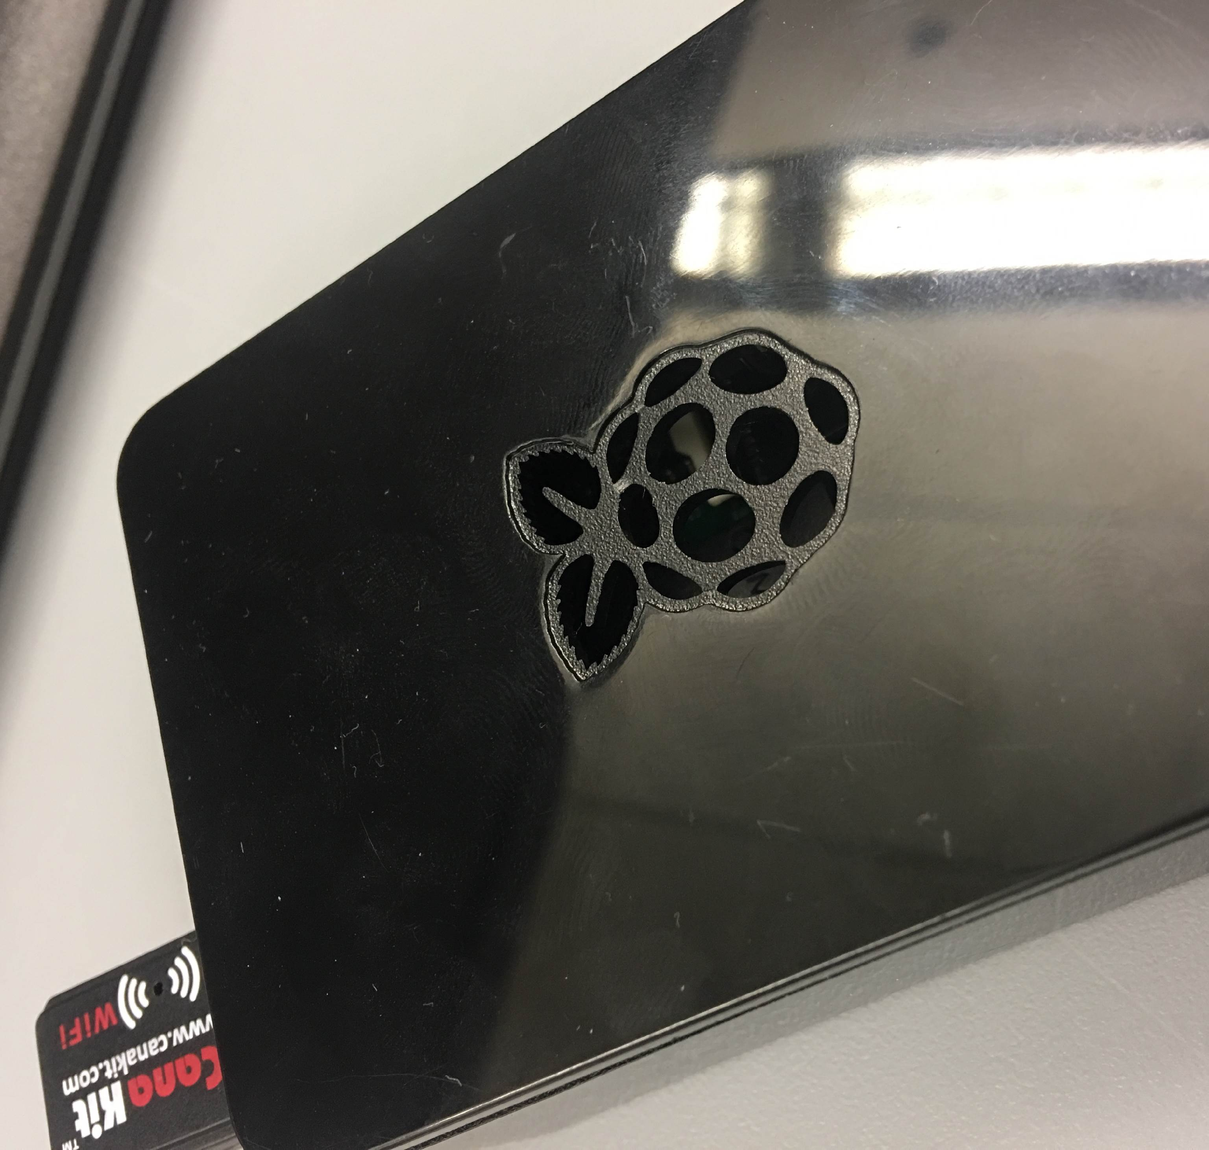
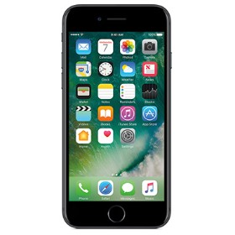
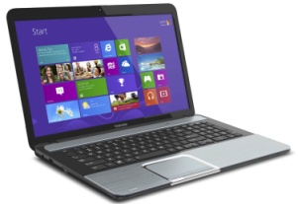
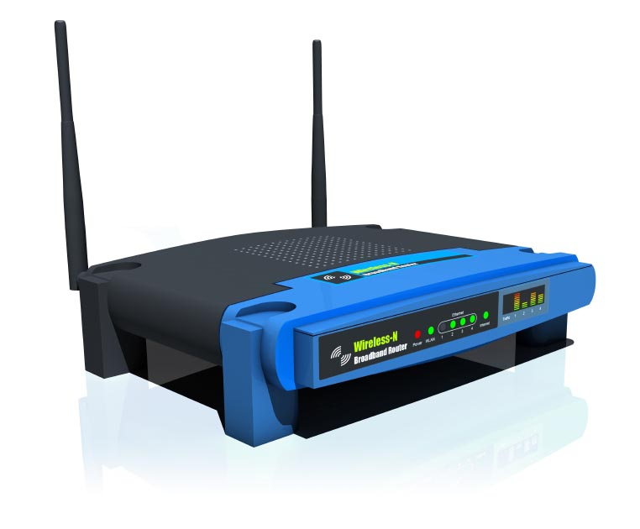
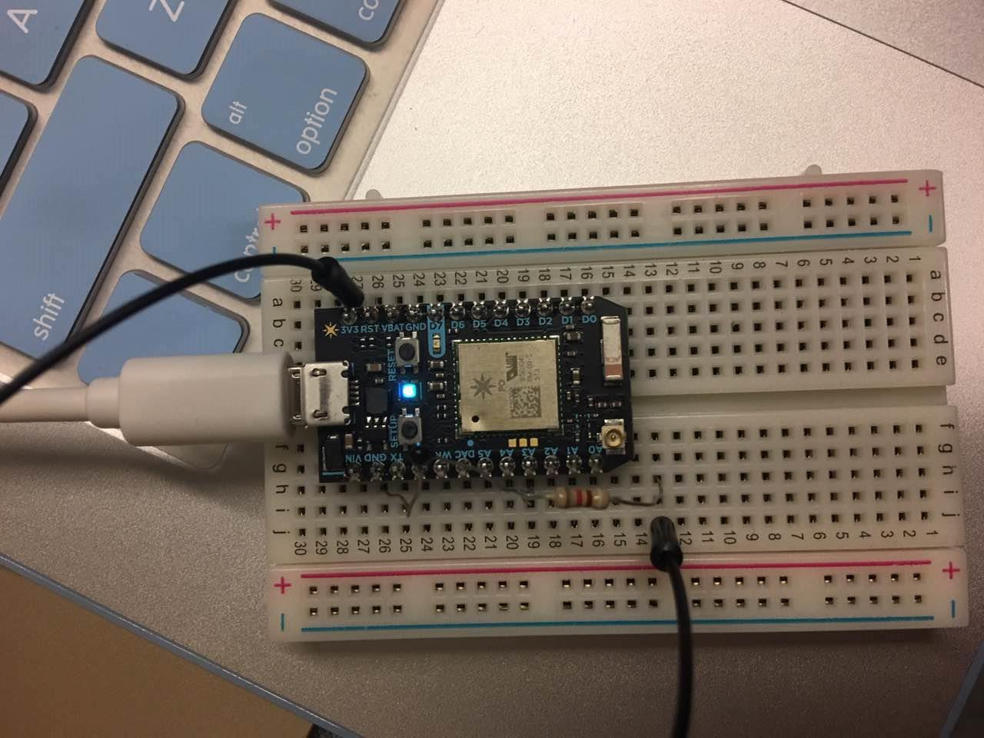
Devices
Raspberry Pi
Laptop
Phone
Router
Photons & thermistors

Slide 5
MAIN ARCHITECTURE
Photons
ThingSpeak
Real-time Chart
Particle Cloud
Historical
Chart Server
Historical
Chart
Server
Mongo DB

Slide 6

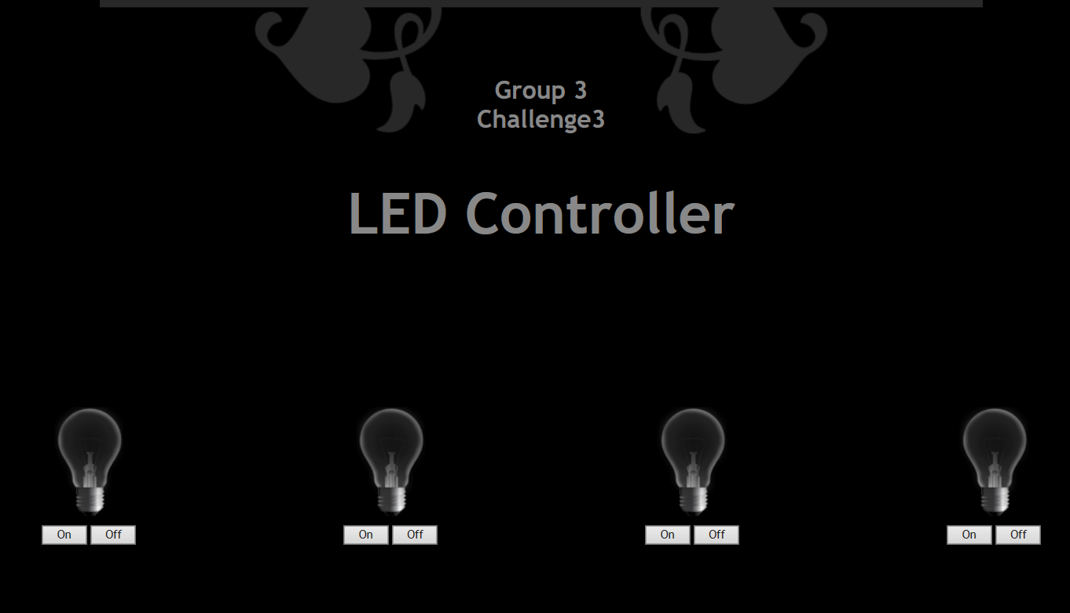
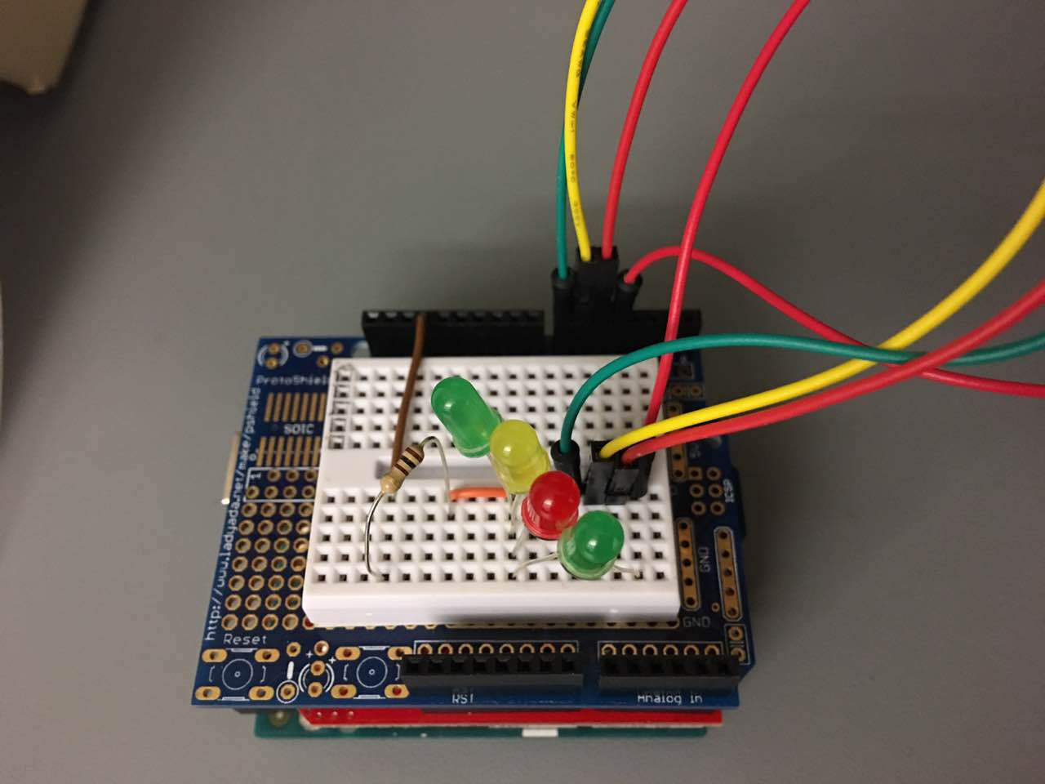

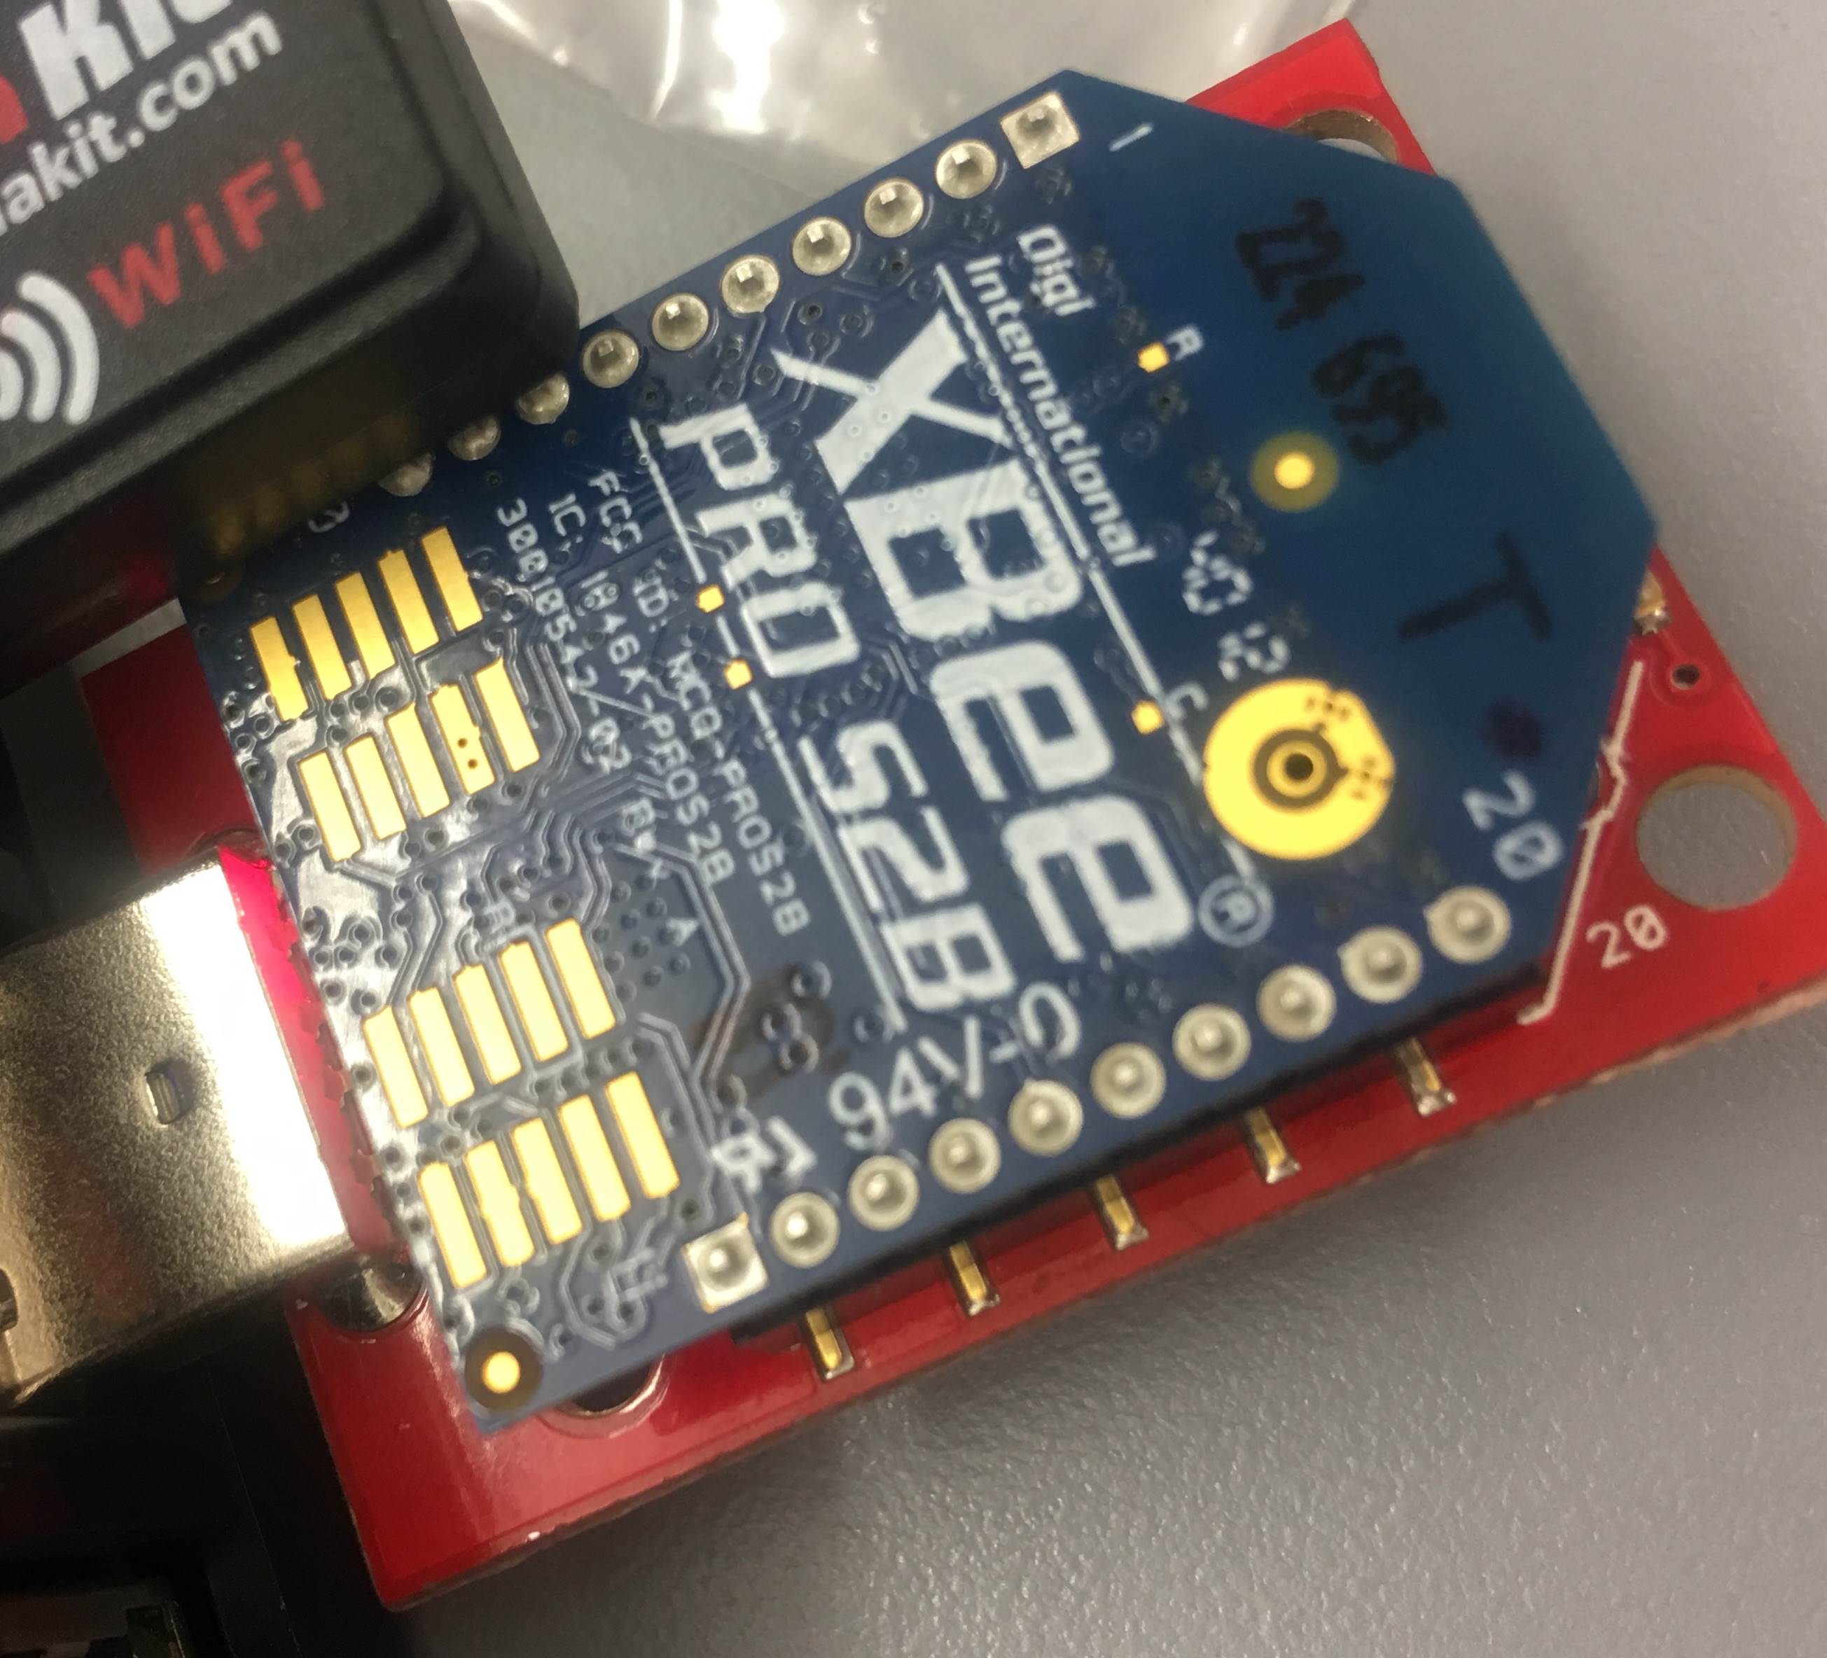
MAIN ARCHITECTURE
group3story.hopto.org
Port: 3000
Client: Laptop & Phone
Under Group3 WiFi
Port Forwarding
to Server’s Static
Address: 3000
Bidirectional
Data Exchange
Server: Pi & Laptop

Slide 7
DESIGN DETAILS
Particle Cloud:
Webhook

Slide 8
DESIGN DETAILS
Particle Cloud:
ThingSpeak:

Slide 9
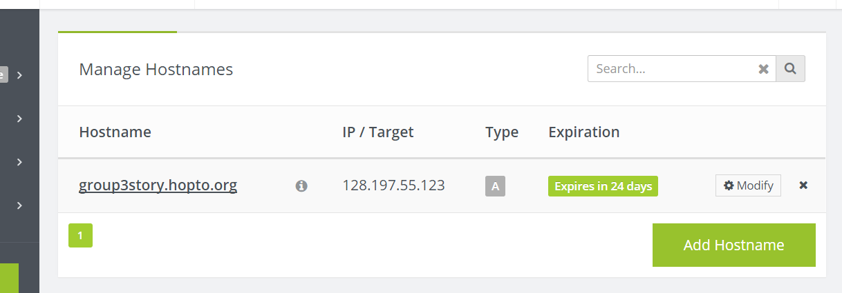
DESIGN DETAILS
Remote access control:
DDNS

Slide 10
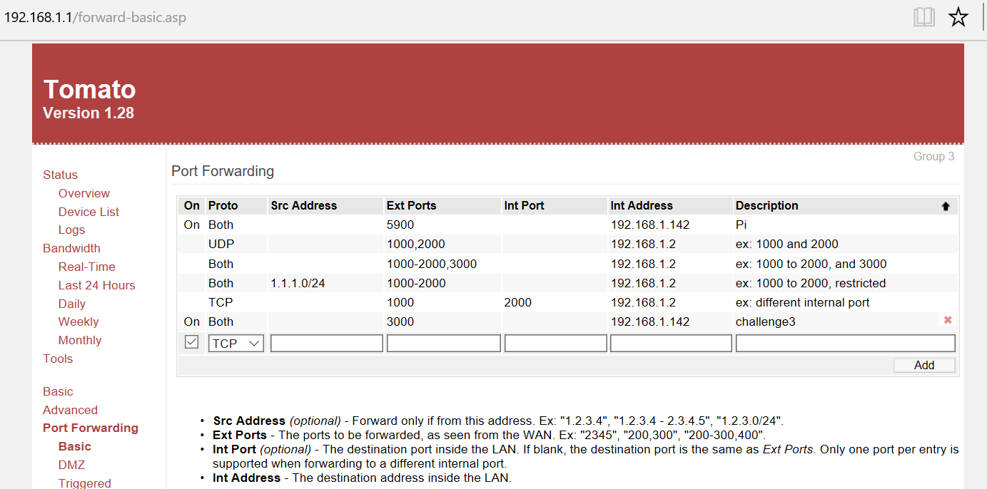
DESIGN DETAILS
Remote access control:
Port Forwarding:

Slide 11
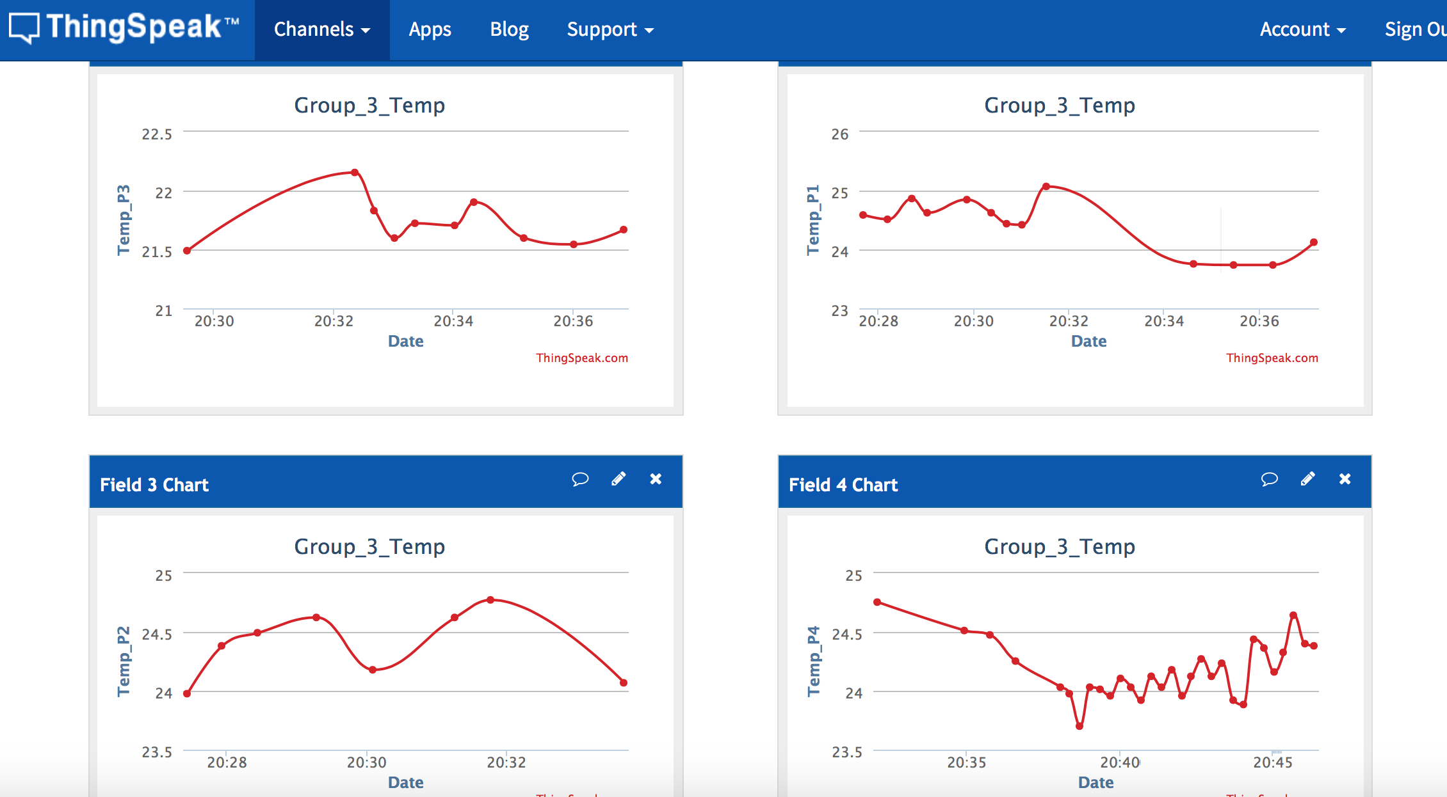
DISPLAY DETAILS
Real-time chart:

Slide 12
DISPLAY DETAILS
Historical Chart:

Slide 13
CHALLENGES ENCOUNTERED AND RESOLVED
Revise time zone of data
Publish data from 4 different photons for historical chart
VNC remote control raspberry Pi
Raspberry Pi memory issue

