Slide 1
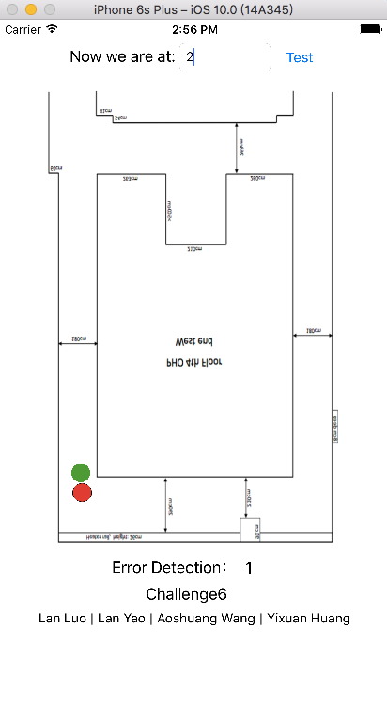
IOS Application

Slide 2
Function:
Movement tracking
Graphic display in 2D
Error Detection
Library:
socket.io-client-swift:
Socket.IO-client for iOS/OS X

