Slide 1
For each Arduino
We tag every Arduino(XBee) with its serial address, which is unique to every Xbee.
Maintain a list of addresses of XBees that it can successfully hear from.
Whenever we add a few more new Xbees into the network, the election system can handle it by adding the address of new Xbees to the tail of the list.

Slide 2
For each Arduino - Messages in payload includes :
Discovery :
Happens when a device is just set up/join the network at the first time
Acknowledge :
Happens when my device received a message of “begin election” from other devices
Election :
Happens when I am the one who starts the election
Victory :
Happens when I have won this election
Heartbeat :
Happens when I am the leader and I have to tell others that I am alive
Clear :
Happens when I am the leader and my button has been pressed
Infection :
Happens when I am the non-leader and my button has been pressed

Slide 3
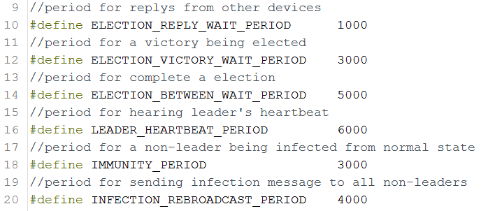
For each Arduino - Timers

Slide 4
Set up
Initial LEDs :
Light up three LEDs
Get My Serial Address
and use it as ID
leaderAddress=Myaddress
Send Message: MSG_DISCOVERY
To every device
Start counting my heartbeat

Slide 5
Loop
Read button state
Use 50ms time interval to debounce
Set LEDs status according to button state and leader/non-leader
Read packets from other devices and handle them
Record my heartbeats if I am the leader; or start election if I don’t hear heartbeat from leader anymore

Slide 6
Discovery
Send “Discovery”
Receive “Discovery”
Read Packet(MSG_DISCOVERY)
Receive ZB_RX_RESPONSEj
FALSE
TRUE
Leader Address=Remote Address
Ask for the correct message to be sent again
Get My Address from rxResponse
Leader Address<My Address
TRUE
Begin Election

Slide 7
Clear Infection
Read Pin Button
Present State=Last State
TRUE
FALSE
Did Press The Button & Button State Changes
Break
TRUE
Button State=LOW
TRUE
I am the leader
FALSE
isInfected=True
TRUE
isInfected=False
SendMessage: MSG_CLEAR

Slide 8
Every Time Receive A New Packet:
Receive a new packet
Ensure it is a ZB_RX_RESPONSE
Check if the device has already added into the device list
TRUE
FALSE
inList=TRUE
Add this device into device list
Continue

Slide 9
Begin Election:
Function Start
Is electing now?
YES
RETURN
NO
IsElecting=TRUE, isAcknowledge=FALSE, countdevice=0
For all devices, is its address bigger than my address?
FALSE
TRUE
SendMessage: MSG_ELECTION to that device

Slide 10
MSG_ELECTION - RECEIVE
Get message(MSG_ELECTION) from device A
SendMessage:MSG_ACK to device A
Device A get message(MSG_ACK) from that device
IsAcknowledege=TRUE
Variable isAcknowledge becomes TRUE only if one device is not the leader of the system, which means if we find isAcknowledge is FALSE in the main loop, this device should be the leader. Then it can send message MSG_VICTORY to every device.

Slide 11
MSG_ELECTION - SEND
I am the one who start the election?
NO
YES
Use a for loop to check devices in my list
NO
listAddress[i] > myAddress?
YES
Send MSG_ELECTION this address

Slide 12
MSG_VICTORY
Receive MSG_VICTORY
Remote Address> My Address?
FALSE
TRUE
Leader Address=Remote Address
Break
MSG_HEARTBEAT
Receive MSG_HEARTBEAT
TRUE
Remote Address > My Address
My Address=Leader Address
TRUE
FALSE
FALSE
Break
Leader Address=Remote Address

Slide 13
MSG_INFECTION
Receive MSG_INFECTION
Leader Address = My Address?
TRUE
FALSE
isInfected=TRUE
Break

