Slide 1
Product updates

Slide 2
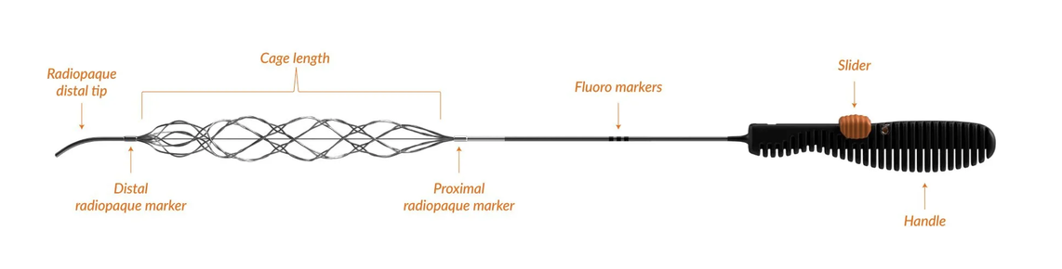
SPECIFICATIONS
(Illustrations not to scale)
BLACK HANDLE
Cage length
[US]
[T13,T17,T17U,T21,T25]
[OUS]
[T17,T17U,T21,TXL,T25]
Control
WHITE HANDLE
[US]
[T13M]
[OUS]
[T13]
Radiopaque
distal tip
Proximal radiopaque marker
Distal radiopaque marker
Fluoro markers
MODEL AVAILABILITY |
Black handle: [Model numbers] White handle: [Model numbers]
[or]

Slide 3

https://ous.rapid-medical.com/lvo
Products | Catalog Number | Cage Diameter (mm) | Cage Length (mm) | Minimum Microcatheter Compatibility ID (in) | Total Length excluding handle (cm)
TIGERTRIEVER™ 13 | TRPP3144 | 0.5 - 2.5 | 20.5 | 0.0165” / 0.013” | 233
TIGERTRIEVER™ 17 | TRPP3166 | 0.5 - 3.0 | 23 | 0.017” | 223
TIGERTRIEVER™ 17 ULTRA | TRPP3266 | 0.5 - 3.0 | 32 | 0.017” | 224
TIGERTRIEVER™ | TRPP3155 | 1.5 - 6.0 | 32 | 0.021” | 224
TIGERTRIEVER™ 25 | TRPP3125 | 1.5 - 7.5 | 53 | 0.025” | 226
Add row
*Not all products are available in all countries.
Removed “recommened vessel size column”

Slide 4
https://ous.rapid-medical.com/mvo
Product | Catalog Number | Cage Diameter (mm) | Cage Length (mm) | Minimum Microcatheter Compatibility ID (in) | Total Length excluding handle (cm)
TIGERTRIEVER™ 13 | TRPP3144 | 0.5 - 2.5 | 20.5 | 0.0165” / 0.013” | 233
TIGERTRIEVER™ 17 | TRPP3166 | 0.5 - 3.0 | 23 | 0.017” | 223
TIGERTRIEVER™ 17 ULTRA | TRPP3266 | 0.5 - 3.0 | 32 | 0.017” | 224
Add
*Not all products are available in all countries.
Removed “recommended vessel size column”

Slide 5
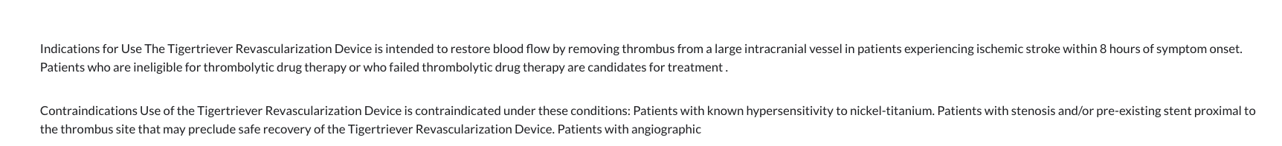
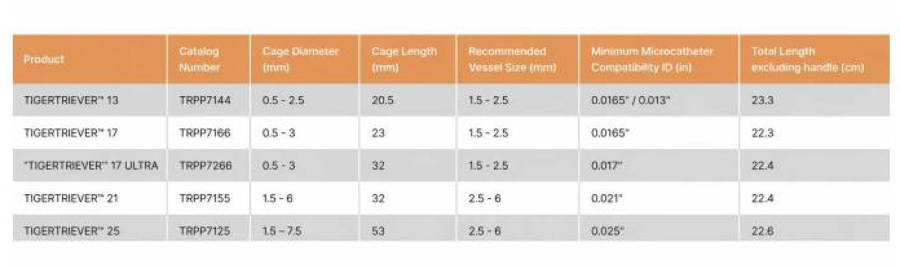
https://us.rapid-medical.com/lvo
Fix the data in this column.
Product | Catalog Number | Cage Diameter (mm) | Cage Length (mm) | Recommended Vessel Size (mm) | Minimum Microcatheter Compatibility ID (in) | Total Length excluding handle (cm)
TIGERTRIEVER™ 13 | TRPP7144 | 0.5 - 2.5 | 20.5 | 1.5 - 2.5 | 0.0165” / 0.013” | 233
TIGERTRIEVER™ 13 Micro | TRPP7244 | 0.5 - 2.5 | 20.5 | 1.5 - 2.5 | 0.0165” / 0.013” | 233
TIGERTRIEVER™ 17 | TRPP7166 | 0.5 - 3 | 23 | 1.5 - 2.5 | 0.0165” | 223
TIGERTRIEVER™ 17 ULTRA | TRPP7266 | 0.5 - 3 | 32 | 1.5 - 2.5 | 0.017” | 224
TIGERTRIEVER™ 21 | TRPP7155 | 1.5 - 6 | 32 | 2.5 - 6 | 0.021” | 224
TIGERTRIEVER™ 25 | TRPP7125 | 1.5 - 7.5 | 53 | 2.5 - 6 | 0.025” | 226
Add
*Not all products are available in all countries.
Add the following text to complete the sentence:
evidence of carotid dissection.

Slide 6
https://us.rapid-medical.com/access
Product | Catalog Number (single unit) | OD (in) | Effective length (cm) | Radiopaque length (cm) | Hydrophilic coating length (cm) | Distal tip length (mm) | Tip bend diameter (mm) | Microcatheter ID compatibility (in)
DRIVEWIRE™ 24 | DRPP2411 | 0.024” | 192 | 40 | 42 | 15.7 | 10 | 0.027”
DRIVEWIRE™ 35 | DRPP3511 | 0.035” | 180 | 44 | 42 | 15.7 | 10 | 0.043”
Replace the table
Indications for Use: The Drivewire Guidewire is intended for general intravascular use, including the neuro and peripheral vasculature. The Drivewire Guidewire is intended to facilitate the selective placement of diagnostic or therapeutic catheters. This device is not intended for use in the coronary arteries.
Updated language

