Slide 1
Natural language processing (NLP)
Presented by Lana almorabah

Slide 2
01
02
03
Concept
What problems can NLP solve?
Bert
04
conclusion
What is NLP?
NLP breakthrough
05
references

Slide 3
01
What is NLP?

Slide 4
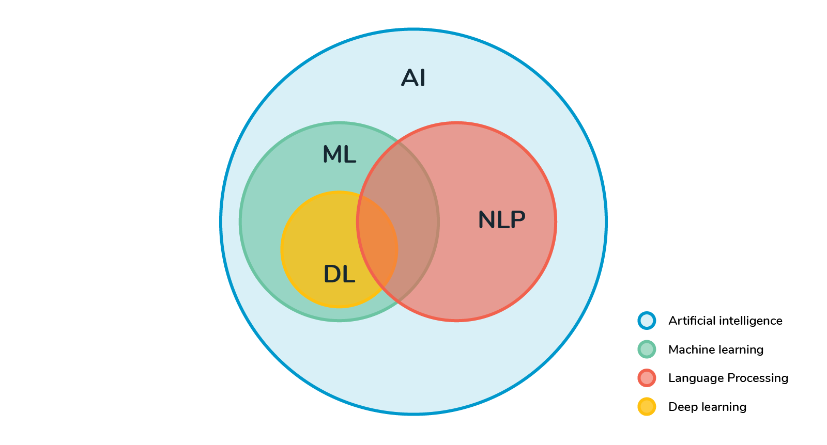
What is NLP?
Subfield of linguistics, computer science, and artificial intelligence concerned with the interactions between computers and human language[1]. It describes the ability to understand text and spoken words in much the same way human beings can.
Notes:
NLP combines computational linguistics—rule-based modeling of human language—with statistical, machine learning, and deep learning models

Slide 5
How do humans process language?
How much water do I give plants?
paris came to class late.
Pretty rough
She got cold feet
Notes:
Language consists of tone, context and intention. And not just a string of words

Slide 6
Why is natural language hard?
Different dialects
Segmentation issues
Idioms
Neologism
World knowledge
tricky entry names
Notes:
NLP combines computational linguistics—rule-based modeling of human language—with statistical, machine learning, and deep learning models

Slide 7
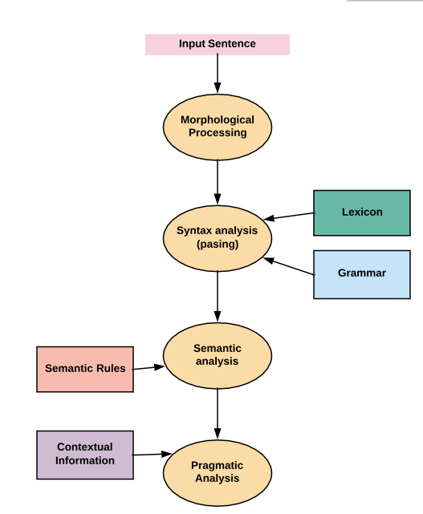
Components of NLP
Morphological and Lexical Analysis
Syntactic Analysis
Semantic Analysis
Discourse Integration
Pragmatic Analysis

Slide 8
Components of NLP
Morphological and Lexical Analysis
identifying and analyzing the structure of words
The lexical analysis divides the text into paragraphs, sentences, and words
lexicon normalization techniques such as stemming which is the process of reducing derived words to their word stem, base, or root
Notes:
“ing”, “ly”, “es”, “s”, etc

Slide 9
Components of NLP
Syntactic Analysis
Is Used to :
check grammar
arrangements of words
interrelationship between the words.
Notes:
“ing”, “ly”, “es”, “s”, etc

Slide 10
Components of NLP
Semantic Analysis
Is a structure that assigns mean to words
This component transfers linear sequences of words into structures. It shows how the words are associated with each other.
focuses only on the literal meaning of words, phrases, and sentences
“colorless green idea"
Notes:
This would be rejected by the Symantec analysis as colorless Here; green doesn’t make any sense.

Slide 11
Components of NLP
Semantic Analysis
Process of extraction of insights from the text. It includes the repetition of words, who said to whom? etc.
“close the window?”
Notes:
should be interpreted as a request instead of an order.

Slide 12
02
What problems can NLP solve?

Slide 13
Text Summarization
The main objective is to identify the significant sentences of the text and add them to the summary
There is two types of text summarization
-Extractive Text Summarization which uses exact sentences from the text in the summery
-Abstractive Text Summarization which Rephrases extracted sentences
Notes:
The method of extracting these summaries from the original huge text without losing vital information , In fact, the google news, the inshorts app and various other news aggregator apps take advantage of text summarization algorithms.

Slide 14
Topic Modeling
Is a technique that's capable of scanning a corpus (documents, tweets, etc.) , detecting word and phrase patterns within them, and automatically clustering word groups and similar expressions that best characterize a set of documents
Examples:
Filtering emails based on topic
categorizing research paper based on topic

Slide 15
Information extraction
Is the process of extracting specific (pre-specified) information from textual sources.
Examples:
Creating calendar entries from emails and text messages
Google’s featured snippets

Slide 16
Transcription
transcribe spoken audio into text.
Examples:
siri

Slide 17
03
Bert
Notes:
This framework learns information from both the right and left side of a word

Slide 18

What is BERT?
BERT stands for Bidirectional Encoder Representations from Transformers.
BERT is a deep learning framework, developed by Google, that can be applied to NLP.
Notes:
B : This makes it more efficient at understanding context.

Slide 19
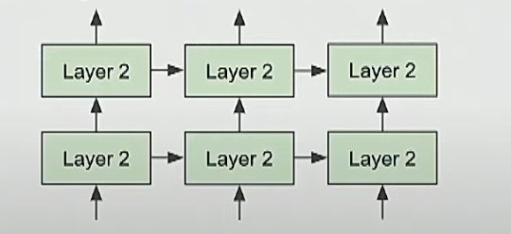
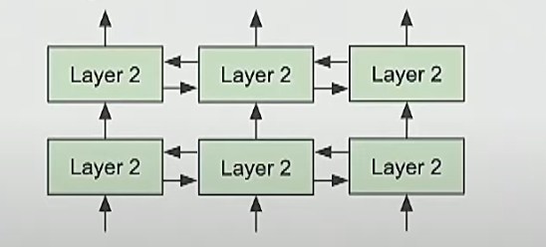
What is BERT?
Bidirectional (B)
Unidirectional: builds representation incrementally
Bidirectional: words can “see themselves”
Notes:
This framework learns information from both the right and left side of a word

Slide 20
What is BERT?
Encoder Representations (ER)
This refers to an encoder which is a program or algorithm used to learn a representation from a set of data. . In BERT’s case, the set of data is vast, drawing from both Wikipedia (2,500 millions words) and Google’s book corpus (800 million words).
Notes:
This framework learns information from both the right and left side of a word

Slide 21
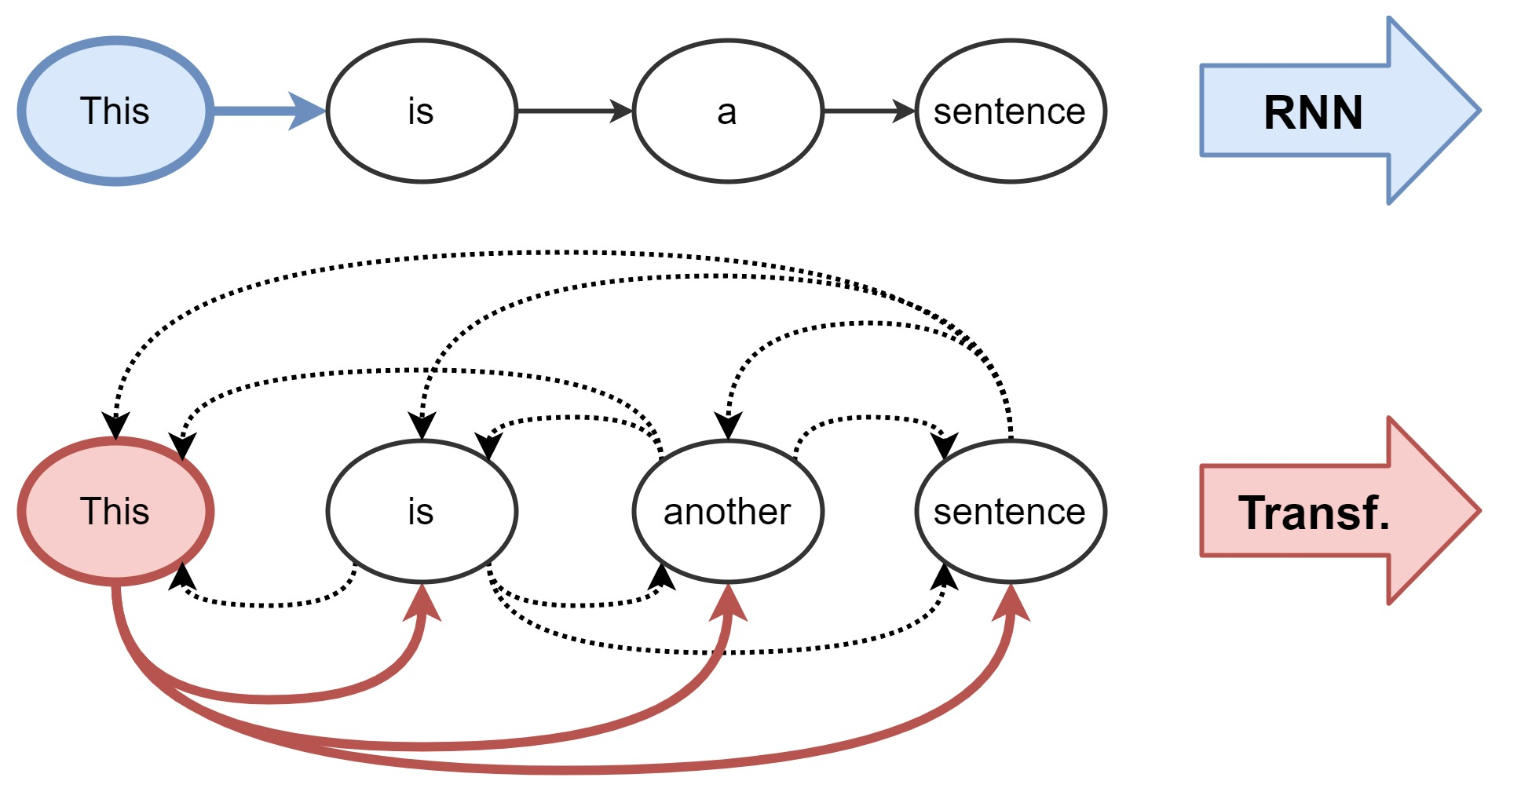
What is BERT?
Transformer (T)
Transformer is a deep machine learning model that was released in 2017, as a model for NLP.
Transformer is similar to an RNN.
unlike RNNs, the Transformer model doesn’t have to analyze the sequence in order.
Notes:
RNN, i.e. it processes ordered sequences of data, applies an algorithm, and returns a series of outputs
Therefore, when it comes to natural language, the Transformer model can begin by processing any part of a sentence, not necessarily reading it from beginning to end.

Slide 22
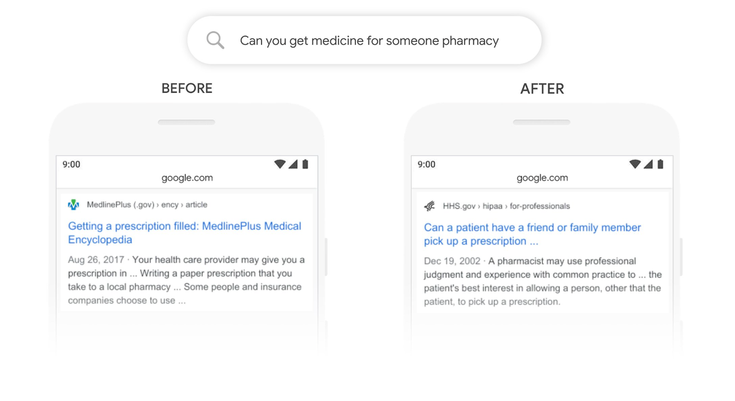
Before and after bert

Slide 23
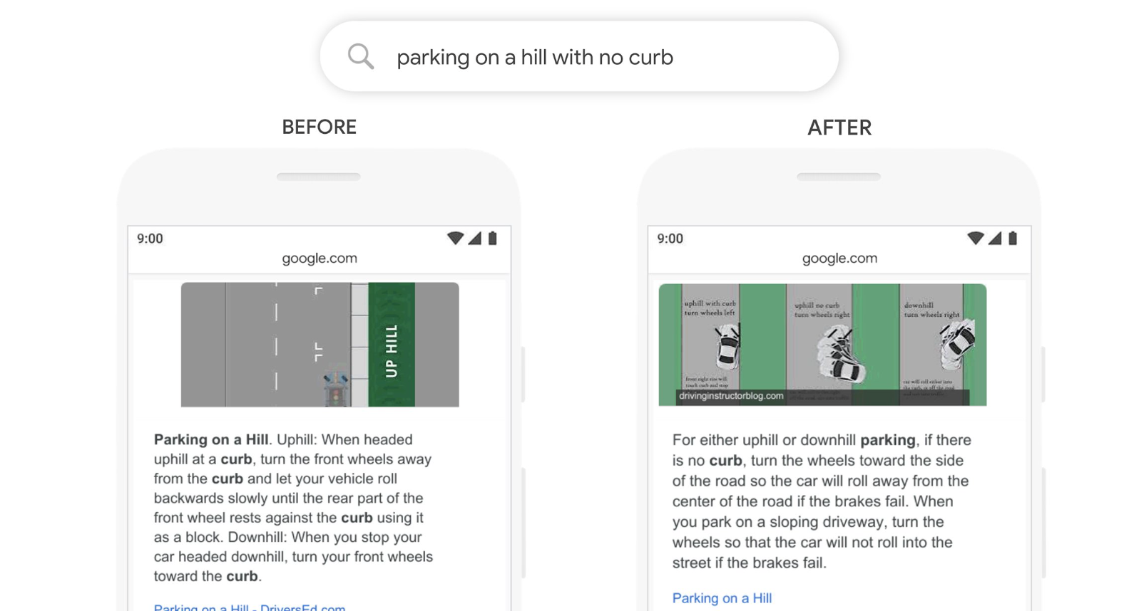
Before and after bert

Slide 24
conclusion
04

Slide 25
conclusion
NLP has many beneficial applications
NLP can help bridge the gap between humans and computers

Slide 26
references
05

Slide 27
references
https://www.analyticsvidhya.com/blog/2021/05/natural-language-processing-step-by-step-guide/
https://www.youtube.com/watch?v=knTc-NQSjKA&ab_channel=StanfordOnline
https://datascience.foundation/sciencewhitepaper/natural-language-processing-nlp-simplified-a-step-by-step-guide
https://www.ibm.com/cloud/learn/natural-language-processing

