Slide 1
PsyClick
Clinical decision support for single-session psychomotor disturbances
EWMA-based multivariate analysis of keystroke and cursor dynamics
CS0029 Information Assurance and Security | July 2026
PsyClick | CS0029 | July 2026

Slide 2
Background and Problem
Mental-health assessment can miss distress because of concealment, recall bias, stigma, and delayed help-seeking.
PsyClick supplies objective behavioral evidence while keeping professional judgment central.
Security is essential because telemetry may function as behavioral biometric data.
PsyClick | CS0029 | July 2026

Slide 3
Proposed Solution
Local-first, non-diagnostic desktop workflow.
10–15 minute session: login → intake/consent → calibration → tasks → analytics → dashboard/report.
Data minimization, pseudonymous identifiers, and clinician-facing rationale.
PsyClick | CS0029 | July 2026

Slide 4
Objectives
Hardware abstraction and high-resolution telemetry.
Within-session EWMA personal baseline.
Hotelling’s T², PSI/PAI contribution analysis, fuzzy classification.
Information-assurance controls and security evaluation.
PsyClick | CS0029 | July 2026

Slide 5
System Workflow
1. Authenticate clinician
2. Create/select pseudonymous client and record consent
3. Calibrate keyboard and mouse
4. Administer PHQ-9/GAD-7 and emotional tasks
5. Review report, export only when authorized, audit and logout
PsyClick | CS0029 | July 2026

Slide 6
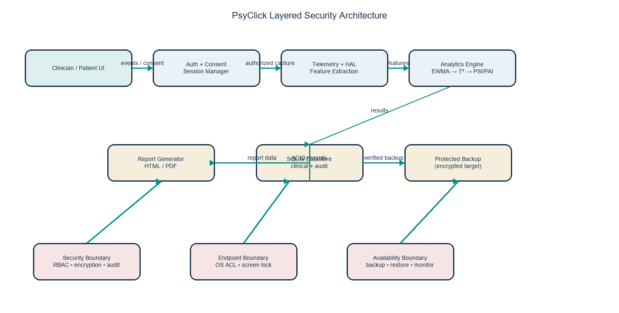
System Architecture
PsyClick | CS0029 | July 2026

Slide 7
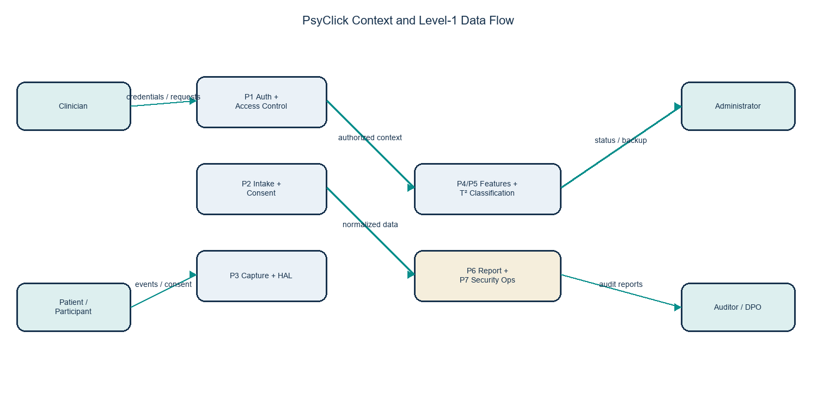
Data Flow and ERD
PsyClick | CS0029 | July 2026

Slide 8
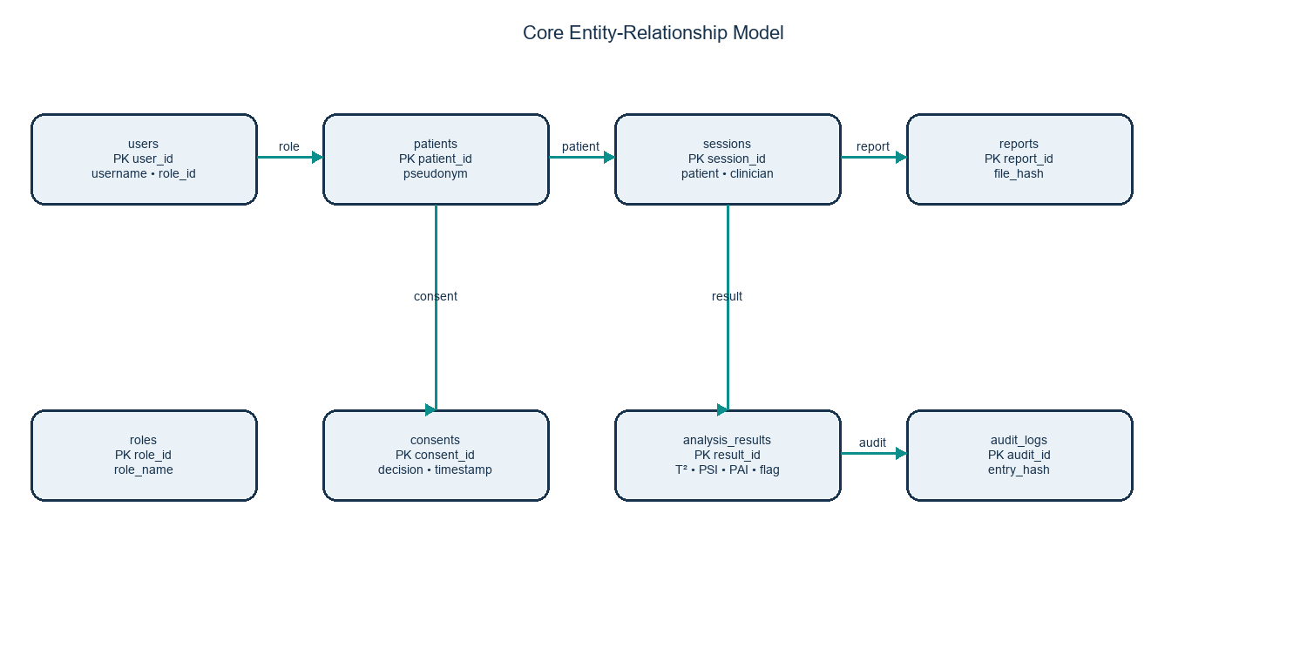
Database Model
PsyClick | CS0029 | July 2026

Slide 9
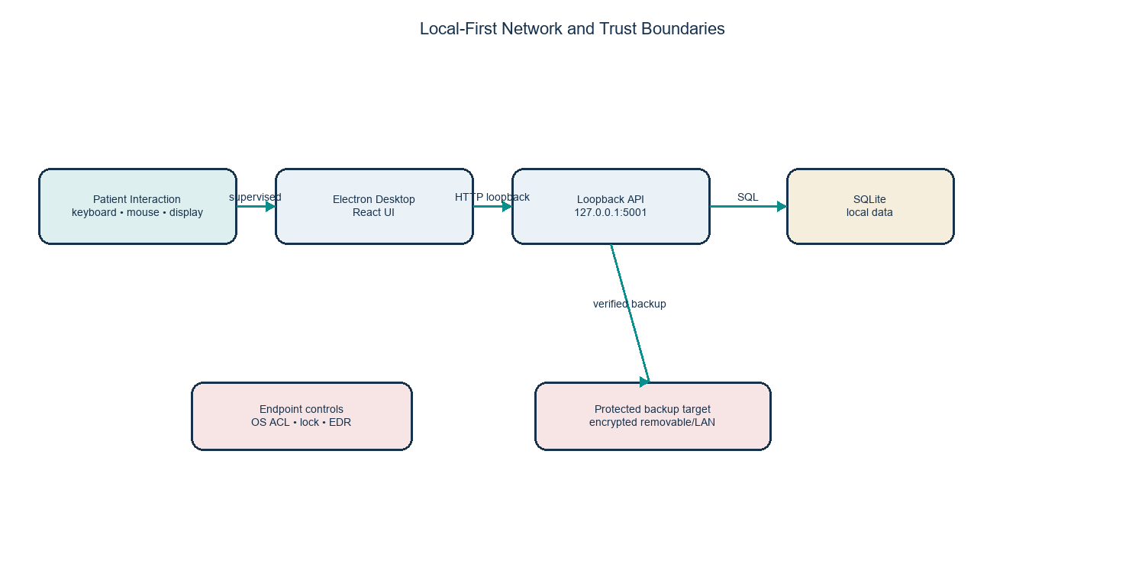
Network Architecture
PsyClick | CS0029 | July 2026

Slide 10
Analytical Pipeline
HAL normalization → sliding-window features → EWMA baseline.
Eight biomarkers: flight time, dwell time, typing velocity, error rate, path entropy, cursor velocity, jerk, pause frequency.
Hotelling’s T² → Feature Contribution Analysis → PSI/PAI → fuzzy logic → Green/Amber/Red.
PsyClick | CS0029 | July 2026

Slide 11
Threat Model
Assets: identity, consent, telemetry, derived features, reports, credentials, keys, audit records, clinical trust.
Actors: local insiders, compromised accounts, malware, accidental actors, supply-chain attackers.
STRIDE: spoofing, tampering, repudiation, information disclosure, denial of service, elevation of privilege.
PsyClick | CS0029 | July 2026

Slide 12
Security Architecture
Implemented: authenticated hashed, expiring sessions with revocation; RBAC (admin/clinician/auditor); server-side fail-closed consent gate; DPAPI-encrypted backups; hash-chained audit integrity.
Prototype topology: loopback Flask API (127.0.0.1:5101), local SQLite, parameterized queries, Electron isolation, restricted CORS.
Residual items tracked in the risk register: MFA and field-level database encryption remain documented recommendations.
PsyClick | CS0029 | July 2026

Slide 13
Authentication and Authorization
Implemented: scrypt password hashing with a 12-character policy; hashed, expiring bearer sessions with revocation.
Account lockout after 5 failed attempts / 15 minutes; threshold-based intrusion monitor throttles brute-force and credential-stuffing sources and logs security events.
Backend RBAC via require_roles (admin/clinician/auditor) with ownership-scoped queries; negative-path tests included.
PsyClick | CS0029 | July 2026

Slide 14
Data Protection and Privacy
Implemented: local-only processing, pseudonymous client identifiers, no storage of full response text.
DPAPI-encrypted backups with SHA-256 integrity and isolated-directory restore validation; secrets removed from tracked configuration.
Residual: the live SQLite database is not yet field-level encrypted (tracked risk R-06); a deterministic blind-index scheme is proposed.
PsyClick | CS0029 | July 2026

Slide 15
Risk Assessment
16-item register scored Likelihood x Impact, inherent vs. residual. Former Critical items (plaintext passwords, unauthenticated API, unauthorized record access) are now mitigated to Low/Medium residual.
Remaining Medium residual: brute-force exposure (mitigated by lockout + intrusion monitor), vulnerable build-toolchain devDependencies, and absent MFA / field-level DB encryption.
Treatment: implemented controls verified in code and tests; residual risks accepted with documented recommendations. See standalone Risk Assessment Report.
PsyClick | CS0029 | July 2026

Slide 16
Security Testing
Regression suite: 10 security tests - 9 pass on any platform; the Windows DPAPI backup-encryption test additionally passes on the Windows target.
SAST (bandit, 10 modules): 0 High, 13 Medium (B608 reviewed as false positives - parameterized binds), 15 Low. SCA (npm audit): 16 to 8 advisories, all confined to devDependencies.
Conceptual / simulated penetration testing across 10 scenarios (password guessing, session/consent/RBAC bypass, audit tampering, brute-force). See standalone Security Testing Report.
PsyClick | CS0029 | July 2026

Slide 17
Thesis Results
105 normative adult participants and 15 clinical sessions.
Overall ISO/IEC 25010 mean: 4.54/5.00.
Security evaluation mean: 4.64/5.00; Reliability: 4.67/5.00.
Cohen’s κ = 0.466, Moderate Agreement.
PsyClick | CS0029 | July 2026

Slide 18
Incident Response and Recovery
Preparation → identification → containment → eradication → recovery → post-incident review.
Proposed RPO: 24 hours; proposed RTO: 4 hours for a workstation deployment.
Encrypted backups, hash verification, isolated restore, administrator and clinical-owner approval.
PsyClick | CS0029 | July 2026

Slide 19
Conclusions and Recommendations
PsyClick is a functional, explainable research prototype and behavioral signal amplifier, now hardened with the CS0029 security controls implemented in code.
The mandatory controls - authentication, RBAC, data protection, audit, backup/recovery, and monitoring - are implemented and tested; residual items are documented, not blocking.
Before clinical production: add MFA and field-level DB encryption, and complete external evidence - independent install, live restore drill, and authorized dynamic penetration test.
PsyClick | CS0029 | July 2026

Slide 20
Live Demonstration
Login and re-authentication
Consent-gated intake and calibration
Core assessment and dashboard
Report export and audit review
Backup verification / recovery procedure (synthetic data only)
PsyClick | CS0029 | July 2026

Slide 21
Questions
Thank you.
PsyClick remains non-diagnostic and subject to professional judgment.
PsyClick | CS0029 | July 2026

