Slide 1
PsyClick Secure
A Hardened Clinical Decision-Support System for Detecting Single-Session Psychomotor Disturbances
EWMA-based multivariate analysis of keystroke & cursor dynamics, hardened with Information-Assurance controls
CS0029 — Information Assurance and Security | Final Project
Añonuevo · Ballano · Huertas · Tablate
Adviser: Mr. Justine Jude C. Pura · FEU Institute of Technology — BSCS (Software Engineering)
Non-diagnostic · Local-first · July 2026

Slide 2
OVERVIEW
Agenda
01
Background & Objectives
04
Information Assurance & Security
The clinical problem and what PsyClick sets out to do
authN/Z, data protection, audit, availability, monitoring
02
Proposed Solution & Workflow
05
Threat Model, Risk & Testing
A local-first, non-diagnostic decision-support system
STRIDE, risk register, SAST/SCA, regression & penetration testing
03
System Design & Architecture
06
Results, Conclusions & Demo
Security architecture, DFD, ERD, network & trust boundaries
Software-quality evaluation, conclusions, and live demonstration
PsyClick Secure · CS0029 Information Assurance & Security · July 2026

Slide 3
MOTIVATION
Background & the Problem
Mental-health signals are easy to miss.
Concealment, recall bias, stigma, and delayed help-seeking mean distress is often under-reported in standard screening. Clinicians need objective, behavioral evidence that complements — not replaces — professional judgment.
The gap PsyClick addresses
No objective within-session signal
Screening relies on self-report alone
Why security is essential here.
Keystroke and cursor telemetry function as behavioral biometrics and, combined with screening scores, constitute sensitive health data under the Data Privacy Act. A tool that captures it must protect confidentiality, integrity, and accountability by design.
Sensitive data, weak safeguards
Behavioral biometrics need real protection
Judgement must stay central
Tool must be explainable & non-diagnostic
PsyClick Secure · CS0029 Information Assurance & Security · July 2026

Slide 4
WHAT WE SET OUT TO BUILD
Objectives
Research / System Objectives
Information-Assurance Objectives
Hardware-abstracted, high-resolution telemetry capture (HAL)
Within-session EWMA personal baseline (no population priors)
Multivariate anomaly detection — Hotelling's T², PSI/PAI, fuzzy classification
Convergent validity & ISO/IEC 25010 software-quality evaluation
Authentication, authorization & accountability by design
Encryption of exports/backups and secure credential storage
Auditability, recoverability, and security monitoring
Conceptual/simulated security testing & risk assessment
PsyClick Secure · CS0029 Information Assurance & Security · July 2026

Slide 5
PSYCLICK SECURE
Proposed Solution
A local-first, non-diagnostic clinical decision-support desktop application that amplifies behavioral signals for the clinician — hardened end-to-end with information-assurance controls.
Local-first & offline
Explainable, non-diagnostic
Loopback API on 127.0.0.1:5101 and local SQLite. No raw telemetry leaves the workstation by default; no cloud in the default deployment.
Every flag carries a rationale (T², PSI/PAI, fuzzy label). The clinician decides — the system never diagnoses.
Secure by design
Data-minimizing
scrypt credentials, RBAC, consent gating, hash-chained audit, DPAPI-encrypted backups, intrusion monitoring.
Pseudonymous client identifiers; full free-text responses are not stored.
PsyClick Secure · CS0029 Information Assurance & Security · July 2026

Slide 6
A SUPERVISED 10–15 MINUTE SESSION
System Workflow
1
2
3
4
5
6
Authenticate
›
Consent
›
Calibrate
›
Assess
›
Analyze
›
Report & Audit
Clinician login + session
Pseudonymous client, recorded consent
Keyboard & mouse calibration
PHQ-9 / GAD-7 + emotional tasks
HAL → EWMA → T² → PSI/PAI → fuzzy
Review, export, audit, logout
Consent gates all telemetry capture — a fail-closed check enforced server-side before any keystroke or cursor data is recorded.
PsyClick Secure · CS0029 Information Assurance & Security · July 2026

Slide 7
03
System Design & Architecture
Security architecture, data flow, data model, and network trust boundaries

Slide 8
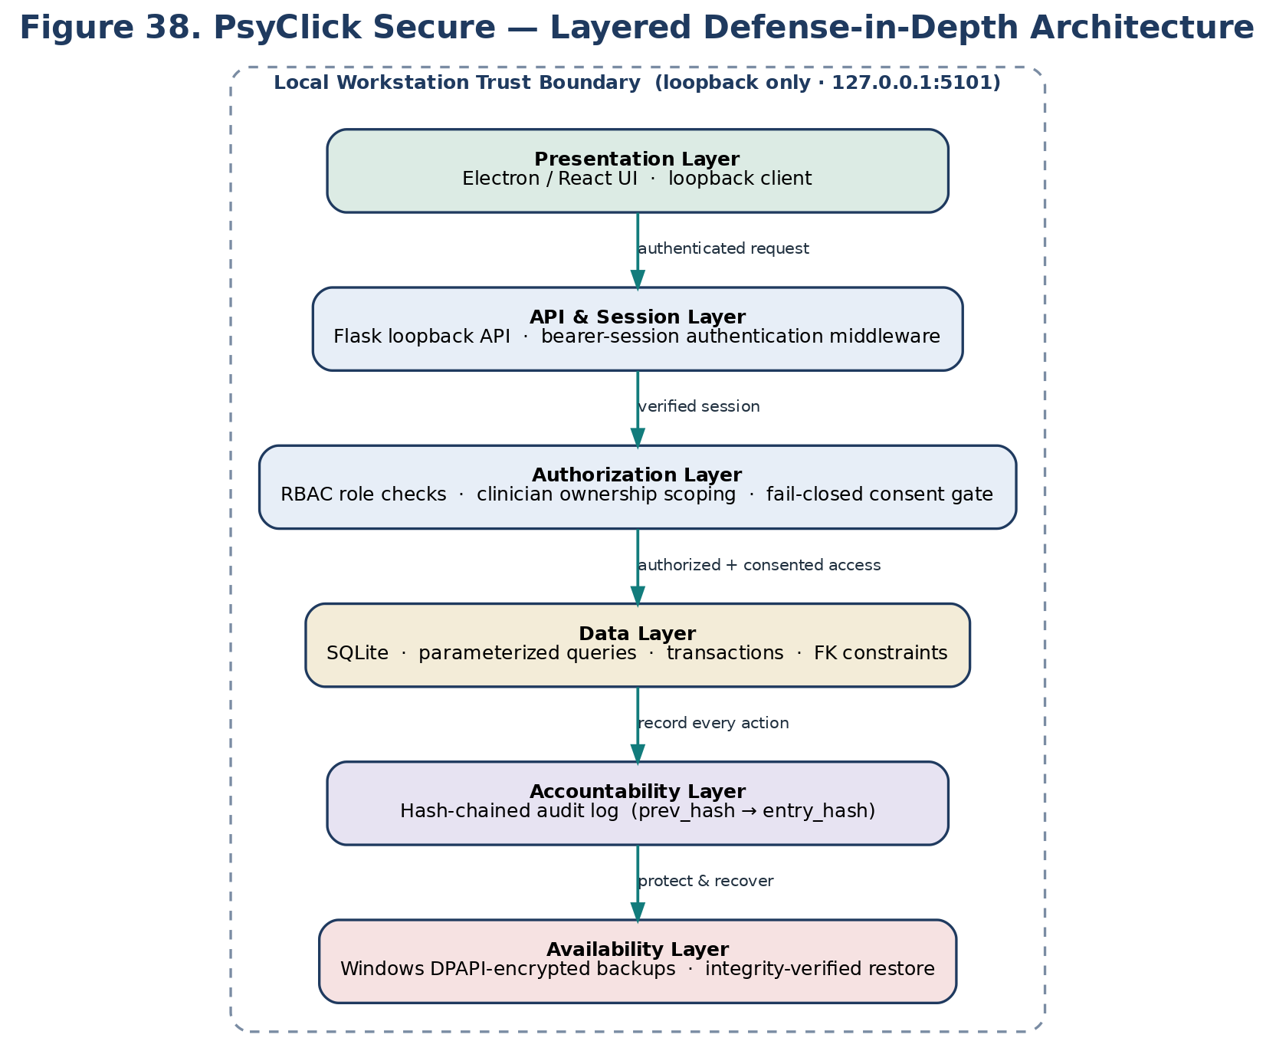
FIGURE 38 · DEFENSE IN DEPTH
Security Architecture
Highlights
Six independent layers inside the workstation trust boundary
Each layer authorizes before passing control downward
Loopback-only API on 127.0.0.1:5101
PsyClick Secure · CS0029 Information Assurance & Security · July 2026

Slide 9
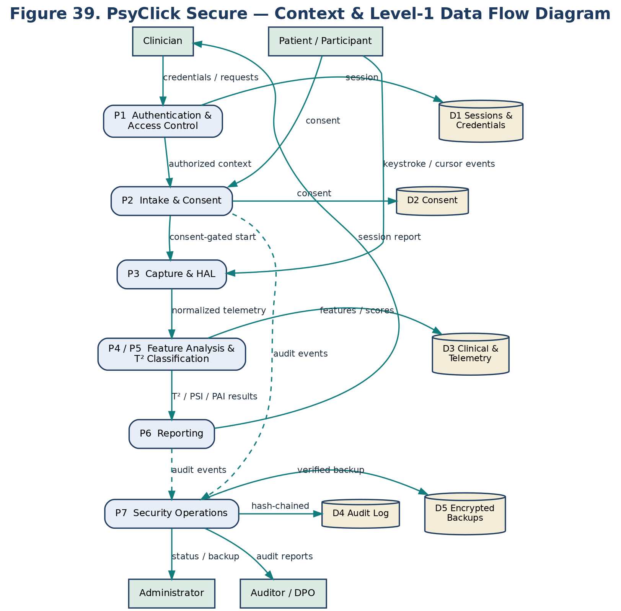
FIGURE 39 · CONTEXT & LEVEL-1
Data Flow Diagram
Highlights
Clinician, patient, administrator, auditor as external actors
Consent-gated capture; results flow to reporting
Security Operations writes hash-chained audit + backups
PsyClick Secure · CS0029 Information Assurance & Security · July 2026

Slide 10
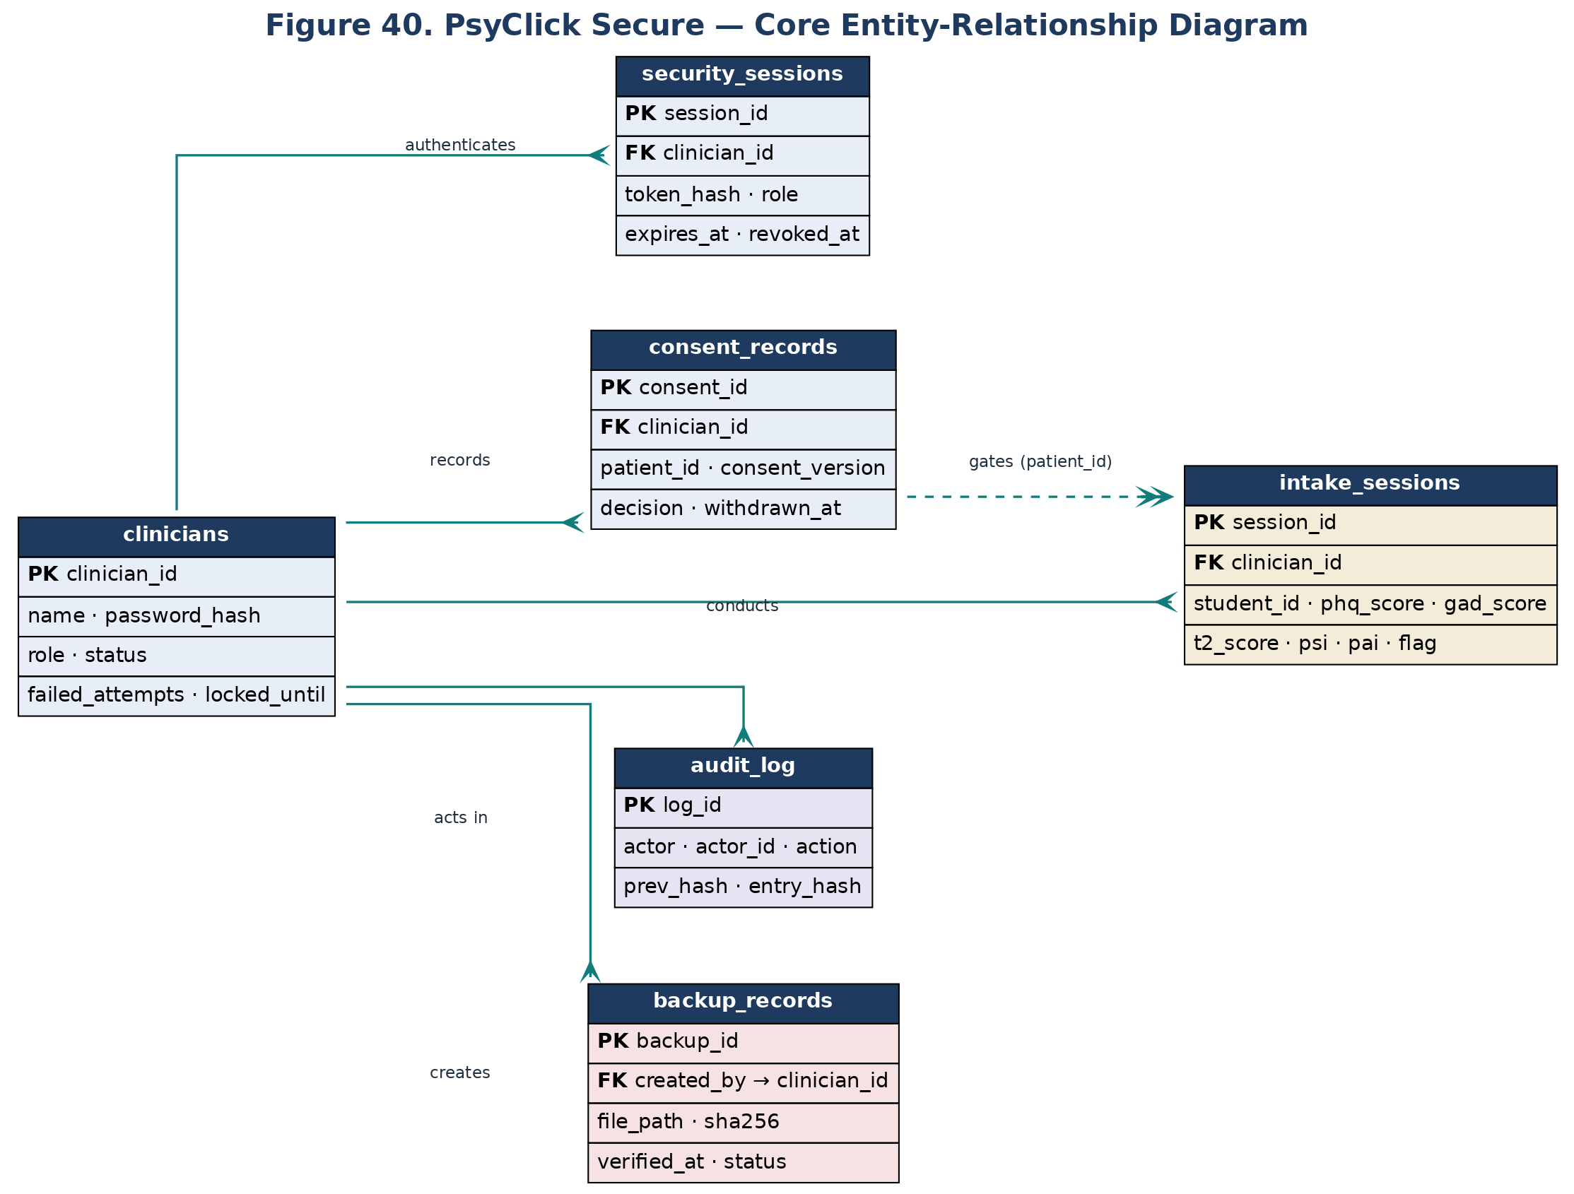
FIGURE 40 · CORE DATA MODEL
Entity-Relationship Diagram
Highlights
Identity, sessions, consent, clinical records separated
Supports least privilege & retention decisions
Backups & audit tracked as first-class entities
PsyClick Secure · CS0029 Information Assurance & Security · July 2026

Slide 11
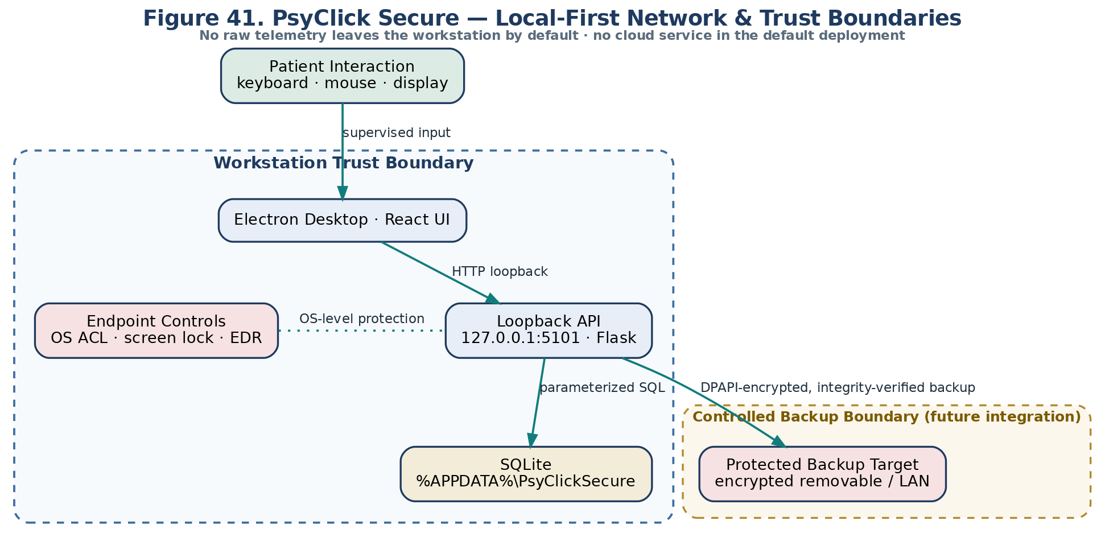
FIGURE 41 · LOCAL-FIRST TOPOLOGY
Network & Trust Boundaries
Highlights
Workstation boundary contains UI, API, DB, endpoint controls
No raw telemetry leaves the workstation by default
Backup target is a controlled, future integration
PsyClick Secure · CS0029 Information Assurance & Security · July 2026

Slide 12
04
Information Assurance & Security
The six mandatory control families — implemented in code, not just documented

Slide 13
SPEC SECTION III
Mandatory Security Requirements — Coverage
Authentication
Authorization
Data Protection
scrypt hashing · 12-char policy · account lockout
RBAC (admin/clinician/auditor) · ownership scoping
DPAPI-encrypted backups · SHA-256 · restricted CORS
✓ Implemented
✓ Implemented
✓ Implemented
Audit & Accountability
Availability
Security Monitoring
Hash-chained audit log · verification endpoint
Encrypted backup + integrity-verified restore
Threshold intrusion monitor · incident-response plan
✓ Implemented
✓ Implemented
✓ Implemented
MFA and field-level database encryption are documented recommendations (tracked residual risk), not blocking items.
PsyClick Secure · CS0029 Information Assurance & Security · July 2026

Slide 14
IDENTITY AND LEAST PRIVILEGE
Authentication & Authorization
Authentication
Authorization
scrypt password hashing
Role-based access control
Per-account random salt; parameters stored with the hash. No plaintext credentials.
require_roles() gates every protected route for admin / clinician / auditor.
12-character password policy
Ownership scoping
Minimum length enforced server-side, with a common-password blocklist.
_scoped_clinician_id() restricts clinicians to their own records.
Account lockout
Fail-closed consent gate
5 failed attempts → 15-minute lock, tracked per account.
Server-side check blocks telemetry capture without recorded consent.
Bearer sessions
Bootstrap rule
Hashed, expiring tokens with idle/absolute expiry and revocation.
First account becomes admin; further provisioning needs an admin session.
PsyClick Secure · CS0029 Information Assurance & Security · July 2026

Slide 15
CONFIDENTIALITY BY DESIGN
Data Protection & Privacy
Encrypted backups
Secure transmission
Windows DPAPI protects exports and SQLite backups; SHA-256 integrity with isolated-directory restore validation.
Loopback-only API (127.0.0.1:5101) with restricted CORS origins and Electron renderer isolation.
Data minimization
Parameterized storage
Pseudonymous client identifiers; full free-text responses are not persisted.
All queries use parameterized binds and transactions; no string-built SQL.
PsyClick Secure · CS0029 Information Assurance & Security · July 2026

Slide 16
DETECT, RECORD, RECOVER
Accountability, Availability & Monitoring
Audit & Accountability
Availability
Security Monitoring
Hash-chained audit log (prev_hash → entry_hash)
Every actor, action & outcome recorded
verify_audit_chain() detects tampering
Login history & action tracking
Encrypted, verifiable SQLite backups
Isolated-directory restore validation
Administrator approval before restore
Proposed RPO 24h / RTO 4h (workstation)
Threshold intrusion monitor
Brute-force / credential-stuffing detection
Throttles offending source; logs event
/api/security/intrusion-alerts (admin/auditor)
PsyClick Secure · CS0029 Information Assurance & Security · July 2026

Slide 17
STRIDE OVER THE LOCAL-FIRST DEPLOYMENT
Threat Model
Assets
Threat Actors
STRIDE → Mitigation
Client identifiers & consent
Screening scores & telemetry
T²/PSI/PAI results & reports
Credentials, session tokens, keys
Audit records & backups
Clinical trust
Unauthorized local users
Compromised accounts
Malware on the endpoint
Accidental / careless users
Supply-chain attackers
Participants seeking admin access
Spoofing → auth + sessions
Tampering → hash-chained audit
Repudiation → action logging
Info disclosure → encryption + CORS
DoS → lockout + intrusion monitor
Elevation → RBAC + ownership scoping
PsyClick Secure · CS0029 Information Assurance & Security · July 2026

Slide 18
16-ITEM REGISTER · INHERENT → RESIDUAL
Risk Assessment
Former Critical risks are now mitigated to Low/Medium residual.
Each risk scored Likelihood × Impact, inherent vs. residual, with a documented treatment plan. Plaintext passwords, unauthenticated API, and unauthorized record access — the original Criticals — are closed in code.
Residual risk heat map
Key residual risks
Low
Brute-force / credential stuffing — Lockout + intrusion monitor
Med
Build-toolchain devDependencies — Dev-only; runtime clean
Med
No MFA — Documented recommendation
Med
Live-DB field encryption (R-06) — Blind-index scheme proposed
Impact →
Most residual risks sit Low–Medium after treatment.
PsyClick Secure · CS0029 Information Assurance & Security · July 2026

Slide 19
STATIC, COMPOSITION, REGRESSION & CONCEPTUAL PEN-TEST
Security Testing
Regression suite
10
SAST — bandit
0 High
security tests — 9 pass on any platform; the 10th (Windows DPAPI backup) passes on the Windows target.
13 Medium (B608 reviewed as false positives — parameterized binds) · 15 Low, across 10 modules.
SCA — npm audit
16 → 8
Penetration test
10
advisories after non-breaking fixes; all remaining are dev-dependencies, none in shipped runtime.
conceptual/simulated scenarios: password guessing, session/consent/RBAC bypass, audit tampering, brute-force.
PsyClick Secure · CS0029 Information Assurance & Security · July 2026

Slide 20
ISO/IEC 25010 · CONVERGENT VALIDITY
Software Quality & Validation Results
4.54
4.64
4.67
κ = 0.466
/ 5.00
/ 5.00
/ 5.00
Moderate
ISO 25010 overall mean
Security characteristic
Reliability characteristic
Clinician concordance
Evaluated with 105 normative participants and 15 clinical sessions. Convergent validity assessed against PHQ-9 / GAD-7; software quality via a structured ISO/IEC 25010 survey.
Research-integrity note. Chapter 4 figures must be re-verified against the primary dataset before final submission — the raw participant data and analysis scripts should trace every reported statistic. This is flagged as the top pre-defense action item.
PsyClick Secure · CS0029 Information Assurance & Security · July 2026

Slide 21
WHAT PSYCLICK SECURE DEMONSTRATES
Conclusions
1
A functional, explainable prototype
PsyClick amplifies behavioral signals for the clinician while remaining strictly non-diagnostic.
2
Security implemented, not just documented
All six mandatory control families are enforced in code and verified by a passing regression suite.
3
Local-first and offline by design
The system runs entirely on the workstation — no cloud dependency, protecting sensitive telemetry.
4
Honest about its boundaries
Residual risks and pending external evidence are documented, not hidden.
PsyClick Secure · CS0029 Information Assurance & Security · July 2026

Slide 22
BEFORE PRODUCTION CLINICAL USE
Recommendations & Future Work
Security Enhancements
Evidence & Validation
Add multi-factor authentication
Clean-install & restore drills
Strengthen credential security beyond password + lockout.
Verify install on an independent workstation; live restore evidence.
Field-level database encryption
Signed UAT & sign-off
Deterministic blind-index scheme for lookup fields (risk R-06).
Collect signed user-acceptance forms and clinical-owner approval.
Independent security retest
Verify Chapter 4 data provenance
Authorized dynamic penetration test on a running deployment.
Trace every reported statistic to primary data before defense.
PsyClick Secure · CS0029 Information Assurance & Security · July 2026

Slide 23
WHAT WE WILL SHOW
Live Demonstration
User login and re-authentication (lockout and intrusion-monitor behavior)
Role management — create clinician / auditor accounts and assign roles (admin)
Core system functionality — consent-gated intake, calibration, assessment, dashboard and report
Security controls — authorization checks on export and DPAPI-encrypted backup
Audit logs — review activity and verify hash-chain integrity
Backup verification and recovery (synthetic data only)
Runs fully offline
Loopback API on 127.0.0.1:5101
Local SQLite under %APPDATA%\PsyClickSecure
No internet connection required
Only synthetic / non-clinical data is used in the demonstration.
PsyClick Secure · CS0029 Information Assurance & Security · July 2026

Slide 24
Thank you
Questions & Discussion
PsyClick Secure remains a non-diagnostic research and decision-support system, subject to professional judgment.
Añonuevo · Ballano · Huertas · Tablate — CS0029, FEU Institute of Technology

