Slide 1



< >
Search here
Lana Fuadi
Random Forest:
Unleashing the Power of Ensemble Learning
for Enhancing Credit Risk Predictive Accuracy
source
Start!

Slide 2



ID/X PARTNERS
Step 1
Preparation
X
Step 2
EDA
id/x was established in 2002 by ex-bankers and management consultants who have vast experiences in credit cycle and process management, scoring development, and performance management. Our combined experience has served corporations across Asia and Australia regions and in multiple industries, specifically financial services, telecommunications, manufacturing and retail. We provides consulting services that specializes in utilizing data analytic and decisioning (DAD) solutions combined with an integrated risk management and marketing discipline to help clients optimize the portfolio profitability and business process.
Step 3
Preprocessing
Step 4
Modeling
Step 5
Result

Slide 3
Problem Statement
Step 1
Preparation
X
Problem Statement
Model
Credit risk assessment is a fundamental challenge in the financial industry. Lenders face the critical task of evaluating the creditworthiness of borrowers to make informed lending decisions and manage their risk exposure. Inaccurate credit risk predictions can lead to substantial financial losses, deteriorating loan portfolios, and economic instability.
Therefore, developing an accurate and reliable credit risk predictive model is essential to streamline operations, optimize resources, and ensure sound decision-making in lending institutions.
Objective
Step 2
EDA
Step 3
Preprocessing
Step 4
Modeling
Step 5
Result

Slide 4
Random Forest
Bab 1
PENDAHULUAN
Problem Statement
X
Model
Random Forest has the ability to effectively handle data that includes a wide range of variables with complex relationships, making it suitable for modeling credit risk.
Objective
Random Forest is known for its high accuracy in predicting outcomes. By combining multiple decision trees, it reduces the risk of overfitting and provides robust predictions. It is even outperforms the ensemble model.
Step 2
EDA
X
Step 3
Preprocessing
Random Forest is less sensitive to outliers and missing values compared to some other machine learning algorithms. It can handle noisy data and missing values by utilizing the information from other variables, making it a robust choice for credit risk prediction.
Step 4
Modeling
Step 5
Result

Slide 5

Objective
Step 1
Preparation
Problem Statement
Why
Objective
1
To enhance profitability and minimize potential losses.
Goal :
Step 2
EDA
2
Build machine learning model to improve the accuracy and reliability of credit risk predictions.
Objective :
Step 3
Preprocessing
3
Prediction Accuracy.
Metric :
Step 4
Modeling
Step 5
Result

Slide 6

Quick Overview
Step 1
Preparation
X
Step 2
EDA
Our dataset consist of 466285 rows and 75 features.
There are 460160 missing values
There are 17 features with 100% missing values.
There are 0 Duplicated Value.
Numerical features contains 53 features.
Categorical features contains 22 features.
Target feature is ‘loan_status’, which contains 9 unique values.
Quick Overview
Correlation
Distribution
Step 3
Preprocessing
Step 4
Modeling
Step 5
Result

Slide 7

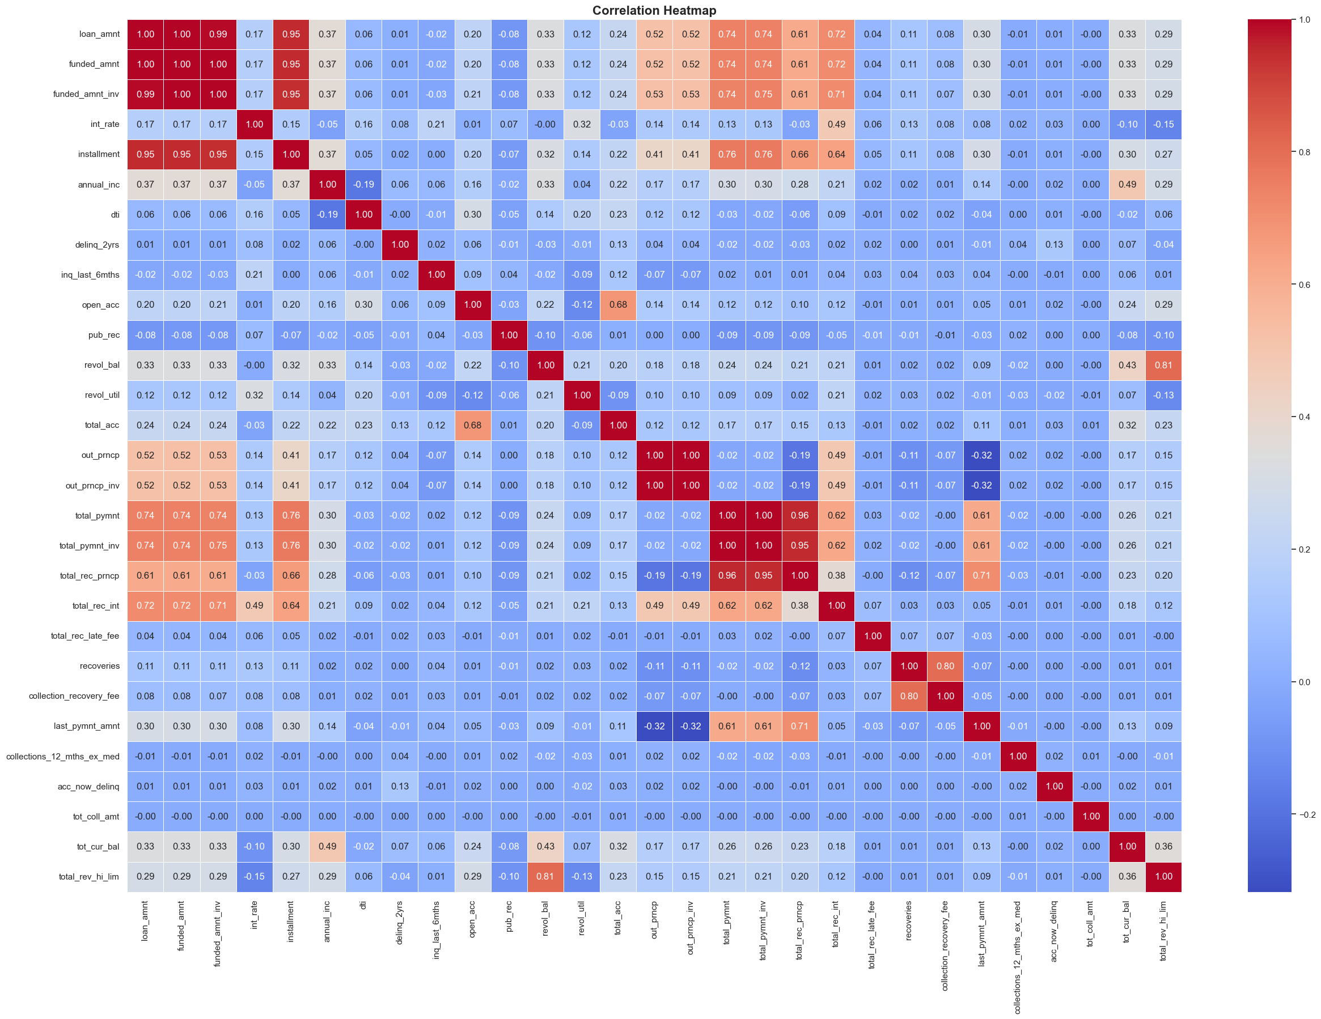
loan_amnt, funded_amnt, funded_amnt_inv, installment have perfect multicollinearity score. We will keep loan_amnt and drop the rest.
Total_pymnt, total_pymnt_inv, and total_rec_prncp have perfect multicollinearity score. We eill keep toal_pymnt and drop the rest.
Step 1
Preparation
Step 2
EDA
Quick Overview
Correlation
Distribution
Step 3
Preprocessing
Step 4
Modeling
Click here for more detail correlation picture.
out_prncp and out_prncp_inv has very high multicollinearity. We will keep out_prncp and drop out_prncp_inv.
Step 5
Result

Slide 8
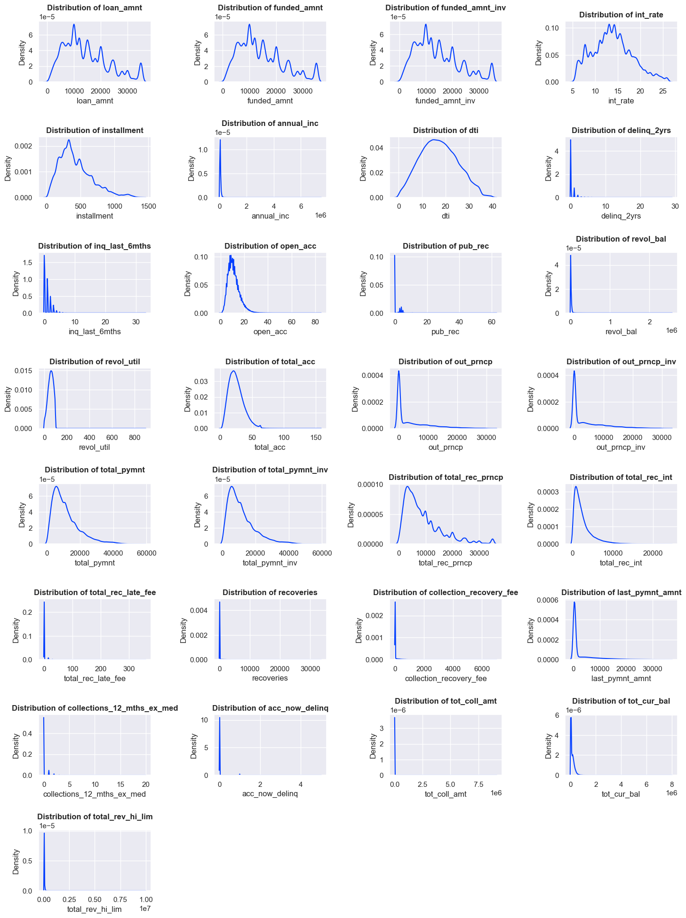
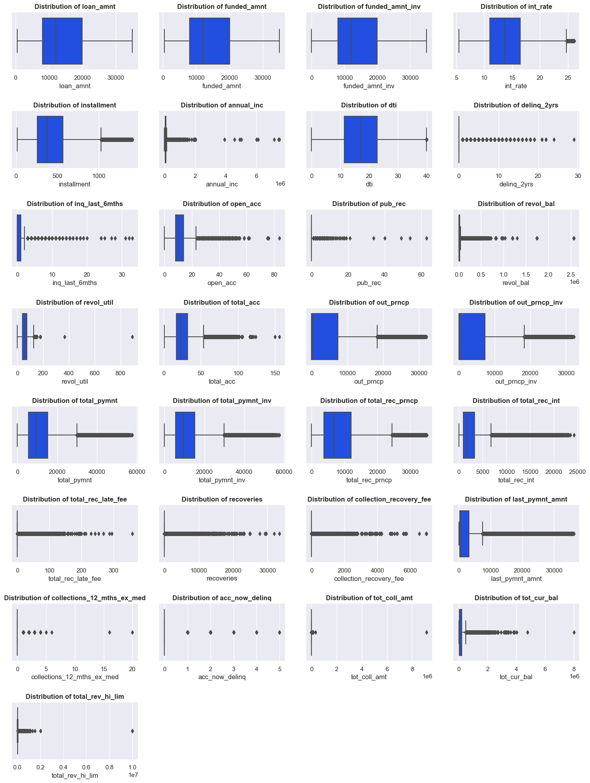
Step 1
Distribution
Preparation
KDE PLOT
X
Step 2
EDA
BOX PLOT
BOX PLOT
BOX PLOT
Quick Overview
Correlation
Distribution
Step 3
X
Preprocessing
Most Features have positive
skewness.
Most Features have outlier.
Click here for more detail distribution picture.
Step 4
Modeling
Step 5
Result

Slide 9
Step 1
Pipeline
Preparation
Step 2
EDA
We use pipeline in preprocessing to streamline and automate the data transformation steps before feeding the data into a machine learning model.
Step 3
Dropping features that: 1. has more than 50% null
2. Ver high multicollinearity
3. Has too many uniques or only one
4. Has severe imbalance class
Preprocessing
4
We applied log1p for positive skew
And reciprocal for negative skew.
1
Pipeline
Encoding
We applied median imputation for numerical value and mode imputation for categorical value.
5
We do numerical transformer using MinMaxScaler for scaling
.
2
Step 4
Modeling
Then we handle outlier use winsorization IQR.
3
Extract the year value from all datetime values.
6
Step 5
Result

Slide 10

Step 1
Feature Encoding
Preparation
X
Step 2
EDA
We do label encoding for ordinal or Boolean feature such as term, grade, emp_length, initial_list_status, and loan_status.
Step 3
Preprocessing
Pipeline
Encoding
Then one hot encoding for nominal features such as home_ownership, verification_status, purpose, and zip_code.
Step 4
Modeling
Step 5
Result

Slide 11

Ensemble Method
Step 1
Preparation
The top 20 features are selected based on their frequencies, score, their importance in LogisticRegression, VarianceThreshold, Chi-Squared, MutualInformation, and ANOVA feature selection methods, also based on their relevance from business and credit loan perspective.
Step 2
EDA
Step 3
Preprocessing
Using ensemble method we compared LogisticRegression, RandomForest, GradientBoosting, XGB, LGBM, and SVC based on accuracy, precision, recall, F1, and F2 score. Turn out that RandomForest is the best.
Step 4
Modeling
Then we recompared RandomForest vs Ensemble model based on accuracy, mean accuracy, and standar deviation score. In the end we use RandomForest as our final model since it outperforms other models in various evaluation metrics.
Ensemble Method
Step 5
Result
We do hyperparameter tuning and train model for optimization.

Slide 12

Step 1
INTERPRETATION
Preparation
Step 2
The result tell us that:
The less update last_pymnt_d is more likely to default.
The lower Last_pymnt_amnt is more likely to default.
The higher out_prncp is more likely to default.
The lower total_pymnt is more likely to default.
The higher int_rate is more likely to default.
The less update last_credit_pull_d is more likely to default.
The lower grade applicants are more likely to default.
The longer term is more likely to default.
The higher inq_last_6mths is more likely to default.
Applicants who are not_verified are more likely to default.
EDA
Step 3
Preprocessing
Step 4
Modeling
Step 5
Result
Interpretation
Business Recommendation

Slide 13
Business Recommendation
Step 1
Preparation
Identify any seasonal or cyclical patterns that could help optimize payment reminders or collection strategies.
Explore ways to incentivize borrowers to make faster payments.
Try targeted campaigns to encourage borrowers to make additional payments or refinance their loans to reduce the principal faster.
Monitor and improve customer experience to ensure borrowers feel they are getting value for their payments.
Consider adjusting interest rates to stay competitive or attract borrowers with more favorable rates.
Monitor and update credit information regularly to ensure accurate and up-to-date credit assessments.
Develop tailored strategies for different loan grades to manage risk effectively and optimize loan portfolio performance.
Explore options for shorter or longer loan terms based on customer demand and market trends.
Provide discounts, rewards, or personalized offers based on payment behavior.
Consider implementing stricter verification processes or
providing additional incentives for verified borrowers.
Step 2
EDA
Step 3
Preprocessing
Step 4
Modeling
Step 5
Result
Interpretation
Business Recommendation

Slide 14





X
GitHub
Gmail
Linkedin
X
“The more that you read, the more things you will know, the more that you learn, the more places you'll go.”
—Dr. Seuss.
Let’s Connect !

