Slide 1
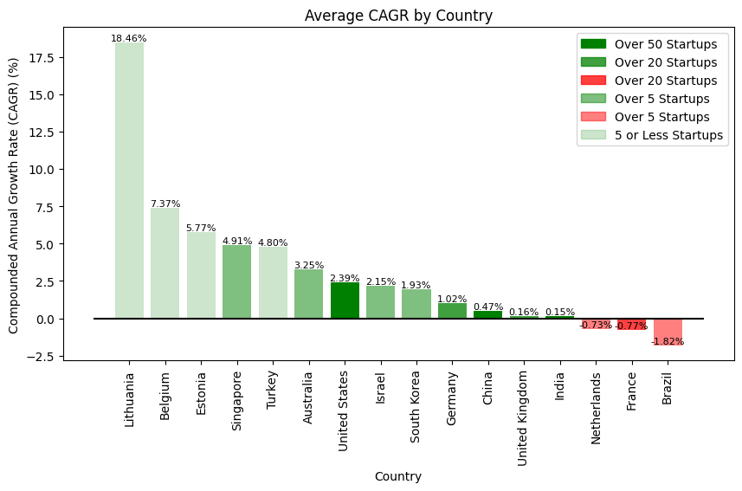
Compounded Annual Growth Rate (CAGR) is the average annual growth rate over the past two years (2022 to 2023 and 2023 to 2024).
Average CAGR by Country
Lithuania leads with an average CAGR of 18.46%.
Focus on external markets
Collaborate ecosystem
Top three countries in terms of avg. CAGR are European
A potential greater growth trajectory in Europe in terms of the global startup ecosystem
U.S. and China lead in the number of unicorn startups but exhibit lower growth rates.
Suggests that a larger volume of unicorn startups may impede overall growth due to greater competition, market saturation, and a focus on internal markets

Slide 2
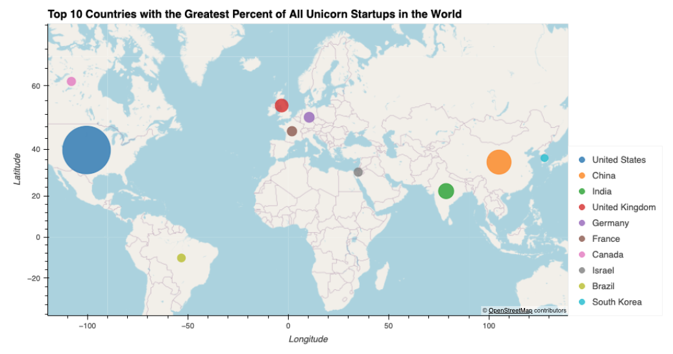


Map Visualizations by Country

Slide 3
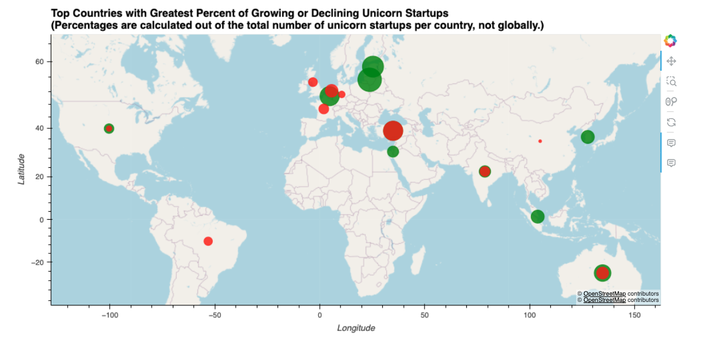
MAP VISUALIZATIONS BY COUNTRY

Slide 4
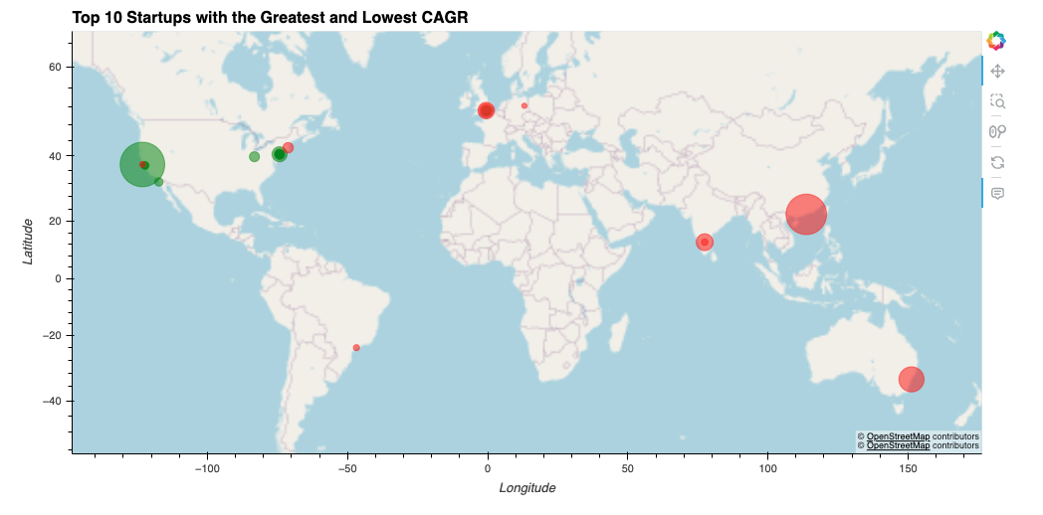
MAP VISUALIZATIONS BY STARTUP

