Slide 1
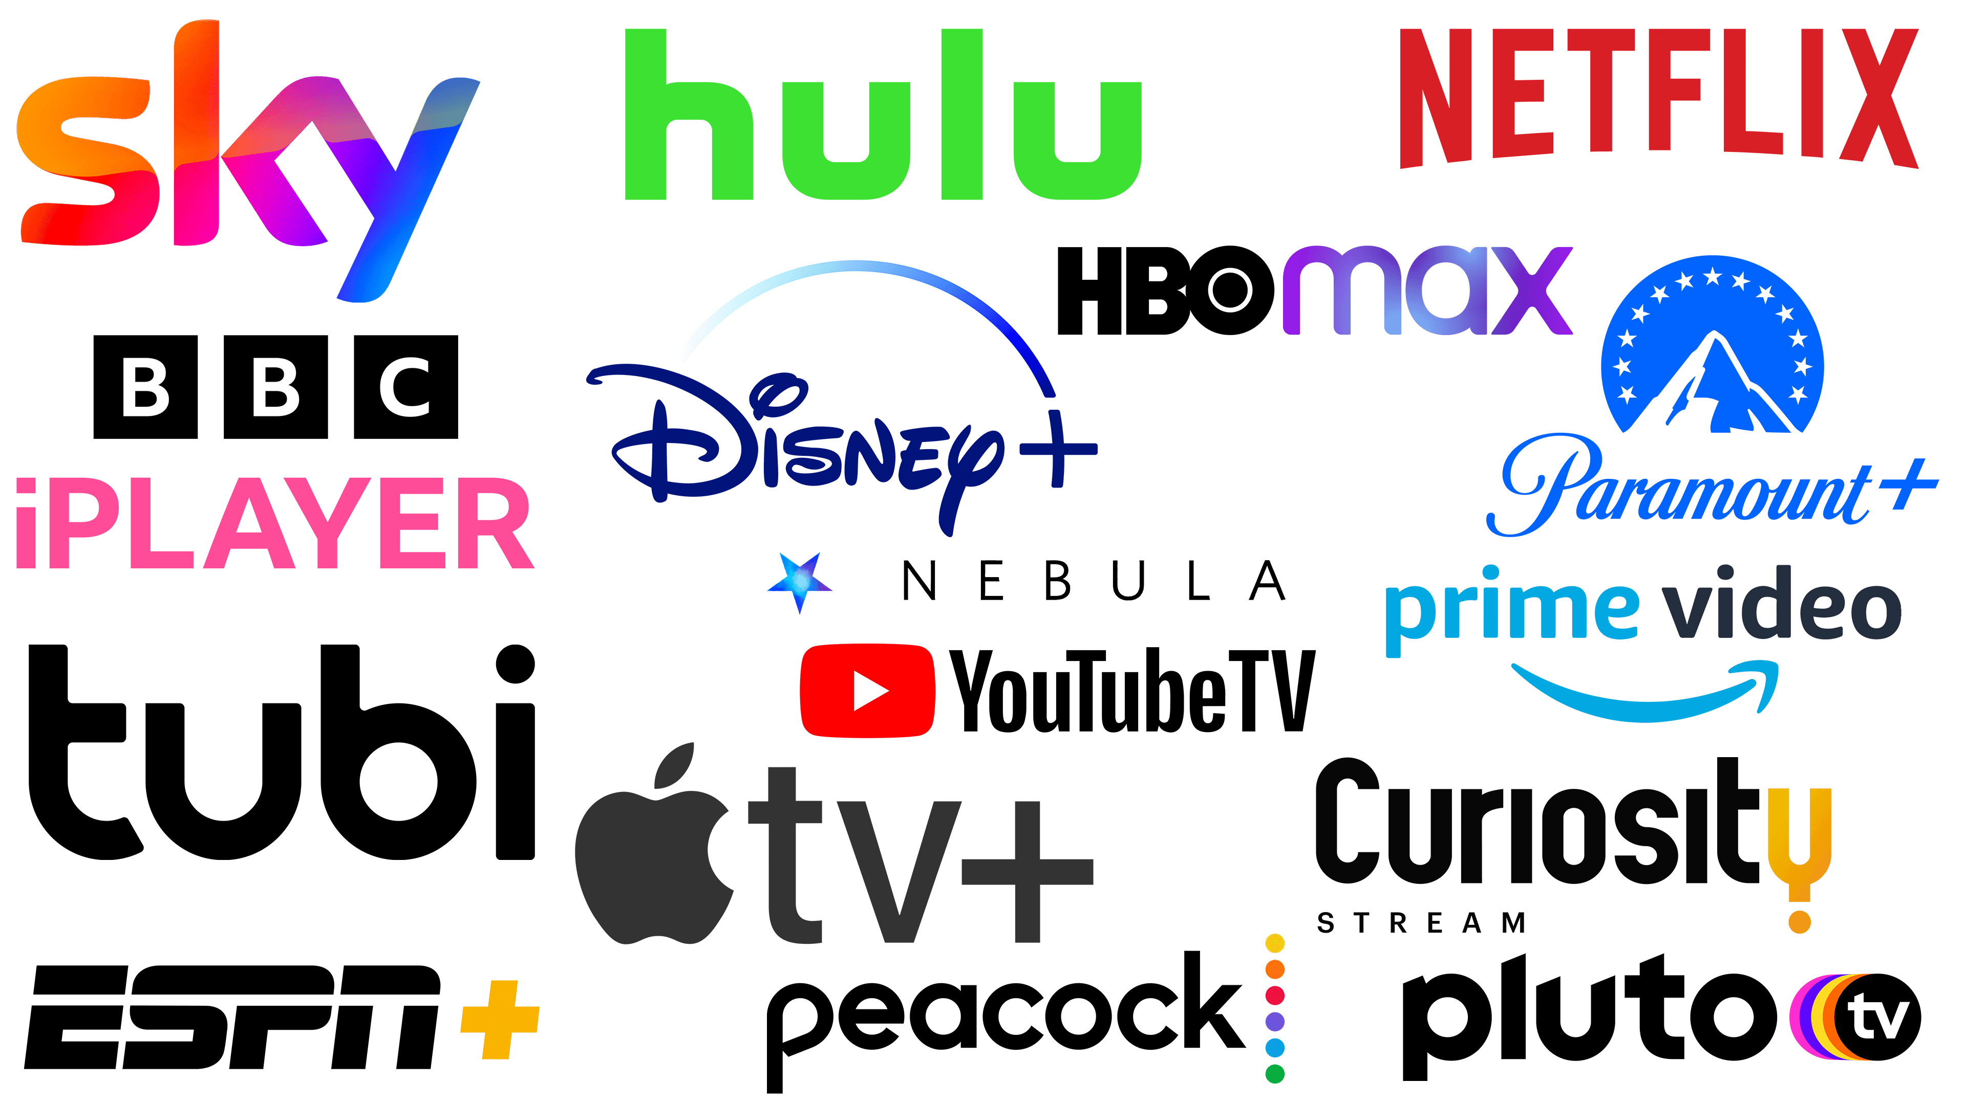
Streaming Platforms : Media Consumption
Exploring Viewer Behavior, Content Quality, and Market Trends

Slide 2
Introduction
Content:
• Overview of the media streaming revolution and its impact on traditional media consumption.
• Mention the datasets used (Netflix, IMDb, subscription price history) and the scope of the analysis.

Slide 3
Through The Years
Radio Era (1920s - 1950s)
• 1920s: The first commercial radio stations began broadcasting in the early 1920s, with KDKA in Pittsburgh being one of the first.
• 1930s - 1940s: Radio became the dominant form of media, providing news, music, and serialized dramas. Families would gather around the radio in the evenings.
• Fun Fact: By the late 1930s, approximately 80% of American households owned a radio.
Television Era (1950s - 1990s)
• 1960s - 1970s: Color TV was introduced, and network television became a staple in households.
• 1980s - 1990s: Cable TV introduced a wider variety of channels, including news, sports, and movie channels.
• Fun Fact: In 1960, the first televised presidential debate between John F. Kennedy and Richard Nixon drew over 70 million viewers.
Digital Media and DVDs (2000s)
• 2000s: DVDs, DVRs, and digital downloads started to provide more options for viewers. The internet became a new platform for media consumption.
• 2010s: Streaming platforms like Netflix, Hulu, and Amazon Prime Video changed the landscape of media consumption, offering on-demand content.
• 2013: Netflix released its first original series, House of Cards, marking the beginning of the “binge-watching” trend.
• 2020s: Streaming services dominate media consumption, with many people “cutting the cord” and canceling traditional cable TV subscriptions.
• Fun Fact: As of 2022, Netflix has over 230 million subscribers worldwide.
• Fun Fact: By 2022, over 70% of U.S. households subscribed to at least one streaming service.
Streaming Era (2010s - Present)

