Slide 1
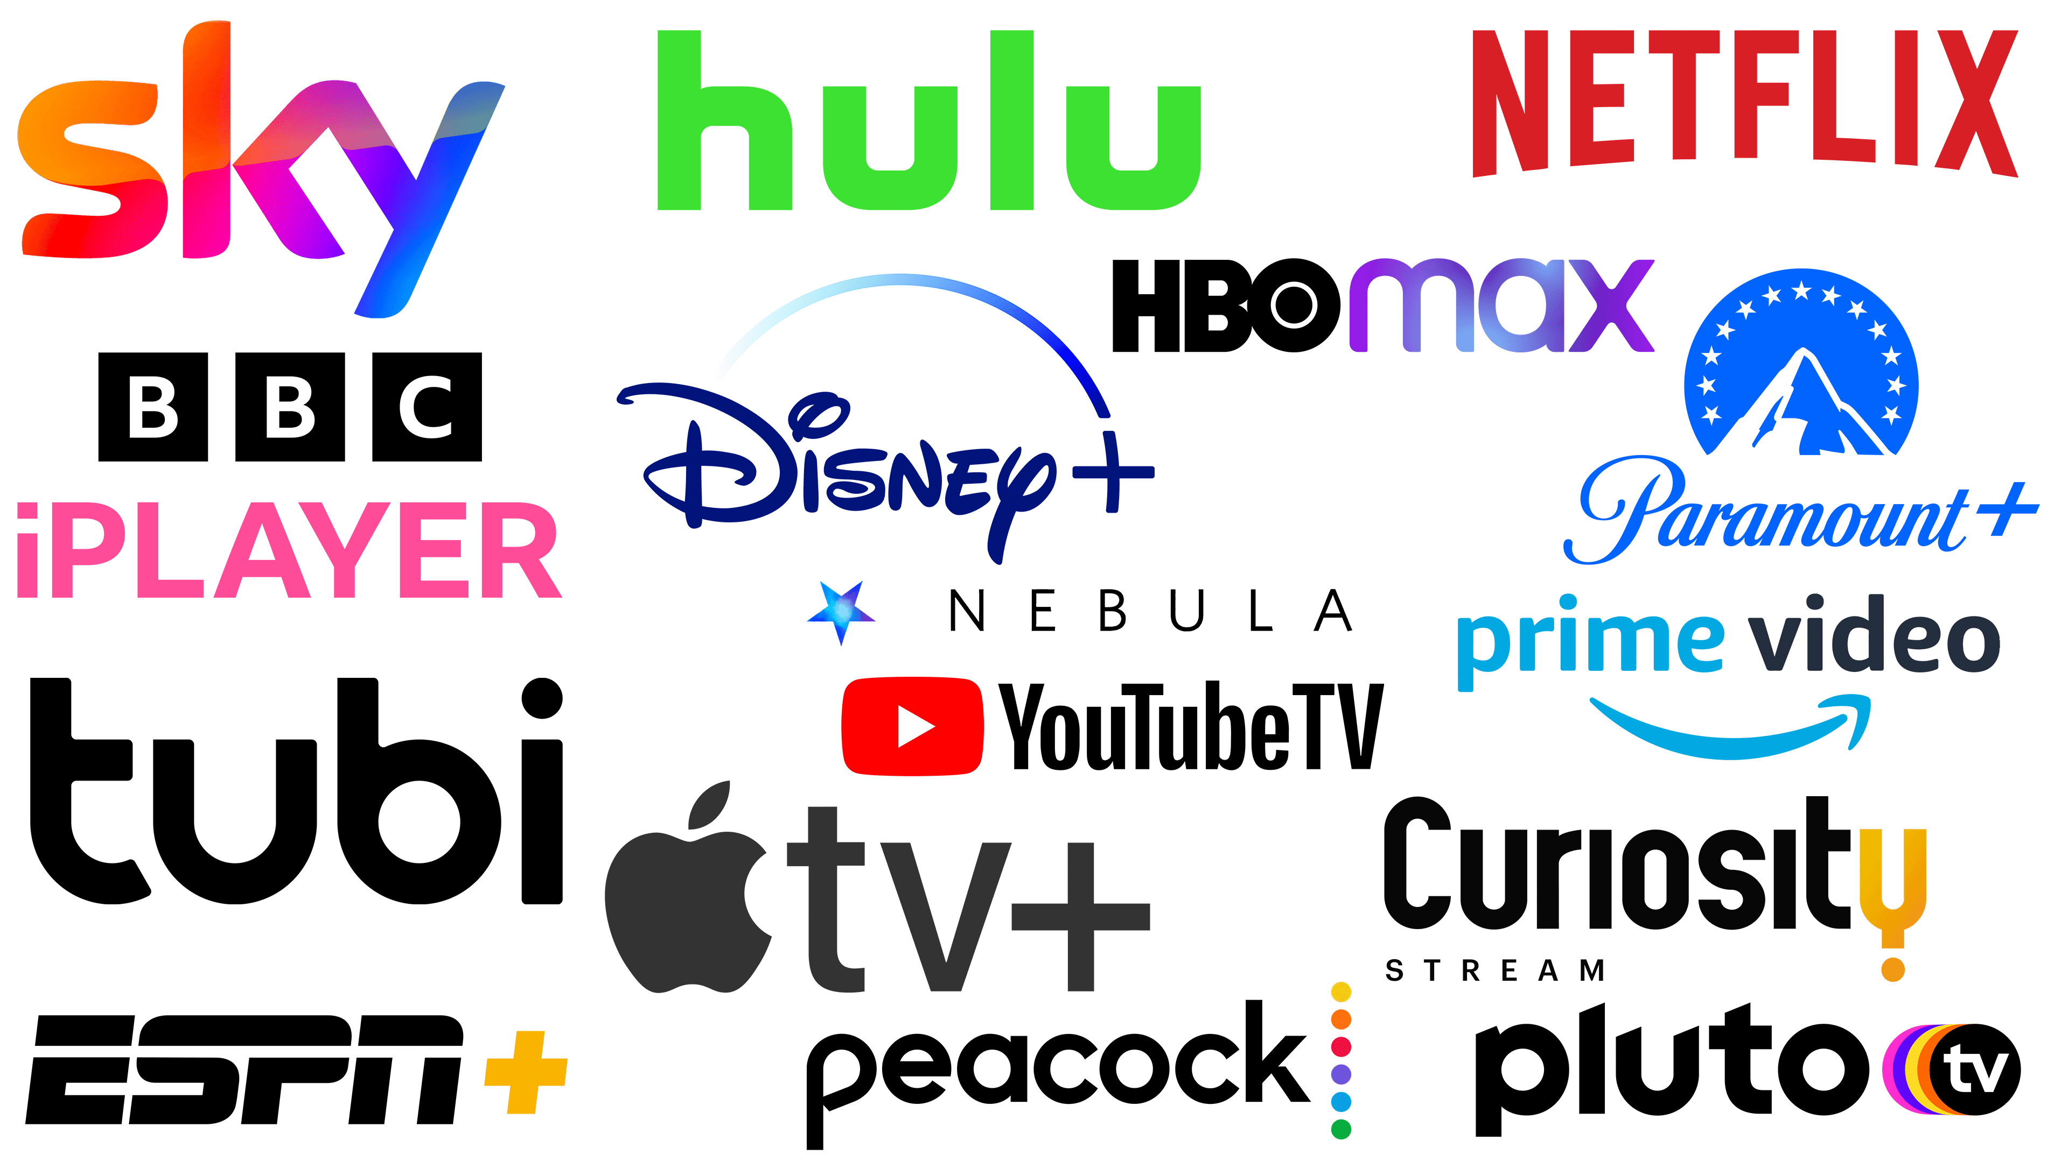
Streaming Platforms : Media Consumption
Athena Wu, Ian Nguyen, Lana Huyen, Oty Baasandorj
Exploring Viewer Behavior, Content Quality, and Market Trends

Slide 2
Introduction
Content:
• Overview of the media streaming revolution and its impact on traditional media consumption.
• Mention the datasets used (Netflix, IMDb, subscription price history) and the scope of the analysis.

Slide 3
Through The Years
Radio Era (1920s - 1950s)
• 1920s: The first commercial radio stations began broadcasting in the early 1920s, with KDKA in Pittsburgh being one of the first.
• 1930s - 1940s: Radio became the dominant form of media, providing news, music, and serialized dramas. Families would gather around the radio in the evenings.
• Fun Fact: By the late 1930s, approximately 80% of American households owned a radio.
Television Era (1950s - 1990s)
• 1960s - 1970s: Color TV was introduced, and network television became a staple in households.
• 1980s - 1990s: Cable TV introduced a wider variety of channels, including news, sports, and movie channels.
• Fun Fact: In 1960, the first televised presidential debate between John F. Kennedy and Richard Nixon drew over 70 million viewers.
Digital Media and DVDs (2000s)
• 2000s: DVDs, DVRs, and digital downloads started to provide more options for viewers. The internet became a new platform for media consumption.
• 2010s: Streaming platforms like Netflix, Hulu, and Amazon Prime Video changed the landscape of media consumption, offering on-demand content.
• 2013: Netflix released its first original series, House of Cards, marking the beginning of the “binge-watching” trend.
• 2020s: Streaming services dominate media consumption, with many people “cutting the cord” and canceling traditional cable TV subscriptions.
• Fun Fact: As of 2022, Netflix has over 230 million subscribers worldwide.
• Fun Fact: By 2022, over 70% of U.S. households subscribed to at least one streaming service.
Streaming Era (2010s - Present)

Slide 4


Cable TV
72.2 million: Number of US households subscribing to cable TV.
Noted drop of 2 million subscribers a year.
• $184.99 billion: Projected advertising revenue for TV in 2022.
• 1,775 TV stations: Current operational TV stations in the US.

Slide 5

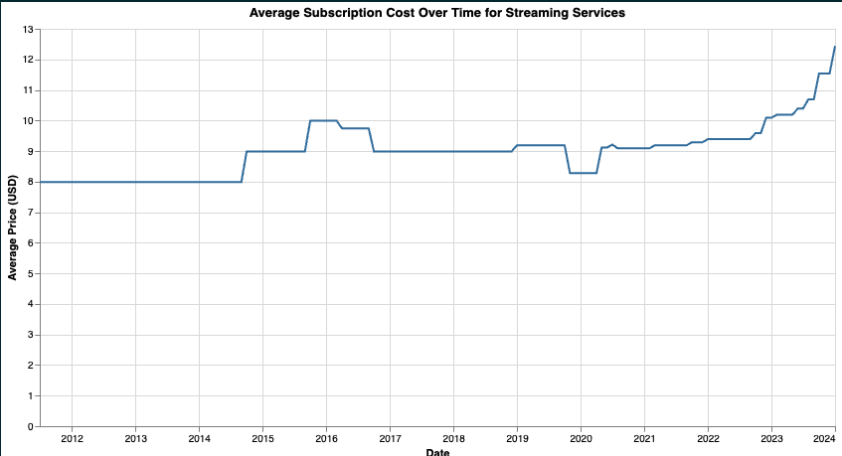
The Rise of Streaming Platforms
Streaming platforms have seen exponential growth, offering viewers a convenient and diverse array of content. This growth is reflected in the rapid increase in user adoption and platform diversity

Slide 6
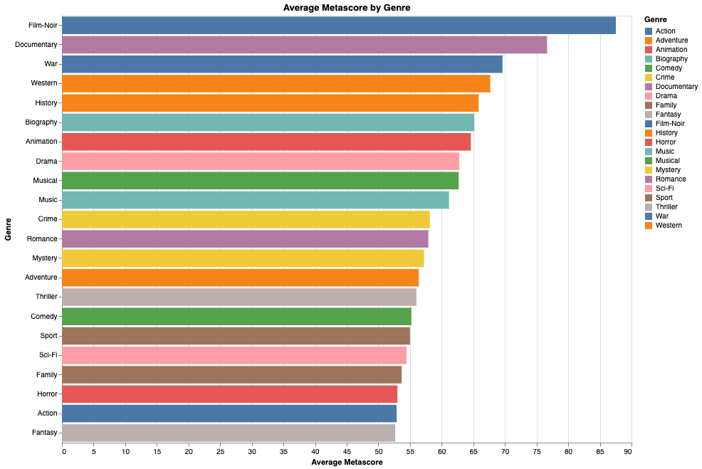
Content Quality Across Platforms
Content quality is a key driver of platform success. Our analysis reveals how platforms like Netflix and Amazon Prime consistently offer highly-rated content, attracting diverse audiences

Slide 7
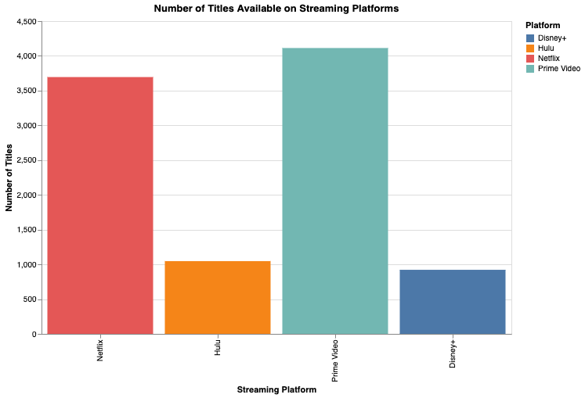
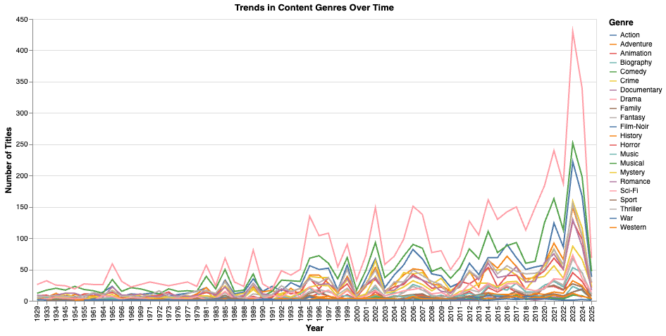
Exploring Genre Diversity
Genre diversity plays a crucial role in attracting and retaining viewers. Our analysis of the IMDb dataset reveals a rich variety of genres, catering to diverse viewer preferences

Slide 8
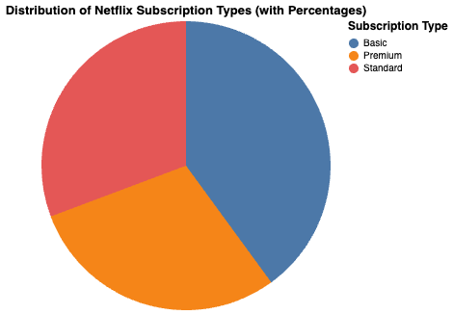
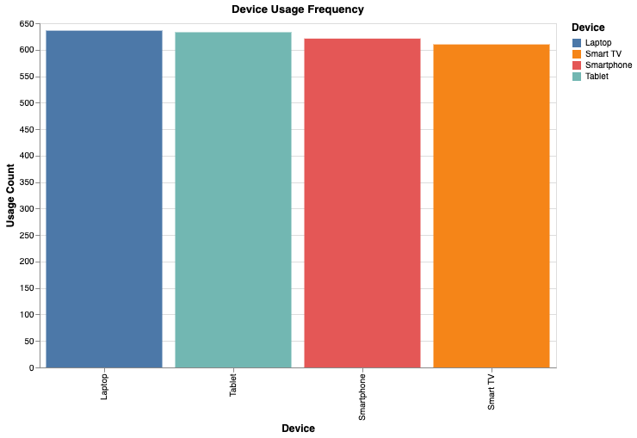
Understanding Viewer Behavior
Viewer behavior varies significantly, with a range of subscription models catering to different demographics. This breakdown illustrates the popularity of various subscription tiers

Slide 9
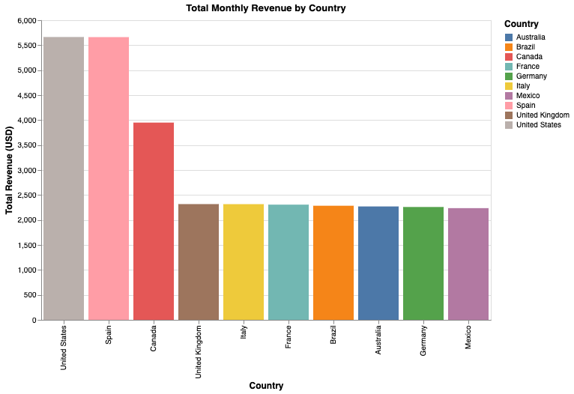
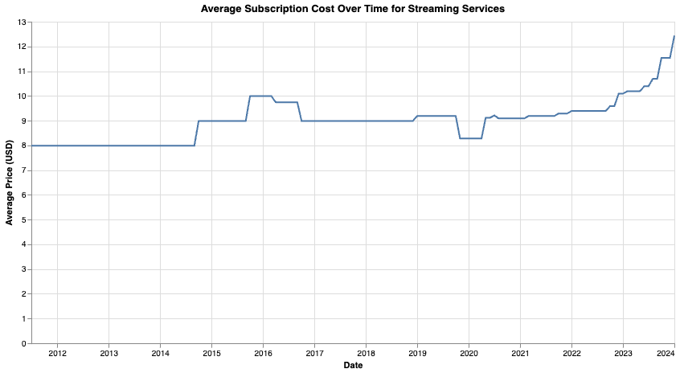
Pricing Trends in Streaming Services
Price has been showing a steady increase, especially since COVID times

Slide 10
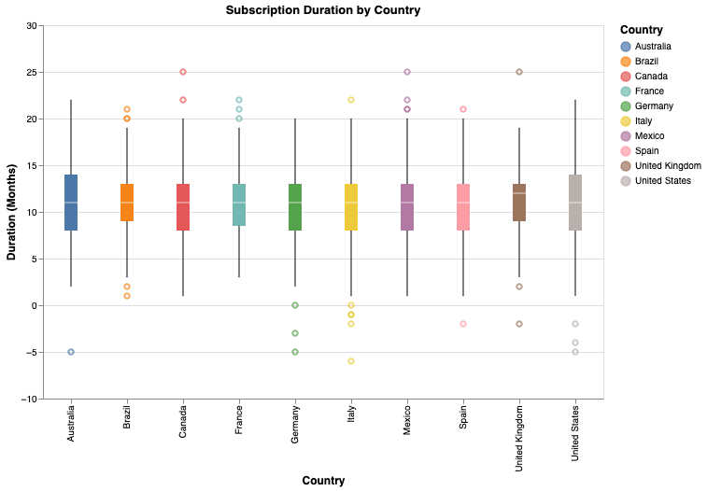
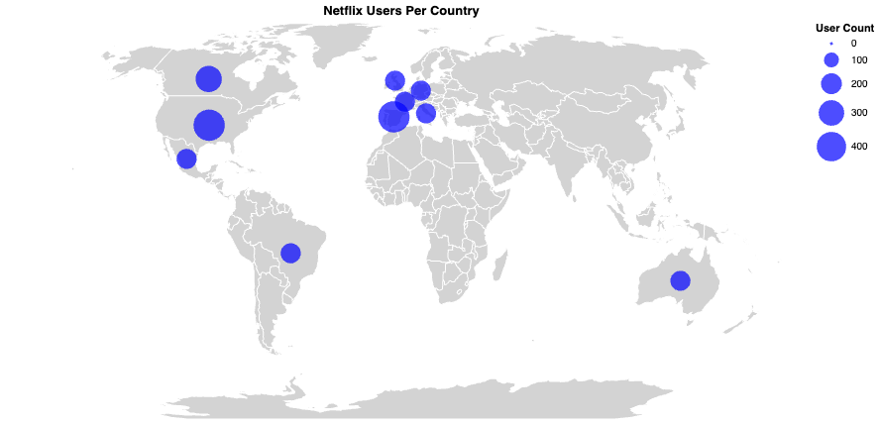
Location

Slide 11
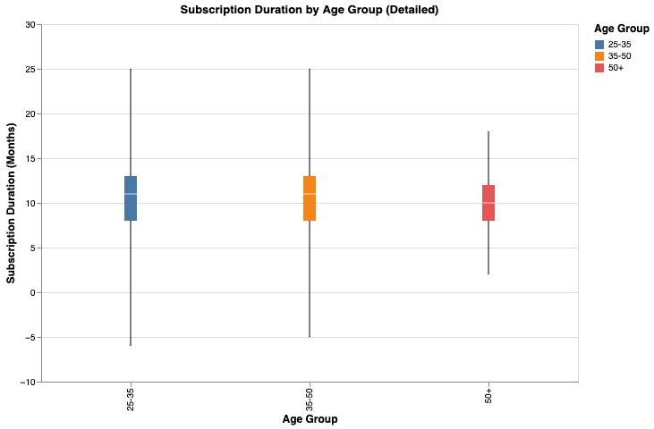
Duration
The 35 – 50 age group shows the highest duration for keeping a subscription

Slide 12

Rapid Change
the media landscape is undergoing a profound transformation, with streaming platforms leading the charge in redefining how we consume content. By offering high-quality, diverse, and on-demand experiences tailored to user preferences, these platforms are rapidly surpassing traditional cable TV

