Slide 1
“THE HOSTS” RESEARCH AGENCY
WHERE TO INVEST IN ORDER TO BE A HOST IN CDMX?

Slide 2
Research Question
Considering the public available dataset of Airbnb of CDMX:
Which is the best neighbourhood to become an Airbnb host?

Slide 3
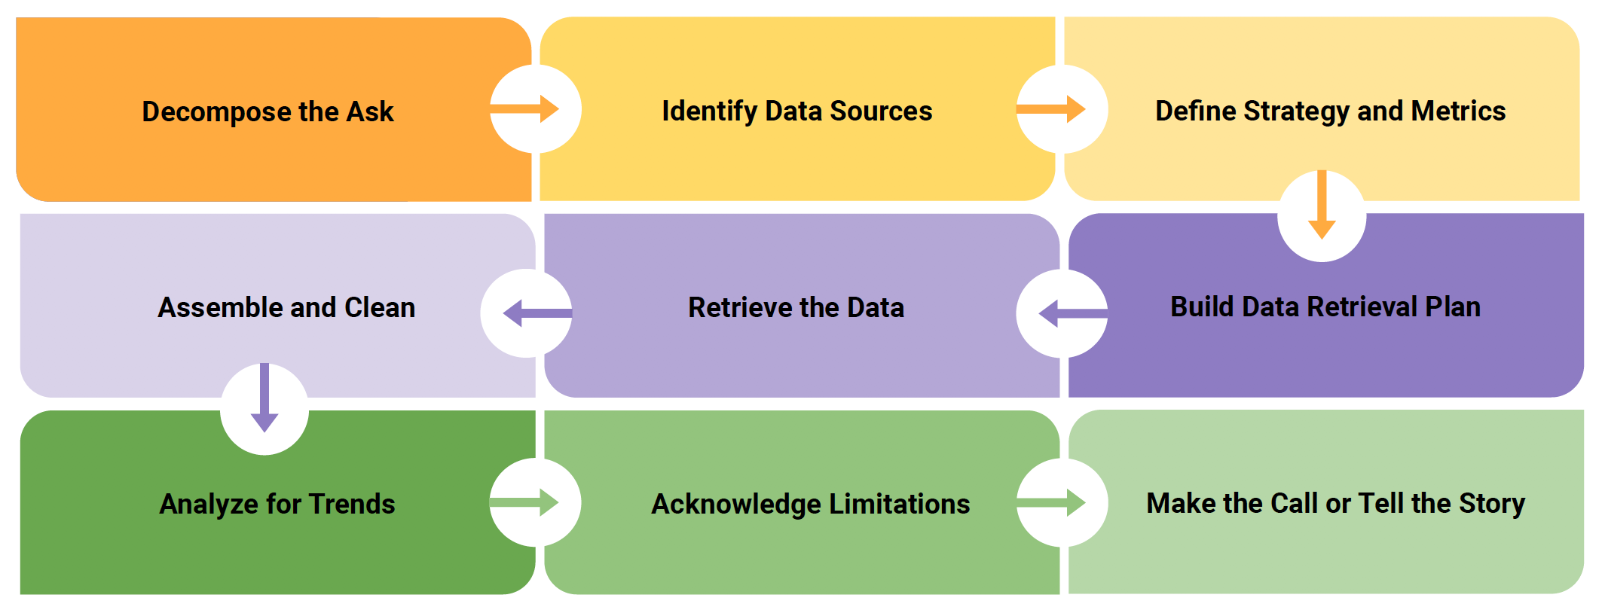
Analytics Paradigm

Slide 4
Step 1: Decompose the “Ask”
Questions.
Is there a relation between price and location?
Is there a relation between room type and location?
Is there a relation between reviews/scores and location?
Is there a relation between amount of properties and location?
Is there a relation between amount of properties and price?
Assumptions
The information is accurate.
The reviews are considered as objective.
The input dataset is updated.
Null entries locations were not taken into account.

Slide 5
Step 1: Decompose the “Ask”
Which metrics use to answer the ASK?
Location
Average price per night
Amount of offer / Airbnb announcements

Slide 6
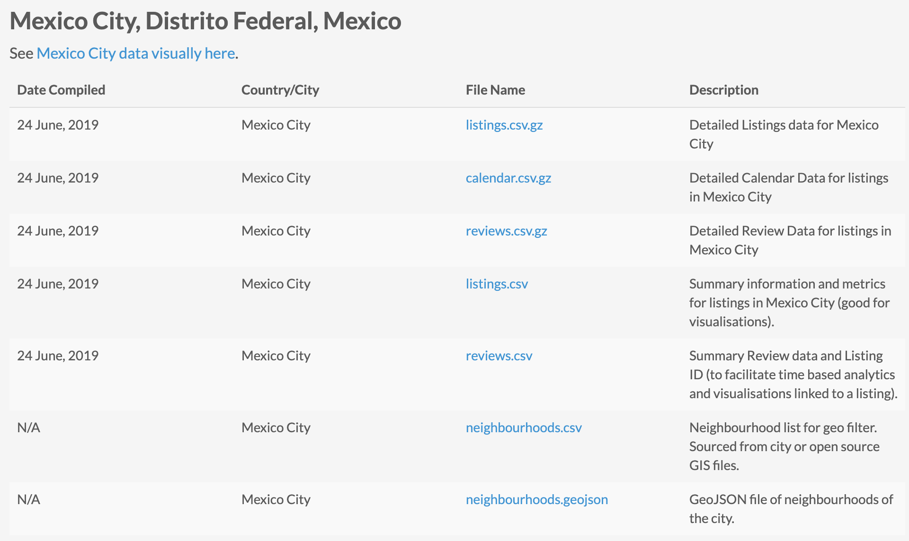
Step 2: Identify Data Sources
Airbnb dataset.
API geo location.
Location
Price per night
Reviews
Scores

Slide 7
Step 3: Define Strategy and Metrics
Locations:
Neighbourhoods of each announcement.
Defined by latitude and longitude.
Reviews:
Monthly reviews.
Scores:
Review score ratings.
Rooms:
Room type.
Price:
Price per night MXN.

Slide 8
Step 3: Define Strategy and Metrics
Dataframe Screenshoots

Slide 9
Step 4: Build Data Retrieval Plan
csv file

Slide 10
Step 5: Retrieve the Data
Dataframe Screenshoots

Slide 11
Step 6: Assemble and Clean the Data
Dataframe Screenshoots

Slide 12
Step 7: Analyze for Trends
Dataframe Screenshoots

Slide 13
Step 8: Acknowledge Limitations
Dataframe Screenshoots

Slide 14
Step 9: Make the Call
Dataframe Screenshoots

