Slide 1
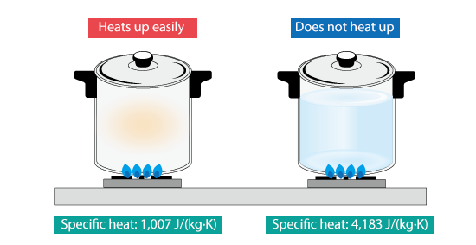
Heat Capacity Demonstration
The heat capacity (Cv) is equal to the ratio of the heat added to (or removed from) an object to the resulting temperature change. Is expressed as Joules/Kelvin
*
*
* If applied to a material it convets to specific heat capacity

Slide 2
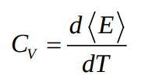



Derivative of the average energies over temperature (d<E>)/(dT)
Fluctuation (std = σ) of the energies and formula
Linear Fit
y = (a) x + (b)
Cv

