Slide 1
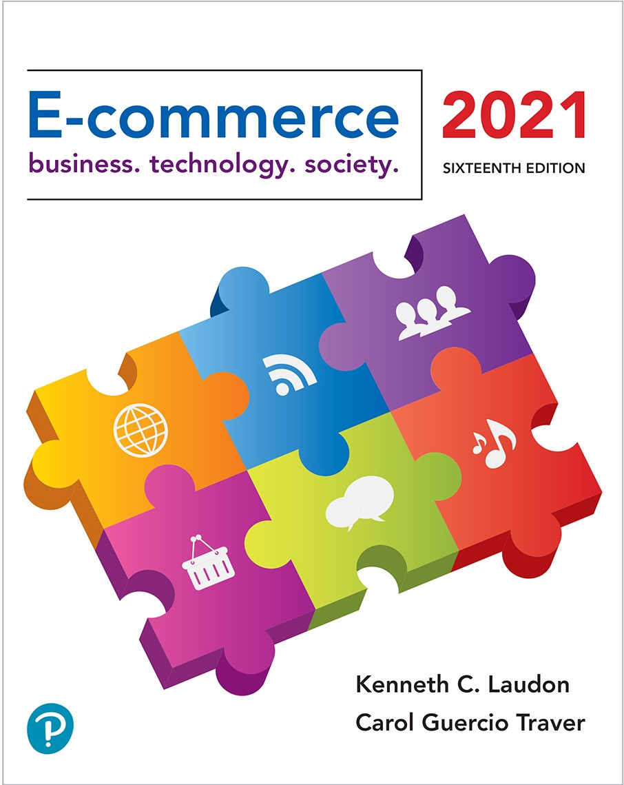

E-commerce 2021: Business. Technology. Society.
Sixteenth Edition
Chapter 3
E-commerce Infrastructure: The Internet, Web, and Mobile Platform
Copyright © 2022, 2019, 2018 Pearson Education, Inc. All Rights Reserved
Notes:
If this PowerPoint presentation contains mathematical equations, you may need to check that your computer has the following installed:
1) MathType Plugin
2) Math Player (free versions available)
3) NVDA Reader (free versions available)
Slides in this presentation contain hyperlinks. JAWS users should be able to get a list of links by using INSERT+F7

Slide 2
Learning Objectives
3.1 Discuss the origins of, and the key technology concepts behind, the Internet.
3.2 Explain the current structure of the Internet.
3.3 Understand how the Web works.
3.4 Describe how Internet and web features and services support e-commerce.
3.5 Understand the impact of mobile applications.

Slide 3
The Covid-19 Pandemic: Will the Internet Break?
Class Discussion
How has your usage of the Internet changed as a result of the pandemic?
Why are fears that the Internet will break misguided?
How has the pandemic highlighted the issues raised by the “digital divide”?

Slide 4
The Internet: Technology Background
Internet
Interconnected network of thousands of networks and millions of computers
Links businesses, educational institutions, government agencies, and individuals
World Wide Web (Web)
One of the Internet’s most popular services
Provides access to billions, possibly trillions, of web pages

Slide 5
The Evolution of the Internet 1961–Present
Innovation Phase, 1961–1974
Creation of fundamental building blocks
Institutionalization Phase, 1975–1995
Large institutions provide funding and legitimization
Commercialization Phase, 1995–present
Private corporations take over, expand Internet backbone and local service

Slide 6
The Internet: Key Technology Concepts
Internet defined as network that:
Uses I P addressing
Supports T C P/I P
Provides services to users, in manner similar to telephone system
Three important concepts:
Packet switching
T C P/I P communications protocol
Client/server computing

Slide 7
Packet Switching
Slices digital messages into packets
Sends packets along different communication paths as they become available
Reassembles packets once they arrive at destination
Uses routers
Less expensive, wasteful than circuit-switching

Slide 8
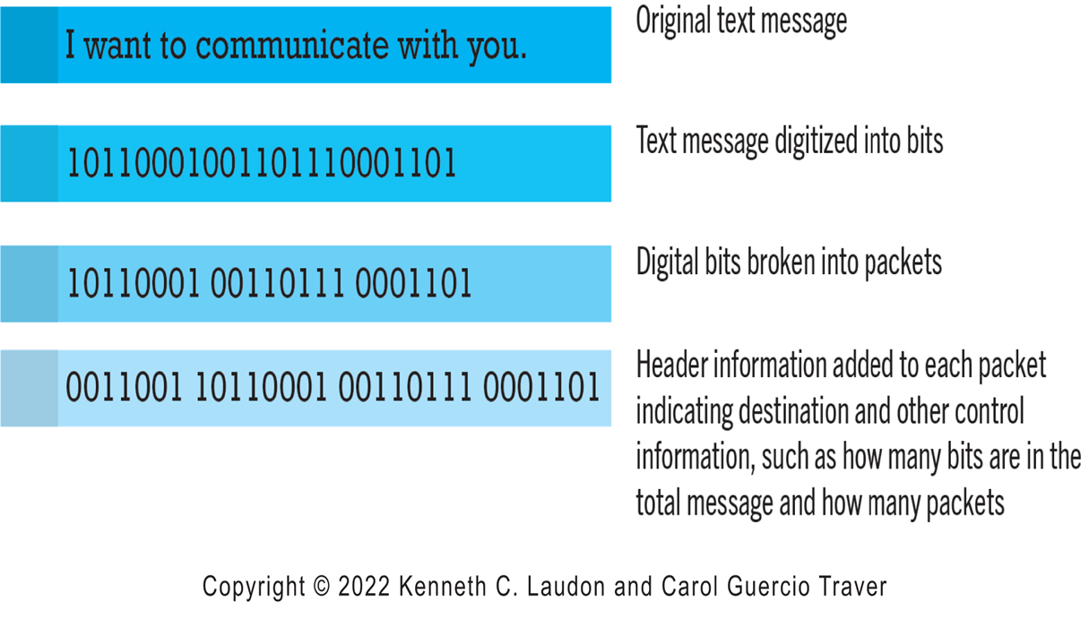
Figure 3.3 Packet Switching
Notes:
Figure 3.3, Page 119.
In packet switching, digital messages are divided into fixed-length packets of bits (generally about 1,500 bytes). Header information indicates both the origin and the ultimate destination address of the packet, the size of the message, and the number of packets the receiving node should expect. Because the receipt of each packet is acknowledged by the receiving computer, for a considerable amount of time, the network is not passing information, only acknowledgments, producing a delay called latency.
Alt Text
Long description: An illustration explains how packet switching works, as follows: The original text message reads, I want to communicate with you. The text message is digitized into bits, or a series of 1’s and 0’s. Digital bits are broken into packets of 7 or 8 1’s and 0’s. Header information is added to each packet indicating destination and other control information, such as how many bits are in the total message and how many packets.

Slide 9
T C P/I P
Transmission Control Protocol (T C P)
Establishes connections among sending and receiving Web computers
Handles assembly of packets at point of transmission, and reassembly at receiving end
Internet Protocol (I P)
Four T C P/I P layers
Network interface layer
Internet layer
Transport layer
Application layer

Slide 10
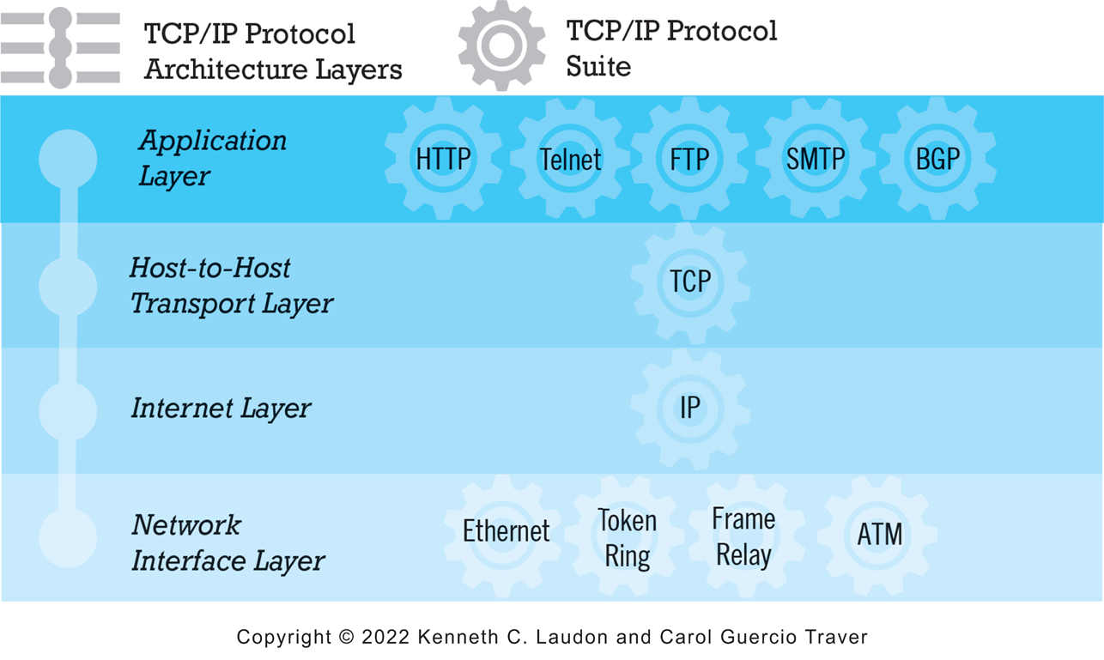
Figure 3.4 The T C P/I P Architecture and Protocol Suite
Notes:
Figure 3.4, Page 121.
TCP/IP is an industry-standard suite of protocols for large internetworks. The purpose of TCP/IP is to provide high-speed communication network links.
Alt Text
Long description: An illustration depicts the T C P and IP protocol architecture layers and the related elements of the T C P and I P protocol suite., as follows: From the bottom up, Network Interface layer: Ethernet, token ring, frame relay, and A T M; Internet Layer: I P; Host to host transport layer, T C P; Application layer: H T T P, Telnet, F T P, S M T P, and B G P.

Slide 11
Internet (I P) Addresses
I P v4
32-bit number
Four sets of numbers marked off by periods: 201.61.186.227
Class C address: Network identified by first three sets, computer identified by last set
I P v6
128-bit addresses, able to handle up to 1 quadrillion addresses (I P v4 can handle only 4 billion)

Slide 12
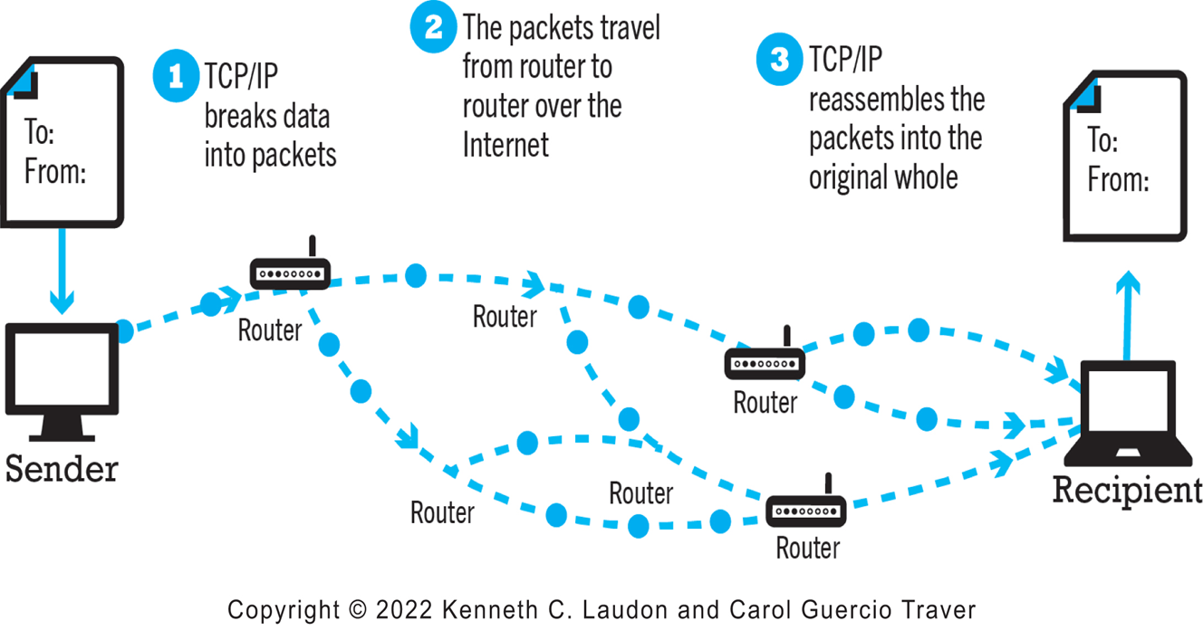
Figure 3.5 Routing Internet Messages: T C P/I P and Packet Switching
Notes:
Figure 3.5, Page 122.
The Internet uses packet-switched networks and the TCP/IP communications protocol to send, route, and assemble messages. Messages are broken into packets, and packets from the same message can travel along different routes.
Alt Text
Long description: An illustration explains how T C P, I P, and packet switching are used to route internet messages, as follows: A message is sent from the sender. Step 1, T C P, I P breaks the data into packets. Step 2, the packets travel from router to router over the Internet. Step 3, T C P, I P reassembles the packets into the original whole. The message arrives at the receiver.

Slide 13
Domain Names, D N S, and U R L s
Domain name
I P address expressed in natural language
Domain name system (D N S)
Allows numeric I P addresses to be expressed in natural language
Uniform resource locator (U R L)
Address used by web browser to identify location of content on the Web
For example:
http://www.azimuth-interactive.com/

Slide 14
Client/Server Computing
Powerful desktop computers (clients) connected in network with one or more servers
Servers perform common functions for the clients
Storing files
Software applications
Access to printers, and so on

Slide 15
The Mobile Platform
Primary Internet access is now through smartphones and tablets
Smartphones are a disruptive technology
New processors and operating systems
Over 245 million in U.S. access Internet with mobile phone
Tablets supplement P C s for mobile situations
Over 170 million in U . S. use Internet with tablets

Slide 16
The Internet “Cloud Computing” Model (1 of 2)
Firms and individuals obtain computing power and software over Internet
Three types of services
Infrastructure as a service (I a a S)
Software as a service (S a a S)
Platform as a service (P a a S)
Public, private, and hybrid clouds

Slide 17
The Internet “Cloud Computing” Model (2 of 2)
Drawbacks
Security risks
Shifts responsibility for storage and control to providers
Radically reduces costs of:
Building and operating websites
Infrastructure, I T support
Hardware, software

Slide 18
Other Internet Protocols and Utility Programs
Internet protocols
H T T P
E-mail: S M T P, P O P 3, I M A P
F T P, Telnet, S S L/T L S
Utility programs
Ping
Tracert

Slide 19
Internet Infrastructure
Internet has been able to grow exponentially without disruption because of:
Client/server computing model
Hourglass, layered architecture
Network Technology Substrate
Transport Services and Representation Standards
Middleware Services
Applications

Slide 20
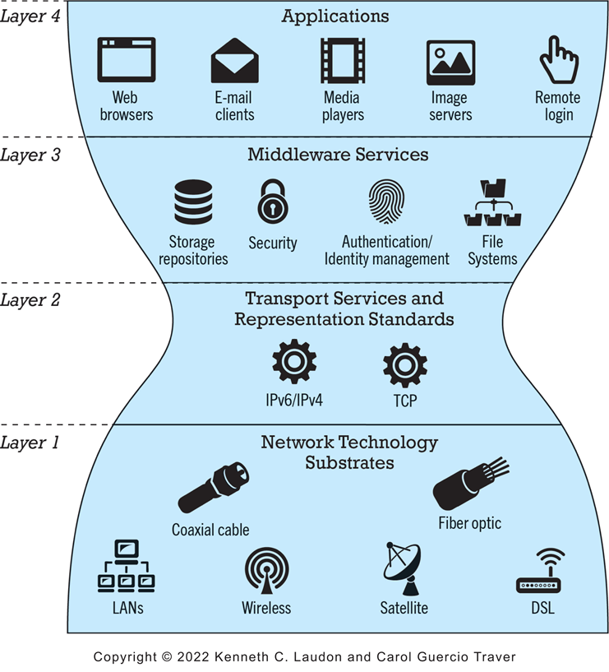
Figure 3.10 The Hourglass Model of the Internet
Notes:
Figure 3.10 Page 132.
The Internet can be characterized as an hourglass modular structure with a lower layer containing the bit-carrying infrastructure (including cables and switches) and an upper layer containing user applications such as e-mail and the Web. In the narrow waist are transportation protocols such as TCP/IP.
Alt Text
Long description: A diagram illustrates the hourglass model of the internet, as follows: The hourglass model depicts the internet as being divided into 4 layers, in an hourglass shape, from bottom to top, as follows. Layer 1 at the wide bottom of the hourglass: Network technology substrates including coaxial cable, LANs, wireless, satellite, fiber optic, and D S L. Layer 2, at the narrowest part of the hourglass: Transport services and representation standards including I P v 6, I P v 4, and T C P. Layer 3 at the widening middle of the hourglass: middleware services including storage repositories, security, authentication and identity management, and file systems. Layer 4, at the top and widest part of the hourglass: applications including web browsers, email clients, media players, image servers, and remote login.

Slide 21
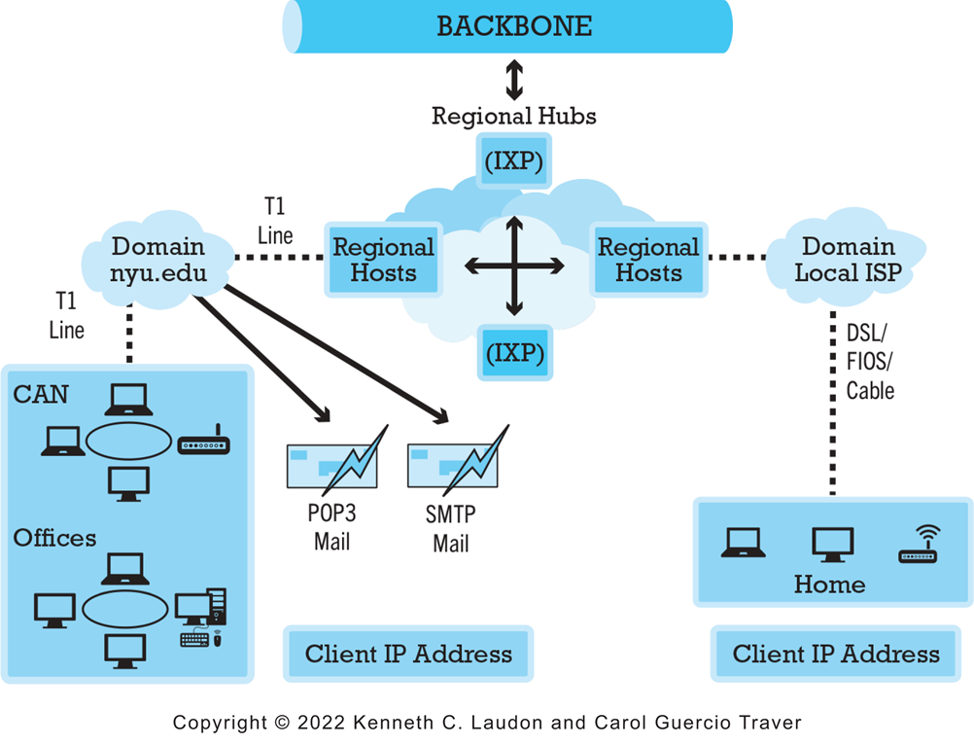
Figure 3.11 Internet Network Architecture
Notes:
Figure 3.11, Page 133.
Today’s Internet has a multi-tiered open network architecture featuring multiple backbones, regional hubs, campus/corporate area networks, and local client computers.
Alt Text
Long description: An illustration depicts internet network architecture, as follows: The backbone exchanges information with the regional hubs, I X P’s. The I X P’s exchange information with regional hosts. Regional hosts are connected to domain local I S P’s and domains like N Y U dot edu. The Domain Local I S P’s are connected via D S L, FIOS or cable to the home computer at the client I P address. The domain N Y U dot e d u is connected via T1 line to a CAN or offices at the client I P address.

Slide 22
The Internet Backbone
Comprised of fiber-optic cable: hundreds of glass strands that use light to transmit data
Faster speeds and greater bandwidth
Thinner, lighter cables
Less interference
Better data security
Tier 1 Internet Service Providers (Tier 1 I S P s) or transit I S P s
Numerous private networks physically connected to each other
Undersea fiber optics, satellite links

Slide 23
Internet Exchange Points (I X P s)
Regional hubs where Tier 1 I S P s physically connect with one another and with regional Tier 2 I S P s.
Tier 2 I S P s provide Tier 3 I S P s with Internet access.
Originally called Network Access Points (N A P s) or Metropolitan Area Exchanges (M A E s).

Slide 24
Tier 3 Internet Service Providers
Retail providers
Lease Internet access to homeowners, small businesses
Large providers: Comcast, Charter Spectrum, A T&T, Verizon, Altice (Optimum)
Smaller local providers
Services
Narrowband
Broadband
Digital subscriber line (D S L)
Cable Internet
Satellite Internet

Slide 25
Campus/Corporate Area Networks
Local area networks operating within single organization, such as N Y U or Microsoft Corporation
Lease Internet access directly from regional and national carriers

Slide 26
Mobile Internet Access
Two basic types of wireless Internet access:
Telephone-based (mobile phones, smartphones)
Computer network-based (wireless local area network-based)
Telephone-based wireless Internet access
Currently based on 3G and 4G technologies
5G will provide higher bandwidth with speeds reaching 10 G b p s or more

Slide 27
Wireless Local Area Network (W L A N) -Based Internet Access
Wi-Fi (various 802.11 standards)
High-speed, fixed broadband wireless L A N (W L A N)
Wireless access point (“hot spots”)
Limited range but inexpensive
WiMax
Bluetooth

Slide 28
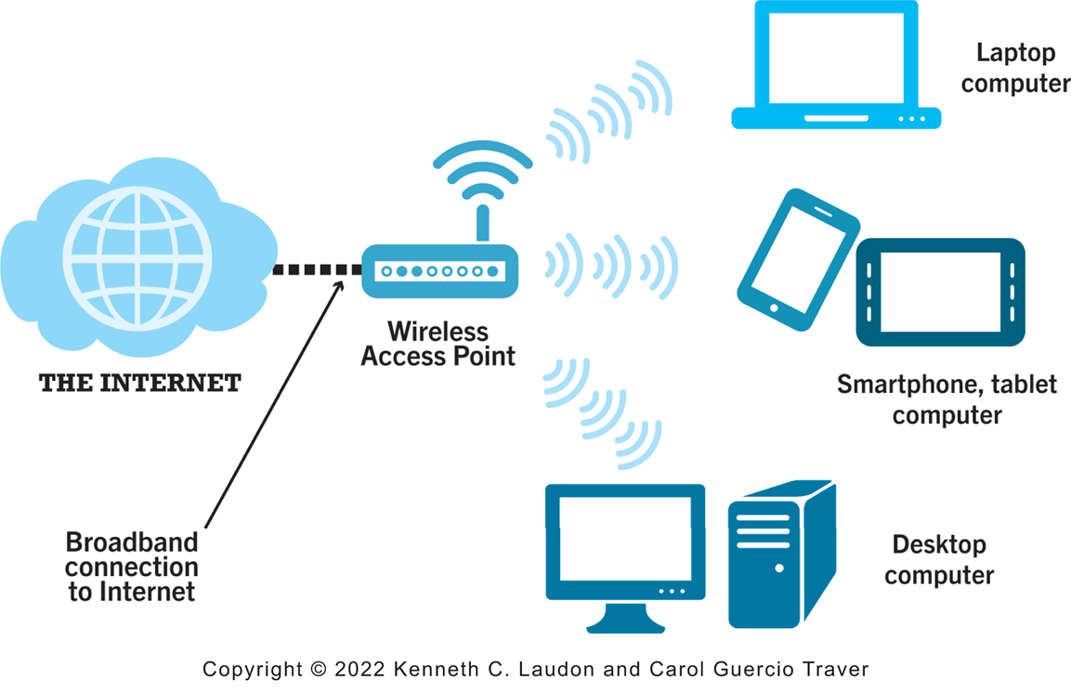
Figure 3.13 Wi-Fi Networks
Notes:
Figure 3.13, page 141.
In a Wi-Fi network, wireless access points connect to the Internet using a land-based broadband connection. Clients, which could be desktops, laptops, tablet computers, or smartphones, connect to the access point using radio signals.
Alt Text
Long description: An illustration depicts WI FI networks, as follows: A wireless access point is connected to the internet by a broadband connection. The access point provides internet access to devices such as a laptop and desktop computer and a smartphone or tablet computer.

Slide 29
Other Innovative Internet Access Technologies: Drones, Balloons, and White Space
Google: Project Loon
Facebook: Facebook Connectivity Lab/Acquila drone
Microsoft: Airband Initiative (white spaces)

Slide 30
The Internet of Things (I O T)
Objects connected via sensors/R F I D to the Internet
“Smart things”
Interoperability issues and standards
Security and privacy concerns

Slide 31
Insight on Business: The Apple Watch: Bringing the Internet of Things to Your Wrist
Class Discussion
Are you or anyone you know using the Apple Watch? If not, why not? If so, what apps do you use most?
What are the potential benefits of wearable technology? Are there any disadvantages?
What effects will features like the Apple Pay button and Taptic Engine have?
Are there any privacy issues raised by wearable technology?

Slide 32
Who Governs the Internet?
Organizations that influence the Internet and monitor its operations include:
Internet Corporation for Assigned Names and Numbers (I C A N N)
Internet Engineering Task Force (I E T F)
Internet Research Task Force (I R T F)
Internet Engineering Steering Group (I E S G)
Internet Architecture Board (I A B)
Internet Society (I S O C)
Internet Governance Forum (I G F)
World Wide Web Consortium (W3C)
Internet Network Operators Groups (N O G s)

Slide 33
Insight on Society: Government Regulation and Surveillance of the Internet
Class discussion:
How is it possible for any government to “control” or censor the Web?
Does the Chinese government, or the U.S. government, have the right to censor online content?
How should U.S. companies deal with governments that want to censor content?
What would happen to e-commerce if the existing Web split into a different Web for each country?

Slide 34
The Web
1989–1991: Web invented
Tim Berners-Lee at C E R N
H T M L, H T T P, web server, web browser
1993: Mosaic web browser w/G U I
Andreessen and others at N C S A
Runs on Windows, Macintosh, or Unix
1994: Netscape Navigator, first commercial web browser
1995: Microsoft Internet Explorer

Slide 35
Hypertext
Text formatted with embedded links
Links connect documents to one another, and to other objects such as sound, video, or animation files
Uses Hypertext Transfer Protocol (H T T P) and U R L s to locate resources on the Web
Example U R L:
http://megacorp.com/content/features/082602.html
Notes:
Note: Example URL is not an actual URL.

Slide 36
Markup Languages
Hypertext Markup Language (H T M L)
Fixed set of pre-defined markup “tags” used to format text
Controls look and feel of web pages
Used in conjunction with C S S (Cascading Style Sheets)
H T M L5 the newest version
eXtensible Markup Language (X M L)
Designed to describe data and information
Tags used are defined by user

Slide 37
Web Servers and Web Clients
Web server software
Enables a computer to deliver web pages to clients on a network that request this service by sending an H T T P request
Basic capabilities: Security services, F T P, search engine, data capture
Web server
May refer to either web server software or physical server
Specialized servers: Database servers, ad servers, and so on
Web client
Any computing device attached to the Internet that is capable of making H T T P requests and displaying H T M L pages

Slide 38
Web Browsers
Primary purpose is to display web page, but may include added features
Google’s Chrome: almost 70% of desktop market and about 65% of mobile market
Open source
Mozilla Firefox: 8% desktop, >1% mobile
Open source
Microsoft Edge: 7% desktop
Internet Explorer: 6% desktop
Apple’s Safari: 4% desktop, 27% mobile

Slide 39
The Internet and Web: Features
Features on which the foundations of e-commerce are built:
Communication tools
Search engines
Downloadable and streaming media
Web 2.0 applications and services
Virtual reality and augmented reality
Intelligent digital assistants

Slide 40
Communication Tools
E-mail
Most used application of the Internet
Messaging Applications
Instant messaging
Online message boards
Internet telephony
V O I P
Videoconferencing, video chatting, telepresence

Slide 41
Insight on Technology: Zoom in the Midst of the Pandemic
Class Discussion
What has your experience using Zoom and other videoconferencing services during the pandemic been like?
What challenges does Zoom face?
How has Zoom responded to those challenges?

Slide 42
Search Engines
Identify web pages that match queries based on one or more techniques
Keyword indexes
Page ranking
Also serve as:
Shopping tools
Advertising vehicles (search engine marketing)
Tool within e-commerce sites
Top three providers: Google, Microsoft’s Bing, Verizon Media (Yahoo)

Slide 43
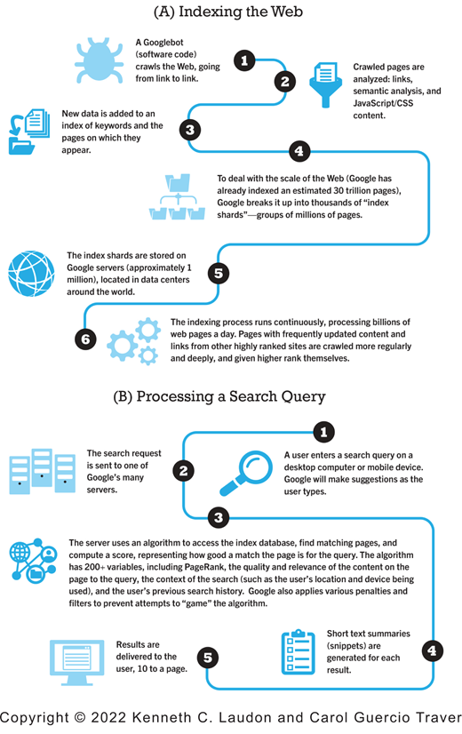
Figure 3.17 How Google Works
Notes:
Figure 3.17, page 167.
Alt Text
Long description: A flow chart depicts how Google works, as follows: A, Indexing the web. Step 1, a Googlebot, which is a form of software code, crawls the web, going from link to link. Step 2, crawled pages are analyzed: links semantic analysis and JavaScript or C S S content. Step 3, new data is added to an index of keywords and the pages on which they appear. Step 4, to deal with the scale of the Web, Google has already indexed an estimated 30 trillion pages, Google breaks it up into thousands of index shards, groups of millions of pages. Step 5, the index shards are stored on Google servers, approximately 1 million, located in data centers around the world. Step 6, the indexing process runs continuously, processing billions of web pages a day. Pages with frequently updated content and links from other highly ranked sites are crawled more regularly and deeply and given higher rank themselves. B, Processing a Search Query. Step 1, a user enters a search query on a desktop computer or mobile device. Google will make suggestions as the user types. Step 2, the search request is sent to one of Google’s many servers. Step 3, the server uses an algorithm to access the index database, find matching pages, and compute a score, representing how good a match the page is for the query. The algorithm has 200 plus variables, including page rank, the quality and relevance of the content on the page to the query, the context of the search such as the user’s location and device being used, and the user’s previous search history. Google also applies various penalties and filters to prevent attempts to game the algorithm. Step 4, short text summaries or snippets are generated for each result. Step 5, results are delivered to the user, 10 to a page.

Slide 44
Downloadable and Streaming Media
Downloads:
Growth in broadband connections enables large media file downloads
Streaming technologies
Enables music, video, and other large files to be sent to users in chunks so that the file can play uninterrupted
Podcasting
Explosion in online video viewing

Slide 45
Web 2.0 Features and Services
Online Social Networks
Services that support communication among networks of friends, peers
Blogs
Personal web page of chronological entries
Enables web page publishing with no knowledge of H T M L
Wikis
Enables documents to be written collectively and collaboratively
E.g., Wikipedia

Slide 46
Virtual Reality and Augmented Reality
Virtual reality (V R)
Immersing users within virtual world
Typically uses head-mounted display (H M D)
Oculus Rift, Vive, PlayStation V R
Augmented reality (A R)
Overlaying virtual objects over the real world, via mobile devices or H M D s
Pokémon G O
Mixed reality (A R)
Enhanced version of A R

Slide 47
Intelligent Digital Assistants
Computer search engine using:
Natural language
Conversational interface, verbal commands
Situational awareness
Can handle requests for appointments, flights, routes, event scheduling, and more.
Examples:
Apple’s Siri
Google Now/Google Assistant
Amazon Alexa

Slide 48
Mobile Apps
Use of mobile apps has exploded
Most popular entertainment media, over T V
Always present shopping tool
Almost all top 100 brands have an app
Platforms
iPhone/iPad (i O S), Android
App marketplaces
Google Play, Apple’s App Store, Amazon’s Appstore

Slide 49
Careers in E-commerce
Position: E-commerce Specialist
Qualification/Skills
Preparing for the Interview
Possible Interview Questions

Slide 50

Copyright
This work is protected by United States copyright laws and is provided solely for the use of instructors in teaching their courses and assessing student learning. Dissemination or sale of any part of this work (including on the World Wide Web) will destroy the integrity of the work and is not permitted. The work and materials from it should never be made available to students except by instructors using the accompanying text in their classes. All recipients of this work are expected to abide by these restrictions and to honor the intended pedagogical purposes and the needs of other instructors who rely on these materials.

