Slide 1
Answerability prediction

Slide 2
Problem: can the agent answer?
Objective
Improve reliability, preventing the agent from being overconfident. Giving it the ability to reject a prompt\ ask based on the users query.
Detect not can_answer
Optimize resource allocation
Enhance users trust
Dataset
A collection of over 3.4k task records measuring how compatible a prompt is to the domains of the AI
Binary results
Benchmark being 64% live tasks
Dominant domain: gender\other

Slide 3

Refusal insights
Weve observed that
The more complex the prompt the more prone it is to be “can answer”
aspect_coverage_ratio is our strongest indicator if a query is answerable . Rejected queries rarely match tool’s aspects
Data Noise In the "Other" domain tehres no predicrting which aspects will turn us to refusal

Slide 4
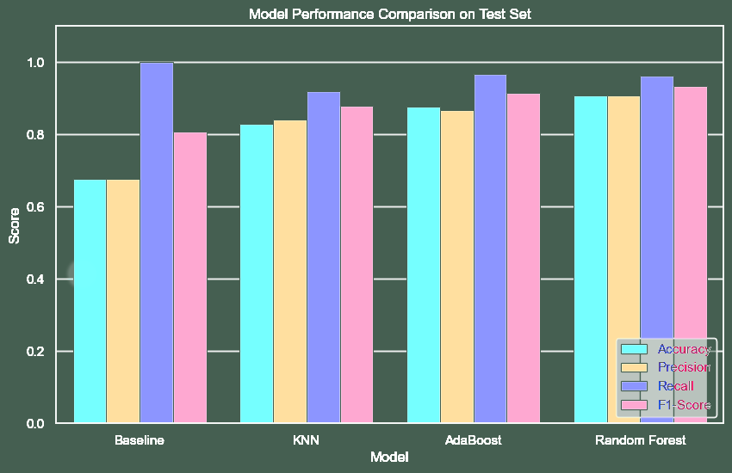
 | Model | Accuracy | Precision | Recall | F1-Score
0 | Baseline | 67.7 % | 0.677143 | 1.000000 | 0.807496
1 | KNN | 82.8 % | 0.841699 | 0.919831 | 0.879032
2 | AdaBoost | 87.7 % | 0.867424 | 0.966245 | 0.914172
3 | Random Forest | 90.8 % | 0.908367 | 0.962025 | 0.934426
Best RF Params: {'n_estimators': 200, 'max_depth': 20}
Fandom forest is our top achieving tree with 90.8%accuracy and 0.93 F1 score, and a balance between recall and presicion
Hyperparamater tuning shows 200 estimators and 20 depth as the optimal shape for handling the features

Slide 5
clustering
cluster | size | answer rate | key pattern | descriptive name
1 | 3 | 0.0% | Low aspect coverage, zero Jaccard similarity, ... | Unmatched / Refusal Candidates
0 | 2555 | 65.6% | High tool count, high params, long complex que... | Complex Multi-Tool Scenarios
2 | 933 | 74.0% | High aspect coverage, few tools, direct token ... | Simple Direct Matches
We know that lower token similarity is a strong indicator for refusal to answer and so We isolated the pure refusal group, which will have 0% answerable rate, using ward linkage clustering. Picking those with token jaccard →0 meaning it has almost no overlap between the user’s words and the tokens.

Slide 6
summary
Best model | Random forest - 90.8% accuracy
Main metric | F1 score 0.934 – robust to class imbalance
Critical error | False positive
Data noise | Too many of “other” domain, thowing off the system

