Slide 1
System Development Scrum 1
Datamatiker /Computer Science
2nd Semester
Spring 2015

Slide 2
2nd Semester
Focus
Multi User System
Organizational Challenges
Project
Build IT system in project group using system development and project management techniques
You get help from …
Scrum – a process tool
UML – a modeling tool
XP – development practices

Slide 3
Agenda for Scrum Days
Scrum
Process tool that describes how teams can work together to develop a product
Scrum Day 1
Overview of Scrum
Requirement specification (customer view)
Requirement implementation (developer view)
Scrum day 2
Product backlog
Poker game
User stories
Estimation
Done criteria
Scrum Day 3
Sprint planning
Tasks
Daily scrum meeting

Slide 4
Learning Objectives for Scrum
Knowledge of Scrum basic process model
How to document and estimate customer requirements
How to turn these requirements into an operational format the developers can use to control their daily work
How to monitor and manage the development effort
How to calculate team velocity, meaning how much work a team can handle in time-boxed period
How to work in an iterative manner where software is build piece by piece

Slide 5
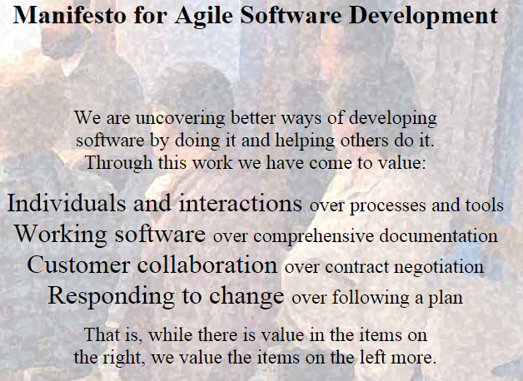
Agile Processes
Agile software development is a group of software development methods in which requirements and solutions evolve through collaboration between self-organizing, cross-functional teams. It promotes adaptive planning, evolutionary development, early delivery, continuous improvement and encourages rapid and flexible response to change.
Kilde: http://en.wikipedia.org/wiki/Agile_software_development
http://agilemanifesto.org

Slide 6
Main literature
Henrik Kniberg Scrum and XP from the Trenches:
http://www.infoq.com/minibooks/scrum-xp-from-the-trenches
Pages : p. 1-41 (Scrum Day 1) + 43-71 (Scrum Day 2)
Lynda
http://www.lynda.com/Business-Project-Management-tutorials/Agile-Project-Management/122428-2.html
http://www.lynda.com/Business-Skills-tutorials/Managing-Project-Stakeholders/168242-2.html

Slide 7
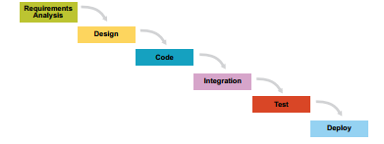
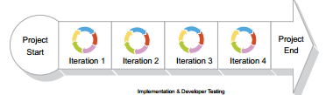
Scrum in a Nutshell
The Scrum is iterative process
Many small water falls, called sprints
TRADITIONAL WATERFALL
SCRUM - ITERATIVE – MINI WATERFALLS

Slide 8
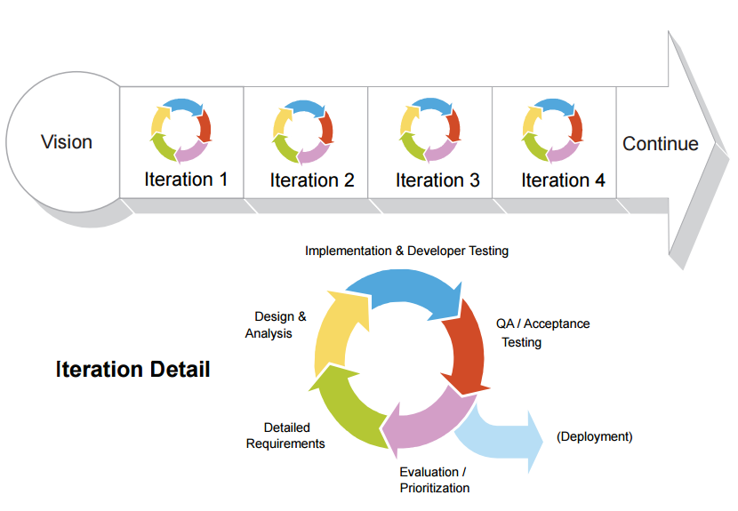
Iteration Detail

Slide 9
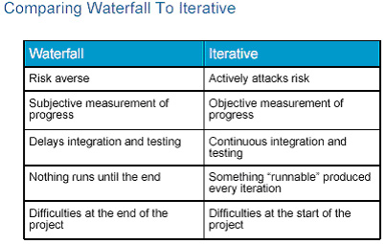
Traditional Waterfall vs. Iterative Approach
General comparison of two paradigms (i.e. methodology classifications)
Traditional “waterfall” development depends on a perfect understanding of the product requirements from the beginning and minimal errors made in each phase.
Source: http://www.ibm.com/developerworks/rational/library/4029.html
Notes:
Averse – modvillig
http://en.wikipedia.org/wiki/Risk_aversion

Slide 10
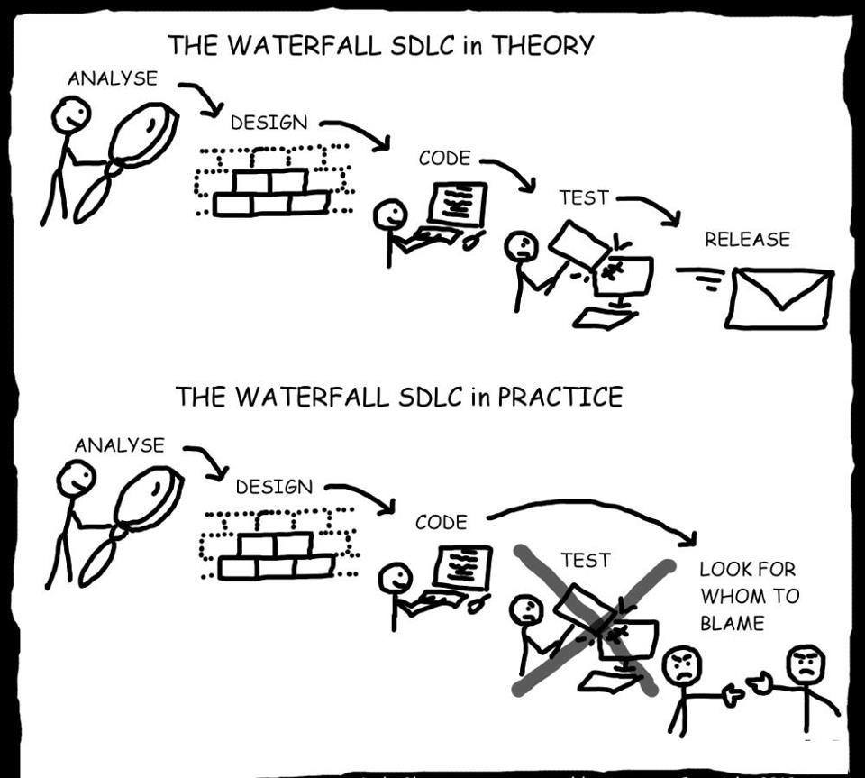
Waterfall

Slide 11
Scrum in a Nutshell
Split your organization into small, cross-functional, self organizing teams.
Source: Kniberg ” KANBAN AND SCRUM – MAKING THE MOST OF BOTH”
Notes:
Size 3-12

Slide 12
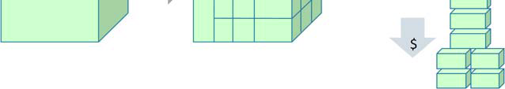
Scrum in a Nutshell
Split your work into a list of small, concrete deliverables.
Sort the list by priority
Estimate the effort of each item
Source: Kniberg ” KANBAN AND SCRUM – MAKING THE MOST OF BOTH”

Slide 13
Scrum in a Nutshell
Split time into short fixed-length iterations (usually 1 – 4 weeks), with potentially shippable code demonstrated after each iteration.
Short sprints are good = short feedback cycle = more frequent deliveries = more frequent customer feedback = less time spent in the wrong direction = learn and improve faster.
Long sprints are good too. The team gets more time to build up momentum, they get more room to recover from problems and still make the sprint goal; less overhead for sprint planning meetings, demos etc. (Kniberg p.19-20)
Notes:
3 uger (2 – 6 weeks)

Slide 14
Scrum in a Nutshell
After each iteration …
Optimize the release plan and update priorities in collaboration with the customer, based on insights gained by inspecting the release
Optimize the process by having a retrospective after each iteration.
Source: Kniberg ” KANBAN AND SCRUM – MAKING THE MOST OF BOTH”

Slide 15

Time Boxing
In time management, timeboxing allocates a fixed time period, called a time box, to each planned activity. Several project management approaches use timeboxing. It is also used for individual use to address personal tasks in a smaller time frame. It often involves having deliverables and deadlines, which will improve the productivity of the user
Kilde: http://en.wikipedia.org/wiki/Timeboxing
Agile teams not only like to have timeboxed projects, they also prefer to break projects down into smaller timeboxed durations, commonly referred to as iterations.
Iteration lengths are fixed and not flexible in anyway, meaning it will end regardless of whether all assigned work is completed. Outstanding work is either assigned to the next iteration, or reprioritized amongst the remaining tasks.

Slide 16
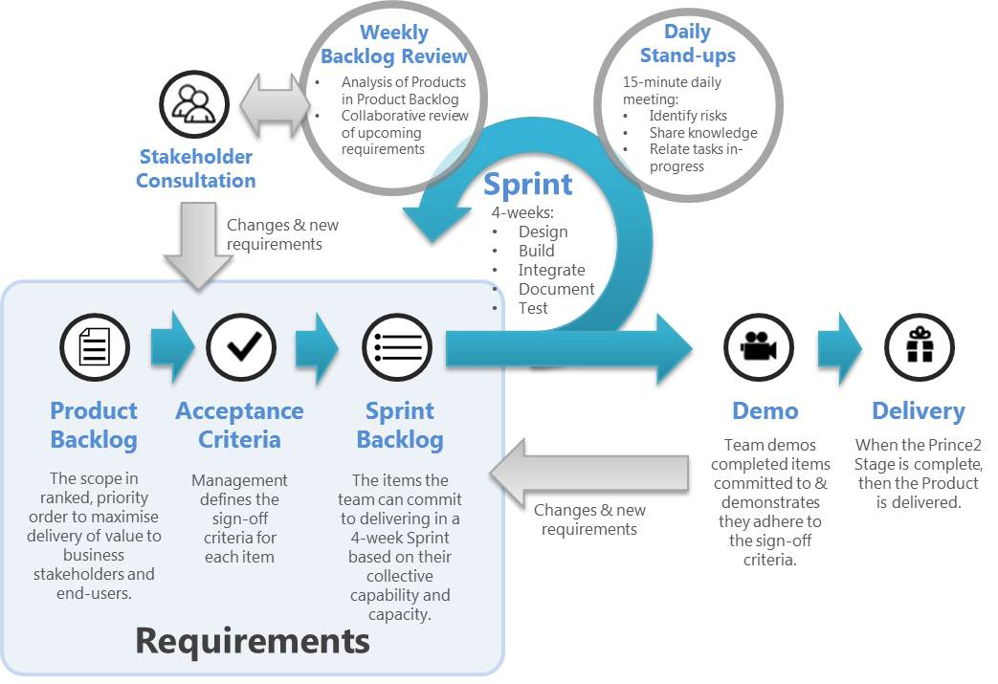
Scrum in a Nutshell

Slide 17
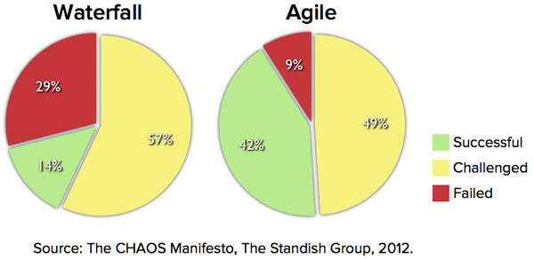
Scrum in a Nutshell

Slide 18
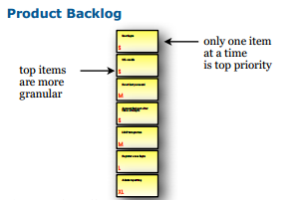
The Product Backlog
A prioritized list of everything that might be needed in the product:
requirements, features etc.
Things that the customer wants, described using the customer’s terminology.

Slide 19
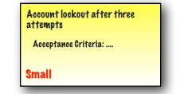
Product Backlog Item
Often called (user) story, or just PBI.
Example:

Slide 20
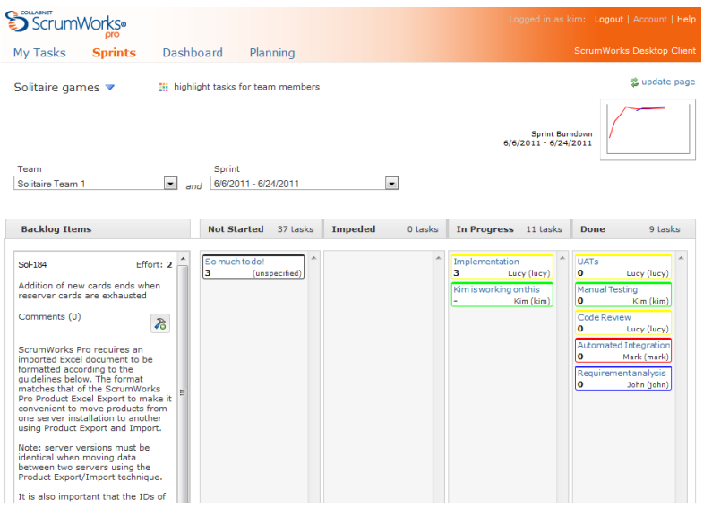
Product Backlog - Software

Slide 21
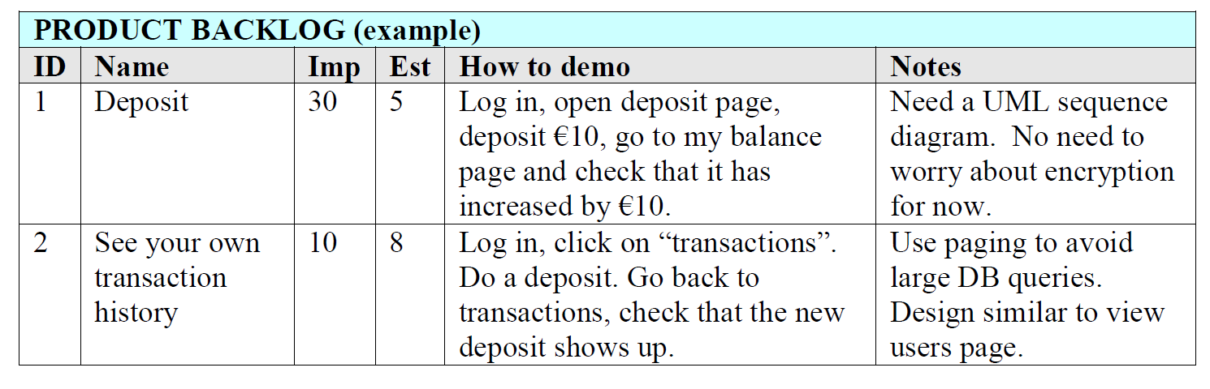
Product Backlog Example
Story example where feature description is specified in “How to demo” field, i.e. test steps description (acceptance criteria) (Kniberg p. 10)

Slide 22
Who is Responsible for Product Backlog?
The Product Owner!
Represents the stakeholders, i.e. the voice of the customer.
Is responsible for maximizing product value
Is responsible for managing the PBL:
Creating Product Backlog items (user stories)
Prioritizes the items in the Product Backlog
Ensuring the Development Team understands items to the level needed.

Slide 23

User Story
… is short, simple description of a feature told from the perspective of the person who desires the new capability (typically user or customer)
User stories can be written informally:
Registered users can reset their password
Or use a bit more formal template
As a registered user,
I want to reset my password,
so that I can get back into the site if I forget my password

Slide 24
Scrum in a nutshell - Video
Let’s watch Introduction to Scrum video (17 minutes ++):
http://scrumtrainingseries.com/
Nordstrom Innovation Lab: Sunglass iPad App Case Study
https://www.youtube.com/watch?v=szr0ezLyQHY
Notes:
Watch video http://blog.crisp.se/author/henrikkniberg

Slide 25
Scrum Roles
Product Owner: responsible for the business value of the project
Development Team: self-organizes to get the work done
Scrum Master: ensures that the team is functional and productive

Slide 26
Product Owner
Single person responsible for maximizing the return on investment (ROI) of the development effort
Responsible for product vision
Constantly re-prioritizes the Product Backlog, adjusting any longterm expectations such as release plans
Final arbiter of requirements questions
Accepts or rejects each product increment
Decides whether to ship
Decides whether to continue development
Considers stakeholder interests
May contribute as a team member
Has a leadership role

Slide 27
Scrum Development Team
Cross-functional (e.g., includes members with testing skills, and often others not traditionally called developers: business analysts, domain experts, etc.)
Self-organizing / self-managing, without externally assigned roles
Negotiates commitments with the Product Owner, one Sprint at a time
Has autonomy regarding how to reach commitments
Intensely collaborative
Most successful when located in one team room, particularly for the first few Sprints
Most successful with long-term, full-time membership. Scrum moves work to a flexible learning team and avoids moving people or splitting them between teams.
7 ± 2 members
Has a leadership role

Slide 28
ScrumMaster
Facilitates the Scrum process
Helps resolve impediments
Creates an environment conducive to team self-organization
Captures empirical data to adjust forecasts
Shields the team from external interference and distractions to keep it in group flow
Enforces timeboxes
Keeps Scrum artifacts visible
Promotes improved engineering practices
Has no management authority over the team (anyone with authority over the team is by definition not its ScrumMaster)
Has a leadership role

Slide 29
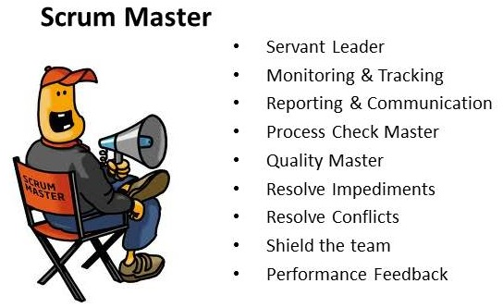
Scrum Master
The Scrum Master is the process owner
responsible for ensuring Scrum is understood and enacted
Helps the team perform at their highest level
Protector of the team (coach)
Notes:
Source: http://www.mountaingoatsoftware.com/scrum/scrummaster
Note: Many new to the ScrumMaster role struggle with the apparent contradiction of the ScrumMaster as both a servant & leader to the team and also someone with no authority.
The seeming contradiction disappears when we realize that although the ScrumMaster has no authority over Scrum team members, the ScrumMaster does have authority over the process. Although a ScrumMaster may not be able to say, “You’re fired,” a ScrumMaster can say, “I’ve decided we’re going to try two-week sprints for the next month.”

Slide 30
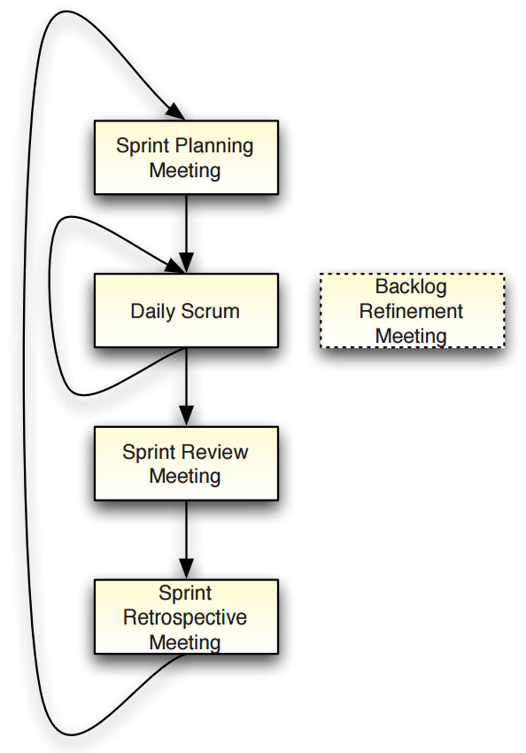
Scrum Meetings - Flow

Slide 31
Product Backlog Grooming Meeting
Let’s “attend” a backlog refinement meeting by watching another video (13 minutes++):
http://scrumtrainingseries.com/
We will see Product Owner, Scrum Master and Team in action!
Notes:
http://scrumtrainingseries.com/
Afterwards Scrum test på fronter

