Slide 1
FINAL
ASSESSMENT

Slide 2
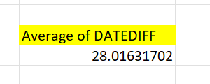
FROM THE WORK ORDER DATA SET WE COME TO KNOW THE DIFFERENCE BETWEEN REQUEST DATE AND COMPLETION DATE ONLY FOR THE DATA ROWS IN WHICH WORKDATE IS GIVEN FOR ALL WORK ORDERS
WE THEN CALCULATE THE AVERAGE
TASK 1

Slide 3
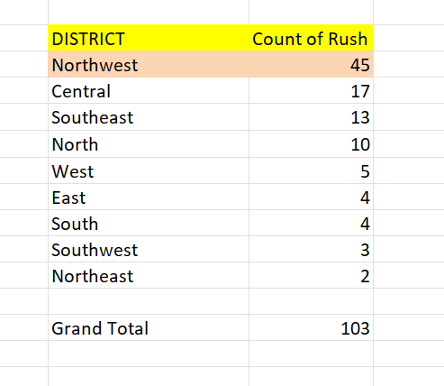
FROM THE DATA SET WE CAN BE ABLE TO FIND THE UNIQUE DISTRICTS AND THE COUNT OF ITS RUSH JOBS , NOW SORTING THE COLUMN WE GET THE DISTRICT WITH HIGHEST NUMBER OF RUSH JOB
TASK 2

Slide 4
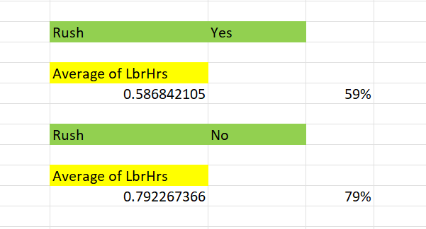
FIRST FILTERING THE RUSH HOURS THAT HAVE YES AND FIND THE AVERAGE
AND THE FINDING AVERAGE FOR THE RUSH HOURS WHICH ARE NON-RUSH JOBS AND NOW WE CAN INFER THAT THE AVERAGE IS HIGH FOR THE NON-RUSH JOBS
TASK 3

Slide 5
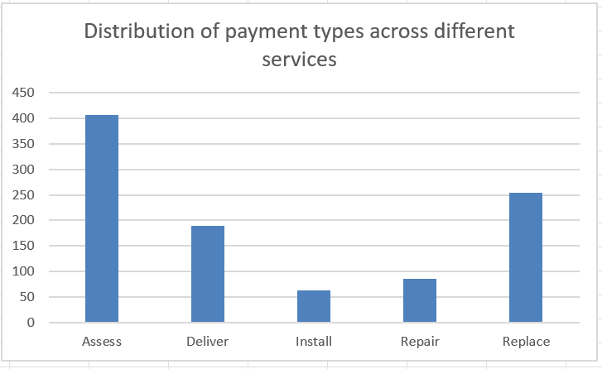
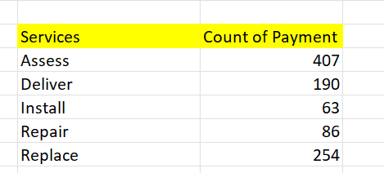
DISTRIBUTION OF PAYMENT ACROSS SERVICES
FINDING THE COUNT OF PAYMENT TYPES ACROSS EACH DIFFERENT SERVICES AND SHOWING ITS DISTRIBUTION
TASK 4

Slide 6
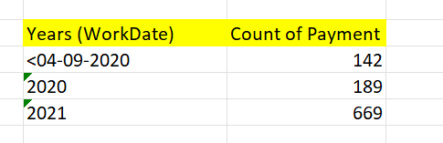
TREND IN PAYMENT TYPE OVER THE YEARS
WE CAN SEE THE INCREASE IN PAYMENT TYPES OVER THE YEARS
TASK 5

Slide 7
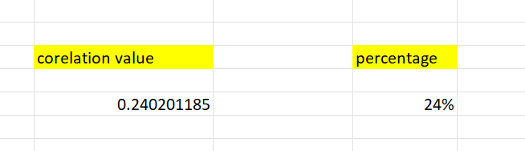
RELATIONSHIP BETWEEN NUMBER OF TECHNICIANS AND COST PARTS
By Calculating the corelation between technicians and cost of parts we get 24% , so the count of technicians positively impact the cost of parts
TASK 6

Slide 8
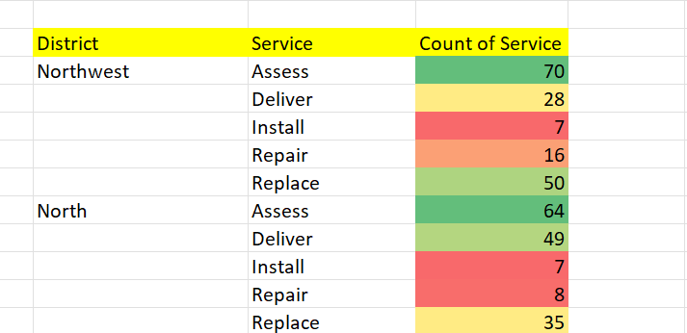
MOST COMMON TYPE OF SERVICE REQUESTED
From the given data we can find that ASSESS SERVICE Type is been requested the most
TASK 7

Slide 9
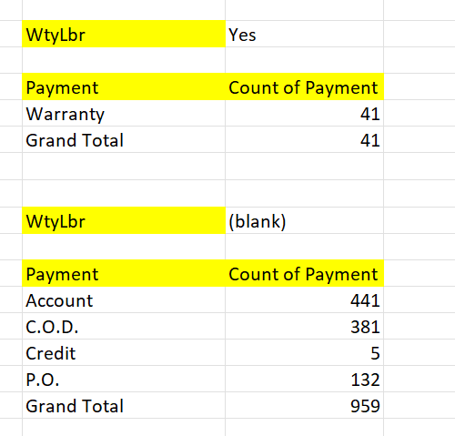
Difference in Distribution of payment types
For finding the difference in payment type for order with and without
TASK 8

Slide 10
Dashboard

Slide 11
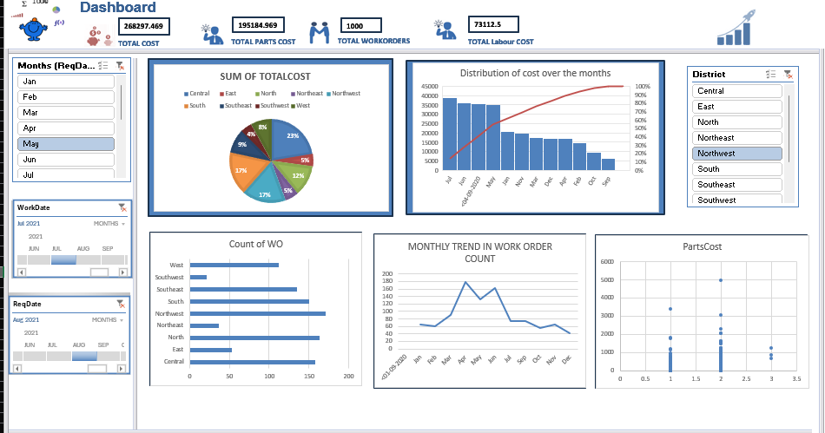

Slide 12
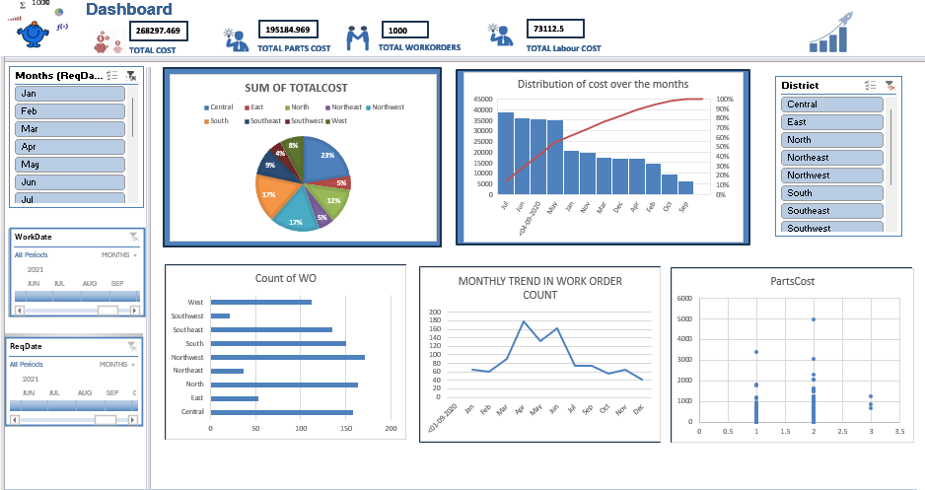

Slide 13
