Slide 1
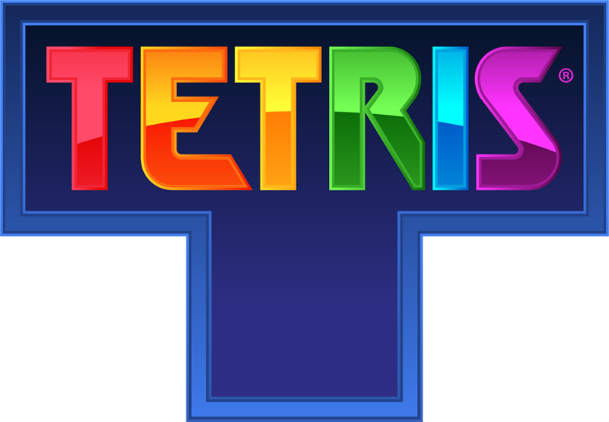
Recreating Tetris
A project for WP in tecnum

Slide 2
To begin with…
Since the aim of this project is just to create a game on our own with JavaScript and html, we decided to recreate Tetris—a classic video game that is still trending until now by ourselves.
In case of anyone who had never played Tetris before, here are the basic rules of Tetris:
Pieces (7 different available shapes) fall vertically down from the sky (i.e. the top of the screen)
They continue to fall until landing on top of another piece or hitting the bottom of the screen
When an entire row is filled by pieces, it disappears, and the player receives points
Pieces can be rotated clockwise; thus, each piece can, in effect, take 4 different shapes
The game ends when the board is filled and no new pieces can descend onto the screen

Slide 3
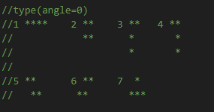
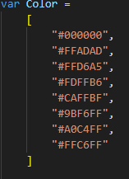
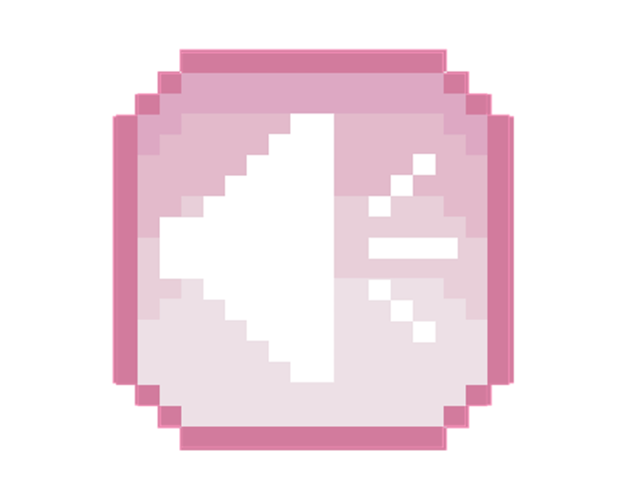
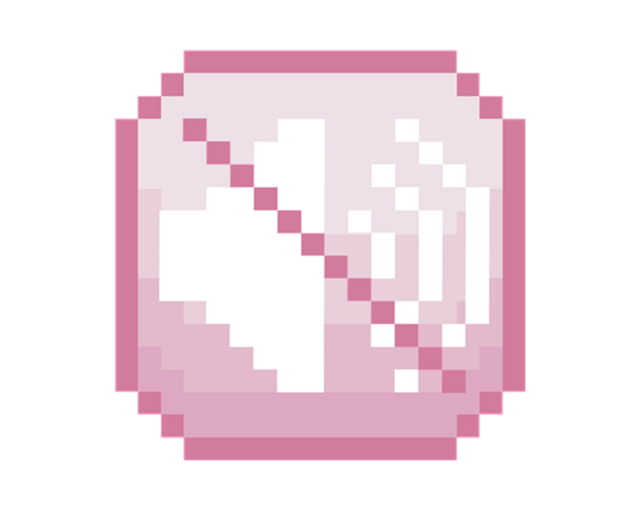
We successfully accomplished most of the functions in the original game, including the basic rules of the game and some additional ones in order to help the players, like pausing and muting the game.
Block types
Some carefully selected colors for our Tetris.

Slide 4
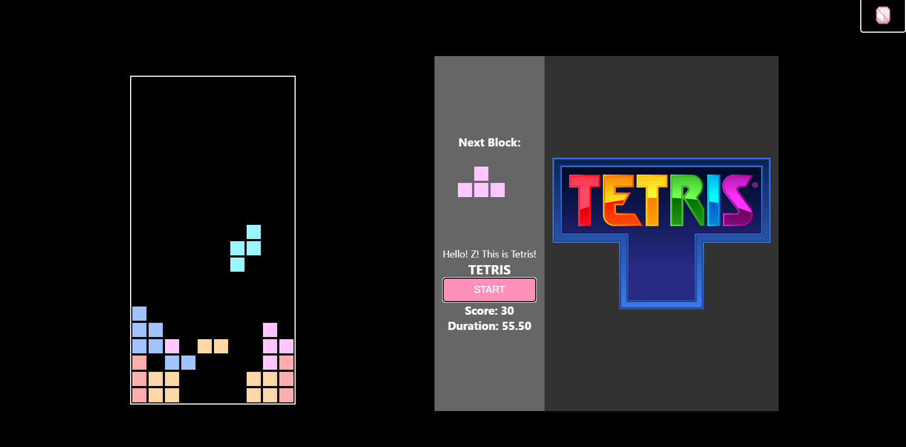
Here’s a screenshot of the game!
mute

Slide 5
¡Gracias!

