Slide 1
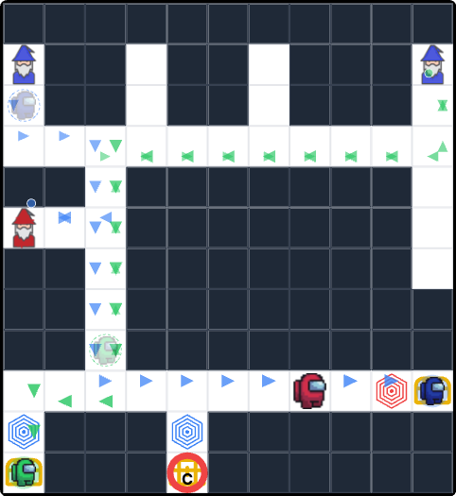
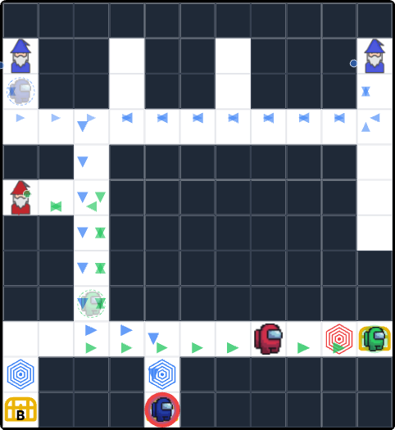
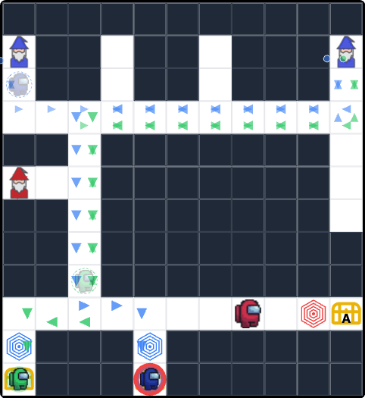
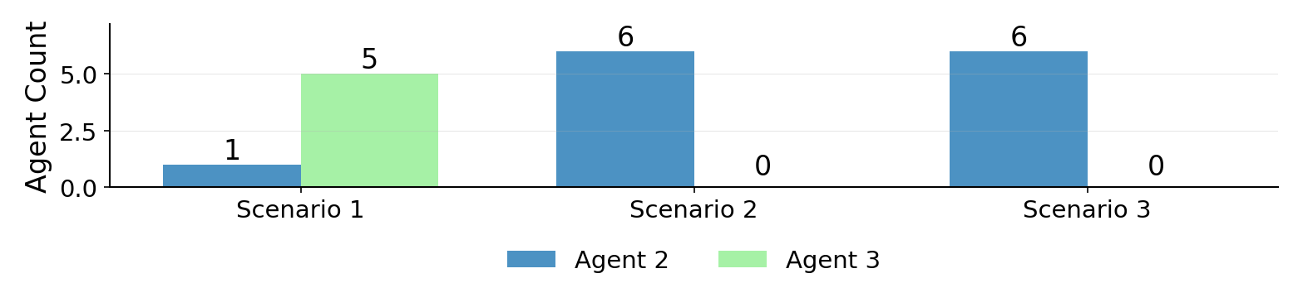
SM211
Expert
Novice
Novice
Novice
Novice
Novice
Scenario 1
Scenario 2
Scenario 3
Icon Key:
= Agent 2 (Blue bars)
= Agent 3 (Green bars)

Slide 2
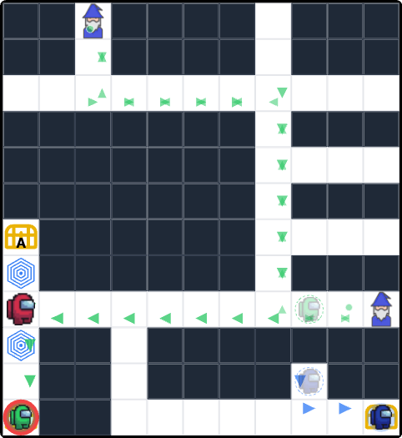
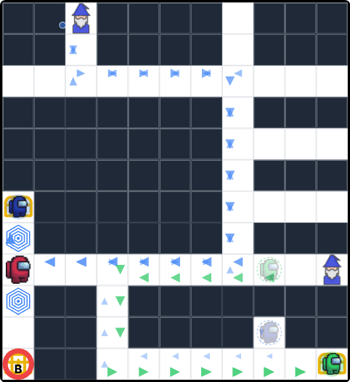
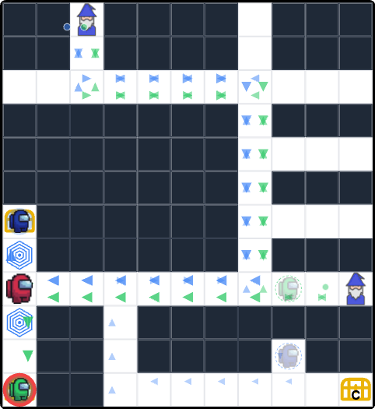
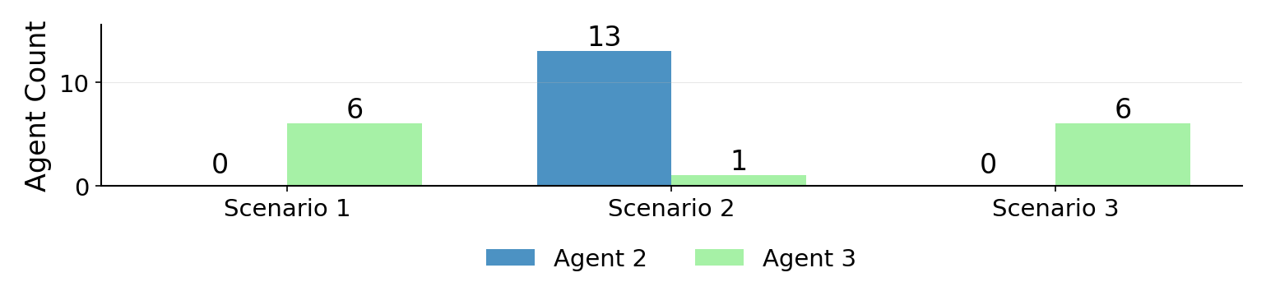
SM221
Novice
Expert
Expert
Expert
Expert
Expert
Scenario 1
Scenario 2
Scenario 3
Icon Key:
= Agent 2 (Blue bars)
= Agent 3 (Green bars)

Slide 3
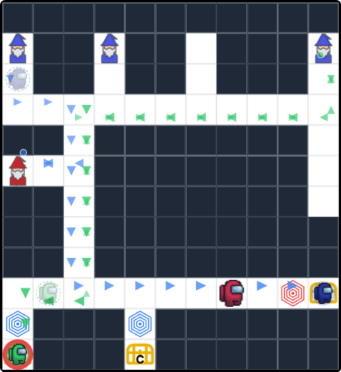
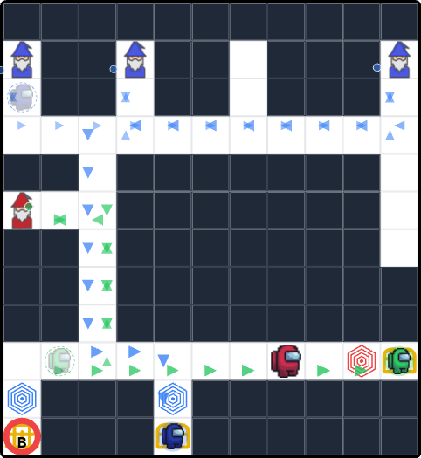
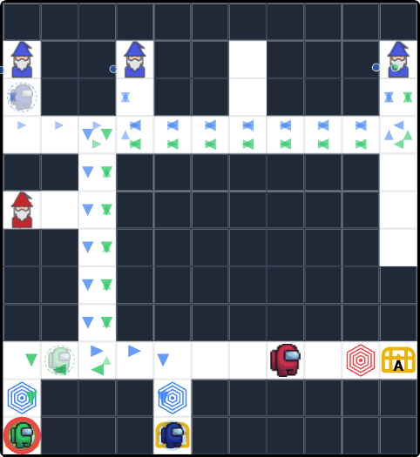
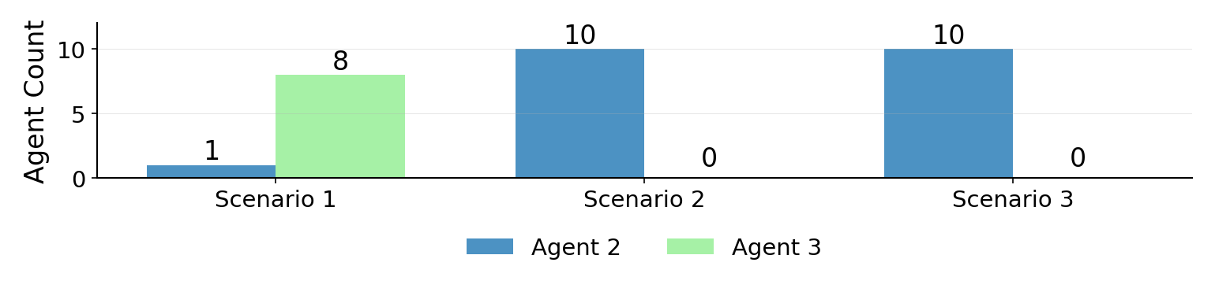
SM311
Expert
Novice
Novice
Novice
Novice
Novice
Scenario 1
Scenario 2
Scenario 3
Icon Key:
= Agent 2 (Blue bars)
= Agent 3 (Green bars)

Slide 4
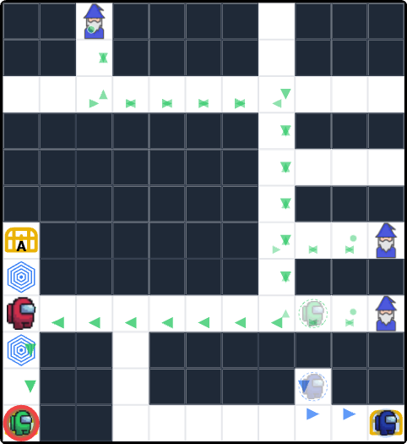
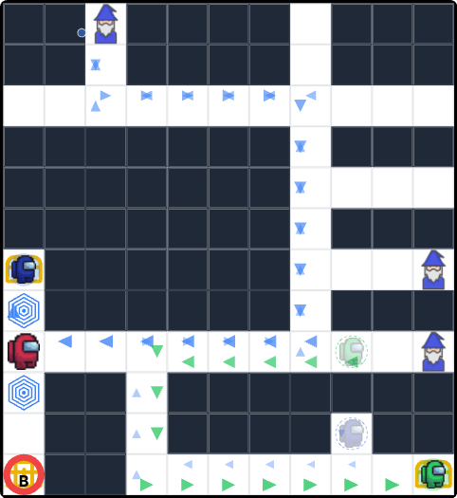

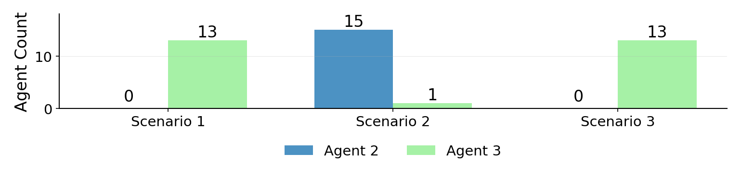
SM321
Novice
Expert
Expert
Expert
Expert
Expert
Scenario 1
Scenario 2
Scenario 3
Icon Key:
= Agent 2 (Blue bars)
= Agent 3 (Green bars)

Slide 5
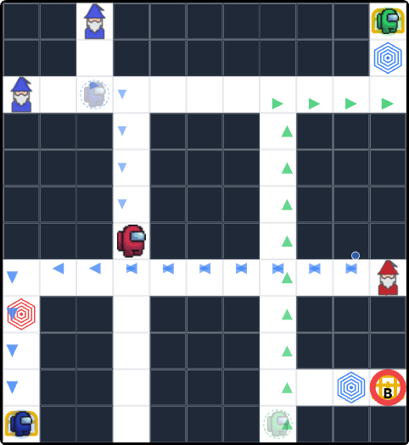
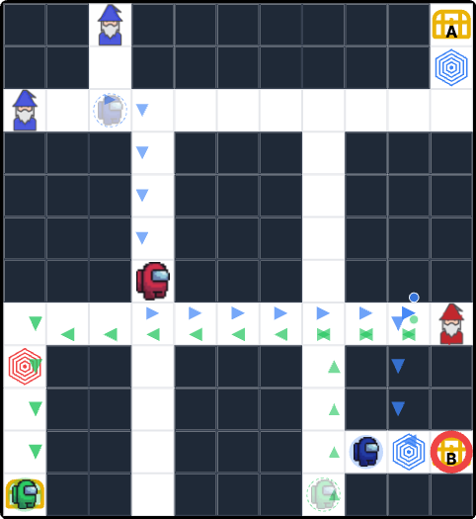
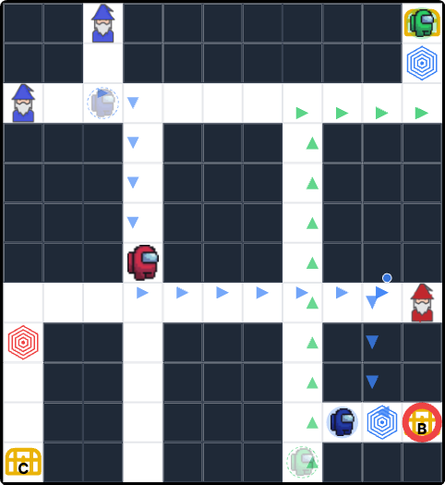
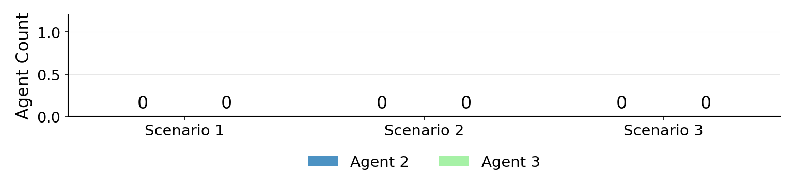
SM331
Expert
Novice
Novice
Novice
Novice
Novice
Scenario 1
Scenario 2
Scenario 3
Icon Key:
= Agent 2 (Blue bars)
= Agent 3 (Green bars)

Slide 6
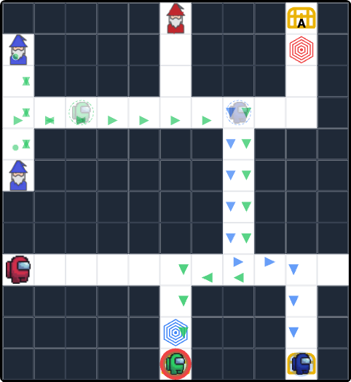
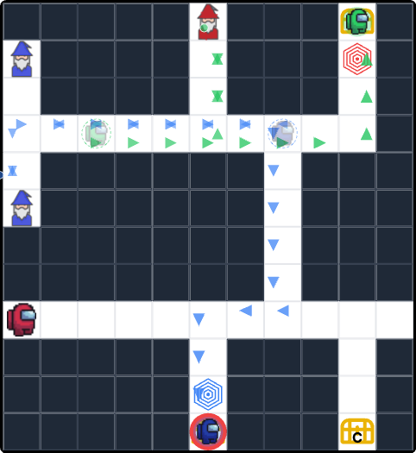
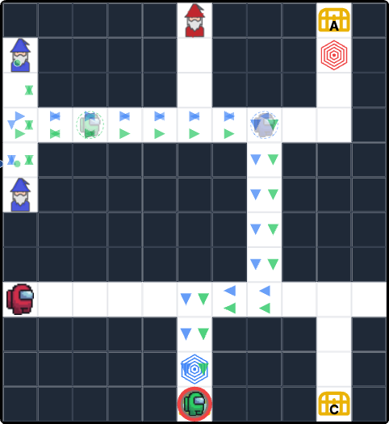
SM341
Novice
Expert
Expert
Expert
Expert
Expert
Scenario 1
Scenario 2
Scenario 3
Icon Key:
= Agent 2 (Blue bars)
= Agent 3 (Green bars)

Slide 7
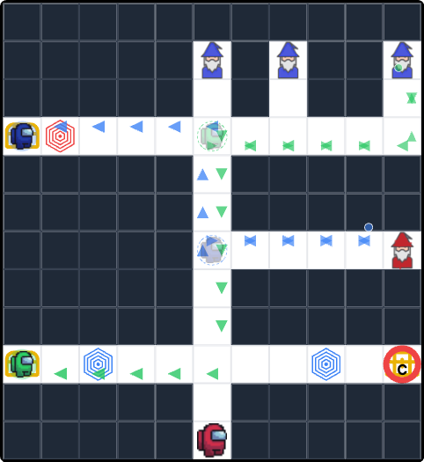
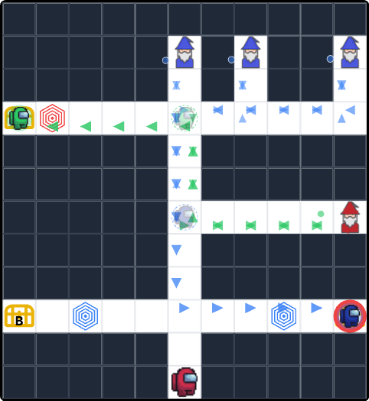
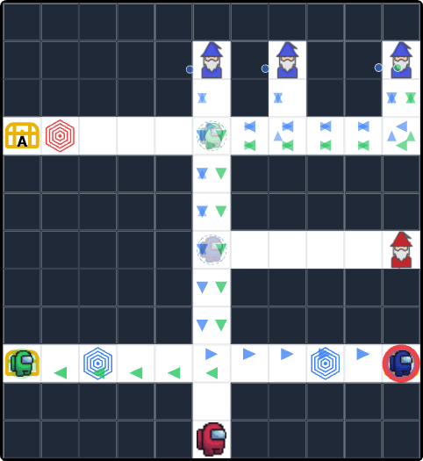
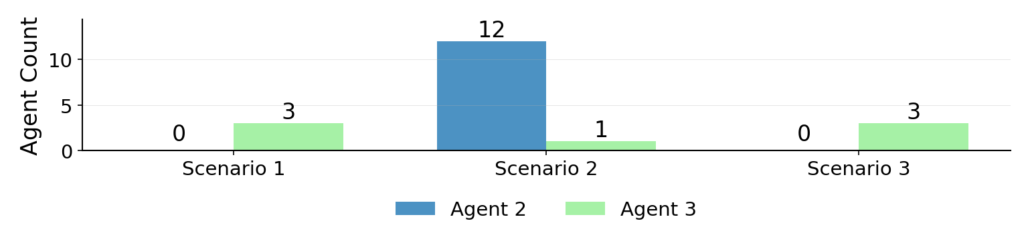
SM351
Novice
Expert
Expert
Expert
Expert
Expert
Scenario 1
Scenario 2
Scenario 3
Icon Key:
= Agent 2 (Blue bars)
= Agent 3 (Green bars)

Slide 8
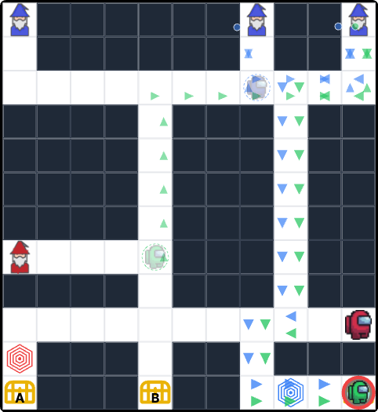
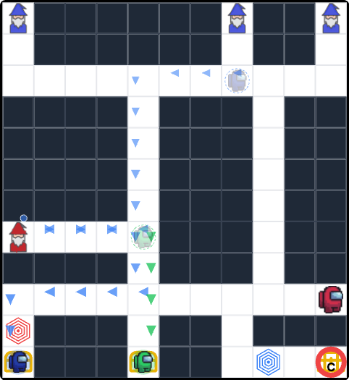
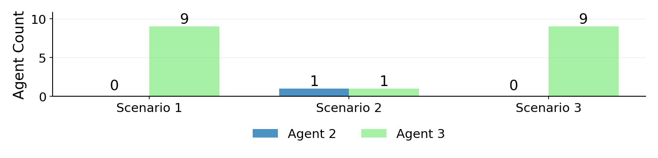
SM361
Expert
Novice
Novice
Novice
Novice
Novice
Scenario 1
Scenario 2
Scenario 3
Icon Key:
= Agent 2 (Blue bars)
= Agent 3 (Green bars)

Slide 9
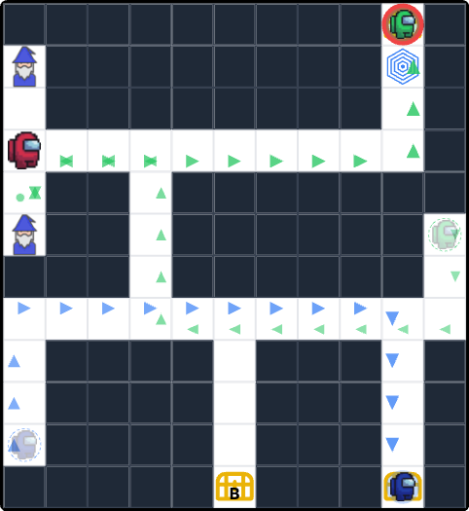
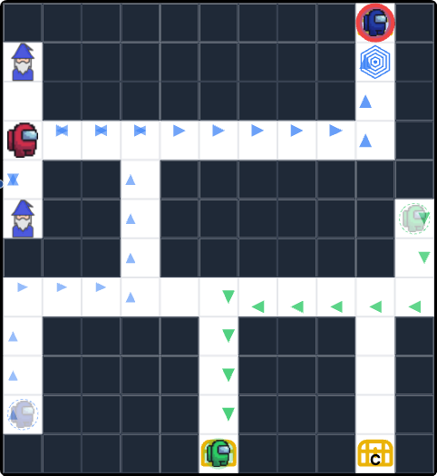
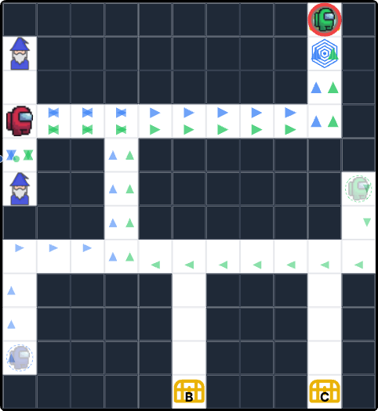
SM371
Novice
Expert
Expert
Expert
Expert
Expert
Scenario 1
Scenario 2
Scenario 3
Icon Key:
= Agent 2 (Blue bars)
= Agent 3 (Green bars)

Slide 10
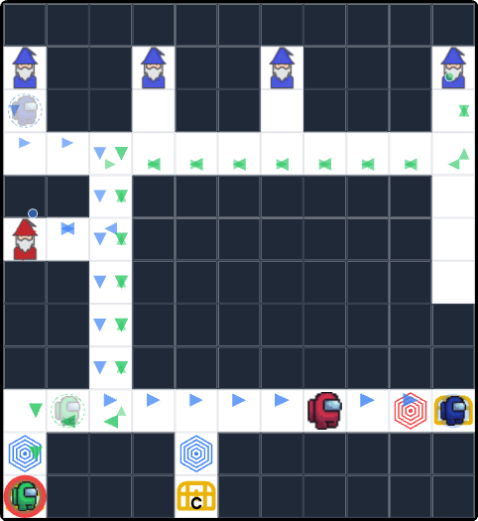
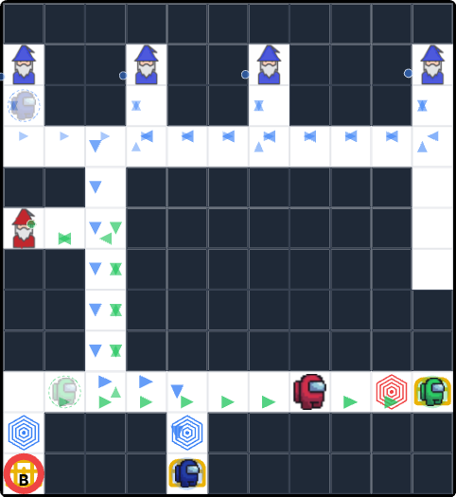
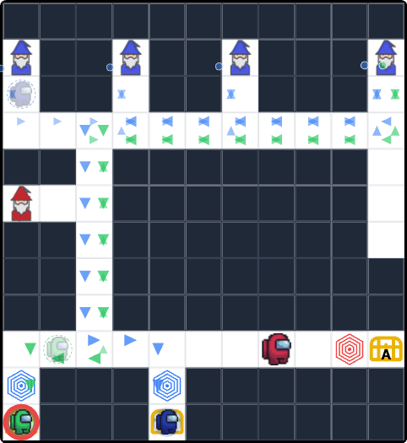
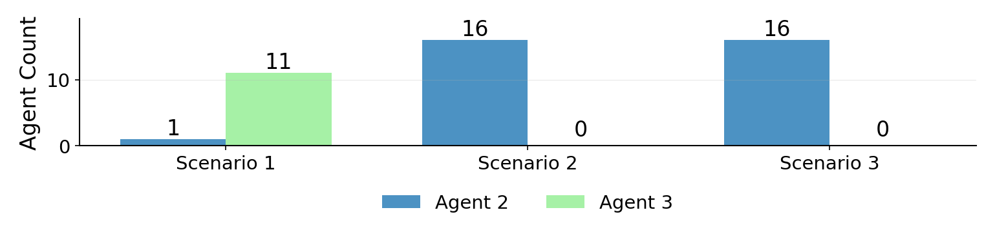
SM411
Expert
Novice
Novice
Novice
Novice
Novice
Scenario 1
Scenario 2
Scenario 3
Icon Key:
= Agent 2 (Blue bars)
= Agent 3 (Green bars)

Slide 11
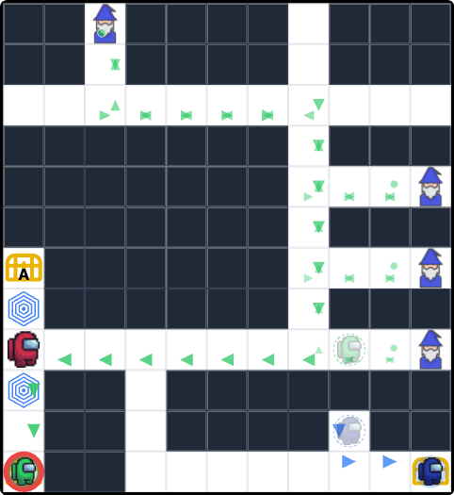

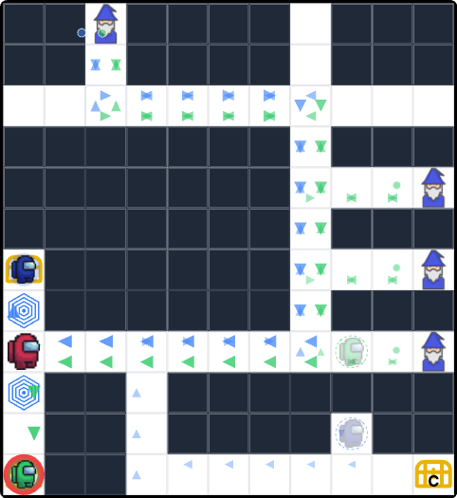
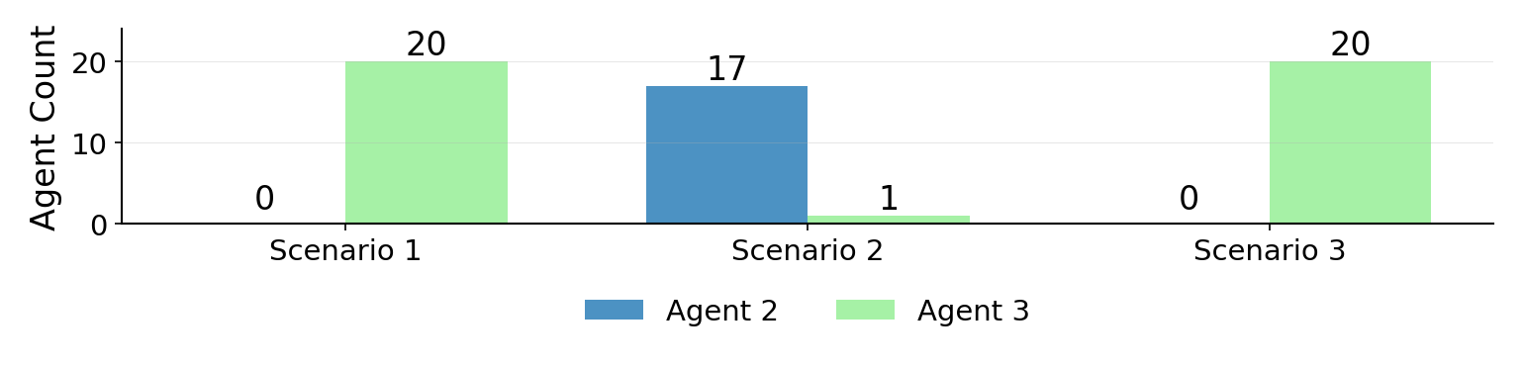
SM421
Novice
Expert
Expert
Expert
Expert
Expert
Scenario 1
Scenario 2
Scenario 3
Icon Key:
= Agent 2 (Blue bars)
= Agent 3 (Green bars)

Slide 12
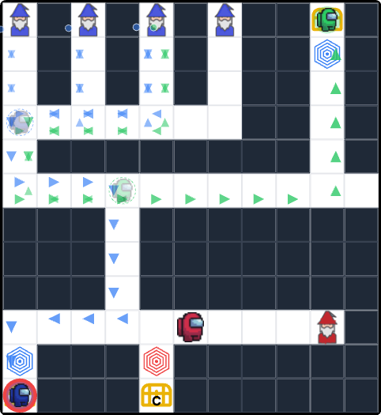
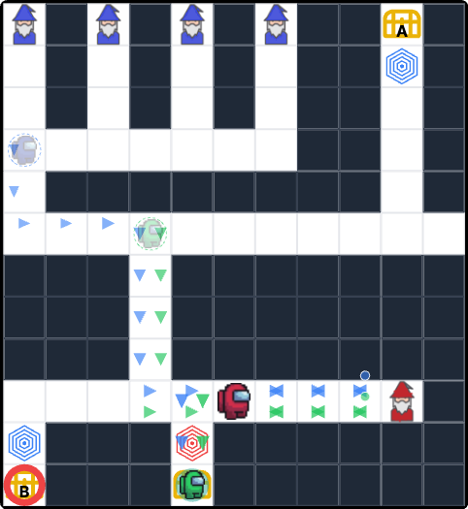
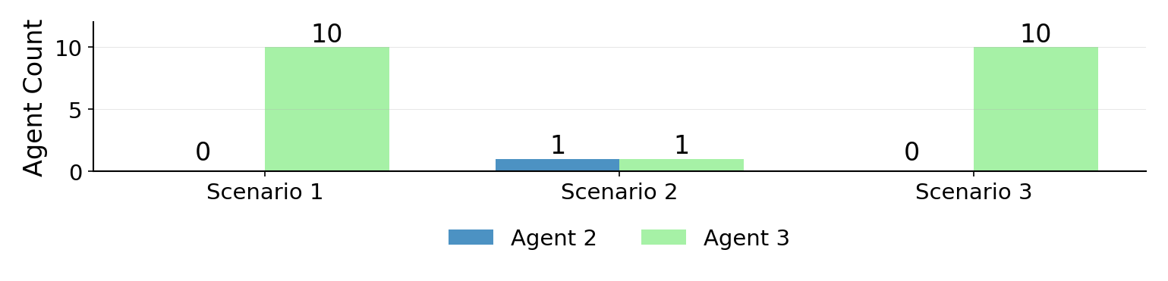
SM431
Expert
Novice
Novice
Novice
Novice
Novice
Scenario 1
Scenario 2
Scenario 3
Icon Key:
= Agent 2 (Blue bars)
= Agent 3 (Green bars)

Slide 13
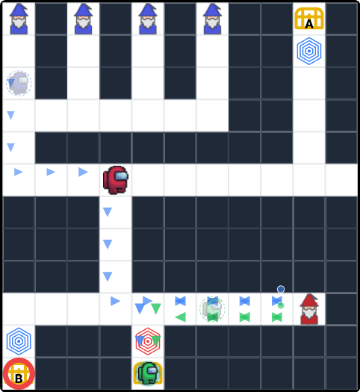
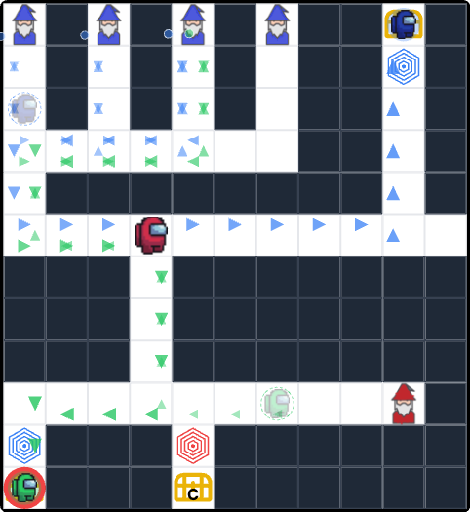
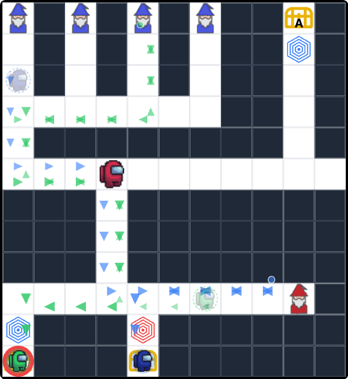
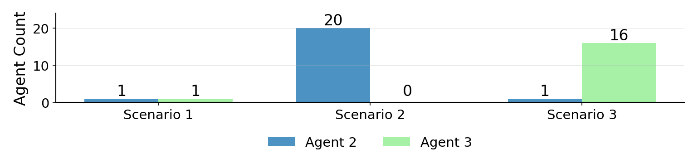
SM432
Expert
Novice
Novice
Novice
Novice
Novice
Scenario 1
Scenario 2
Scenario 3
Icon Key:
= Agent 2 (Blue bars)
= Agent 3 (Green bars)

Slide 14
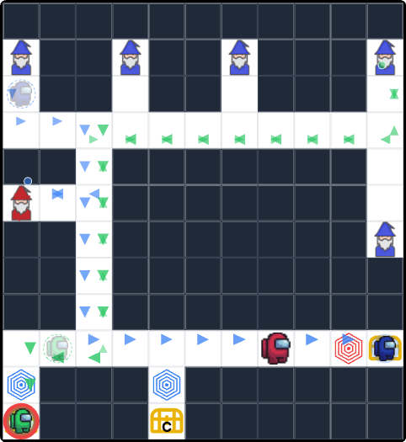
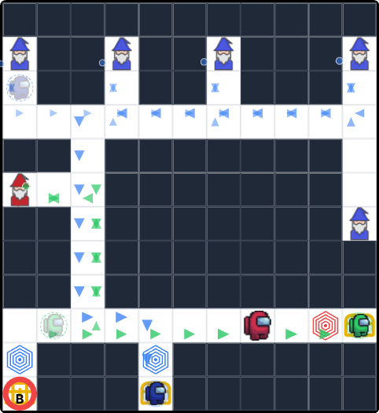
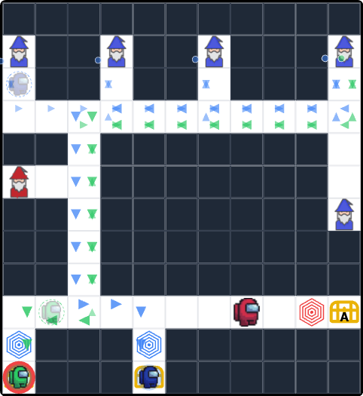
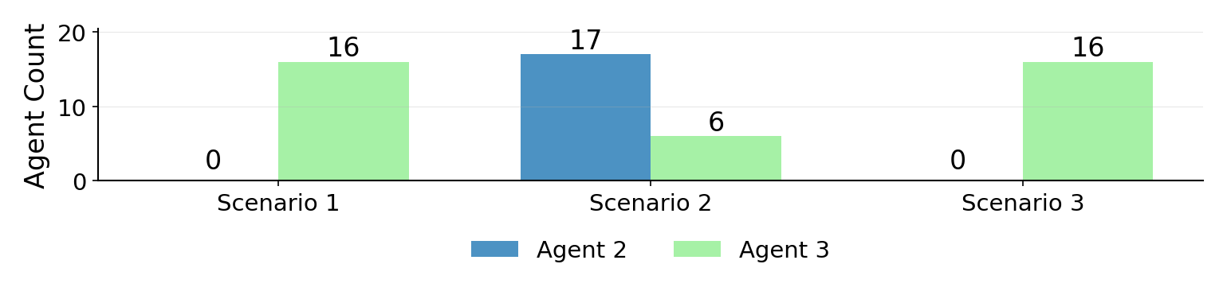
SM511
Expert
Novice
Novice
Novice
Novice
Novice
Scenario 1
Scenario 2
Scenario 3
Icon Key:
= Agent 2 (Blue bars)
= Agent 3 (Green bars)

Slide 15




SM521
Novice
Expert
Expert
Expert
Expert
Expert
Scenario 1
Scenario 2
Scenario 3
Icon Key:
= Agent 2 (Blue bars)
= Agent 3 (Green bars)

Slide 16




SM531
Novice
Expert
Expert
Expert
Expert
Expert
Scenario 1
Scenario 2
Scenario 3
Icon Key:
= Agent 2 (Blue bars)
= Agent 3 (Green bars)

Slide 17



SM541
Expert
Novice
Novice
Novice
Novice
Novice
Scenario 1
Scenario 2
Scenario 3
Icon Key:
= Agent 2 (Blue bars)
= Agent 3 (Green bars)

Slide 18



SM543
Novice
Expert
Expert
Expert
Expert
Expert
Scenario 1
Scenario 2
Scenario 3
Icon Key:
= Agent 2 (Blue bars)
= Agent 3 (Green bars)

Slide 19




SM611
Expert
Novice
Novice
Novice
Novice
Novice
Scenario 1
Scenario 2
Scenario 3
Icon Key:
= Agent 2 (Blue bars)
= Agent 3 (Green bars)

Slide 20




SM621
Novice
Expert
Expert
Expert
Expert
Expert
Scenario 1
Scenario 2
Scenario 3
Icon Key:
= Agent 2 (Blue bars)
= Agent 3 (Green bars)

Slide 21




SM631
Novice
Expert
Expert
Expert
Expert
Expert
Scenario 1
Scenario 2
Scenario 3
Icon Key:
= Agent 2 (Blue bars)
= Agent 3 (Green bars)

