Slide 1
Introduction to Dalvik Virtual Machine

Slide 2
Agenda
Syllabus & Homework
Java Virtual Machine
Dalvik Virtual Machine
References

Slide 3
Syllabus
第一周
介紹 JVM
實驗 Simple Java Virtual Machine
第二周
介紹 DVM 如何解析指令並回顧第一周重要內容
編譯 Dalvik Virutal Machine on X86 on Ubuntu
第三周
實驗 Simple Dalvik Virtual Machine

Slide 4
Homework
A Dex Format Report (deadline : 2013/11/30)
研究 Dex Format 心得報告, 需包含定義Dex資料結構, 抄襲與複製成績為0分
http://source.android.com/devices/tech/dalvik/dex-format.html

Slide 5
Java Virtual Machine

Slide 6
Java Virtual Machine Overview
Java Virtual Machine
JVM Model
Java ByteCode
Java ByteCode instructions
How to make a Java VM
A Simple Java Virtual Machine
Experiment

Slide 7
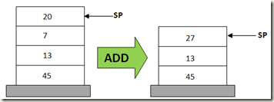
Java Virtual Machine
Stack-based (Last-In First-Out) Virtual Machine
Computation in Stack
Load Java ByteCode to execute program
Lines | Stack-based VM Pseudo Code
0 | POP 20
1 | POP 7
2 | ADD 20, 7, result
3 | PUSH result
http://www.codeproject.com/Articles/461052/Stack-based-vs-Register-based-Virtual-Machine-Arch

Slide 8
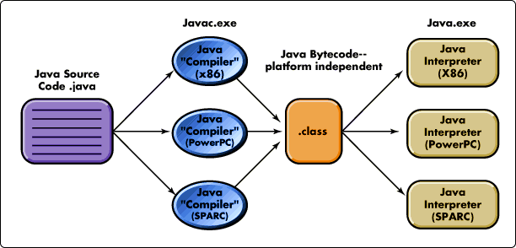
Java Source to ByteCode
http://javabook1.blogspot.tw/2013/07/introduction-to-java.html

Slide 9
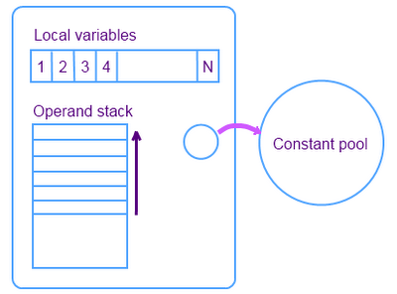
JVM Model
Local Variables:
place the method input parameters
Operand Stack:
Computation Area
Put Instruction Operands and Return address
Constant Pool
Put Constant Data

Slide 10
Java ByteCode
What is ByteCode ?
also known as p-code (portable code), is a form of instruction set designed for efficient execution by a software interpreter.
An Java Addition Example a = 20, b = 30
C-pseudo | X86 ASM | Java ByteCode (Human-syntax) | Java ByteCode binary
int add (int a, int b ) { return a+b; } | mov eax, byte [ebp-4] | iload_1 | 0x1a
 | mov edx, byte [ebp-8] | iload_2 | 0x1b
 | add eax, edx | iadd | 0x60
 | ret | ireturn | 0x3e

Slide 11
A Java Addition Example
Local Variables
20
30
<<init>>
C-pseudo | Java ByteCode (Human-syntax)
void add (int a, int b ) { b = a+b; } | iload_1
 | iload_2
 | iadd
 | istore_2
An Addition Example a = 20, b = 30
Stack
Local Variables
20
30
Local Variables
20
30
Local Variables
20
30
Local Variables
20
50
0
1
2
Stack
20
Stack
20
30
Stack
50
Stack
50
iload_1
iload_2
iadd
istore_2

Slide 12
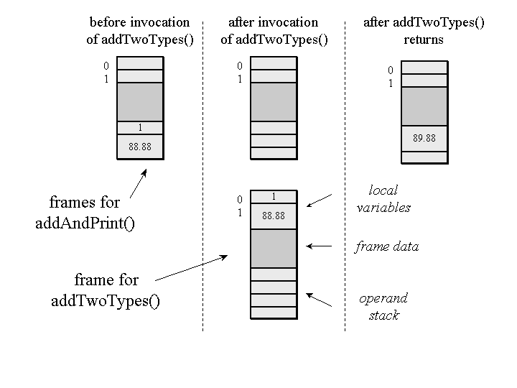

More Java ByteCode Example
class Example3c {
public static void addAndPrint() {
double result = addTwoTypes (1, 88.88);
System.out.println(result);
}
public static double addTwoTypes (int i, double d) {
return i + d;
}
}
Inside the Java Virtual Machine, 2000, Bill Venners

Slide 13
Java Bytecode instructions (Partials)
Mnemonic | Opcode | Stack
iadd | 0x60 | Pop value1, Pop value2 result = value1 + value2 Push result
isub | 0x64 | Pop value1, Pop value2 result = value1 - value2 Push result
idiv | 0x6C | Pop value1, Pop value2 result = value2 / value1 Push result
imul | 0x68 | Pop value1, Pop value2 result = value1 * value2 Push result
irem | 0x70 | Pop value1, Pop value2 result = value2 % value1 Push result
http://en.wikipedia.org/wiki/Java_bytecode_instruction_listings

Slide 14
How to make a Java Virtual Machine
At least to know about Java Class File
Wikipedia
http://en.wikipedia.org/wiki/Java_bytecode
http://en.wikipedia.org/wiki/Java_class_file
the Java Specification
http://docs.oracle.com/javase/6/docs/index.html

Slide 15
Java Class File
Java Class File Structure
Magic Number: | 0xCAFEBABE
Version of Class File Format: | the minor and major versions of the class file
Constant Pool: | Pool of constants for the class
Access Flags: | for example whether the class is abstract, static, etc.
This Class: | The name of the current class
Super Class: | The name of the super class
Interfaces: | Any interfaces in the class
Fields: | Any fields in the class
Methods: | Any methods in the class
Attributes: | Any attributes of the class (for example the name of the sourcefile, etc.)

Slide 16
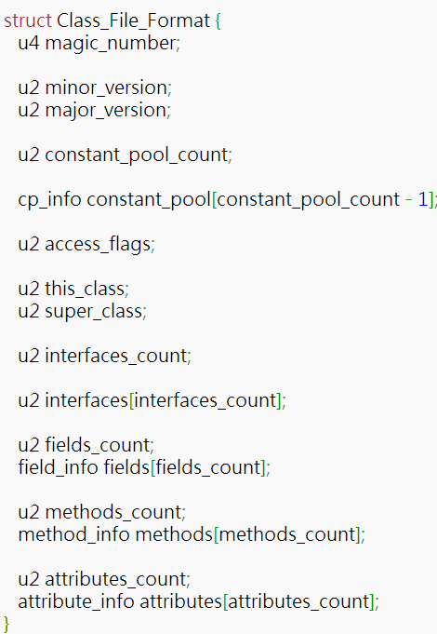
Java Class File Structure

Slide 17
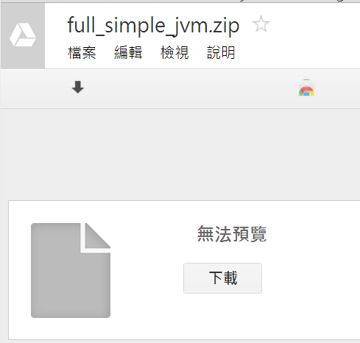
Download Simple JVM
goo.gl/FA3fwx

Slide 18
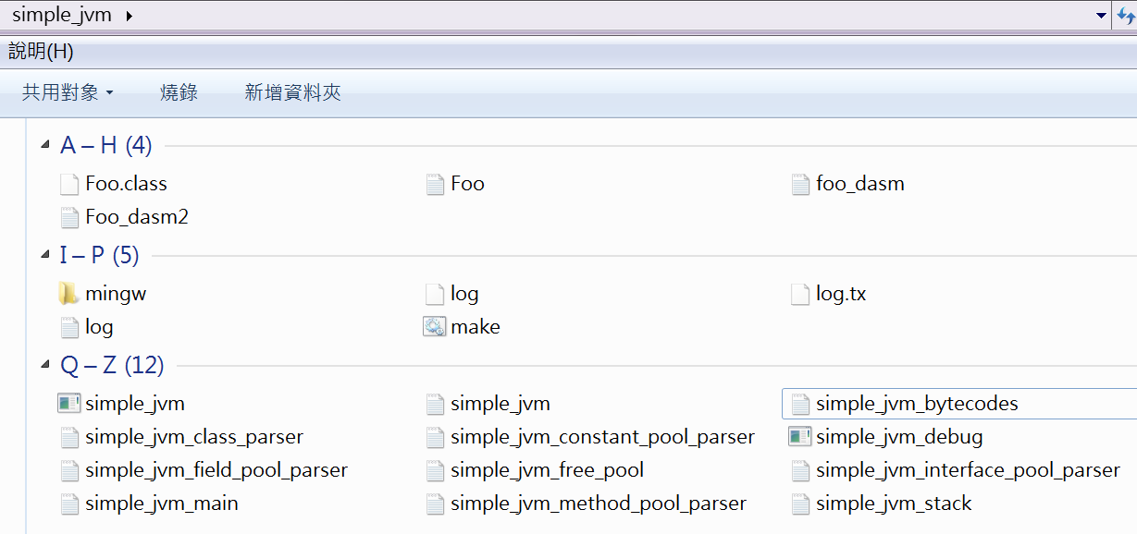
Simple JVM Source Code Structure

Slide 19
Simple JVM
Constant Pool
Interface Pool
Stack
Method Pool
VM Engine ( Bytecode Loader)
Class File Parser

Slide 20
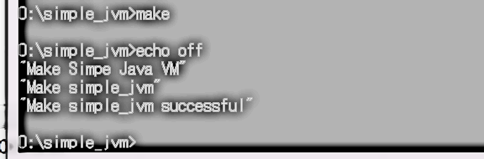
Compile Simple JVM

Slide 21
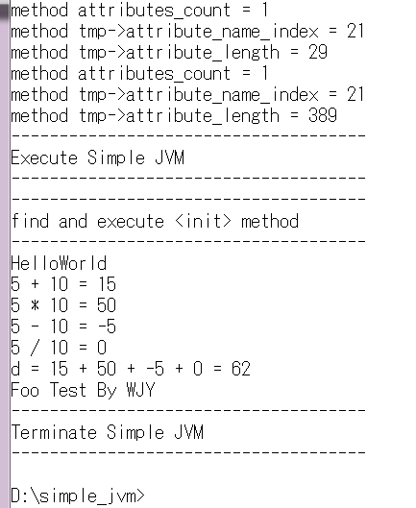
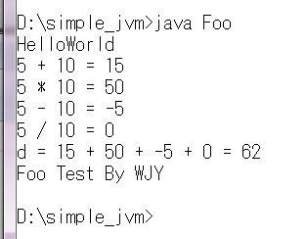
Test Foo
Java Foo
Simple JVM Foo

Slide 22
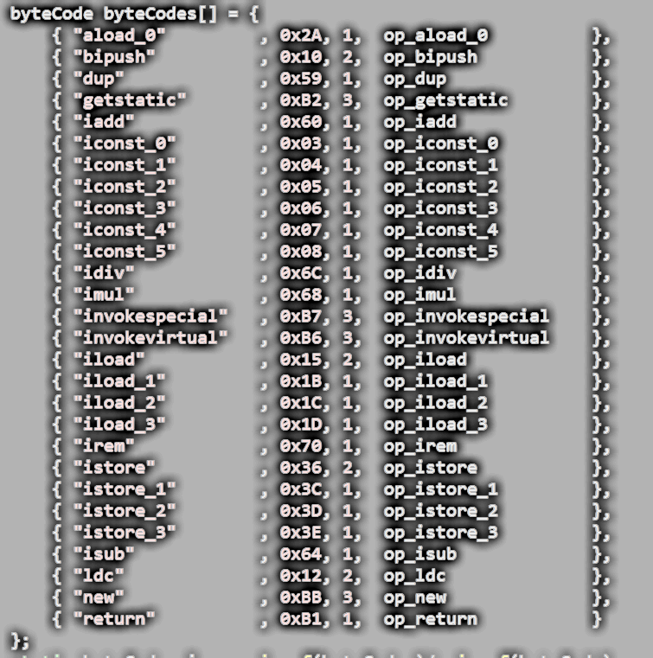
Simple JVM Instruction Table : simple_jvm_bytecodes.c

Slide 23
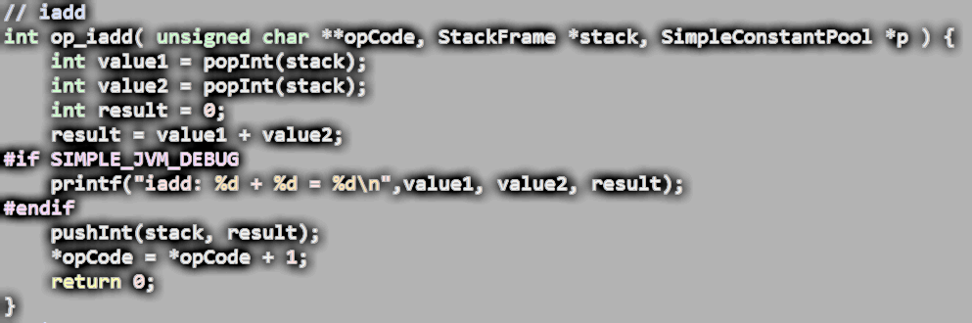
iadd : simple_jvm_bytecodes.c
iadd | 0x60 | Pop value1, Pop value2 result = value1 + value2 Push result

Slide 24
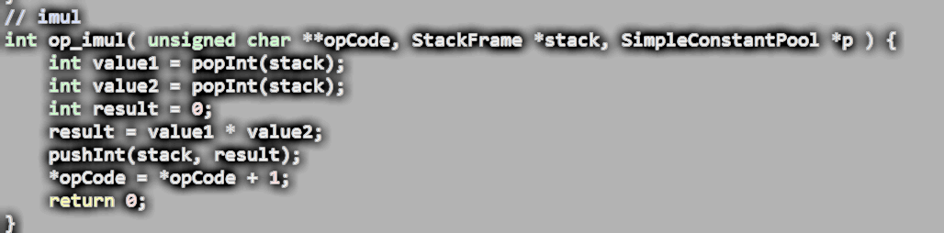
imul: simple_jvm_bytecodes.c
imul | 0x68 | Pop value1, Pop value2 result = value1 * value2 Push result

Slide 25
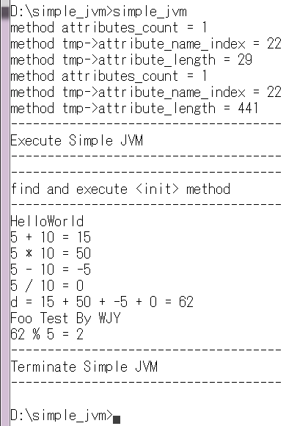
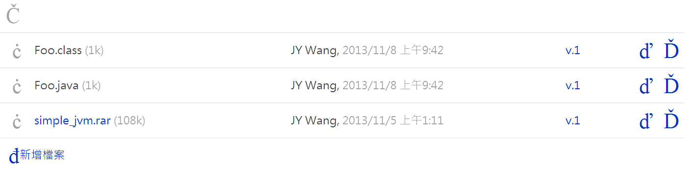
Experiment: add irem instruction into Simple JVM
irem | 0x70 | Pop value1, Pop value2 result = value2 % value1 Push result
goo.gl/xIMuym
Execution Result:

Slide 26
Dalvik Virtual Machine

Slide 27
Dalvik Virtual Machine Overview
Java Translation for JVM and DVM
Hello World on Dalvik VM
DVM ByteCode
DVM ByteCode Interpreter Generation on Android Open Source
Dex File Header
An Simple Dalvik Virtual Machine

Slide 28
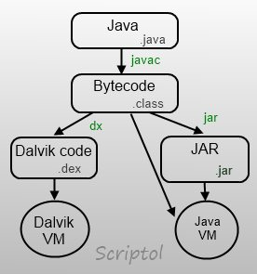
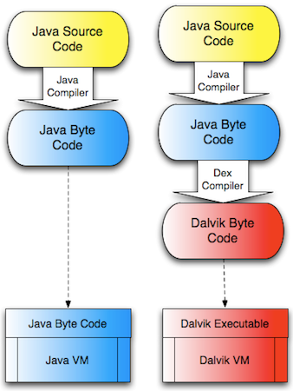
Java Translation for JVM and DVM
http://www.codeproject.com/Articles/461052/Stack-based-vs-Register-based-Virtual-Machine-Arch

Slide 29
Hello World on Dalvik VM Roadmap
Build Environment Setup
JDK Installation
Download Android Open Source
Compile Dalvik VM x86 host
Build Dalvik VM
Produce
Compile Hello World
Foo.jar
Dalvik x86
Run
Compile Hello World

Slide 30
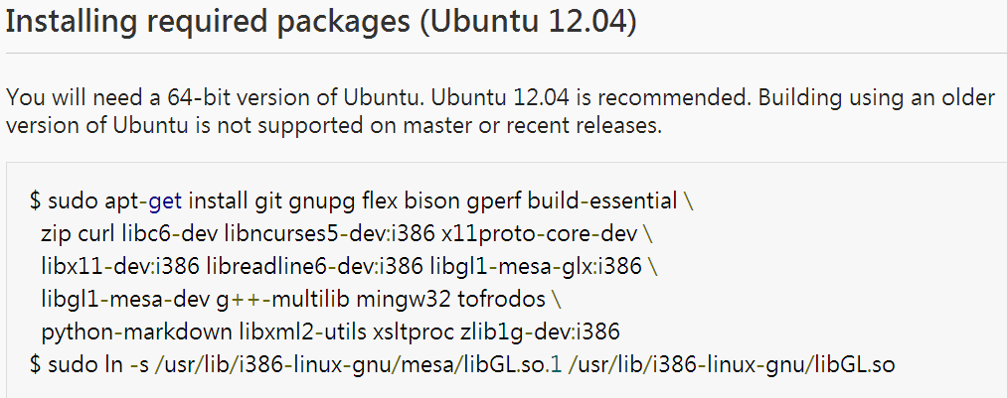
Android Open Source Build Setup
Ubuntu 12.04
Virtual Box
sudo apt-get install git gnupg flex bison gperf build-essential zip curl libc6-dev libncurses5-dev:i386 x11proto-core-dev libx11-dev:i386 libreadline6-dev:i386 libgl1-mesa-dri:i386 libgl1-mesa-dev g++-multilib mingw32 tofrodos python-markdown libxml2-utils xsltproc zlib1g-dev:i386
如果發生衝突使用 libgl1-mesa-glx:i386
Android Open Source Initializing a Build Environment
http://source.android.com/source/initializing.html

Slide 31
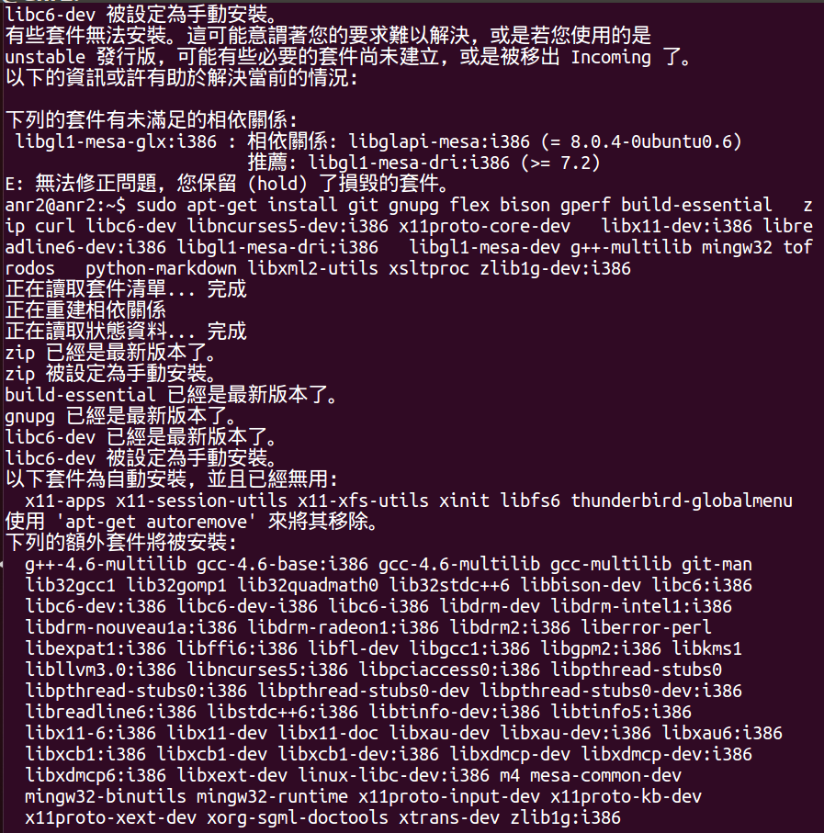
Build Setup Result

Slide 32
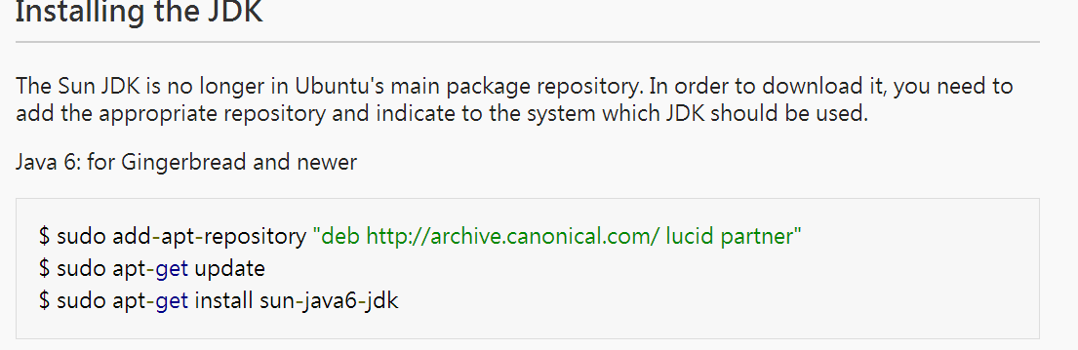
JDK Installation on Ubuntu
sudo add-apt-repository ppa:webupd8team/java
sudo apt-get update
sudo apt-get install oracle-java6-installer
Android Open Source Initializing a Build Environment
http://source.android.com/source/initializing.html

Slide 33
Download Android Open Source(1)
cd ~
mkdir android_source
cd android_source
mkdir bin
curl http://commondatastorage.googleapis.com/ git-repo-downloads/repo > repo
chmod a+x repo
cd ..

Slide 34
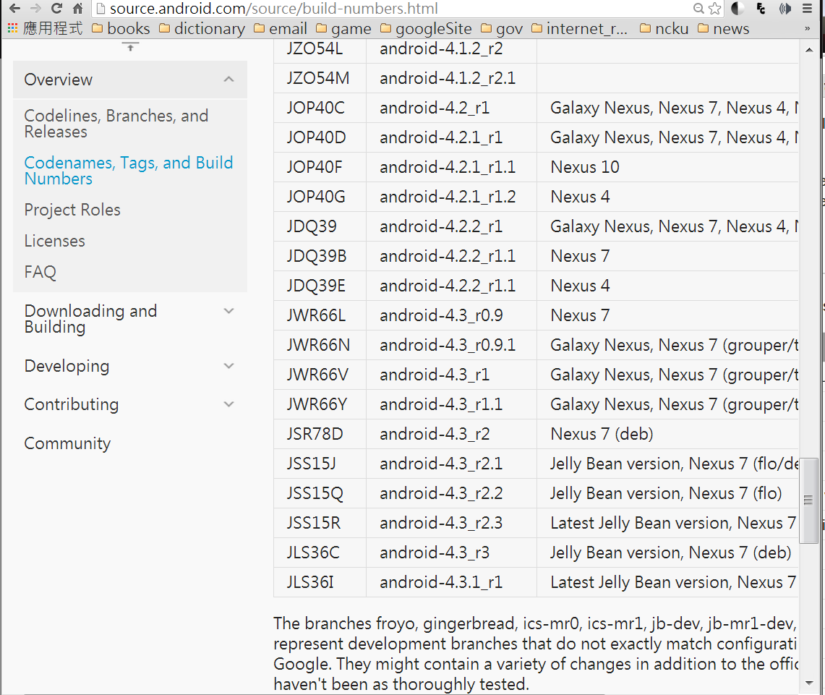
Download Android Open Source(2)
Check android release Tag

Slide 35
Download Android Open Source(3)
mkdir test & cd test
mkdir bin & cd bin
curl http://commondatastorage.googleapis.com/git-repo-downloads/repo > repo
chmod 777 repo
cd ..
mkdir android-4.3_r1
cd android-4.3_r1
../bin/repo init -u https://android.googlesource.com/platform/manifest -b android-4.3_r1
Initial android-4.3_r1
repo sync
Download Android Open Source

Slide 36
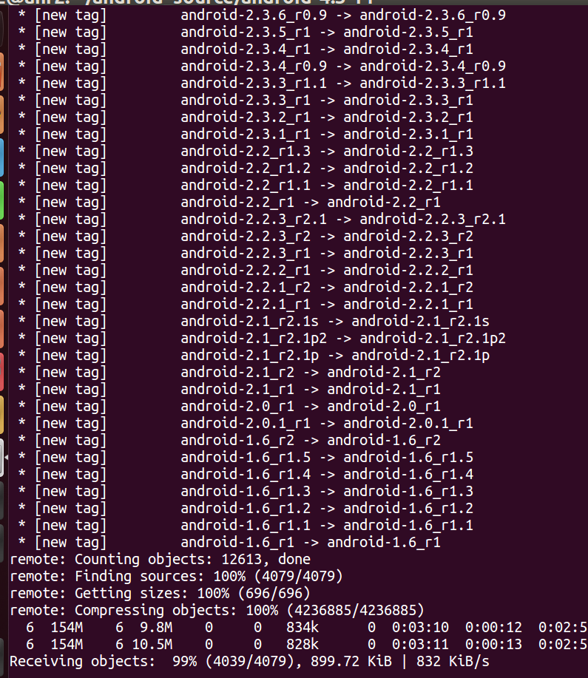
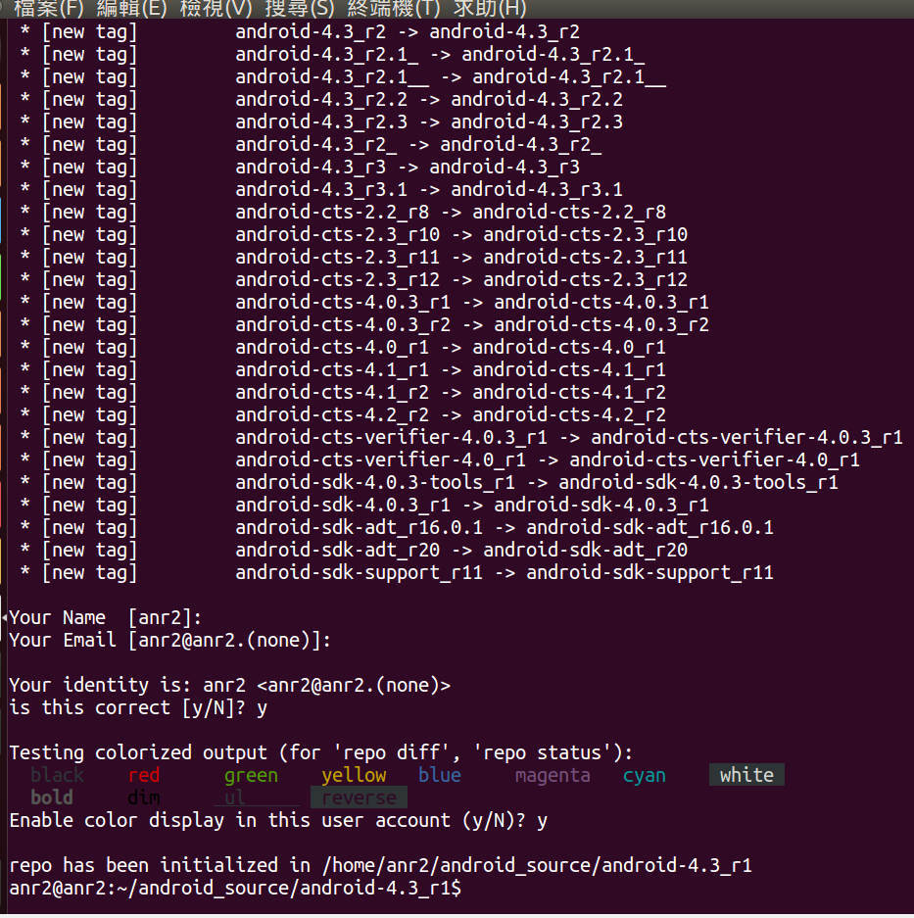
Download Android Open Source Result
Repo Init
Repo Sync

Slide 37
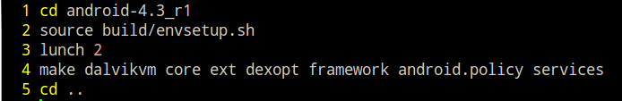
Compile Dalvik VM x86
source build/envsetup.sh
lunch 2
make dalvikvm dalvik-host core ext dexopt framework android.policy services
make_dvm.sh

Slide 38
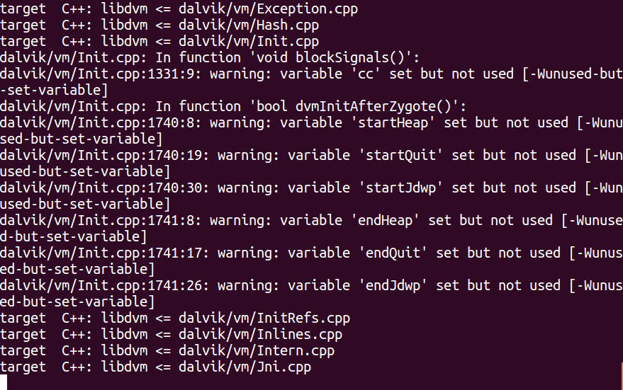
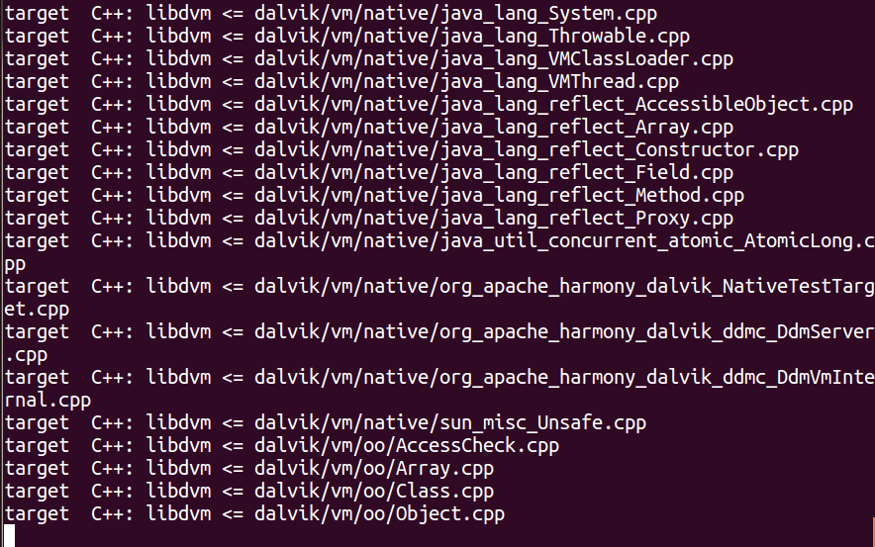
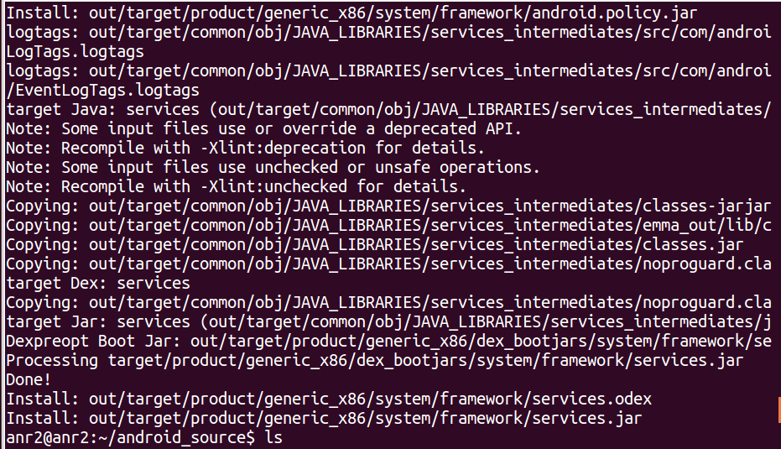
Compile Dalvik VM x86 Result

Slide 39
Setup DalvikVM x86
mkdir -p dalvik-x86-android-4.3
mkdir -p dalvik-x86-android-4.3/tmp/dalvik-cache
cp -r android-4.3_r1/out/target/product/generic_x86/system/ dalvik-x86-android-4.3/system/
cp -r android-4.3_r1/out/host/linux-x86/bin dalvik-x86-android-4.3/
cp -r android-4.3_r1/out/host/linux-x86/lib dalvik-x86-android-4.3/
cp -r android-4.3_r1/out/host/linux-x86/usr dalvik-x86-android-4.3/system/

Slide 40
Hello World on Dalvik VM Roadmap
Build Environment Setup
JDK Installation
Download Android Open Source
Compile Dalvik VM x86 host
Build Dalvik VM
Produce
Compile Hello World
Foo.jar
Dalvik x86
Run
Compile Hello World

Slide 41
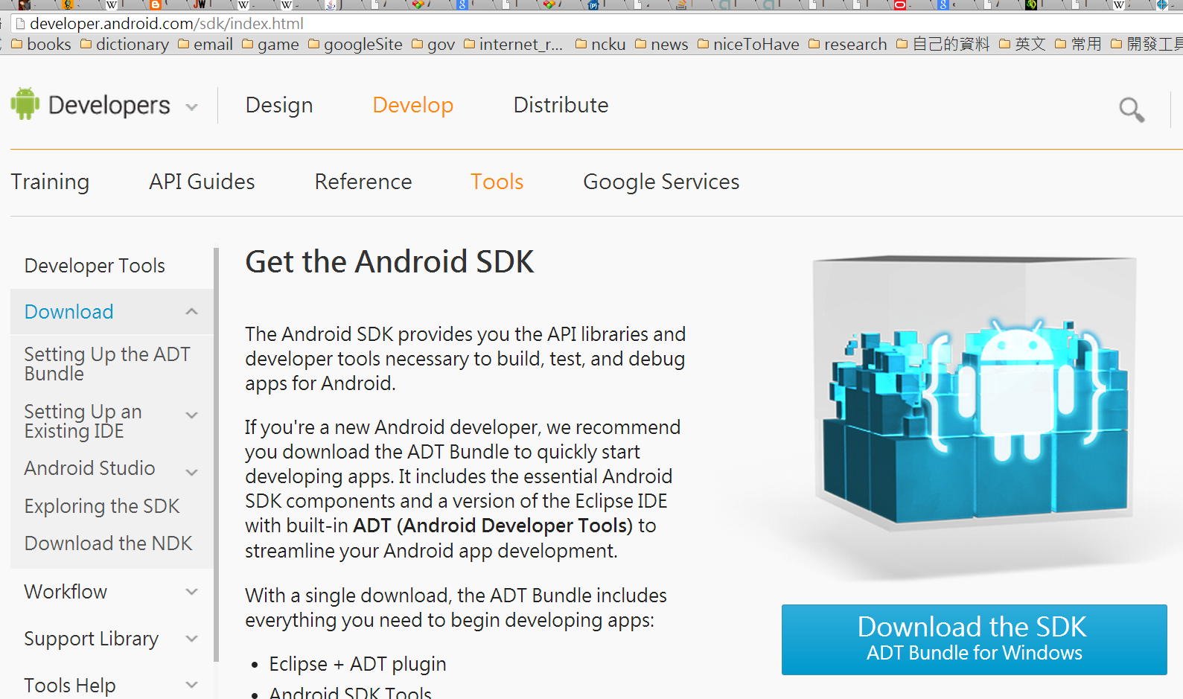
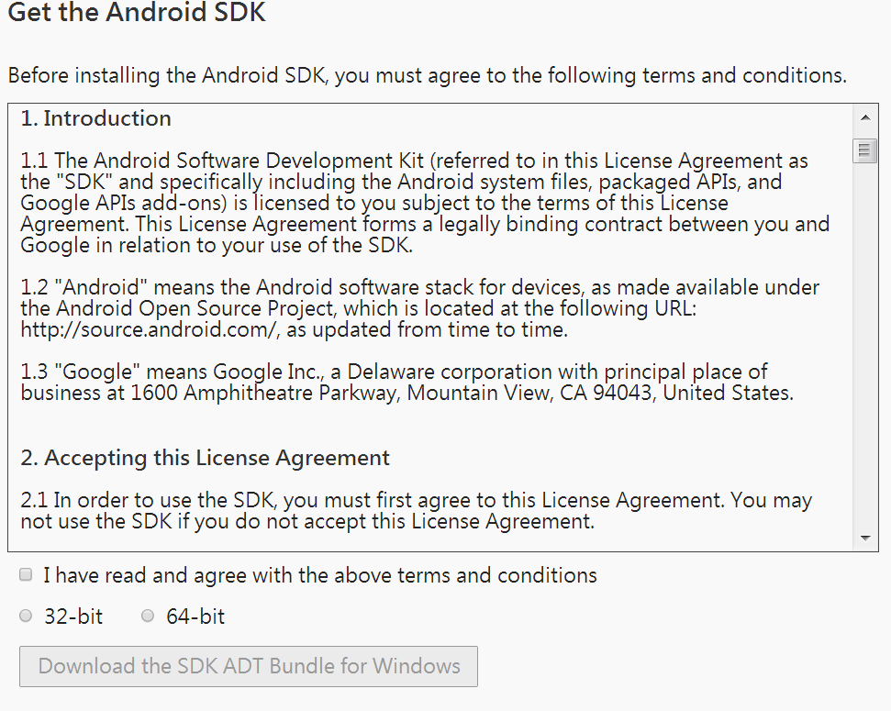
Download ADT (Android Development Tools ) for Compile Hello World
http://developer.android.com/sdk/index.html#download

Slide 42
Compile Hello World to DEX
Foo.java
javac Foo.java
javac
Foo.class
Classes.dex
dx
foo.jar
dx --dex –output=foo.jar Foo.class

Slide 43
Hello World
Foo1.java
Foo1 {
public static void main ( String args[] ) {
System.out.println(“Hello World”);
}
}
javac Foo1.java
dx --dex --output=foo1.jar Foo1.class

Slide 44
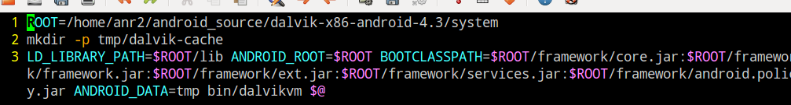
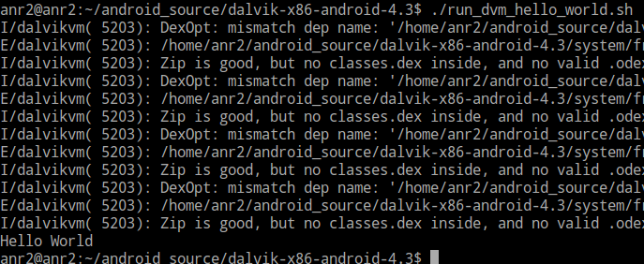
Run Hello World on DalvikVM x86
run_dvm2.sh
$@ 是 bash script 的 parameters
./run_dvm2.sh –cp foo1.jar Foo

Slide 45
Dalvik VM and ByteCode
Register-based, 32bits
Instructions Fetch Unit : 16 bits
Byte code store as binary
Constant pools
String, Type, Field, Method, Class
Human-syntax and mnemonics
Insturction Suffix
-wide(64bits OpCodes) | -char
-boolean | -short
-byte | -int
-long | -float
-object | -string
-class | -void

Slide 46
Dalvik ByteCode Human-syntax
Example "move-wide/from16 vAA, vBBBB":
Opcode : “move" move a register's value).
"wide" is the name suffix
it operates on wide (64 bit) data.
"from16" is the opcode suffix
16-bit register reference as a source.
"vAA" is the destination register
v0 – v255.
"vBBBB" is the source register
v0 – v65535.

Slide 47
Dalvik ByteCode Example
OpCode | suffix1 | Suffix2 | destination | source
move | wide | from16 | vAA | vBBBB
const |  | 4 | v6 | int #0
double-to-int |  |  | v0 | v0
invoke-virtual |  |  | method@0002 | {v3,v4}
const-string |  |  | string@0005 | v4
mul-int |  |  | v3 | v0,v1
add-int |  | 2addr | v2 | v2,v3

Slide 48
DVM ByteCode Interpreter Generation on AOSP
How to generate the InterpC-portable.cpp
rebuild.sh TARGET_ARCH=portable
parse Makefile-mterp
gen-mterp.py TARGET_ARCH=portable
parse config-portable
concatenate cpp files to one files
InterpC-portable.cpp

Slide 49
Dalvik Mterp Generation flow
Rebuild.sh
Invoke makefile
Makefile-mterp
TARGET_ARCH_EXT=portable
gen-mterp.py
parse config-portable
Concatenate files
InterpC-portable.cpp

Slide 50
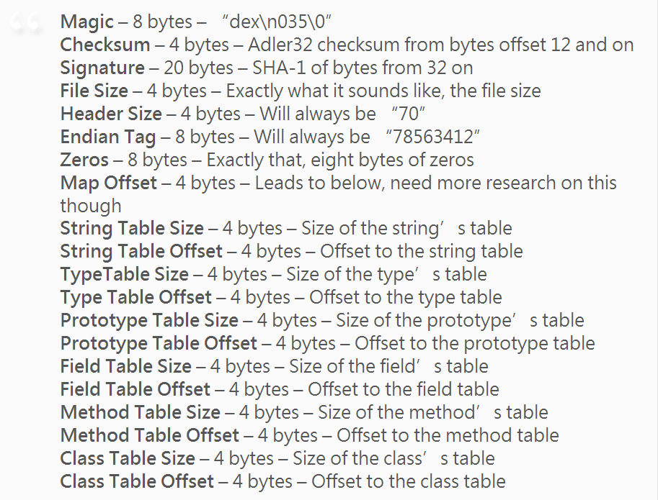
Dex Header
http://www.strazzere.com/blog/2008/11/updated-dalvik-vm-dex-file-format/

Slide 51
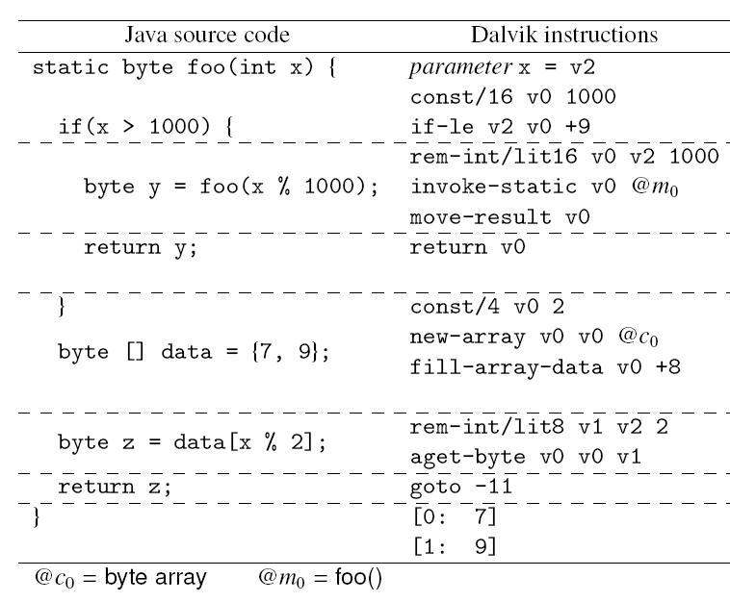
Dex Translation Example
SymDroid: Symbolic Execution for Dalvik Bytecode- Technical Report CS-TR-5022, July 2012
Jinseong Jeon, Kristopher K. Micinski, Je rey S. Foster
Department of Computer Science, University of Maryland, College Park

Slide 52
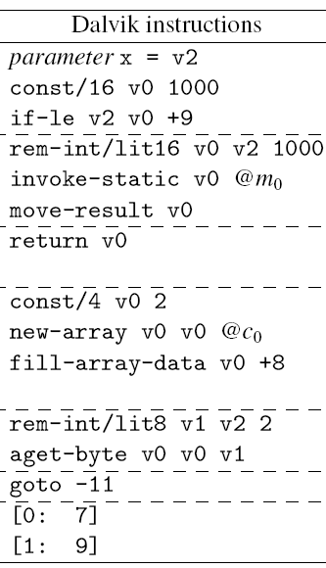
Dalvik ByteCode Example 2

Slide 53
A Simple Dalvik Virtual Machine
Register Bank
v0 ~ v65535
Program Context
VM Stat / PC
Heap
VM Engine
DEX Parser

Slide 54
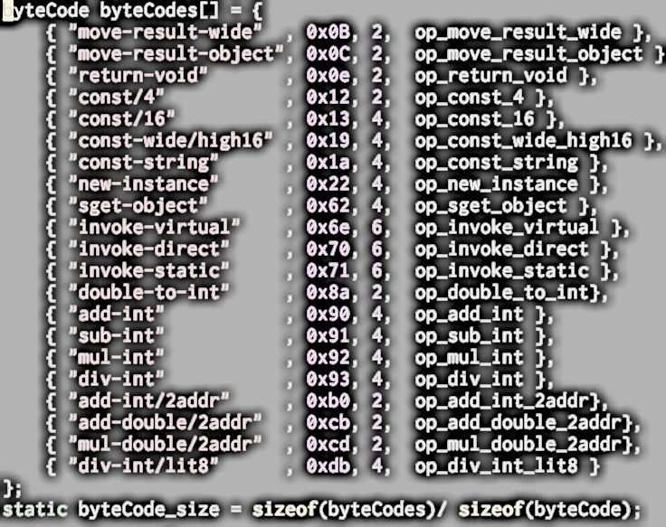
Simple DVM Instruction Table : simple_dvm_bytecodes.c

Slide 55
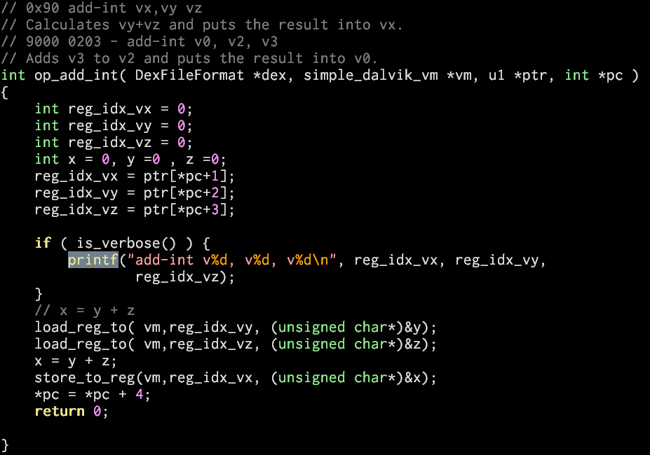
add-int implementation

Slide 56
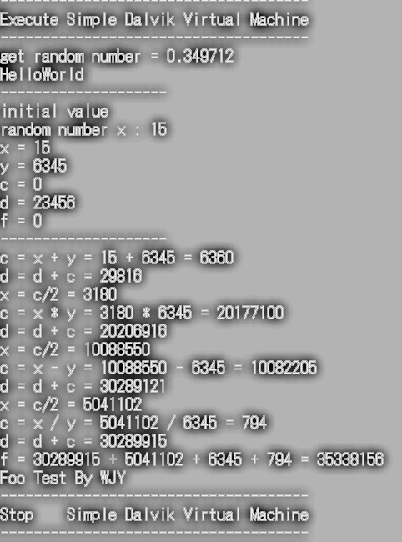
An Simple Dalvik VM Experiment
oo.gl/J5VFQV
make_simple_dvm
simple_dvm Foo1.dex

Slide 57
References
Android Open Source
http://source.android.com/index.html
Android XRef
http://androidxref.com/
Java ByteCodes Fundamentals
http://arhipov.blogspot.tw/2011/01/java-bytecode-fundamentals.html
Java ByteCode Instruction listings
http://en.wikipedia.org/wiki/Java_bytecode_instruction_listings
Dalvik Wiki
http://en.wikipedia.org/wiki/Dalvik_(software)

