Slide 1
Frame Buffer Postprocessing Effects in DOUBLE-S.T.E.A.L (Wreckless)
Masaki Kawase
BUNKASHA GAMES
BUNKASHA PUBLISHING CO.,LTD
http://www.bunkasha-games.com
http://www.daionet.gr.jp/~masa/

Slide 2
Today’s Contents
Xbox DirectX
Fake HDR and Glare filters
Depth of Field (DOF)
Post-processing image filters

Slide 3
Xbox DirectX
Xbox DirectX Extensions
  Same as GeForce3 OpenGL Extensions
    Texture shader
    Register combiners
    Shadow mapping
Capability to typecast resources
  Use D3DFMT_D2S8 depth-buffer as a 3DFMT_A8R8G8B8 texture
  Render to a Vertex Buffer

Slide 4
Pixel Shader Extensions
Register combiners for Pixel Shader
  General combiners
    Color blending instructions
  Final combiner
    Fog blending
    Specular add

Slide 5
General Combiners (1)
xmma d0,d1,d2, s0,s1,s2,s3
  d0 = s0*s1
  d1 = s2*s3
  d2 = s0*s1 + s2*s3
xmmc d0,d1,d2, s0,s1,s2,s3
  d0 = s0*s1
  d1 = s2*s3
  d2 = (r0.a>0.5) ? s2*s3 : s0*s1

Slide 6
General Combiners (2)
xdd d0,d1, s0,s1,s2,s3
  d0 = s0 dp3 s1
  d1 = s2 dp3 s3
xdm d0,d1, s0,s1,s2,s3
  d0 = s0 dp3 s1
  d1 = s2*s3

Slide 7
Final Combiner
xfc s0,s1,s2,s3, s4,s5, s6
  Final output rgb = s0*s1 + (1-s0)*s2 + s3
  Final output alpha = s6
  Final combiner special input registers
    PROD = s4*s5
    SUM = r0+v1
    FOG.a = fog factor

Slide 8
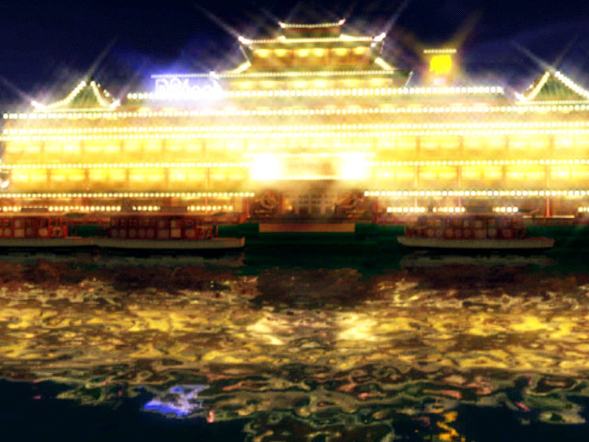
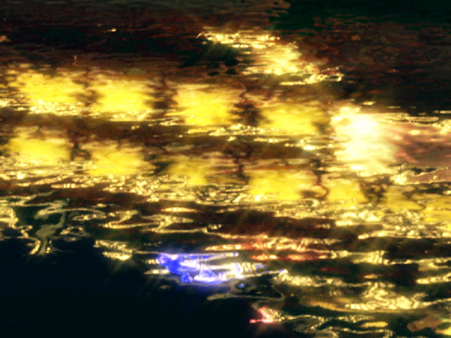
Fake HDR and Glare filters
Images Copyright© 2002 BUNKASHA PUBLISHING CO.,LTD.

Slide 9
High Dynamic Range (HDR) Rendering
Very important in representing
real-world brightness
Very bright scene causes “Glare”

Slide 10
HDR Rendering Process
Render scene with HDR
Generate glare images from bright pixels
Add glare to Frame Buffer

Slide 11
HDR Scene Rendering with A8R8G8B8 Frame Buffer
Glare effects need HDR
Use alpha channel as an additional information about pixel brightness
  Render scene with alpha channel
  Output higher alpha values to bright pixels

Slide 12
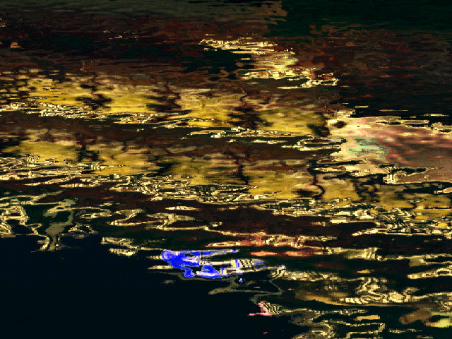
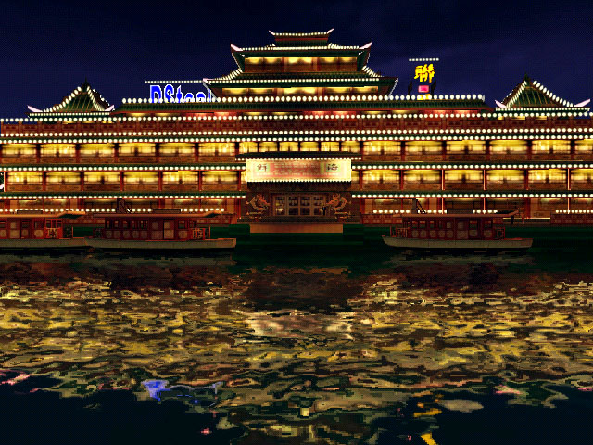
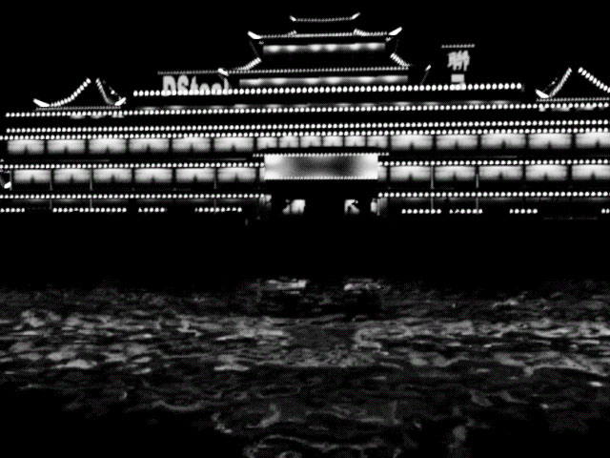

Glare-generation Process
Frame buffer
Frame buffer
Frame buffer alpha
+
=
Generate glare
Final image
Final image
Images Copyright© 2002 BUNKASHA PUBLISHING CO.,LTD.

Slide 13
Glare filters
Downsample frame buffer to
¼ * ¼ (1/16) the size
Pixel brightness = RGB * A
Generate glare
  Afterimage
  Bloom
  Star (light streaks)
  Ghost (not used in DOUBLE-S.T.E.A.L)

Slide 14
Afterimage
Update afterimage
  Next afterimage =
    Previous frame afterimage * p +
    current frame image * c – 1/255
    p: previous image weight
    c: current image weight
It’s not LERP (Linear intERPolation)
  p+c can be greater than 1.0
    e.g.
      p = 0.9
      c = 0.25
Bias –1/255
  Prevent dirty pixels from remaining

Slide 15
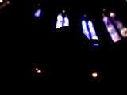


Bloom
Repeatedly apply small blur filters

Slide 16
Bloom filter (1st pass)
1st pass
1/16
2/16
1/16
2/16
4/16
2/16
1/16
2/16
1/16
Pixel being Rendered
Texture sampling points

Slide 17
Bloom filter (2nd, 3rd, … pass)
2nd pass
3rd pass
SetTexture(0-3, 1st render target) ;
SetTexture(0-3, 2nd render target) ;
Repeat as many times as you like

Slide 18
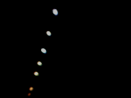

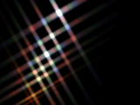
Star (light streaks)
Caused by
diffraction or refraction
of incoming light
  Cross filter
  Stop (Diaphragm blades)

Slide 19
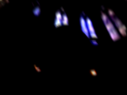
Light streak (1st pass)
Texcoord[s] = rendering point + s texels
color weight[s] = a^s
s=0
s=1
s=2
s=3
a: attenuation(about ~0.9-0.95)
s: sampling (texture stage 0-3)
weight =
a^0
a^1
a^2
a^3
4-pixel blur

Slide 20

Light streak (2nd pass)
SetTexture(s, 1st render target) ;
Texcoord[s] = rendering point + 4*s
color weight[s] = a^(4*s)
s=0
s=1
s=2
s=3
w =
a^0
a^4
a^8
a^12
16-pixel blur

Slide 21
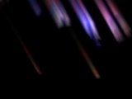
Light streak (n^{th} pass)
n^{th} pass
  SetTexture(s, n-1th render target) ;
  b = 4^(n-1)
  Texcoord[s] = rendering point + b*s
  color weight[s] = a^(b*s)
Modulate color for
spectral dispersion
4^n-pixel blur
  n=2 or 3 for good results
3rd pass
64-pixel blur

Slide 22
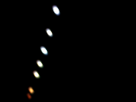


Repeat the above process
2, 4, 6 or 8 directions
1st pass
2nd pass
3rd pass
x4 directions
4 pixels
16 pixels
64 pixels
64*4 pixels

Slide 23
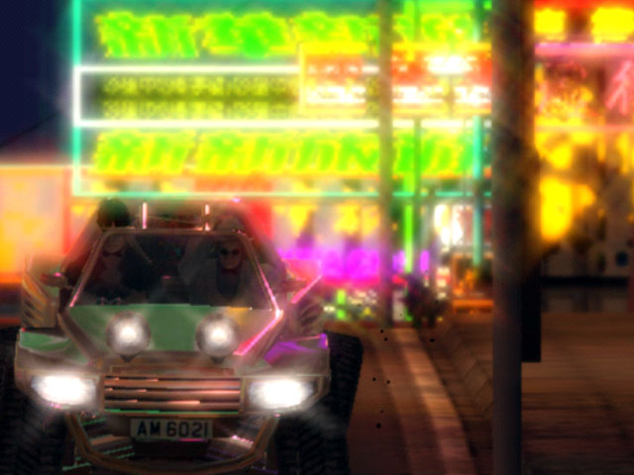
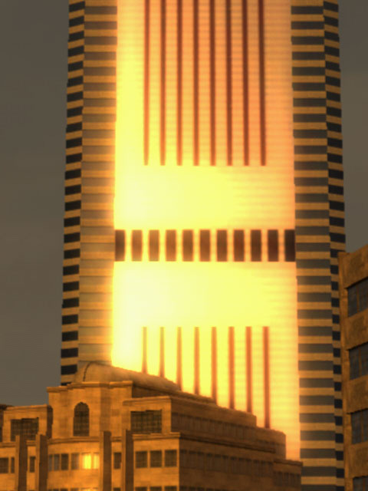
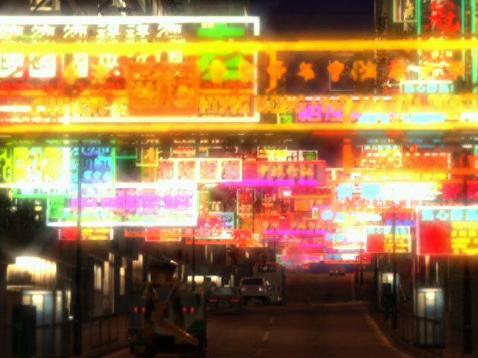
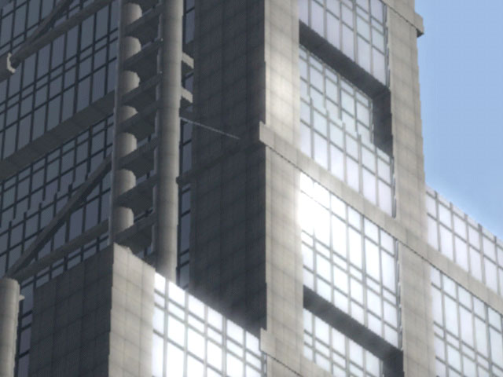
Images Copyright© 2002 BUNKASHA PUBLISHING CO.,LTD.

Slide 24
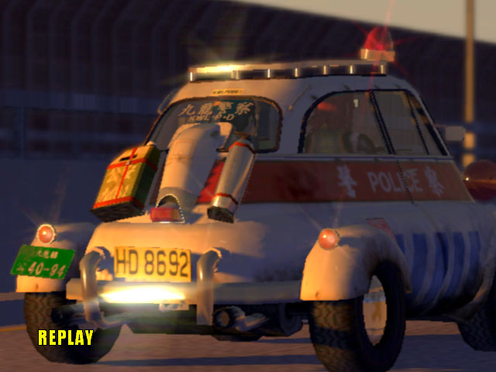
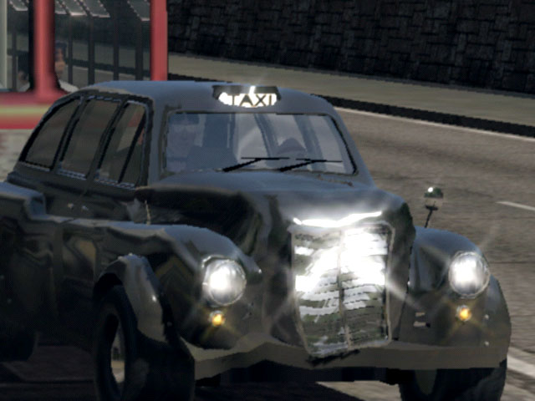
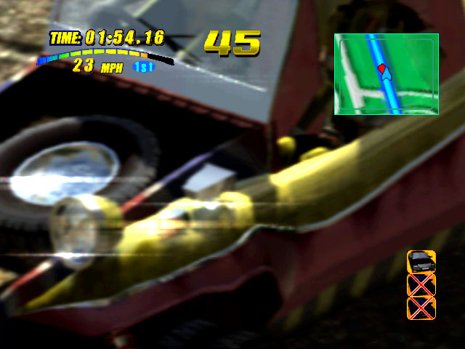
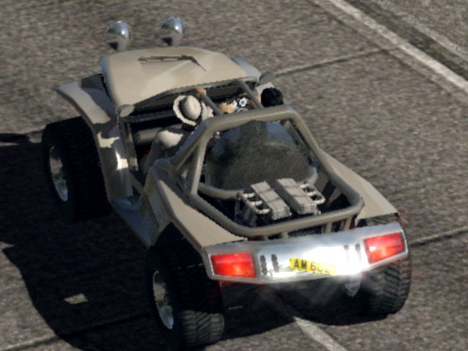
Images Copyright© 2001 BUNKASHA PUBLISHING CO.,LTD.

Slide 25
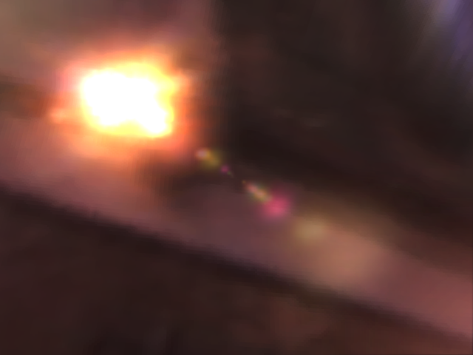
Ghost
(not used in DOUBLE-S.T.E.A.L)
Caused by
internal reflections inside the lens system
Scaling about the screen center

Slide 26

Scaling about the screen center
texcoord = (original texcoord - 0.5) * s + 0.5
  s: An arbitrary scaling factor
e.g. scaling by s = -2.0
original texcoords
scaled texcoords
(0,0)
(1,0)
(-0.5,-0.5)
(1.5,-0,5)
Scaling by
s = -2.0
(0,1)
(1,1)
(-0.5,1.5)
(1.5,1.5)

Slide 27


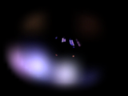
Ghost (1st pass)
Mask the source images with a smooth circle
  To prevent rectangular edges
*
+
*
Scaling
Scaling

Slide 28
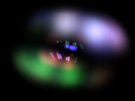
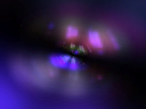
Ghost (2nd and 3rd passes)
Multi-tap scaling and color modulation
Scaling and color modulation
+
Final ghost image

Slide 29
Glare Effects in DirectX9
High-Precision buffer formats
  True HDR frame buffer
More complex pixel operations
  Gorgeous glare effects
  Still too expensive for games
    Will hopefully be of practical use in the near future

Slide 30
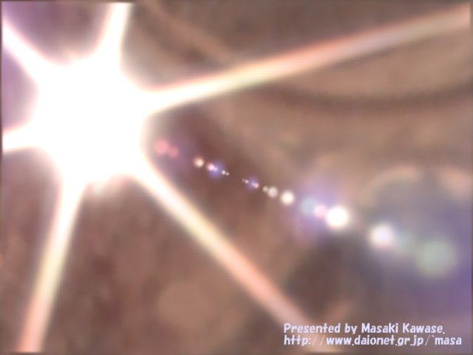
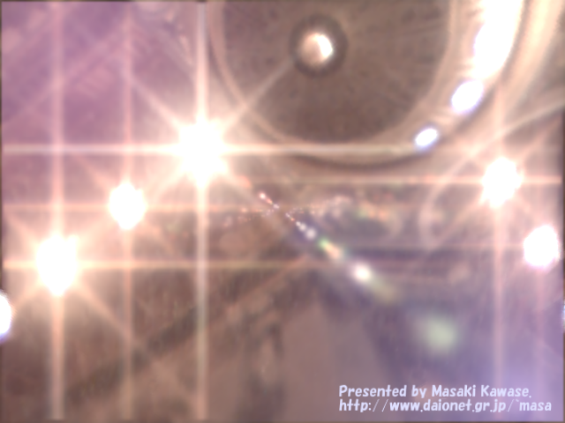
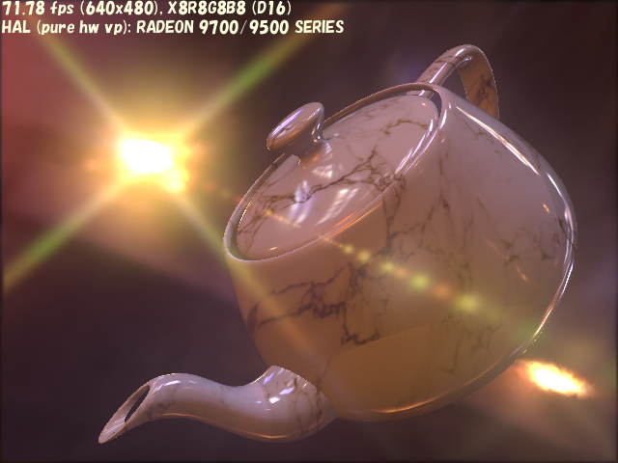

Slide 31
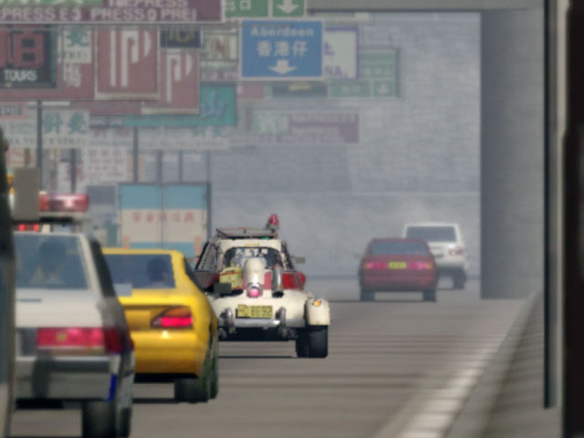
Depth of Field (DOF)
Copyright© 2002 BUNKASHA PUBLISHING CO.,LTD.

Slide 32
DOF Process
Use depth buffer
(W buffer in DOUBLE-S.T.E.A.L)
  Generate blurred frame buffer
    Can be smaller than the frame buffer
    But don’t use box filter to resize
      Multi-tap blur filter is recommended
  Calculate screen-space blurriness based on
  W buffer and focal distance per pixel
  Blend the blurred image and the frame buffer based on the blurriness

Slide 33
Look up screen-space blurriness from W buffer
Calculating screen-space blurriness per pixel is a bit complex operation
  Directly look up blurriness from W value
  1D look-up texture
    8-bit table for mapping the W value to blurriness
    Calculate blurriness for each W value by CPU
      8 bits : 256 elements per frame

Slide 34
Lookup screen-space blurriness
Sample D24S8 W value as A8R8G8B8 texture
  Can get the highest 8 bits of depth component as 8-bit alpha by typecasting
Use dependent texture read “texreg2ar”
  “texreg2ar” uses alpha and red components of another texture as the current texture coordinates (u,v)
D24
S8
typecast
A8
R8
G8
B8

Slide 35

Lookup blurriness
Look up screen-space blurriness from W value
D24
S8
typecast
texreg2ar
A8
R8
G8
B8
a:0.0(camera)
a:1.0(far)
A8
8-bit precision distance from camera
  0.0: camera position
  1.0: far clip
1D look-up texture
Get the screen-space blurriness

Slide 36
Blending based on blurriness
Use two blurred images in addition
to the original frame buffer
  One is a bit blurred and the other is strongly blurred
  The DOF result is a blend of three images
  (the frame buffer and two blurred images)
  Better than a blend of two images
  (the frame buffer and one blurred image)
The blurred images can be small
  256x192 and 160x120 in DOUBLE-S.T.E.A.L

Slide 37
Calculate Blend factor Alpha and Color (1)
Calculate “Blend Alpha” and “Blend Color” in Pixel Shader
Alpha-blend with the frame buffer
  Blend Alpha should always be smaller than 1.0
Ideally, alpha and color outputs satisfy:
    r : screen-space blurriness
    blur1 : a bit blurred image (256x192)
    blur2 : strongly blurred image (160x120)
  When r = 0.0
      .a = 0.0 (no blend)
      .rgb = blur1 (will not affect the result)
    The resulting pixel is 100% the frame buffer

Slide 38
Calculate Blend factor Alpha and Color (2)
  When r = 0.5
      .a = somewhat smaller than 1.0
      .rgb = blur1
    The result is almost the blur1 image
  When r = 1.0
      .a = slightly smaller than 1.0
      .rgb = a blend of blur1 and blur2 (almost blur2)
    The result is almost the blur2 image

Slide 39
DOF Shader Code
if (blurriness > 0.5) {
out.a = blurriness * 0.25 + 0.75 ;
}
else {
out.a = blurriness * 1.5 ;
}
// blurriness: 0.0 -> rgbFactor = -0.75
// blurriness: 0.5 -> rgbFactor = 0.0
// blurriness: 1.0 -> rgbFactor = 0.75
rgbFactor = blurriness * 0.75 - 0.75 ;
// lerp blur1 and blur2 by rgbFactor
out.rgb = blur1 + (blur2 - blur1) * rgbFactor ;
output.a
output.rgb
1.0
blur2
0.9
0.75
0.0
blur1
0.0
0.5
1.0
blurriness

Slide 40
DOF Pixel Shader
xps.1.1
def c0, 0.0f, 0.0f, 0.0f, 0.15f // (0.9f - 0.75f)
def c1, 0.0f, 0.0f, 0.0f, 0.75f
tex t0 // t0.a : W buffer (distance from camera)
texreg2ar t1, t0 // t1.a : screen-space blurriness
tex t2 // t2 : blurred frame buffer (256x192)
tex t3 // t3 : strongly blurred buffer (160x120)
mad_d2 r0.rgb, t1_bx2.a, c0.a, c1.a
+mov r0.a, t1.a
mul r1.rgb, t1_bx2.a, c1.a
+xmmc_x2 DISCARD.a, DISCARD.a, r0.a, t1.a, c1.a, 1-ZERO, r0.b
// Color output will be alpha blended with the frame buffer based on the alpha output
xfc r1.b, t3, t2, ZERO, ZERO, ZERO, r0.a
“DISCARD” output register discards the results

Slide 41
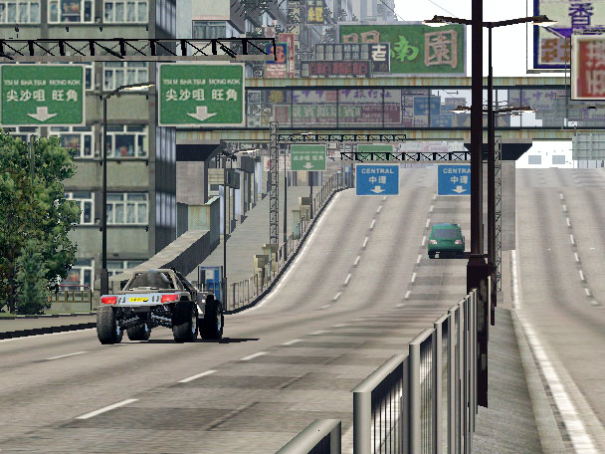
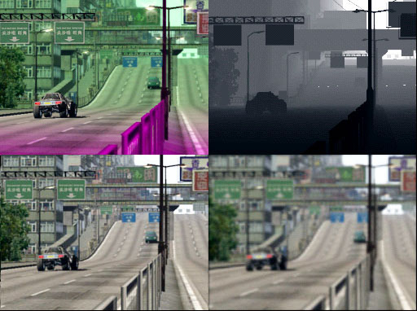
DOF processing textures
Final image with blurriness
Original frame buffer
W buffer
1D look-up texture
that maps W value to blurriness
256x192
Blurred image
160x120 Strongly blurred
Images Copyright© 2002 BUNKASHA PUBLISHING CO.,LTD.

Slide 42
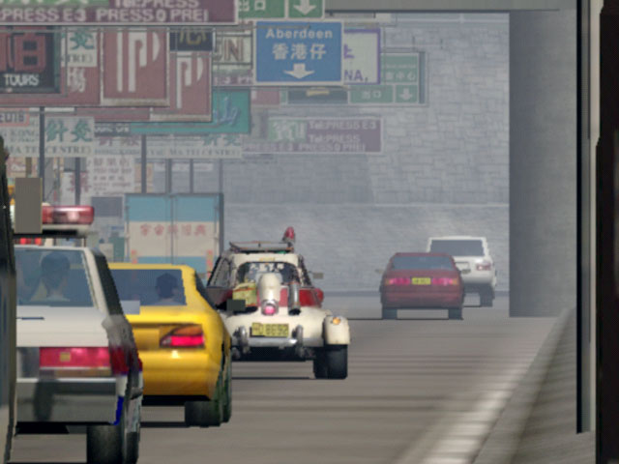
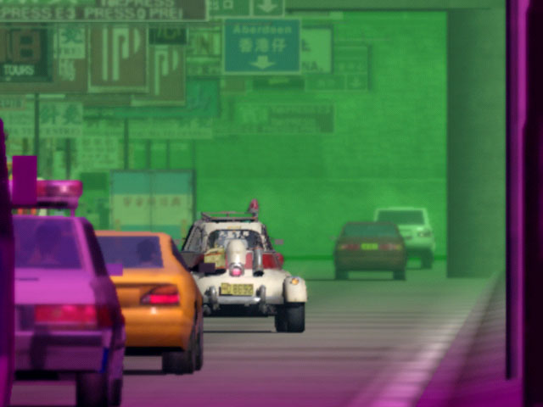
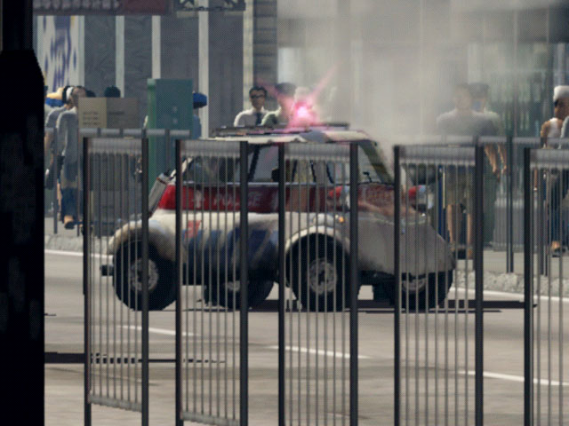
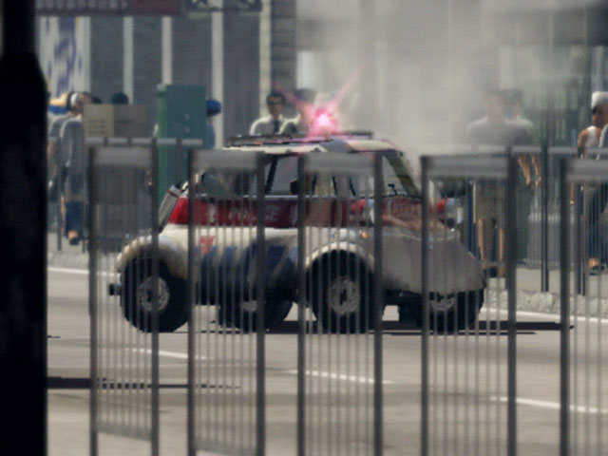
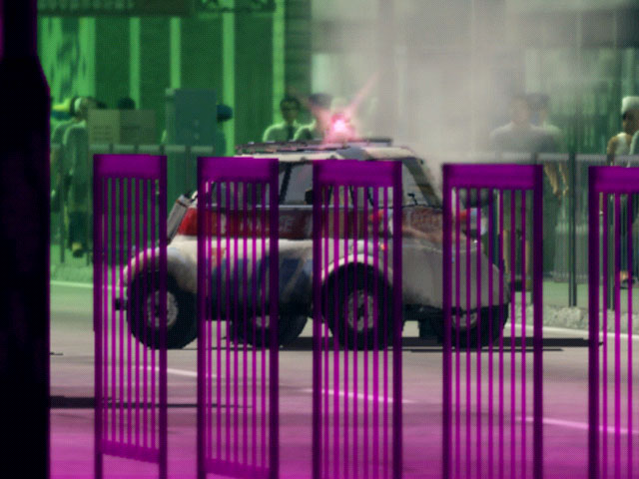
Depth of Field images
Final images with blurriness
Original images
Final images
Images Copyright© 2002 BUNKASHA PUBLISHING CO.,LTD.

Slide 43
Final Image (1)
Copyright© 2002 BUNKASHA PUBLISHING CO.,LTD.

Slide 44
Final Image (2)
Copyright© 2002 BUNKASHA PUBLISHING CO.,LTD.

Slide 45
Other post-processing filters
Projector
  Separation of RGB components
Camera image
  Emphasize contrast
  Soften edges
Illustration
  Edge detection
  Pale coloring

Slide 46
Projector (RGB separation) Pixel Shader
xps.1.1
// c0.rgb : glare intensity
// c2.rgb : fadeout color
// c2.a : fadeout factor
// c3.rgb : modulator
def c5, 1.0f, 0.0f, 0.0f, 0.0f // R mask
def c6, 0.0f, 1.0f, 0.0f, 0.0f // G mask
def c7, 0.0f, 0.0f, 1.0f, 0.0f // B mask
tex t0 // frame buffer(R jittered)
tex t1 // frame buffer(G jittered)
tex t2 // frame buffer(B jittered)
tex t3 // generated glare
// Sum up using RGB masks
xmma DISCARD.rgb, DISCARD.rgb, r0.rgb, t0, c5, t1, c6
mad r0.rgb, t2, c7, r0
// Add glare
mad r0, t3, c0, r0
// Modulate and fadeout
xfc c2.a, c2, r0, ZERO, r0, c3, r0.a
Texcoords for t0,t1,t2 are jittered for RGB separation (Left/Center/Right)

Slide 47
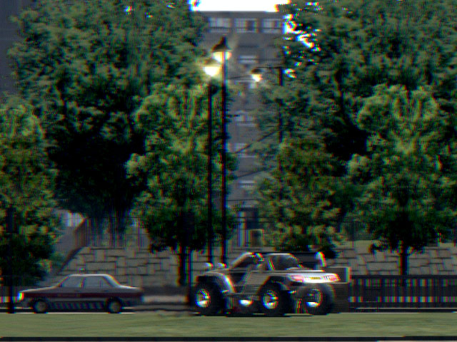
Projector (RGB separation)
Copyright© 2002 BUNKASHA PUBLISHING CO.,LTD.

Slide 48
Camera image Pixel Shader
xps.1.1
// c4.rgb : gray scale coefficients
def c4, 0.30f, 0.59f, 0.11f, 0.0f
// blend factor for three images
def c5, 0.0f, 0.0f, 0.0f, 0.5f
def c6, 0.0f, 0.0f, 0.0f, 0.333333333f
tex t0 // frame buffer
tex t1 // frame buffer
tex t2 // frame buffer
tex t3 // glare
// Soften frame buffer edges
lrp r0, c5.a, t1, t2
lrp r0, c6.a, t0, r0
// Add glare
mad r0, t3, c0, r0
// Calculate luminance
dp3 r1, r0, c4
// Emphasize contrast
mul_x2 v0, r0, r0
lrp r0, r1, r0, v0
// Modulate color
mul_x2 r0, r0, c3
// Fadeout
xfc c2.a, c2, r0, ZERO, ZERO, ZERO, r0.a
Texcoords for t0,t1,t2 are jittered for softening edges

Slide 49
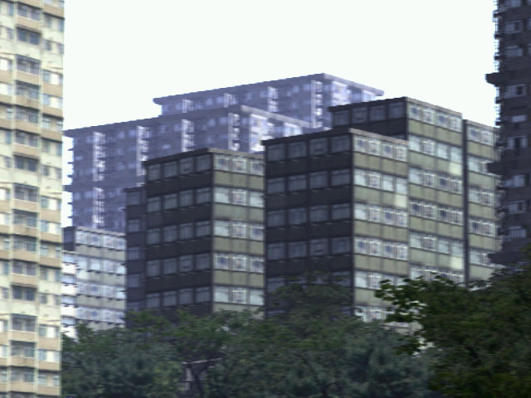
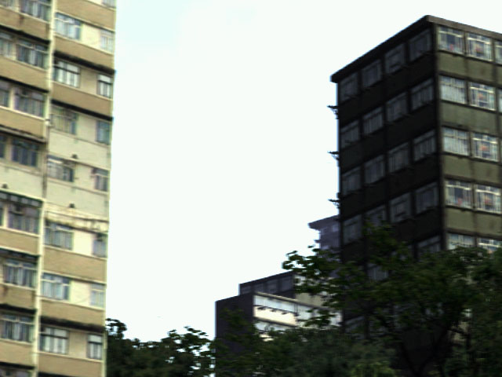
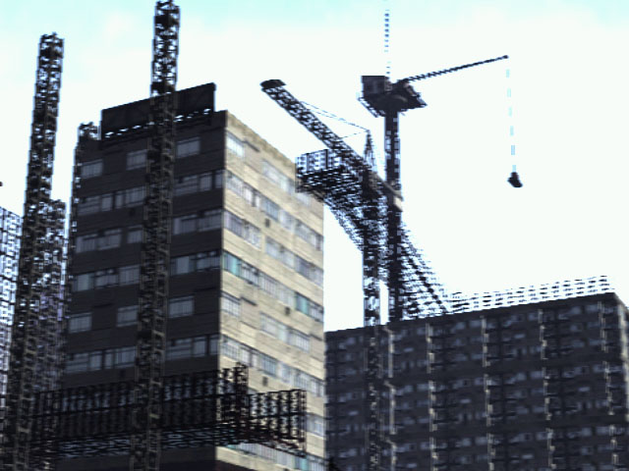
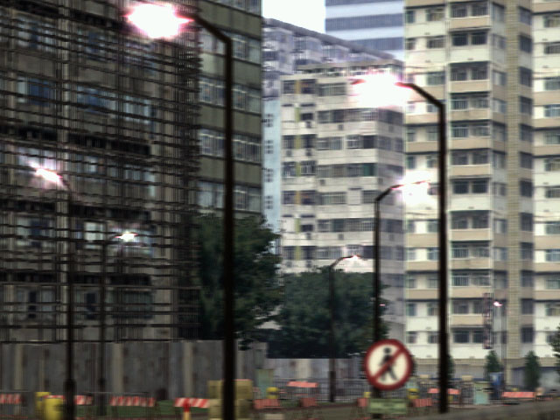
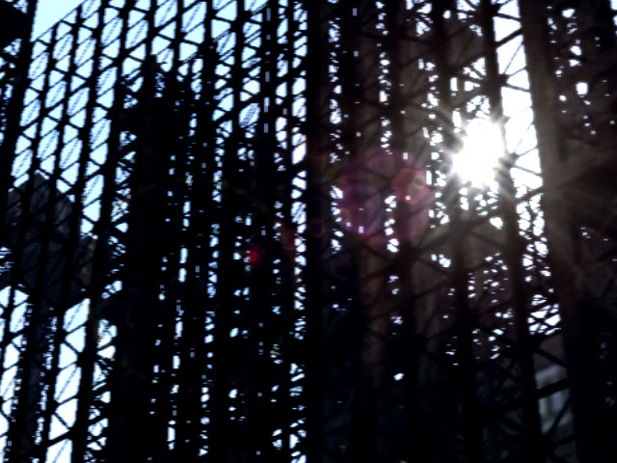
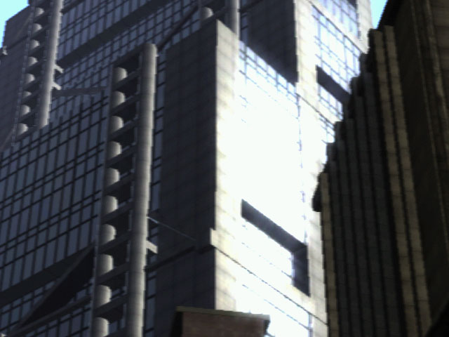
Camera image
Images Copyright© 2002 BUNKASHA PUBLISHING CO.,LTD.

Slide 50
Edge Detection Pixel Shader
// Edge detection pixel shader
xps.1.1
// Up/Down/Left/Right jittered sampling
tex t0 // frame buffer (jittered)
tex t1 // frame buffer (jittered)
tex t2 // frame buffer (jittered)
tex t3 // frame buffer (jittered)
// R/G/B sub
sub_x2 r0, t0, t1
sub_x2 r1, t2, t3
// Approximate absolute values
// dp3_x4 r0, r0, r0
// dp3_x4 r1, r1, r1
xdd_x4 r0, r1, r0, r0, r1, r1
// complement
sub r0, 1-r0, r1 // 1 - r0 - r1

Slide 51
Illustration Pixel Shader
// Illustration pixel shader
xps.1.1
def c2, 0.0f, 0.0f, 0.0f, 0.0f
def c3, 0.0f, 0.0f, 0.0f, 0.5f
def c4, 0.30f, 0.59f, 0.11f, 0.0f
def c7, 0.0f, 0.0f, 0.5f, 0.75f
// jittered sampling
tex t0 // frame buffer (jittered)
tex t1 // frame buffer (jittered)
tex t2 // frame buffer (jittered)
tex t3 // frame buffer (jittered)
// Edge detection
sub_x2 r0, t0, t1
sub_x2 r1, t2, t3
xdd_x4 r0, r1, r0, r0, r1, r1
sub r0, 1-r0, r1 // 1 - r0 - r1
// Pale coloring
dp3_x4 t1, t0, c4
lrp t1.a, c7.b, 1-ZERO, t1.a
lrp t0, c7.a, t0, t1.a
mul_x2 r0, r0_bx2, t0
xfc c2.a, c2, PROD, ZERO, r0, r0, r0.a

Slide 52
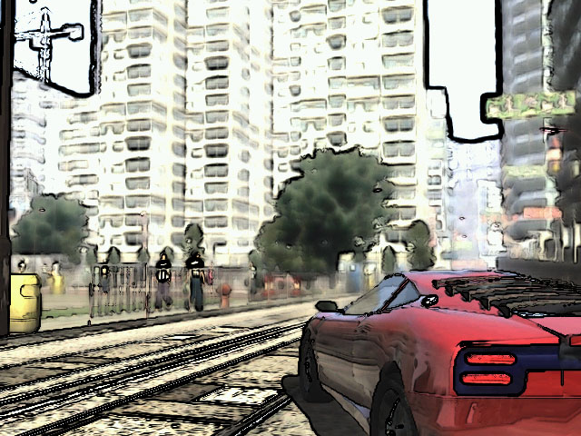
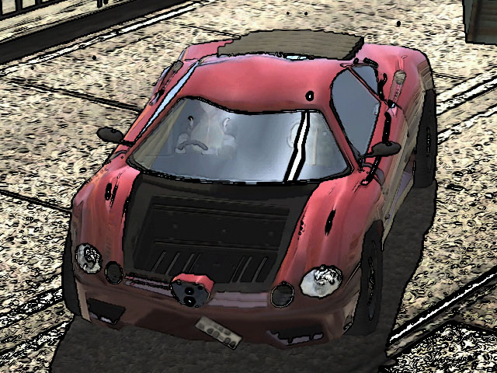
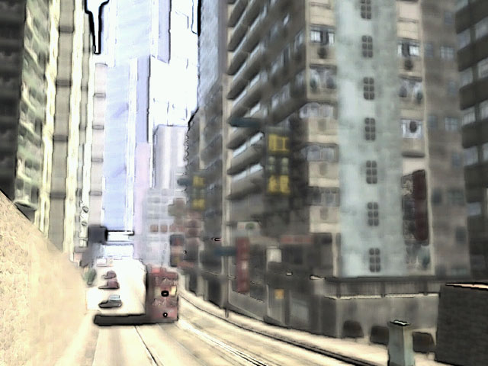
Illustration
Images Copyright© 2002 BUNKASHA PUBLISHING CO.,LTD.

