Slide 1
Different City Similarities
From New York and Los Angeles to the world

Slide 2
City Similarities
In the previous project, we have used the K-Mean model to cluster Toronto's neighborhoods based on the classification of venues near the neighborhood. In such projects, our classification goals are limited to the same city.
Now let’s take a longer-term view and continue to explore the similarity between different cities. For example, a person who dislikes change very much must move out of his city for some irresistible reasons. Instead of living in another city, how would he choose the area of his new home?
We want to compare the similarities of different cities.

Slide 3
From simple to complex
Two cities compare
New York neighborhoods v.s. Los Angeles neighborhoods
New York v.s. Los Angeles
padding
Multi-cities compare
Global Cities
Country grouped

Slide 4
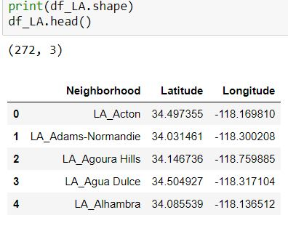
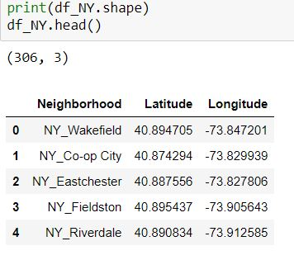
Data pre-process
New York and Los Angeles neighborhood coordinates

Slide 5
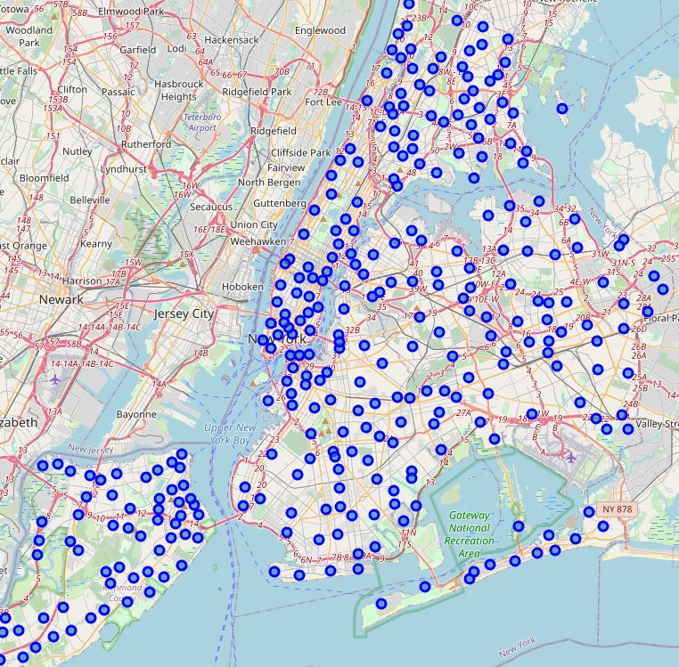
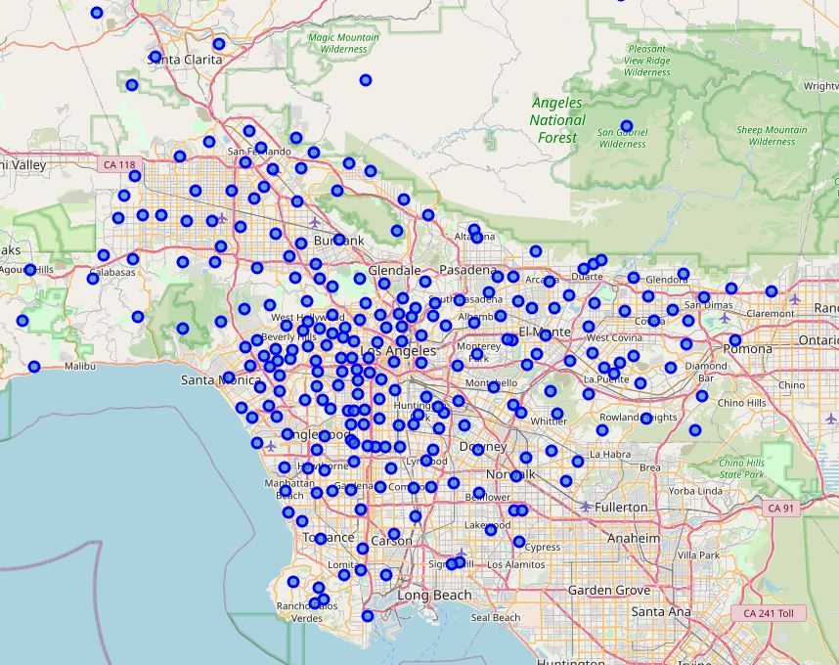
Neighborhoods positions

Slide 6
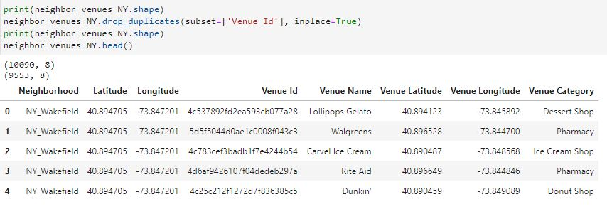
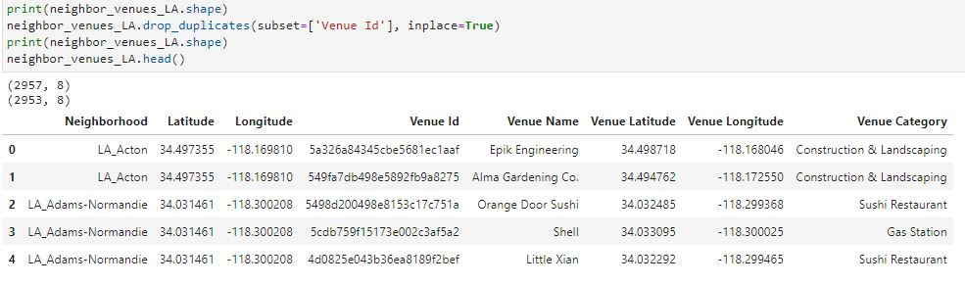
Venues: detailed

Slide 7
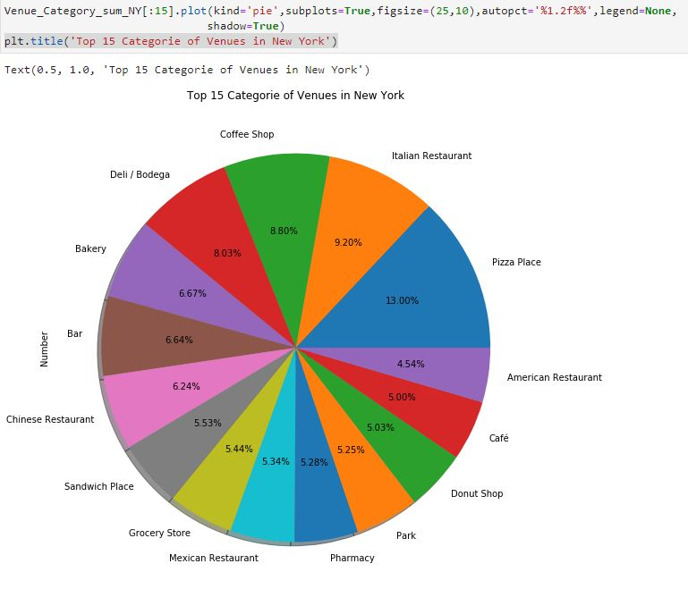
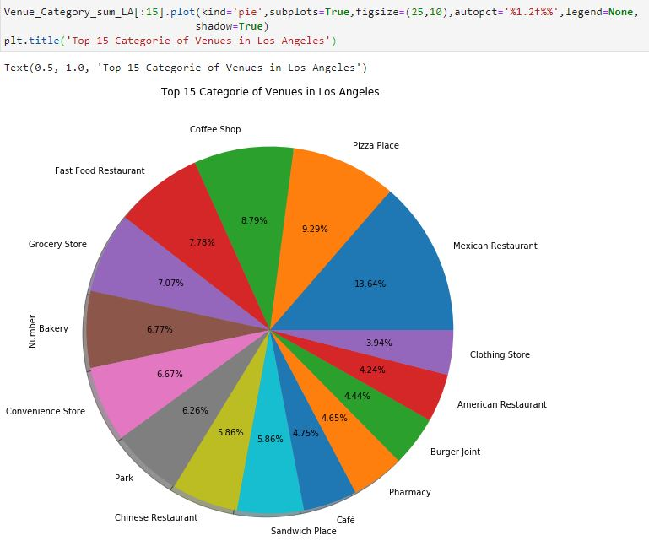
Top 15 categories from New York and Los Angeles

Slide 8
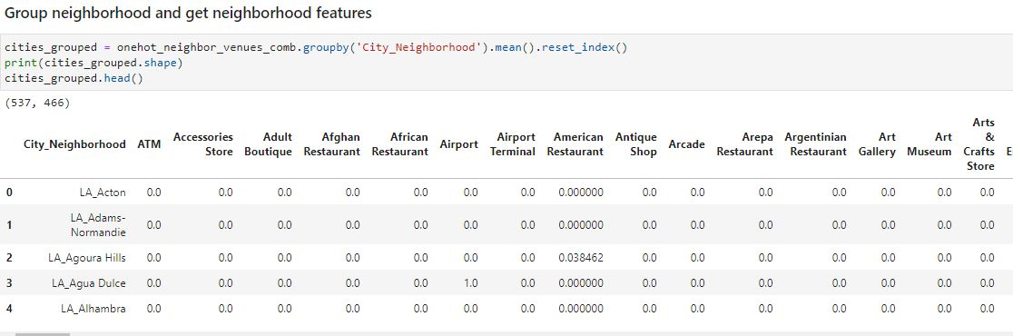
K-Mean clustering feature feed to the model

Slide 9
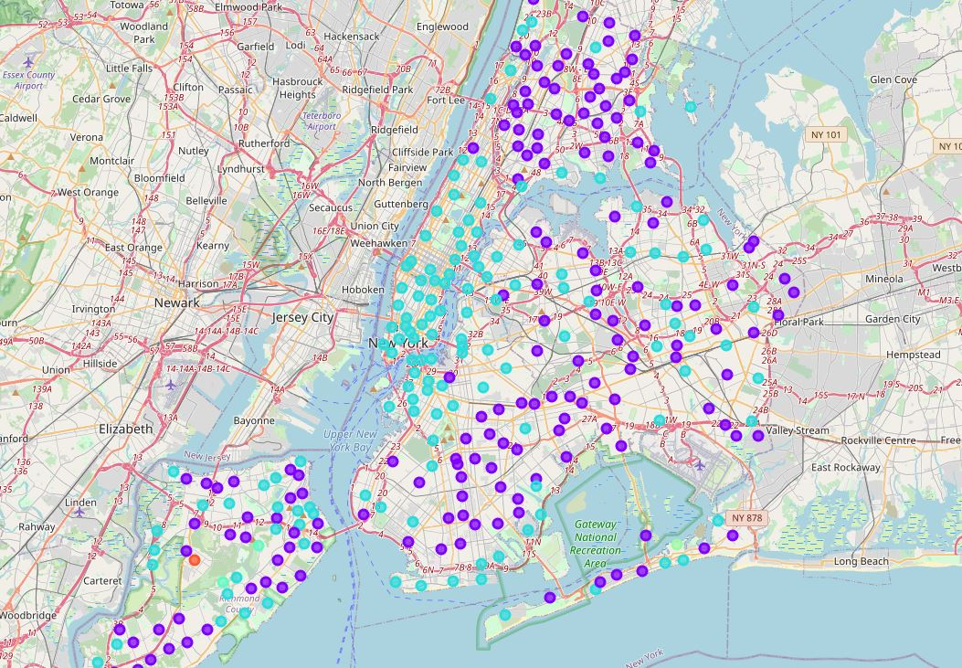
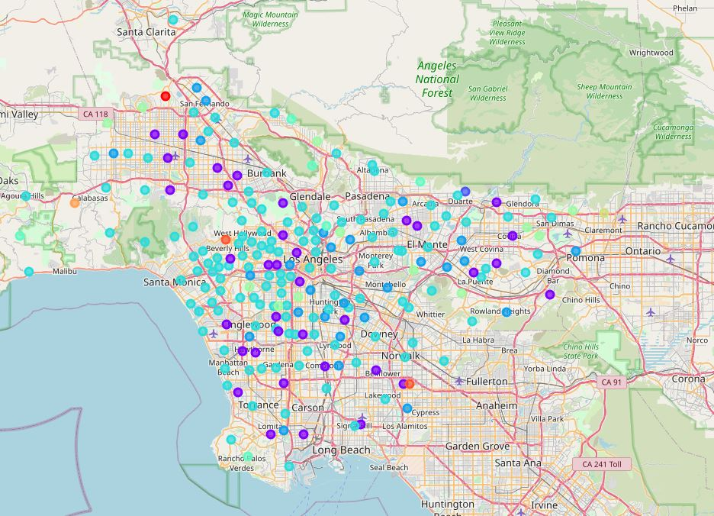
New York and Los Angeles clustered much similar groups

Slide 10
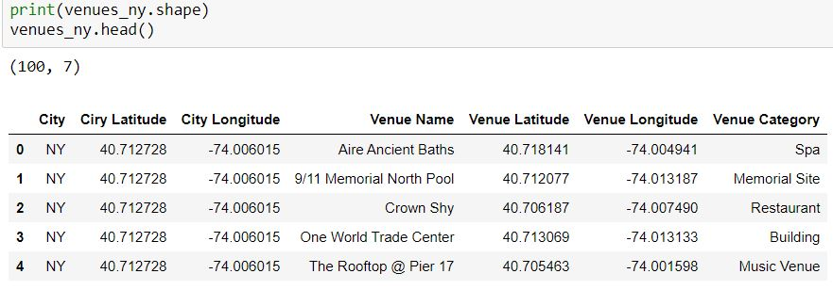
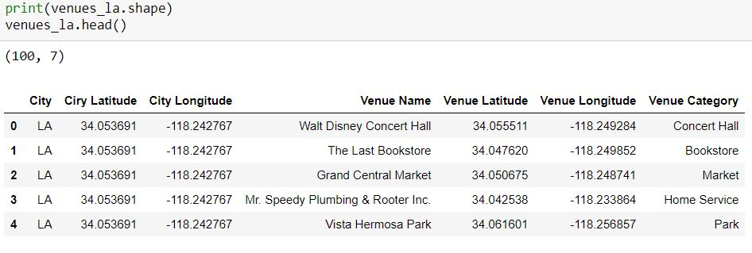

City venues: un-padding

Slide 11
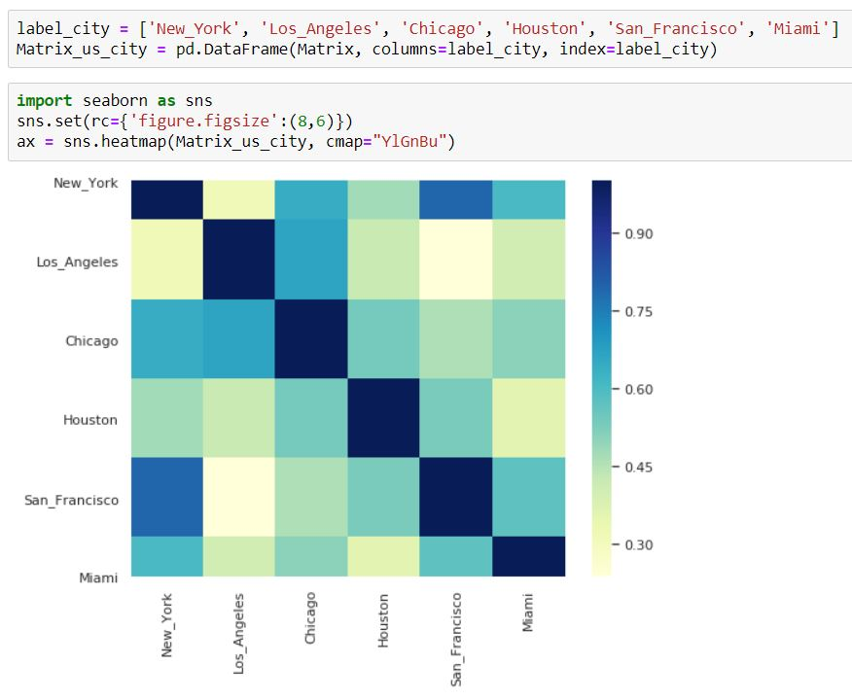
US cities comparison

Slide 12
Thinking: Why low Similarities NY & LA?
Foursquare request limited searching radius and number for single request.
Didn’t cover all the city area.
Neighborhood sparse in suburb, especially in Los Angeles

Slide 13
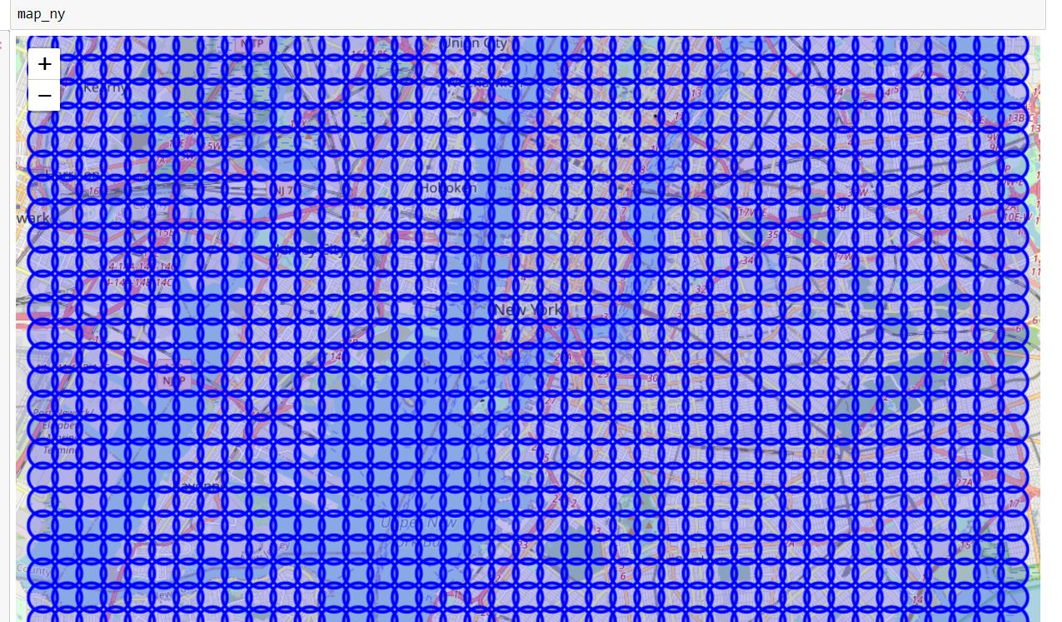
Solution : Padding the whole city

Slide 14
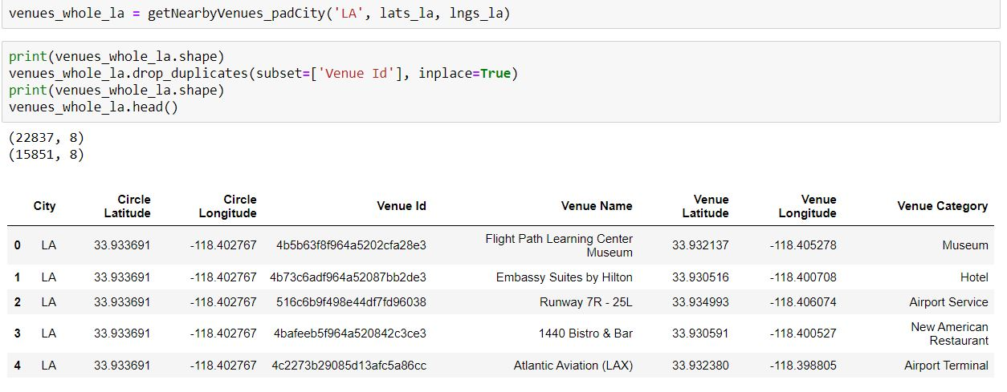
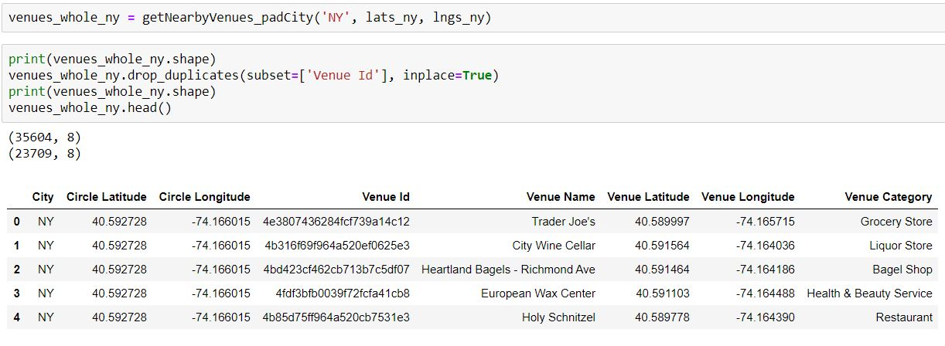
More venues more better

Slide 15
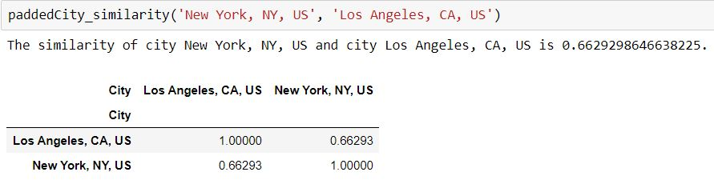
Un-padding Similarity: 0.31 Padding Similarity: 0.66

Slide 16
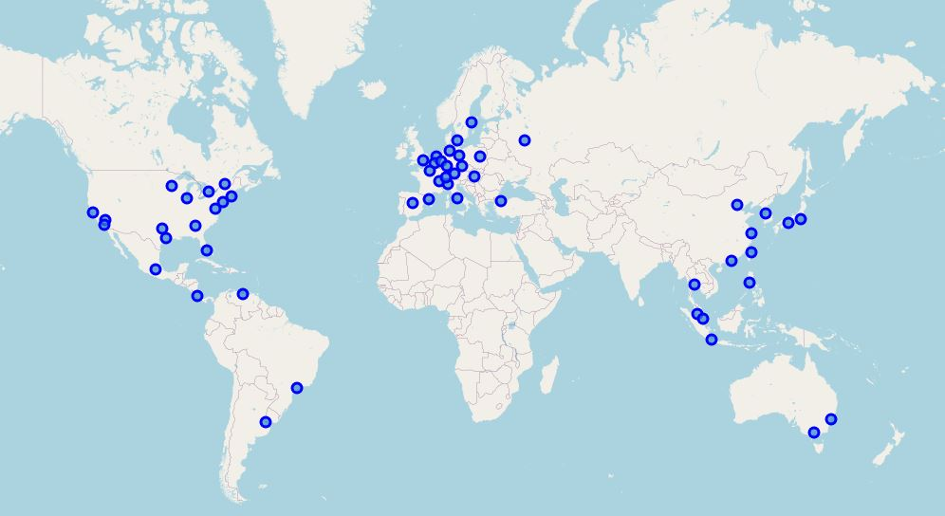
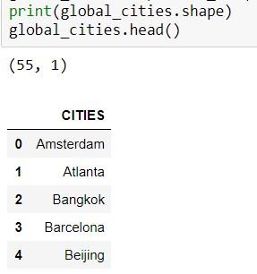
Global Cities: Top 55 cities from Globalization and World Cities

Slide 17
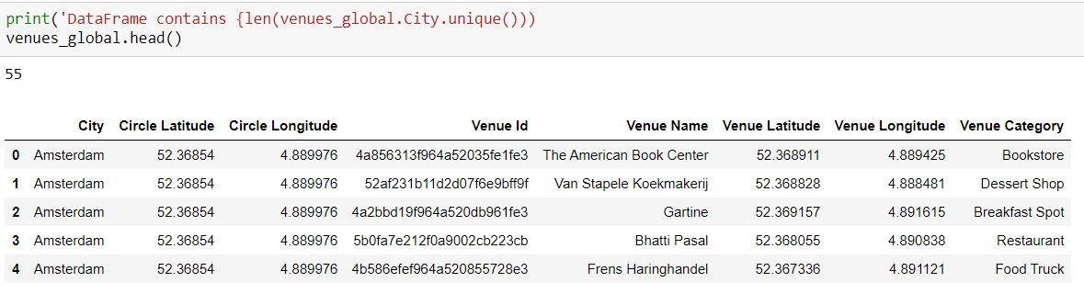
Venues: Padding and request Foursquare

Slide 18
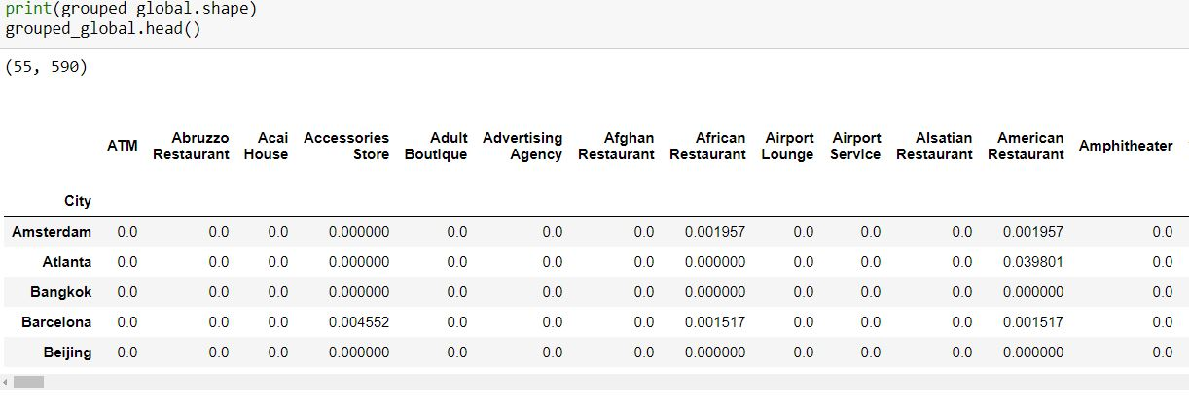
Encoding and city grouped

Slide 19
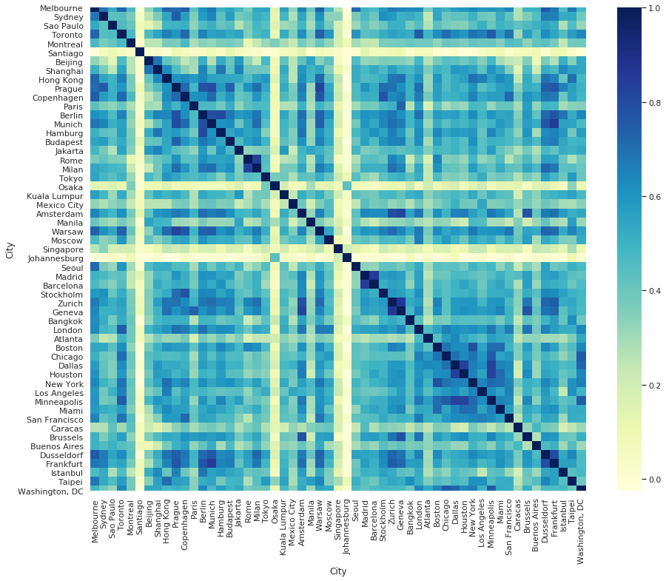
Result:
Some cities different than any others
East Asian
South American
Diagnose square
Same country similar culture
International City
Multi-culture

