Slide 1
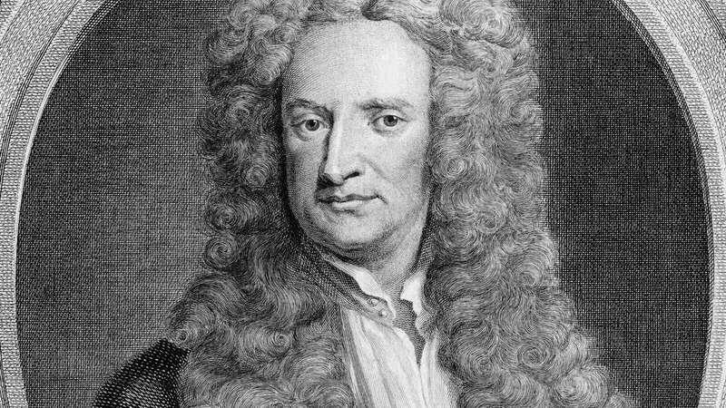
Newton’s Fractals
Lance Bergeron

Slide 2

Newton’s Iteration (Newton’s Method)
$$z_{i+1}=z_{i}−\frac{P\left(z\right)}{P^{′}\left(z\right)}$$

Slide 3
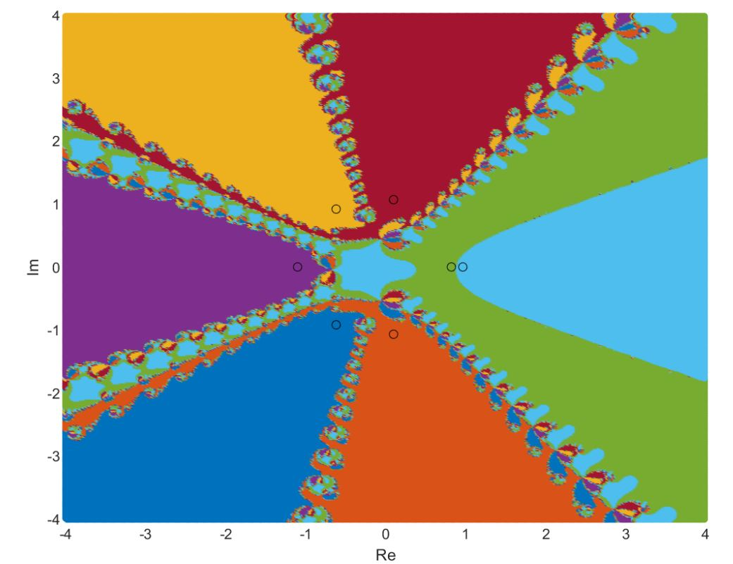

Slide 4
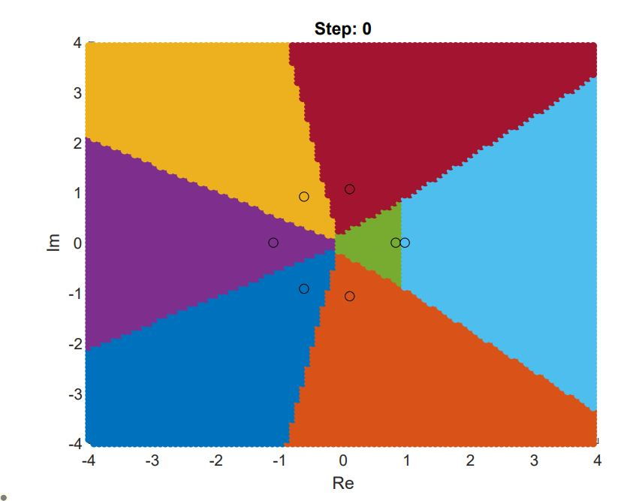


Slide 5
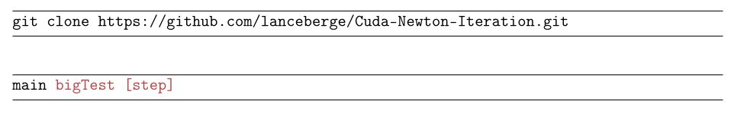
smallTest – 3rd order
bigTest – 7th order
bigTest2 – 12th order
bigTest3 – 30th order

Slide 6
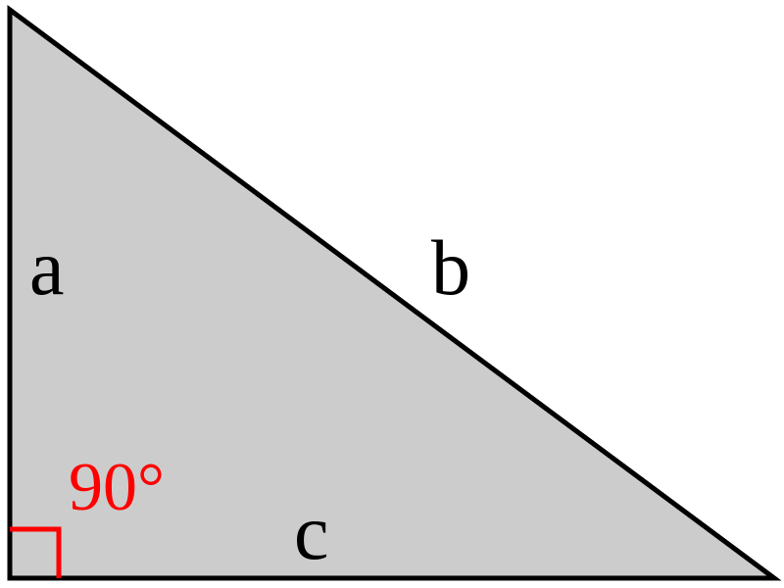
L1 Norm

