Slide 1
Ship motion prediction with IMU-data and images
Lance De Waele

Slide 2
Contents
Introduction
Goal & Incentive
Data
Deep learning
Proposed Models
Performance & Results
Conclusion

Slide 3
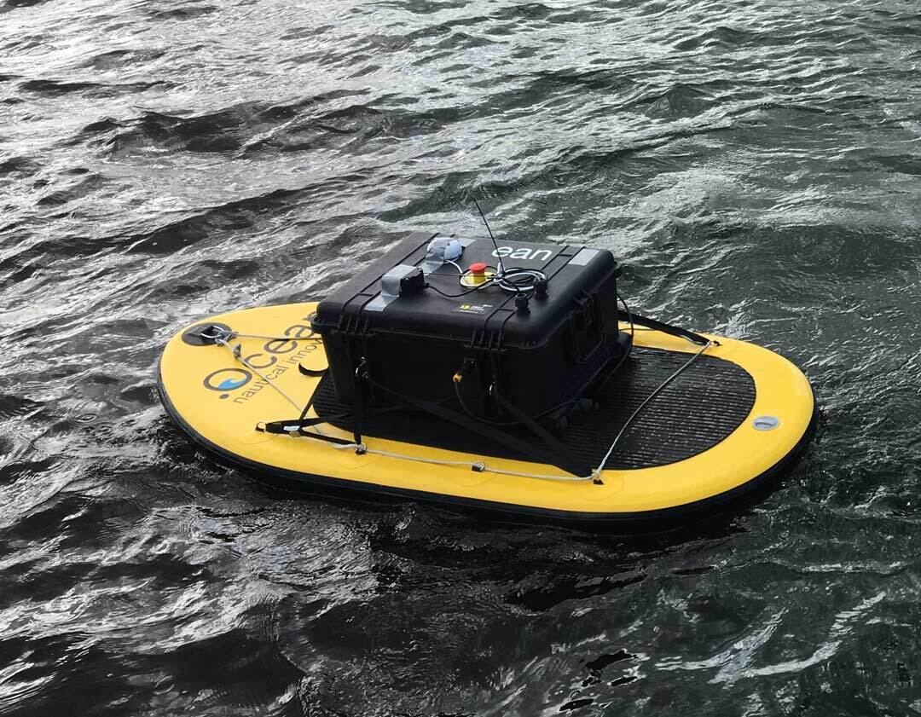
Introduction
Royal Military Academy
Robotics & Autonomous Systems lab
Marsur
Developing an autonomous surface vessel (ASV)
Marland
Developing an autonomous drone (UAV)
Take-off and landing on moving vessels

Slide 4
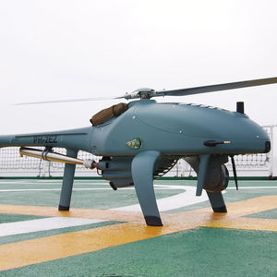
Goal & Incentive
Predict the motion of the ASV
Define optimal moment to land drone
Landing deck stabile and level
Minimal impact
Deep learning approach
Prediction:
Sequence of Pitch, Roll and Heave
Minimum 30 seconds

Slide 5
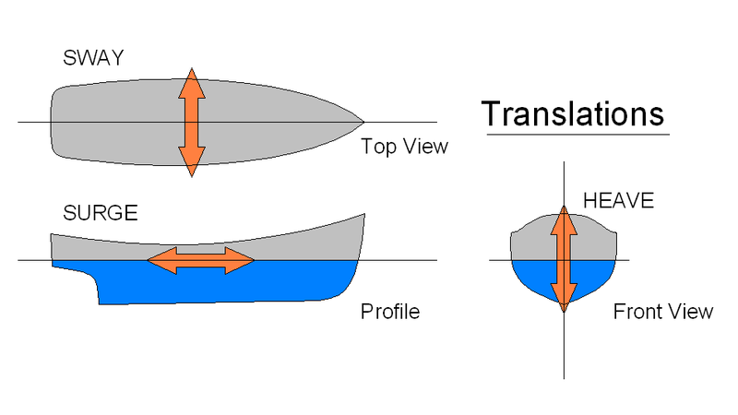
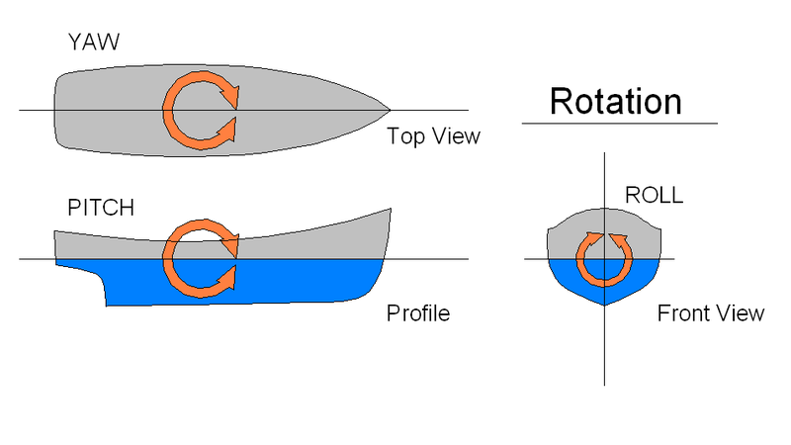
Data
Ship motion in 6 degrees of freedom
Translational
Sway
Surge
Heave
Rotational
Yaw
Pitch
Roll

Slide 6
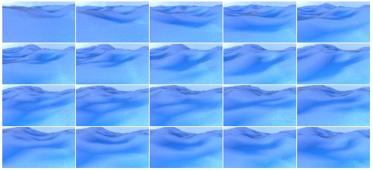
Simulated data
540 episodes of 400 images
Rendered at 2 frames/second
Avoid duplicate data at higher fps
30 hours of simulation
Resolution 96x54
Pitch & roll per image
₁Source: https://github.com/Nazotron1923/ship-ocean_simulation_BLENDER

Slide 7
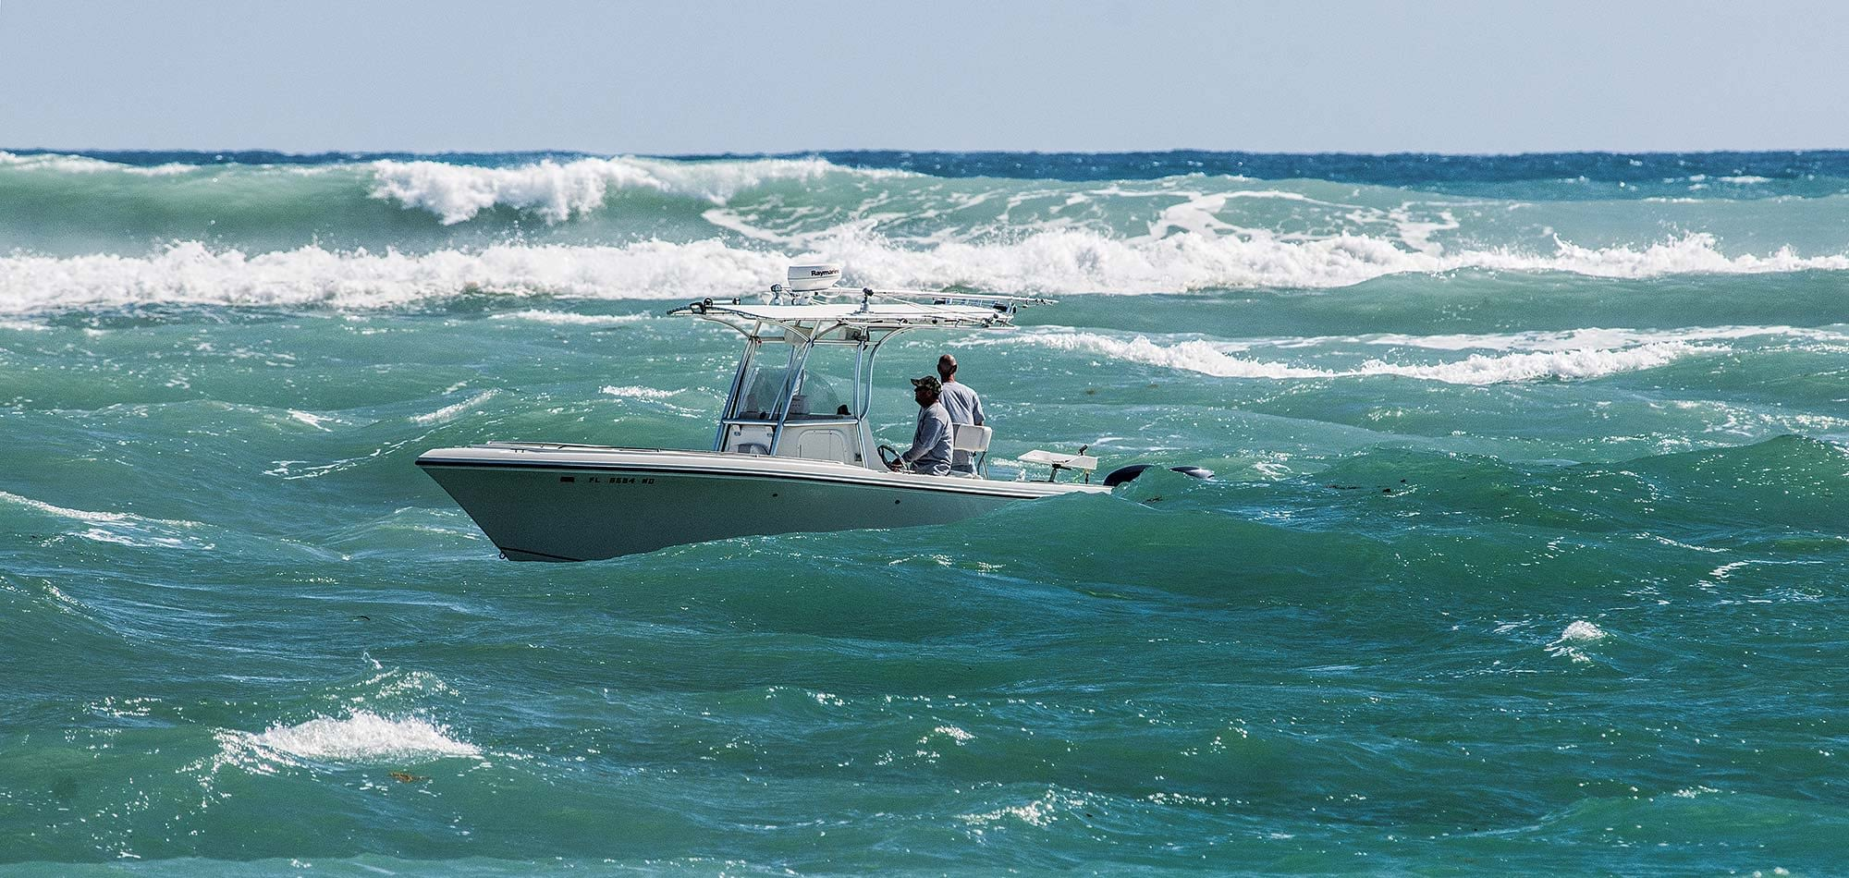
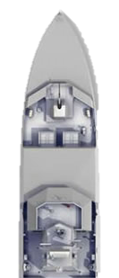
Real data
Live video
Live IMU data
Additionally
Wind sensor data
Thrust (ASV)
Challenges
Find optimal fps
Objects in images
Stabilization
Noise
…

Slide 8
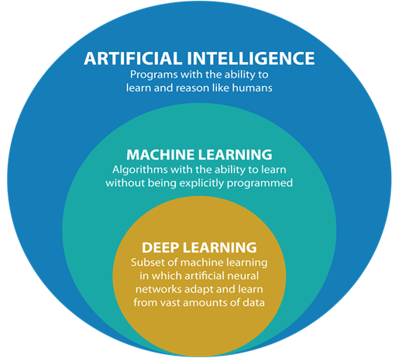
Deep learning

Slide 9
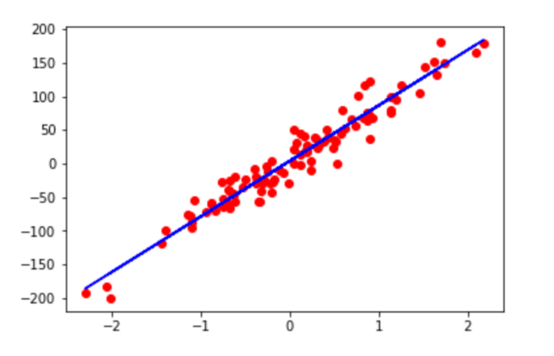
Deep learning
w
b
x
Y
Neural networks
Layers of neurons
Neurons learn
Weight (w)
Bias (b)
Y = w*x + b

Slide 10
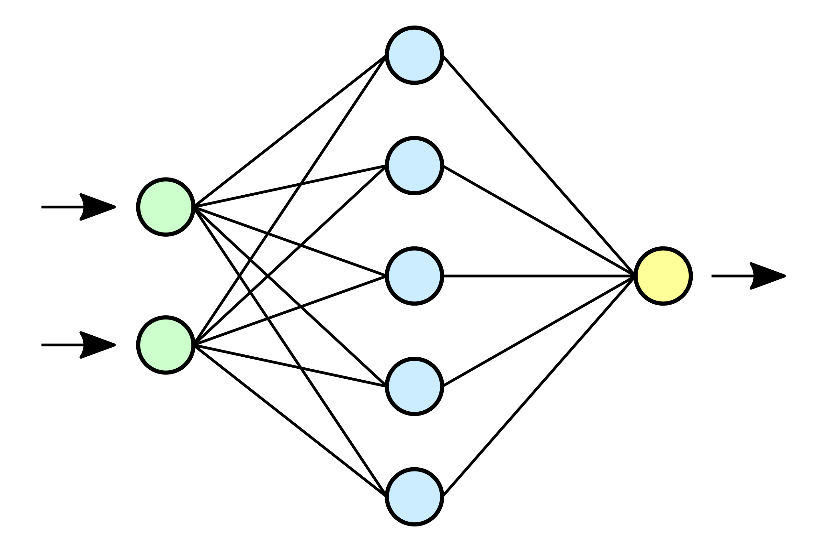

Deep learning
Predicted sequence
IMU data
Input
Output
Hidden

Slide 11
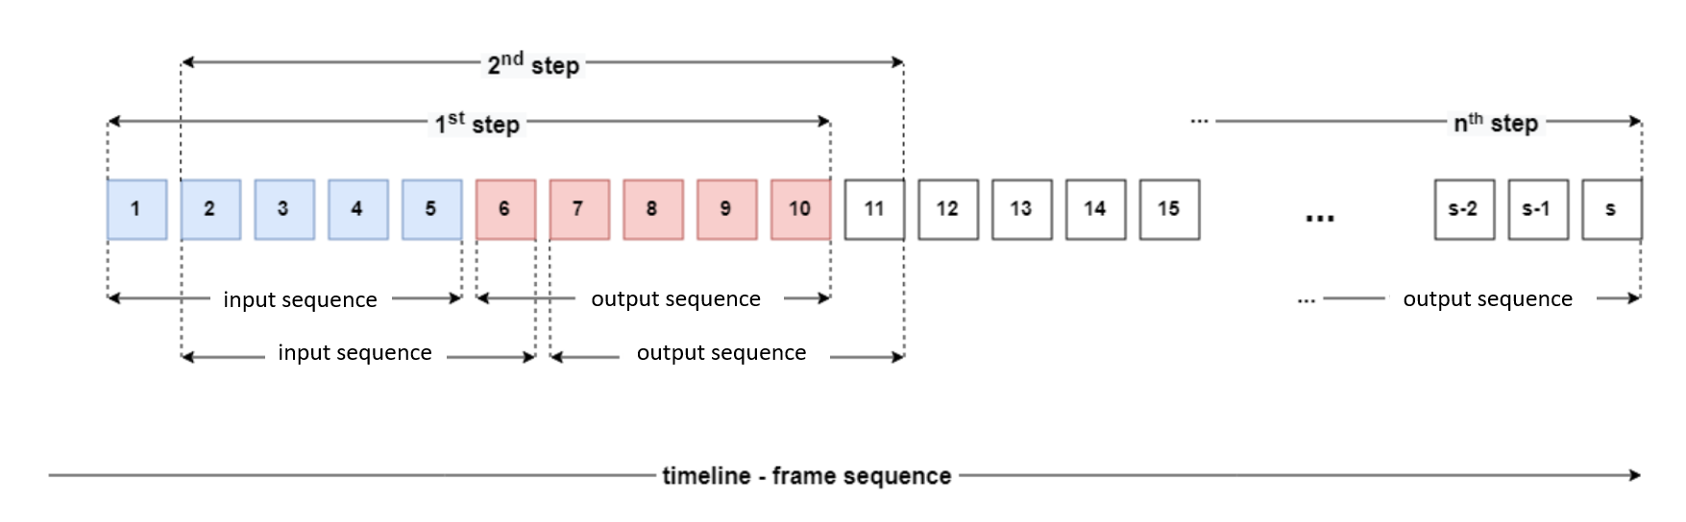
Deep learning

Slide 12
Deep learning models
Continuous data -> linear regression
<-> logistic regression
Sequences -> LSTM
Feedback connections
Images -> CNN
Moving image kernels
https://setosa.io/ev/image-kernels/
=> Together strong

Slide 13
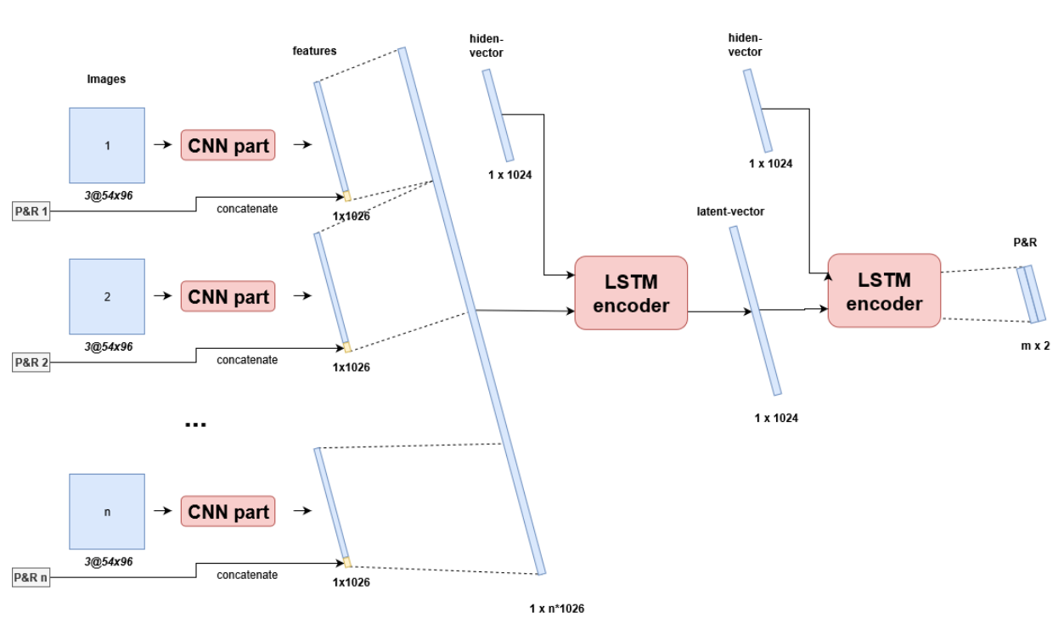

Slide 14
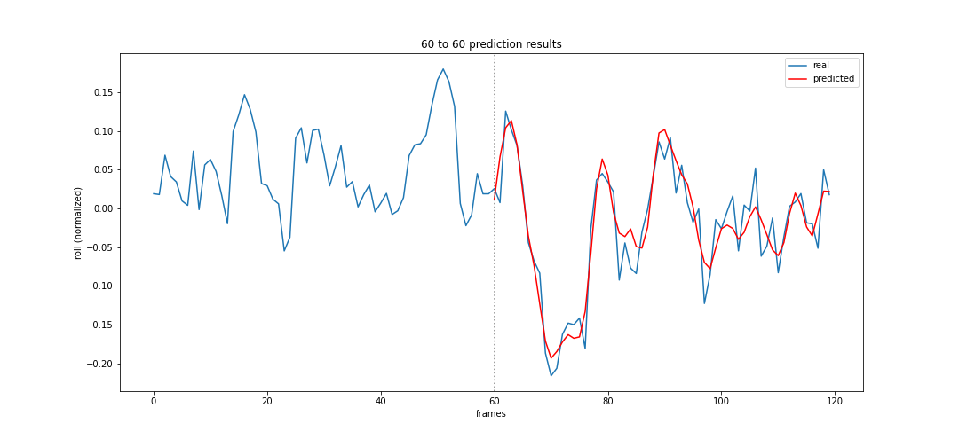
Some results

Slide 15
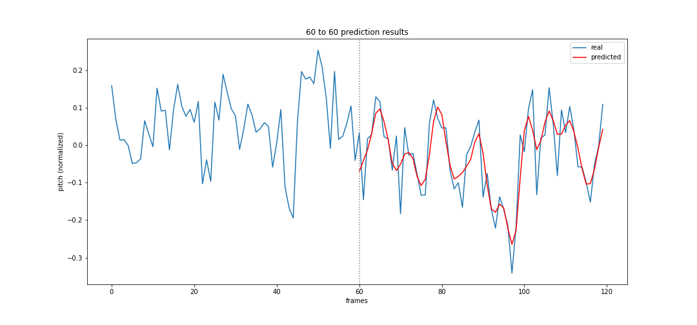
Some results

Slide 16
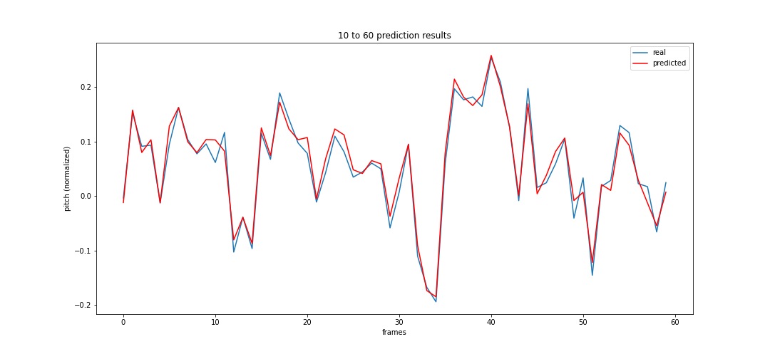
Some results

Slide 17
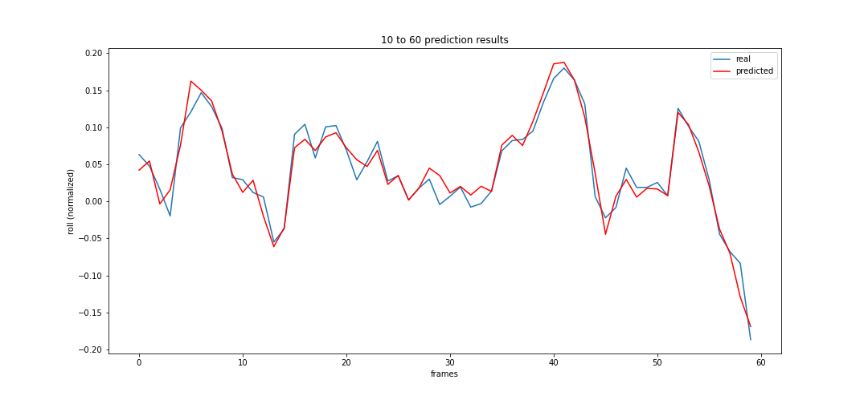
Some results

Slide 18
Some results
MODEL (input/output) | Avg. PITCH error (°) | Avg. ROLL error (°)
60/60 LSTM | 2.23° | 1.96°
10/60 LSTM | 5.18° | 4.66°
10/60 CNN-LSTM | 1.51° | 1.46°
10/60 Zero | 6.33° | 7.43°

Slide 19
Questions

