Slide 1
Ship motion prediction with IMU-data and images
Lance De Waele
Supervisors:
Prof. dr. ir. Hiep Luong
Prof. dr. ir. Jan Aelterman
Counselors:
Charles Hamesse
Ir. Tien-Thanh Nguyen (Royal Military Academy)
Dr. ir. Benoit Pairet (Royal Military Academy)

Slide 2
Contents
Introduction
Goal & Incentive
Data
Deep learning
Proposed models
Results
Conclusion

Slide 3

Introduction
Royal Military Academy
Robotics & Autonomous Systems lab
MarLand
Developing an autonomous drone
Vertical Take-off and Landing (VTOL) on Belgian navy vessels
Notes:
The Robotics & Autonomous Systems lab is a research unit of the department of Mechanics of the Belgian Royal Military Academy.

Slide 4
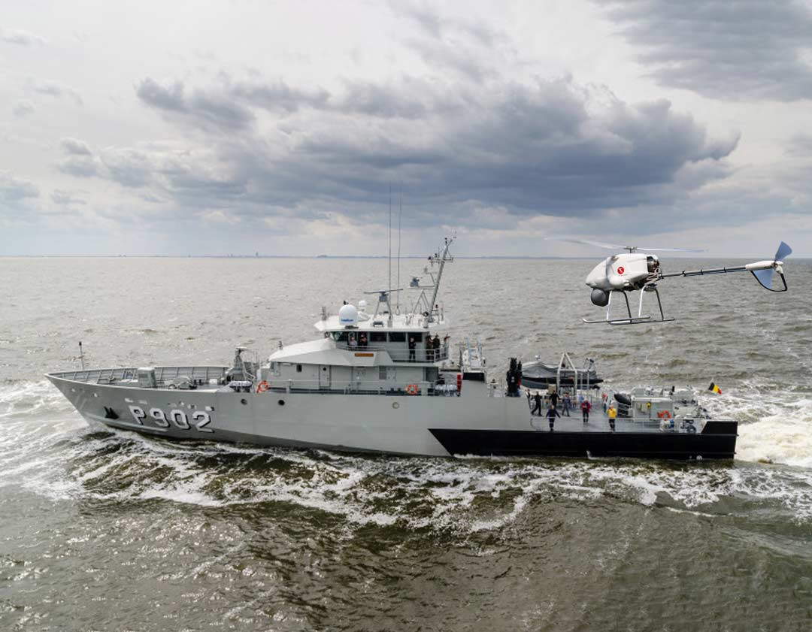
Goal & Method
Safe VTOL procedures:
Drone and surroundings
Landing deck stabile and level
Minimize impact
Predict motion of the vessel
Anticipate movements
Requirements:
Optimized for application
Minimum 30 seconds
Low latency & HW requirements

Slide 5
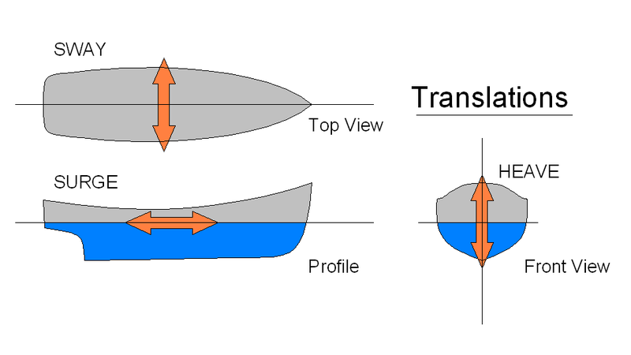
Ship Motion
Six degrees of freedom (DoF)
Translational
Sway
Surge
Heave

Slide 6
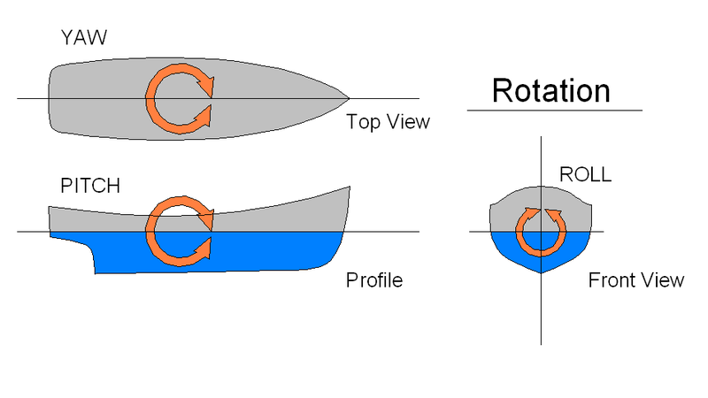
Ship Motion
Six degrees of freedom (DoF)
Translational
Sway
Surge
Heave
Rotational
Yaw
Pitch
Roll

Slide 7
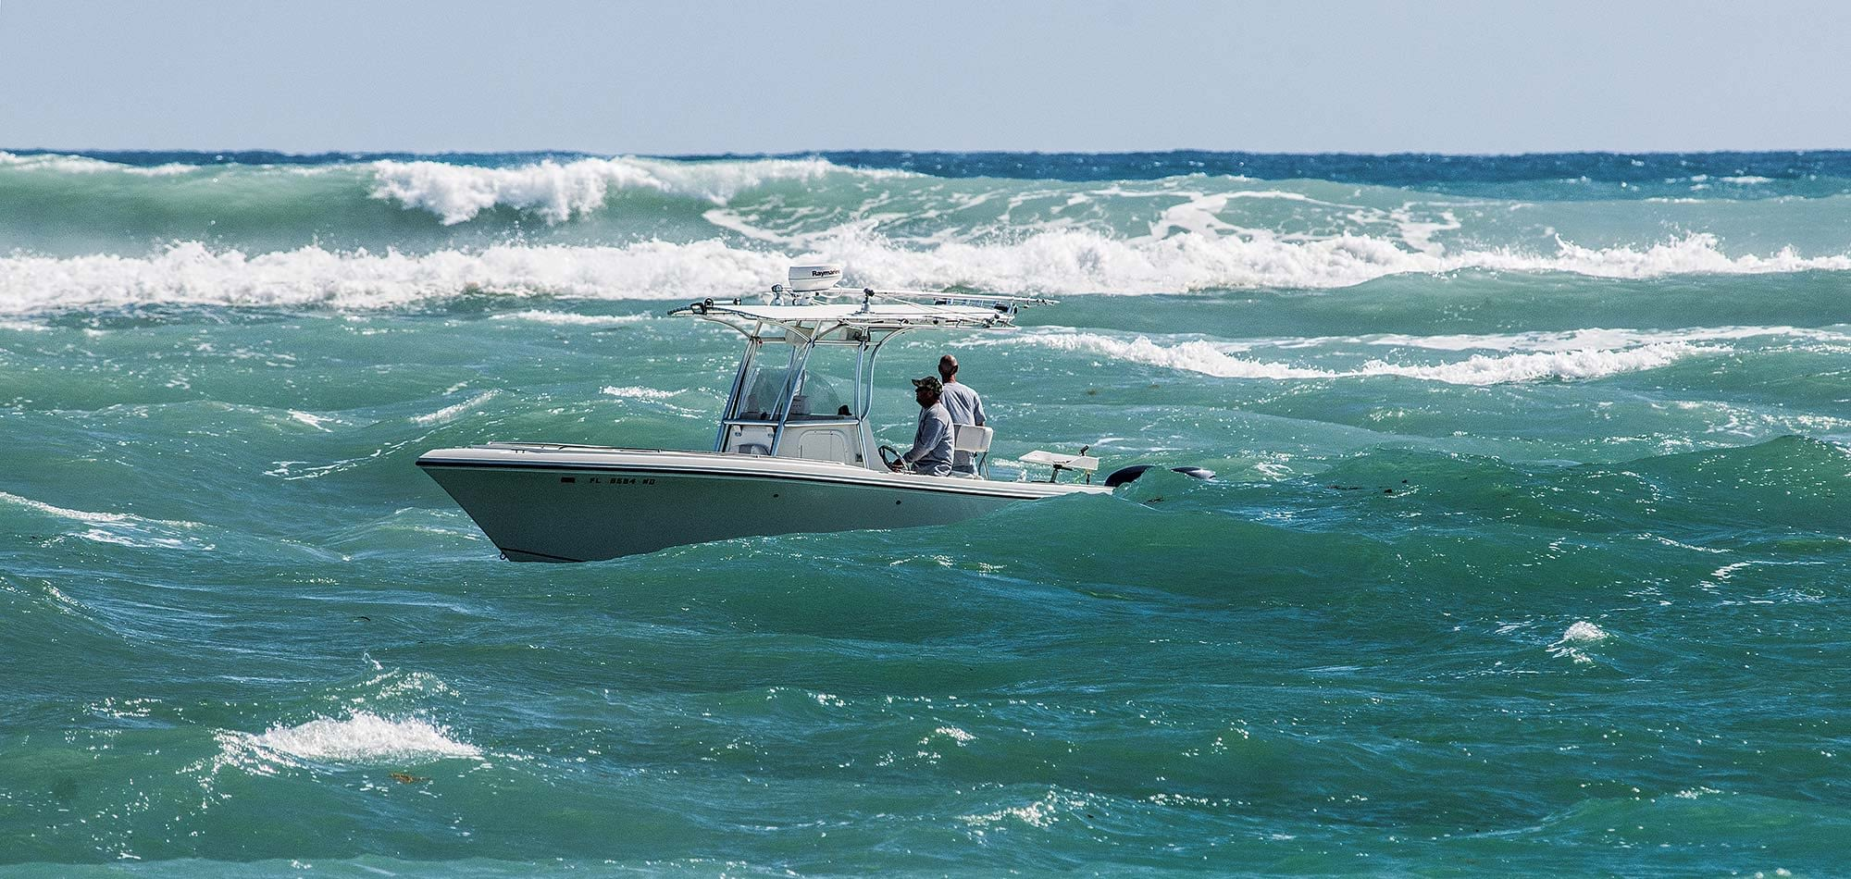
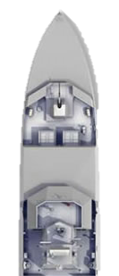
Conditions
Inertial Measurement Unit (IMU)
Translational
Rotational
Stereo Camera
Incoming waves

Slide 8
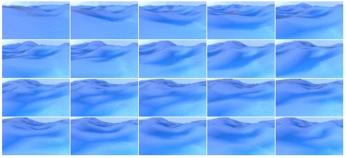
Simulated data
540 episodes of 400 images
Rendered at 2 frames/second (2Hz)
Overlap, processing demand
Aliasing <-> Accuracy
30 hours of simulation
Resolution 96x54
Pitch & Roll (PR) per image
No heave?
₁Source: https://github.com/Nazotron1923/ship-ocean_simulation_BLENDER
Notes:
Why only pitch and roll is enough:
Drone has large range of motion in heave but very small window in vertical hover pitch and roll
Lightweight drone with low inertia/high thrust can heave up/down based on measurements in real time

Slide 9
Properties
Property | Pitch | Roll
Count | 216.000 | 216.000
Mean | 0,07° | 0,30°
Median | 0,03° | 0,23°
st. dev. | 6,6° | 7,1°
Min | -53,7° | -58,8°
Max | 61,3° | 62,2°
Notes:
First, count: 540 episodes, each with 400 frames equals to 216k total images
Second, mean and median are equal, near zero
Third, stdev from roll is slightly higher than pitch => more spread-out values
Minimum and maximum similar and

Slide 10
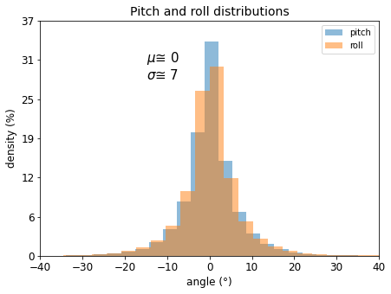
Properties
216.000
99.7% : µ ± 3σ ≈ [-20°, 20°]
Notes:
Both pitch and roll are normally distributed, 99.7% in interval [-20°, 20°]

Slide 11
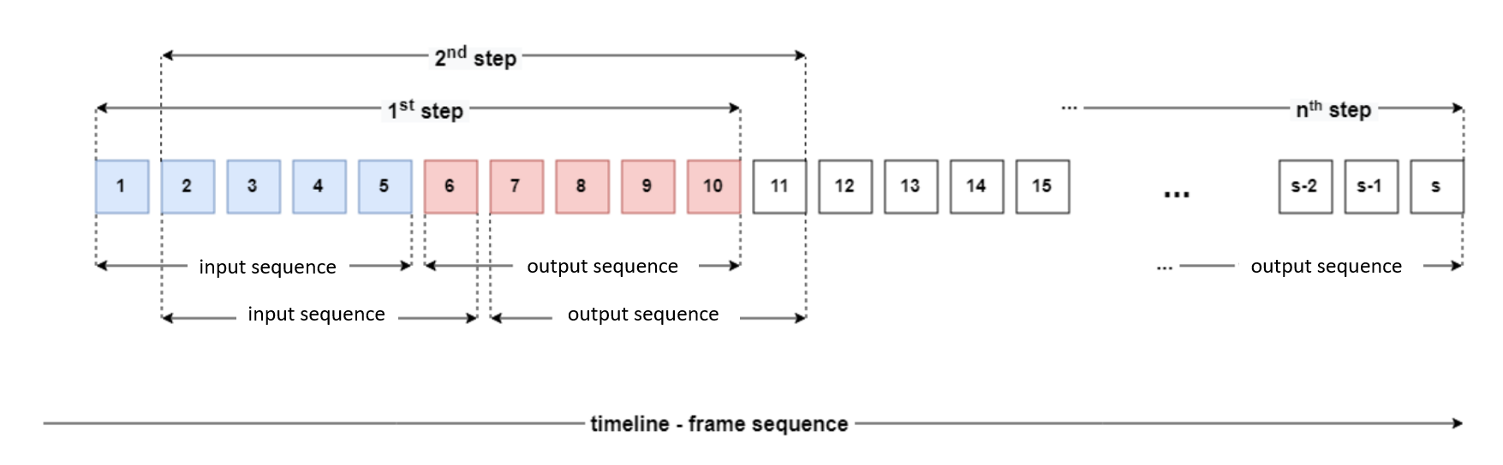
Pre-processing

Slide 12
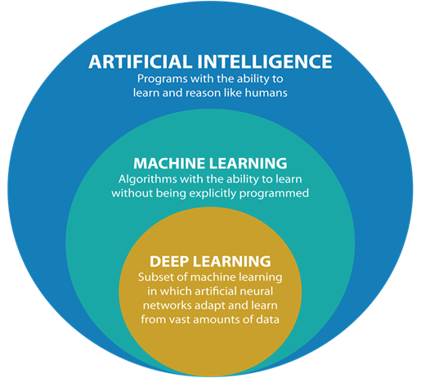
Deep learning

Slide 13
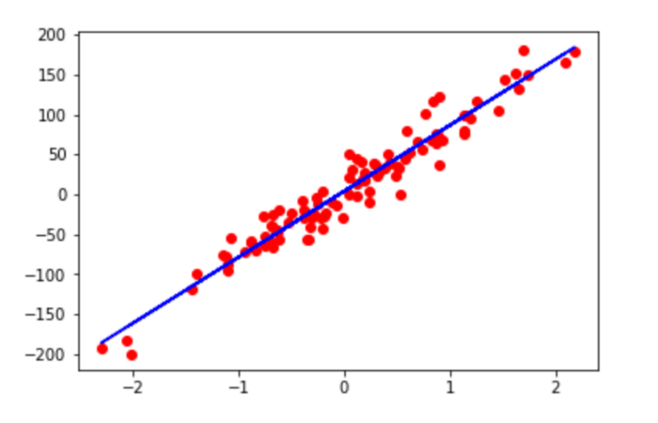

Deep learning
$$wx+b$$
x
Y
Neural networks
Layers of neurons
Neurons learn
Weight (w)
Bias (b)
Y = wx + b

Slide 14
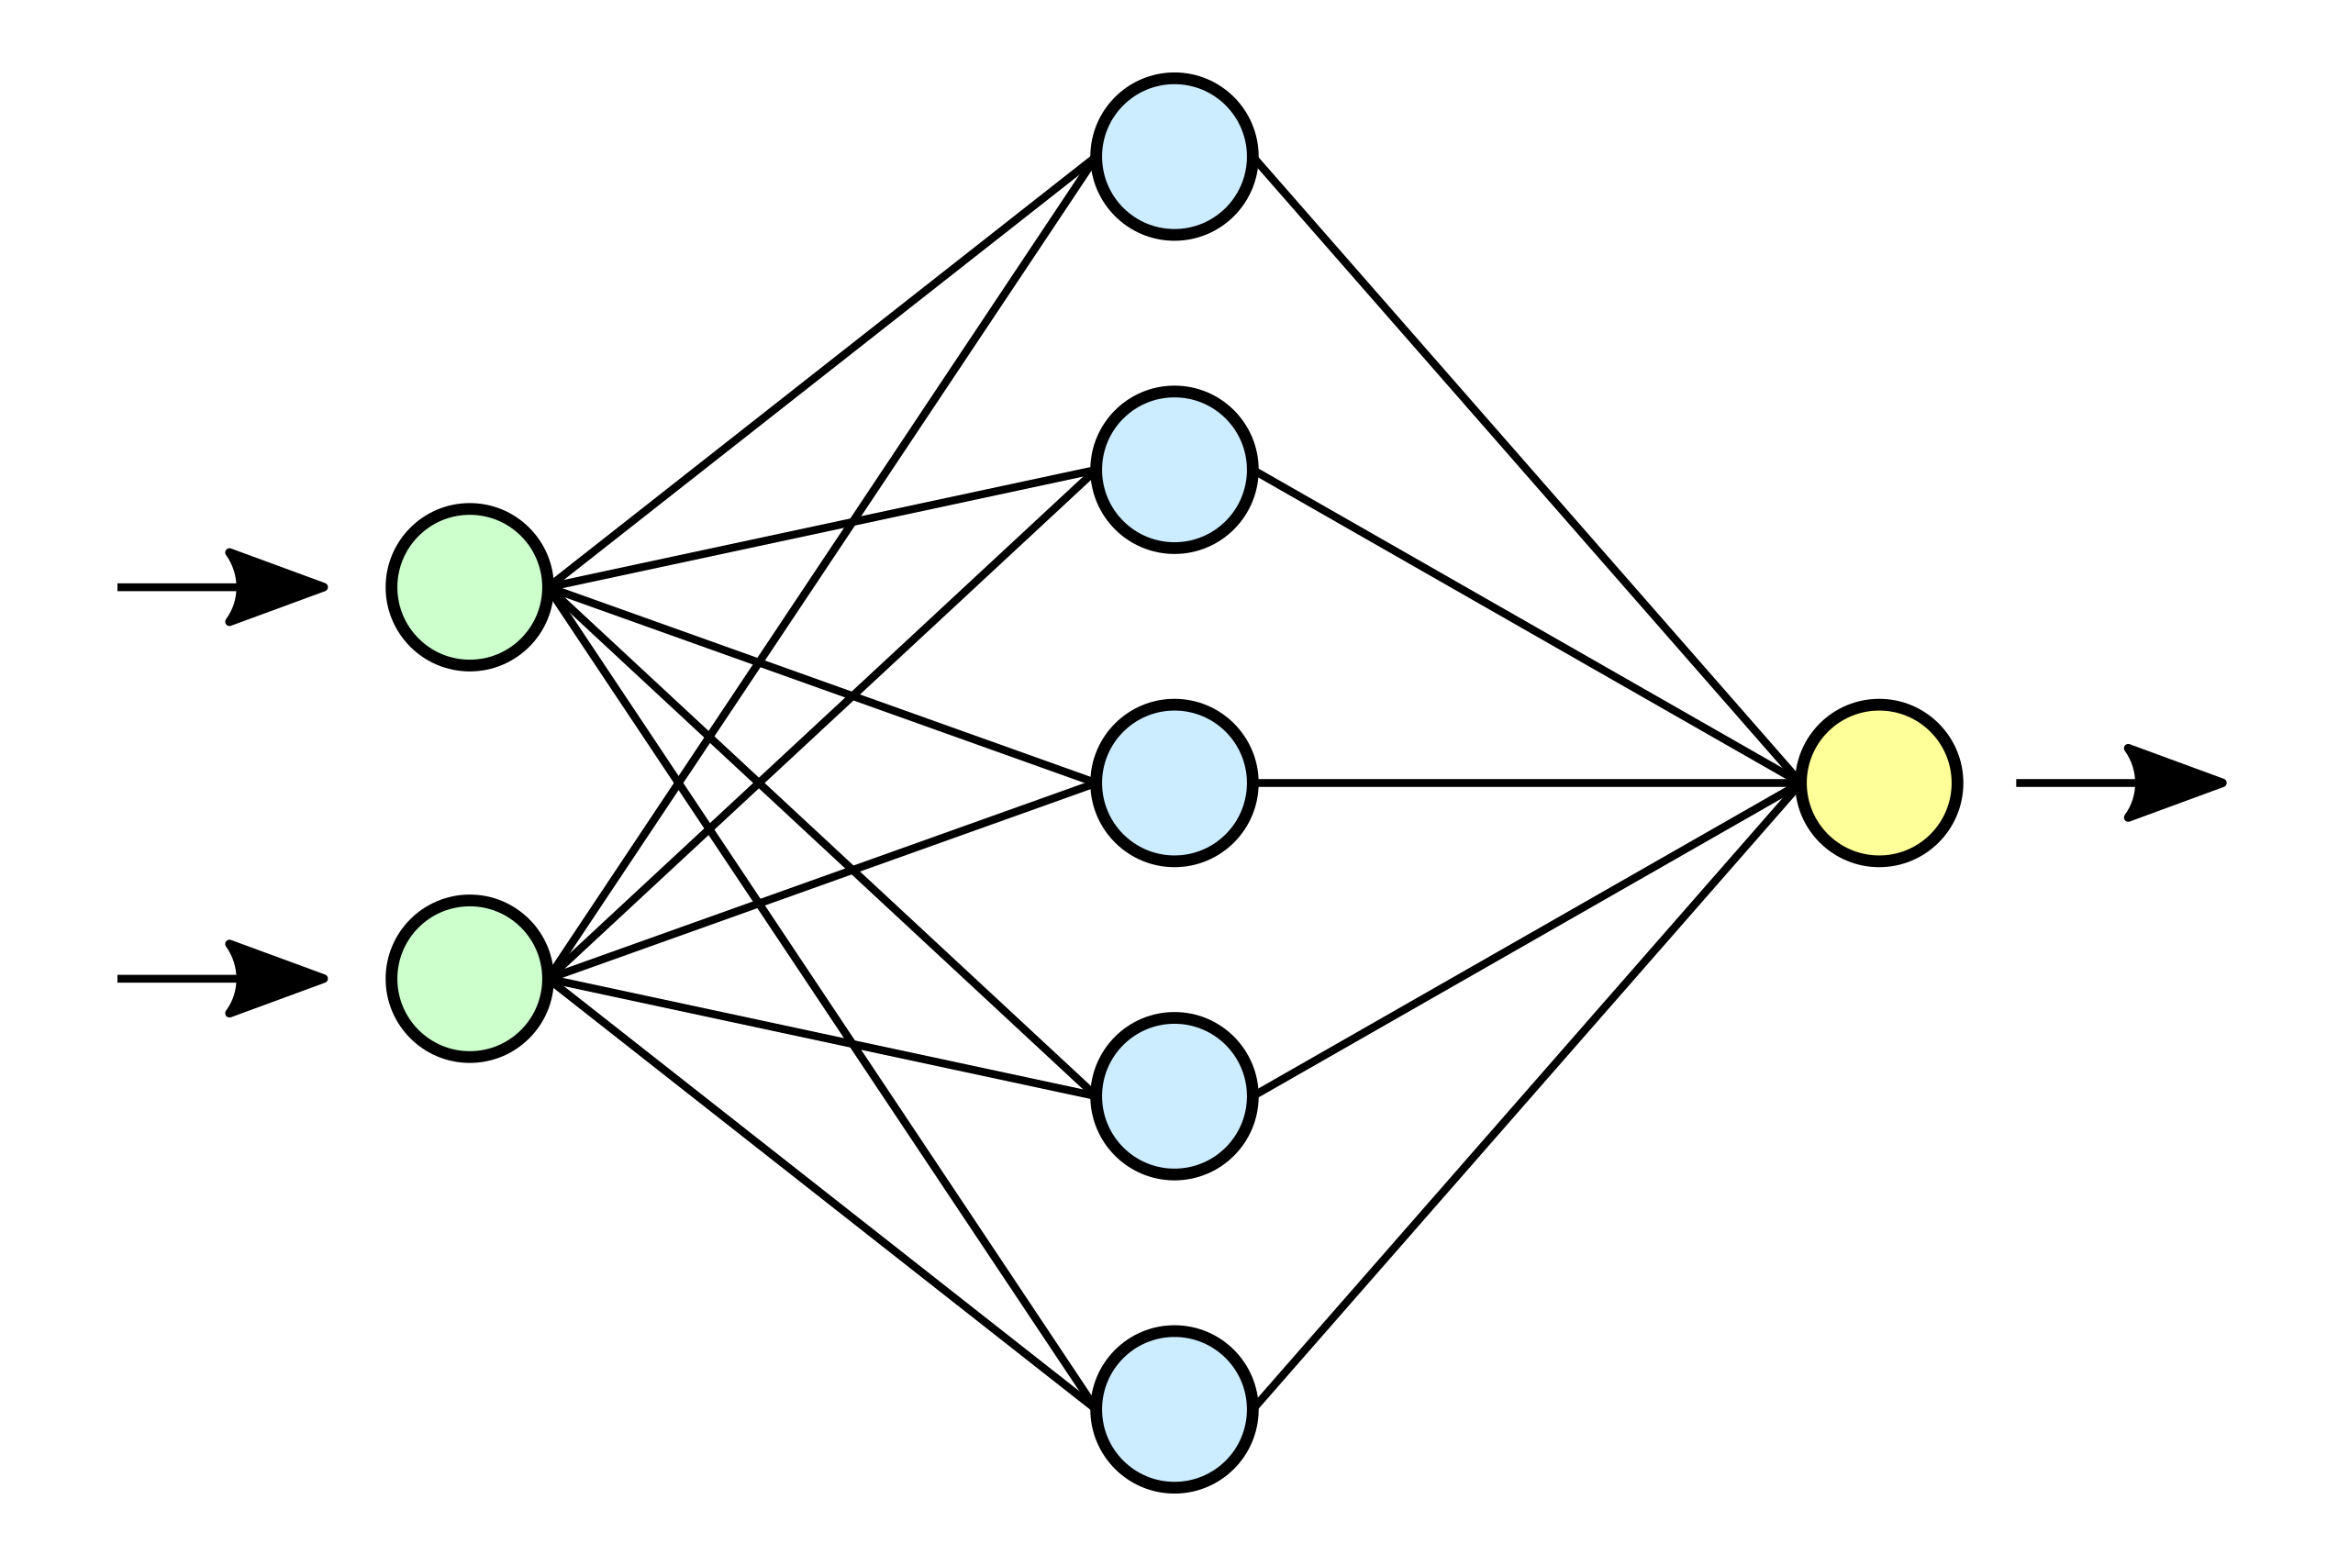

Deep learning
Predicted sequence
IMU data
Input
Output
Hidden

Slide 15
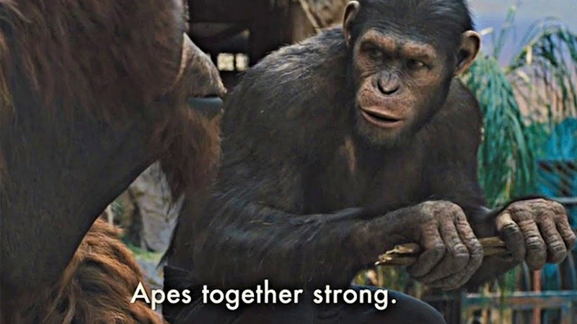
Neural network architectures
Continuous data -> linear regression
<-> logistic regression
Time series data -> LSTM
Feedback connections
Images -> CNN
Moving image kernels

Slide 16
Optimal architecture?
Inputs ?
Hidden layers ?
Hyperparameters ?
Input
Output
Hidden

Slide 17
Proposed models

Slide 18
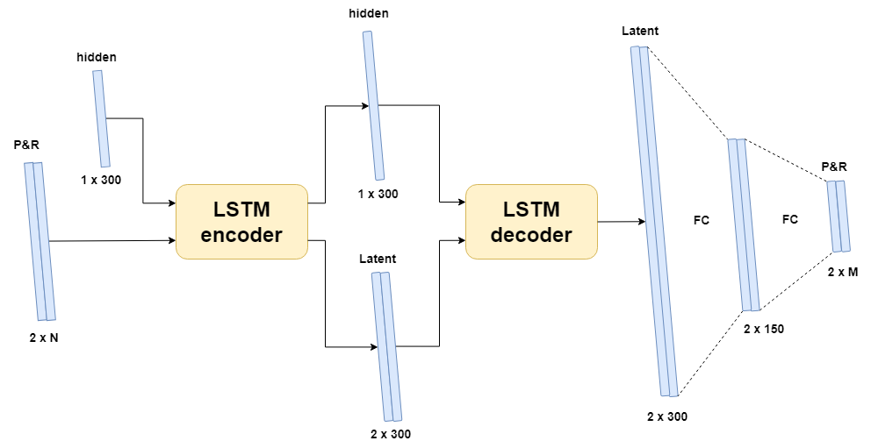
Encoder-Decoder LSTM
Notes:
No images

Slide 19
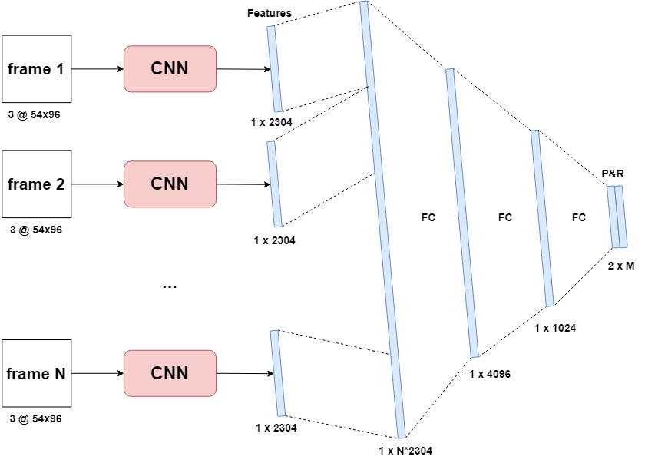
Sequential CNN
Notes:
No PR

Slide 20
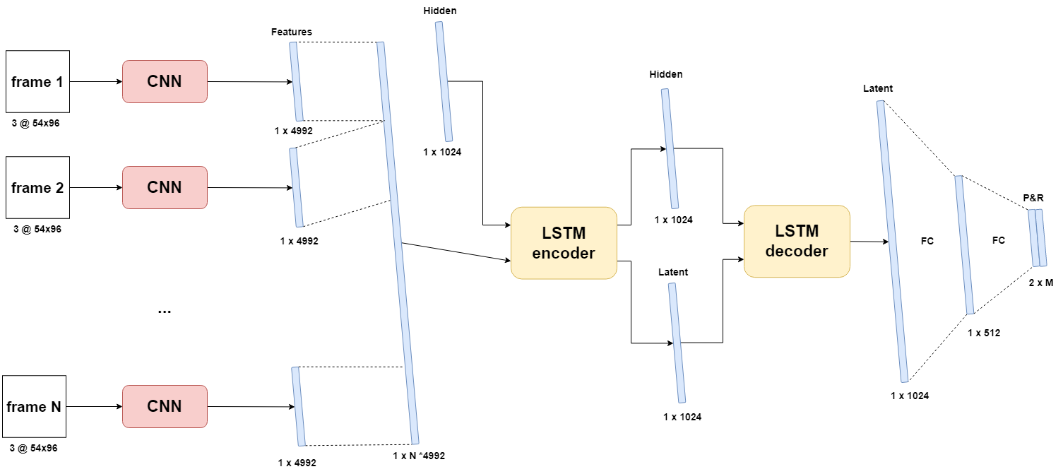
CNN-LSTM [img]

Slide 21
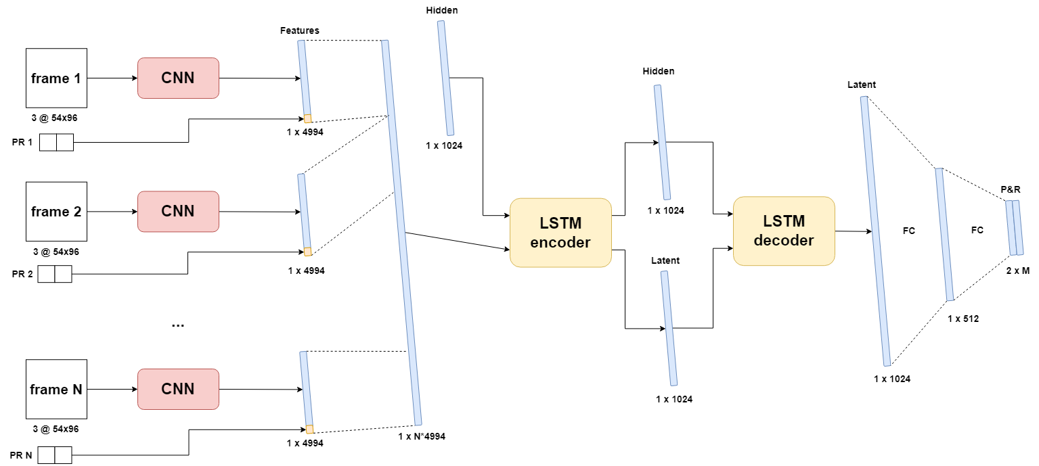
CNN-LSTM [img+PR]
Notes:
Also, img only

Slide 22
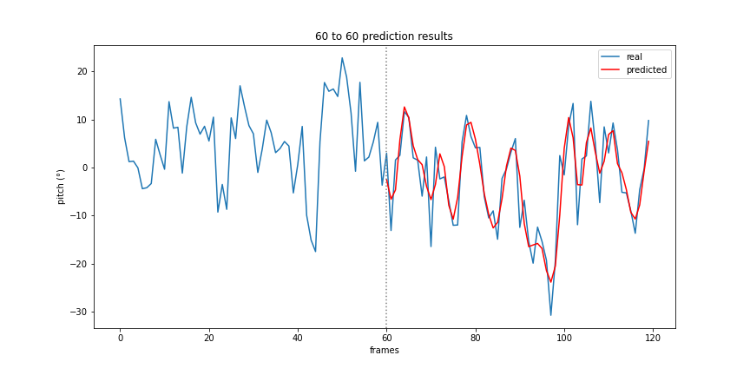
Encoder-Decoder LSTM
Notes:
Encoder decoder LSTM, consistent accuracy

Slide 23
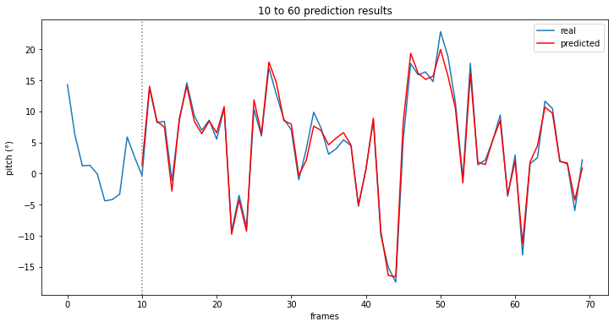
LSTM CNN [img-PR]
Notes:
IMG PR LSTM CNN

Slide 24
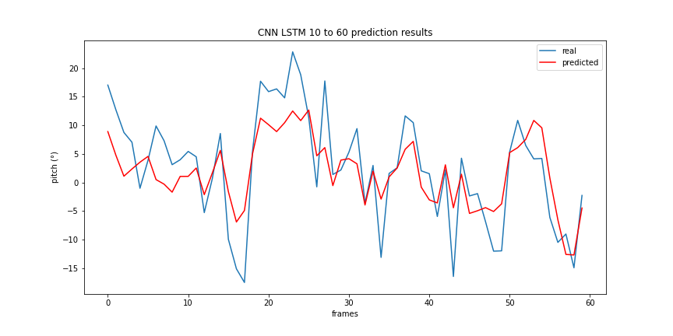
Sequential CNN
Notes:
Sequential CNN

Slide 25
Optimized results
Model name | IO-ratio | Inference time | Avg. PR error | Trainable parameters
Encoder-Decoder LSTM* | 120/60 | 155ms | 2° | 1.211.010
Sequential CNN | 10/30 | 4.203ms | 5,79° | 98.639.180
CNN LSTM [img] | 10/120 | 4.042ms | 1,73° | 217.659.752
CNN LSTM [img] (gray) | 10/120 | 3.545ms | 1,71° | 217.659.352
CNN LSTM [img-PR] | 10/120 | 4.453ms | 1,72° | 217.741.672
CNN LSTM [img-PR] (gray) | 10/120 | 3.797ms | 1,81° | 217.741.272

Slide 26
Optimized results
Model name | IO-ratio | Inference time | Avg. PR error | Trainable parameters
Encoder-Decoder LSTM* | 120/60 | 155ms | 2° | 1.211.010
Sequential CNN | 10/30 | 4.203ms | 5,79° | 98.639.180
CNN LSTM [img] | 10/120 | 4.042ms | 1,73° | 217.659.752
CNN LSTM [img] (gray) | 10/120 | 3.545ms | 1,71° | 217.659.352
CNN LSTM [img-PR] | 10/120 | 4.453ms | 1,72° | 217.741.672
CNN LSTM [img-PR] (gray) | 10/120 | 3.797ms | 1,81° | 217.741.272
Notes:
Up to 120 second prediction, low 10% relative error, good inference time

Slide 27
Optimized results
Model name | IO-ratio | Inference time | Avg. PR error | Trainable parameters
Encoder-Decoder LSTM* | 120/60 | 155ms | 2° | 1.211.010
Sequential CNN | 10/30 | 4.203ms | 5,79° | 98.639.180
CNN LSTM [img] | 10/120 | 4.042ms | 1,73° | 217.659.752
CNN LSTM [img] (gray) | 10/120 | 3.545ms | 1,71° | 217.659.352
CNN LSTM [img-PR] | 10/120 | 4.453ms | 1,72° | 217.741.672
CNN LSTM [img-PR] (gray) | 10/120 | 3.797ms | 1,81° | 217.741.272
Notes:
Suffers from not having LSTM, high inference time, low IO still high error

Slide 28
Optimized results
Model name | IO-ratio | Inference time | Avg. PR error | Trainable parameters
Encoder-Decoder LSTM* | 120/60 | 155ms | 2° | 1.211.010
Sequential CNN | 10/30 | 4.203ms | 5,79° | 98.639.180
CNN LSTM [img] | 10/120 | 4.042ms | 1,73° | 217.659.752
CNN LSTM [img] (gray) | 10/120 | 3.545ms | 1,71° | 217.659.352
CNN LSTM [img-PR] | 10/120 | 4.453ms | 1,72° | 217.741.672
CNN LSTM [img-PR] (gray) | 10/120 | 3.797ms | 1,81° | 217.741.272
Notes:
Gray, little improvement in accuracy, high latency for all, much better with lstm

Slide 29
Conclusion
Images contribute to …
Marginal increase in accuracy
Significant increase in latency
Prone to occlusion/obstructions
LSTM module is crucial
Encoder-Decoder LSTM is the optimal model
Up to 120 seconds
2° error on average
Consistent & equal accuracy

Slide 30
Future work

Slide 31
Real data
Video + IMU data (ZED-mini)
Additional inputs
Angular velocity
Wind speed/direction
Thrust
Challenges:
Optimal sample rate
Objects in images
Stabilization
Noise

Slide 32
Questions

