Slide 1
Ship motion prediction with IMU-data and images
Lance De Waele
Supervisors: Prof. dr. ir. Hiep Luong, Prof. dr. ir. Jan Aelterman
Counsellors: Charles Hamesse, Ir. Tien-Thanh Nguyen (Royal Military Academy), Dr. ir. Benoit Pairet (Royal Military Academy)

Slide 2
Contents
Introduction
Goal & Incentive
Data
Deep learning
Proposed models
Results
Conclusion

Slide 3
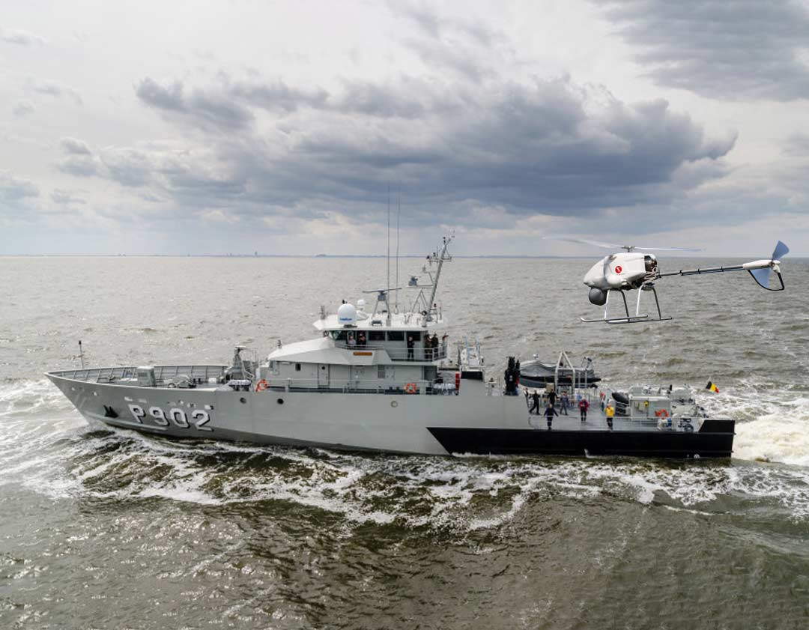
Introduction
Royal Military Academy
Robotics & Autonomous Systems lab
MarLand
Developing an autonomous drone
Vertical Take-off and landing (VTOL) on moving vessels
Notes:
The Robotics & Autonomous Systems lab is a research unit of the department of Mechanics of the Belgian Royal Military Academy.

Slide 4
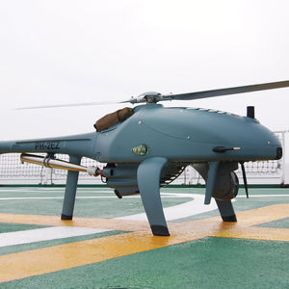
Goal & Method
Safe VTOL procedures:
Drone and surroundings
Landing deck stabile and level
Minimize impact
Predict the motion of the vessel
Anticipate movements
Requirements:
Optimized for application
Minimum 30 seconds
Low latency & HW requirements

Slide 5
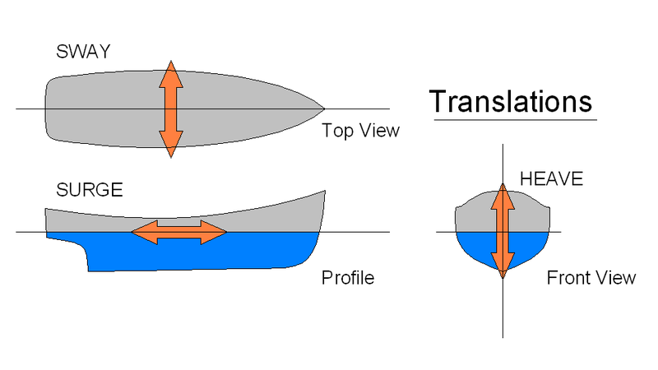
Ship Motion
Six degrees of freedom (DoF)
Translational
Sway
Surge
Heave

Slide 6
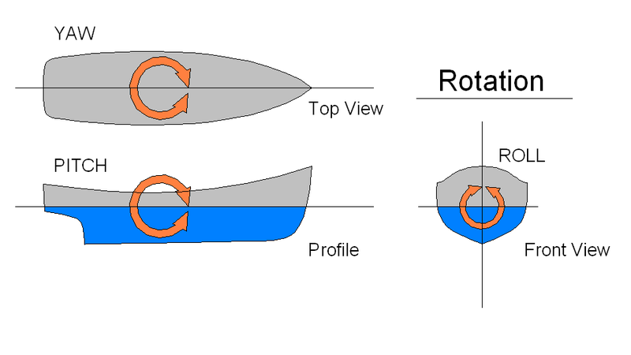
Ship Motion
Six degrees of freedom (DoF)
Translational
Sway
Surge
Heave
Rotational
Yaw
Pitch
Roll

Slide 7
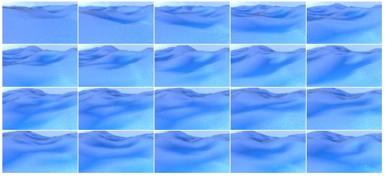
Simulated data
540 episodes of 400 images
Rendered at 2 frames/second (2Hz)
Overlap, processing demand
Aliasing <-> Accuracy
30 hours of simulation
Resolution 96x54
Pitch & Roll (PR) per image
No heave?
₁Source: https://github.com/Nazotron1923/ship-ocean_simulation_BLENDER
Notes:
Why only pitch and roll is enough:
Drone has large range of motion in heave but very small window in vertical hover pitch and roll
Lightweight drone with low inertia/high thrust can heave up/down based on measurements in real time

Slide 8
Properties
Property | Pitch | Roll
count | 216.000 | 216.000
mean | 0,07° | 0,30°
standard deviation | 6,6° | 7,1°
minimum | -53,7° | -58,8°
25% | -2,7° | -2,6°
50% | 0,03° | 0,23°
75% | 2,8° | 3,2°
maximum | 61,3° | 62,2°
Notes:
First, count: 540 episodes, each with 400 frames equals to 216k total images
Second, mean and median are equal, near zero
Third, stdev from roll is slightly higher than pitch => more spread-out values
Minimum and maximum similar and

Slide 9
Properties
Property | Pitch | Roll
count | 216.000 | 216.000
mean | 0,07° | 0,30°
standard deviation | 6,6° | 7,1°
minimum | -53,7° | -58,8°
25% | -2,7° | -2,6°
50% | 0,03° | 0,23°
75% | 2,8° | 3,2°
maximum | 61,3° | 62,2°
400 frames/episode * 540 episodes
Notes:
First, count: 540 episodes, each with 400 frames equals to 216k total images
Second, mean and median are equal, near zero
Third, stdev from roll is slightly higher than pitch => more spread-out values
Minimum and maximum similar and

Slide 10
Properties
Property | Pitch | Roll
count | 216.000 | 216.000
mean | 0,07° | 0,30°
standard deviation | 6,6° | 7,1°
minimum | -53,7° | -58,8°
25% | -2,7° | -2,6°
50% | 0,03° | 0,23°
75% | 2,8° | 3,2°
maximum | 61,3° | 62,2°
Notes:
First, count: 540 episodes, each with 400 frames equals to 216k total images
Second, mean and median are equal, near zero. Ship naturally wants to remain upright, symmetrical distributions
Third, stdev from roll is slightly higher than pitch => more spread-out values
Minimum and maximum similar and

Slide 11
Properties
Property | Pitch | Roll
count | 216.000 | 216.000
mean | 0,07° | 0,30°
standard deviation | 6,6° | 7,1°
minimum | -53,7° | -58,8°
25% | -2,7° | -2,6°
50% | 0,03° | 0,23°
75% | 2,8° | 3,2°
maximum | 61,3° | 62,2°
Notes:
First, count: 540 episodes, each with 400 frames equals to 216k total images
Second, mean and median are equal, near zero
Third, stdev from roll is slightly higher than pitch => more spread-out values
Minimum and maximum similar and

Slide 12
Properties
Property | Pitch | Roll
count | 216.000 | 216.000
mean | 0,07° | 0,30°
standard deviation | 6,6° | 7,1°
minimum | -53,7° | -58,8°
25% | -2,7° | -2,6°
50% | 0,03° | 0,23°
75% | 2,8° | 3,2°
maximum | 61,3° | 62,2°
Notes:
First, count: 540 episodes, each with 400 frames equals to 216k total images
Second, mean and median are equal, near zero
Third, stdev from roll is slightly higher than pitch => more spread-out values
Minimum and maximum similar and around 60: good perspective of the conditions of the vessel

Slide 13
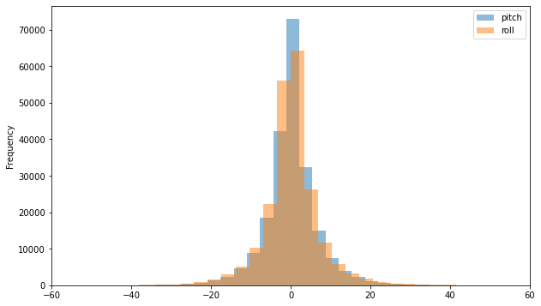
Properties
99.7% : µ ± 3σ ≈ [-20°, 20°]
Notes:
Both pitch and roll are normally distributed, 99.7% in interval [-20°, 20°]

Slide 14
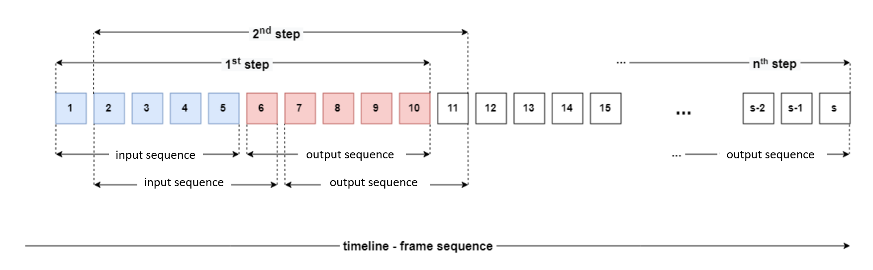
Pre-processing

Slide 15
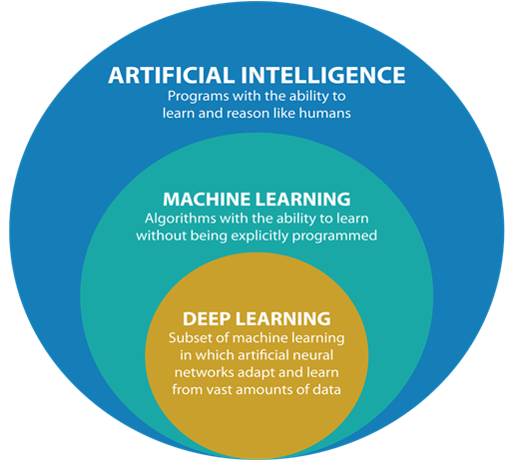
Deep learning

Slide 16
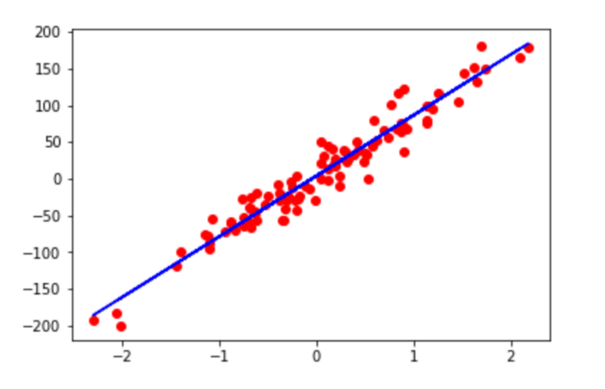

Deep learning
$$wx+b$$
x
Y
Neural networks
Layers of neurons
Neurons learn
Weight (w)
Bias (b)
Y = wx + b

Slide 17
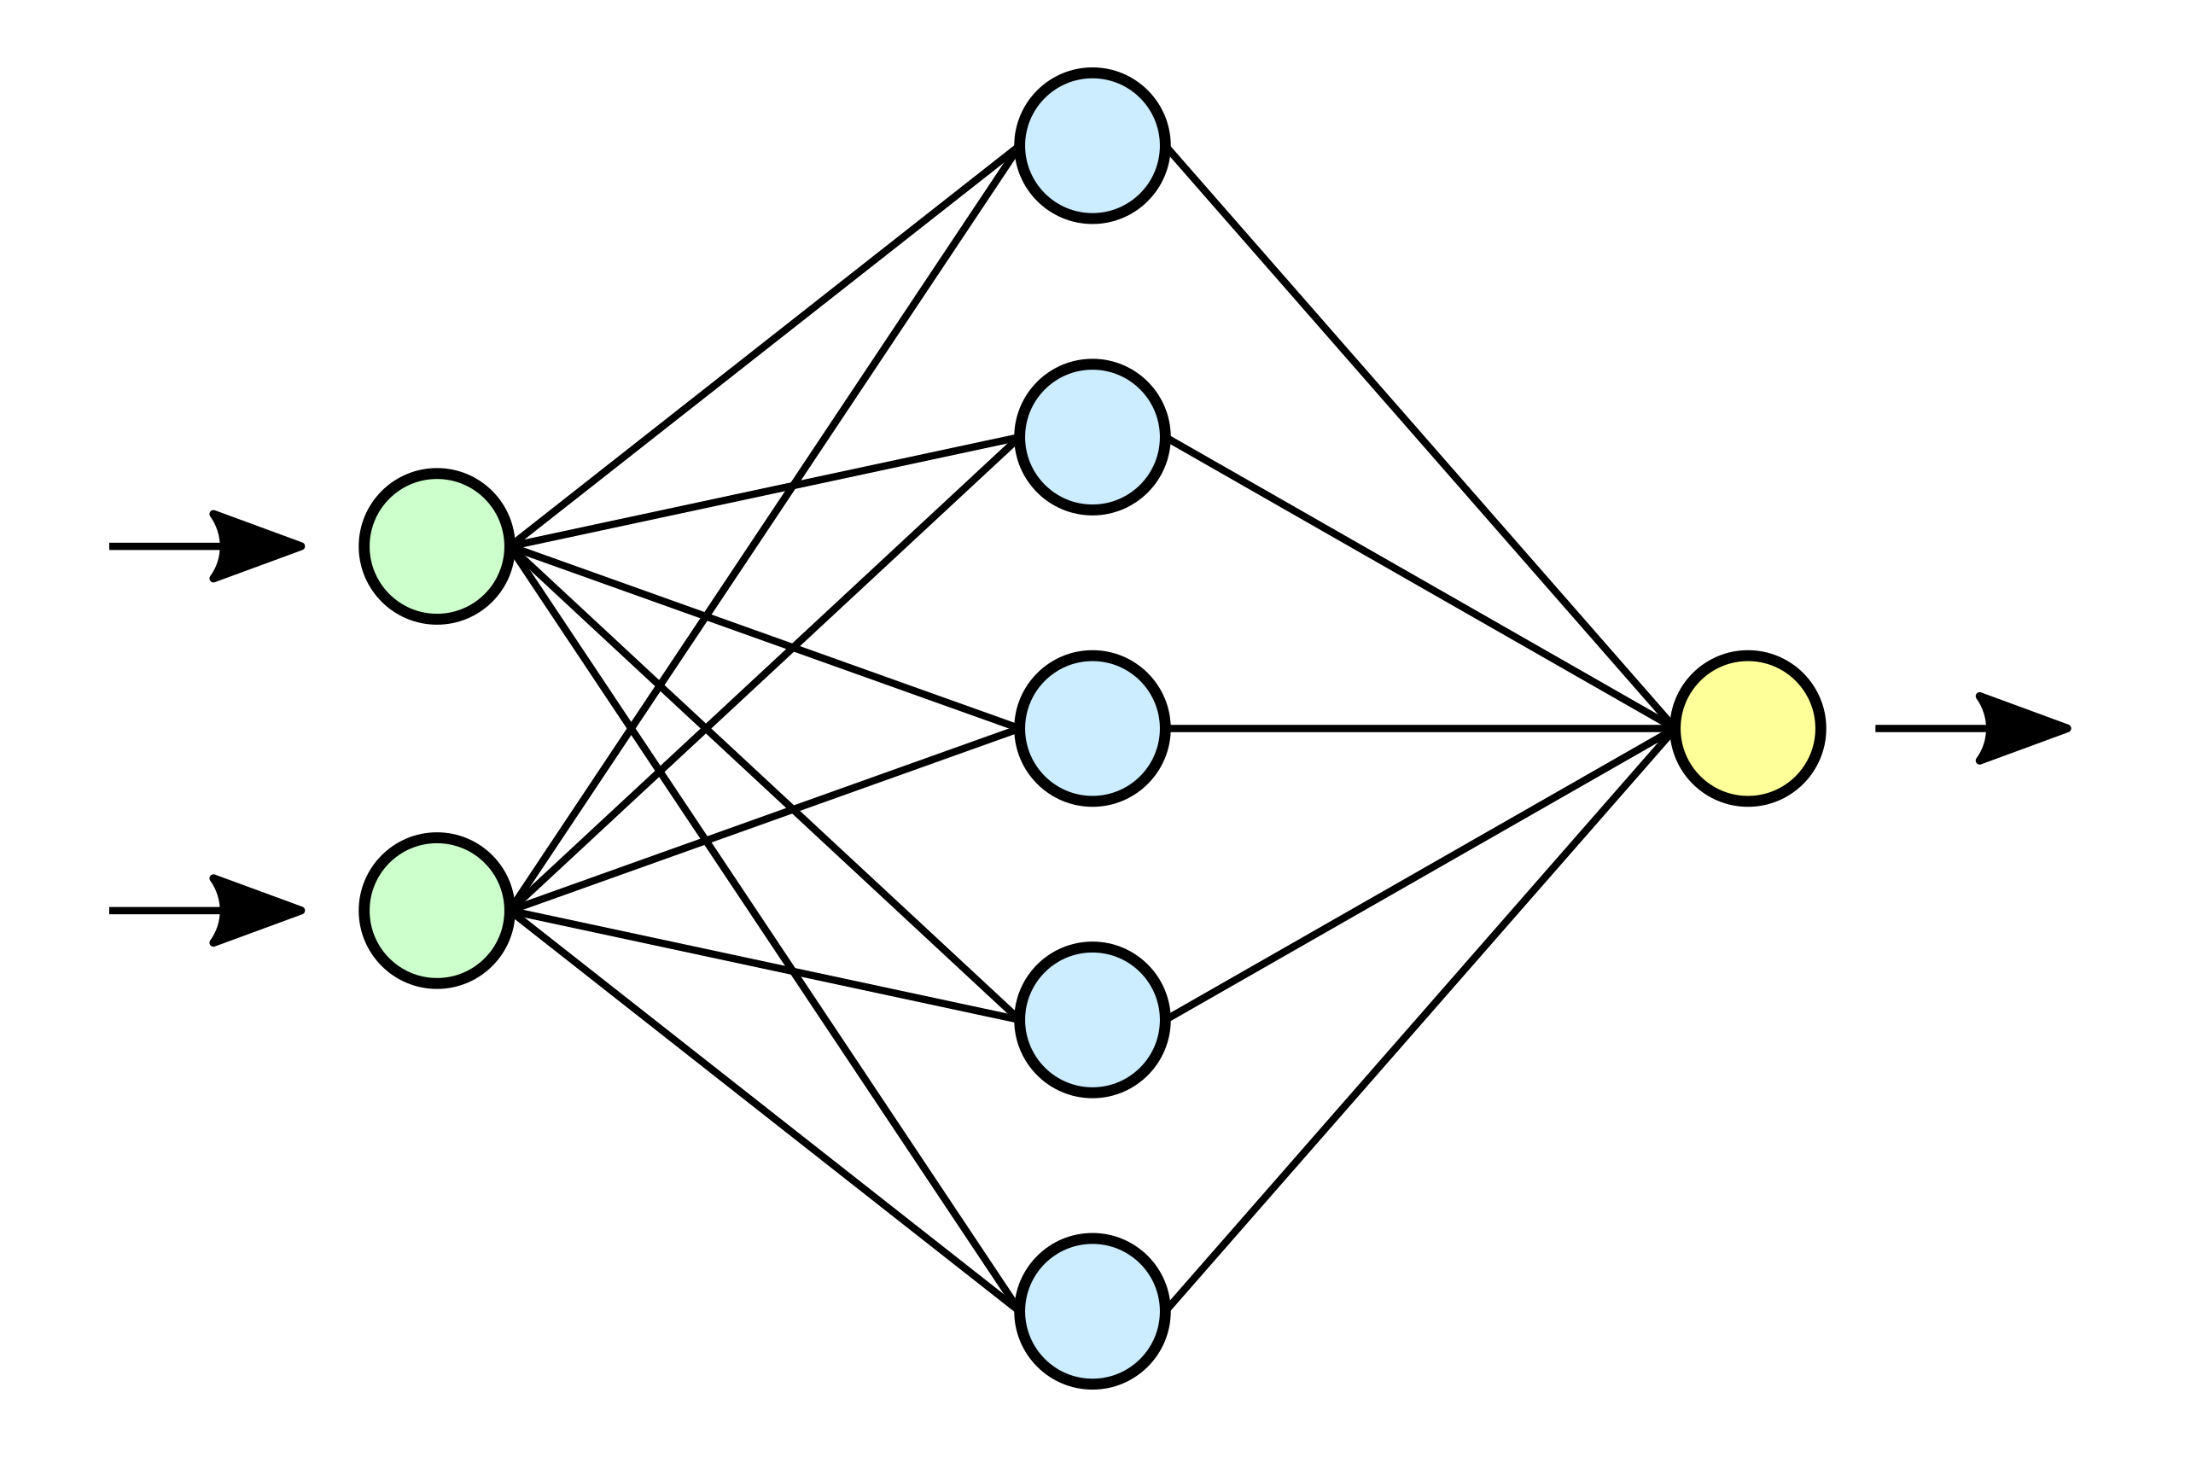

Deep learning
Predicted sequence
IMU data
Input
Output
Hidden

Slide 18
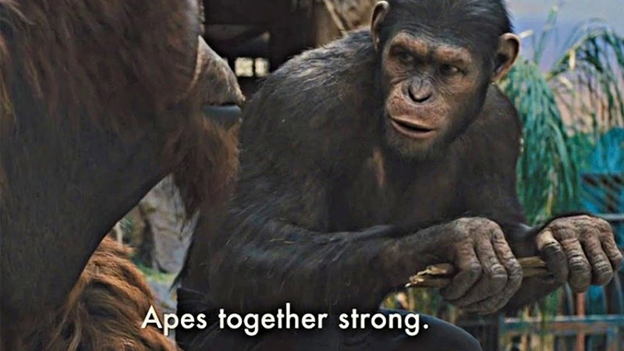
Neural network architectures
Continuous data -> linear regression
<-> logistic regression
Time series data -> LSTM
Feedback connections
Images -> CNN
Moving image kernels

Slide 19
Optimal architecture?
Inputs ?
Hidden layers ?
Hyperparameters ?
Input
Output
Hidden

Slide 20
Proposed models

Slide 21
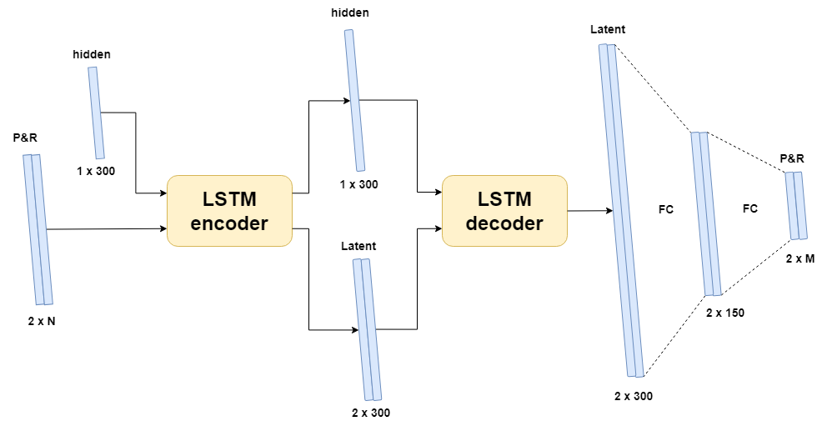
Encoder-Decoder LSTM
Notes:
No images

Slide 22
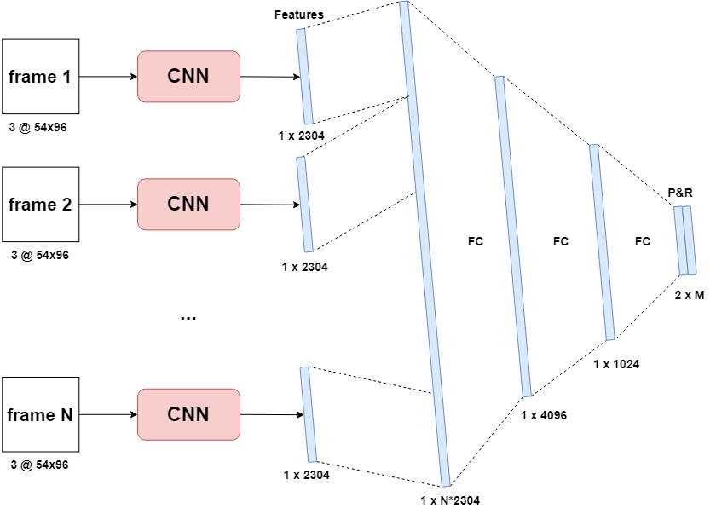
Sequential CNN
Notes:
No PR

Slide 23
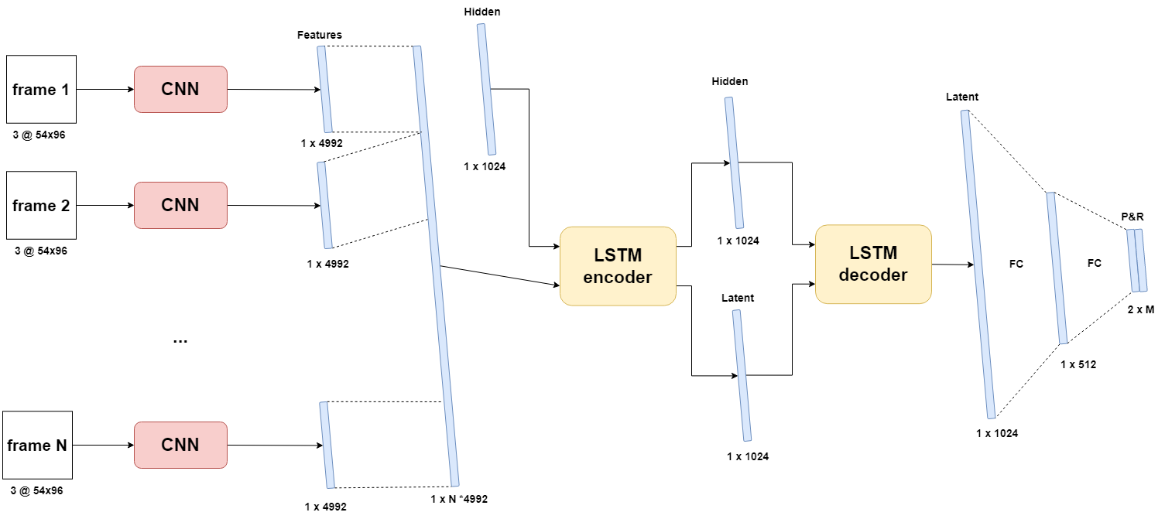
CNN-LSTM [img]

Slide 24
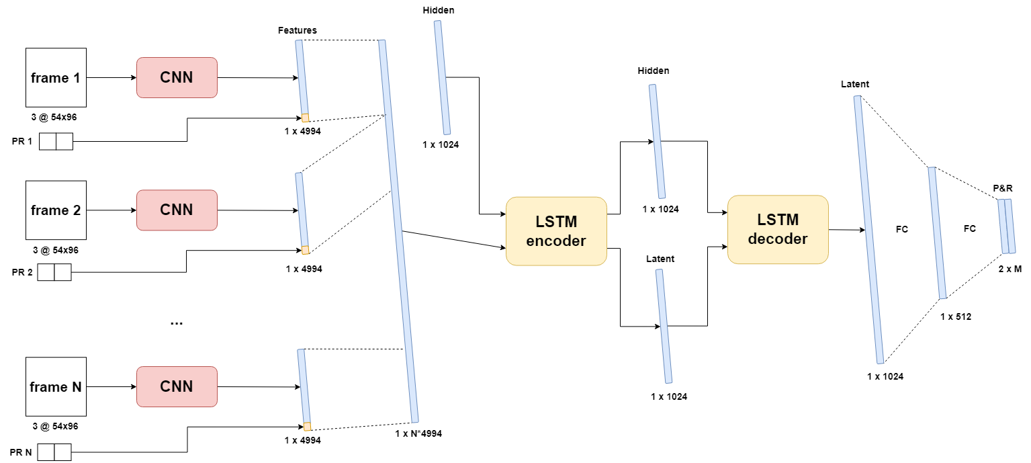
CNN-LSTM [img+PR]
Notes:
Also, img only

Slide 25
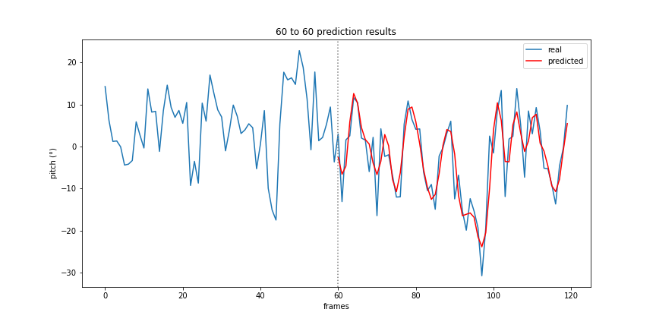
Encoder-Decoder LSTM
Notes:
Encoder decoder LSTM, consistent accuracy

Slide 26
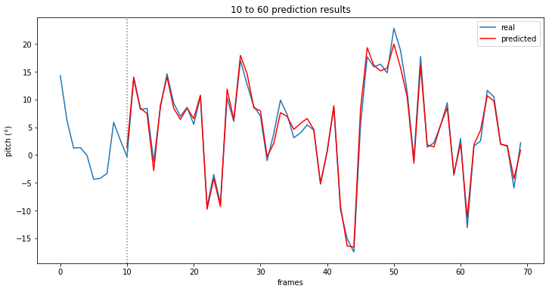
LSTM CNN [img-PR]
Notes:
IMG PR LSTM CNN

Slide 27
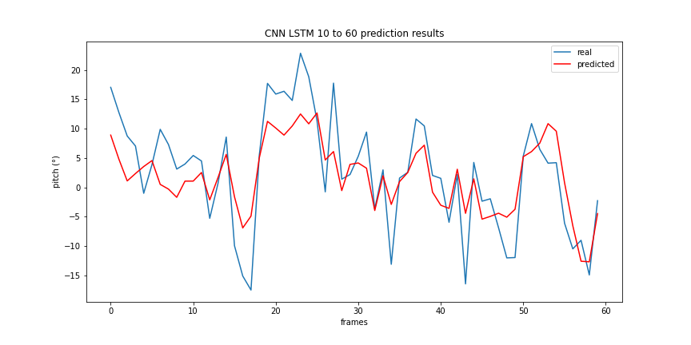
Sequential CNN
Notes:
Sequential CNN

Slide 28
Optimized results
Model name | IO-ratio | Inference time | Avg. PR error | Trainable parameters
Encoder-Decoder LSTM* | 120/60 | 155ms | 2° | 1.211.010
Sequential CNN | 10/30 | 4.203ms | 5,79° | 98.639.180
CNN LSTM [img] | 10/120 | 4.042ms | 1,73° | 217.659.752
CNN LSTM [img] (gray) | 10/120 | 3.545ms | 1,71° | 217.659.352
CNN LSTM [img-PR] | 10/120 | 4.453ms | 1,72° | 217.741.672
CNN LSTM [img-PR] (gray) | 10/120 | 3.797ms | 1,81° | 217.741.272

Slide 29
Optimized results
Model name | IO-ratio | Inference time | Avg. PR error | Trainable parameters
Encoder-Decoder LSTM* | 120/60 | 155ms | 2° | 1.211.010
Sequential CNN | 10/30 | 4.203ms | 5,79° | 98.639.180
CNN LSTM [img] | 10/120 | 4.042ms | 1,73° | 217.659.752
CNN LSTM [img] (gray) | 10/120 | 3.545ms | 1,71° | 217.659.352
CNN LSTM [img-PR] | 10/120 | 4.453ms | 1,72° | 217.741.672
CNN LSTM [img-PR] (gray) | 10/120 | 3.797ms | 1,81° | 217.741.272
Notes:
Up to 120 second prediction, low 10% relative error, good inference time

Slide 30
Optimized results
Model name | IO-ratio | Inference time | Avg. PR error | Trainable parameters
Encoder-Decoder LSTM* | 120/60 | 155ms | 2° | 1.211.010
Sequential CNN | 10/30 | 4.203ms | 5,79° | 98.639.180
CNN LSTM [img] | 10/120 | 4.042ms | 1,73° | 217.659.752
CNN LSTM [img] (gray) | 10/120 | 3.545ms | 1,71° | 217.659.352
CNN LSTM [img-PR] | 10/120 | 4.453ms | 1,72° | 217.741.672
CNN LSTM [img-PR] (gray) | 10/120 | 3.797ms | 1,81° | 217.741.272
Notes:
Suffers from not having LSTM, high inference time, low IO still high error

Slide 31
Optimized results
Model name | IO-ratio | Inference time | Avg. PR error | Trainable parameters
Encoder-Decoder LSTM* | 120/60 | 155ms | 2° | 1.211.010
Sequential CNN | 10/30 | 4.203ms | 5,79° | 98.639.180
CNN LSTM [img] | 10/120 | 4.042ms | 1,73° | 217.659.752
CNN LSTM [img] (gray) | 10/120 | 3.545ms | 1,71° | 217.659.352
CNN LSTM [img-PR] | 10/120 | 4.453ms | 1,72° | 217.741.672
CNN LSTM [img-PR] (gray) | 10/120 | 3.797ms | 1,81° | 217.741.272
Notes:
Gray, little improvement in accuracy, high latency for all, much better with lstm

Slide 32
Conclusion
Images contribute to …
Marginal increase in accuracy
Significant increase in latency
Prone to occlusion/obstructions
LSTM module is crucial
Encoder-Decoder LSTM is the optimal model
Up to 120 seconds
2° error on average
Consistent & equal accuracy

Slide 33
Future work

Slide 34
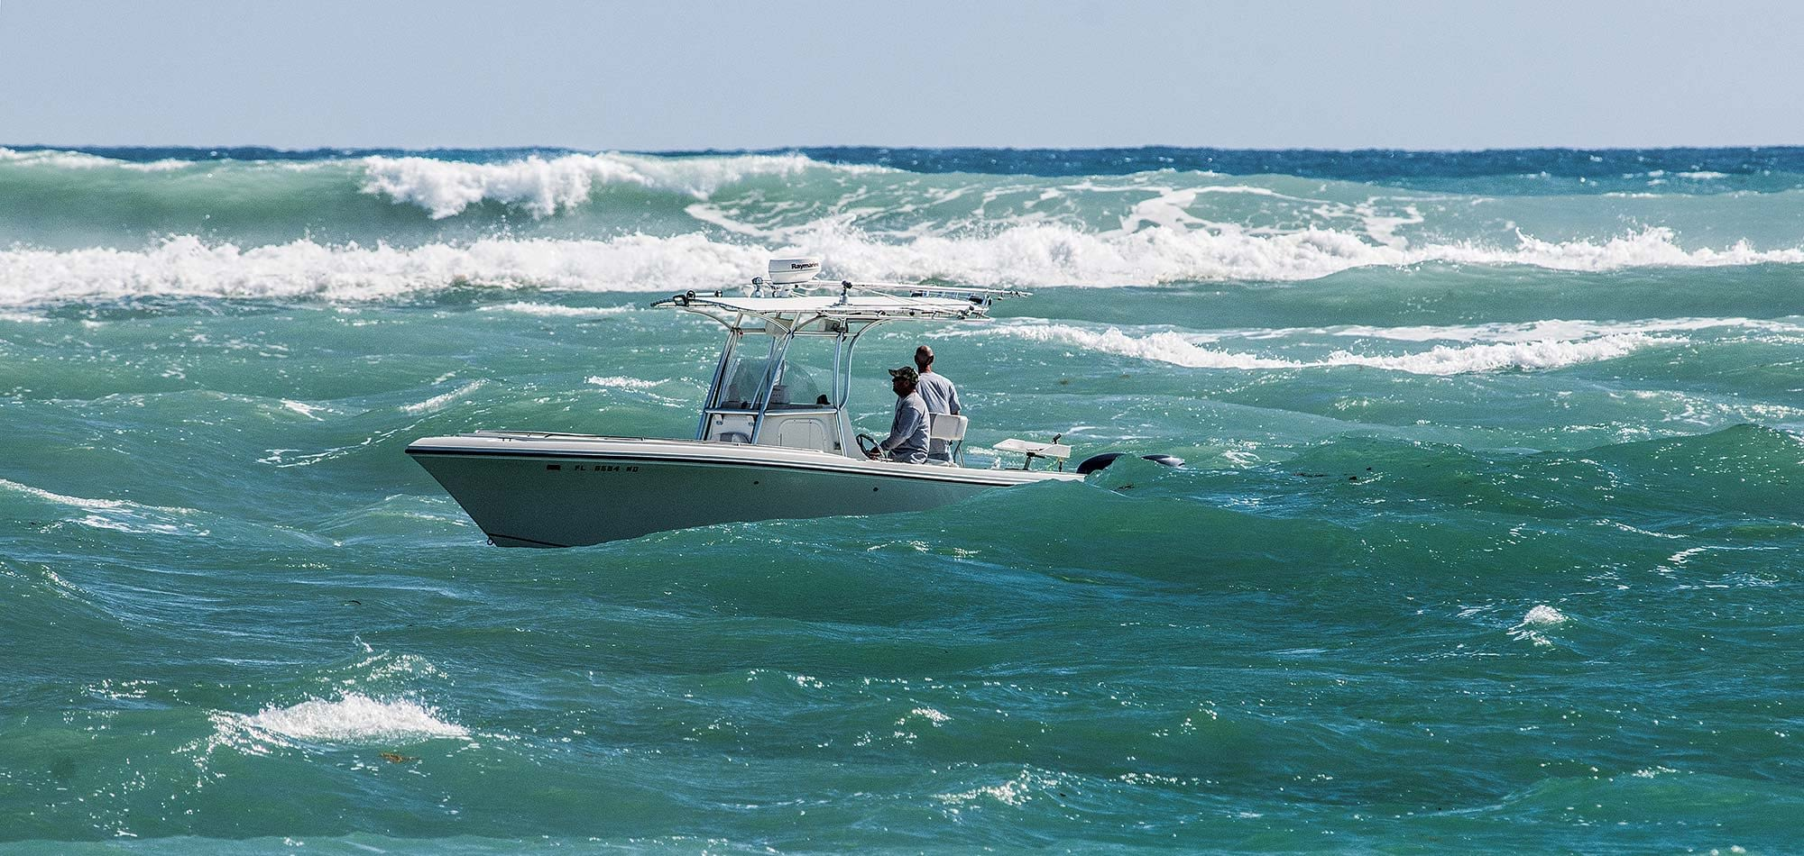
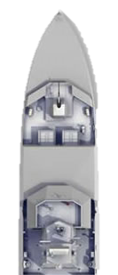
Real data
Video + IMU data (ZED-mini)
Additional inputs
Angular velocity
Wind speed/direction
Thrust
Challenges:
Optimal sample rate
Objects in images
Stabilization
Noise

Slide 35
Questions

