Slide 1
People
UGent
Student: Lance De Waele : lancedewaele@icloud.com
Professor: Hiep Luong hiep.luong@ugent.be and Jan Aelterman Jan.Aelterman@ugent.be
RMA
MarLand: Tien-Thanh Nguyen tien.thanh@eu4m.eu
MarSur: Benoit Pairet Benoit.Pairet@mil.be
VR – SLAM: Charles Hamesse Charles.Hamesse@mil.be

Slide 2
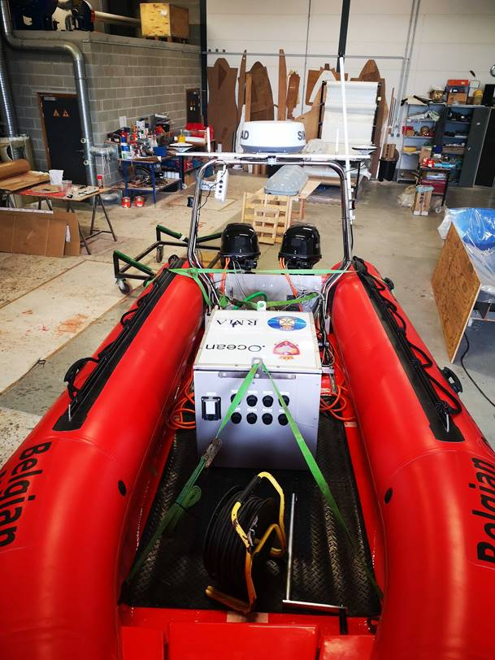
Timeline
Master thesis:
Oct 2021 – end of May 2022
Midterm presentation in November – January (!?)
22nd Oct: work plan
9th June: submit thesis
29 June or 1st July: thesis defense
December – January: exam time
Project
Data acquisition: planned for October (TBC)
ZED Mini: IMU, Stereo cameras
Data acquisition hardware: mid October (integrate with MarSur USV ?)
Problem formulation, workplan, [literature study]: 22nd October
Required skills (Python, Pytorch, RNN, time-series analysis …): January
Work on problem: March
Writing thesis: May

Slide 3
Motivation
Estimate and predict the ship motion from IMU – and stereo vision
MarLand:
Define the optimum moment for the drones to land on the ship
Less impact on the drone
MarSur (!?):
Stabilize the sensor inputs
Filter out the ship movement
Horizon detection, could be used for control USV
State prediction problem
Given current states (and states in the past): IMU data
Given latent space (images) of future action/input: images of incoming waves
Predict the states in future
Stock market example

Slide 4
Problem
Inputs:
Sequence of IMU data + stereo images in the timeframe (t-∆t_1,t)
Other sensor maybe used – wind sensor, thrust of the USV
Output
Ship motion: altitude (z), roll, pitch, yaw (angles and angular velocities) in the time (t, t+∆t_2)
Challenges:
Estimation + prediction for time series sequences (visual features: water/waves)
Define ∆t_1 and ∆t_2
Realtime

Slide 5
Way of Working
Bi-weekly meeting with small presentation
Status/Result of given tasks (from previous meeting)
Issues
Plan for next 2 weeks
2 tasks will be given after each meeting
Use Slack as communication channel
New ideas
Issues
Q&A

