Slide 1


Insert Client Name
Options List

Slide 2

Contents
1
Options List
2
About KMC
3
Contact

Slide 3
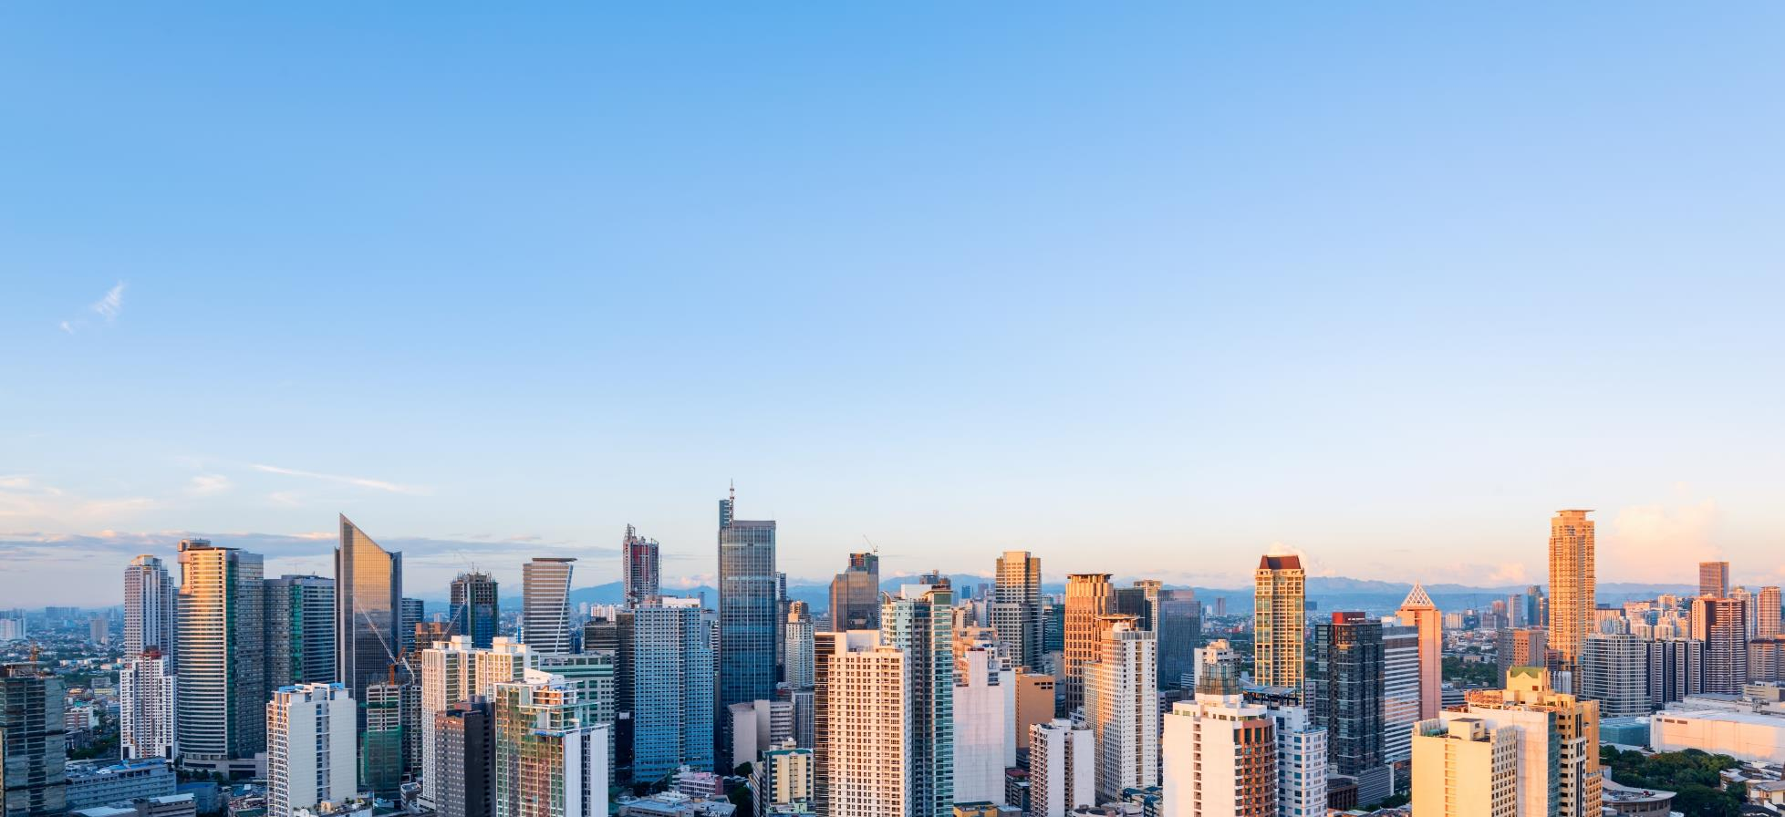
About KMC
KMC is focused on providing exceptional results which reflect our clients’ vision. We pride ourselves on building outstanding relationships based on integrity and trust.

Slide 4

About KMC
KMC aims to be the preferred provider of professional real estate services in the Philippines, operating with the needs of foreign and local clients and providing services that are timely, responsive and informative –merged with local expertise and passion.
KMC MAG Group is founded by Gregory Kittelson, Michael McCullough, and Amanda Carpo.
KMC wins another 5-star award from the IPA for Best Real Estate Website.
MD Michael McCullough wins as 2014’s Top Young Leader at the Asia CEO Awards.
KMC launches KMC One Integrated Services. A combined services solution between KMC Savills and KMC Solutions.
Doubled the revenue growth from the previous year.
Fully leased Insular Life Makati, the country’s first co-landlord representation project.
2009
2013
2014
2015
2016
2017
2018
KMC MAG Group is declared the Best Real Estate Agency in the Philippines by the International Property Awards (IPA) and becomes an International Associate of Savills.
KMC launches Research & Consultancy service line.
KMC opens a Cebu Office.
KMC transacts more than 300,000 sq m and has more than 100,000 sq m under management.
Rosario Carbonell wins Corenet Young Leader Award.
150+
PROFESSIONALS
10
YEARS OF WORLD-CLASS
REAL ESTATE SERVICES
300+
CLIENTS FOR OFFICE,
COMMERCIAL, CAPITAL MARKETS,
RESIDENTIAL, INDUSTRIAL
107%
REVENUE INCREASE

Slide 5
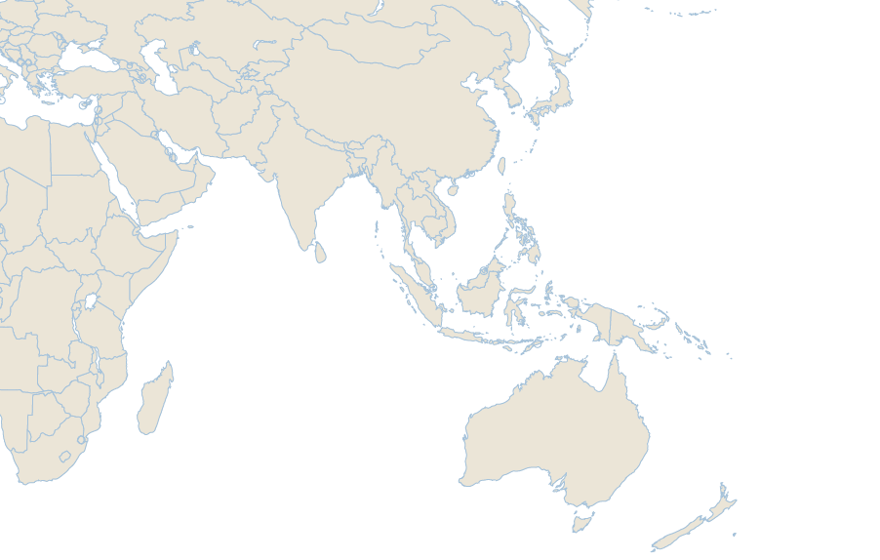
Savills Asia Pacific Network
AUSTRALIA
Adelaide
Brisbane
Canberra
Double Bay
Gold Coast (2)
Gordon
Lindfield
Melbourne
Notting Hill
Parramatta
Perth
Roseville
St Ives
Sunshine Coast
Sydney (2)
Turramurra
CAMBODIA
Phnom Penh
CHINA
Beijing
Chengdu
Chongqing
Dalian
Guangzhou
Hangzhou
Nanjing
Qingdao
Shanghai
Shenyang
Shenzhen
Tianjin
Xi’an
Zhuhai
HONG KONG
Exhange Square (2)
Discovery bay
Taikoo Shing
Kowloon Tong
Kowloon
INDIA
Bangalore
INDONESIA
Jakarta
JAPAN
Tokyo (2)
MACAU
Macau
MALAYSIA
Johor Bahru
Kuala Lumpur
Penang
MYANMAR
Yangon
NEW ZEALAND
Auckland (2)
Christchurch (2)
PHILIPPINES
Bonfiacio Global City
Cebu City
SINGAPORE
Singapore (4)
SOUTH KOREA
Seoul
TAIWAN
Taichung
Taipei (3)
THAILAND
Bangkok
Pattaya
VIETNAM
Hanoi
Ho Chi Minh City
2
ASIA
47
6
3
OFFICES
4
AUSTRALIA /
NEW ZEALAND
18
3
OFFICES
10
2

Slide 6
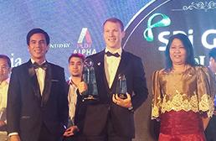
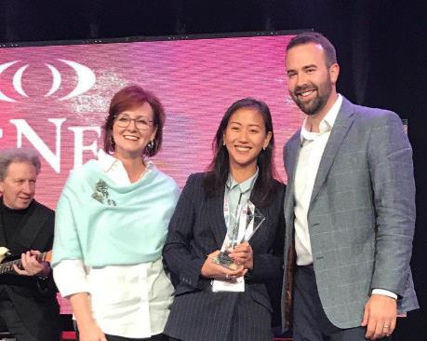
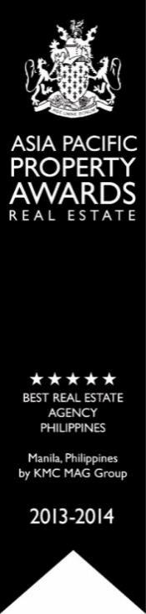


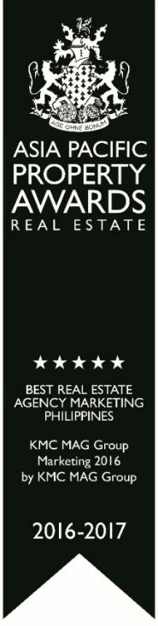

Achievements
KMC has been named winner of the following awards: ‘Best Real Estate Agency-Philippines’ in 2013-2014, ‘Best Property Consultancy Website Philippines’ in 2014-2015, and ‘Best Property Consultancy Philippines’ in 2015-2016.

Slide 7

Our Services
1
2
3
Investment Services
Developer Services
Occupier Services
Capital Markets
Asset Management
Buyer-side Advisory
Appraisal Services
Project Management
Feasibility Studies
Market Research
Project Marketing
Project Leasing Services
Property Management
Leasing
Advisory
Tenant Representation
Project Management
Valuation & Appraisals

