Slide 1
THE INCA EMPIRE

Slide 2
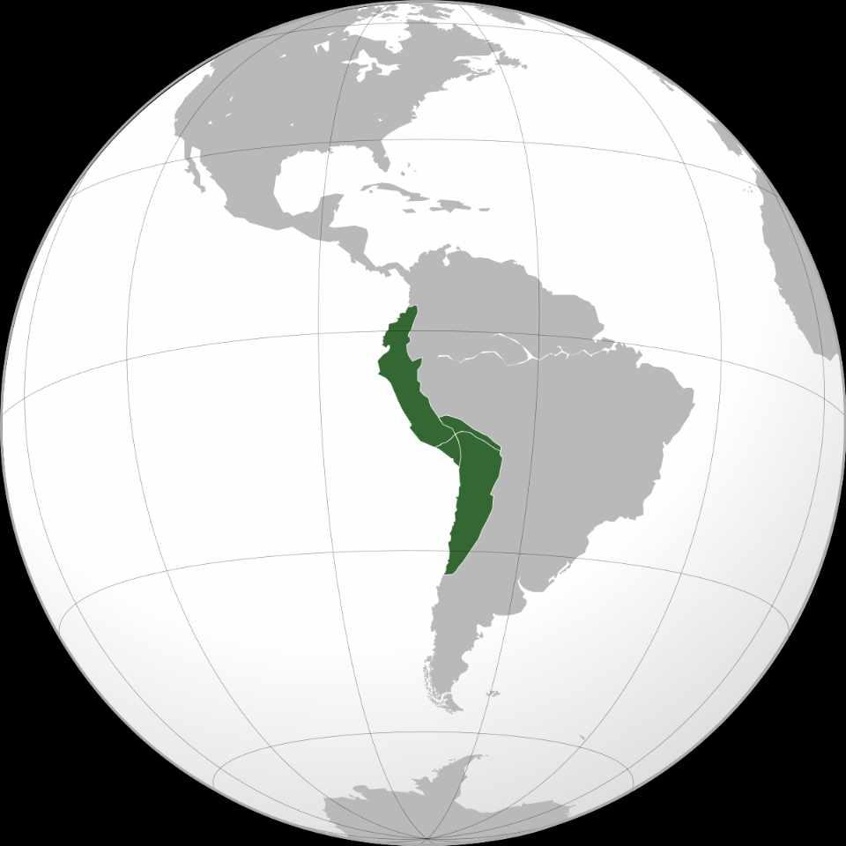
The Inca Empire, officially known as the ‘Realm of the Four Parts’ (Quechua: Tawantinsuyu, “ four parts together”).

Slide 3
It was the largest empire in pre-Columbian America. The administrative, political, and military center of the empire was in the city of Cusco. The Inca civilization rose from the Peruvian highlands sometime in the early 13th century. The Spanish began the conquest of the Inca Empire in 1532 and by 1572, the last Inca state was fully conquered.

Slide 4
The Inca Empire was the last chapter of thousands of years of Andean civilizations. The Andean civilization is one of at least five civilizations in the world deemed by scholars to be “pristine.” The concept of a “pristine” civilization refers to a civilization that has developed independently of external influences and is not a derivative of other civilizations.

Slide 5
From 1438 to 1533, the Incas incorporated a large portion of western South America, centered on the Andean Mountains, using conquest and peaceful assimilation, among other methods. At its largest, the empire joined modern-day Peru, what are now western Ecuador, western and south central Bolivia, northwest Argentina, the southwestern most tip of Colombia and a large portion of modern-day Chile into a state comparable to the historical empires of Eurasia. Its official language was Quechua.

Slide 6
The Inca Empire was unique in that it lacked many of the features associated with civilization in the Old World. Anthropologist Gordon McEwan wrote that the Incas were able to construct “one of the greatest imperial states in human history” without the use of the wheel, draft animals, knowledge of iron or steel, or even a system of writing. Notable features of the Inca Empire included its monumental architecture, especially stonework, extensive road network (Qhapaq Ñan) reaching all corners of the empire, finely-woven textiles, use of knotted strings (quipu) for record keeping and communication, agricultural innovations and production in a difficult environment, and the organization and management fostered or imposed on its people and their labor.

Slide 7
The Inca Empire functioned largely without money and without markets. Instead, exchange of goods and services was based on reciprocity between individuals and among individuals, groups, and Inca rulers. “Taxes” consisted of a labour obligation of a person to the Empire. The Inca rulers (who theoretically owned all the means of production) reciprocated by granting access to land and goods and providing food and drink in celebratory feasts for their subjects.
Many local forms of worship persisted in the empire, most of them concerning local sacred Huacas, but the Inca leadership encouraged the sun worship of Inti – their sun god – and imposed its sovereignty above other religious groups, such as that of Pachamama. The Incas considered their king, the Sapa Inca, to be the “son of the sun”

Slide 8
The Inca economy, especially in the past, was often the subject of scholarly debate. Darrell E. La Lone, in his work The Inca as a Nonmarket Economy, noted that scholars have previously described it as “feudal, slave, [or] socialist,” as well as “a system based on reciprocity and redistribution; a system with markets and commerce; or an Asiatic mode of production.

