Slide 1
Web drivers
Introduction to webdrivers
webDriver Architecture
Invoking webDrivers and scripting
Different webDrivers
Troubleshooting

Slide 2
Introduction to WebDriver
WebDriver is an interface, which has several classes and methods defined in it. These will be implemented in the selenium code
It has seperate classes for the each browser
We can create an object of the desired browser class and access the methods in the class in order to perform various actions on the browser
Though there are seperate classes for all the browsers, the method names inside the class is same. Hence we can easily switch from one browser to another with out changing much on the code
Some common methods from the WebDriver interfaces are get(), getTitle(),findElement(),findElements(), close(), quit() etc

Slide 3
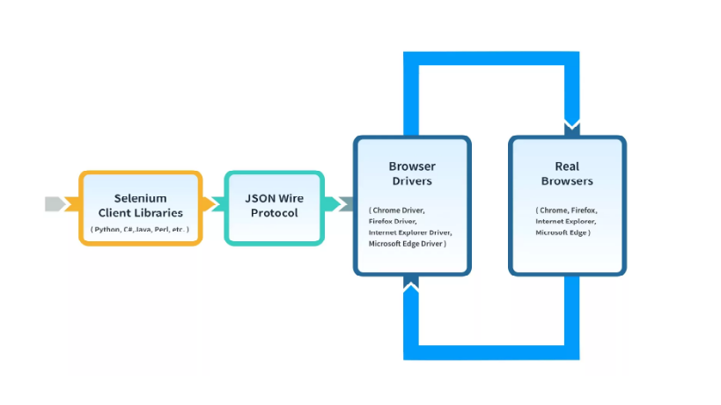
webDriver Architecture
WebDriver Architecture is made up of four major components:
1. Selenium Client library
2. JSON wire protocol over HTTP
3. Browser Drivers
4. Browsers

Slide 4
Invoking web driver and scripting in selenium
Download the driver for the desired browser
Version of the driver must be same as the version of the browser, else it will throw an exception while running the code
Set the location in the code from where the driver must be invoked using setProperty method
Syntax: System.setProperty("webdriver.chrome.driver","<path of the driver in the local>");
Eg: System.setProperty("webdriver.chrome.driver","E:\\Selenium\\Applications\\chromedriver.exe");
Create the object for the webDriver class and call the class for the specific browser

Slide 5
Different WebDrivers
Various browser drivers are chromeDriver, edgeDriver, safariDriver, firefoxDriver etc
Following are the syntaxes for invoking the commonly used webDrivers
ChromeDriver:
System.setProperty("webdriver.chrome.driver","E:\\Selenium\\Applications\\chromedriver.exe");
WebDriver driver=new ChromeDriver();
firefoxDriver:
System.setProperty("webdriver.gecko.driver","E:\\Selenium\\Applications\\geckodriver.exe");
WebDriver driver=new FirefoxDriver();
edgeDriver:
System.setProperty("webdriver.edge.driver","E:\\Selenium\\Applications\\msedgedriver.exe");
WebDriver driver=new EdgeDriver();

Slide 6
Advantages and Disadvantages of the webDriver
Advantages:
Open source
Supports multiple OS
Compatibility with various programming languages
Compatible with almost all the browsers
Faster execution time
Limitations:
Support to new browser will not readily available
Supports only web applications
No built in command for auto generation of test result
For automating window based applications, we have to use the tools like sikuli, AutoIT etc

Slide 7
Troubleshooting
Most commonly used troubleshooting method is to import the required packages
Handling keyboard and mouse events
Downloading and updating webDrivers whenever the browser updates
javascript executor
JavascriptExecutor interface is a part of org.openqa.selenium and implements java.lang.Object class.
JavascriptExecutor presents the capabilities to execute JavaScript directly within the web-browser

