Slide 1
QA Concepts
Testing
SDLC
STLC
Responsibilities of Tester

Slide 2
Testing
Testing is checking the behavior of the application w.r.t its requirement
In essance it is comparision of the actual behavior of the system with its expected behavior in order to confirm that it is developed as required
Intention of the testing is to find all the possible defects in the application which may cause lot impact when it is used by the end users and rectify them in the early stages
This will make sure that the application is developed as per the requirement and end user can use it in his business without any risks that leads to the loss
Though we can’t test the application to the fullest, we have to make sure that all the major scenarios which will be used in day to day activities have been tested and there are no defects
None of the application can be bug free, but it is the responsibility of the tester to make sure that there are no such defects in the application, that can potentially incur a huge loss to the customer when it is used in real time
It is imposible to test an application to the fullest. But testers should make sure that the application is tested for all possible combinations of the data that can use in real time

Slide 3
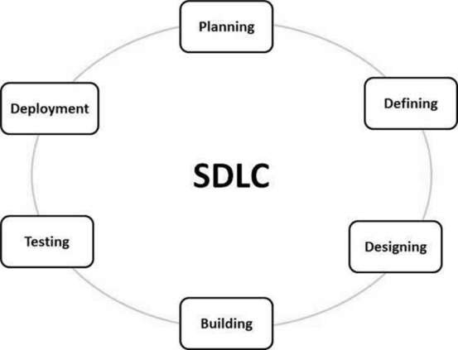
SDLC

Slide 4
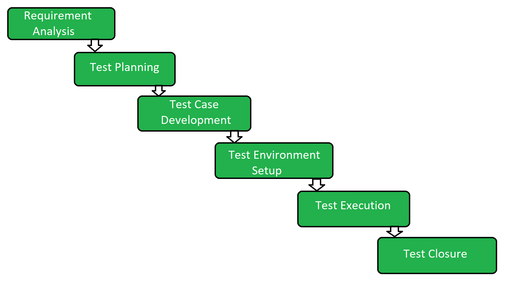
STLC

Slide 5
Tester Responsibilities
Testing is not just about finding bugs in the application
Tester has to understand the requirements of the project and what exactly the end user of the application is expecting
Then he has to plan the testing activities such that it should uncover most of the defects at the early stages so that it will be easy to fix them
Then create the test cases such that it should cover maximum functionalities in minimum tests
Set up the test environment such that it should simulate the realtime usage of the application. Prepare the test data such that it should effectively test the application
Execute the test cases. This is where the tester’s skill will come into picture. While executing the test cases, intention of the tester should be majorly on breaking the application.
Number of the test cases will never be a matrix to analyse the quality of the testing. The volume of the defects it will uncover or the percentage of the functionality it will cover matters
Update the test report and the test summary. It should effectively summerize the features of that were tested, defects found, impact of those defects on the application etc. This helps the stakeholders to get some confidence on the application

