Slide 1

1. BDD 概述
讲师：Ray

Slide 2
BDD vs TDD
BDD (Behavioral-driven development)
TDD (Test-Driven Development)

Slide 3
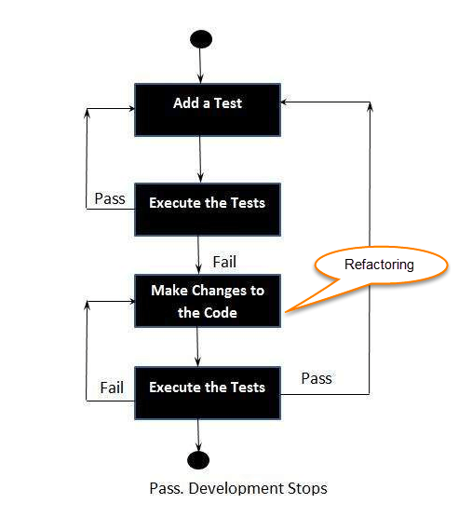
TDD (Test-Driven Development)
Benefits:
减少重复劳动时间
快速反馈系统缺陷
快速反馈系统交付标准
帮助开发形成良好的代码设计
提高开发者产出率
增强开发者代码重构的信心

Slide 4
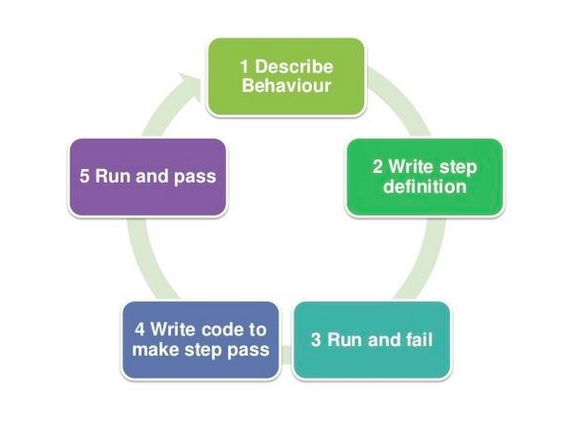
BDD (Behavioral-Driven Development)
Benefits:
通过使用非技术语言让更广泛的用户了解系统功能
重点关注从用户角度来看系统如何运作
减少了验收测试所需的时间

Slide 5
2. 使用Cucumber编写脚本
讲师：Ray

Slide 6
Environment
Java SE, JDK 1.8 is recommended
Maven version 3.3.1 or higher
IDE (IntelliJ IDEA, Eclipse)
IntelliJ IDEA Cucumber for Java plugin
Cucumber Eclipse

Slide 7
Features Example
Feature: Add Another Cellphone to cart
Scenario: Add cellphone to cart with sufficient stock
Given I have login in the shopping website
When I add one cellphone into the cart
Then I can see one cellphone in my cart

Slide 8
3. Gherkin syntax
讲师：Ray

Slide 9
Gerkin Primary Keywords
Feature
Rule (as of Gherkin 6)
Example (or Scenario)
Given, When, Then, And, But for steps (or *)
Background
Scenario Outline (or Scenario Template)
Examples

Slide 10
Gerkin Secondary Keywords
""" (Doc Strings)
| (Data Tables)
@ (Tags)
# (Comments)

Slide 11
4. 脚本参数化
讲师：Ray

Slide 12
5. Expressions
讲师：Ray

Slide 13
Expressions
Regular Expression
Cucumber Expression

Slide 14
Examples
类型 | 正则
word | "\w+"
string | .*
bigdecimal | "-?\d*[.,]\d+"
double | "-?\d*[.,]\d+"
float | "-?\d*[.,]\d+"
byte | "-?\d+" 或者 "\d+"
int | "-?\d+" 或者 "\d+"
short | "-?\d+" 或者 "\d+"
long | "-?\d+" 或者 "\d+"
biginteger | "-?\d+" 或者 "\d+"

Slide 15
6. Parameter Type Registry
讲师：Ray

Slide 16
7. DataTable 的使用
讲师：Ray

Slide 17
DataTable
DataTable 使用场景
DataTable 的基本操作（定义TypeRegistry）
DataTable.TableConverter 使用

Slide 18
8. DataTable List Object
讲师：Ray

Slide 19
DataTable
TypeRegistryConfigurer
public <T> DataTableType(Class<T> type, TableRowTransformer<T> transformer)
public <T> DataTableType(Class<T> type, TableEntryTransformer<T> transformer)

Slide 20
9. Hooks And Tags
讲师：Ray

Slide 21
Hooks
Scenario Hooks
Before, After
Step Hooks
BeforeStep, AfterStep
Conditional Hooks
@Before(“@tag1 and not tag2”)

Slide 22
Tags
Tags 用来指定一个特定场景；限制Hooks在指定场景中运行
Tags 使用的位置
Feature, Scenario, Scenario Outline, Examples
Tags 继承性
Tags 运行方法
@CucumberOptions(tags = "@smoke and @fast")
Tags Expressions
and, and not, or, not

Slide 23
10. Cucumber Reporting
讲师：Ray

Slide 24
thank you
PPT模板下载：www.1ppt.com/moban/ 行业PPT模板：www.1ppt.com/hangye/
节日PPT模板：www.1ppt.com/jieri/ PPT素材下载：www.1ppt.com/sucai/
PPT背景图片：www.1ppt.com/beijing/ PPT图表下载：www.1ppt.com/tubiao/
优秀PPT下载：www.1ppt.com/xiazai/ PPT教程： www.1ppt.com/powerpoint/
Word教程： www.1ppt.com/word/ Excel教程：www.1ppt.com/excel/
资料下载：www.1ppt.com/ziliao/ PPT课件下载：www.1ppt.com/kejian/
范文下载：www.1ppt.com/fanwen/ 试卷下载：www.1ppt.com/shiti/
教案下载：www.1ppt.com/jiaoan/ PPT论坛：www.1ppt.cn

