Slide 1
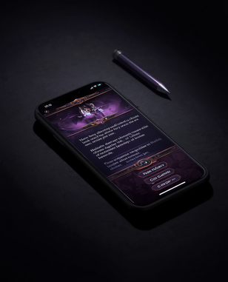
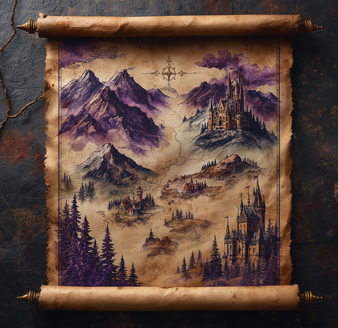

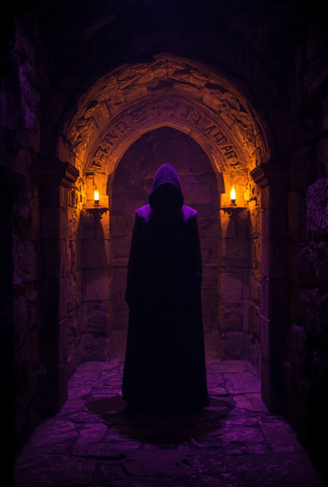
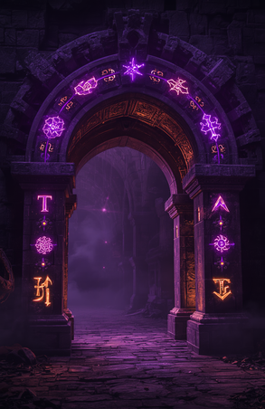



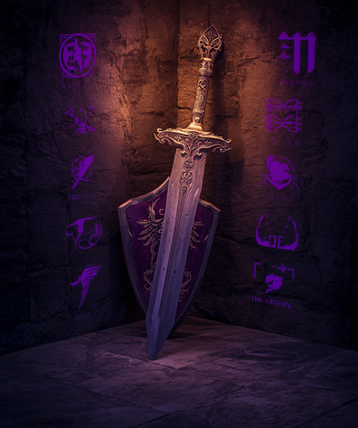
QUESTIE
BY
LANCE LIM
QUESTIE
APP

Slide 2



QUESTIE
QUESTIE APP
The Problem
NO PERSONALIZATION
TOO RIGID & LINEAR
NO STRUCTURE
Existing games offer no real customization. Players are stuck in worlds they didn't create, following paths they didn't choose.
Interactive fiction locks you into a single track. No room for branching choices or real creative agency.
Tabletop RPGs need a group and a DM. Solo, on-demand storytelling has no home that actually works.

Slide 3
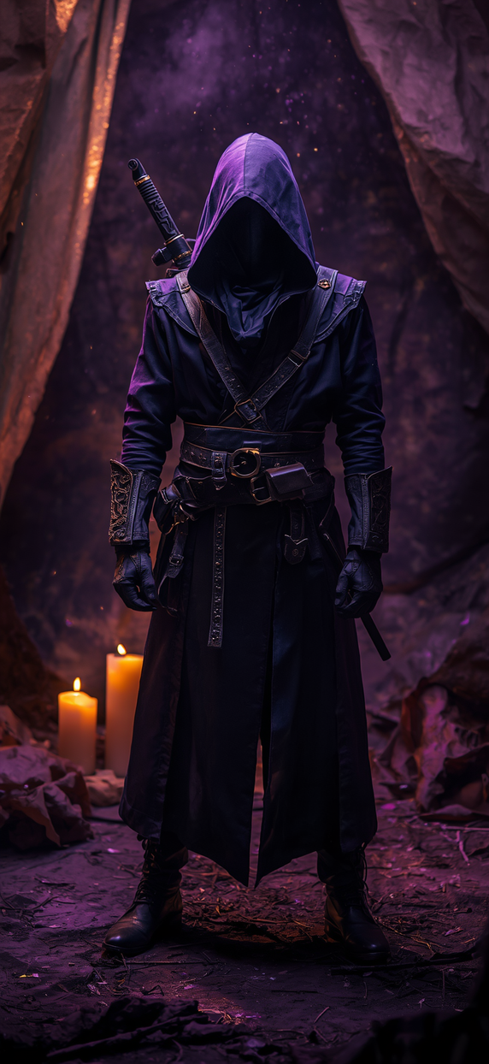
QUESTIE APP
QUESTIE
Questie: How it works
The player selects a genre, setting, character class, tone, and difficulty.
Questie sends these choices to the Groq AI API, which generates the opening story, objective, characters, inventory, and suggested actions.
The player can choose a suggested action or enter a custom response.
The application tracks the player’s health, inventory, location, decisions, and story progress to generate a consistent outcome.

Slide 4
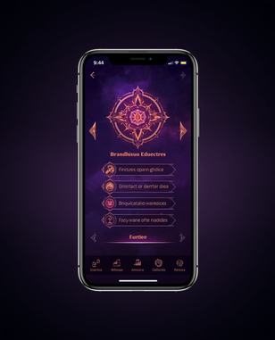
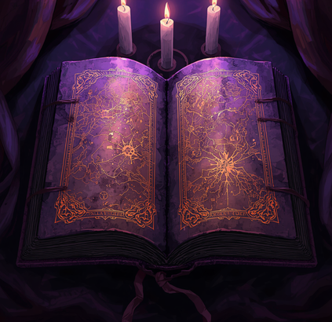
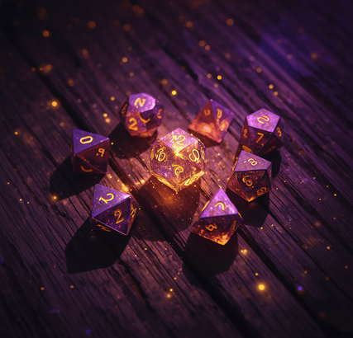
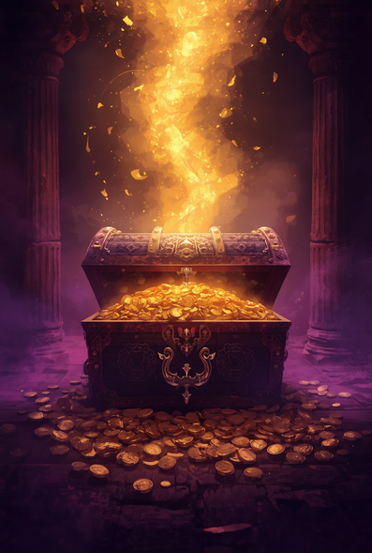

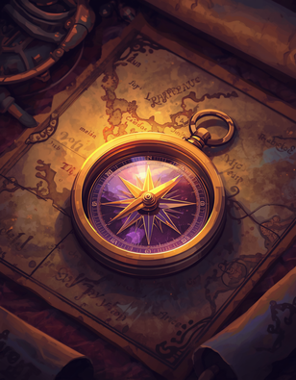
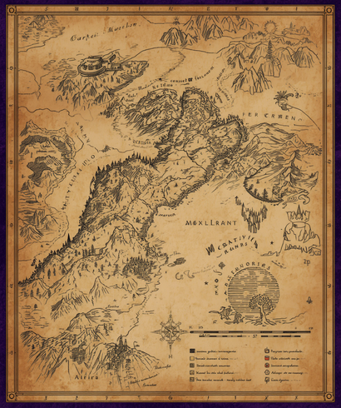
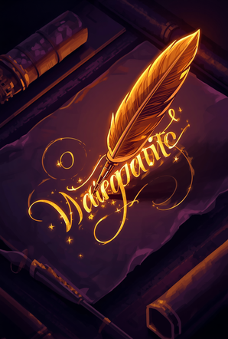
LIVE DEMO
QUESTIE
APP

Slide 5
THANK YOU
QUESTIE
APP

