Slide 1

Automatic Merging Attributes for Data Preparation
Felix Grzelka, Margaux Gatrio

Slide 2

Agenda
Introduction
Use Cases
Merge duplicated columns
Merge date parts
Merge interleaving columns
Statistic test?
calApplicability?
Open tasks
Summary

Slide 3
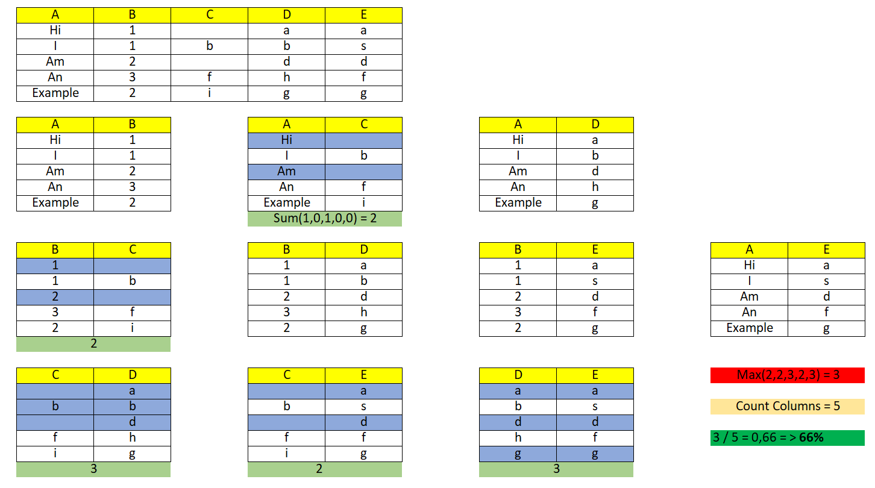
Introduction
Last time:

Slide 4



Use Case 1: Merge Duplicates

Slide 5
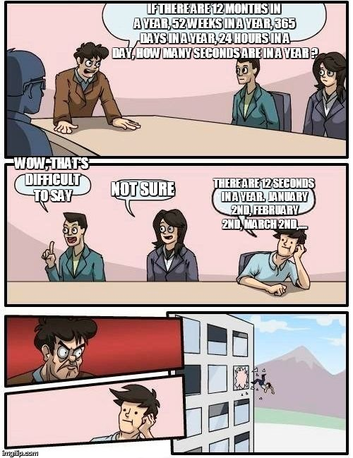

Use Case 2: Merge date parts

Slide 6
Use Case 3: Merge Interleaving columns

Slide 8
Open tasks

Slide 9
Summary
Hier Excel picture to summarize functions

Slide 10

Thank you for your attention!
Felix Grzelka, Margaux Gatrio

Slide 11
Merge Attributes
Felix Grzelka, Margaux Gatrio

Slide 12


Slide 13


Slide 14
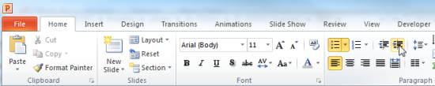
Explanations - Text layers
First text layer for running text.
Second level for bullet points
Third level for bullet points
Fourth level for bullet points
Fifth level for numberings
Sixth level for listings
Seventh text layer for Core Messages
In this template, we pre-formatted different text layers (as you can see on the right side). You don’t have to generate bullet points manually. By the way: Please avoid this!
To change from one text layer to the next, use the Increase / Decrease List Level buttons:

Slide 15
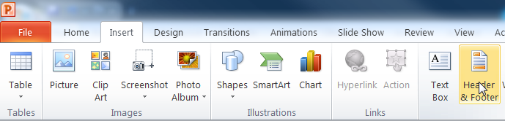
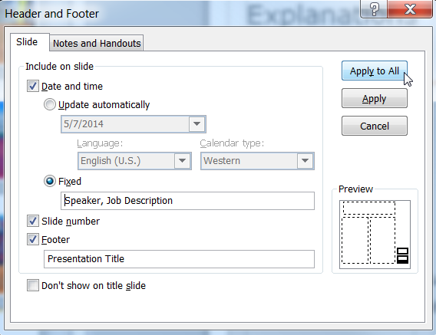
Explanations - Footer
You can insert or change your presentation‘s footer. Click on the Insert-tab | Header and Footer | After filling in your descriptions click on Apply to All.
Descriptions:
Activate date and time and write in:Speaker, Job Description
Activate the slide number.
Activate the footer and write in: Presentation Title
Don‘t use the template without the complete footer.

Slide 16
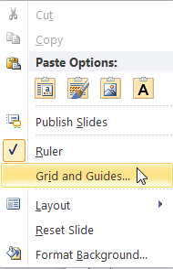
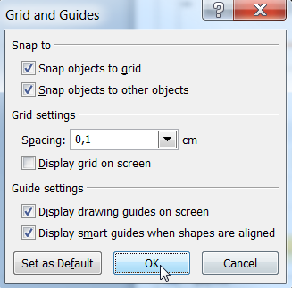
Explanations - Drawing guides
You can enable your guide-lines to align objects on the slide (View | Show | Select the option „Guides“)
Or hit the right mouse button outside the slide and go at „Grid and Guides…“

Slide 17
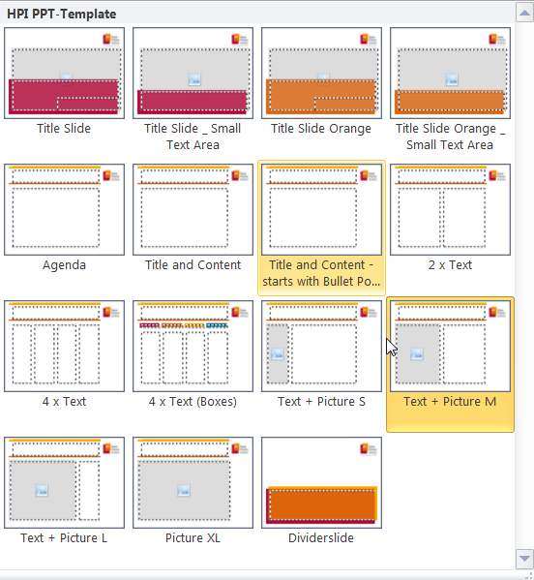
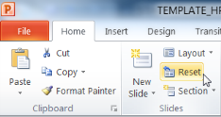
Explanations - Slide layouts
You can choose between different slide layouts. These pre-defined layouts gives you the oportunity to use text and visualisations just the right way.
To use these layouts:
Click on the Home-tab | New Slide or Layout | and choose one out of the layouts
Click „Reset“ to reset to the predefined slide layout.

