Slide 1

Automatic Merging Attributes for Data Preparation
Felix Grzelka, Margaux Gatrio

Slide 2

Agenda
Introduction
Use Cases Merge interleaving columns
Threshold and Weight function
Statistical test
Merge conflicts
Use Case Merge date parts
Open tasks
Summary

Slide 3
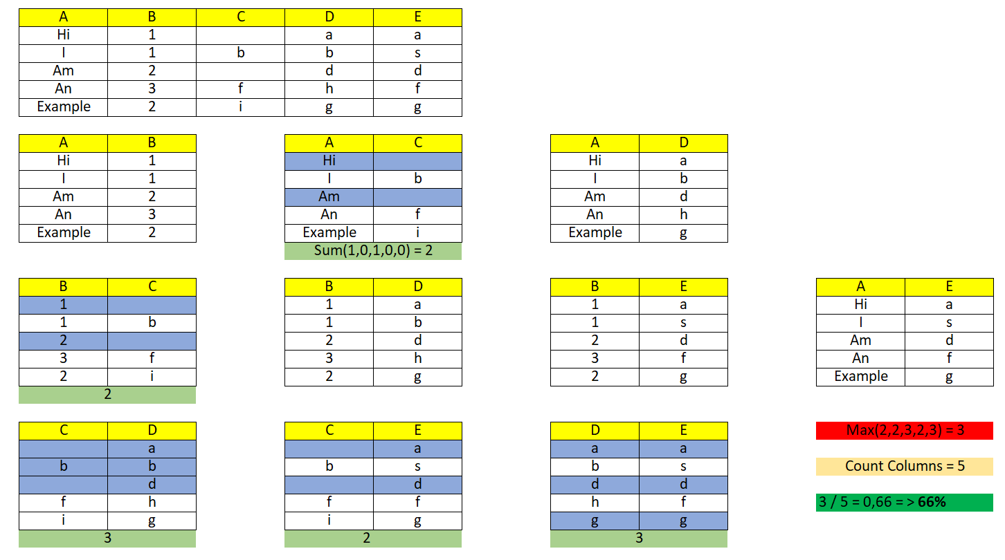
Introduction
Last time:
Notes:
Last stand: calApl., same for merge function
-> mergeable columns are saved during calApl to be used, when actually called
-> depending on significan test, weight function to decrease result

Slide 4
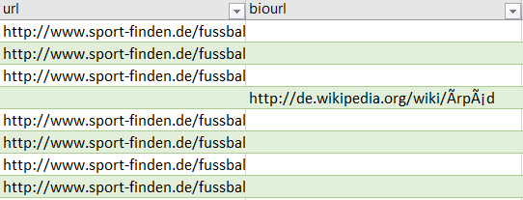
Use Case 1: Merge Interleaving columns
Math.max(applicability + bias,0) * weight
Weight = 4
Bias = -0.75

Slide 5
Two Sample Hypothesis Test
Do two columns (samples) belong to the same population ?
We don't know the distributions of the two samples
Data can be categorical
Use chi-squared test of homogeneity
Use string length instead of strings
Selection of statistical tests in Spark is limited, no two sample tests
Scale applicability by test result
Notes:
Idea: Compare probability distributions for 2 columns using statistical tests
(maybe just string length comparision)
-> test are still in need (no two sample test)

Slide 6
Merge Conflicts
Two different values
Options:
Choose one of them (e.g. always the attribute of the first column)
User decides (similar to Git)
User defined function to solve merge conflicts (e.g. always take smaller value or newer values)
Concatenate the values

Slide 7

Duplicates?
-> Automatically merging of duplicated columns

Slide 8
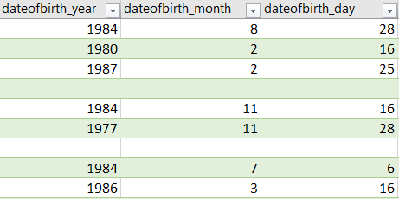
Use Case 2: Merge date parts
Identifying date parts: Days, Months, Years
Notes:
Implemented as a second prep

Slide 9
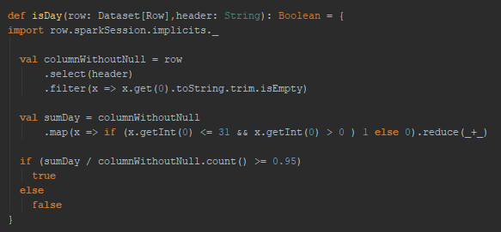
Merge date parts – Column Semantics
Check columns semantics?

Slide 10
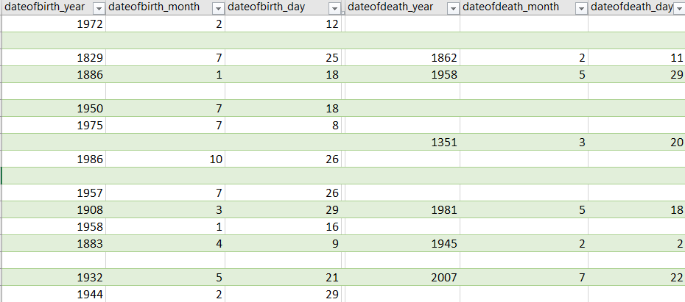
Merge date parts - Headers
Check headers for date substrings?
Notes:
Longest common substring
Analyze of Null values (scoring via cross joins)

Slide 11
Summary
Two preparators:
Merging of interleaving columns and duplicates
Merging of date parts
Open tasks:
Statistical tests
Scoring of related date parts
Fine tuning

Slide 12

Thank you for your attention!
Felix Grzelka, Margaux Gatrio

Slide 13
Merge Attributes
Felix Grzelka, Margaux Gatrio

Slide 14


Slide 15


Slide 16
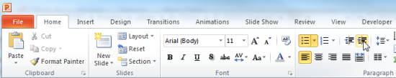
Explanations - Text layers
First text layer for running text.
Second level for bullet points
Third level for bullet points
Fourth level for bullet points
Fifth level for numberings
Sixth level for listings
Seventh text layer for Core Messages
In this template, we pre-formatted different text layers (as you can see on the right side). You don’t have to generate bullet points manually. By the way: Please avoid this!
To change from one text layer to the next, use the Increase / Decrease List Level buttons:

Slide 17
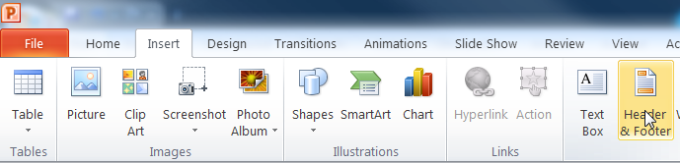
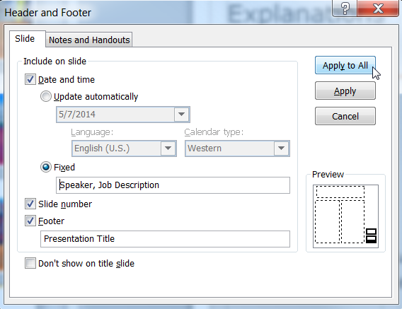
Explanations - Footer
You can insert or change your presentation‘s footer. Click on the Insert-tab | Header and Footer | After filling in your descriptions click on Apply to All.
Descriptions:
Activate date and time and write in:Speaker, Job Description
Activate the slide number.
Activate the footer and write in: Presentation Title
Don‘t use the template without the complete footer.

Slide 18
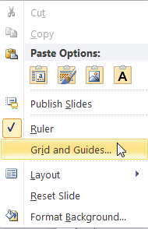
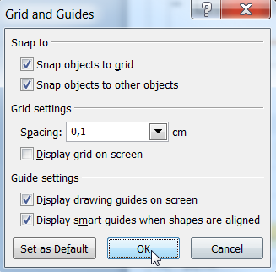
Explanations - Drawing guides
You can enable your guide-lines to align objects on the slide (View | Show | Select the option „Guides“)
Or hit the right mouse button outside the slide and go at „Grid and Guides…“

Slide 19
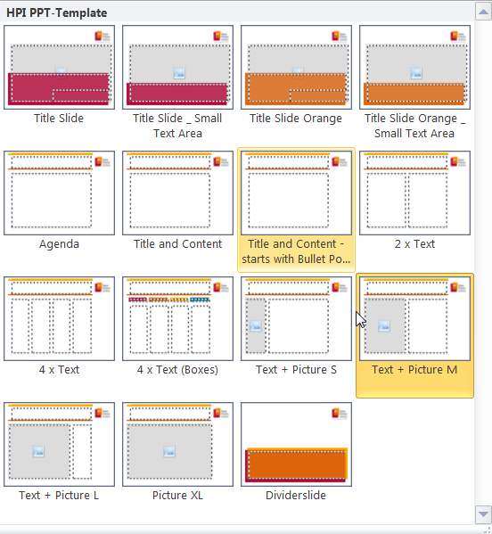
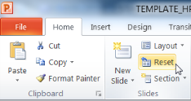
Explanations - Slide layouts
You can choose between different slide layouts. These pre-defined layouts gives you the oportunity to use text and visualisations just the right way.
To use these layouts:
Click on the Home-tab | New Slide or Layout | and choose one out of the layouts
Click „Reset“ to reset to the predefined slide layout.

