Slide 1
Well-classified Examples are Underestimated in Classification with Deep Neural Networks
Guangxiang Zhao, Wenkai Yang, Xuancheng Ren, Lei Li, Yunfang Wu, Xu Sun.
Peking University
AAAI-22
Notes:
https://recorder-v3.slideslive.com/?share=61339&s=97b56f6c-a166-4087-ac2b-c3ad87fc6ca9

Slide 2
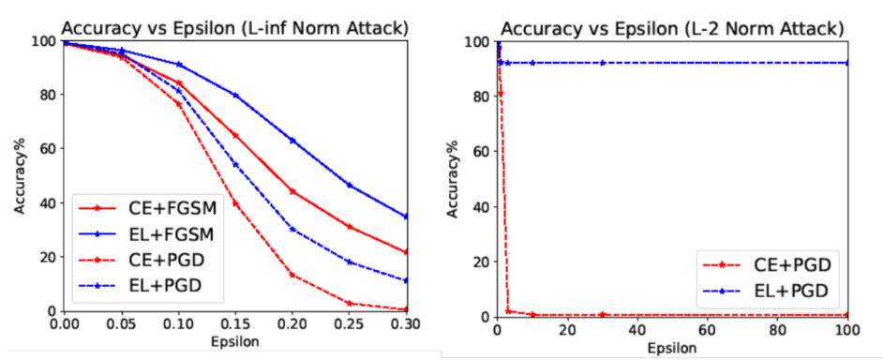
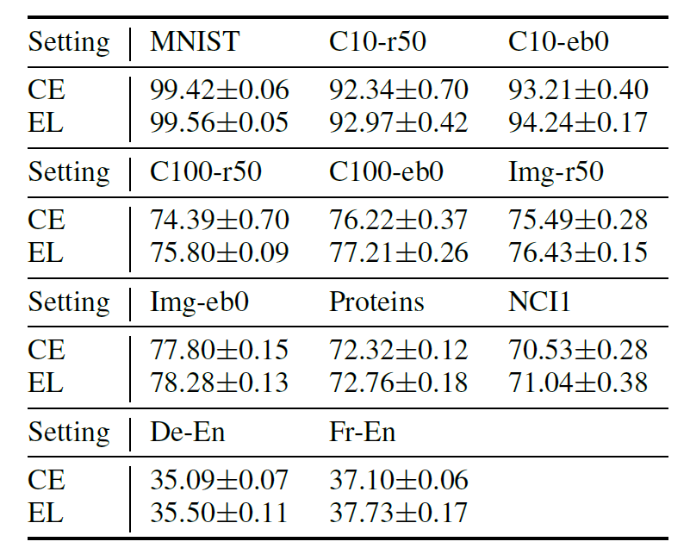
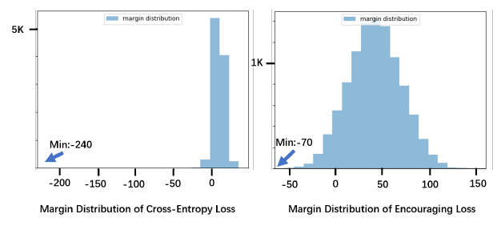
Summary
Have you ever trained deep classification models with Cross-Entropy (CE) loss, and been told to focus on hard examples but ignore easy ones?
We find that common belief does not stand! Learning easy examples actually improves margin, robustness and performance on graph, text, and image classification tasks, without tuning any original hyperparameters.
Target class
easy examples
hard examples
Other classes
Boundary
Notes:
In this presentation, I will tell you how that can be possible.

Slide 3
Content
1. What is the common practice and why we doubt it? (Research topic)
2. How does CE loss suffer from underestimating well-classified examples theoretically? (New problem)
3. What can we gain from reviving the learning of well-classified examples theoretically? (Solution)
4. What is the practical effect? (Empircal results)
5. Can our idea extend to MSE or variations of CE loss？(Versatility)
Notes:
The structure of this talk is in this page.

Slide 4
1. What is the common practice and why we doubt it? (Research topic)
Cross Entropy loss and its variations dominate the training of deep classification models
Variantions of CE loss:
Focal loss,
Label smoothing,
Large margin softmax,
….
MSE[1]
CE Loss[2]
1986
1988
Now
[1] Rumelhart, D. E.; Hinton, G. E.; and Williams, R. J. 1986.
Learning representations by back-propagating errors. Nature
[2] Baum, E.; and Wilczek, F. 1988. Supervised Learning of
Probability Distributions by Neural Networks. NeurIPS

Slide 5
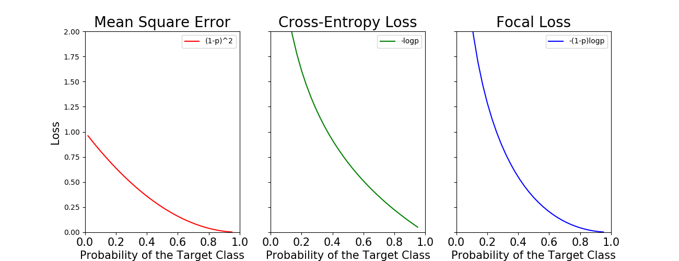
1. What is the common practice and why we doubt it? (Research topic)
What is the conventional wisdom in classification with deep neural networks?
Well-classified
examples
Loss is not steep
They all focus on bad-classified examples but ignore well-classified examples
that are far from the decision boundary and have high probability regarding the target

Slide 6
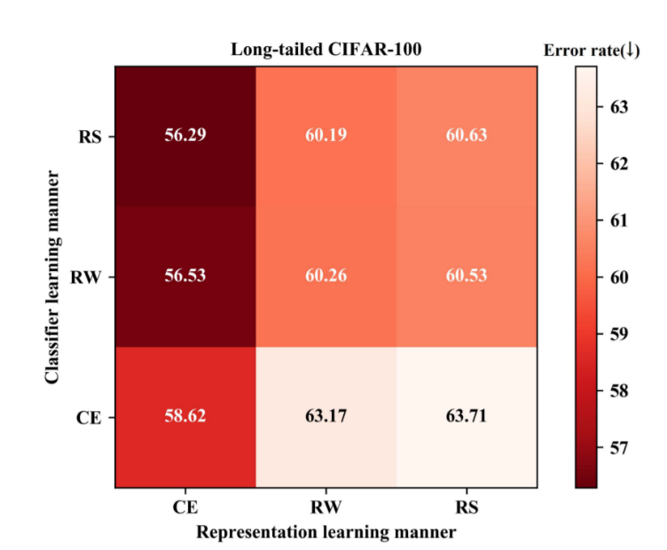
1. What is the common practice and why we doubt it? (Research topic)
Why we doubt that common practice?
  1. Inspired by the progress in imbalanced learning
    They find that down-weighting the learning of examples with common
    classes hinders the representation learning [1].
CE is better than re-weighting
methods (RW&RS) for
representation learning
[1] Zhou et al., 2020, bbn bilateral-branch network with cumulative
learning for long-tailed visual recognition, CVPR

Slide 7
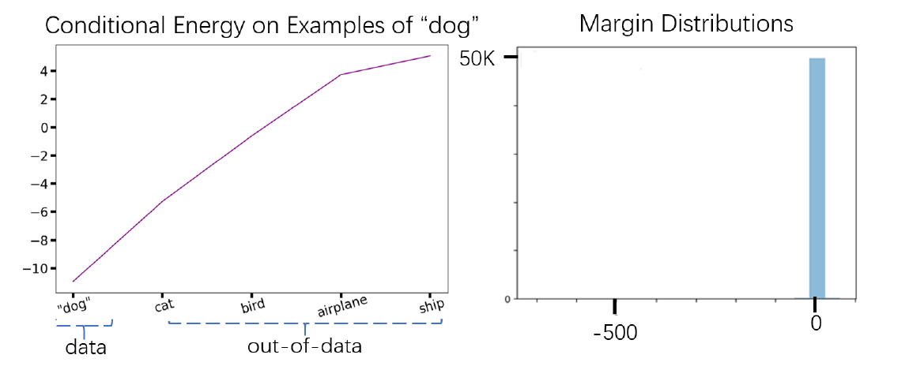
1. What is the common practice and why we doubt it? (Research topic)
Why we doubt that common practice?
  2. Our observations:
  b. Margins are small.
  Energy surface
  around data is not
  sharp.

Slide 8



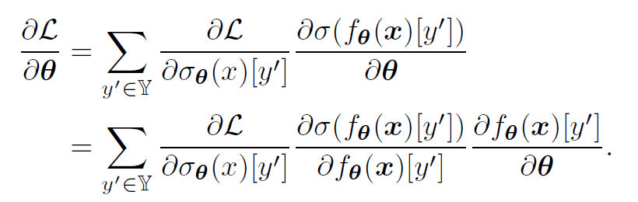
2. How does CE Loss suffer from underestimating well-classified examples theoretically? (New problem)
Definition
  Likelihood: probability of the target
  CE loss
  Back-propagation

Slide 9
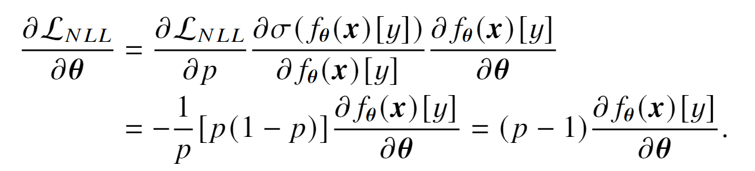
2. How does CE Loss suffer from underestimating well-classified examples theoretically? (New problem)
Gradient vanishing for easy examples
  Baum and Wilczek (1988) introduce CE loss to back-propagation and point out it addresses the gradient vanishing in MSE and makes predictions more accurate.
  However, the normalization function (softmax or sigmoid) brings the gradient vanishing back as the probability of the target becomes large.

Slide 10
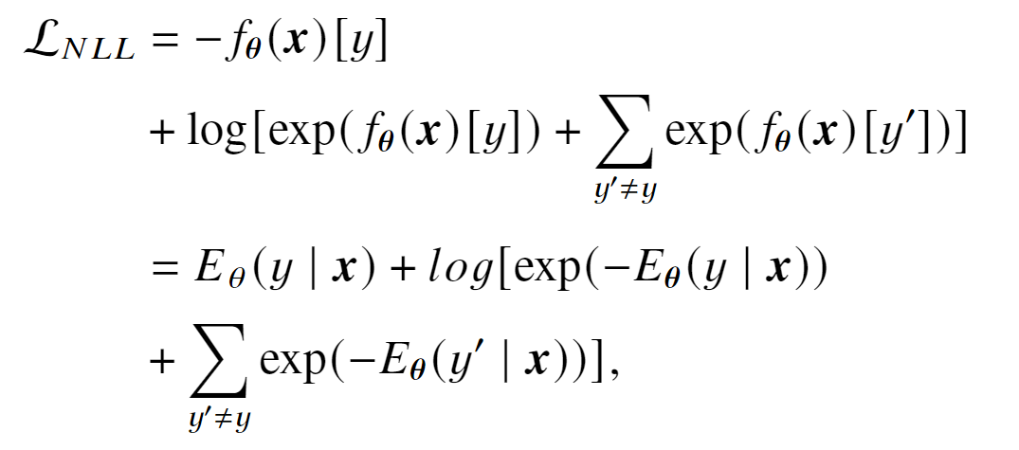
2. How does CE Loss suffer from underestimating well-classified examples theoretically? (New problem)
CE loss has insufficient power in reducing the energy on the data manifold.
Opposite power
in the denominator

Slide 11
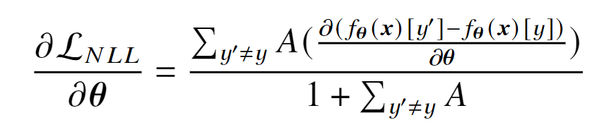

2. How does CE Loss suffer from underestimating well-classified examples theoretically? (New problem)
CE loss is not effective in enlarging margins.
  When the prediction gets close to the target during training, A gets close to 0, but the denominator has a constant 1, so the incentive to further enlarge the margin gets close to 0.
A denotes

Slide 12
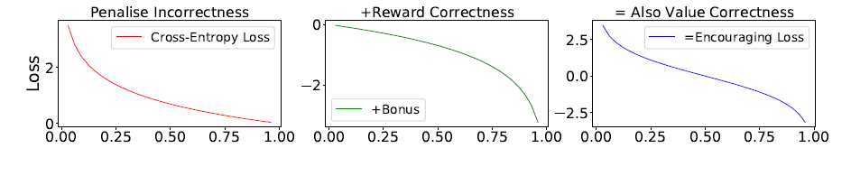
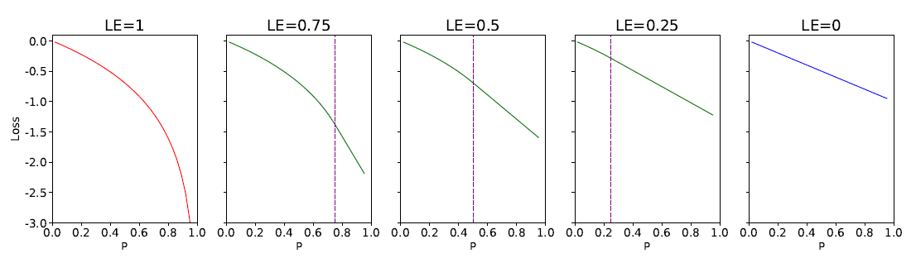
3. What can we gain from reviving the learning of well-classified examples theoretically? (Solution)
We define Encouraging Loss (EL) that revives the learning of well-classified examples by rewarding correct predictions.
We can early stop the log curve of the bonus to make it more conservative.
Notes:
What if we enhance the learning of well-classified examples

Slide 13


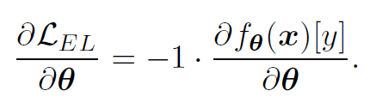
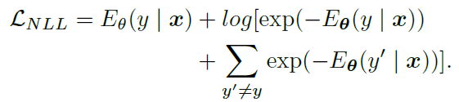
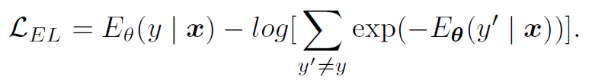
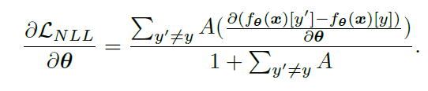
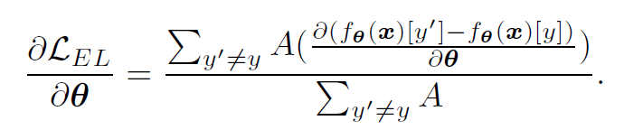
3. What can we gain from reviving the learning of well-classified examples theoretically? (Solution)
Can enhancing the learning of well-classified examples by EL solve the three issues of CE loss?
a. Gradient
a. The first term of EL is always 1.
b. Energy
b. EL has no barrier in the second term.
c. Margin
Comment: The conservative variants can
also partially solve the problems.
c. A still gets to 0 when margin gets larger,
But 1 is removed from denominator.

Slide 14
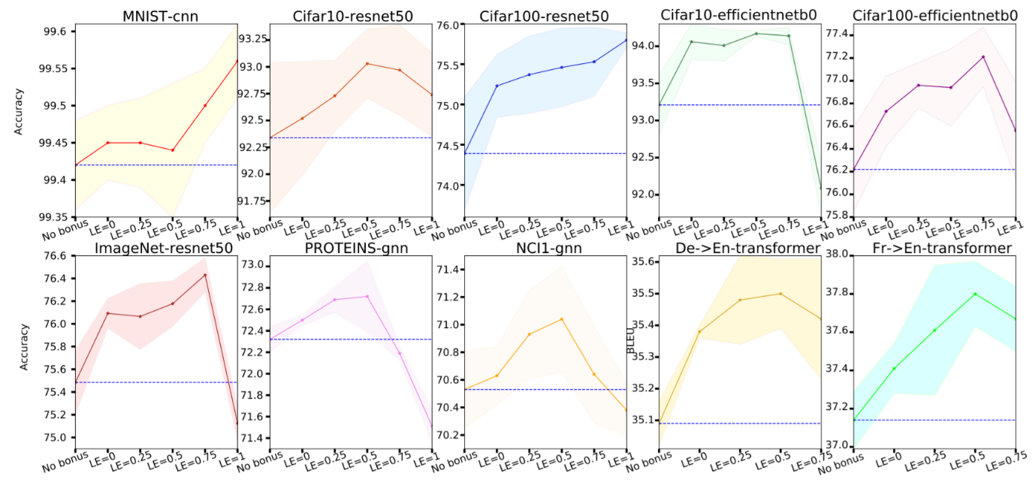
4. What is the practical effect? (Empircal results)
Can the learning of well-classified examples improves performance?
Yes!
Without changing any original
hyper-parameters.

Slide 15

4. What is the practical effect? (Empircal results)
Can the learning of well-classified examples improves performance?
  One-line code can deserve 300M data.
+
=
Improve sota model efficientnet-b0
From 77.3 to 78.1 on ImageNet
With Noisy Student [1]
Imagenet (1.2M)
GOOGLE’ Private JFT300M
+
Import EncouragingLoss as loss
=
Improve sota model efficientnet-b0
From 77.8 to 78.3 on ImageNet
With Our Method
Imagenet (1.2M)
One Line code
[1] Xie et al., Self-training with Noisy Student improves ImageNet classification, CVPR 2020

Slide 16
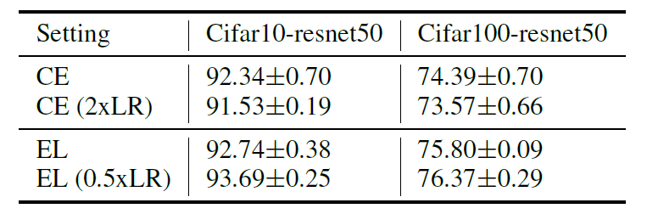
4. What is the practical effect? (Empircal results)
Can we tune the original hyper-parameters to get more improvements?
  Yes!
  EL (LE=1) greatly increases the overall norm of gradients. Enlarging learning rate of CE loss also hurts performance.
  Sot we can turn down the learning rate to adapt EL to existing optimization systems.

Slide 17
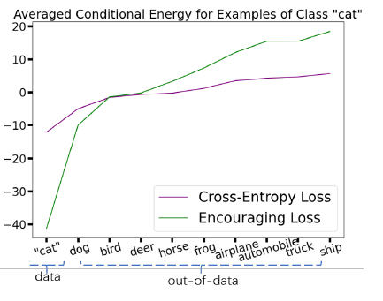
4. What is the practical effect? (Empircal results)
Can we address theoretical issues of CE loss in practice?
Yes!
a. Reduce conditional energy E(y|x)
by 4x
b.Move the majority of margin from 0 to 50

Slide 18
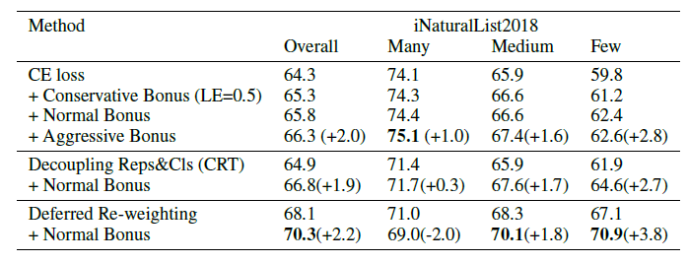
4. What is the practical effect? (Empircal results)
Dose down-weighting the learning of well-classified examples also despair representation learning?
Yes! We empirically verify that the traditional re-weighting at the sample level (CE loss down-weights the importance of well-classified samples) is also harmful to representation learning.
Decoupling Reps&Cls: Do not down-weight
common classes in representation learning
+Normal Bonus: Nor does it down-weight the
learning from easy examples.
Comparison between CE loss and encouraging loss
(add a bonus to CE loss) on the large-scale imbalanced
classification dataset iNaturalist 2018

Slide 19
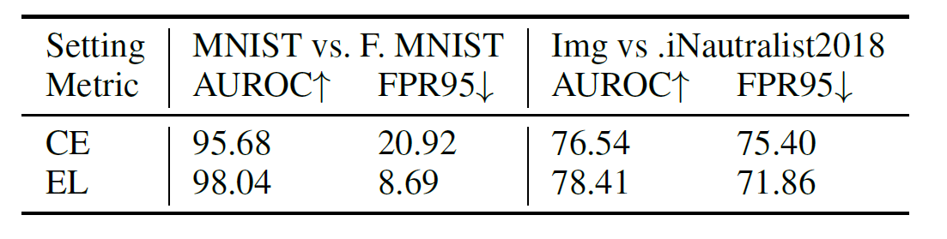
4. What is the practical effect? (Empircal results)
Can the discriminative energy distribution help OOD detection (To detect whether the input is in the training set distribution)?
  Yes!

Slide 20

4. What is the practical effect? (Empircal results)
Can the large margin brought by reviving the learning of well-classified examples help defend against adversarial attacks?
  Yes!
Accuracy on MNIST

Slide 21
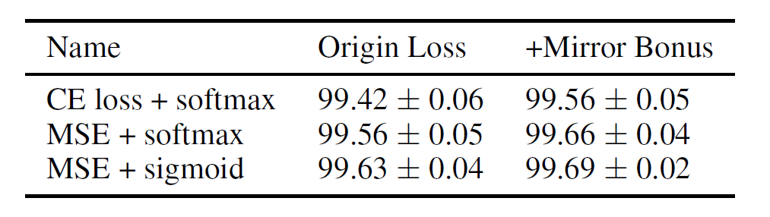
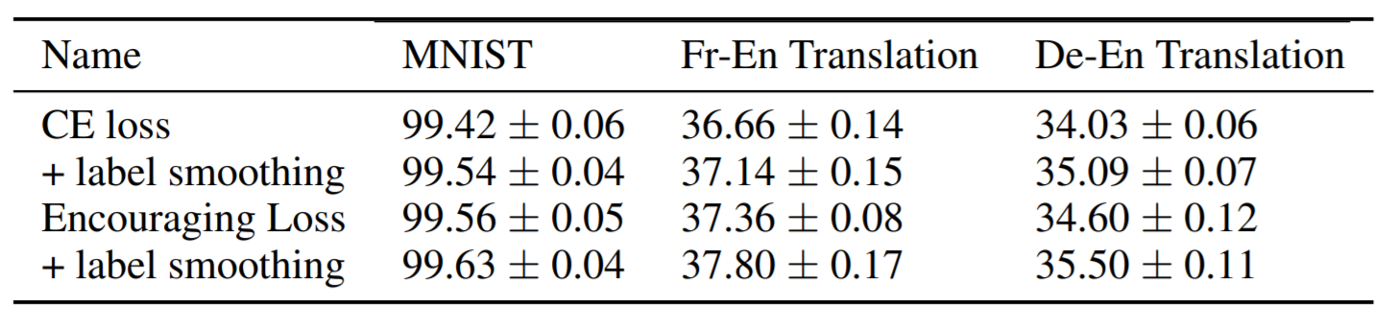
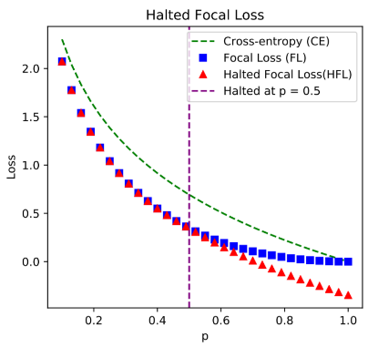
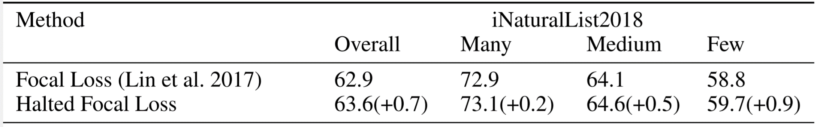
5. Can our idea extend to MSE or variations of CE loss? (Versatility)
MSE:
  Even MSE is better than CE
  on MNIST, it also gets benefits
  from learning well-classified
  examples.
Label smoothed CE loss
  Our improvements are
  on par with it.
Focal loss
Enhancing the learning of well-classified examples instead improves
the performance of rare classes.

Slide 22
Conclusion
We theoretically and empirically show that well-classified examples help:
  representation learning
  energy optimization
  and the growth of margin.
We show that this small change consistently improve performance on image, text, graph datasets.
The learning of well-classified examples improves imbalanced learning, OOD detection, and adversarial robustness.

Slide 24
Thanks

