Slide 1

The Social Coding Environment for Big Data Analytics and Visualization
https://rcloud.social/index.html

Slide 2
Why RCloud
RCloud was primarily created to facilitate collaboration for big data analytics and visualizations.
It was built to help teams of data scientists, working on the same project, to create reusable code, share code and annotate their work.

Slide 3
Features and Benefits
Collaboration
Rate other peoples code and share your code with others
Topic areas search for similar relevant code
Code is available on github
Distributed Computing
Parallel and distributed processing
Can handle large data sets – “big data”

Slide 4
Features and Benefits
Version Control
Web-based notebooks
Make it easy to create a new version or fork an existing version of code
Plus its easier to see what packages, code, data sources and web servers were used.
Multiple Languages
R and Python supported

Slide 5
Features and Benefits
Deployment as a web service
Accessible through a web browser so you can access your code anywhere.
Scalability
Integration of analysis language with UI
Has the capability to hide your code and present it nicely so anyone from business executive to project managers can understand and interact.

Slide 6
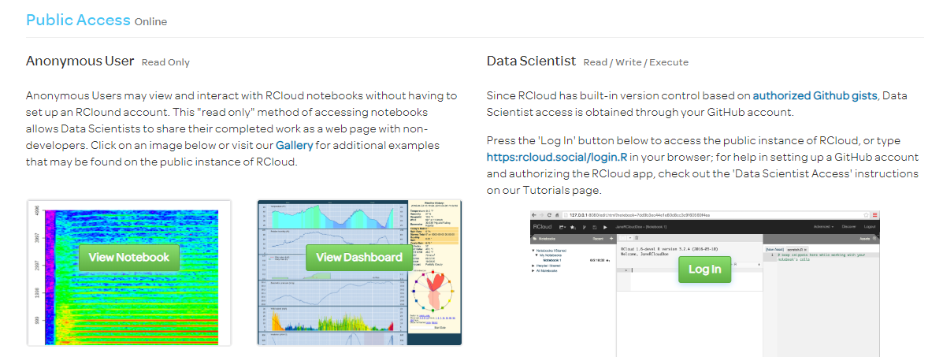
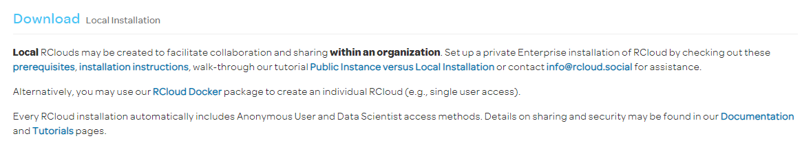
Public or Private?
You can create a public account as a data scientist or view and interact with shared notebooks as an anonymous user.
OR you can set up a local Rcloud that only shares your code within an organisation.

Slide 7
Tutorials that may interest us
Tutorials
Creating, Forking and Saving web notebooks
Data – Loading and Saving
Sharing note books
Privacy, Security and notebook protection
Using Shiny on RCloud
Documentation
Community

Slide 8
Test Driving Rcloud
Anyone with a github account can access the public Rcloud online.
Local installation is not available currently for Windows… only for OS X.
Can only be used through Google chrome currently…
Errors in the tutorial page – early stages of development - but has potential https://rcloud.social/view.html?notebook=af829ffb418ed0f054d1

Slide 9
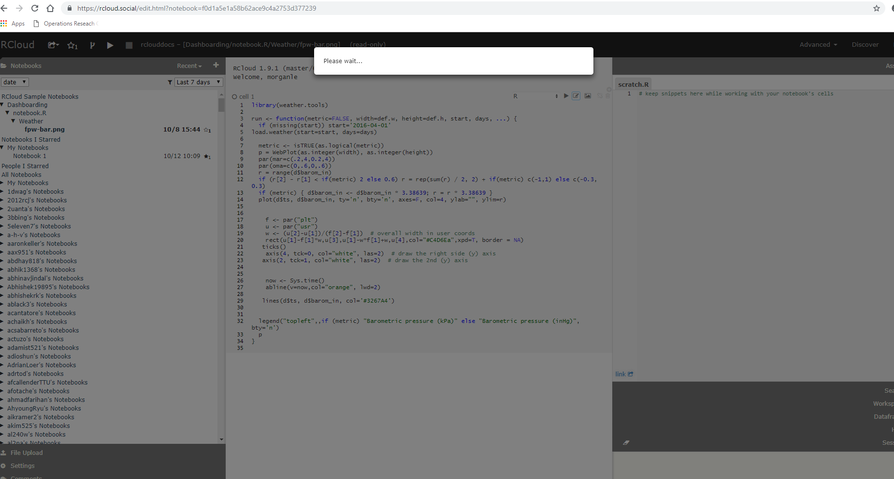
Having a go…

