Slide 1



Search in Imperfect Information Games using Online Monte Carlo Counterfactual Regret Minimization
Marc Lanctot¹, Viliam Lisý², and Michael Bowling³
¹Games and AI Group
Dept. of Knowledge Engineering
Maastricht University
The Netherlands
²Agent Technology Center
Dept. of Computer Science, FEE
Czech Technical University in Prague
Czech Republic
³Computer Poker Research Group Dept. of Computing Science
University of Alberta
Canada

Slide 2
Online Game Playing Setting
Exact game description is known shortly before the match
Game size prohibits its complete construction in memory
Limited computation time, mostly during the game play
Strategy in vast majority of information sets is irrelevant
We focus on two player zero-sum extensive form games with imperfect information.
Notes:
Stress that it contracts to what is common in Poker, but it complements each other
There are domains where building abstract game an solving it for few weeks if a good approach, and there are domains, where it is not the case

Slide 3
Example domains
General game playing
Formal description of rules of generally large games
Few seconds/minutes of initial thinking time
Seconds per move in the game
Real-time robotics
Pursuit-evasion in previously unknown environment
Various robots’ capabilities

Slide 4
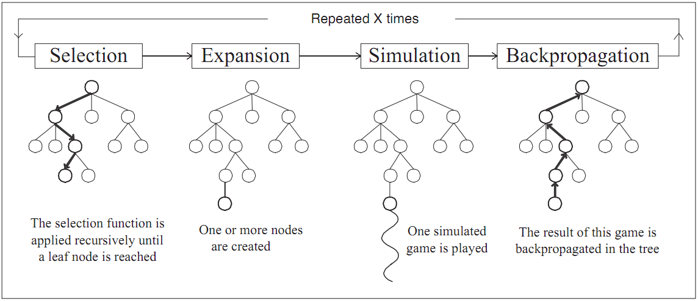
Previous Work
MCTS recently very successful in perfect information
Adaptations for imperfect information
Perfect information sampling MCTS (Ginsberg 2001)
MCTS on information set tree in Kriegspiel (Ciancarini, Favini 2010)
MCTS with short term imperfect information (Teytaud, Flory 2011)
ISMCTS on EFG without modelling beliefs (Cowling, Powley 2012)
Picture from Chaslot et al. 2007
Notes:
Only one has a chance to converge to NE

Slide 5
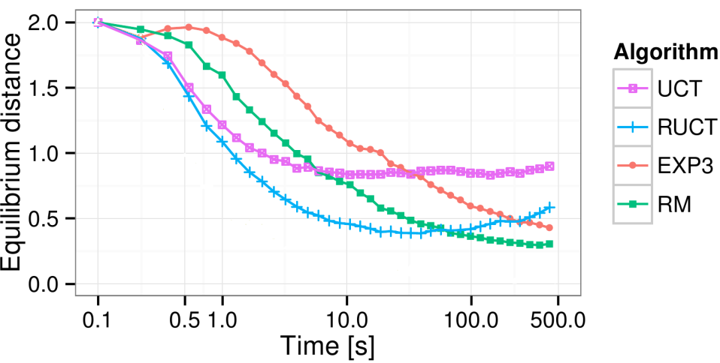
Convergence guarantees
Perfect information sampling MCTS (Ginsberg 2001)
Strategy fusion, non-locality
MCTS on information set tree in Kriegspiel (Ciancarini, Favini 2010)
Requires evaluation function, no mixed strategies
MCTS with short term imperfect information (Teytaud, Flory 2011)
Should converge, but no evaluation in this direction
ISMCTS on EFG without modelling beliefs (Cowling, Powley 2012)
Notes:
ISMCTS no belief=no chance in game play
Even without that, it does not converge

Slide 6

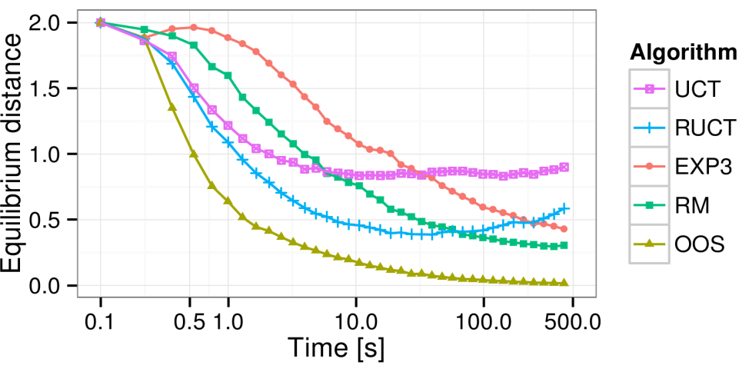
Convergent MCTS algorithm for IIGs
Main Goal
Create MCTS algorithm for imperfect information games that converges to Nash Equilibrium of the game
II-Goofspiel(6)
MCCFR
Notes:
May not be the best thing to do, we might want to remove dominated strategies as quickly as possible, but it is definitiely important to look at the problem from GT perspective

Slide 7
Online Outcome Sampling
Main idea
Start from Monte Carlo Counterfactual Regret Minimization
Add incremental tree building to save memory
Target the search towards relevant parts of the search tree
Clear the information sets that became irrelevant from memory
Notes:
May not be the best thing to do, we might want to remove dominated strategies as quickly as possible, but it is definitiely important to look at the problem from GT perspective

Slide 8
Online Outcome Sampling
Single
iteration
γ-on policy
selection
MCCFR
update
Incremental
tree building
Current
information set
Newly added
information set
Random
simulation
-1
Terminal state

Slide 9
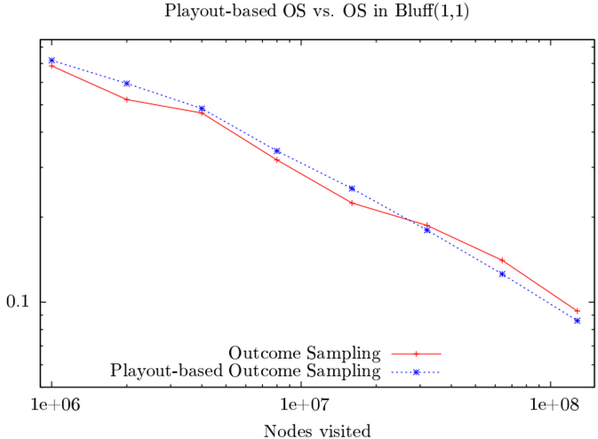
Incremental Tree Building
Does incremental tree building substantially slow down convergence?
Liar’s Dice (1,1)
Distance form Nash Equilibrium

Slide 10
Search Targeting
Consistent with outcome sampling with non-uniform sampling scheme to preserve convergence guarantees.
γ-on policy sampling for relevant part of the game
Information set targeting
Sample more often the histories in the current IS
To much focus assumes the opponent has our information
Public sub-game targeting
Target the parts of the game everybody knows will occur
Too much focus may bias past decision probabilities
Notes:
Consistency -> keep track of overall prob. of sampling a leaf
γ-on policy – sample more the actions that seem to be more likely to be played

Slide 11
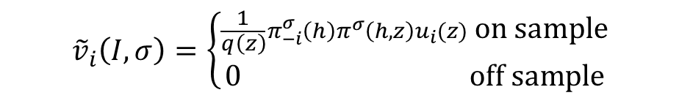
Irrational opponent’s moves
$${\tilde{v}}_{i}\left(I,σ\right)=\left\{\begin{aligned}\frac{1}{q\left(z\right)}π_{−i}^{σ }\left(h\right)π^{σ}\left(h,z\right)u_{i}(z) \text{on} \text{sample} \\ \text{0} \text{off} \text{sample}\end{aligned}\right.$$
We cannot restrict the game only to what was played
The opponent may not know we know he played irrationally
ε-regret matching
Does not strongly influence convergence guarantees

Slide 12
Pruning the tree in memory
Perfect information games
We can drop everything out of the current sub-game
Imperfect information games
Rarely include sub-games, e.g., simultaneous move games
Public sub-game under some conditions
What else?

Slide 13
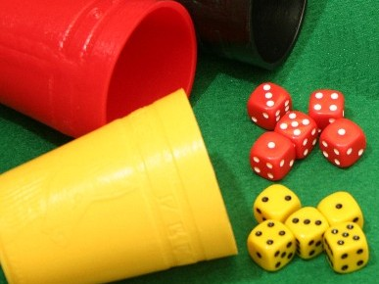
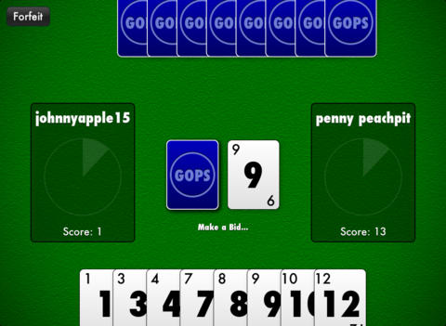
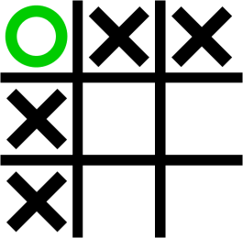
Experimental domains
Liar’s Dice
Includes public actions
Imperfect Information Goofspiel
No public actions
Phantom Tic-Tac-Toe
Different history lengths in an information set
Asymmetric
Reference implementation: http://agents.fel.cvut.cz/topics/Computational_game_theory
Notes:
LD: Each player sees only their dice and they alternate in bidding how good is the combination of all dice, until one of them accused the other of lying. Each bid has to be higher then the previous one.
Goof: Each player, cards with values 1 to n and there are n points cards. Each trick starts by revealing the points card. Each player chooses simultanously one of his cards as a bid and the player with higher card wins. In imperfect invormation variant, players learn only if they won the trick, but not the value of the card

Slide 14
Distance from Nash Equilibrium
No standard methods
Only small part of strategy is computed / used
Tournament
Exploitability in the root
Full Stitching
Make the algorithm reach each IS and stitch the strategies
Aggregate Method
Run large number of matches and combine computed parts
Notes:
Tournament = Depends on opponents, time consuming, hard to interpret
Exploitability in the root = Does not tell a lot about actual performance in the game
Full Stitching too time consuming
Aggregate method a reasonable approximation

Slide 15
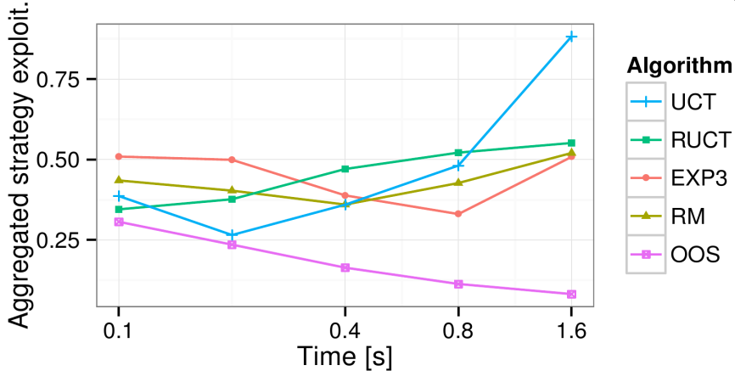
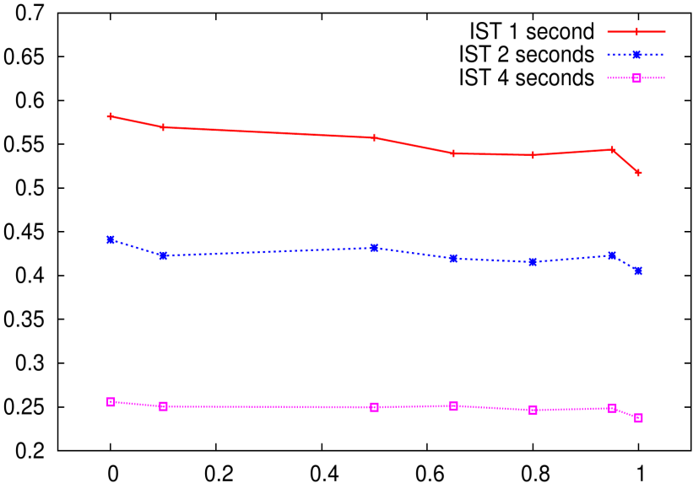
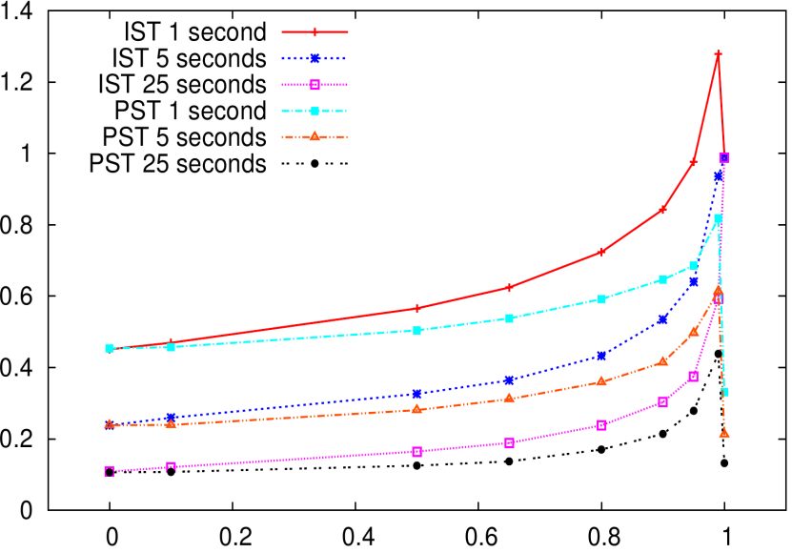
Distance from Nash Equilibrium
II-Goofspiel(6)
II-Goofspiel(6)
Liar’s Dice (1,1)
Exploitability (Aggregated)
Probability of targeting the current information set - δ
Notes:
We have succeeded, not only in root as I have shown you, but in multi-match as well
Added time hepls, that was the main goal

Slide 16
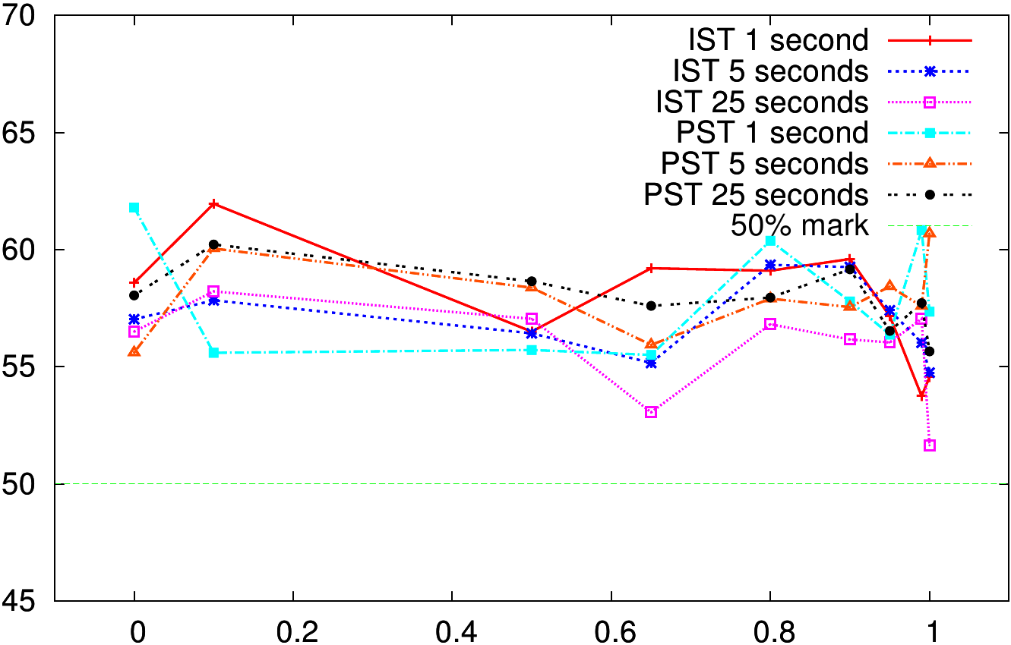
Head-to-head against IS-MCTS
Liar’s Dice (1,1)
Draw game in: II-Goofspiel(13), Liar’s Dice (2,2), Phantom Tic-Tac-Toe
Notes:
In large games, it cannot get the benefit.
OOS can likely still be improved
IS-MCTS worth more studying, possibly removed dominated moves much more quickly

Slide 17
Conclusions
Existing MCTS methods do not converge to NE in IIGs
We provide Online Outcome Sampling that does
It provides low exploitability even with very short computation
However, it still only ties with ISMCTS on large games

