Slide 1
Introduction to Browser DevTools
Ci-Wei Lan 藍啟維
Dept. of CSE, NTOU

Slide 2
Open DevTools in Browsers
Keyboard:
  Windows: Ctrl + Shift + I or F12
  macOS: ⌘ + ⌥ + I
  Linux: F12
Menu bar:
  Firefox: Menu (☰) ➤ More tools ➤ Web Developer Tools
  Chrome: More tools ➤ Developer tools
  Opera: Developer ➤ Developer tools
  Safari: Develop ➤ Show Web Inspector.
Context Menu (Right Click):
  Press-and-hold/right-click an item on a webpage (Ctrl-click on the Mac), and choose Inspect Element from the context menu that appears. (An added bonus: this method straight-away highlights the code of the element you right-clicked.)
Quick Reference
  https://developer.mozilla.org/en-US/docs/Learn_web_development/Howto/Tools_and_setup/What_are_browser_developer_tools

Slide 3
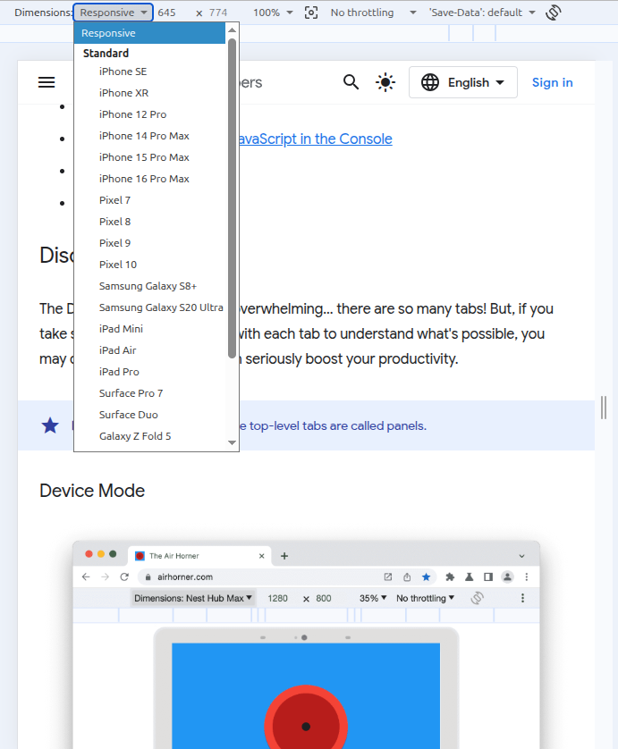
Device Mode
Simulating a mobile viewport
Think of device mode as a first-order approximation of how your page looks and feels on a mobile device. With device mode you don't actually run your code on a mobile device. You simulate the mobile user experience from your laptop or desktop.
References
  https://developer.chrome.com/docs/devtools/device-mode
  https://developer.chrome.com/docs/devtools/sensors

Slide 4
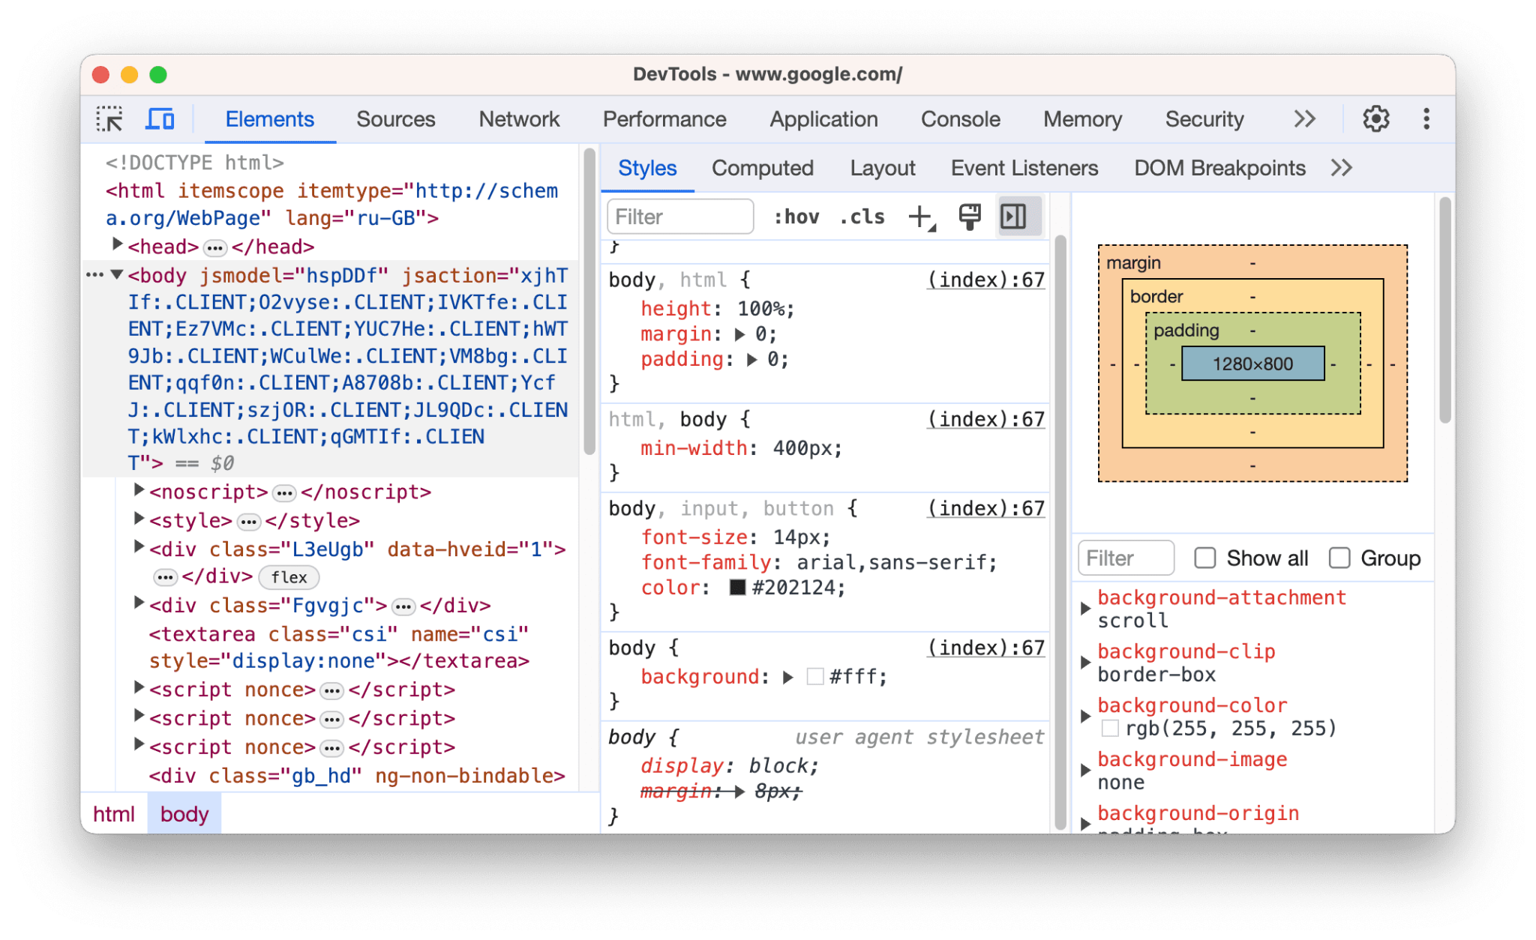
Elements panel
View and change the DOM and CSS.
  Get started with viewing and changing the DOM
  Get started with viewing and changing CSS
  Edit CSS
  Edit the DOM
  Find invalid, overridden, inactive, and other CSS
  Identify potential CSS improvements
  Emulate light/dark themes, contrast, and other CSS media features
  Find unused CSS
  Inspect animations
https://developer.chrome.com/docs/devtools/overview#elements

Slide 5
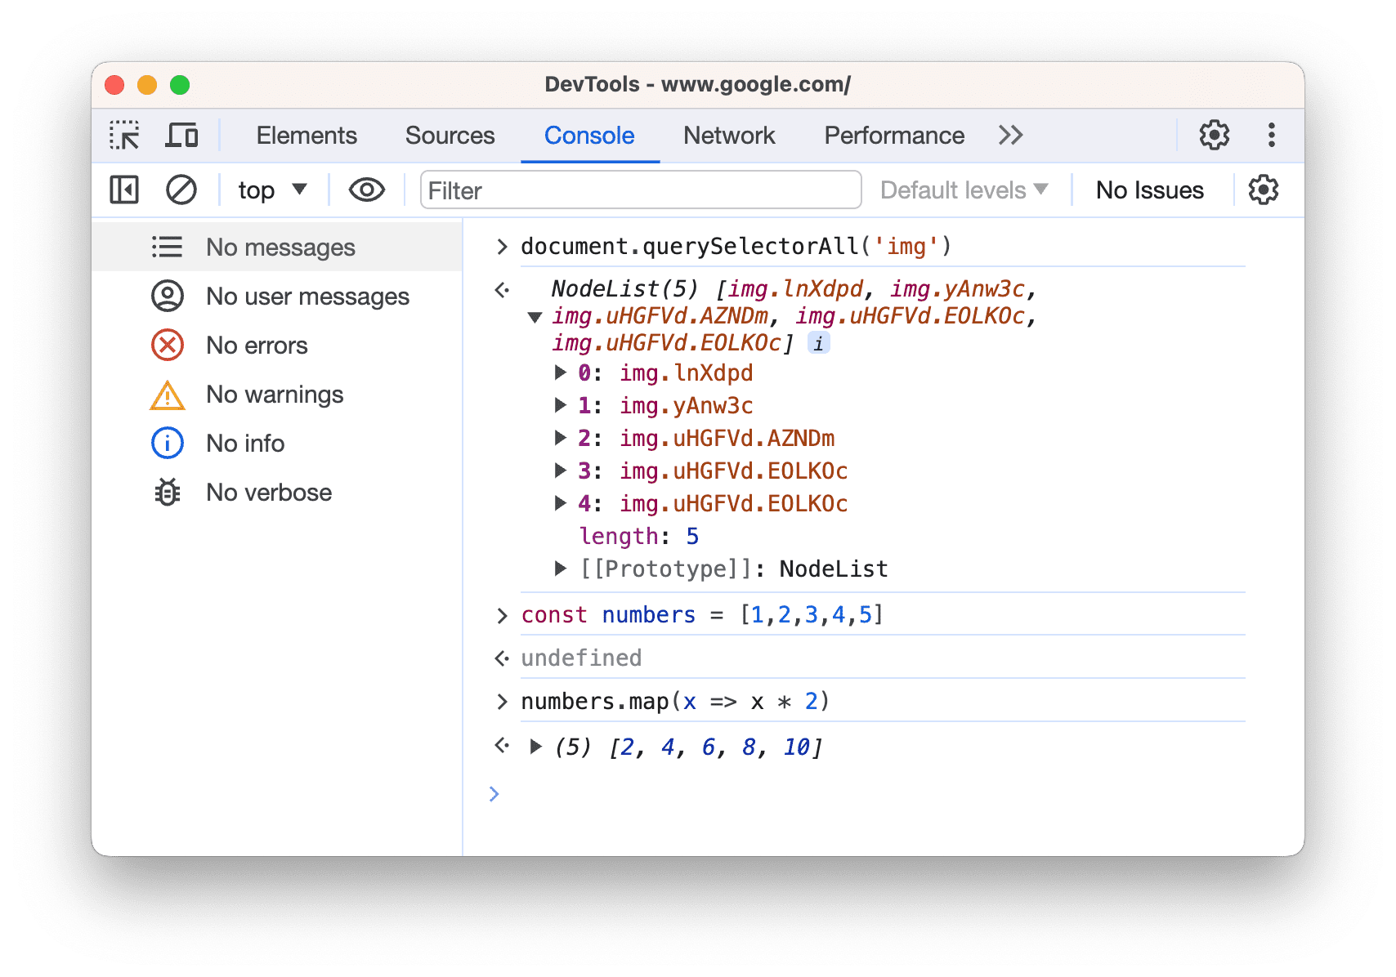
Console panel
View messages and run JavaScript from the Console.
  Get started with the Console
  Console Utilities API reference
  Console API reference
https://developer.chrome.com/docs/devtools/overview#console

Slide 6
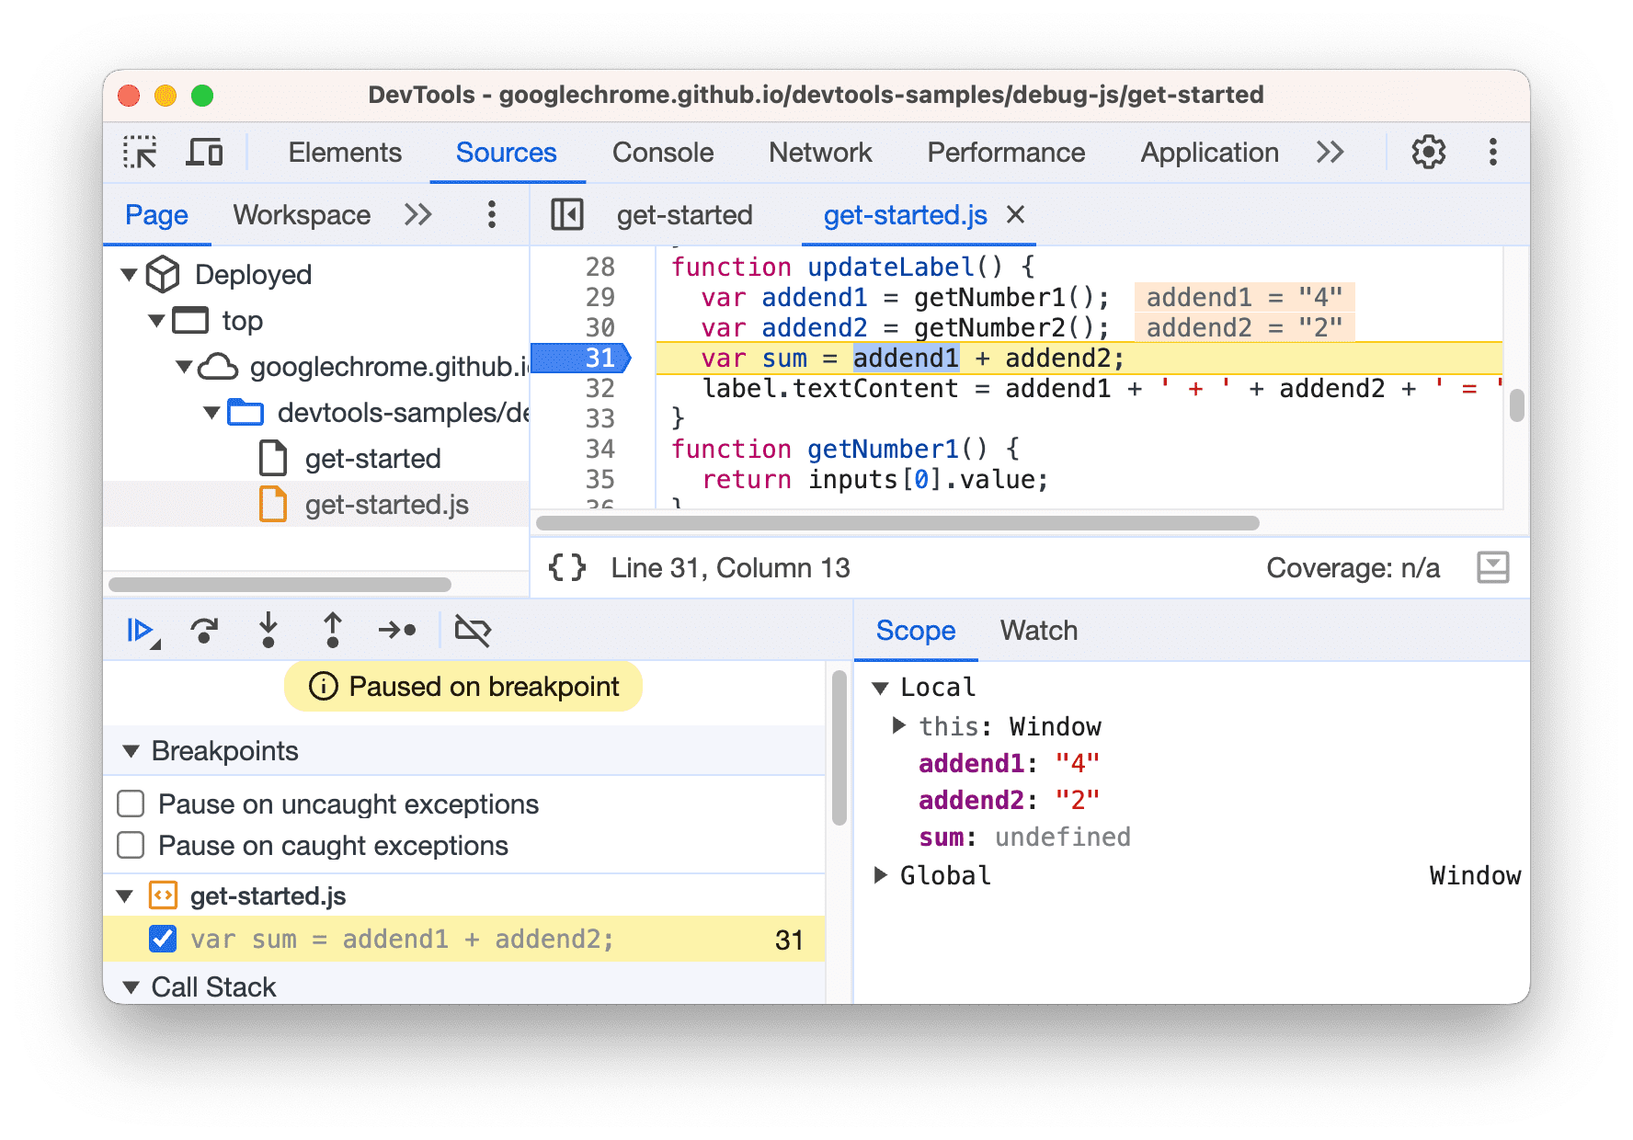
Sources panel
Debug JavaScript, persist changes made in DevTools across page reloads, save and run snippets of JavaScript, and save changes that you make in DevTools to local sources.
  Get started with debugging JavaScript
  Pause your code with breakpoints
  Edit and save files in a workspace
  Run snippets of JavaScript
  JavaScript debugging reference
  Override web content and HTTP response headers locally
https://developer.chrome.com/docs/devtools/overview#sources

Slide 7
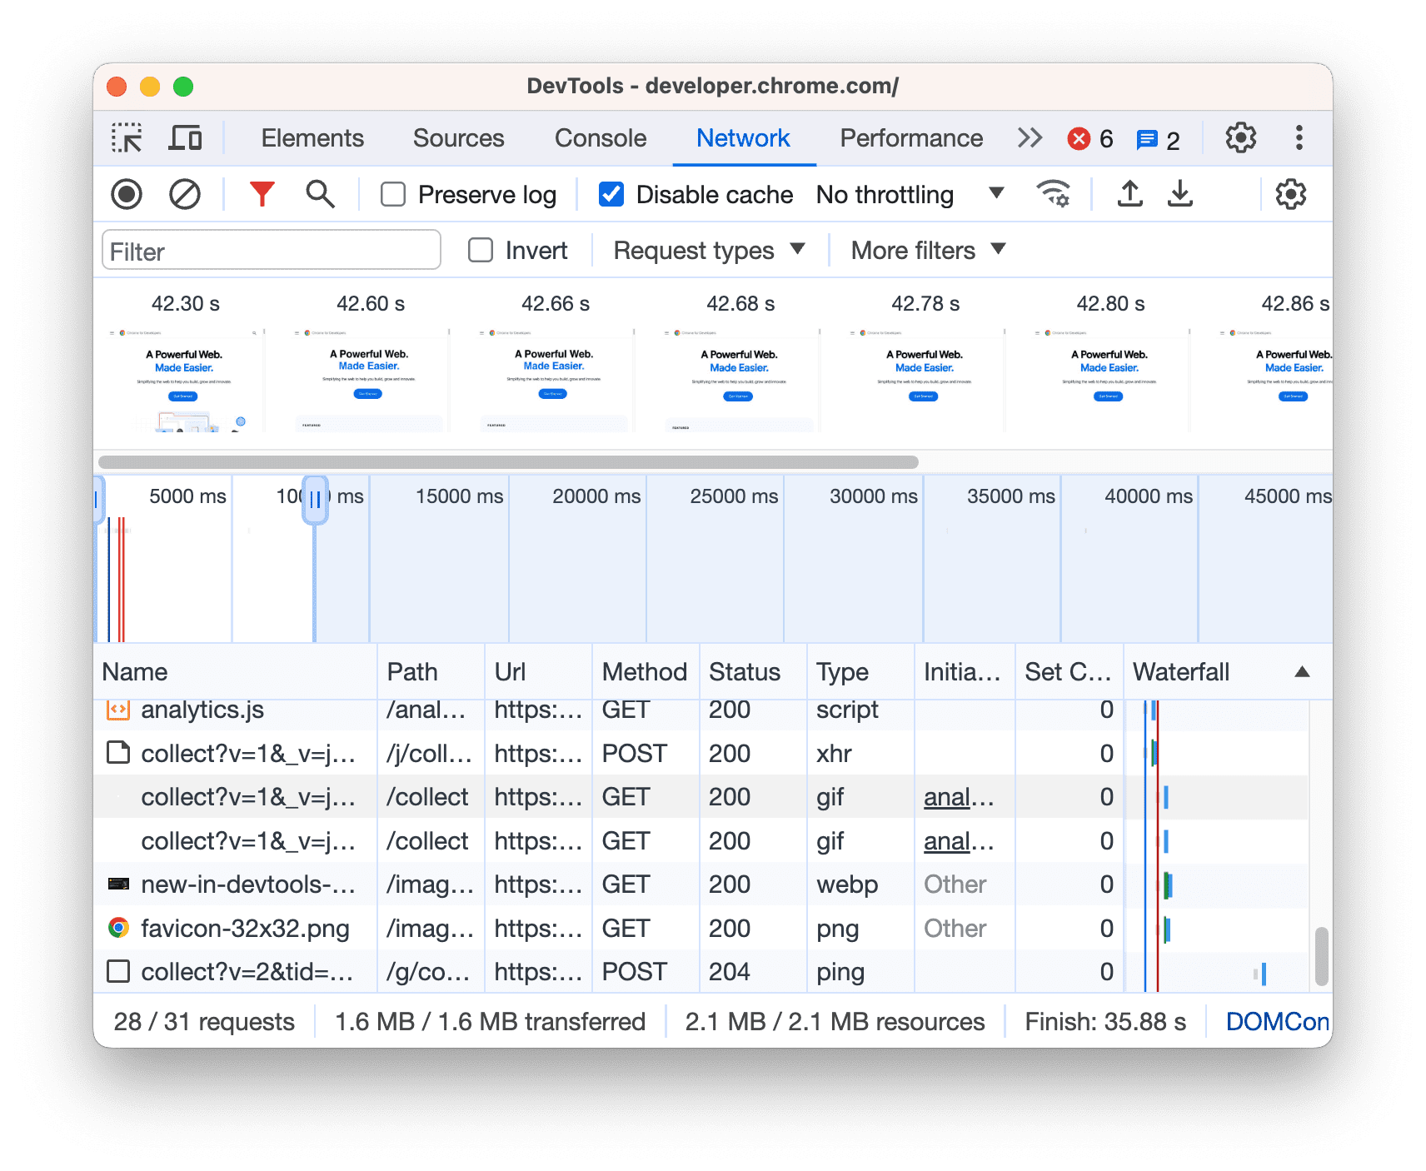
Network panel
View and debug network activity.
  Inspect network activity
  Network features reference
  View page resources
https://developer.chrome.com/docs/devtools/overview#network

Slide 8
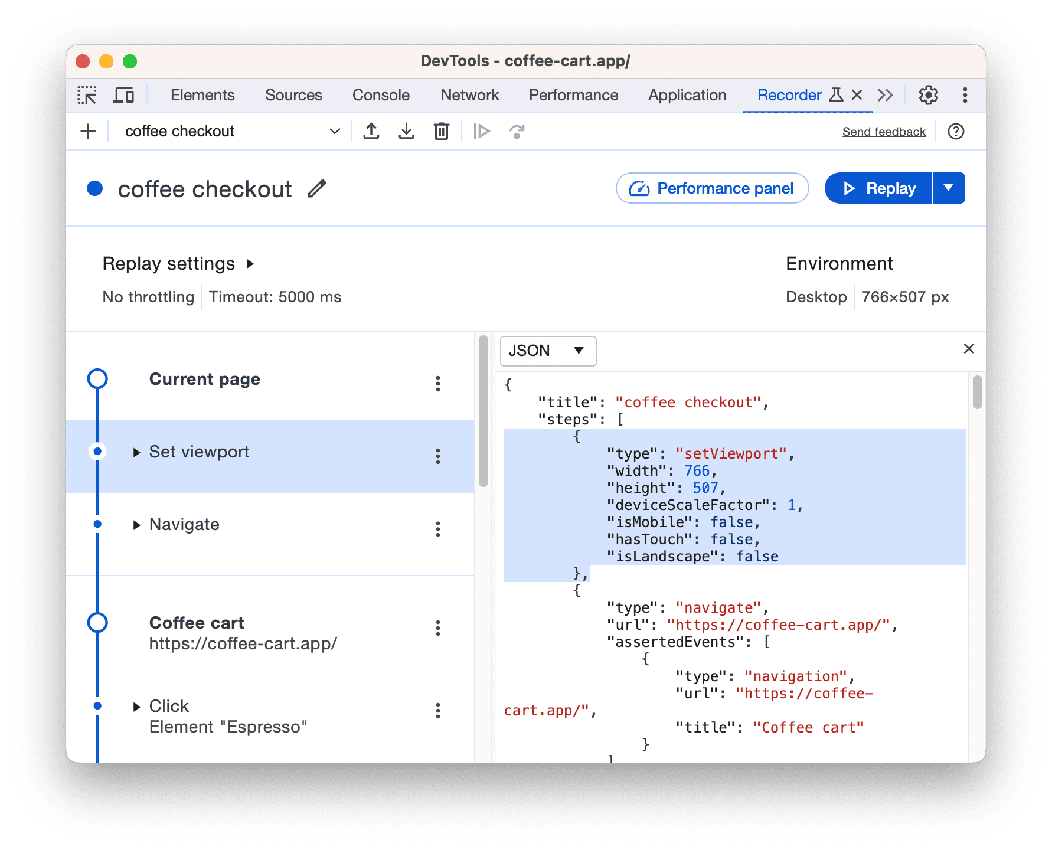
Recorder panel
Record, replay, and measure user flows.
  Record, replay, and measure user flows
  Customize the Recorder with extensions
  Recorder features reference
https://developer.chrome.com/docs/devtools/overview#recorder

Slide 9
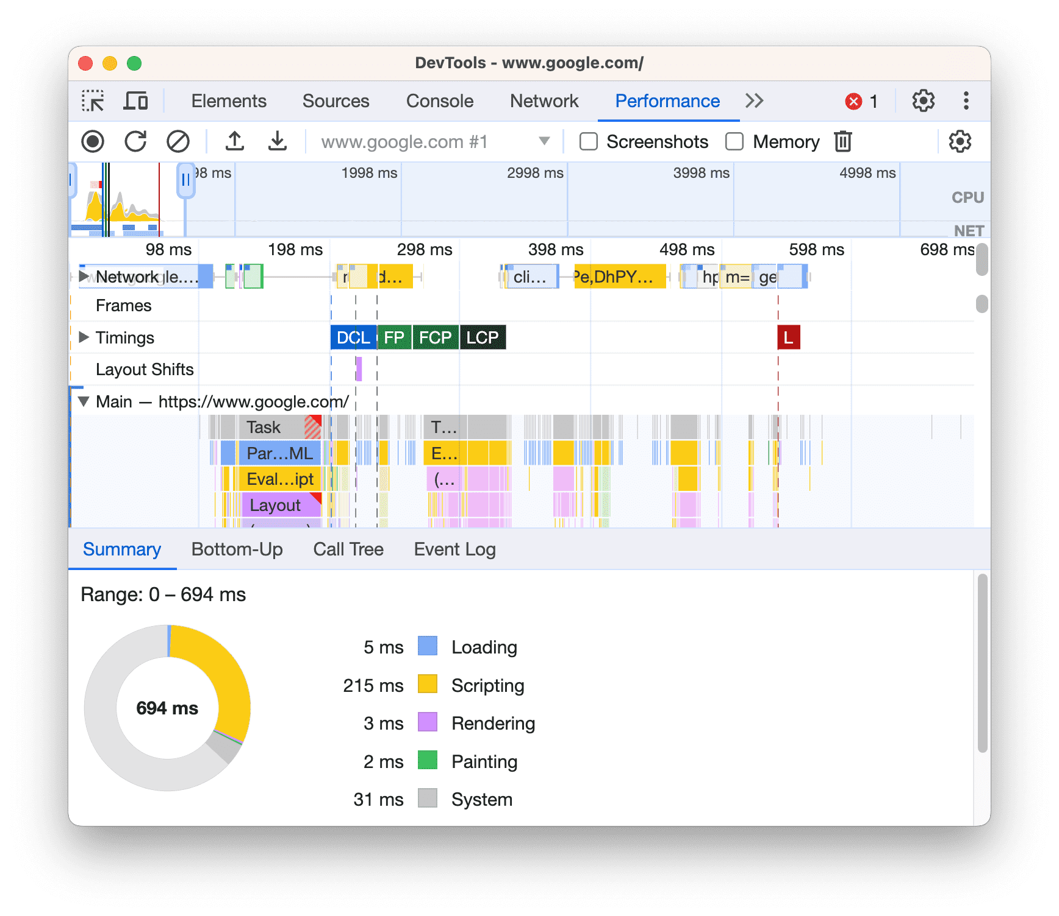
Performance panel
Find ways to improve load and runtime performance.
  Optimize website speed
  Analyze runtime performance
  Performance features reference
https://developer.chrome.com/docs/devtools/overview#performance

Slide 10
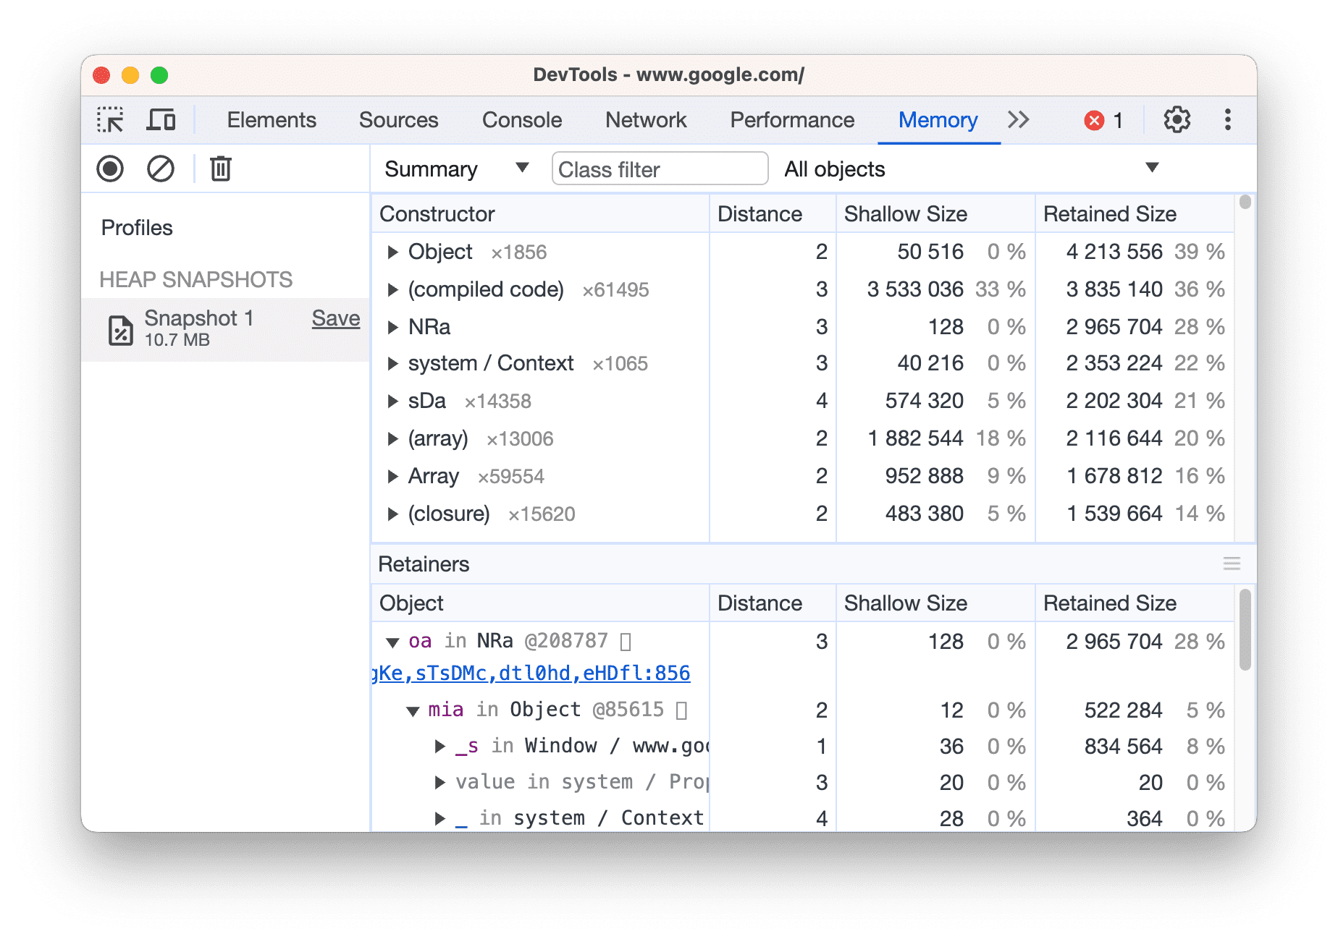
Memory panel
Find and fix memory issues that affect page performance, for example, memory leaks.
  Fix memory problems
https://developer.chrome.com/docs/devtools/overview#performance

Slide 11
Application panel
Inspect all resources that are loaded, including IndexedDB or Web SQL databases, local and session storage, cookies, Application Cache, images, fonts, and stylesheets.
  Debug Progressive Web Apps
  View and edit local storage
  View, add, edit, and delete cookies
  View origin trial information
https://developer.chrome.com/docs/devtools/overview#application

Slide 12
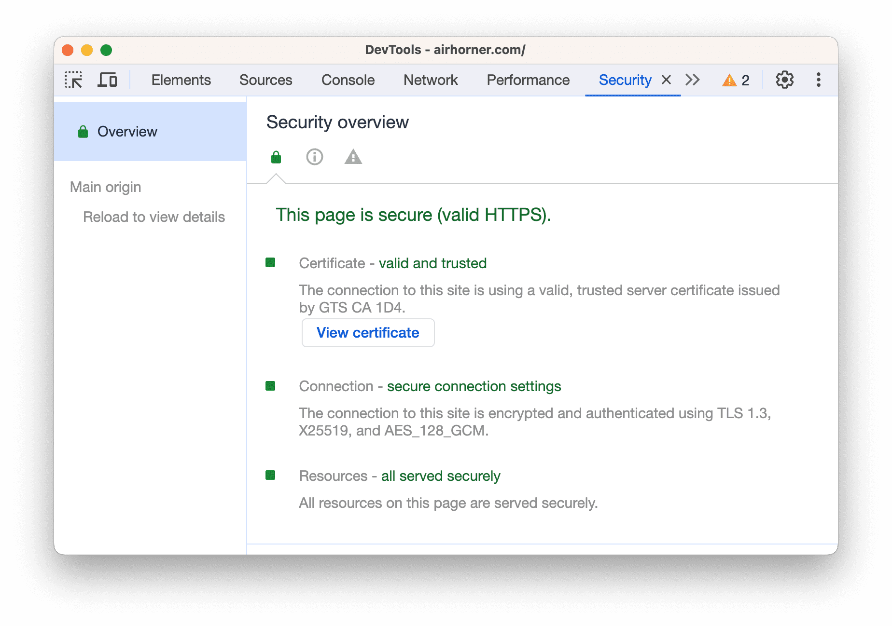
Security panel
Debug mixed content issues, certificate problems, and more.
  Understand security issues
https://developer.chrome.com/docs/devtools/overview#security

