Slide 1
Git and Github
Ci-Wei Lan 藍啟維
Dept. of CSE, NTOU

Slide 2
Version Control System
A Version Control System (VCS) is a tool that helps developers track, manage, and collaborate on changes to code or files.
  Modification are recorded as a snapshot
  Allowing teams to work together without overwriting each other’s work and to roll back to earlier versions when needed.
Local VCS: Stores versions on a single computer.
  Simple, but not suitable for collaboration.
Centralized VCS: All files and history on a central server.
  Easy to manage, but server downtime halts work
  SVN (Apache Subversion), CVS (Concurrent Versions System) etc.
Distributed VCS: Each developer has a full copy of the repo.
  Flexible, supports offline work; Git is the most popular example
  Git, Mercurial, Bazaar etc.

Slide 3
Git and Github Overview
Git is a free and open source distributed version control system designed to handle everything from small to very large projects with speed and efficiency.
Git was created by Linus Torvalds in 2005 for Linux kernel changes management.
  Distributed version control
  Coordinates work between multiple developers
  Who made what changes and when
  Revert back at any time
  Local & remote repos.
GitHub is a cloud-based platform built on Git that supports the entire software development lifecycle—from planning and coding to testing, deployment, and collaboration.
  Repositories: Central units where code and project files are stored.
  Collaboration Tools: Issues, pull requests, discussions, and project boards.
  CI/CD Automation: GitHub Actions enables automated testing, builds, and deployments.
  Security: Dependency scanning, vulnerability alerts, and code review tools.
  Community: Millions of developers contribute to open-source projects, making GitHub the largest collaborative coding hub.

Slide 4
Typical Git Workflow
Local Machine
Authorized Repository in Github
Working Directory
Files
`add`
Remote Repository
Remote Files
Staging Area
Index
`push`
`commit`
Local Repository
Local History
`pull`
(fetch & merge)

Slide 5
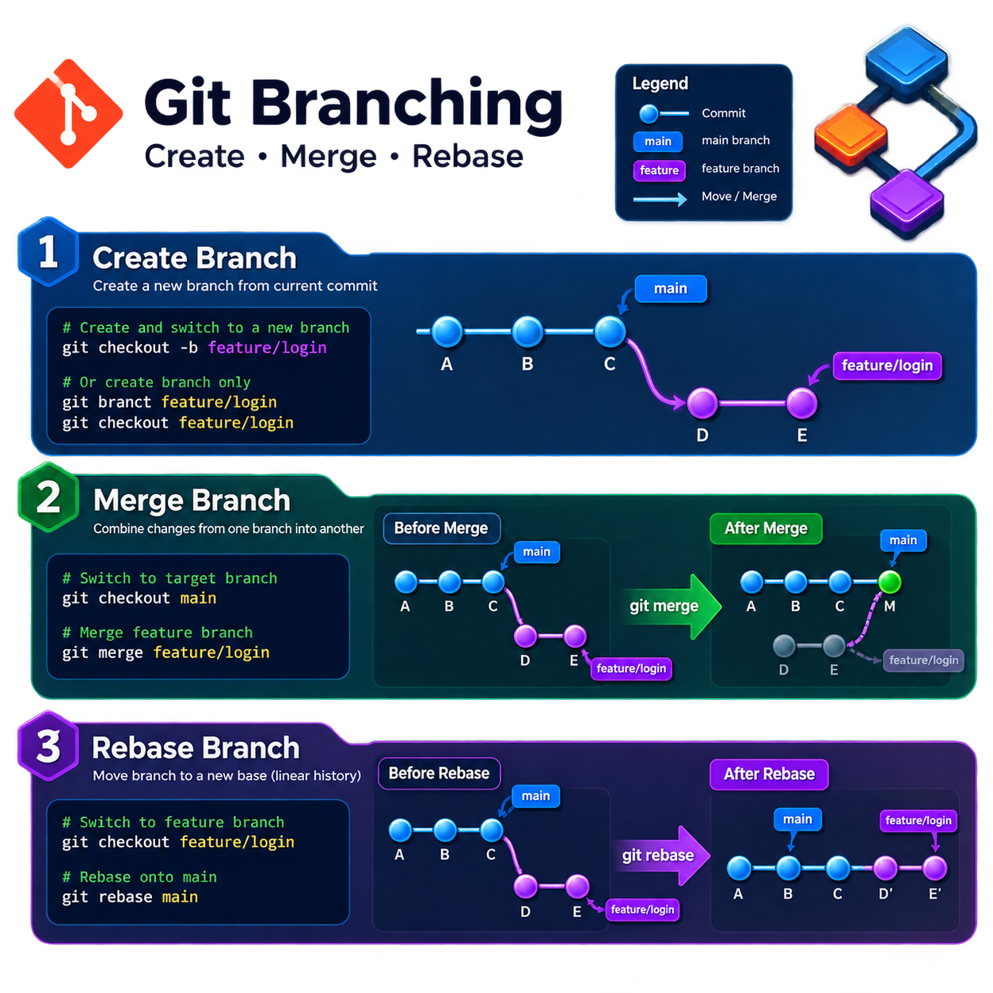
 | Merge | Rebase
Purpose | Combine two branch histories | Move/replay a branch onto a new base
History | Preserves the original branching history | Creates a linear history
Commit IDs | Existing commits are preserved | Rebasing creates new commit IDs
Graph | Often has a merge commit | No merge commit in the typical case
Best for | Shared/public branches | Local/private feature branches
Risk | Low; non-destructive | Higher; rewrites history
Typical command | git merge feature | git rebase main
Source: AI Generated, OpenAI Chatgpt, 2026.

Slide 6
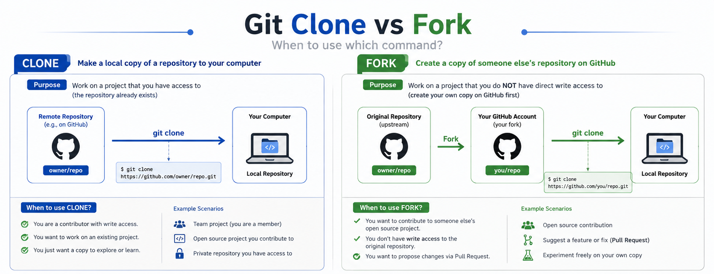
Source: AI Generated, OpenAI Chatgpt, 2026.

Slide 7
Key Concepts with Git
Repository: A folder where Git tracks your project and its history.
Clone: Make a copy of a remote repository on your computer.
Stage: Tell Git which changes you want to save next.
Commit: Save a snapshot of your staged changes.
Branch: Work on different versions or features at the same time.
Merge: Combine changes from different branches.
Pull: Get the latest changes from a remote repository.
Push: Send your changes to a remote repository.

Slide 8
Independent Development
Student: Alice
Project: todo-web
Goal: Build a Node.js web application and eventually release version 1.0.0.

Slide 9
1. Install Git
Windows: Download and run the installer.
  Click "Next" to accept the recommended settings.
  This will install Git and Git Bash.
macOS:
  If you use Homebrew, open Terminal and type brew install git.
  Or, download the .dmg file and drag Git to your Applications folder.
Linux:
  Open your terminal and use your package manager.
  For example, on Ubuntu: sudo apt-get install git.
References
  https://git-scm.com/install/linux
  https://www.w3schools.com/git/git_install.asp?remote=github

Slide 10
2. Configure Git identity
Set the identity that will be recorded in commits:
  git config --global user.name "Alice"
  git config --global user.email "alice@example.com"
Check:
  git config --global --list
A commit will then contain information such as:
  Author: Alice <alice@example.com>
  This is commit identity, not GitHub authentication.
Local configuration is also applicable
Identity can be verified by GPG key setup.
  https://docs.github.com/en/authentication/managing-commit-signature-verification

Slide 11
3. Create a GitHub account
Alice creates a GitHub account and signs in.
  https://github.com/
Then she creates an empty repository:
  Repository name: todo-web
  Visibility: Public
  The repository is empty.

Slide 12
4. Configure authentication (SSH Based)
Generate an SSH key (in Alice’s local computer):
  ssh-keygen -t ed25519 -C "alice@example.com"
Then start the SSH agent and add the private key:
  eval "$(ssh-agent -s)"
  ssh-add ~/.ssh/id_ed25519
The public key is typically located at ~/.ssh/id_ed25519.pub
Copy the public key
  Cat ~/.ssh/id_ed25519.pub
Add the public key to Github:
  GitHub → Settings → SSH and GPG keys → New SSH key
Test:
  ssh -T git@github.com
Reference
  https://docs.github.com/en/authentication/connecting-to-github-with-ssh

Slide 13
5. Create the local project
Alice creates the project:
  mkdir todo-web
  cd todo-web
Initialize Git:
  git init
Project folder structure looks like:
  todo-web/
  └── .git/
  .git/ is the Git repository.
Create .gitignore to exclude files for tracking
Environment & Sensitive Data
  .env, .env.local, .env.*.local, *.pem, *.key
Dependency Directories
  # JavaScript / Node.js: node_modules/, npm-debug.log*
  # Python: venv/, .venv/, __pycache__/, *.pyc
  # Java / Maven / Gradle: .gradle/, target/
  # PHP / Composer: vendor/
Build & Output Directories
  # General build outputs: dist/, build/, out/, *.o, *.exe, *.dll, *.so
Operating System Files
IDE & Editor Configurations
Logs & Databases

Slide 14
6. Create the first commit
Alice finish some works with certain files.
Check:
  git status
She sees untracked files:
    Index.html
    package.json
Add them (Staging):
  git add .
Then:
  git commit -m "Initial project setup"
Now Git history is a single commit of “Initial project setup”.
Check commit history:
  git log --oneline

Slide 15
7. Connect local Git to GitHub
Add the GitHub repository as a remote:
  git remote add origin git@github.com:alice/todo-web.git
Check:
  git remote -v
Conceptually:
  Local Repository
  │
  ▼
  GitHub Repository (origin as an alias of todo-web Repo)

Slide 16
8. Push the first version
Rename the main branch if necessary:
  git branch -M main
Push:
  git push -u origin main
  Now:
    Local GitHub
    Commit_A ────────────── Commit_A
    main origin/main
  The -u establishes the upstream relationship.
After this, Alice can generally use `git push` instead of specifying `git push origin main`

Slide 17
9. Start more developments
Alice shouldn't necessarily develop everything directly on main.
Create a feature branch:
  git switch -c feature/login
Now:
  main──A──B──C
  \
  D──E
  ↑
  feature/login
She finishes login implementation.
Then:
  git add .
  git commit -m "Add user login"
Push the branch:
  git push -u origin feature/login
GitHub now contains two branches:
  main
  feature/login

Slide 18
10. Finish the feature
Because Alice is working alone, she can merge locally:
  git switch main
  git merge feature/login
History becomes:
  A──B──C──── M
  \ /
  D───E
Then:
  git push
The stable main is now updated.

Slide 19
11. Release a stable version
Suppose Alice considers this version stable.
Create a Git tag:
  git tag -a v1.0.0 -m "Release version 1.0.0"
Push the tag:
  git push origin v1.0.0
Now the history looks like:
  A──B──C──── M ← v1.0.0
  \ /
  D───E

Slide 20
12. Continue development toward v1.1
Alice starts another feature:
  git switch -c feature/dark-mode
Develop:
  git add .
  git commit -m "Add dark mode"
Push:
  git push -u origin feature/dark-mode
After testing:
  git switch main
  git merge feature/dark-mode
  git push
Then:
  git tag -a v1.1.0 -m "Release version 1.1.0"
  git push origin v1.1.0

Slide 21
Team Development
Project: campus-event
Team: Alice (frontend), Bob (backend), and Charlie (database and API)

Slide 22
1. Alice creates the repository
Alice creates:
  GitHub
  └── campus-event
She initializes the project and pushes:
  git init
  git add .
  git commit -m "Initial project setup"
  git branch -M main
  git remote add origin git@github.com:alice/campus-event.git
  git push -u origin main

Slide 23
2. Add team members
Alice gives Bob and Charlie access to the repository.
They now have permission to work on the same repository.

Slide 24
3. Each developer clones the repository
Bob does not run git init.
  He uses: git clone git@github.com:alice/campus-event.git
Charlie does the same:
  git clone git@github.com:alice/campus-event.git

Slide 25
4. Everyone starts from main branch
Initially:
  main
  │
  A──B──C
Everyone has:
  Alice's computer → A B C
  Bob's computer → A B C
  Charlie's computer → A B C
  GitHub → A B C

Slide 26
5. Bob needs to implement authentication
First, Bob makes sure his local main is current:
  git switch main
  git pull
Then:
  git switch -c feature/authentication
His repository:
  main
  │
  A──B──C
  \
  D──E
  ↑
  feature/authentication
He commits:
  git add .
  git commit -m "Implement authentication"
Then pushes:
  git push -u origin feature/authentication

Slide 27
6. Charlie works simultaneously
Charlie starts from main:
  git switch main
  git pull
  git switch -c feature/database
He develops the database layer:
  git add .
  git commit -m "Add database repository layer"
  git push -u origin feature/database
Now GitHub has:
main
│
A─B─C
├─ D─E feature/authentication
│
└─ F─G feature/database

Slide 28
7. Pull Request
Bob finishes his authentication feature.
Instead of directly merging into main, Bob creates:
  feature/authentication
  ↓
  Pull Request
  ↓
  Main
The team reviews:
Bob
│
│ Push
▼
GitHub
│
│ Pull Request
▼
Alice / Charlie
│
├── Code review
├── Automated tests
├── Comments
└── Approval

Slide 29
8. CI tests the Pull Request
A typical modern team might configure GitHub Actions:
Pull Request → GitHub Actions → npm test → npm run lint → npm build → PASS / FAIL
The PR should not be merged if important tests fail.

Slide 30
9. Merge the Pull Request
After review:
feature/authentication → main (Pull Request)
  GitHub merges it.
Now everyone needs to synchronize.
  Bob:
    git switch main
    git pull
  Charlie:
    git switch main
    git pull

Slide 31
10. What if Bob's branch becomes outdated?
Suppose main has moved:
Main:
  A──B──C──M──N
Bob:
  A──B──C
  \
  D──E
Bob wants to update his feature branch.
  He can use:
    git switch feature/payment
    git fetch origin
    git rebase origin/main
  Now:
  A──B──C──M──N──D'──E'
  ↑
  feature/payment
Notice: D → D', E → E'. They are new commits.

Slide 32
11. Team rule: protect main
A professional GitHub repository should normally protect main.
  No direct push
  Pull Request required
  CI tests required
  Review required
  Merge only when conditions pass
Then the workflow becomes:
  Developer→feature branch→Commit→Push→Pull Request (Code Review, CI/CD, Automated Tests)→Merge→main→Release

Slide 33
12. Handling a merge conflict
Suppose:
main:
  A──B──C──D
Alice:
  A──B──C──X
Bob:
  A──B──C──Y
Alice merges first:
  A──B──C──D──X
Bob's branch now conflicts with main.
Bob does:
  git fetch origin
  git rebase origin/main
Git reports:CONFLICT
Bob manually resolves the conflicting file.
Then:
  git add .
  git rebase --continue
Eventually:
  A──B──C──D──X──Y'
Then, because rebase changed Bob's commit IDs:
  git push --force-with-lease
Not: git push --force
--force-with-lease is the safer form because it checks whether the remote branch has unexpectedly advanced.

Slide 34
13. Finish the release
Suppose the team has:
  main
  │
  A──B──C──D──E──F
CI passes.
The team decides this is production-ready.
Tag:
  git tag -a v1.0.0 -m "Release version 1.0.0"
  git push origin v1.0.0
GitHub can then publish:
  Release v1.0.0

