Slide 1
Cascade Style Sheet (CSS)
Ci-Wei Lan 藍啟維
Dept. of CSE, NTOU

Slide 2
Outlines
Control a website's appearance with style sheets.
Use a style sheet to give all the pages of a website the same look and feel.
Use the class attribute to apply styles.
Specify the precise font, size, color and other properties of displayed text.
Specify element backgrounds and colors.
Understand the box model and how to control margins, borders and padding.
Use style sheets to separate presentation from content.

Slide 3
Cascading Style Sheets (CSS)
A stylesheet language used to describe the presentation of a document written in HTML or XML (including XML dialects such as SVG, MathML or XHTML).
Previously, the development of various parts of CSS specification was done synchronously, which allowed the versioning of the latest recommendations. You might have heard about CSS1, CSS2.1, or even CSS3. There will never be a CSS3 or a CSS4; rather, everything is now just "CSS" with individual CSS modules having version numbers.
CSS syntax reference: https://developer.mozilla.org/en-US/docs/Web/CSS
CSS syntax validation: https://jigsaw.w3.org/css-validator/

Slide 4
CSS Official Definition
As of 2026, Cascading Style Sheets (CSS) is defined by the following specifications.
CSS Level 2, latest revision (including errata) [CSS2]
  This defines the core of CSS, parts of which are overridden by later specifications. We recommend in particular reading Chapter 2, which introduces some of the basic concepts of CSS and its design principles.
CSS Syntax Module Level 3 [CSS-SYNTAX-3]
  Replaces CSS2§4.1, CSS2§4.2, CSS2§4.4, and CSS2§G, redefining how CSS is parsed.
CSS Style Attributes [CSS-STYLE-ATTR]
  Defines how CSS declarations can be embedded in markup attributes.
Media Queries Level 3 [CSS3-MEDIAQUERIES]
  Replaces CSS2§7.3 and expands on the syntax for media-specific styles.
CSS Conditional Rules Module Level 3 [CSS-CONDITIONAL-3]
  Extends and supersedes CSS2§7.2, updating the definition of @media rules to allow nesting and introducing the @supports rule for feature-support queries.
Selectors Level 3 [SELECTORS-3]
  Replaces CSS2§5 and CSS2§6.4.3, defining an extended range of selectors.
CSS Namespaces Module Level 3 [CSS3-NAMESPACE]
  Introduces an @namespace rule to allow namespace-prefixed selectors.
https://www.w3.org/TR/css/

Slide 5
Approaches of Combining HTML with CSS
Independent CSS files (External CSS)
  Add a <link> element within <head> element in HTML files. Set the rel attribute as ‘stylesheet’ and the href attribute as URL.
Embedded CSS codes (Internal CSS)
  Add a <style> element within <head> element in HTML files. Describe CSS rules within <style> element.
Inline CSS codes
  Add the style attribute of element where CSS takes effect. Set the style value as property:value paris.
CSS at-rule
  In the beginning of either independent CSS files or embedded CSS section by @import url.
    Url: Is a <string> or a <url> type representing the location of the resource to import. The URL may be absolute or relative.
    @import "custom.css";
    @import url("chrome://communicator/skin/communicator.css");

Slide 6
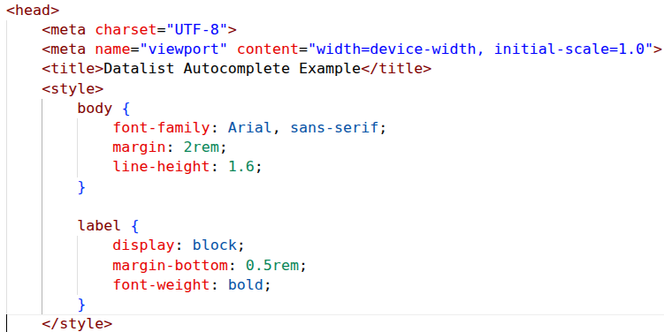
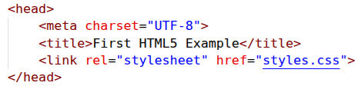

Syntax of Applying CSS to HTML

Slide 7
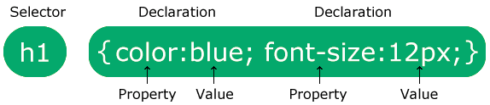
CSS Rulesets and Comment Syntax
A CSS ruleset (or rule) has two main parts: a selector, and one or more declarations.
Both single and multiline comments are represented by the pair of /*...*/.
  Cannot be nested
Source: CSS Syntax, W3Schools, https://www.w3schools.com/css/css_syntax.asp

Slide 8
Selectors ─ Basic

Slide 9
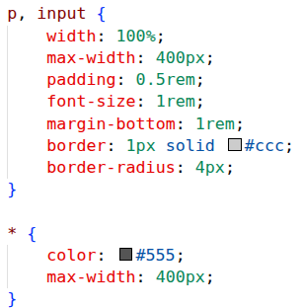
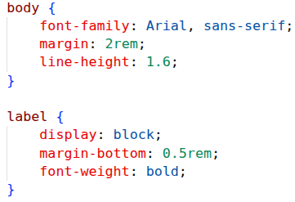
Basic Selectors ─ Type Selector
The CSS type selector matches elements by node name. In other words, it selects all elements of the given type within a document.
The universal selector, denoted with an asterisk (*), is a special type selector that selects all elements.
Grouping selectors: Using comma to separate selectors.
Syntax: element { style properties }

Slide 10

Basic Selectors ─ Class Selector
The CSS class selector matches elements based on the contents of their class attribute.
The class_name value must be a valid CSS identifier. HTML class attributes which are not valid CSS identifiers must be escaped before they can be used in class selectors.
Syntax: .class_name { /* … */ }

Slide 11
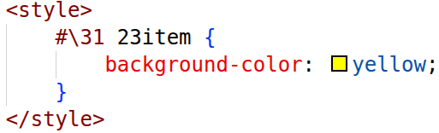

Basic Selectors ─ Id Selector
The CSS ID selector matches an element based on the value of the element's id attribute.
The id_value value must be a valid CSS identifier. HTML id attributes which are not valid CSS identifiers must be escaped before they can be used in ID selectors.
Syntax: #id_value { /* … */ }

Slide 12
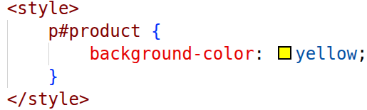
Basic Selectors ─ Compound Selector
A compound selector is a sequence of simple selectors that are not separated by a combinator.
A given element is said to match a compound selector when the element matches all the simple selectors in the compound selector.
In a compound selector, the type selector or universal selector must come first in the sequence of selectors. Only one type selector or universal selector is allowed in the sequence.

Slide 13
Basic Selectors ─ Attribute Selector
Matches elements based on the element having a given attribute explicitly set, with options for defining an attribute value or substring value match.
  A universal element * is added if no element is specified. This may increase performance concerns due to global DOM traversal.
[attr]: elements with an attribute name of attr.
[attr=value]: elements with an attribute name of attr whose value is exactly value.
[attr~=value]: elements with an attribute name of attr whose value is a whitespace-separated list of words, one of which is exactly value.
[attr|=value]: elements with an attribute name of attr whose value can be exactly value or can begin with value immediately followed by a hyphen, - (U+002D). It is often used for language subcode matches.
[attr^=value]: elements with an attribute name of attr whose value is prefixed (preceded) by value.
[attr$=value]: elements with an attribute name of attr whose value is suffixed (followed) by value.
[attr*=value]: elements with an attribute name of attr whose value contains at least one occurrence of value within the string.
[attr operator value i]: Adding an i (or I) before the closing bracket causes the value to be compared case-insensitively (for characters within the ASCII range).
[attr operator value s]: Adding an s (or S) before the closing bracket causes the value to be compared case-sensitively (for characters within the ASCII range).
https://developer.mozilla.org/en-US/docs/Web/CSS/Reference/Selectors/Attribute_selectors

Slide 14
Selectors ─ Combinator

Slide 15
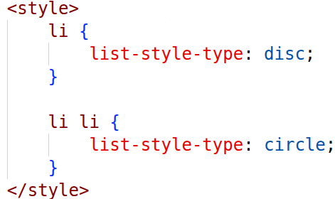
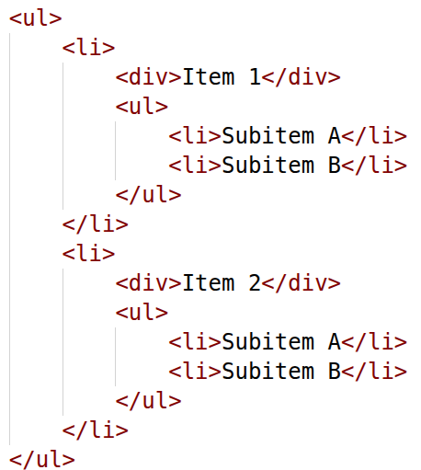
Combinator Selectors ─ Descendent
Denoted with one or more spaces (typically one), selects nodes that are descendants of the first element, e.g. elements matched by the second selector are selected.
Syntax: selector1 selector2 { /* property declarations */ }

Slide 16
Combinator Selectors ─ Child
Denoted with one or more spaces (typically one), selects nodes that are descendants of the first element, e.g. elements matched by the second selector are selected.
Direct children of the first element are selected.
Syntax: selector1 > selector2 { /* property declarations */ }

Slide 17
Combinator Selectors ─ Subsequent Sibling
The subsequent-sibling combinator (~, a tilde) separates two selectors and matches all instances of the second element that follow the first element (not necessarily immediately) and share the same parent element.
Syntax: former_element ~ target_element { style properties }

Slide 18
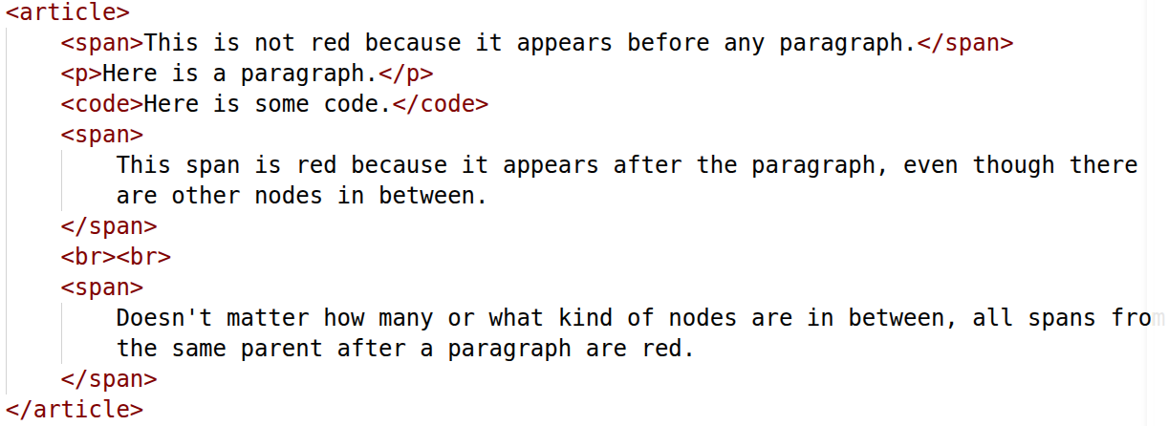
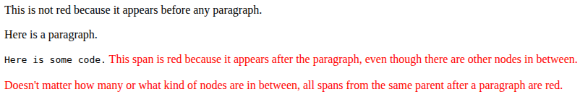
An Example of Subsequent Sibling

Slide 19
Combinator Selectors ─ Next Sibling
Denoted by the plus symbol (+), is similar to the subsequent-sibling. However, given A + B, it only matches B if B is immediately preceded by A, with both sharing the same parent.
Syntax: former_element + target_element { style properties }

Slide 20
Property ─ Text

Slide 21
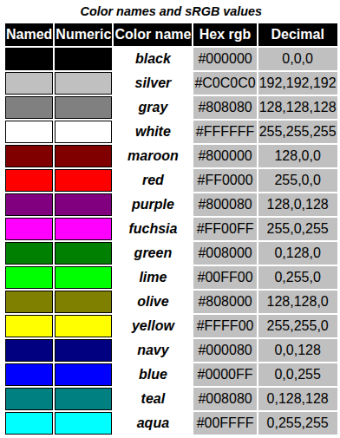
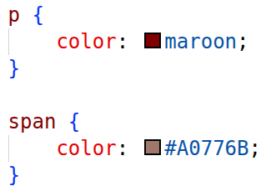
Textual Property ─ Color
Color names and hexadecimal codes may be used as the color property value.
CSS Color Module Level 3
  https://www.w3.org/TR/css-color-3/

Slide 22
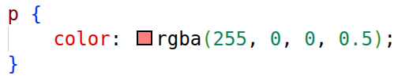

RGBA Colors
RGBA is an extension of RGB that adds an alpha channel for transparency.
Syntax: rgba(red, green, blue, alpha)
  red, green, blue: values from 0–255 or percentages.
  alpha: value between 0.0 (fully transparent) and 1.0 (fully opaque).

Slide 23
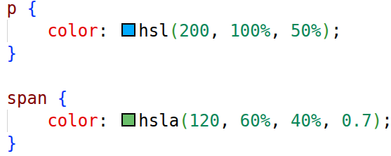
HSLA and HSL Colors
HSL stands for Hue, Saturation and Lightness.
HSLA adds an alpha channel for transparency.
Syntax:
  hsl(hue, saturation, lightness)
  hsla(hue, saturation, lightness, alpha)
Parameters:
  hue: angle on the color wheel (0–360deg).
  saturation: percentage (0% = gray, 100% = full color).
  lightness: percentage (0% = black, 50% = normal, 100% = white).
  alpha: transparency, 0–1.

Slide 24
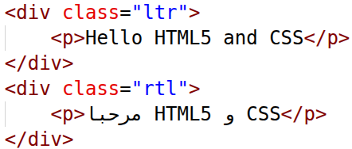
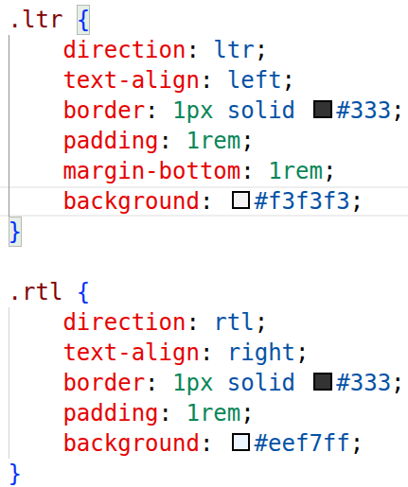
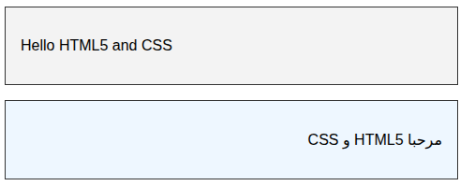
Textual Property ─ Direction
The direction CSS property sets the direction of text, table and grid columns, and horizontal overflow.
Use rtl for languages written from right to left (like Hebrew or Arabic), and ltr for those written from left to right (like English and most other languages).

Slide 25
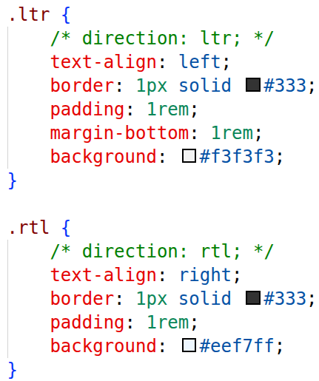
Textual Property ─ Text-align
Sets the horizontal alignment of the inline-level content inside a block element or table-cell box.
Visualized demo of different values.
  https://developer.mozilla.org/en-US/docs/Web/CSS/Reference/Properties/text-align

Slide 26
Textual Property ─ Text-Decoration
Sets the appearance of decorative lines on text.
It is a shorthand for text-decoration-line, text-decoration-color, text-decoration-style, and the newer text-decoration-thickness property.
  The order of values does not matter.
Visualized demo of different values.
  https://developer.mozilla.org/en-US/docs/Web/CSS/Reference/Properties/text-decoration

Slide 27
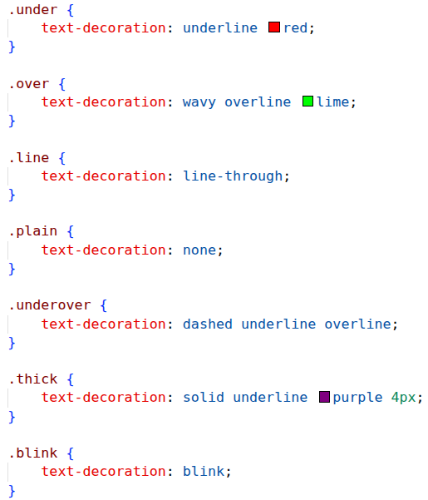
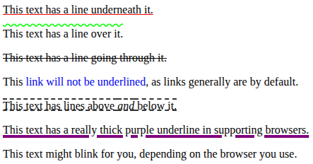
An Example of Text-Decoration

Slide 28
Textual Property ─ Text-Transform
The text-transform CSS property specifies how to capitalize an element's text.
Values: none; capitalize; uppercase; lowercase; full-width; full-size-kana; math-auto;
The text-transform property takes into account language-specific case mapping rules.
  https://developer.mozilla.org/en-US/docs/Web/CSS/Reference/Properties/text-transform

Slide 29
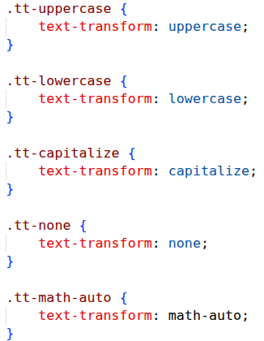
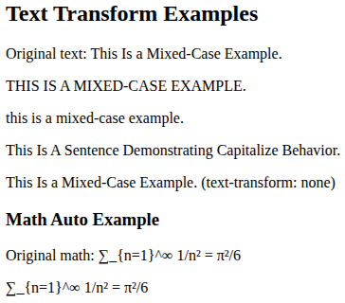
An Example of Text-Transform

Slide 30
Textual Property ─ Text Spacing
Adjusts the space between characters, words, and lines of text by fine-tuning the horizontal and vertical spacing within text elements. Properties include letter-spacing, word-spacing, and line-height.
Check examples at MDN:
  Letter-spacing (Arabic script expect connected letters): https://developer.mozilla.org/en-US/docs/Web/CSS/Reference/Properties/letter-spacing
  Word-spacing: https://developer.mozilla.org/en-US/docs/Web/CSS/Reference/Properties/word-spacing
  Line-height (Space between lines in vertical writing modes): https://developer.mozilla.org/en-US/docs/Web/CSS/Reference/Properties/line-height

Slide 31
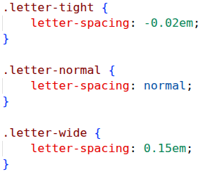
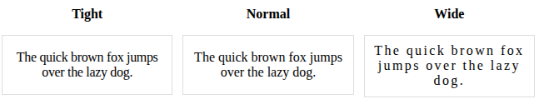
An Example of Letter-Spacing

Slide 32
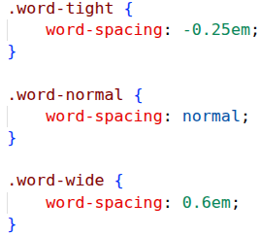
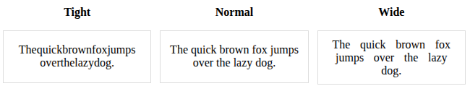
An Example of Word-Spacing

Slide 33
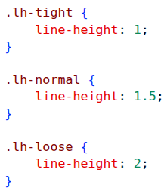
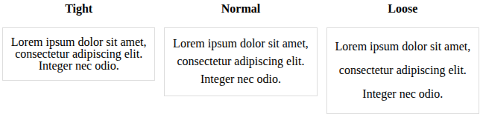
An Example of Line-Height

Slide 34
Sizing Unit
Absolute Units
  px: Fixed pixel size. Best for borders, icons, shadows. Avoid for font sizes (hurts accessibility).
  pt, pc: Print typography units. Use only when matching print/PDF.
    pt (points; 1 pt = 1/72 in)
    pc (picas; 1 pc = 12 pt)
  cm, mm, in: Physical units. Reliable only in print contexts, not screens.
Relative Units
  %: Relative to parent element. Great for fluid widths/heights.
  em: Relative to parent font size. Good for component spacing, but beware compounding in nested elements.
    1em is equal to the current font size
    Nested elements multiply values
  rem: Relative to root <html> font size. Best for font sizes and global spacing systems.
  ch: Width of “0” character. Useful for text line length control.
Functions
  Using min(), max(), clamp() etc., e.g. width: max(50px, 50%); width: clamp(20%, 1px, 80%);
  https://developer.mozilla.org/en-US/docs/Web/CSS/Guides/Values_and_units/Using_math_functions

Slide 35
Textual Property ─ Font
The font CSS shorthand property sets all the different properties of an element's font.
Alternatively, it sets an element's font to a system font.
This property is a shorthand for the following CSS properties: font-style, font-variant, font-weight, font-stretch, font-width, font-size/line-height, font-family.
  The order of values does matter!
  If the value is missing, browsers reset the element to their initial defaults.
The value is either a shorthand specifying the various font-related properties or a single <system-font-family-name> keyword.

Slide 36
Textual Property ─ system-font-family-name
caption
  The system font used for captioned controls (buttons, drop-downs, etc.).
icon
  The system font used to label icons.
menu
  The system font used in menus (e.g., dropdown menus and menu lists).
message-box
  The system font used in dialog boxes.
small-caption
  The system font used for labeling small controls.
status-bar
  The system font used in window status bars.

Slide 37



An Example of Normal Font

Slide 38



An Example of Italic and Weighted Font

Slide 39



An Example of Font Width

Slide 40
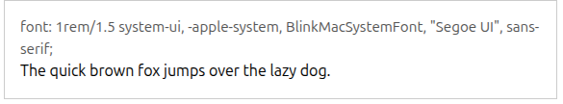
An Example of System Font

Slide 41
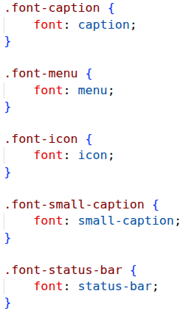
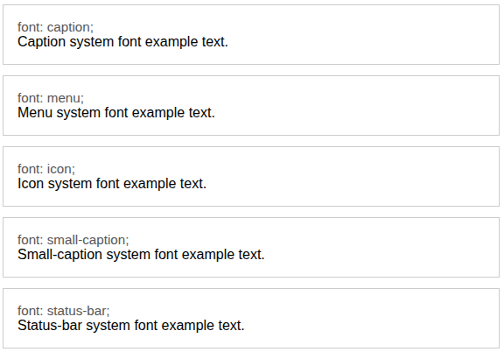
An Example of System Font Keywords

Slide 42
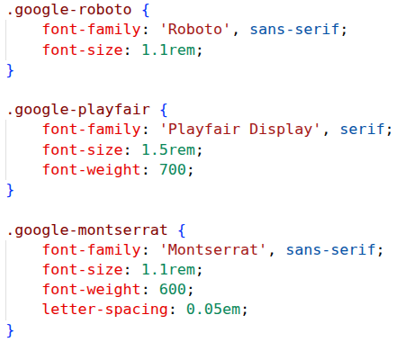
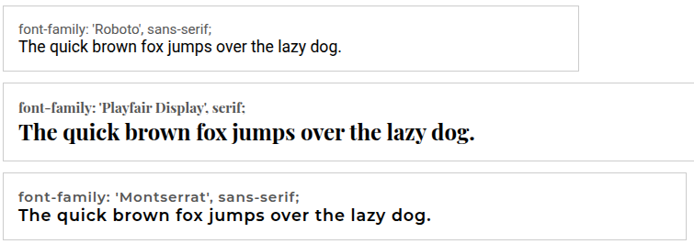
An Example of Google Font

Slide 43
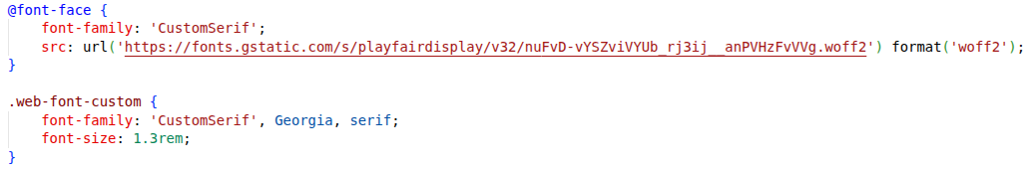

An Example of Web Font

Slide 44
Textual Property ─ Opacity
The opacity CSS property sets the opacity of an element. Opacity is the degree to which content behind an element is hidden, and is the opposite of transparency.
A <number> in the range 0.0 to 1.0, inclusive, or a <percentage> in the range 0% to 100%, inclusive, representing the opacity of the channel (that is, the value of its alpha channel). Any value outside the interval, though valid, is clamped to the nearest limit in the range.
Check examples at https://developer.mozilla.org/en-US/docs/Web/CSS/Reference/Properties/opacity

Slide 45
Property ─ Background Appearance

Slide 46
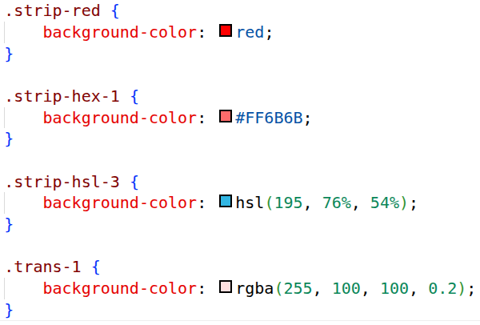
Background Properties ─ background-color
Specifies a single <color> value.
  https://developer.mozilla.org/en-US/docs/Web/CSS/Reference/Values/color_value
It is rendered behind any background-image that is specified.

Slide 47
Background Properties ─ background-image
Each background image is specified either as the keyword none or as an <image> value.
  https://developer.mozilla.org/en-US/docs/Web/CSS/Reference/Values/image
    A <gradient> data type is a kind of <image> data type.
  Specifies the URL of the image, in the format url(file_location)
To specify multiple background images, supply multiple values, separated by a comma.
  The first layer specified is drawn as if it is closest to the user.
Check examples at https://developer.mozilla.org/en-US/docs/Web/CSS/Reference/Properties/background-image

Slide 48
Background Properties ─ <gradient> data type
The <gradient> data type is defined with one of the function types listed below.
  linear-gradient(), radial-gradient(), conic-gradient(), repeating-linear-gradient(), repeating-radial-gradient(), and repeating-conic-gradient().
  A CSS gradient has no intrinsic dimensions; i.e., it has no natural or preferred size, nor a preferred ratio. Its concrete size will match the size of the element to which it applies.
Check examples at https://developer.mozilla.org/en-US/docs/Web/CSS/Reference/Values/gradient

Slide 49
Background Properties ─ background-position
Places the image on the page top, bottom, center, left and right individually or in combination for vertical and horizontal positioning.
  background-position: top;
  background-position: bottom;
  background-position: left;
  background-position: right;
  background-position: center;
You can also position by using lengths
  background-position: 0 0;
  background-position: 1cm 2cm;
  background-position: 10ch 8em;
Multiple images
  background-position: 0 0, center;
Edge offsets values
  background-position: bottom 10px right 20px;
  background-position: right 3em bottom 10px;
  background-position: bottom 10px right;
  background-position: top right 10px;

Slide 50
Background Properties ─ background-repeat
Controls the tiling of the background image.
no-repeat: displays one copy of the background image on screen
repeat (the default): tiles the image vertically and horizontally
repeat-x: tiles the image only horizontally
repeat-y: tile the image only vertically

Slide 51
Background Properties ─ background-attachment
Sets whether a background image is fixed or scrolls with the rest of the page
Scroll (default)
  Scrolling the browser window will not move the image from its set position.
Fixed
  Fixes the image in the position specified by background-position.

Slide 52
Try it Yourself ─ Masking Practices
Play around CSS masking properties
  https://developer.mozilla.org/en-US/docs/Web/CSS/Guides/Masking/Introduction

Slide 53
Box Model ─ Elements as Rectangles

Slide 54
Box Model and Text Flow
HTML elements have a virtual box drawn around them based on the box model.
When the browser renders an element using the box model, the content is surrounded by padding, a margin and a border.
Box width and height properties:
  Dimensions of elements on a page can be set with CSS by using properties height and width.
  Their values can be relative or absolute
Content might sometimes exceed the set boundaries, in which case the element must be made large enough for all the content to fit.
  Sets the overflow property to scroll, which adds scroll bars if the text overflows the boundaries.

Slide 55
Box Model ─ Padding and Margin Properties
Padding
  The padding property determines the distance between the content inside an element and the edge of the element
  Padding be set for each side of the box by using padding-top, padding-right, padding-left and padding-bottom.
Margin
  Determines the distance between the element’s edge and any outside text.
  Margins for individual sides of an element can be specified by using margin-top, margin-right, margin-left and margin-bottom.

Slide 56
Box Model ─ Border Properties
The border is controlled using the properties:
Border-width
  May be set to any of the CSS lengths or to the predefined value of thin, medium or thick .
Border-color
  Sets the color used for the border
Border-style
  Options are: none, hidden, dotted, dashed, solid, double, groove, ridge, inset and outset

Slide 57
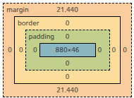
Inspection by Developer Tool in Browser
h1 {
display: block;
font-size: 2em;
margin-block-start: 0.67em;
margin-block-end: 0.67em;
margin-inline-start: 0px;
margin-inline-end: 0px;
font-weight: bold;
unicode-bidi: isolate;
}

Slide 58
CSS Conflicting
Styles may be defined by a user, an author or a user agent.
  User style sheet
    A user agent may also allow a user to create a customized set of styles to use by default, or for specific documents.
  Author style sheets
    that are linked to the document via a link element, specified using a style element within the document’s head element, or specified within an element style attribute
  User Agent (typically a web browser) style sheets
    the default sets of declarations applied by the user agent
Priority: author > user > user agent

Slide 59
Box Model ─ Float Property
Floating allows you to move an element to one side of the screen; other content in the document then flows around the floated element.
  Values: none, left or right.
  Absolutely positioned elements ignores the float property!
  It’s a legacy layout technique – now prefer Flexbox/Grid for layout; use float mainly for text wrap.
CSS Float Theory (Out of normal flow in terms of box model)
  When we float an element it is shifted to the right or to the left until it reaches the edge of the containing block.
  If we then float another element nearby in the same direction, it will be shifted until its edge reaches the edge of the first floating element.
  When there is insufficient space on the line, they are shifted downward until they fit.
  https://developer.mozilla.org/en-US/docs/Web/CSS/Reference/Properties/float

Slide 60
Try it Yourself ─ Box Model Practices
Play around more box model properties
  Outline: https://developer.mozilla.org/en-US/docs/Web/CSS/Reference/Properties/outline
  Box shadow: https://developer.mozilla.org/en-US/docs/Web/CSS/Reference/Properties/box-shadow

Slide 61
Display and Position

Slide 62
Display Property
The display property sets whether an element is treated as a block or inline box and the layout used for its children, such as flow layout, grid or flex.
  Formally, the display property sets an element's inner and outer display types.
The outer type sets an element's participation in flow layout; the inner type sets the layout of children.
  The inner value defaults to flow if only outer value is specified.
  Mostly the outer value defaults to block if only inner value is specified (exception like ruby).
The CSS display property is specified using keyword values.
  For browser compatibility, you may use the single-value syntax as a fallback for multi-keyword syntax.
  .container {
  display: inline-flex;
  display: inline flex;
  }
Some values of display are fully defined in their own individual specifications
  https://developer.mozilla.org/en-US/docs/Web/CSS/Reference/Properties/display

Slide 63
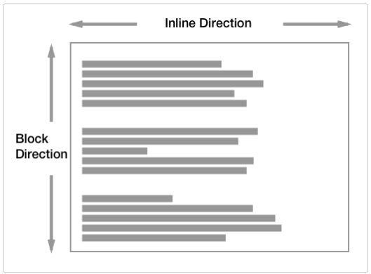
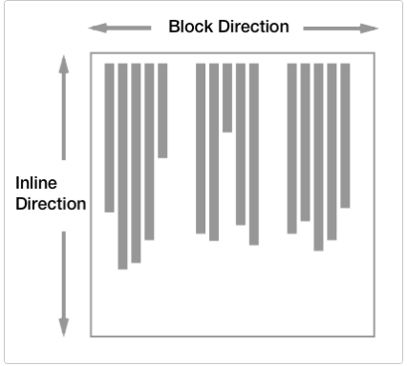
Display Property ─ Outside
Block
  Generates a block box, line breaks both before and after the element when in the normal flow.
Inline
  Generates one or more inline boxes that do not generate line breaks before or after themselves.
Block and inline layout in normal flow
  https://developer.mozilla.org/en-US/docs/Web/CSS/Guides/Display/Block_and_inline_layout
Horizontal writing
Vertical writing

Slide 64
Display Property ─ Inside
Flow
  The element lays out its contents using flow layout (block-and-inline layout).
Flow-root
  The element generates a block box that establishes a new block formatting context, defining where the formatting root lies.
Table
  These elements behave like HTML <table> elements. It defines a block-level box.
Flex
  The element behaves like a block-level element and lays out its content according to the flexbox model.
Grid
  The element behaves like a block-level element and lays out its content according to the grid model.
Ruby
  The element behaves like an inline-level element and lays out its content according to the ruby formatting model. It behaves like the corresponding HTML <ruby> elements.

Slide 65
Display Property ─ List Item
The element generates a block box for the content and a separate list-item inline box.
  Generates a ::marker pseudo-element with the content specified by its list-style properties (for example a bullet point) together with a principal box of the specified type for its own contents.
A single value of list-item will cause the element to behave like a list item. This can be used together with list-style-type and list-style-position.
.fake-list {
display: list-item;
list-style-position: inside;
}

Slide 66
Display Property ─ Box
Contents
  These elements don't produce a specific box by themselves. They are replaced by their pseudo-box and their child boxes.
    Useful for scenarios with semantic tags or div soups. Styles can be applied to descendants.
None
  Turns off the display of an element so that it has no effect on layout (the document is rendered as though the element did not exist).
  All descendant elements also have their display turned off.
  To have an element take up the space that it would normally take, but without actually rendering anything, use the visibility property instead.

Slide 67
Position Property
static : positioned element is always positioned according to the normal flow of the page.
  The top, right, bottom, left, and z-index properties have no effect.
relative: positioned relative to its normal position
absolute : positioned relative to the first parent element
fixed: positioned relative to the browser window (viewport)
sticky: positioned according to the normal flow of the document, and then offset relative to its nearest scrolling ancestor and containing block (nearest block-level ancestor), including table-related elements, based on the values of top, right, bottom, and left.
  "sticks" to its nearest ancestor that has a "scrolling mechanism"
Check examples at https://developer.mozilla.org/en-US/docs/Web/CSS/Reference/Properties/position

Slide 68
Position Property ─ z-index
The z-index (the stack order of an element) property sets the z-order of a positioned element and its descendants or flex and grid items.
Overlapping elements with a larger z-index cover those with a smaller one.
If two positioned elements overlap without a z-index specified, the element positioned last in the HTML code will be shown on top.
Check effects at https://developer.mozilla.org/en-US/docs/Web/CSS/Reference/Properties/z-index

Slide 69
Try it Yourself ─ Element Specific Effects
Any two of followings for each element: properties, functions, Pseudo-elements.
Table
  https://developer.mozilla.org/en-US/docs/Web/CSS/Guides/Table
List and Counter
  https://developer.mozilla.org/en-US/docs/Web/CSS/Guides/Lists
Image
  https://developer.mozilla.org/en-US/docs/Web/CSS/Guides/Images
Filter
  https://developer.mozilla.org/en-US/docs/Web/CSS/Guides/Filter_effects

Slide 70
Mastering the CSS Cascade & Specificity

Slide 71
The 5 Steps of the Cascade Algorithm
When multiple CSS rules target the same HTML element, the browser filters and sorts them using 5 distinct steps:
  Relevance – Filter out non-matching rules
  Origin & Importance – Check where the style comes from and if it has !important
  Specificity – Calculate the weight of the selectors
  Scoping Proximity – Measure DOM distance within @scope
  Order of Appearance – Apply the "last one wins" rule if all else is equal

Slide 72
Origin & Importance Hierarchy
Styles are sorted by their source and weight. The order below runs from lowest to highest precedence (the latter overrides the former):
  User-Agent Styles (Browser defaults)
  User Styles (Custom browser settings/extensions)
  Author Styles (Normal) (Styles written by developers—External, Embedded, Inline)
  CSS Animations (@keyframes execution)
  Author Styles (!important)
  User Styles (!important)
  User-Agent Styles (!important)
  CSS Transitions (Active state transitions hold the absolute highest priority)

Slide 73
How @layer Affects Precedence
Within the same origin (e.g., Author Styles), Cascade Layers modify the priority chain:
  Normal Styles: Unlayered styles always win over layered styles.
    Order: Unlayered > Later Layers > Earlier Layers
  Important Styles (!important): The logic is completely reversed!
    Order: Earlier Layers > Later Layers > Unlayered
  Inline Styles (style="..."): Higher than any normal layer/unlayered styles, but still overridden by any !important declaration.

Slide 74
The Specificity Scoring System
If competing rules are in the same origin and layer, the browser calculates a three-column score: (ID, CLASS, TYPE)
  Compared from left to right, one column at a time. A higher value in a left column wins instantly.
    ID Column (1, 0, 0) – Counts ID selectors (e.g., #header).
    CLASS Column (0, 1, 0) – Counts Class selectors (.btn), Attribute selectors ([type="text"]), and Pseudo-classes (:hover).
    TYPE Column (0, 0, 1) – Counts Element tags (p, div) and Pseudo-elements (::before).
  Special Score Rules:
    Universal selector (*) and :where() pseudo-class have zero weight (0, 0, 0).
    :is(), :not(), and :has() have no weight themselves, but they take the weight of their most specific argument.

Slide 75
Resolving Equal Specificity
Scoping Proximity
  Applies when conflicting rules are inside @scope blocks.
  The rule with the fewest hops (shortest DOM distance) to its scope root wins.
Order of Appearance (The Final Decider)
  If origin, layer, specificity, and proximity are all identical, the "last one wins" rule applies.
  The declaration loaded later in the source code (or in a subsequent <link>/<style> tag) overrides the earlier one.

Slide 76
Key Rules for Clean Architecture
Direct Selection > Inheritance: Directly targeted elements always override styles inherited from ancestors (inherited styles have a specificity of 0).
Avoid !important Weaponization: Use Cascade Layers (@layer) or manage Specificity instead of relying on !important to force overrides.
Keep Specificity Low: Rely on component classes rather than deep nesting or IDs to keep your stylesheets maintainable and flexible.
References
  https://developer.mozilla.org/en-US/docs/Learn_web_development/Core/Styling_basics/Handling_conflicts
  https://developer.mozilla.org/en-US/docs/Web/CSS/Guides/Cascade/Introduction

Slide 77
Advanced Selector ─
Pseudo-Class and -Element

Slide 78
Pseudo-classes
A CSS pseudo-class is a keyword added to a selector that lets you select elements based on information that lies outside of the document tree, such as a specific state of the selected element(s).
  Pseudo-classes let you apply a style to an element not only in relation to the content of the document tree, but also in relation to external factors like the history of the navigator (:visited, for example), the status of its content (like :checked on certain form elements), or the position of the mouse (like :hover, which lets you know if the mouse is over an element or not).
  A pseudo-class consists of a colon (:) followed by the pseudo-class name (e.g., :hover).
Check pseudo-class names at https://developer.mozilla.org/en-US/docs/Web/CSS/Reference/Selectors/Pseudo-classes

Slide 79
Pseudo-elements
A CSS pseudo-element is a keyword added to a selector that lets you style a specific part of the selected element(s).
Syntax
selector::pseudo-element {
property: value;
}
For example, ::first-line can be used to change the font of the first line of a paragraph.
/* The first line of every <p> element. */
p::first-line {
color: blue;
text-transform: uppercase;
}
Check pseudo-element names at https://developer.mozilla.org/en-US/docs/Web/CSS/Reference/Selectors/Pseudo-elements

Slide 80
Layout Design

Slide 81
Flow Layout
Normal Flow, or Flow Layout, is the way that block and inline elements are displayed on a page before any changes are made to their layout.
Once something is taken out of flow it works independently.
Flow layout and writing mode.
In and out of flow by example:
  https://developer.mozilla.org/en-US/docs/Web/CSS/Guides/Display/In_flow_and_out_of_flow
Box Model ─ float property

Slide 82
Multi-Column Layouts
Multi-column layout, usually referred to as multicol layout, is a specification for laying out content into a set of column boxes much like columns in a newspaper.
  It fragments the content, including all descendant elements, into columns.
Column-count property
  Specifies the number of columns that you would like the content to be displayed as.
Column-width property
  Sets the optimal width for every column box.
  Browsers work out how many columns of that width will fit into the multicol container and distribute any extra space equally between the columns.
Specifying both number and width of columns
  The behavior as described for column-width will happen, until the number of columns in column-count is reached.
Columns property
  You can use the columns shorthand to set the column-count and column-width values.
Check more properties at
  https://developer.mozilla.org/en-US/docs/Web/CSS/Guides/Multicol_layout/Basic_concepts

Slide 83
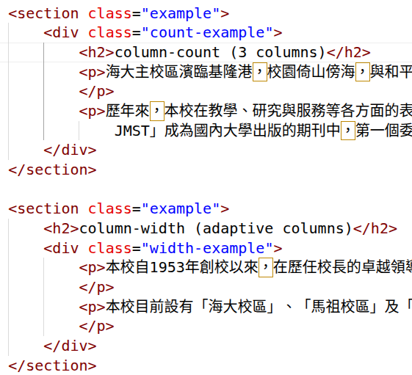
An Example of Multi-Column Layout
h2 {
column-span: all;
}
/* Example using column-count */
.count-example {
column-count: 3;
column-gap: 1.25rem;
}
/* Example using column-width */
.width-example {
column-width: 220px;
column-gap: 1rem;
column-rule: 5px dashed #ccc;
}

Slide 84
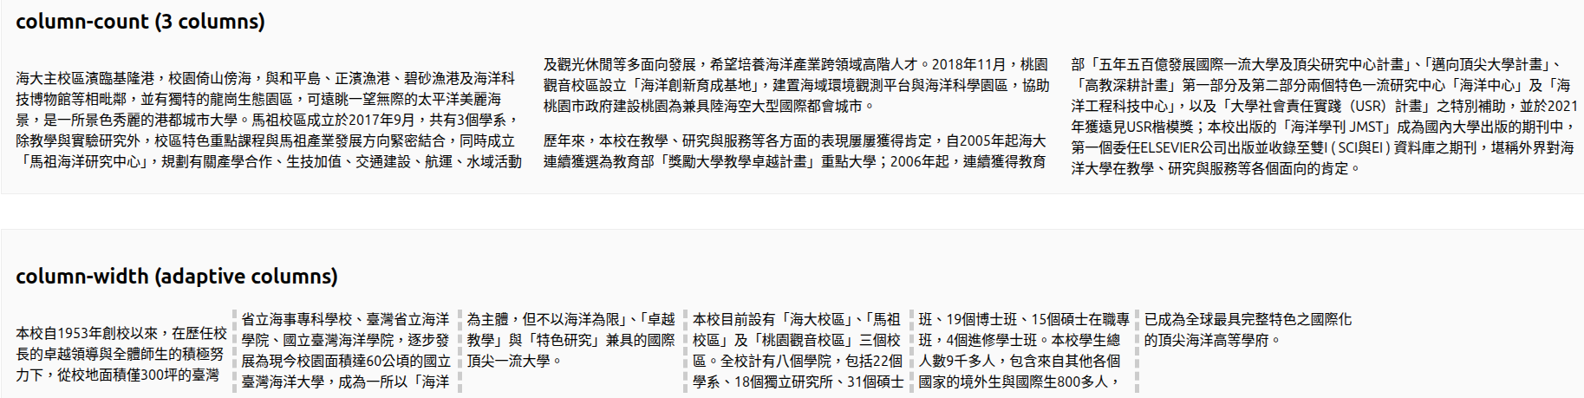
An Example of Multi-Column Layout (Cont.)

Slide 85
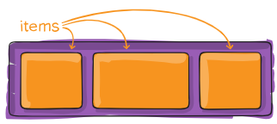
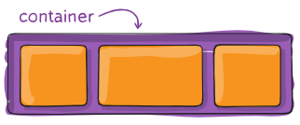
Flexbox Layout
Flexbox is a one-dimensional layout method for arranging items in rows or columns.
  Items flex (expand) to fill additional space or shrink to fit into smaller spaces.
Flex Container
  Adding a display value of flex to an element makes it a flex container.
Flex Item
  When the element is converted to a flex container, its children are converted to (and laid out as) flex items.
section {
display: flex;
}
Source: Coyier, C. (2026, May 28). A Complete CSS Flexbox Layout Guide. https://css-tricks.com/snippets/css/a-guide-to-flexbox/

Slide 86
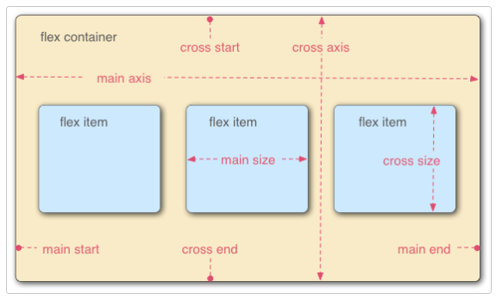
Flexbox Model
Flexbox provides a property called flex-direction that specifies which direction the main axis runs (which direction the flexbox children are laid out in).
By default this is set to row. Other options: column, row-reverse, column-reverse.
flex-direction: column;
Source: MDN. (2026). Flexbox. https://developer.mozilla.org/en-US/docs/Learn_web_development/Core/CSS_layout/Flexbox

Slide 87
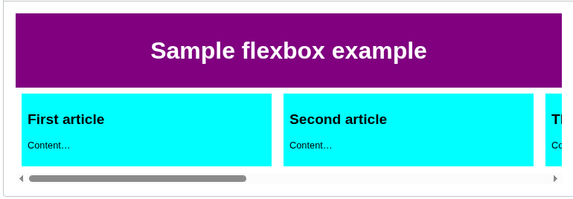
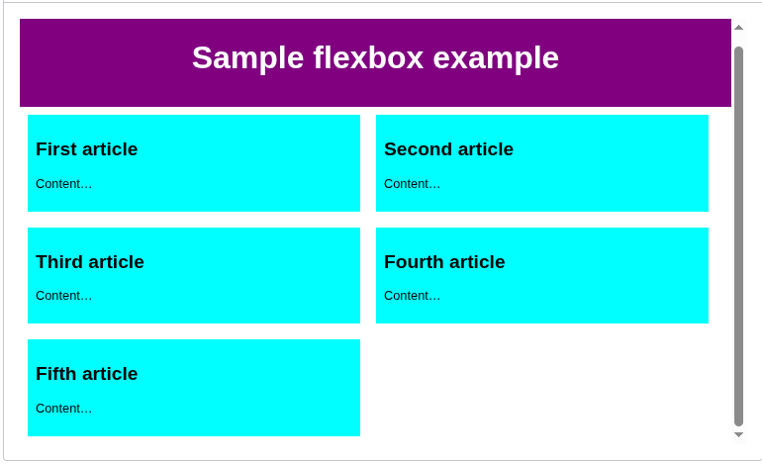
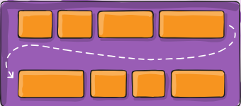
Flexbox Wrapping
When you have a fixed width or height in your layout is that eventually your flexbox children will overflow their container, breaking the layout.
By default, the browser tries to place all the flex items in a single row or column.
  Using {flex-wrap: wrap;} to force a line break among flex items.
Flex-flow: a shorthand for flex-direction and flex-wrap.
  {flex-flow: row wrap;}

Slide 88
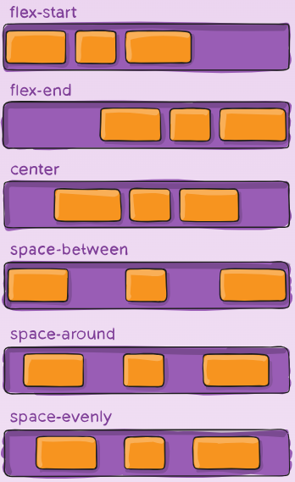
Flexbox ─ justify-content Property
This defines the alignment along the main axis.
Syntax: .container { justify-content: flex-start | flex-end | center | space-between | space-around | space-evenly...;}
https://www.w3schools.com/cssref/playdemo.php?filename=playcss_justify-content&preval=flex-start
Value | Description
flex-start | Default value. Items are positioned at the beginning of the container
flex-end | Items are positioned at the end of the container
center | Items are positioned in the center of the container
space-between | Items will have space between them
space-around | Items will have space before, between, and after them
space-evenly | Items will have equal space around them

Slide 89
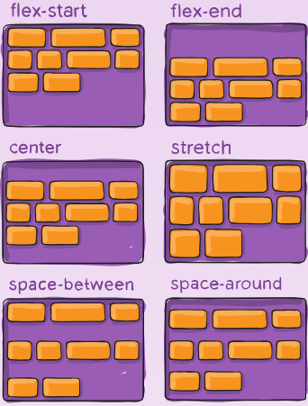
Flexbox ─ align-content Property
Align-content: This aligns a flex container’s lines within when there is extra space in the cross-axis.
This property only takes effect on multi-line flexible containers, where flex-wrap is set to either wrap or wrap-reverse.
https://developer.mozilla.org/en-US/docs/Web/CSS/Reference/Properties/align-content

Slide 90
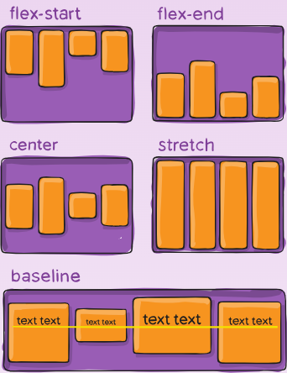
Flexbox ─ align-items Property
This defines the alignment along the cross axis.
Syntax: .container { stretch | flex-start | flex-end | center | baseline...;}
https://www.w3schools.com/cssref/playdemo.php?filename=playcss_align-items
Value | Description
normal | Default. Behaves like 'stretch' for flexbox and grid items, or 'start' for grid items with a defined block size.
stretch | Items are stretched to fit the container
center | Items are positioned at the center of the container
flex-start | Items are positioned at the beginning of the container
flex-end | Items are positioned at the end of the container
start | Items are positioned at the beginning of their individual grid cells, in the block direction
end | Items are positioned at the end of the their individual grid cells, in the block direction
baseline | Items are positioned at the baseline of the container

Slide 91

Flexbox ─ gap, row-gap, column-gap Property
The gap property explicitly controls the space between flex items. It applies that spacing only between items not on the outer edges.
It is not exclusively for flexbox, gap works in grid and multi-column layout as well.
.container {
display: flex;
...
gap: 10px;
gap: 10px 20px; /* row-/column-gap */
row-gap: 10px;
column-gap: 20px;
}

Slide 92

Flexbox ─ Order Property
By default, flex items are laid out in the source order.
Only effect for flex item or grid item.
Items in a container are sorted by ascending order value and then by their source code order.
Syntax: {order: number;}

Slide 93

Flexbox ─ Flex Property
The flex property is the shorthand for flex-grow, flex-shrink and flex-basis combined.
The value default is 0 1 auto.
<'flex-grow'>
  Negative values are considered invalid. Defaults to 1 when omitted. (initial is 0)
<'flex-shrink'>
  Negative values are considered invalid. Defaults to 1 when omitted. (initial is 1)
<'flex-basis'>
  Defaults to 0% when omitted. The initial value is auto.
{
flex: 1 1 100px;
}

Slide 94
Grid Layout
Like tables, grid layout enables aligning elements into columns and rows, i.e. two-dimensional.
  Many more layouts are either possible or easier with CSS grid than they were with tables.
Grid container
  We create a grid container by declaring {display: grid;}
  Grid item: All direct children of that element become grid items.
Grid track
  The space between any two adjacent lines on the grid.
  Rows and columns are defined by the grid-template-rows and grid-template-columns properties.
Shorthands
  Grid property: grid-auto-columns, grid-auto-flow, grid-auto-rows, grid-template-areas, grid-template-columns, grid-template-rows.
  Grid-template property: grid-template-areas, grid-template-columns, grid-template-rows.

Slide 95
Grid Layout ─ Fractional unit
Pixel based
  .wrapper {
  display: grid;
  grid-template-columns: 200px 200px 200px;
  }
fr unit: The fr unit represents a fraction of the available space in the grid container.
  .wrapper {
  display: grid;
  grid-template-columns: 1fr 1fr 1fr;
  }
Unequal sizes
  .wrapper {
  display: grid;
  grid-template-columns: 2fr 1fr 1fr;
  }
Mixing flexible and absolute sizes
  .wrapper {
  display: grid;
  grid-template-columns: 500px 1fr 2fr;
  }

Slide 96
Grid Layout ─ Function and Implicit Grid
repeat() function
  .wrapper {
  display: grid;
  grid-template-columns: repeat(3, 1fr);
  }
Mixed mode
  .wrapper {
  display: grid;
  grid-template-columns: 20px repeat(6, 1fr) 20px;
  }
Repeated pattern
  .wrapper {
  display: grid;
  grid-template-columns: repeat(5, 1fr 2fr);
  }
Implicit grid
  No explicit declared, e.g. grid-template-rows
  The number of grid items exceeds the capacity of the defined tracks.
  Placement of grid item is outside of defined tracks.
Implicit tracks are auto-sized by default
  The auto keyword allows accommodating content while also sharing any remaining space.
  Using grid-auto-rows and grid-auto-columns properties to define size of tracks.
  .wrapper {
  display: grid;
  grid-template-columns: repeat(3, 1fr);
  grid-auto-rows: 200px;
  }
minmax(min_value, max_value)
  .wrapper {
  display: grid;
  grid-template-columns: repeat(3, 1fr);
  grid-auto-rows: minmax(100px, auto);
  }

Slide 97


Grid Layout ─ Grid Line and Positioning Items
Lines are numbered according to the writing mode of the document.
.wrapper {
display: grid;
grid-template-columns: repeat(3, 1fr);
grid-auto-rows: 100px;
}
.box1 {
grid-column-start: 1;
grid-column-end: 4;
grid-row-start: 1;
grid-row-end: 3;
}
.box2 {
grid-column-start: 1;
grid-row-start: 3;
grid-row-end: 5;
}

Slide 98
Grid Layout ─ Line-positioning shorthands
The longhand values used above can be compressed onto one line for columns with the grid-column shorthand, and one line for rows with the grid-row shorthand.
.wrapper {
display: grid;
grid-template-columns: repeat(3, 1fr);
grid-auto-rows: 100px;
}
.box1 {
grid-column: 1 / 4;
grid-row: 1 / 3;
}
.box2 {
grid-column: 1;
grid-row: 3 / 5;
}

Slide 99

Grid Layout ─ Grid Cell and Gaps
The space between two adjacent row and two adjacent column grid lines.
  A grid cell is the smallest unit on a grid.
Gutters or alleys between grid cells can be created using the column-gap and row-gap properties, or the shorthand gap.
.wrapper {
display: grid;
grid-template-columns: repeat(3, 1fr);
column-gap: 10px;
row-gap: 1em;
}

Slide 100
Try it Yourself ─ Nesting Grid and Animations
Learn nesting grids (with keyword subgrid) and layering items with z-index
  https://developer.mozilla.org/en-US/docs/Web/CSS/Guides/Grid_layout/Basic_concepts#nesting_grids
Advanced topics
  Animations
    https://developer.mozilla.org/en-US/docs/Web/CSS/Guides/Animations
  Transforms
    https://developer.mozilla.org/en-US/docs/Web/CSS/Guides/Transforms

Slide 101
Responsive Design ─ Media Query

Slide 102
Using media queries
Allow you to apply CSS styles depending on a device's media type (such as print vs. screen) or other features or characteristics such as screen resolution or orientation, aspect ratio, browser viewport width or height, user preferences such as preferring reduced motion, data usage, or transparency.
The @media CSS at-rule can be used to apply part of a style sheet based on the result of one or more media queries.

Slide 103
Media Types and Media Features
A <media-type> describes the general category of a device. Except when using the only logical operator, the media type is optional and the all type is implied.
All
  Suitable for all devices.
Print
  Intended for paged material and documents viewed on a screen in print preview mode. (Please see paged media for information about formatting issues that are specific to these formats.)
Screen
  Intended primarily for screens.
A <media feature> describes specific characteristics of the user agent, output device, or environment.
Common media features include:
  width—the width of the part of the screen on which the document is rendered, including any scrollbars
  height—the height of the part of the screen on which the document is rendered, including any scrollbars
  orientation—if the height is greater than the width, orientation is portrait, and if the width is greater than the height, orientation is landscape
  aspect-ratio—the ratio of width to height
  device-aspect-ratio—the ratio of device-width to device-height
  Prefers-color-scheme
  Prefers-reduced-motion
https://developer.mozilla.org/en-US/docs/Web/CSS/Reference/At-rules/@media#media_features

Slide 104
@custom-media CSS at-rule
The @custom-media CSS at-rule defines aliases for long or complex media queries.
Instead of duplicate queries, you can define them once in a @custom-media at-rule and referenced throughout the stylesheet whenever needed.
Syntax
  @custom-media <extension-name> [<media-query-list> | true | false ];
  <extension-name>: A <dashed-ident>; the name identifying the custom media query.
  <media-query-list>: A comma-separated list of <media-query> values.
@custom-media --medium-screen (min-width: 40em) and (max-width: 60em);
@media (--medium-screen) {
}
@custom-media --mobile-screen (width < 480px);
@custom-media --tablet-screen (width < 768px);
@custom-media --laptop-screen (width < 1024px);
@custom-media --desktop-screen (width < 1440px);
@custom-media --widescreen (width > 1441px);

Slide 105
Try it Yourself ─ Container Query and Typography
Finer Adjustment ─ Container Query
  https://developer.mozilla.org/en-US/docs/Web/CSS/Guides/Containment/Container_queries
Responsive Typography
  https://www.w3schools.com/howto/howto_css_responsive_text.asp
  https://blog.logrocket.com/elements-responsive-typography/

Slide 106
CSS Variables and Functions
Using CSS custom properties (variables)
  https://developer.mozilla.org/en-US/docs/Web/CSS/Guides/Cascading_variables/Using_custom_properties
CSS value functions
  https://developer.mozilla.org/en-US/docs/Web/CSS/Reference/Values/Functions
Functions in CSS
  https://css-tricks.com/functions-in-css/

Slide 107
Masking Practices
Play around CSS masking properties
  https://developer.mozilla.org/en-US/docs/Web/CSS/Guides/Masking/Introduction

Slide 108
Box Model Practices
Play around more box model properties
  Outline: https://developer.mozilla.org/en-US/docs/Web/CSS/Reference/Properties/outline
  Box shadow: https://developer.mozilla.org/en-US/docs/Web/CSS/Reference/Properties/box-shadow

Slide 109
Element Specific Effects
Any two of followings for each element: properties, functions, Pseudo-elements.
Table
  https://developer.mozilla.org/en-US/docs/Web/CSS/Guides/Table
List and Counter
  https://developer.mozilla.org/en-US/docs/Web/CSS/Guides/Lists
Image
  https://developer.mozilla.org/en-US/docs/Web/CSS/Guides/Images
Filter
  https://developer.mozilla.org/en-US/docs/Web/CSS/Guides/Filter_effects

Slide 110
Nesting Grid and Animations
Learn nesting grids (with keyword subgrid) and layering items with z-index
  https://developer.mozilla.org/en-US/docs/Web/CSS/Guides/Grid_layout/Basic_concepts#nesting_grids
Advanced topics
  Animations
    https://developer.mozilla.org/en-US/docs/Web/CSS/Guides/Animations
  Transforms
    https://developer.mozilla.org/en-US/docs/Web/CSS/Guides/Transforms

Slide 111
Free CSS template
http://www.templatemo.com/
http://www.oswd.org/
http://templated.co/
http://www.myfreecsstemplates.com/
http://www.free-css.com/
http://www.free-css-templates.com/
https://www.freewebtemplates.com/css-templates/

Slide 112

Questions?

