Slide 1
VTD

Slide 2


VTD SETUP
Prerequisite is a licensed and running VTD installation
Files necessary for the completion of the setup are provided. Move these files to the VTD workstation
E.g. for VTD2020, these files are: VTD2020.AVL.tar and VTD2020.Packages.tar
Once the files are copied, right click in the folder where the files are, and select „open in Terminal”
Run the command tar -xvf archive.tar.gz where the archive is e.g., VTD2020.Packages
You should see two new files appear in the folder, PackagesInstaller and Packages.tar.gz
While still in the Terminal, type ./PackageInstaller
If you get some errors like:
Run sudo apt –fix-broken install and select Y when asked. The installation should now be good, and the two files extracted before should be gone

Slide 3
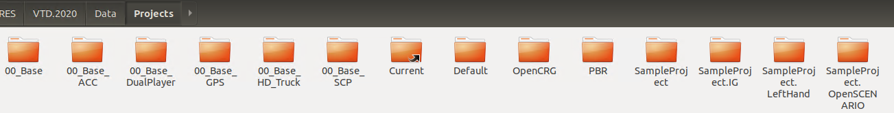
VTD SETUP
Copy the VTD2020.AVL.tar.gz file to the folder where VTD was installed (same folder as bin, Data, Develop, Doc, Installer, Runtime)
Open terminal in this folder and extract the archive with this command: tar -xzf VTD2020.AVL.tar.gz
Navigate to Data\Projects and check that there are projects as in the figure below
VTD needs to be started in Cosimulation mode. Navigate to the bin folder and open the terminal in that folder. Run the command: ./vtdStart.sh
If the VTD is started in the „Standard” setup, it needs to be started in the CoSimulation setup
Close it and in terminal run command: ./vtdStart --select
Find the Cosimulation setup on the list (it should be number 2) and type 2 into the terminal. The VTD is now started in the Cosimulation mode
Open the 00_Base_ACC project and Apply the configuration. VTD needs to be ready for cosim

Slide 4

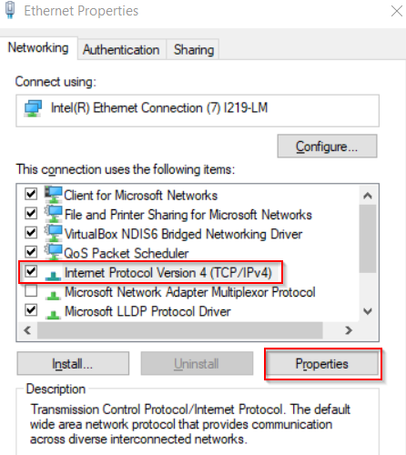
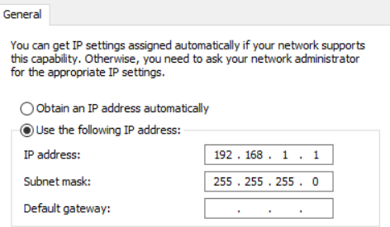
VTD SETUP
Open the terminal and type ifconfig to see the machine’s IP address and connection type. On the figure below, the connection type is enp0s3 and the IP address is 192.168.56.101
Make sure that your machine (where you run Model Connect) and the Linux workstation are on the same network. Easiest setup is to connect them via ethernet cable. Once you connect them, a new network will appear under: Network Settings → Change Adapter Options
Change the IP address to something like: 192.168.56.1 (these numbers need to match the above IP address from the VTD workstation, with the exception of the last number)

Slide 5
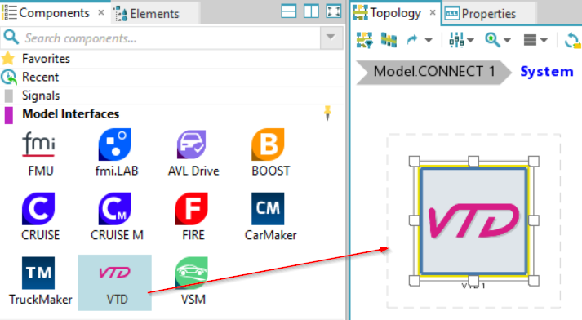
Model.CONNECT Setup
Insert a new Model.CONNECT™ model
In Project | New double-click on the Model.CONNECT™ icon.
The Home tab opens with the default panes: Components, Elements, Topology, Properties, Messages and Layer Configurations.
Insert the VTD component from the Components pane into the Topology pane

Slide 6
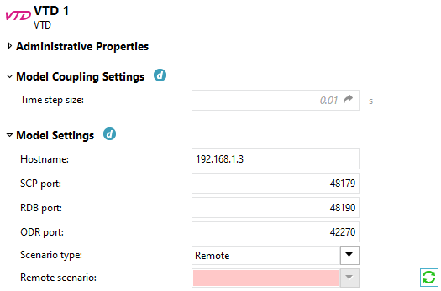

Model.CONNECT Setup
Double-click on the component to open the Properties dialog
Model Settings - To establish the communication with VTD software on a Linux machine, the following settings are required:
Hostname: IP address or machine name the running VTD instance (the IP address from the terminal)
SCP port: 48179 (default value)
RDB port: 48190 (default value)
ODR port: 42270 (default value)
Scenario type: Remote
Remote scenario: Click on the refresh icon
If everything was setup correctly in the VTD SETUP part, the user should see a list of available scenarios located on the VTD machine, under Data\Projects\00_Base_ACC\Scenarios with the Players read from the scenario
If the setup is not correct, there will be a message in the Messages pane like:
Please check the defined IP address, the Network setup and that the configuration is applied on VTD side

Slide 7
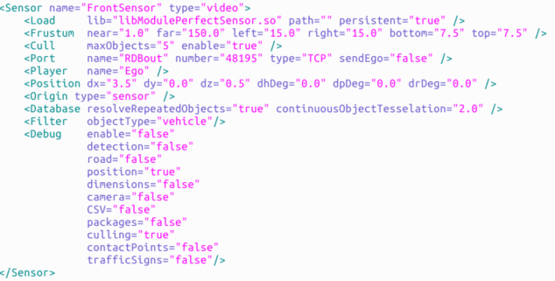
Model.CONNECT Setup
Add a sensor
A sensor is defined in the moduleManager.xml file in VTD (00_Base_ACC\Config\ModuleManager). In our case, we will define sensor as follows:
the Name should correspond to the name defined in the .xml file, e.g.
There can only be one sensor per TCP port. The port is defined in the xml file
Name | TCP port | Max objects | Max Points
Ego.FrontSensor | 48195 | 5 | 1

Slide 8
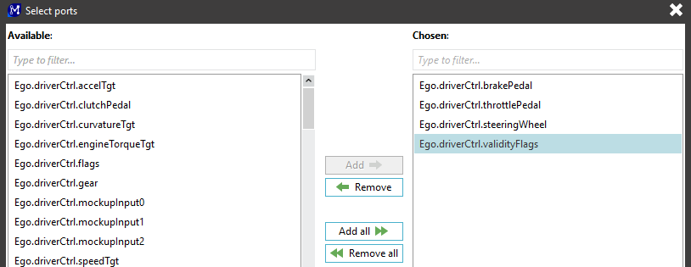
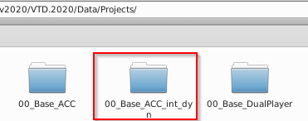

Model.CONNECT Setup – External Driver
Add ports
Ports have to be added manually from the list of the available ports. By clicking on the Add ports button, the list of available ports is presented
Add the ports from the figure as Input ports
On VTD machine, navigate to the project folder, and make a copy of the 00_Base_ACC folder (call it e.g., 00_Base_ACC_int_dyn as we will now add vehicle dynamics)
Within the new folder, there is a .vpj file Rename it also to the folder name

Slide 9


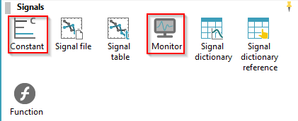
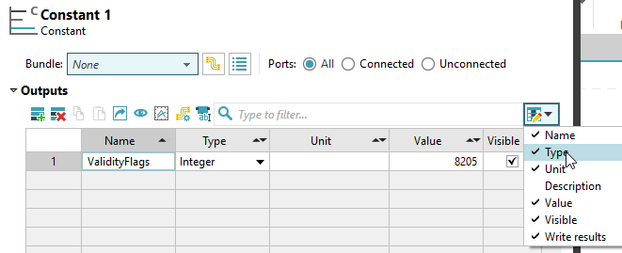
Model.CONNECT Setup – External Driver
Now navigate again to Config/ModuleManager/moduleManager.xml and open it
Uncomment the part where the simple vehicle dynamics are disabled (remove the !-- and --) and save it
Load this project into the VTD and apply the configuration
On Model.CONNECT side, add a Constant and a Monitor block
Double click on the Constant block
Rename the Output to ValidityFlags
Set the Type to Integer
Set the value to 8205 (explained later)

Slide 10
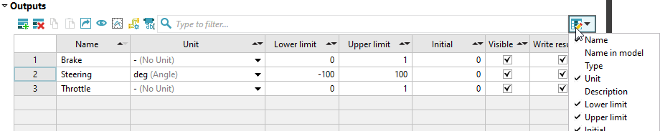
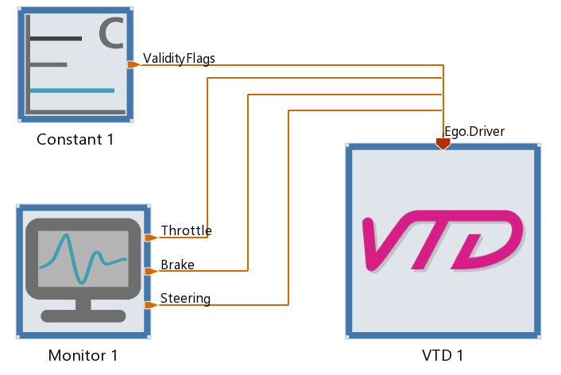
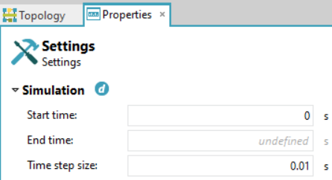
Model.CONNECT Setup – External Driver
Double click on the Monitor block and define 3 outputs:
Throttle
Brake
Steering
Connect the setup
ValidityFlags → Ego.driverCtrl.validityFlags
Brake → Ego.driverCtrl.brakePedal
Throttle → Ego.driverCtrl.throttlePedal
Steering → Ego.driverCtrl.steeringWheel
Simulation settings
Set the end time to undefined

Slide 11
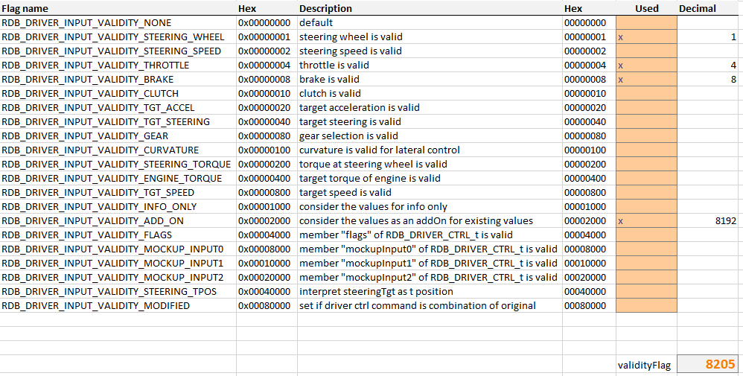
Model.CONNECT Setup – External Driver
Attached you can find the VTD validityFlag Calculator.xlsx where you can find a table that calculates required validityFlag value to externally control some aspects of the VTD driver
In the current case, we want to control Steering, Brake and Throttle. The selection RDB_DRIVER_INPUT_VALIDITY_ADD_ON is always necessary
Put an x in the field you want

Slide 12
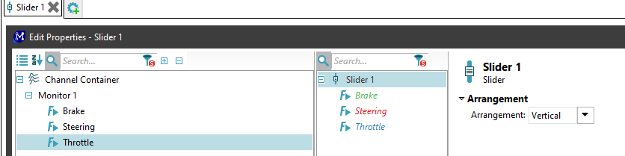
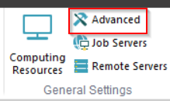
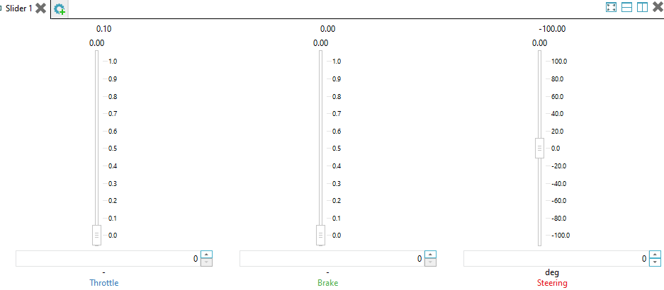
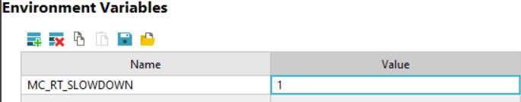
Model.CONNECT Setup – External Driver
In Model.CONNECT, navigate to the Simulations tab and add a Slider component to the Online Monitor. There, add the 3 signals
Apply RT slowdown
Open Advanced Settings:
Under Environmental Variables set:
Start the simulation
Once the simulation starts, play with the values of Throttle, Brake and Steer and see how the vehicle in VTD reacts
Stop the simulation

Slide 13
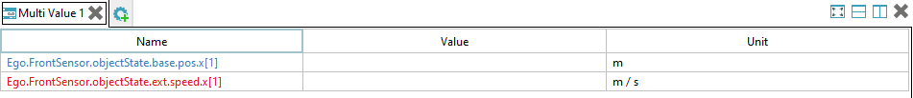
Model.CONNECT Setup – External Driver
Navigate back to the Home tab in Model.CONNECT and double click on the VTD block. In ports tab, add Output ports. Filter the search with „FrontSensor” and select:
Ego.FrontSensor.objectState.base.pos.x
Ego.FrontSensor.objectState.ext.speed.x
These two ports are vectors with the size defined in the Max Objects column of the Sensor properties in the VTD Model.CONNECT component
Add a MultiValue component in the OnlineMonitor and add just the first vector value of both ports
Start the simulation again and stay in lane. Once you approach the other vehicle on the road, the relative distance and speed will be shown at these two ports. Try to balance Throttle and Brake to stay behind the vehicle

Slide 14
Model.CONNECT Setup – External Vehicle
Add a new Model.CONNECT model
Setup the VTD component like on slides 6 and 7
On VTD side, load the provided project called 00_Base
In the VTD component, refresh the Scenarios and select FreeDriving_Passenger.xml
The other required files for this setup can be found by unzipping the installation example VSM_VTD.proj .
When unzipped, SDT projects will provide, among other things, all files embedded into the project.
Under VSM_VTD\project_files\modeling a VSM project can be found under the vsm folder.
In the folder VSM_VTD\project_files\modeling\components\FMU all FMUs required for this project can be found.
In the Model.CONNECT Topology pane, from the Model Interfaces section, add components VSM and FMU
From the Signals section, add a Constant component

Slide 15
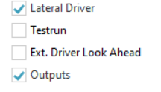
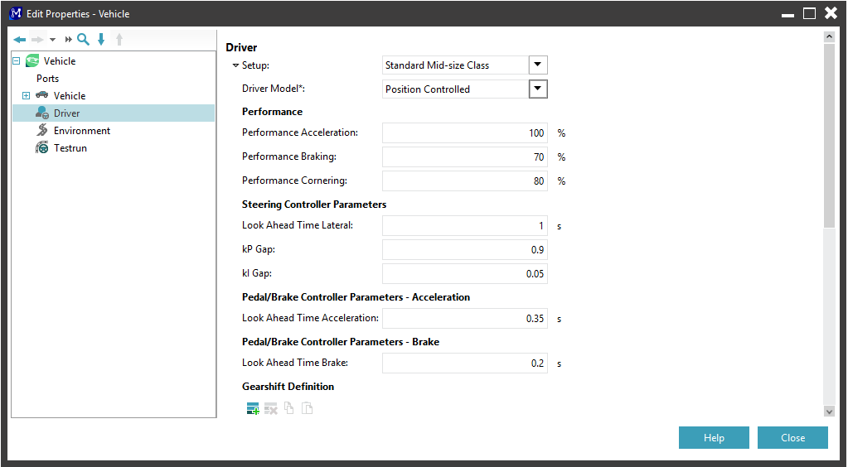
Model.CONNECT Setup – External Vehicle
VSM component
Double-click on the component to open the Properties dialog:
Load the VSM project from the unzipped Model.CONNECT installation example VSM_VTD.proj (VSM_VTD\project_files\modeling\PassengerCar\PassengerCar.vsmprj)
The following VSM modules have to be excluded:
Testrun
Ext. Driver Look Ahead
Setup Driver
By default, the VSM Driver Model is set to Curvature Controlled. If you encounter any issues related to VSM control, try to change it to PositionControlled like on the figure to the right

Slide 16
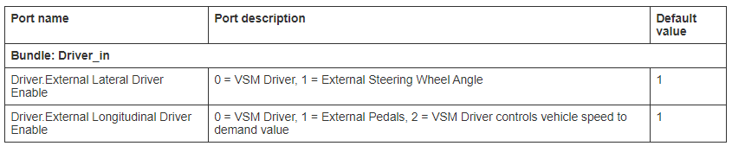
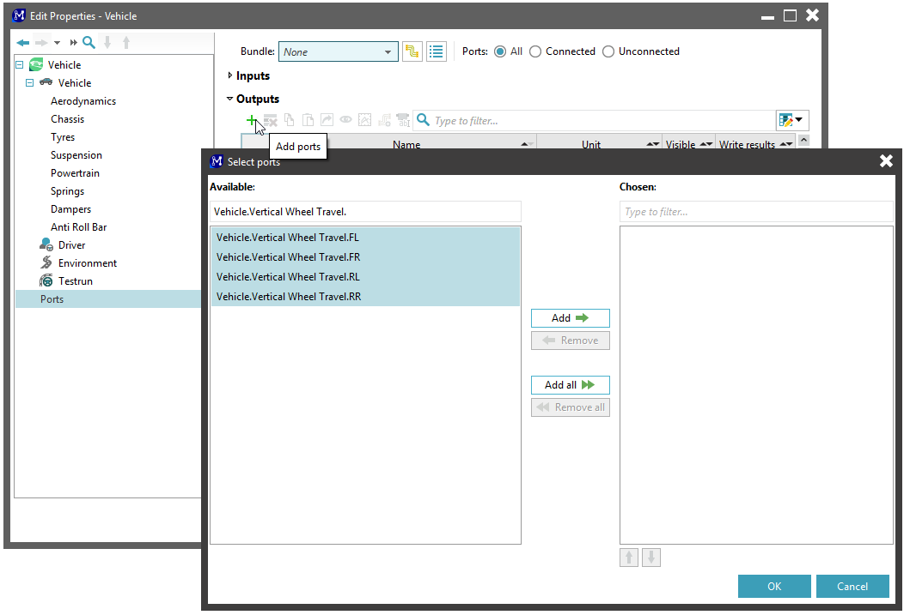
Model.CONNECT Setup – External Vehicle
Enable external driver commands
In order to send external driver commands to VSM, the following VSM ports must have default values as in the table below.
It's recommended to add a port description to understand the value purpose for later applications.
Additional VSM ports are needed for this project. Output ports:
Vehicle.Vertical Wheel Travel.FL/FR/RL/RR
Vehicle.Wheel Contact Point Position WorldX_FL/FR/RL/RR
Vehicle.Wheel Contact Point Position WorldY_FL/FR/RL/RR
Input ports
External Input.SelectorLeverExternal

Slide 17
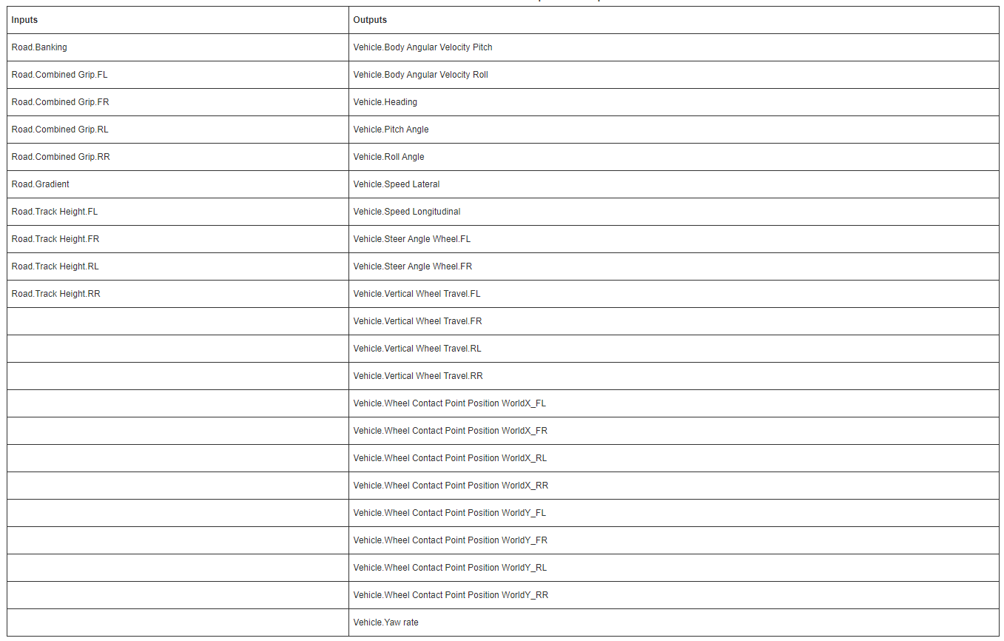
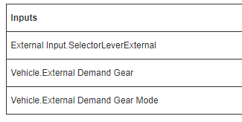
Model.CONNECT Setup – External Vehicle
Bundle ports
Create a new bundle CoSimulation and add the following input and output ports to it:
Create a new bundle Config and add the following input ports to it:

Slide 18
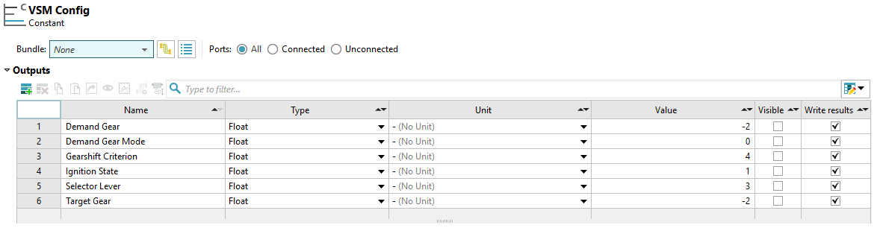
Model.CONNECT Setup – External Vehicle
Constant component
Define the constant component like on the figure below
Bundle the ports into a bundle called „Config”

Slide 19
Model.CONNECT Setup – External Vehicle
FMU Component
Double-click on the component to open the Properties dialog:
Load the CoordinationTransformation.fmu file from the unzipped Model.CONNECT installation example VSM_VTD.proj\VSM_VTD\project_files\modeling\components\FMU\CoordinationTransformation.fmu
To add clarity to the model topology, two bundles should be created:
Filter all FMU Input ports by typing VSM and create a new bundle called VSM Exchange with these ports. Repeat for Output ports
Repeat the process for the Ego ports and create a new bundle called VTD Exchange
VTD Component
As before, add ports, filter them by
Inputs: roadQuery.x , roadQuery.y , wheel.base.springCompression , wheel.base.steeringAngle , Ego.objectState.base.pos , Ego.objectState.ext.speed
Outputs: driverCtrl , contactPoint.friction , contactPoint.roadDataIn.z , [initial]Ego.

Slide 20
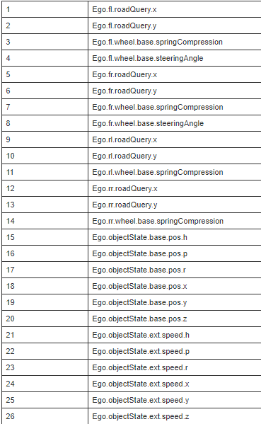
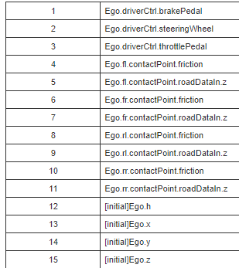
Model.CONNECT Setup – External Vehicle
Inputs Outputs

Slide 21
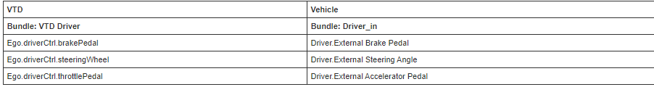
Model.CONNECT Setup – External Vehicle
Bundle ports
Delete all existing bundles (Ego.Driver, Ego.Init, Ego.Road, Ego.Vehicle) and create two new bundles:
CoSimulation
VTD Driver
Add the following ports to the VTD Driver bundle:
Ego.driverCtrl.brakePedal
Ego.driverCtrl.steeringWheel
Ego.driverCtrl.throttlePedal
Add all remaining ports to the CoSimulation bundle.
Connect the components
Connect the appropriate bundles together and make sure that the ports are also correctly connected
VTD component CoSim bundle to FMU component VTD bundle
FMU component VSM bundle to VSM component CoSim bundle
VTD and VSM

Slide 22
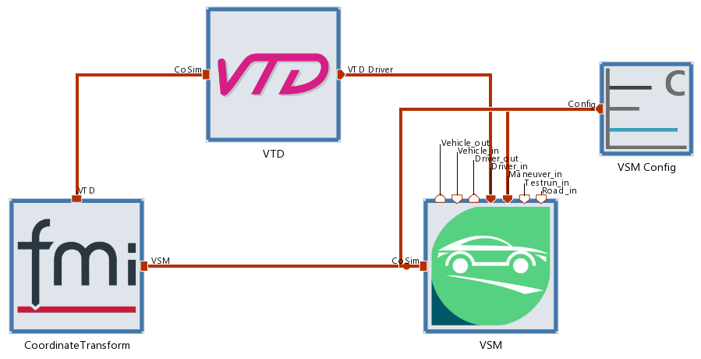
Model.CONNECT Setup – External Vehicle
VSM and Constant
Finished connections
VSM | Constant
Bundle: Maneuver_in | Bundle: Config
Maneuver.Gearshift Criterion | Gearshift Criterion
Maneuver.Ignition State | Ignition State
Maneuver.Target Gear | Target Gear
Bundle: CoSim | Bundle: Config
External Input.SelectorLeverExternal | Selector Lever
Vehicle.External Demand Gear | Demand Gear
Vehicle.External Demand Gear Mode | Demand Gear Mode

Slide 23
Model.CONNECT Setup – External Vehicle
Simulation settings
Set the end time to undefined
Apply RT slowdown
Open Advanced Settings
Under Environmental Variables set
Define the Signals to be Monitored during the Simulation
To define the signals:Right-click on it to open the Gauge window. In the upper part of it, all available signals can be seen.
Select the Driver.Accelerator Pedal from VSM and add it to the monitoring signals by double-clicking on it with the left mouse button.
Repeat the same steps for Driver.Brake Pedal, Driver.Steer Angle
Right-click on the top left Gauge Monitor to open the Gauge Monitor window. Select Driver.Accelerator Pedal and Driver.Brake Pedal signals from the bottom part by using CTRL + click.
Change channel limits in the right part of the display.
For Minimum and Maximum property, select the Custom option, enter 1 for the custom maximum (custom minimum remains zero) and close the window.
For the Driver.Steer Angle, enter -540 for the Custom Minimum and 540 for Custom Maximum.

Slide 24
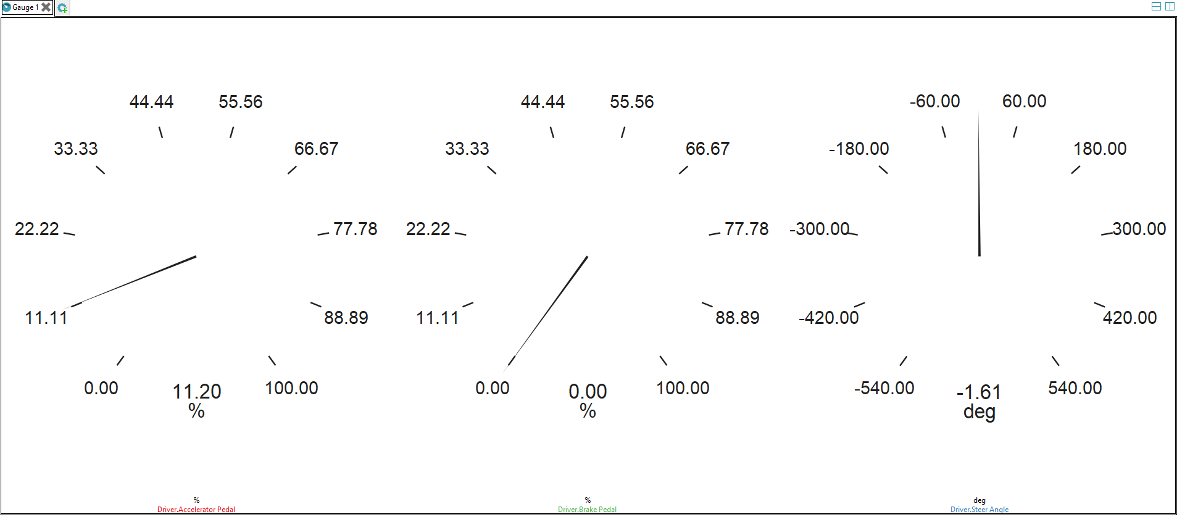
Model.CONNECT Setup – External Vehicle
Online Monitor
Start the Simulation

Slide 25

Model.CONNECT Setup – External Vehicle w. ACC
This setup is based on the previous setup with external vehicle
Copy the ExternalVehicle Model.CONNECT model and rename the new model to ExternalVehicle_ACC
Add a new FMU component and select the ACC.fmu from the folder in slide 14
Rename the component to ACC and bundle the ports like:
Bundle: Environmental information | Bundle: HMI input | Bundle: Vehicle Exchange
Ego.FrontSensor.objectState.ext.accel.x | ACC.Active | Ego.Vehicle.Speed
Ego.FrontSensor.objectState.ext.speed.x | Desired.Timegap | Demand.Vehicle.Speed
Ego.FrontSensor.objectState.ext.speed.y | Desired.Vehicle.Speed | VSM.Longitudinal.Driver.Enabled
Ego.FrontSensor.roadPos.laneId
Ego.FrontSensor.sensorObject.dist
Ego.FrontSensor.sensorObject.sensorPos.x
Ego.FrontSensor.sensorObject.sensorPos.y
Ego.roadPos.laneId

Slide 26
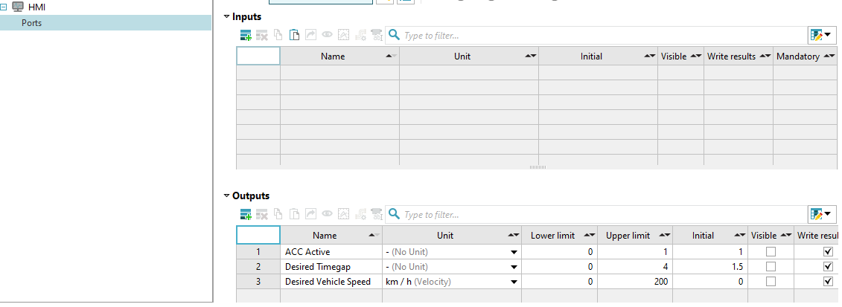
Model.CONNECT Setup – External Vehicle w. ACC
Add a Monitor component, call it HMI and add the output ports like in the figure below and add them to a bundle called HMI.

Slide 27
Model.CONNECT Setup – External Vehicle w. ACC
On the VTD component, add the following output ports:
When added, first seven of these ports should create a new bundle called Ego.FrontSensor, while the last one should create a new bundle called default
Ego.FrontSensor.objectState.ext.accel.x
Ego.FrontSensor.objectState.ext.speed.x
Ego.FrontSensor.objectState.ext.speed.y
Ego.FrontSensor.roadPos.laneId
Ego.FrontSensor.sensorObject.dist
Ego.FrontSensor.sensorObject.sensorPos.x
Ego.FrontSensor.sensorObject.sensorPos.y
Ego.roadPos.laneId

Slide 28
Model.CONNECT Setup – External Vehicle w. ACC
Connect the components
ACC and VSM
HMI and ACC
Self explanatory
ACC and VTD
VSM | ACC
Bundle: Driver_in | Bundle: Vehicle Exchange
Driver.External Demand Value V | Demand.Vehicle.Speed
Driver.External Longitudinal Driver Enable | VSM.Longitudinal.Driver.Enabled
Bundle: Vehicle_out | Bundle: Vehicle Exchange
Vehicle.Vehicle Speed | Ego.Vehicle.Speed
VTD | ACC
Bundle: Ego.FrontSensor | Bundle: Environmental information
All ports with the same name
Bundle: default | Bundle: Environmental information
Ego.roadPos.laneId | Ego.roadPos.laneId

Slide 29
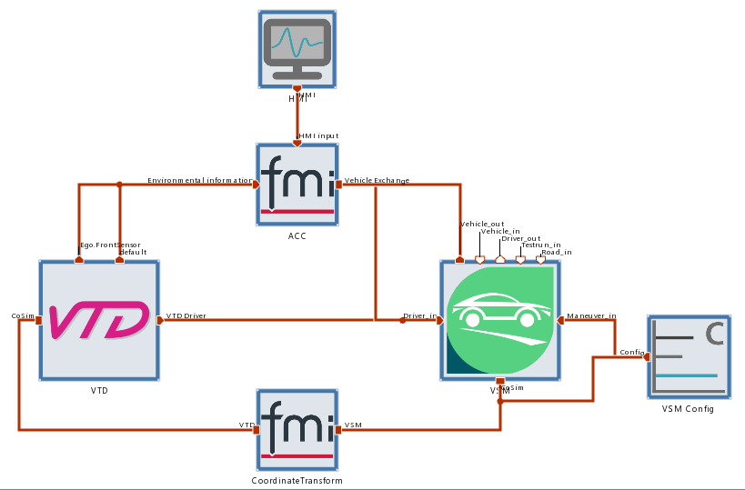
Model.CONNECT Setup – External Vehicle w. ACC
How the setup should look like

Slide 30
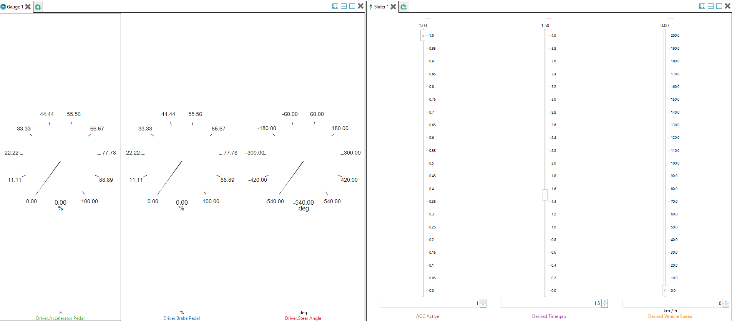
Model.CONNECT Setup – External Vehicle w. ACC
Online Monitor
In the simulations tab, add a Slider component and add the signals from the HMI component to it
In this setup, the VTD driver is no longer relevant as the ACC component will output VSM.Longitudinal.Driver.Enabled with a value of 2. This will command the VSM to listen to the Desired Vehicle Speed set by the ACC component and using the internal VSM driver to achieve it
For this reason, gauges from the previous setup will now show the VSM driver values

Slide 31
Model.CONNECT Setup – External Vehicle w. ACC
On the VTD side, load the 00_Base_ACC project and apply the configuration
On Model.CONNECT, open the VTD component and refresh the scenarios. Select ACC_Passenger.xml
Start the simulation
Play with the slider for setting the Desired Vehicle Speed
Once the other vehicle is in range, the ACC will start to act and will keep the vehicle at the distance defined by the timegap slider

Slide 32
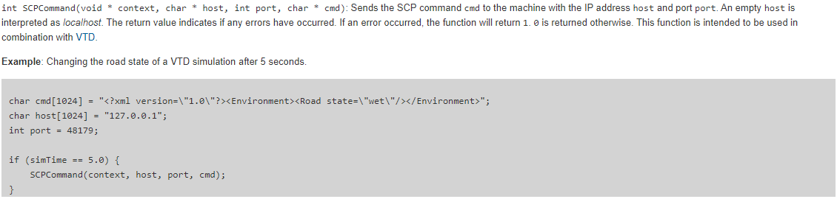
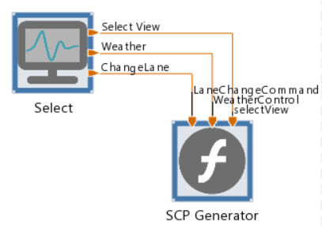
Model.CONNECT Setup – SCP commands
The user can send custom SCP commands to VTD using the Function component in Model.CONNECT. An example can be found in Model.CONNECT manual, chapter Function, section Exposed Functions.
Insert a Function block and add 3 inputs
selectView
weatherControl
laneChange
Insert a Monitor with the same 3 outputs
 | LowerLimit | UpperLimit | Default
SelectView | 1 | 2 | 1
Weather | 0 | 4 | 0
Lane | -1 | 1 | 0

Slide 33
Model.CONNECT Setup – SCP commands
In the Function block body:
Define the weather commands char cmd_sunny[1024] = "<?xml version=\"1.0\"?><Environment><Sky cloudState=\"0/8\" visibility=\"100000.000000\" /><Precipitation intensity=\"0.000000\" type=\"none\" /><Road state=\"dry\"/></Environment>"; char cmd_noRain[1024] = "<?xml version=\"1.0\"?><Environment><Sky cloudState=\"2/8\" visibility=\"100000.000000\" /><Precipitation intensity=\"0.200000\" type=\"rain\" /><Road state=\"wet\"/></Environment>"; char cmd_weak[1024] = "<?xml version=\"1.0\"?><Environment><Sky cloudState=\"4/8\" visibility=\"1000.000000\" /><Precipitation intensity=\"0.400000\" type=\"rain\" /><Road state=\"wet\"/></Environment>"; char cmd_medium[1024] = "<?xml version=\"1.0\"?><Environment><Sky cloudState=\"6/8\" visibility=\"300.000000\" /><Precipitation intensity=\"0.700000\" type=\"rain\" /><Road state=\"wet\"/></Environment>"; char cmd_heavy[1024] = "<?xml version=\"1.0\"?><Environment><Sky cloudState=\"8/8\" visibility=\"100.000000\" /><Precipitation intensity=\"0.900000\" type=\"rain\" /><Road state=\"wet\"/></Environment>";
Define the change view commands char cmd_changeViewThirdPerson[1024] = "<?xml version=\"1.0\"?><Camera name=\"VIEW_CAMERA\" showOwner=\"true\"><Frustum far=\"1500.000000\" fovHor=\"40.000000\" fovVert=\"30.000000\" near=\"1.000000\" offsetHor=\"0.000000\" offsetVert=\"0.000000\" /><PosRelative dx=\"-15.000000\" dy=\"0.000000\" dz=\"5.000000\" player=\"Ego\" /><ViewRelative dh=\"0.000000\" dp=\"0.139626\" dr=\"0.000000\" /><Set /></Camera>"; char cmd_changeViewPassenger[1024] = "<?xml version=\"1.0\"?><Camera name=\"VIEW_CAMERA\" showOwner=\"true\"><Frustum far=\"1500.000000\" fovHor=\"40.000000\" fovVert=\"30.000000\" near=\"1.000000\" offsetHor=\"0.000000\" offsetVert=\"0.000000\" /><PosRelative dx=\"0.700000\" dy=\"0.25\" dz=\"1.150\" player=\"Ego\" /><ViewRelative dh=\"0.000000\" dp=\"0.139626\" dr=\"0.000000\" /><Set /></Camera>";
Define the change lane commands char cmd_changeLaneLeft[1024] = "<?xml version=\"1.0\"?><EgoCtrl><LaneChange direction=\"-1\"/><Speed value=\"100\" /></EgoCtrl>"; char cmd_changeLaneRight[1024] = "<?xml version=\"1.0\"?><EgoCtrl><LaneChange direction=\"1\"/><Speed value=\"100\" /></EgoCtrl>"; char cmd_changeLane0[1024] = "<?xml version=\"1.0\"?><Traffic><ActionLaneChange actor=\"Ego\" direction =\"1\" time=\"3\" force=\"false\" approveByDriver=\"false\" /></Traffic>"; char cmd_changeLane1[1024] = "<?xml version=\"1.0\"?><Traffic><ActionLaneChange actor=\"Ego\" direction =\"-1\" time=\"3\" force=\"false\" approveByDriver=\"false\" /></Traffic>";

Slide 34
Model.CONNECT Setup – SCP commands
Define some General Setup char host[1024] = VTDADDRESS; int port= 48179; int command = (int)selectView; int old_command; int RainLevel = (int)weatherControl; int oldRainLevel; static int exectuion = 0; int commandLane = (int)laneChange; int old_commandLane;
Weather Control if (RainLevel == 0 && oldRainLevel != RainLevel) { SCPCommand(context, host, port, cmd_sunny);} else if (RainLevel == 1 && oldRainLevel != RainLevel) { SCPCommand(context, host, port, cmd_weak);} else if (RainLevel == 2 && oldRainLevel != RainLevel) { SCPCommand(context, host, port, cmd_medium);} else if ((RainLevel == 3 || RainLevel == 4) && oldRainLevel != RainLevel) { SCPCommand(context, host, port, cmd_heavy);} oldRainLevel = RainLevel;

Slide 35
Model.CONNECT Setup – SCP commands
SelectView if (simTime <= 2 * deltaSimTime){ SCPCommand(context, host, port, cmd_changeViewThirdPerson);} if (command != old_command && command != 0){ if (command==1){ SCPCommand(context, host, port, cmd_changeViewThirdPerson);} else if(command == 2){ SCPCommand(context, host, port, cmd_changeViewPassenger);} } old_command = command;
ChangeLane if (commandLane != old_commandLane && commandLane != 0){ if (commandLane==-1){ SCPCommand(context, host, port, cmd_changeLane0);} else if(commandLane == 1){ SCPCommand(context, host, port, cmd_changeLane1);} } old_commandLane = commandLane;
Note that Change Lane seems to work with Projects where there is an external vehicle model. When there are internaly dynamics in VTD, lane change does not seem to work. VTD settings in these two types of projects needs to be checked

