Slide 1
Homebrew Radio Design Deep Dive
01 - Introduction to Series

Slide 2
Deep Dive into Radios
Look into the pieces that make up radios
  Attempt to better understand each block that makes up a radio
Focus on Amateur Radio - HF band
  2-30 MHz
Focus on receiver first, then transmitter
  Some pieces can do double duty
Expect this video series to take time
  Start high level, then low level, then mid level

Slide 3
Nod to other YouTube Creators
Some great creators who focus on homebrew radios
  Alan W2AEW – deep dives
  Charlie Morris ZL2CTW– from first principles – component selection
  Pete Juliano N6QW – great results, lacks details of the pieces
  SolderSmoke N2CQR – MythBusters series is really good
Take a slightly different path
  Choose to use off the shelf kits for pieces where available
    Save time, costs the same or less, longer wait for stuff to come
  Build what needs to be built, some things will be cheaper

Slide 4
Most Basic Operation Level
Receiver
  In from Antenna
  Out to a speaker
Transmitter
  Microphone or Morse key in
  Out to an antenna

Slide 5
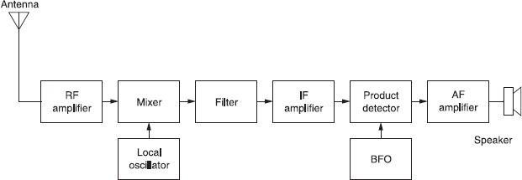
Typical Receiver Block Diagram

Slide 6
Receiver Pieces – Broad Strokes
Amplifiers
  Radio signals are very low level and need amplification
  RF, IF, Audio
Mixers
  Shift signs up/down in frequency
Oscillators
  Tuners, drive mixer
Filters
  Filter out RF signals we don’t want - Bandpass

Slide 7
Technique
Use off the shelf blocks
  Build all blocks with SMA connector
  Test each block
Connect blocks together using SMA cables
  Test blocks in combination
Easy to swap out blocks
  Comparison between alternates

Slide 8
Radio Design Deep Dive
02 - RF Test Equipment

Slide 9
Test Equipment
Recent seismic shift in affordability of test equipment
  NanoVNA - < $60
  TinySA - < $60
  8 digit frequency counter - < $20
  Total cost < $200 – would have been 10’ to 100’s of $K
Build vs Buy pieces?
  Crystal Tester
  RF Noise Generator – less necessary but easy to build
Do you really need these? Probably

Slide 10
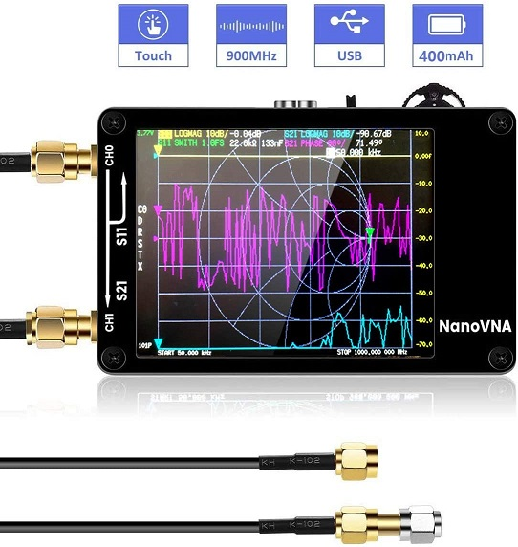
NanoVNA
Vector Network Analyzer
Scans from 0.1-900 MHz
  Does not do audio range – can’t scan audio filters
  This series looks at RF (1-30 MHz range)
Use NanoVNA to
  Sweep filters (bandpass for receivers, lowpass for transmitters)
  Sweep Antennas – check resonance
  Sweep IF/RF Amplifiers
    Make sure to use attenuators before/after the amplifier (power gain stages)

Slide 11
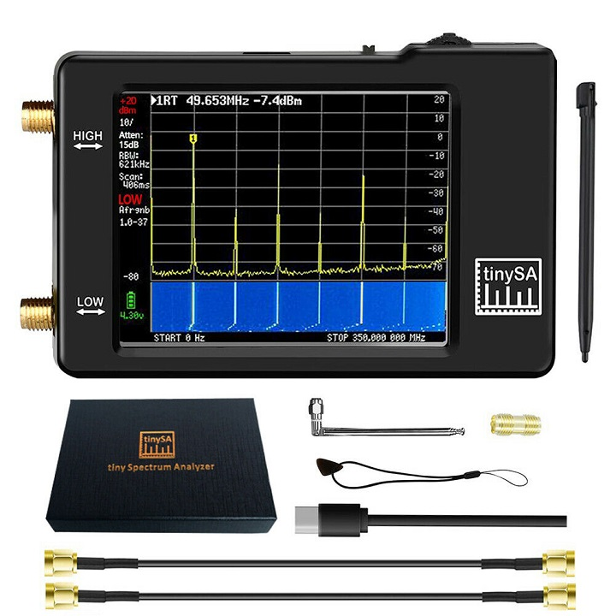
tinySA
Spectrum Analyzer
50KHz to 350 MHz
  Use for RF range 1-30 MHz
Measure
  Signal levels in dBm (dB into 50 Ohms)
  Spectral purity/harmonics
Make sure to use attenuators
  Don’t blow up front end

Slide 12
YouTube Creators
They have pro gear (typically HP) but have videos on less expensive NanoVNA and tinySA
IMSAIGuy
  Very good videos on using the NanoVNA and tinySA - Playlists
  His Intro to Spectrum Analyzers video is a good place to start
W2AEW
  Very good videos on NanoVNA - Playlist

Slide 13
Attenuators
Largely passive devices
Reduce power levels for measurement
Reduce power levels between radio block
  Ex: VFO puts out too much power for mixer LO input
Use appropriate power attenuators
  Radio Transmitters can put out a lot of Watts
  Spectrum Analyzers can’t take high power
  Attenuator has to dissipate the extra power/heat

Slide 14
Attenuators
Buy vs Build?
Buy triple attenuator
Buy adjustable attenuator
Buy higher power attenuator
Build individual small attenuators
  Simple PCB design
  Use between stages Ex: LO to mixer use 6 dB attenuator
  Buy 1% precision SMT resistors
All have SMA in/outs

Slide 15
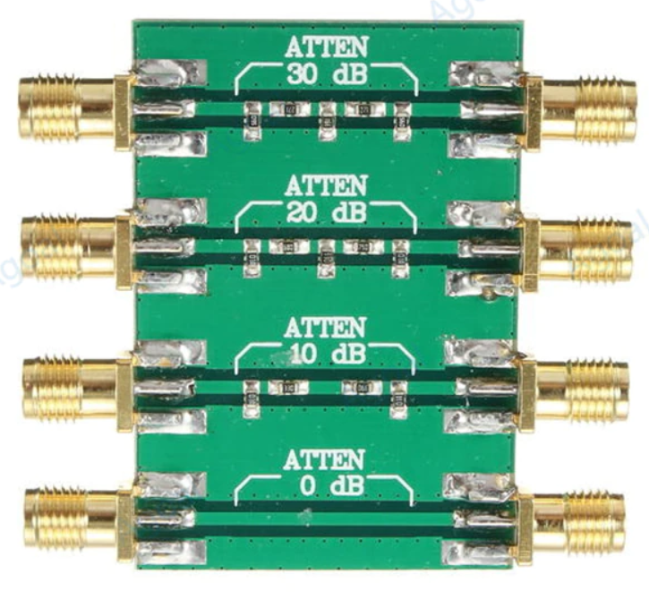
Triple Attenuator Card
Inexpensive
Fixed 0, 10, 20, 30 dB values
  0 dB for passthru calibration?
Not 1% resistors
Relatively large/bulky
Slow from overseas
Easy quick front end scaling into
tinySA and NanoVNA

Slide 16
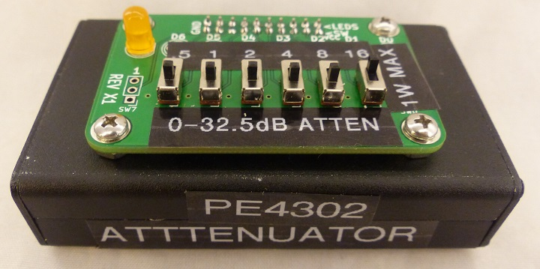
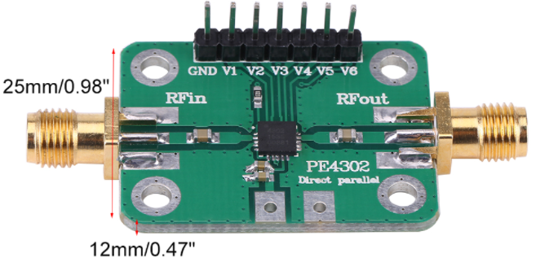
Adjustable Attenuator
Inexpensive - PE4302
Adjustable 0-31.5 dB
  Nice for small adjustment steps
Limited input power
Arduino designs out there – overkill?
Switch board - binary coded
Not purely passive – needs DC power supply
Build into project box

Slide 17
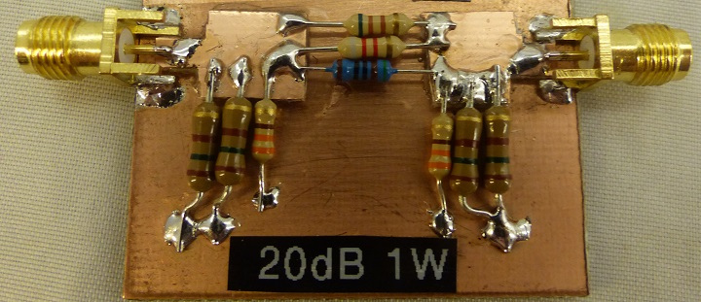
Homebrew Attenuators (1)
Attenuators lend themselves easily to homebrew construction
  Can do while waiting on attenuators to arrive in the mail
  Can also do “odd” values
  Use on-line calculators for values
  Manhattan style
  Carbon composition resistors
  Parallel junkbox 5% resistors
    Higher power
    Better precision – can get to 1%

Slide 18
Homebrew Attenuators (2)
Small PCB
  1206 resistors
  SMA male/female
  Light enough to hang off port

Slide 19
Attenuators
Always use Attenuators when measuring stages with power gain
  Even “small signal” RF Amplifiers can blow up the NanoVNA and tinySA front end
  Ex: 0 dBm from NanoVNA amplified by 20 dB ampliier = 20 dBm into tinySA – too much power
Null out attenuators
  TinySA set external gain to show “true” value with gain stages
Where to put attenuators in measurement?
  Sometimes on input of gain stage
    Bear in mind output compression
  Sometimes on output of gain stage
    Protect

Slide 20
DC Block
TinySA and NanoVNA should not have DC signals applied
Capacitively couples input to output

Slide 21
8 Digit Frequency Counter
Very cheap
VCXO for stability and accuracy
Accuracy adjustment pot
  “Man with one clock...”
  Can zero beat a VFO with WWV then use the VFO to adjust pot
  Or, input from GPS programmed for 10 MHz output on PPS pin

Slide 22
Crystal Tester
Used for hand selecting crystals used in Crystal Bandpass Filters
Colpitts oscillator
Manhattan construction
Junkbox parts
Use with 8 digit frequency counter for precision
Bin crystals and hand select close crystals

Slide 23
Noise Generator
Buy or build
  NanoVNA has a sweep generator
Low level output
Use?
  Receiver input simulus
  Sweep using as source for tinySA?
Measure output levels using tinySA

Slide 24
Radio Design Deep Dive
03 - RF Amplifiers

Slide 25
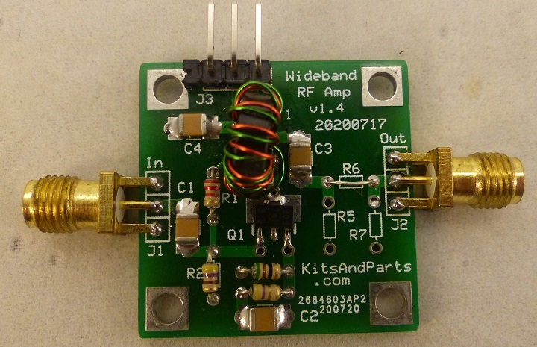
Kits and Parts RF Amplifier
Kits and Parts - $12 for kit, $4 for PCB
  1 toroid transformer to wind
1/8W resistor pad spacing
Large 1206? SMD caps

Slide 26
K&P RF Amp
Spec: 22+ dBm power gain from 2-30 MHz
  Measured +25-27 dBm gain - fairly flat response
  +20 dBm gain up to 80 MHz
50 ohm input and 50 ohm output
100 milliwatt maximum output
Measured power - 0.031A at 12V = 370mW

Slide 27
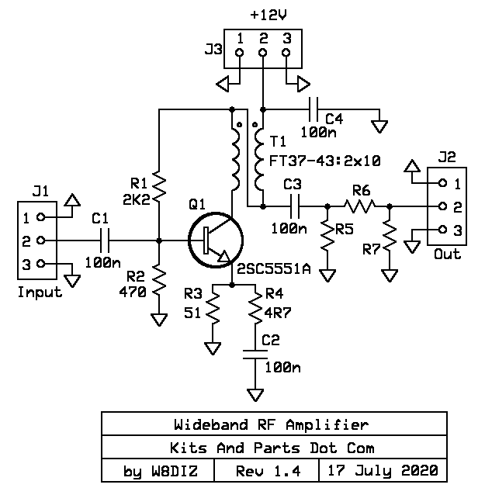
RF Amplifier - Schematic
12V power
“Exotic” transistor 2SC5551A
  3 for $5 from K&P

Slide 28
RF Amplifier - NanoVNA Measurements
Use 30 dB attenuator when measuring performance with NanoVNA
  Measure S11, S12
Where to put attenuator?
  Before or after amp?
  NanoVNA puts out 1 dBm
  Amp has 27 dB gain
  Amp has max 100 mW output

Slide 29
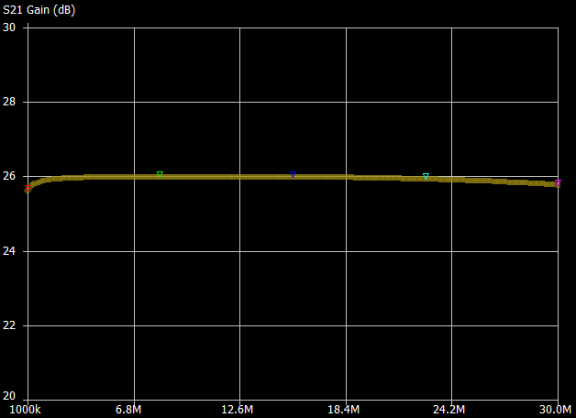
RF Amplifier - S21 (Gain)
Attenuator in the NanoVNA output
Calibrate NanoVNA with just attenuator
Measured 26 dB gain
Flat from 1MHz-30MHz

Slide 30
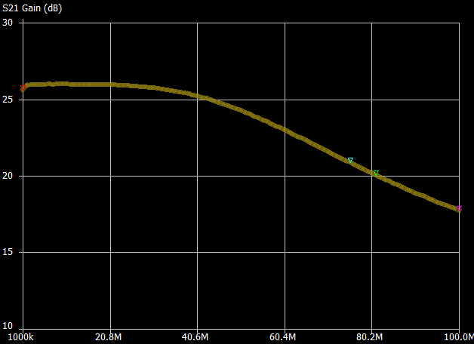
RF Amplifier - S21 (Gain)
Measured from 1-100MHz
+26 dB gain across HF band
Still decent gain at higher frequencies
  +20dBm @ 80 Mhz

Slide 31
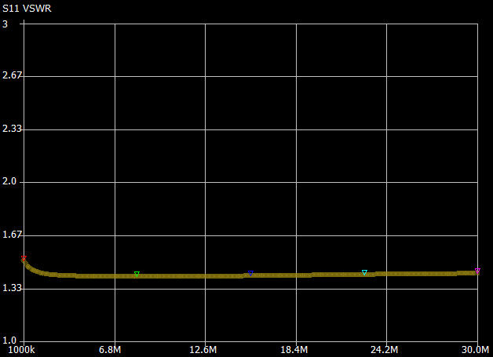
RF Amplifier - VSWR
About 1:1.5 across entire HF band
If measured with attenuator before Amp it would measure 1:1

Slide 32
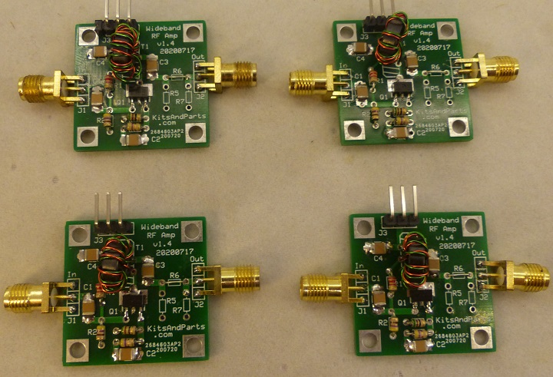
RF Amplifier - Uses
Where to best place RF Amplification?
  Between Antenna and Bandpass filter?
  Between Bandpass filter and Mixer?
  Between Mixer and Crystal Filter?
  After Crystal Filter?
  May need a few of these – Built 4

Slide 33
Radio Design Deep Dive
04 - AF Amplifiers

Slide 34
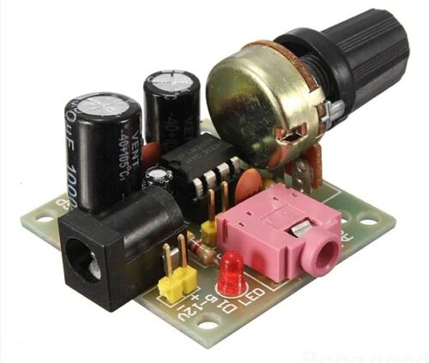
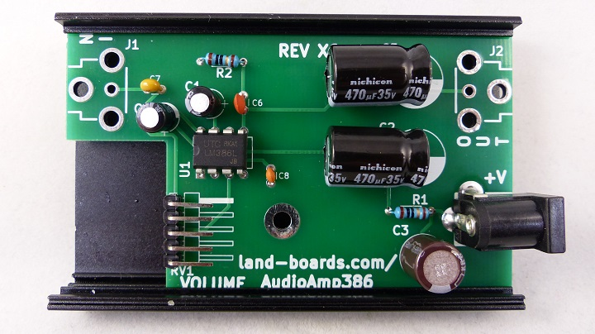
AF Amplifier
Buy (EBay) or Build?
Lots of choices here
  LM386, LM380, LM384
How much power?
How much gain?
Include pre-Amp for impedance matching?
Test finger first by putting finger on input and listening for hum

Slide 35
LM386 Audio Amplifier
700 mW output power
Wide Supply Voltage Range: 4 V–12 V or 5 V–18 V (-4 part)
Low Quiescent Current Drain: 4 mA
Voltage Gains from 20 to 200
Ground-Referenced Input
Self-Centering Output Quiescent Voltage
High input impedance: 50kΩ
  Want 50Ω input to match Mixer (Product Detector) 50Ω output

Slide 36
LM384 Audio Amplifier
5W audio output
Wide supply voltage range: 12- to 26-V
Voltage Gain Fixed at 50
High input impedance: 150kΩ
  Want 50Ω input to match Mixer (Product Detector) 50Ω output

Slide 37
LM380 Audio Amplifier
2.5W audio output
Wide supply voltage range: 10V-22V
Low quiescent power drain: 0.13W (VS= 18V)
Voltage gain fixed at 50 (34 dB)
High peak current capability: 1.3A
Short circuit proof output
High input impedance: 150kΩ
  Want 50Ω input to match Mixer (Product Detector) 50Ω output

Slide 38
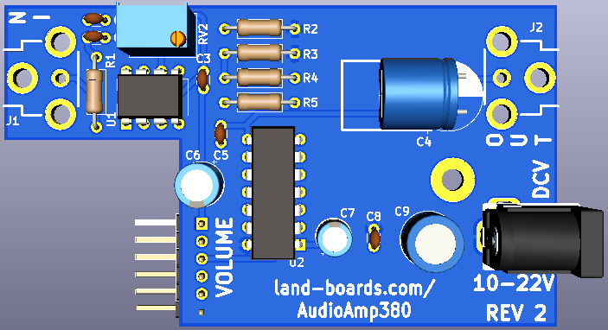
Audio Pre-Amplifier
Use to match input impedance to the output impedance of the Product detector
Not much gain needed here
Charlie Morris ZL2CTM did design
NE5534 pre-amplifier

Slide 39
Radio Design Deep Dive
05 - RF Mixers

Slide 40
Mixers
Three port devices
  LO – Local Oscillator in
  RF – In/out connection
  IF – In/out connection
Technologies include
  Diode Ring Mixers
Transformer coupled
Input drive level

Slide 42
Radio Design Deep Dive
06 - Oscillators

Slide 44
Radio Design Deep Dive
07 - Band Pass Filters

Slide 46
Radio Design Deep Dive
08 - Crystal Filters

