Slide 1
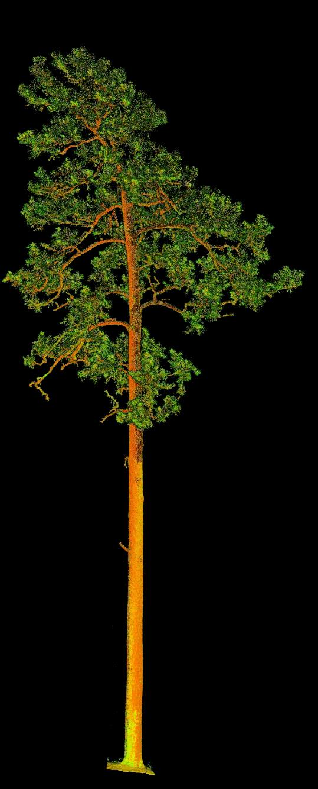
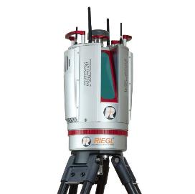
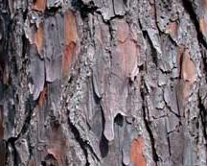
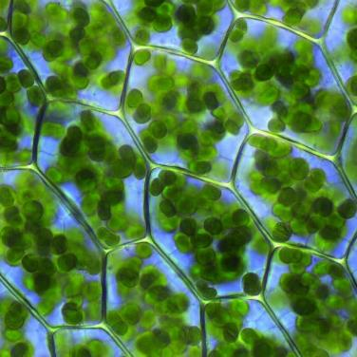
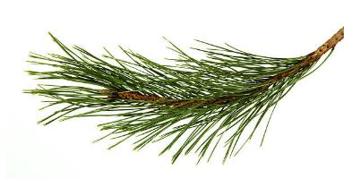
Range and Incidence Angle
Physical properties
Chemical properties
Cannon et al. 2025 Fire Ecology

Slide 2
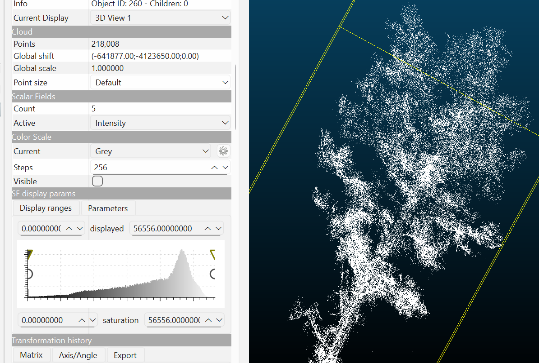
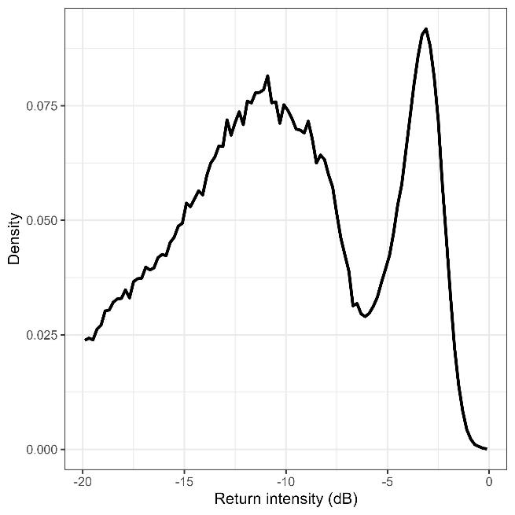

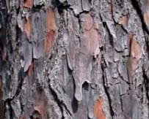
Cannon et al. 2025 Fire Ecology

Slide 3
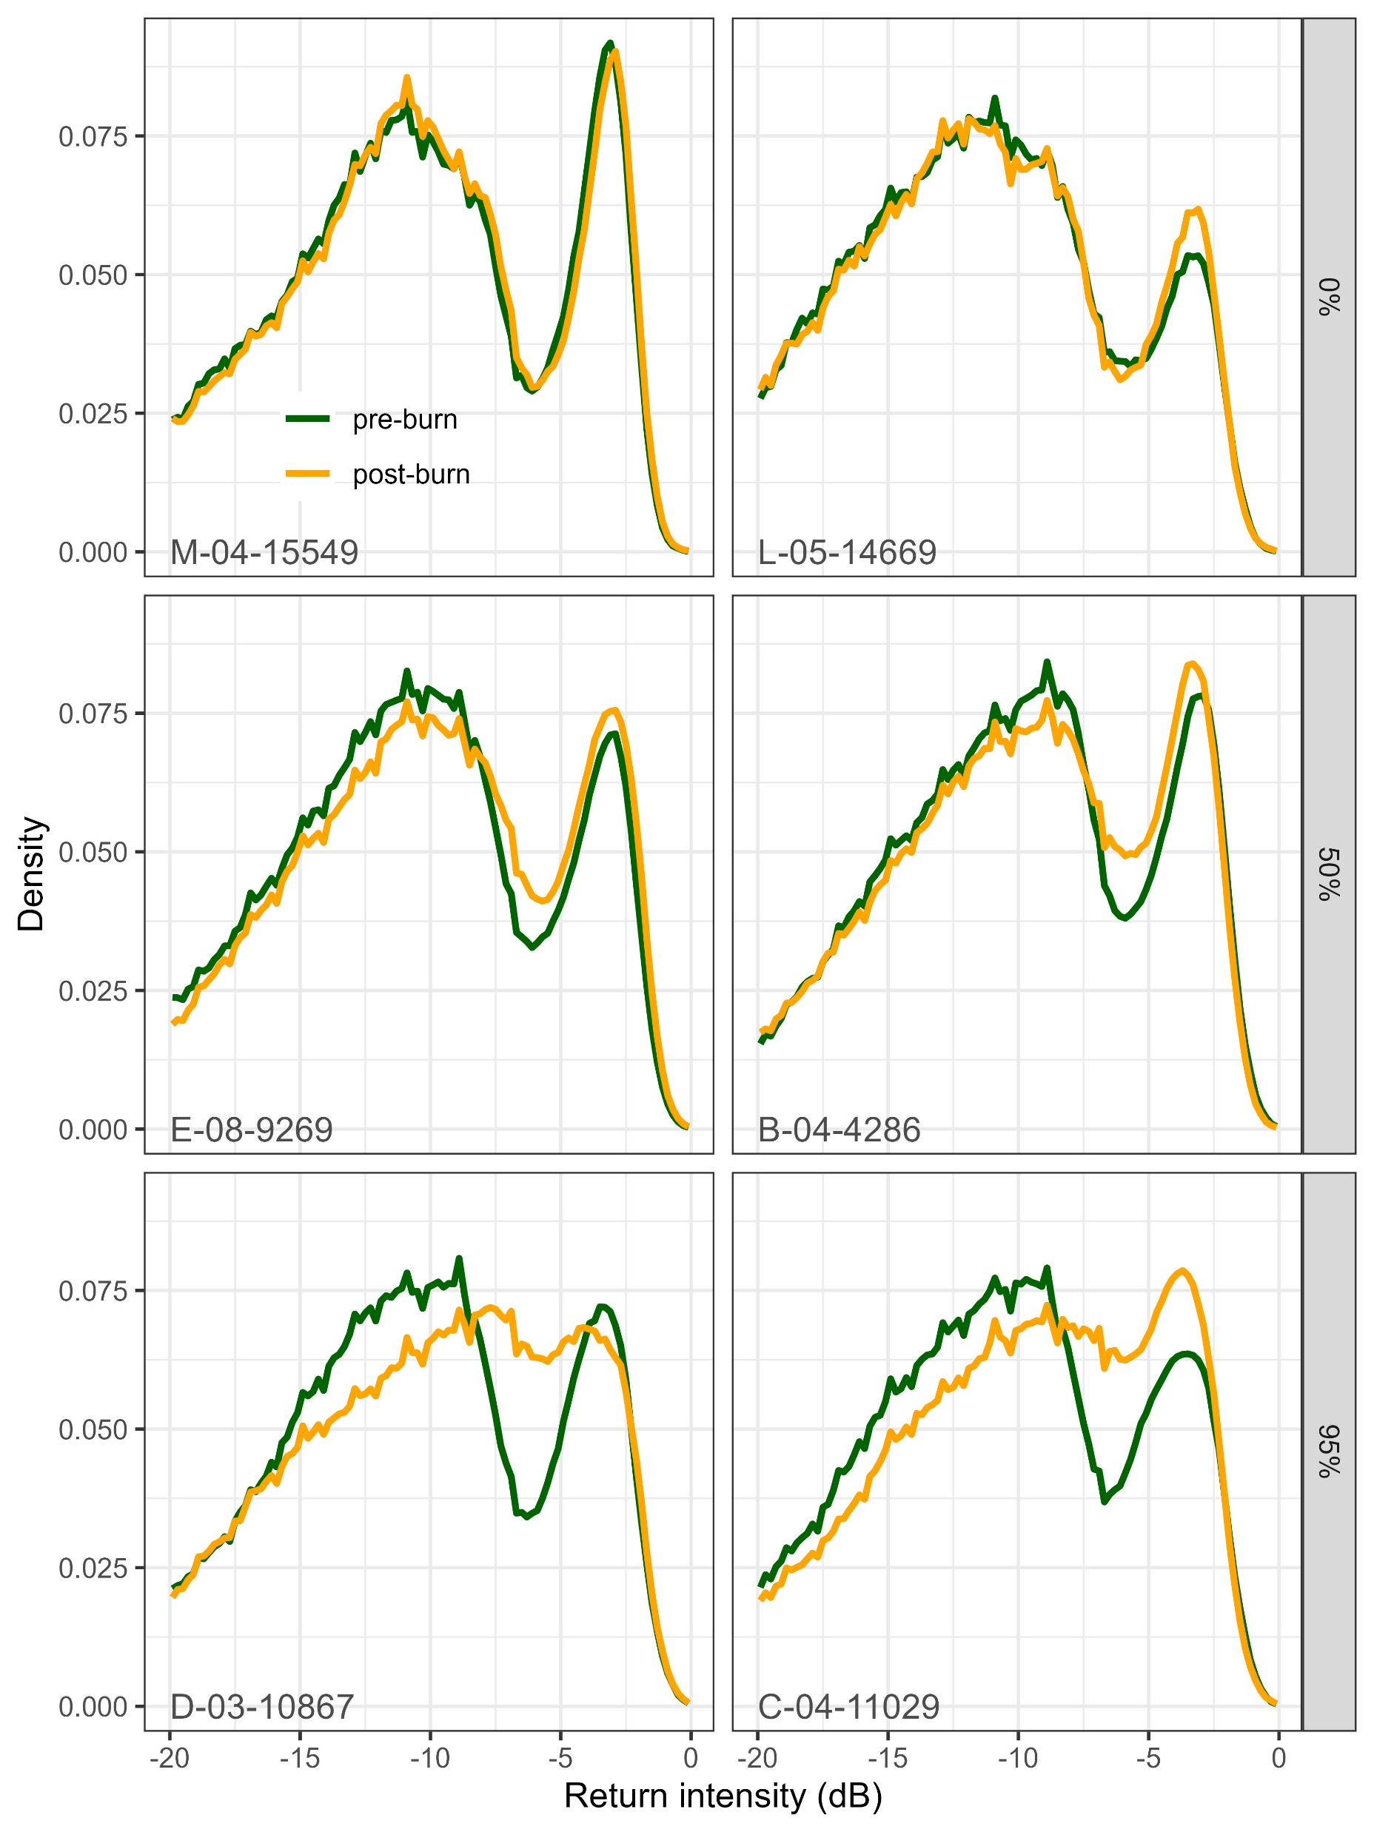
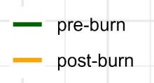
Cannon et al. 2025 Fire Ecology

Slide 4
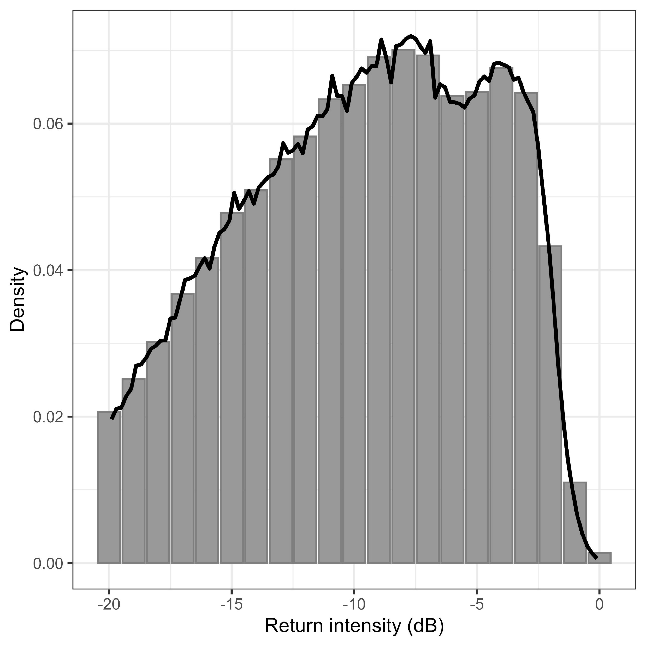
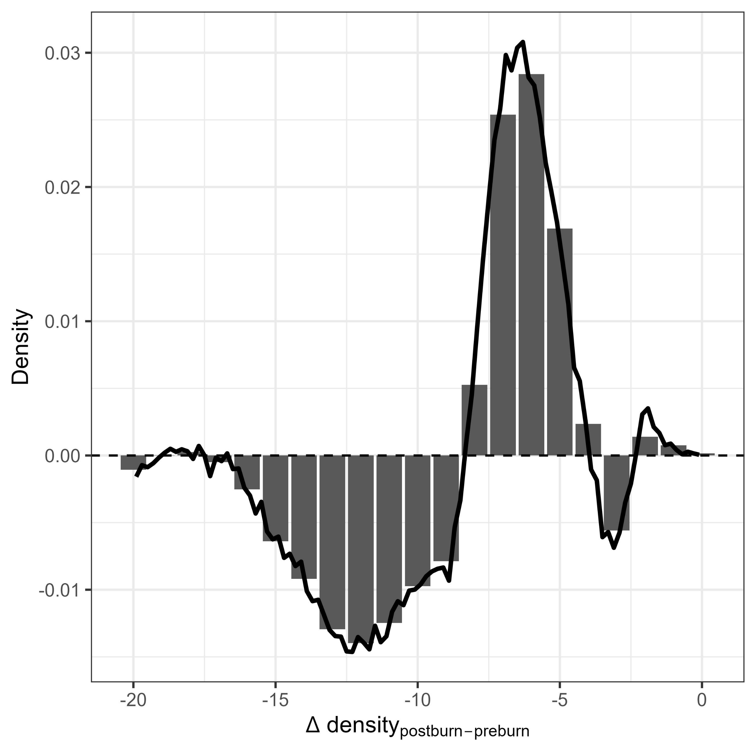
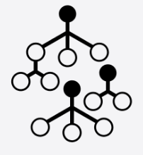
Return intensity (post-burn)
ΔReturn intensity (post-pre)
difference
Random Forests
crown scorch ~ I₁ + I₂ + … + I_{n}
Boruta feature selection
Cannon et al. 2025 Fire Ecology

Slide 5
