Slide 1


OHBM BRAINHACK TRAINTRACK
AN INTRODUCTION TO DATALAD
Adina Wagner
@AdinaKrik
Psychoinformatics lab,
Institute of Neuroscience and Medicine, Brain & Behavior (INM-7) Research Center Jülich
Slides: https: /github.com/datalad-handbook/course/

Slide 2
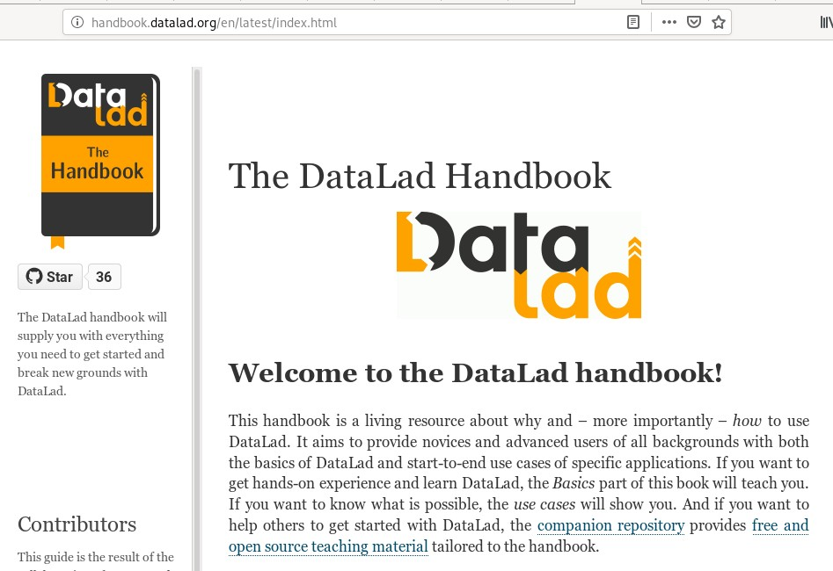
LEARN ALL ABOUT DATALAD AT HANDBOOK.DATALAD.ORG

Slide 3
IN BRIEF
A command-line tool with Python API Build on top of Git and Git-annex Allows...
... version-controlling arbitrarily large content,
... easily sharing and obtaining data (note: no data hosting!),
... (computationally) reproducible data analysis,
... and much more Completely domain-agnostic
available for all major operating systems (Linux, macOS/OSX, Windows)

Slide 4
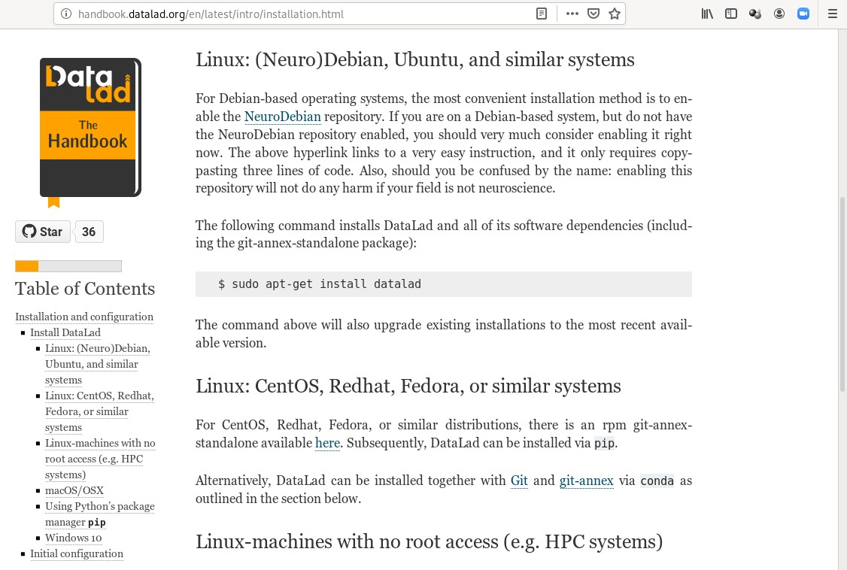
STEP 1: INSTALL DATALAD

Slide 5
STEP 2: CONFIGURE YOUR GIT IDENTITY
>
git config --global --add user.name "Firstname Lastname" git config --global --add user.email "some@email.com"

Slide 6
LET'S START!

Slide 7
FOLLOW ALONG!
Code to follow along:
http: /handbook.datalad.org/en/latest/code_from_chapters/OHBM.html

Slide 8
DATALAD DATASETS
DataLad's core data structure
Dataset = A directory managed by DataLad
Any directory of your computer can be managed by DataLad. Datasets can be created (from scratch) or installed
Datasets can be nested: linked subdirectories

Slide 9
LOCAL VERSION CONTROL

Slide 10


LOCAL VERSION CONTROL
Procedurally, version control is easy with DataLad!
modify the dataset
save changes in meaningful units
datalad save -m "did X" file1
Save meaningful units of change Attach helpful commit messages
Advice:

Slide 11
SUMMARY - LOCAL VERSION CONTROL
datalad create creates an empty dataset.
Conﬁgurations (-c yoda, -c text2git) are useful.
A dataset has a history to track ﬁles and their modiﬁcations.
Explore it with Git (git log) or external tools (e.g., tig).
datalad save records the dataset or ﬁle state to the history.
Concise commit messages should summarize the change for future you and others.
datalad status reports the current state of the dataset.
A clean dataset status is good practice.

Slide 12
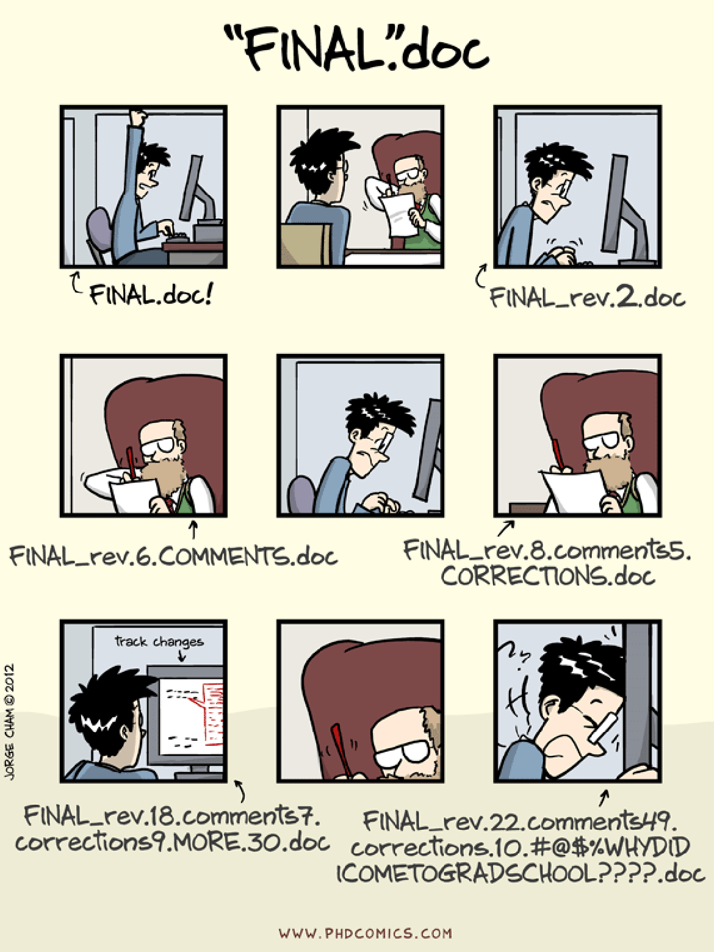
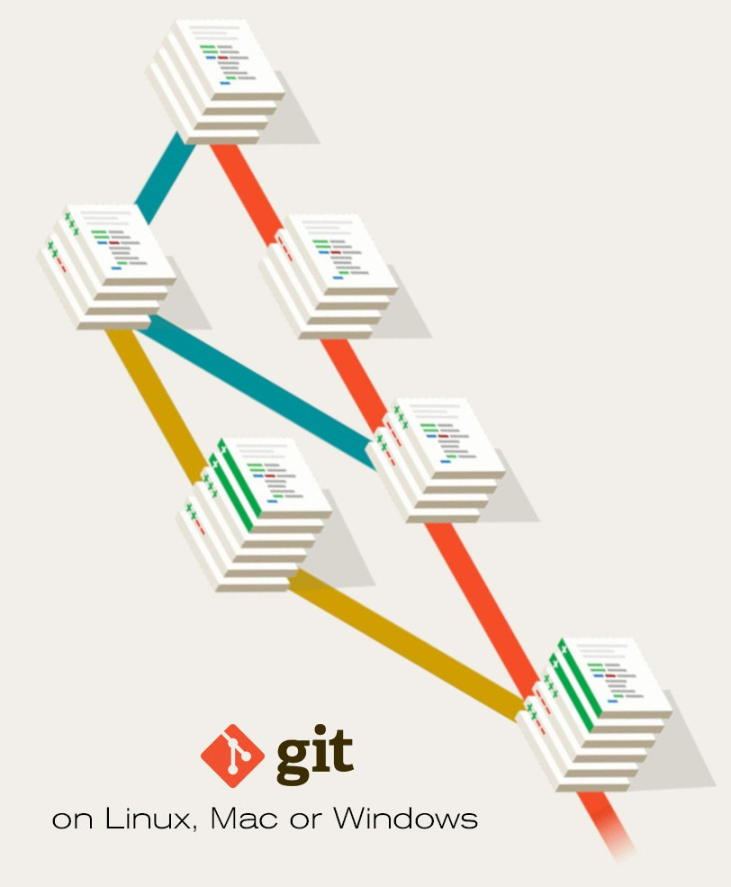
TO THIS:
FROM HERE
Image credit: www.phdcomics.com; www.linode.com

Slide 13
CONSUMING DATASETS AND DATASET NESTING

Slide 14

CONSUMING DATASETS
DataLad-101/ books/
byte-of-python.pdf progit.pdf TLCL.pdf
!
Dataset structure is fully ﬂexible to be able to accommodate domain standards or personal preferences.
super-ds
!
A dataset can be populated with any type of ﬁles, and these ﬁles can be saved to the dataset.
recordings/
sub-ds
longnow/ Long_Now__Conv[...]/
...
Long_Now__Seminars[...]/
2003_12_13[...]
2003_11_15[...]
!
Published repositories can be installed as subdatasets. This nesting can be arbitrily deep. Datasets can be installed from a path, URL., or data collection.
!
DataLad can obtain required subdataset content on demand. Only content elements actually required for an analysis are present. Directory structure is expanded recursively as needed.
...
!
Any content is referenced via the dataset that contains it. Dataset state provides unambi- guous version speciﬁcation for the subdataset.
notes.txt
Datasets are light-weight: Upon installation, only small ﬁles and meta data about ﬁle availability are retrieved.
Content can be obtained on demand via datalad get.

Slide 15
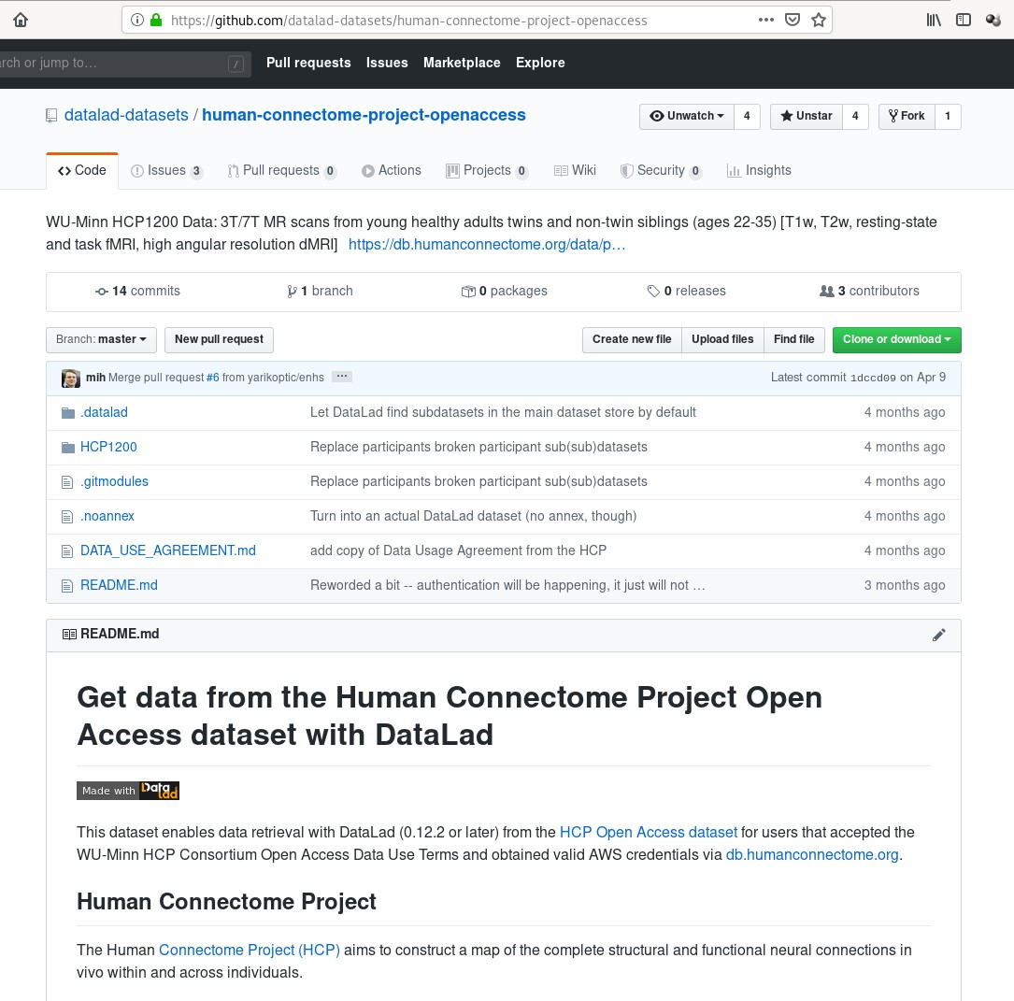

Slide 16
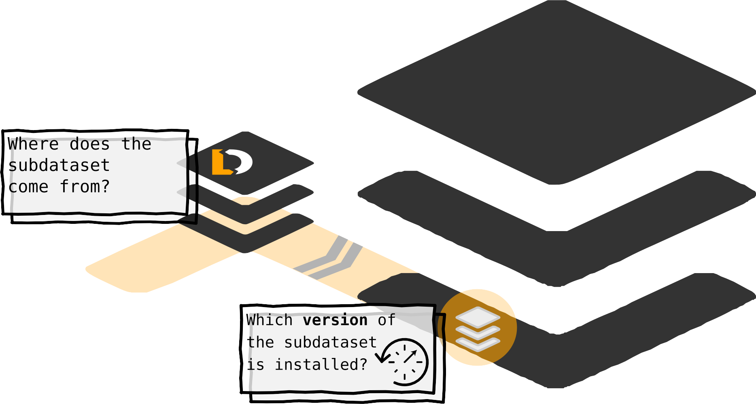







DATASET NESTING
1
1

Slide 17
SUMMARY - DATASET CONSUMPTION & NESTING
datalad clone installs a dataset.
It can be installed “on its own”: Specify the source (url, path, ...) of the dataset, and an optional path for it to be installed to.
Datasets can be installed as subdatasets within an existing dataset.
The --dataset/-d option needs a path to the root of the superdataset.
Only small ﬁles and metadata about ﬁle availability are present locally after an install.
To retrieve actual ﬁle content of larger ﬁles, datalad get downloads large ﬁle content on demand.
Content can be dropped to save disk space with datalad drop.
Do this only if content can be easily reobtained.
Datasets preserve their history.
In nested datasets, the superdataset records only the version state of the subdataset.

Slide 18
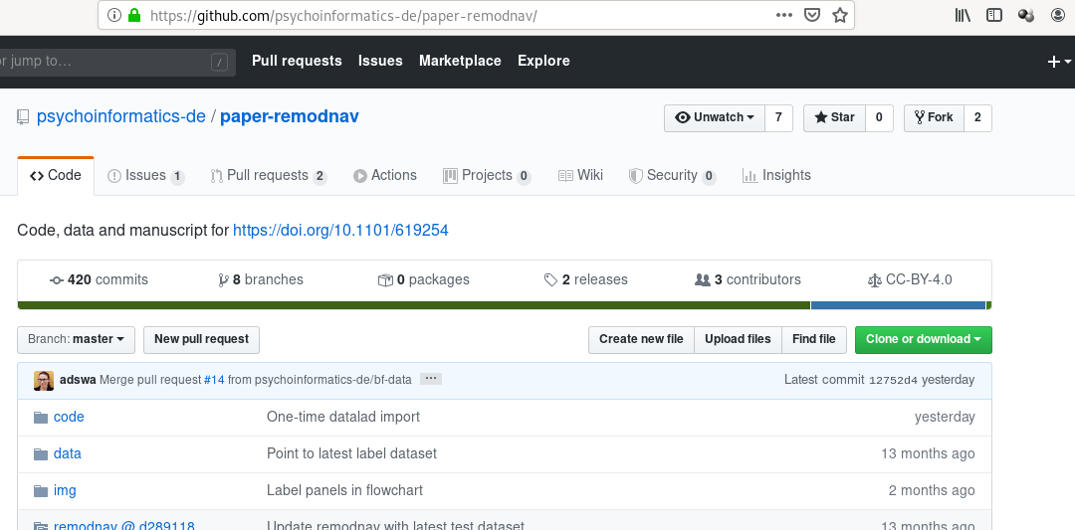
EXAMPLE: REPRODUCIBLE RESEARCH OBJECTS
Find this repo at github.com/psychoinformatics-de/paper-remodnav
Read all about it at handbook.datalad.org/en/latest/usecases/reproducible-paper.html

Slide 19
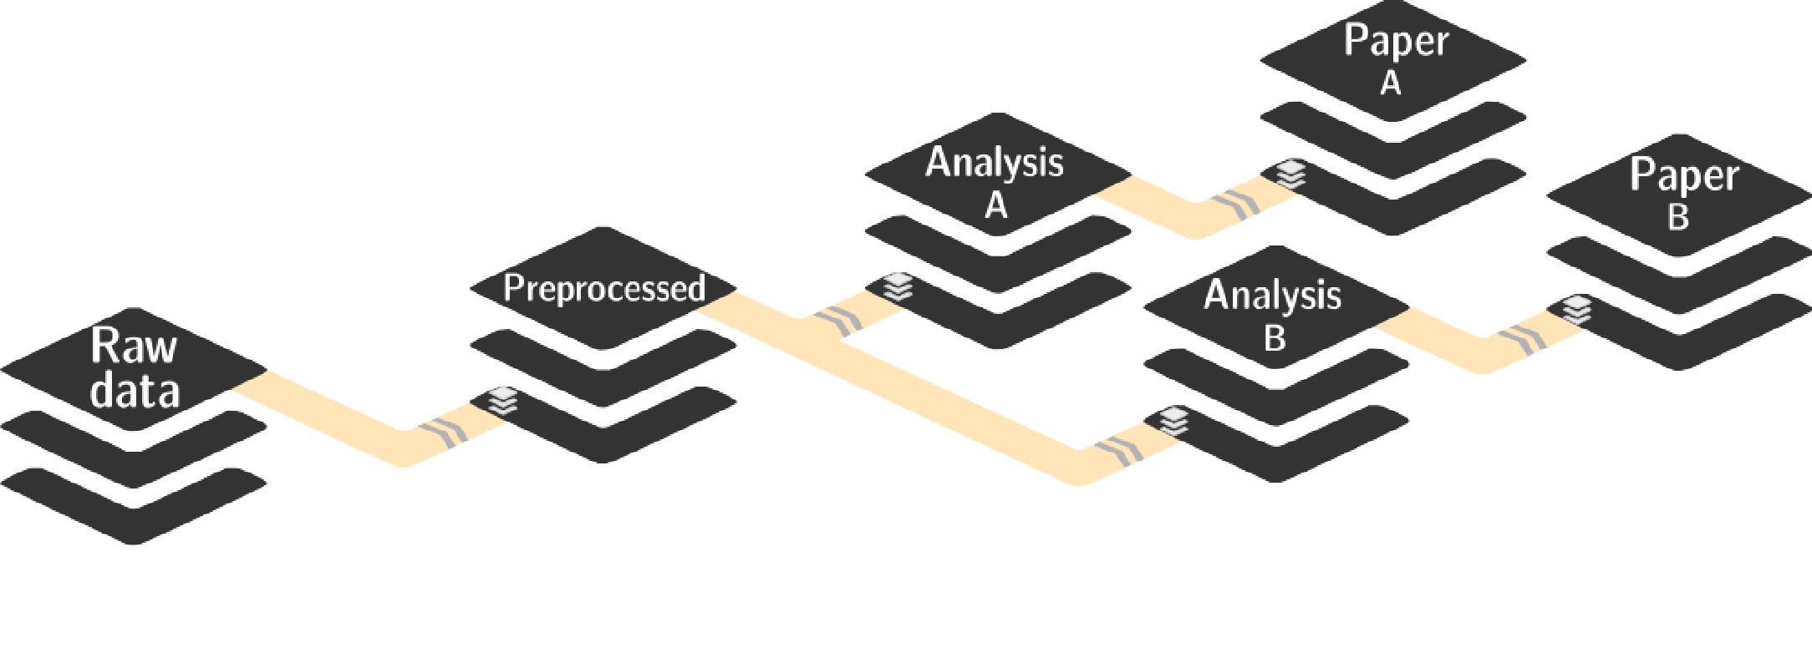
ADVANTAGES OF NESTING
A modular structure makes individual components (with their respective provenance) reusable.
Nesting can ﬂexibly link all components and allows recursive operations across dataset boundaries
Read all about this in the chapter on YODA principles

Slide 20
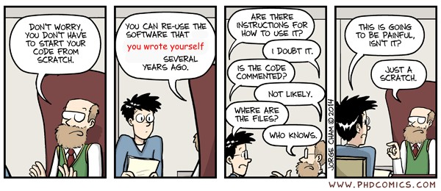
REPRODUCIBLE DATA ANALYSIS
Image credit: Full comic at http: /phdcomics.com/comics.php?f=1979

Slide 21
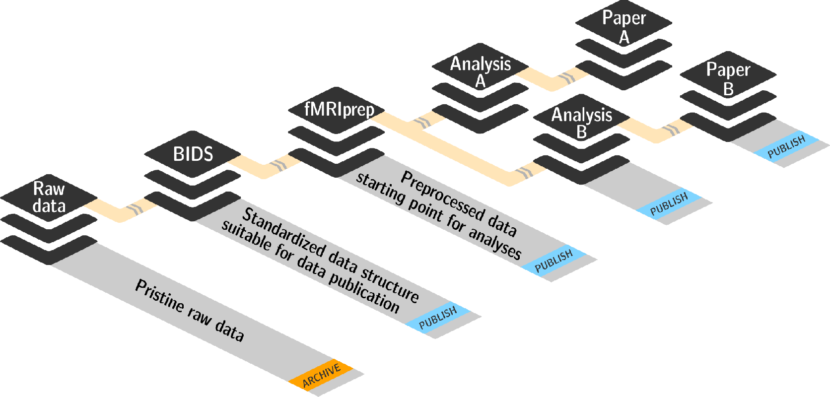
BASIC ORGANIZATIONAL PRINCIPLES FOR DATASETS
Read all about this in the chapter on YODA principles Keep everything clean and modular
├── code/
│ ├── tests/
│ └── myscript.py
├── docs
│ ├── build/
│ └── source/
├── envs
│ └── Singularity
├── inputs/
│ └─── data/
│ ├── dataset1/
│
│
│
│ └── datafile
└── dataset2/
└── datafile
├── outputs/
│ └── important_result
│ └── figures/
└── README.md
do not touch/modify raw data: save any results/computations outside of input datasets
Keep a superdataset self-contained: Scripts reference subdatasets or ﬁles with
relative paths

Slide 22
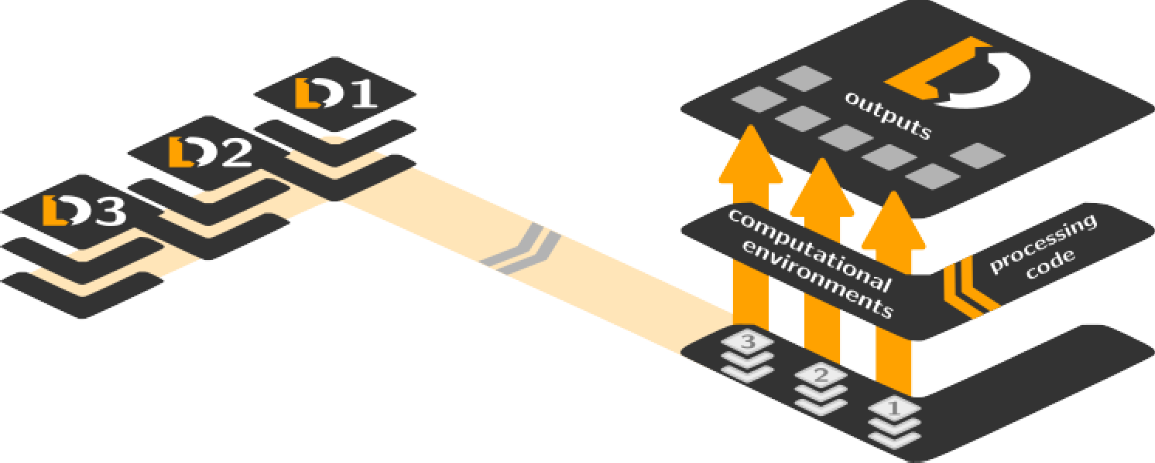
BASIC ORGANIZATIONAL PRINCIPLES FOR DATASETS
Record where you got it from, where it is now, and what you do to it
Link datasets (as subdatasets), record data origin
Collect and store provenance of all contents of a dataset that you create
Record command execution: Which script produced which output? From which data?
In which software environment? ...

Slide 23
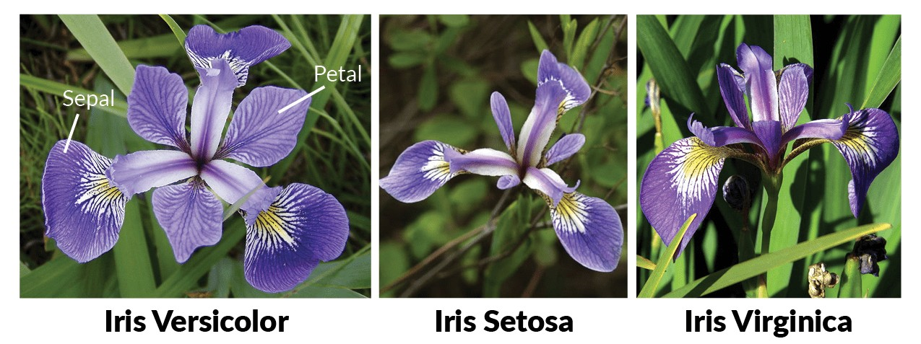
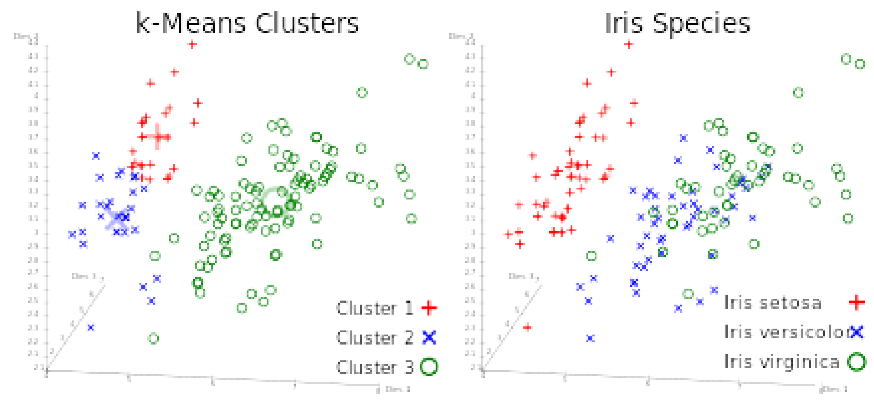
A CLASSIFICATION ANALYSIS ON THE IRIS FLOWER DATASET

Slide 24









REPRODUCIBLE EXECUTION & PROVENANCE CAPTURE
datalad run
Reproducible execution:
link input, code, and output with
datalad run
save all modiﬁcations of the dataset
human-readable commit message
machine-readable
run-record
1
2
2
1
datalad run -m "did XY"
unlock
output ﬁles for modiﬁcation
--output
get input data
--input

Slide 25


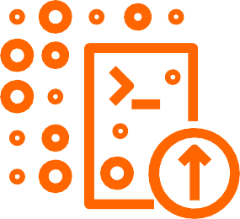

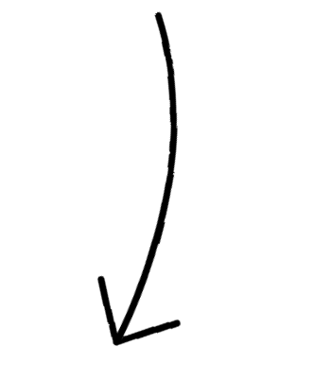
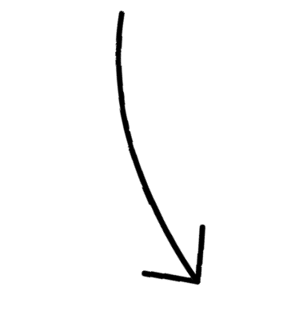
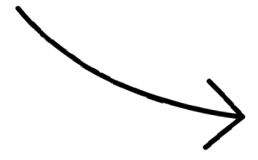

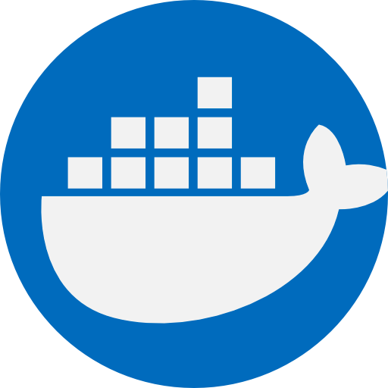
COMPUTATIONAL REPRODUCIBILITY
Code may produce diﬀerent results or fail with diﬀerent software
Datasets can store & share software environments and execute code inside of the software container
DataLad extension: datalad-container
datalad-containers run
save all modiﬁcations of the dataset
link input, code, output, and software with
datalad containers-run
1
2
</>
2
datalad containers-run
1
unlock
output ﬁles for modiﬁcation
--output
get input data
--input
get and use registered software container for computation
--container-name

Slide 27
HOW TO GET STARTED WITH DATALAD
Read the DataLad handbook
An interactive, hands-on crash-course (free and open source)
Check out or used public DataLad datasets, e.g., from OpenNeuro
$ datalad clone ///openneuro/ds000001
[INFO ] Cloning http://datasets.datalad.org/openneuro/ds000001 [1 other candidates] into '/tmp [INFO
|
] access to 1 dataset sibling s3-PRIVATE not auto-enabled, enable with: datalad siblings -d "/tmp/ds000001" enable -s s3-PRIVATE
install(ok): /tmp/ds000001 (dataset)
$ cd ds000001
$ ls sub-01/* sub-01/anat:
sub-01_inplaneT2.nii.gz
sub-01_T1w.nii.gz
sub-01/func:
sub-01_task-balloonanalogrisktask_run-01_bold.nii.gz sub-01_task-balloonanalogrisktask_run-01_events.tsv sub-01_task-balloonanalogrisktask_run-02_bold.nii.gz sub-01_task-balloonanalogrisktask_run-02_events.tsv sub-01_task-balloonanalogrisktask_run-03_bold.nii.gz sub-01_task-balloonanalogrisktask_run-03_events.tsv

Slide 28



ACKNOWLEDGEMENTS
The DataLad Handbook
Laura Waite Michael Hanke
17+ additional contributors
Michael Hanke Yaroslav Halchenko Joey Hess (git-annex) Benjamin Poldrack Kyle Meyer
22+ additional contributors
The
Handbook
Reach out, get to know the team, contribute: DataLad on Riot,
DataLad Handbook @ Github

Slide 29
THANK YOU!
QUESTIONS?

