Slide 1

Agent-Friendly Metaflow Client
Analyzing and Addressing Client API Inefficiencies
Gennaro Francesco Landi - landigf
MSc Computer Science, ETH Zurich
GSoC 2026 Proposal | Mentor: Valay Dave
Outerbounds

Slide 2
Outline
01
The Problem: Why agents struggle with Metaflow today
02
The Discovery: Infrastructure that already exists
03
The Benchmark: Three paths, same question, real numbers
04
The Solution: What we're building
05
GSoC Timeline: 350 hours, four phases

Slide 3

What happens when an agent asks a simple question?
01 The Problem

Slide 4
The agent asks:
"Which tasks failed in my latest ForeachFlow run?"
What the Client API does:
The cost:
for step in run:
for task in step:
if not task.successful:
# Inside task.successful:
# 1. HTTP GET /artifacts/_success
# 2. Read boolean from S3/local
# 3. Unpickle Python object
# 4. Return True/False
#
# PER TASK. 50 tasks = 50x this.
56
HTTP calls
3.8s
wall-clock time
50
datastore reads to unpickle 50 booleans
01 The Problem

Slide 5
Real proof: we asked Claude Sonnet via the API
"Which tasks failed in my latest ForeachFlow run?"
What Claude wrote
What it cost
claude-sonnet-4-20250514 | 132 in / 66 out tokens
57 HTTP calls
from metaflow import Flow
flow = Flow('ForeachFlow')
latest_run = flow.latest_run
for step in latest_run:
for task in step:
if not task.successful:
print(task.pathspec)
2,074 ms
51 artifact fetches (one _success per task)
With filter_tasks_by_metadata:
4 HTTP calls
Correct answer: ForeachFlow/8/process/126
Same answer. Same database.
This is not Claude being inefficient. This is the only way to check task success with the current API. There is no run.failed_tasks(). Full HTTP trace in claude_api_trace.json.
01 The Problem

Slide 6
Two services, same database, different capabilities
PostgreSQL
Metadata Service (port 8080)
UI Backend (port 8083)
Every deployment has this
No pagination
No filtering
No status field
Returns ALL data
Optional, for Web UI only
Python Client API (what agents use today)
Metaflow Web UI (what humans see)
The Client API only talks to the Metadata Service. It has no idea the UI Backend exists.
01 The Problem

Slide 7

Three discoveries that change everything
02 The Discovery

Slide 8
Discovery 1
filter_tasks_by_metadata already finds failures
Since metadata service v2.5.0, this endpoint exists but nobody uses it for failure detection:
# ONE HTTP call. Returns all failed task IDs.
ServiceMetadataProvider.filter_tasks_by_metadata(
"ForeachFlow", "8", "process", "attempt_ok", "False"
)
# --> ["ForeachFlow/8/process/126"]
# Instead of iterating 50 tasks and fetching _success artifact for each one.
When a task finishes, the Metaflow runtime writes attempt_ok = "True" or "False" to the metadata_v3 table. This is the same field the UI Backend reads via SQL. The metadata service has this data. We just need to use it.
02 The Discovery

Slide 9
Discovery 2
The DB layer already supports LIMIT and ORDER BY
postgres_async_db.py has find_records() with limit, offset, and order parameters. The HTTP endpoints just don't expose them.
# What the metadata service does today:
SELECT * FROM runs_v3
WHERE flow_id = 'MyFlow'
-- returns ALL runs, unbounded
# What it COULD do (~15 lines of change):
SELECT * FROM runs_v3
WHERE flow_id = 'MyFlow'
ORDER BY ts_epoch DESC
LIMIT 10
The infrastructure is there. find_records() already accepts limit, offset, and order. ~15 lines per endpoint to expose it. Benefits everyone, not just agents.
02 The Discovery

Slide 10
Discovery 3
Task status computation is simpler than it looks
UI Backend: 300 lines, complex JOINs
What we need: 3 lines
-- UI Backend task status (simplified)
CASE
WHEN attempt_ok IS TRUE -> 'completed'
WHEN attempt_ok IS FALSE -> 'failed'
WHEN heartbeat stale -> 'failed'
WHEN old run no hb -> 'failed'
WHEN no attempt -> 'pending'
ELSE -> 'running'
END
-- 100+ lines of lateral JOINs
-- Simplified status (covers 90% of cases)
CASE
WHEN attempt_ok = 'True' -> 'completed'
WHEN attempt_ok = 'False' -> 'failed'
ELSE -> 'running'
END
The core signal is attempt_ok in the metadata table. The other 97 lines handle edge cases (stale heartbeats, old runs). For agent queries, the simplified version is enough.
02 The Discovery

Slide 11

The Benchmark Three paths, one question, real numbers
03 The Benchmark

Slide 12
"Which tasks failed?" — 50-task foreach, 1 failure
All three paths return the same answer. Same database. Same failed task.
A: Naive Client API
56 calls 3,800ms
Iterate tasks, fetch _success artifact per task
C: Smart Metadata
4 calls 349ms
filter_tasks_by_metadata — no UI Backend needed
B: UI Backend
2 calls 35ms
Requires extra service (port 8083)
Smart Metadata: 8.6x faster than today, works everywhere, no extra infrastructure.
03 The Benchmark

Slide 13
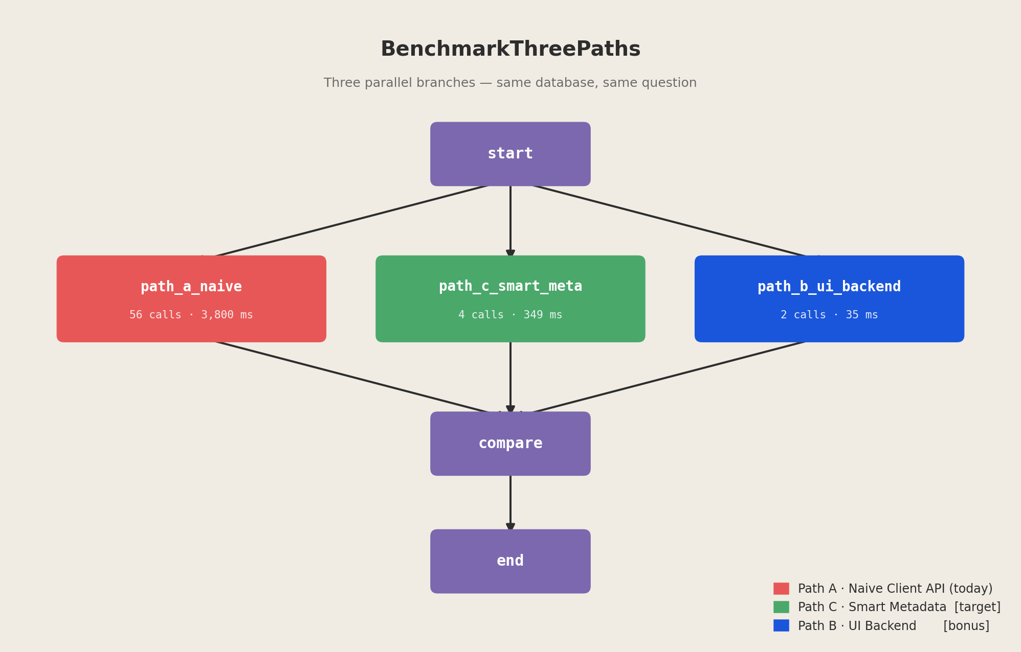
Metaflow benchmarks itself — visible in the UI
BenchmarkThreePaths flow: three branches, same question, join to compare

Slide 14
All 6 GSoC use cases --- benchmarked
UC
Use Case
Client API
Smart Path
Speedup
1
List runs by status
4 calls, 134ms
1 call, 20ms
6.7x
2
Filter runs by time range
2 calls, 18ms
1 call, 12ms
1.5x
3
Find failed tasks + errors
57 calls, 2006ms
5 calls, 105ms
19.1x
4
Artifact metadata (no data)
5 calls, 39ms
4 calls, 133ms
0.3x
5
Bounded log output
6 calls, 93ms
4 calls, 231ms
0.4x
6
Cross-run artifact search
8 calls, 93ms
5 calls, 51ms
1.8x
UC3 (find failures) is the dominant bottleneck: 57 of 82 total calls (70%). UC4/UC5 show the UI Backend is slower for small queries due to cache overhead. The smart approach routes each use case to the best available path.
03 The Benchmark

Slide 15
UC4 and UC5: not about speed, about bounded data
UC4: Artifact metadata
UC5: Bounded logs
Speed is fine (5 calls, $\sim$50ms)
task.stdout loads ENTIRE log
Real problem: no cross-task artifact listing. "Find where accuracy was highest" requires iterating every task.
50MB training output? Agent gets all 50MB. No way to ask for last 10 lines or lines matching an error.
Fix: cross-task artifact endpoint
Fix: bounded log access
One call returns artifact metadata for all tasks in a step, filterable by name. No data loading.
1. Client-side tail: seek to end, read last N lines 2. Service-side: /logs?_limit=N&_pattern=Error
An agent should never download 50MB to read 10 lines, or iterate 1000 tasks to find one artifact.
03 The Benchmark

Slide 16

What we're building
04 The Solution

Slide 17

Three layers, each independently useful
Layer 1
Extension Package
Smart functions using filter_tasks_by_metadata + existing API
metaflow-agent-client
No core changes. Works today on service >= 2.5.0
Layer 2
Metadata Service
Add _limit, _order to endpoints (DB already supports it)
$\sim$150 lines
Benefits everyone. Small, targeted changes.
Layer 3
Client API
Automatically use new query params (version-gated)
ServiceMetadataProvider
Transparent speedup. Existing code gets faster.
No dependency on UI Backend. Every deployment gets the improvement.
04 The Solution

Slide 18
Before and After
Today: 56 HTTP calls
After: 4 HTTP calls
# Agent iterates every task
failures = []
for step in run:
for task in step:
if not task.successful:
failures.append(task.pathspec)
# 56 HTTP calls, ~3800ms
# 50 artifact fetches
# 50 datastore reads
# 50 unpickle operations
# Agent calls one function
from metaflow_extensions.agent_client import (
find_failures
)
result = find_failures("ForeachFlow/8")
# result["failures"]
# -> ["ForeachFlow/8/process/126"]
# 4 HTTP calls, ~350ms
# 0 artifact fetches
# 0 datastore reads
Same answer. 93% fewer calls. 8.6x faster. Works on every deployment with metadata service >= 2.5.0.
04 The Solution

Slide 19
GSoC Timeline: 350 hours, 16 weeks
Phase 1
Weeks 1-4 | 90h
Foundation
Extension package + 6 utility functions + tests
Phase 2
Weeks 5-8 | 90h
Core Implementation
Metadata service _limit/_order + provider enhancement
Phase 3
Weeks 9-12 | 90h
Agent Integration
Agent simulation, tool schemas, robustness testing
Phase 4
Weeks 13-16 | 80h
Documentation & Polish
User/agent docs, PR preparation, final report
Each phase delivers standalone, testable, demonstrable value.
05 GSoC Timeline

Slide 20
Why this matters
For agents
For all users
For Metaflow
Debug flows without hammering the backend
Pagination and ordering on metadata service (benefits everyone)
First systematic mapping of Client API to HTTP calls
Structured responses, bounded queries, predictable cost
Faster Client API iteration (transparent, version-gated)
Extension package pattern for community contributions
Tool schemas for MCP/function-calling integration
Audit reveals where to invest next in the API
Foundation for richer programmatic access
05 GSoC Timeline

Slide 21
Live Demo
Claude debugging a Metaflow flow Side-by-side: naive path vs smart path Real HTTP calls, real Metaflow UI, real numbers
[YouTube video link / screen recording]

Slide 22
Thank you
landigf | MSc CS, ETH Zurich | GSoC 2026
GSoC 2026 | Mentor: Valay Dave | Outerbounds
Code: github.com/landigf/metaflow-agent-client
Benchmarks: demo/benchmark_three_paths.py
RFC: docs/RFC_agent_friendly_client.md
Full audit: demo/full_audit.py (all 6 use cases)

