Slide 1
Radio-Interferometric Measurement Equation Introductory Radio Interferometry Course Centre for Radio Astronomy Techniques and Technologies (RATT) Rhodes University
Modhurita Mitra
February 17, 2015

Slide 2
Radio-Interferometric Measurement Equation (RIME)
Compact, intuitive, matrix-based way of representing propagation effects in radio interferometry.
Useful for calibration (solving for and correcting these propagation effects).

Slide 3

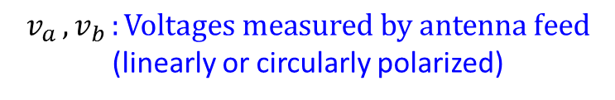

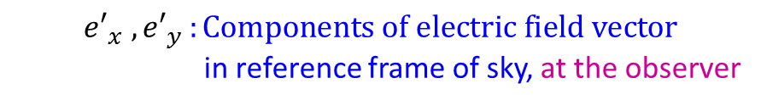

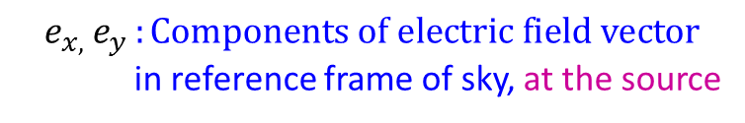


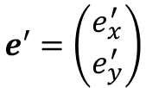







Introduction
$${{e′}_{x} , e′}_{y }:Components of electric field vector$$
in reference frame of sky, at the observer
Source
$${v_{a },v}_{b }:Voltages measured by antenna feed$$
(linearly or circularly polarized)
Propagation effects
$$e_{y}$$
$$e$$
$$e_{x}$$
$${e_{x, }e}_{y }:Components of electric field vector$$
in reference frame of sky, at the source
$$v$$
$$e′$$
$${e′}_{y}$$
$$v_{b}$$
$$e=\left(\begin{matrix}e_{x} \\ e_{y}\end{matrix}\right)$$
$$v_{a}$$
$${e′}_{x}$$
Can be represented
as vectors:
$$e′=\left(\begin{matrix}e_{x}^{′} \\ e_{y}^{′}\end{matrix}\right)$$
Antenna
$$v=\left(\begin{matrix}v_{a} \\ v_{b}\end{matrix}\right)$$

Slide 4






Propagation effects absent
Source
Amplitude and direction of electric vector
remain unchanged during propagation
$$v_{b}$$
No propagation effects
$$e_{y}$$
$$v$$
$$e$$
$$e_{x}$$
$$v_{a}$$
$${e′}_{y}$$
$$e′$$
$${e′}_{x}$$
Antenna

Slide 5

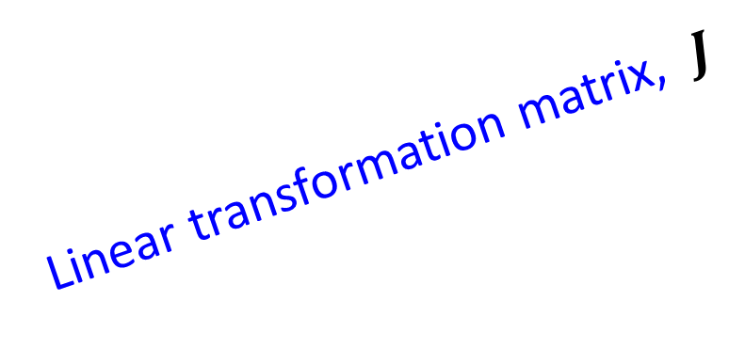







Propagation effects present
Source
Amplitude and direction of electric vector
change during propagation
Propagation effects
$$e_{y}$$
$$v$$
$$e$$
$$v_{b}$$
$$e_{x}$$
$$v_{a}$$
Linear transformation matrix, $J$
$${e′}_{y}$$
$$e′$$
Jones matrix
$${e′}_{x}$$
Voltage vector
$$v=Je$$
Electric field vector
$$\left(\begin{matrix}v_{a} \\ v_{b}\end{matrix}\right)=\left(\begin{matrix}j_{11} & j_{12} \\ j_{21} & j_{22}\end{matrix}\right)\left(\begin{matrix}e_{x} \\ e_{y}\end{matrix}\right)$$
Antenna

Slide 6











Correlation
Source
Antenna p
$$J_{p}$$
$$v_{p}=J_{p}e$$
$$v_{p}$$
$$e_{y}$$
$$v_{pb}$$
$$e$$
$$v_{pa}$$
$$e_{x}$$
Correlator
$$J_{q}$$
Antenna q
$$v_{qb}$$
$$v_{q}=J_{q}e$$
$$v_{q}$$
$$v_{qa}$$
$$V_{pq}=2⟨v_{p}v_{q}^{H}⟩$$
Visibility

Slide 7

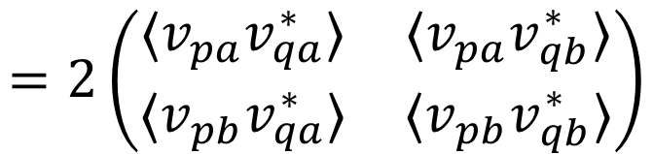
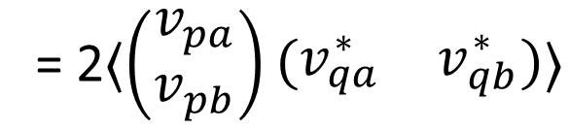
Visibility
The correlator computes the visibility, $V_{pq}$, on the baseline $pq$:
Hermitian conjugate
Outer product
$$V_{pq}=2⟨ v_{p}v_{q}^{H} ⟩$$
These 4 quantities are the outputs from the correlator
Average
= 2$⟨\left(\begin{matrix}v_{pa} \\ v_{pb}\end{matrix}\right)\left(\begin{matrix}v_{qa}^{∗} & v_{qb}^{∗}\end{matrix}\right)⟩$
$$=2\left(\begin{matrix}{⟨v}_{pa}v_{qa}^{∗}⟩ & {⟨v}_{pa}v_{qb}^{∗}⟩ \\ {⟨v}_{pb}v_{qa}^{∗}⟩ & {⟨v}_{pb}v_{qb}^{∗}⟩\end{matrix}\right)$$

Slide 8
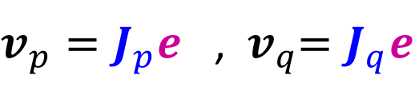




Correlation
Voltages:
$v_{p}=J_{p}e$ , ${ v}_{q}=J_{q}e$
Visibility:
$$V_{pq}=2⟨ v_{p}v_{q}^{H} ⟩$$
$=2⟨\left(J_{p}e\right){\left(J_{q}e\right)}^{H}⟩$
$=2⟨J_{p}\left(ee^{H}\right)J_{q}^{H}⟩$
$=J_{p}{⟨2ee^{H}⟩J}_{q}^{H}$

Slide 9
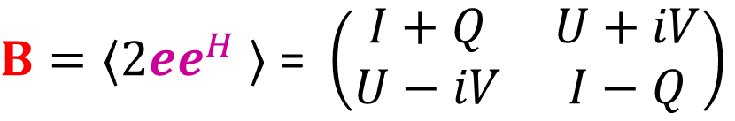


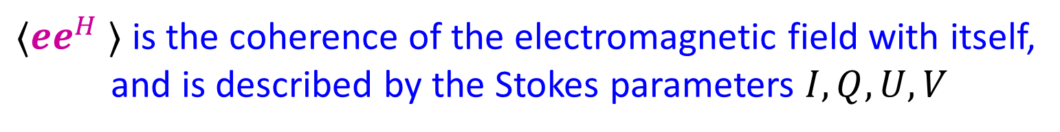
Coherency, or Brightness
$$V_{pq}=J_{p}{⟨2ee^{H} ⟩J}_{q}^{H}$$
By definition, the coherency, or brightness, B, is given by:
$B=⟨2ee^{H}$ $⟩$ = $\left(\begin{matrix}I+Q & U+iV \\ U−iV & I−Q\end{matrix}\right)$
$⟨ee^{H}$ $⟩$ is the coherence of the electromagnetic field with itself,
and is described by the Stokes parameters $I, Q, U, V$
$$V_{pq}= {J_{p} B J}_{q}^{H}$$

Slide 10

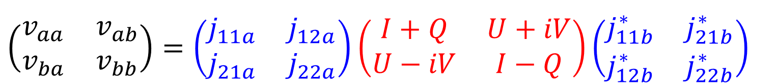
Radio-Interferometric Measurement Equation (RIME)
Visibility
Brightness
$$V_{pq}={J_{p} B J}_{q}^{H}$$
Jones matrices
$$\left(\begin{matrix}v_{aa} & v_{ab} \\ v_{ba} & v_{bb}\end{matrix}\right)=\left(\begin{matrix}j_{11a} & j_{12a} \\ j_{21a} & j_{22a}\end{matrix}\right)\left(\begin{matrix}I+Q & U+iV \\ U−iV & I−Q\end{matrix}\right){\left(\begin{matrix}j_{11b}^{∗} & j_{21b}^{∗} \\ j_{12b}^{∗} & j_{22b}^{∗}\end{matrix}\right)}^{}$$

Slide 11
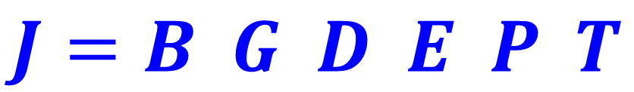
Component Jones matrices
The Jones matrix for an antenna is a product of several component Jones
matrices, corresponding to different corrupting effects along the signal path
Example:
$$J=B G D E P T$$
Bandpass
gain
Instrumental
gain
Polarization
leakage
Primary
beam
Parallactic angle
feed rotation
Ionospheric and
tropospheric effects

Slide 12
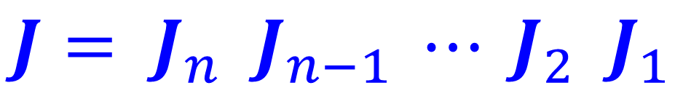
Component Jones matrices
Jones chain:
$$J= J_{n} J_{n−1} ⋯ J_{2} J_{1}$$
Later
in signal path
Earlier
in signal path

Slide 13
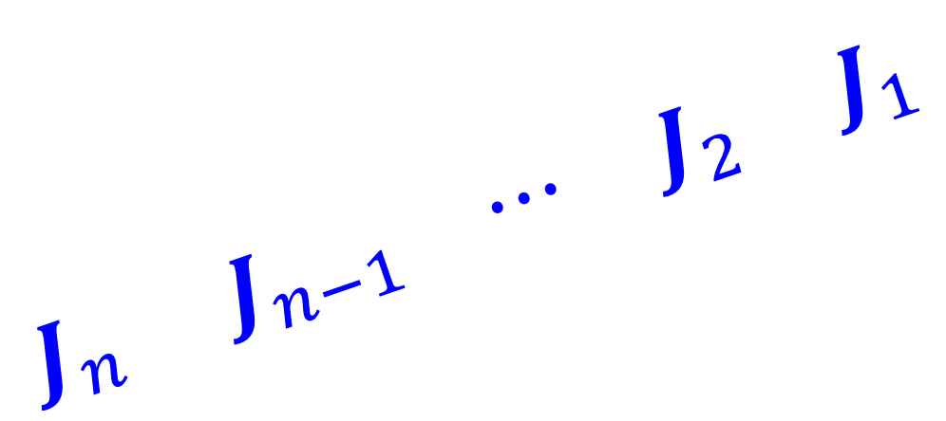

Component Jones matrices
Source
Propagation effects
Jones matrix, $J$
$$J_{n} { J}_{n−1} ⋯ J_{2} J_{1}$$
Earlier
in signal path
Antenna
Later
in signal path

Slide 14



Component Jones matrices
Antenna p :
$$J_{p}= J_{pn} J_{p(n−1)} ⋯ J_{p2} J_{p1}$$
Antenna q :
$$J_{q}= J_{qn} J_{q(n−1)} ⋯ J_{q2} J_{q1}$$
Visibility
Brightness
$$V_{pq}={J_{p} B J}_{q}^{H}$$
Jones matrices
$$V_{pq}=J_{pn} J_{p(n−1)}⋯ J_{p2} J_{p1} B J_{q1}^{H} J_{q2}^{H} ⋯{ J}_{q\left(n−1\right)}^{H} J_{qn}^{H}$$
$$V_{pq}= J_{pn}\left({ J}_{p\left(n−1\right)}\left(⋯\left(J_{p2}\left(J_{p1} B J_{q1}^{H}\right)J_{q2}^{H}\right)⋯\right)J_{q\left(n−1\right)}^{H}\right)J_{qn}^{H}$$

Slide 15
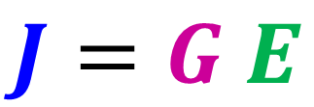
Direction-independent and direction-dependent effects
Propagation effects can be of two kinds:
Direction-independent effects
Direction-dependent effects
These effects can be represented by different Jones matrices:
$$J=G E$$
Final Jones matrix
Direction-independent
effects
Direction-dependent
effects

Slide 16

Direction-independent effects
Source 1
Source 2
$$G$$
Same in all directions
Antenna

Slide 17

Direction-dependent effects
Source 1
Source 2
$$E$$
Varies with direction
Antenna

Slide 18



Direction-independent and direction-dependent effects
$$J=G E$$
Final Jones matrix
Direction-independent
effects
Direction-dependent
effects
Visibility-plane effects
Image-plane effects
$$V_{pq}={J_{p} B J}_{q}^{H}$$
$$V_{pq}=G_{p}\left(E_{p}BE_{q}^{H}\right)G_{q}^{H}$$

Slide 19

Direction-independent and direction-dependent effects
Example:
$$J=B G D E P T$$
Bandpass
gain
Instrumental
gain
Polarization
leakage
Primary
beam
Parallactic angle
feed rotation
Ionospheric and
tropospheric effects
Direction-dependent
effects
Direction-independent
effects

Slide 20


Explicit RIME and phenomenological RIME
Explicit RIME:
$$J=B G D E P T$$
Useful for understanding the component
corrupting effects along the propagation
path
Phenomenological RIME:
$$J=G E$$
Useful for calibration, as these matrices
are easier to solve for

Slide 21
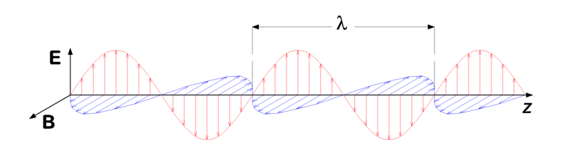
Polarization
Polarization of an electromagnetic wave describes the direction of oscillation of the electric field.
(From https://commons.wikimedia.org/wiki/File:Electromagnetic_wave.png, author: User:P.wormer)
The plane of polarization is perpendicular to the direction of propagation of the wave.
Linearly polarized wave

Slide 22
Polarization
Light can be:
Unpolarized
Polarized
Partially polarized

Slide 23
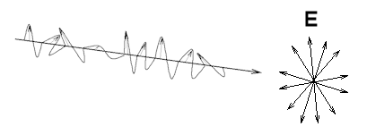
Unpolarized light
Electric vector oscillates in random directions in the plane of polarization.
Most naturally-occurring radiation is unpolarized.
Also called incoherent radiation.
Example: Thermal radiation.
(From http://labman.phys.utk.edu/phys222core/modules/m6/polarization.htm)

Slide 24
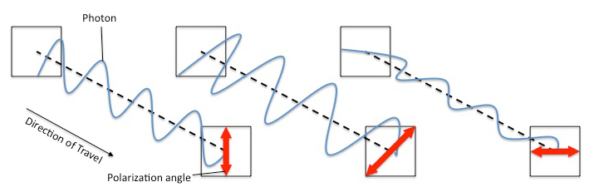
Polarized light
Electric vector oscillates in a well-defined manner.
Also called coherent radiation.
Example: Light from a laser.
(From https://arthropoda.files.wordpress.com/2009/11/pol1.jpg)

Slide 25
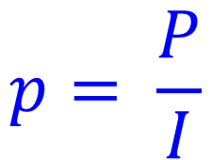
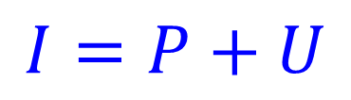
Partially polarized light
Electric vector oscillates randomly, but there is more power in a preferred polarization mode.
Partially polarized light can be expressed as a superposition of its polarized and unpolarized parts:
$$I=P+U$$
Total power
Power in unpolarized component
Power in polarized component
Fractional polarization is defined as the ratio of the power in the polarized component to the total power:
$$p= \frac{P}{I}$$

Slide 26
Polarization
Polarized electromagnetic radiation can be:
Linearly polarized
Circularly polarized
Elliptically polarized

Slide 27
Antenna feeds
An antenna contains feeds, which detect and measure specific polarized components
of an electromagnetic wave:
Antenna with orthogonal
linearly polarized feeds:
x-polarized
feed
y-polarized
feed
Right-circularly
polarized
(RCP)
feed
Left-circularly
polarized
(LCP)
feed
Antenna with orthogonal
circularly polarized feeds:
(From http://cddemo.szialab.org/)

Slide 28
Antenna feeds
Linearly polarized wave, measured by linearly polarized feeds:
y component
Combination of
x and y components
x component
(From http://cddemo.szialab.org/)

Slide 29
Antenna feeds
Linearly polarized wave, measured by circularly polarized feeds:
LCP component
Combination of
RCP and LCP components
RCP component
(From http://cddemo.szialab.org/)

Slide 30
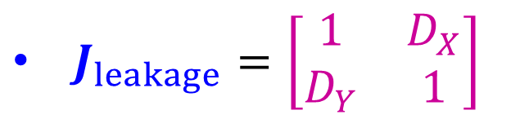
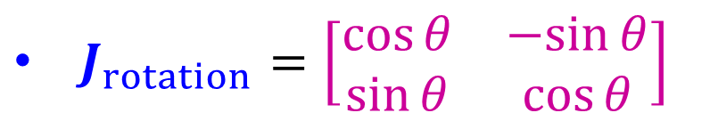
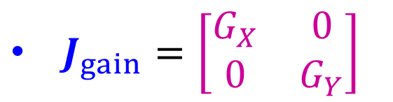
Structure of Jones matrices
Most Jones matrices have a simple form:
$J_{rotation}=\left[\begin{matrix}\cos{θ} & −sin{θ} \\ \sin{θ} & \cos{θ}\end{matrix}\right]$
$J_{leakage}=\left[\begin{matrix}1 & D_{X} \\ D_{Y} & 1\end{matrix}\right]$
$J_{gain}=\left[\begin{matrix}G_{X} & 0 \\ 0 & G_{Y}\end{matrix}\right]$
(in a linearly polarized basis)

Slide 31
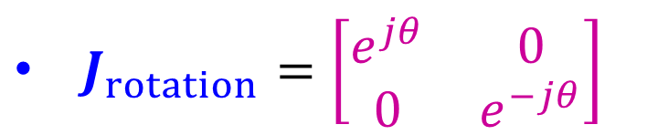
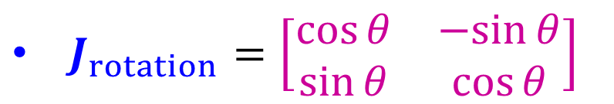
Structure of Jones matrices
The structure of individual Jones matrices depends on the antenna feed polarization basis, but the RIME is valid independent of the polarization basis.
For example,
$J_{rotation}=\left[\begin{matrix}\cos{θ} & −sin{θ} \\ \sin{θ} & \cos{θ}\end{matrix}\right]$
in a linearly polarized basis
$J_{rotation}=\left[\begin{matrix}e^{jθ} & 0 \\ 0 & e^{−jθ}\end{matrix}\right]$
in a circularly polarized basis

Slide 32
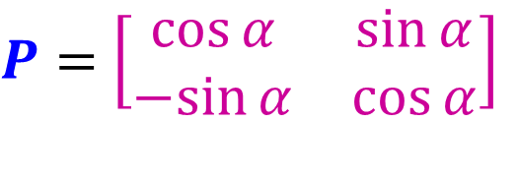
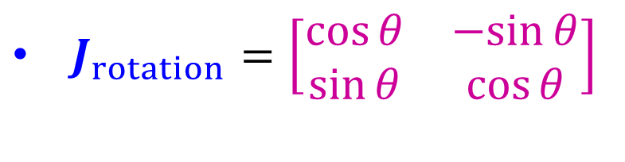
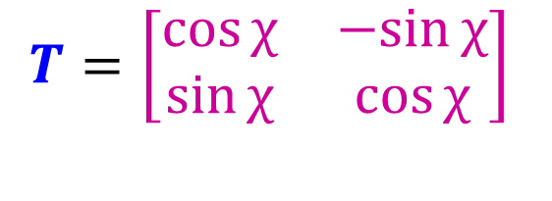
Rotation matrices
$J_{rotation}=\left[\begin{matrix}\cos{θ} & −sin{θ} \\ \sin{θ} & \cos{θ}\end{matrix}\right]$
Examples:
Parallactic angle
$P=$ $\left[\begin{matrix}\cos{α} & \sin{α} \\ −sin{α} & \cos{α}\end{matrix}\right]$
Parallactic angle feed rotation:
$$T=\left[\begin{matrix}\cos{χ} & −sin{χ} \\ \sin{χ} & \cos{χ}\end{matrix}\right]$$
Ionospheric Faraday rotation:
Faraday rotation angle

Slide 33
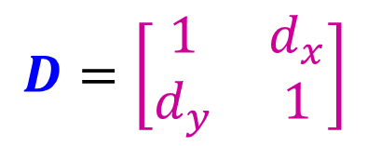
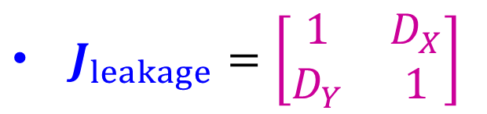
Leakage matrices
$J_{leakage}=\left[\begin{matrix}1 & D_{X} \\ D_{Y} & 1\end{matrix}\right]$
Examples:
$$D=\left[\begin{matrix}1 & d_{x} \\ d_{y} & 1\end{matrix}\right]$$
Polarization leakage:
Polarization leakage terms

Slide 34
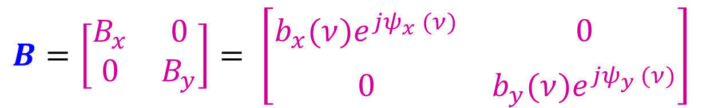
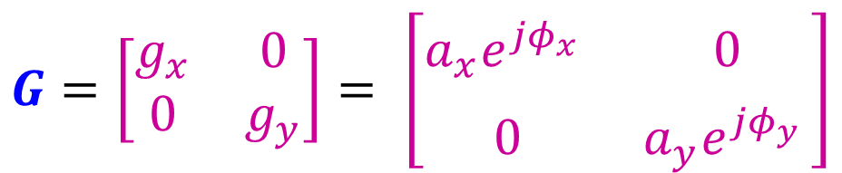
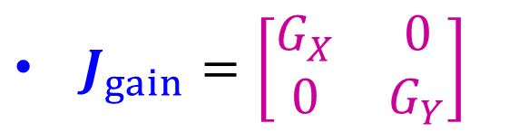
Gain matrices
$J_{gain}=\left[\begin{matrix}G_{X} & 0 \\ 0 & G_{Y}\end{matrix}\right]$
Examples:
$$G=\left[\begin{matrix}g_{x} & 0 \\ 0 & g_{y}\end{matrix}\right]= \left[\begin{matrix}a_{x}e^{{jφ}_{x}^{}} & 0 \\ 0 & a_{y}e^{{jφ}_{y}^{}}\end{matrix}\right]$$
Instrumental gain:
$$B=\left[\begin{matrix}B_{x} & 0 \\ 0 & B_{y}\end{matrix}\right]= \left[\begin{matrix}b_{x}(ν)e^{{jψ}_{x}^{}(ν)} & 0 \\ 0 & b_{y}(ν)e^{{jψ}_{y}^{}(ν)}\end{matrix}\right]$$
Bandpass gain:

Slide 35

Order of Jones matrices in Jones chain
Order of matrices in the Jones chain is important, because matrix multiplication is not commutative, in general.
However, specific kinds of matrices do commute – scalar matrices commute with all kinds of matrices, rotation matrices with each other, diagonal matrices with each other.

Slide 36
References
Thompson, A. R., Moran, J. M., and Swenson, Jr., G. W. (2001), Interferometry and Synthesis in Radio Astronomy, 2nd Edition
G. B. Taylor, C. L. Carilli, & R. A. Perley, editors (1999), Synthesis Imaging in Radio Astronomy II, volume 180 of Astronomical Society of the Paciﬁc Conference Series
14th Synthesis Imaging Workshop lecture slides (2014), National Radio Astronomy Observatory, Socorro, New Mexico, USA
Oleg Smirnov’s RIME lecture from 3GC3 Workshop and Interferometry School (2013), Port Alfred, South Africa

Slide 37
References (continued)
Smirnov, O. M. (2011). Revisiting the radio interferometer measurement equation. I. A full-sky Jones formalism. Astronomy & Astrophysics, Volume 527, A106
Smirnov, O. M. (2011). Revisiting the radio interferometer measurement equation. II. Calibration and direction-dependent effects. Astronomy & Astrophysics, Volume 527, A107
Smirnov, O. M. (2011). Revisiting the radio interferometer measurement equation. III. Addressing direction-dependent effects in 21 cm WSRT observations of 3C 147. Astronomy & Astrophysics, Volume 527, A108

Slide 38
References (continued)
Hamaker, J. P., Bregman, J. D., and Sault, R. J. (1996). Understanding radio polarimetry. I. Mathematical foundations. A&AS, 117, 137–147
Sault, R. J., Hamaker, J. P., and Bregman, J. D. (1996). Understanding radio polarimetry. II. Instrumental calibration of an interferometer array. A&AS, 117, 149–159
Hamaker, J. P. and Bregman, J. D. (1996). Understanding radio polarimetry. III. Interpreting the IAU/IEEE deﬁnitions of the Stokes parameters. A&AS, 117, 161–165
Hamaker, J. P. (2000). Understanding radio polarimetry. IV. The full-coherency analogue of scalar self-calibration: Self-alignment, dynamic range and polarimetric ﬁdelity. A&AS, 143, 515–534

