Slide 1
真值层
0
…
1
…
0
输出层
…
…
隐藏层
…
…
…
输入层
…

Slide 2
隐藏层

Slide 3
W=1.0
W=-1.0
隐藏层
隐藏层

Slide 4


……

Slide 5
W=1.0
W=-1.0
Work Network
Target Network

Slide 6







UTXOLib
……
RN Client
极光推送
Web Server
……
Blockchain

Slide 7




Actor
Critic
CNN
Frame
Actor
Critic
……
Actor
Critic
CNN
CNN
Frame
Frame

Slide 8
Actor
Critic
CNN
Frame
Actor
Critic
……
Actor
Critic
CNN
CNN
Frame
Frame

Slide 9
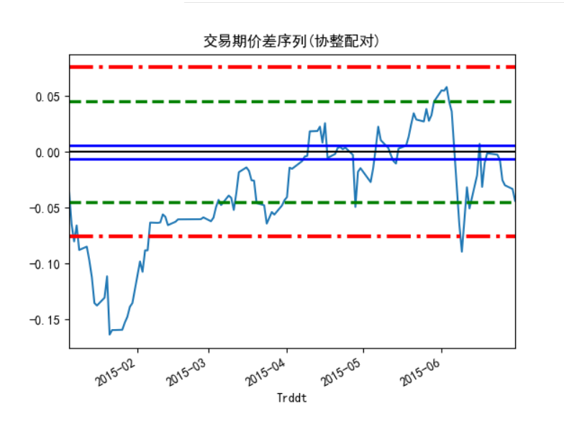
3
-2
2
-1
1
-3

