Slide 1
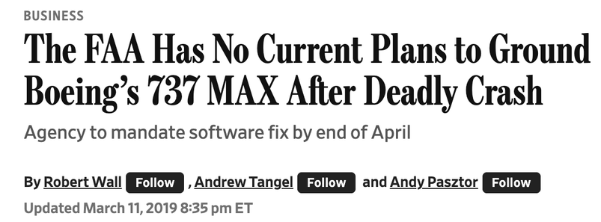
MARCH 11, 2019
The framing that the propaganda model explains.
189 Lion Air 610 · 157 Ethiopian 302 · 346 dead
Robert Wall · Andrew Tangel · Andy Pasztor | The Wall Street Journal
Notes:
OUTLINE
1. Set the death toll cold: 189 + 157 = 346, in 132 days.
2. Same aircraft, same MCAS system, same flight profile.
3. Show what the WSJ chose to frame as the news the next morning.
4. Pause and let the audience read the headline.
SCRIPT
On October 29, 2018, Lion Air Flight 610 crashed twelve minutes after takeoff. 189 dead. On March 10, 2019 — 132 days later — Ethiopian Airlines Flight 302 crashed six minutes after takeoff. 157 more dead. Same aircraft. Same MCAS system. Same fatal flight profile. The morning after the second crash, the Wall Street Journal — America's paper of business record — chose to frame the news this way.
IMAGE SOURCES (to drop into deck/images/ for v3)
• WSJ Mar 11, 2019 article (ProQuest WSJ archive / UChicago library) — https://www.wsj.com/articles/the-faa-has-no-current-plans-to-ground-boeings-737-max-after-deadly-crash-11552324520

Slide 2
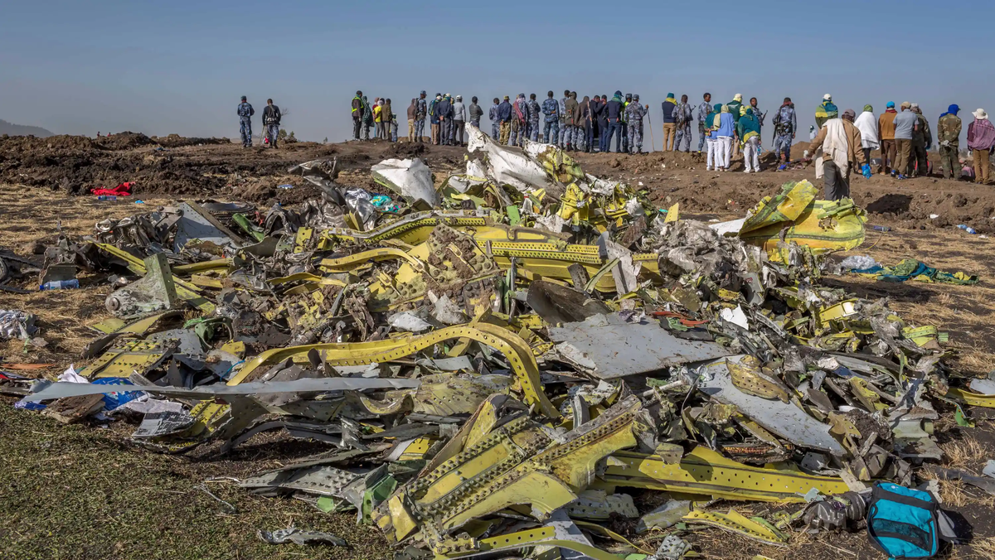
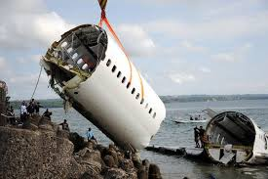
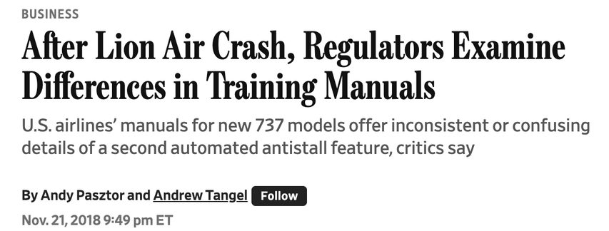
ARTICLE IN CONTEXT
Same aircraft. No changes.
Oct 29, 2018
Nov 13, 2018
Mar 10, 2019
Mar 11, 2019 (AM)
Mar 13, 2019
Lion Air 610
MCAS revealed (WSJ)
Ethiopian 302
China grounds 737 MAX
FAA finally grounds
189 dead
Pasztor/Tangel scoop
157 dead
before WSJ article ran
(last major regulator)
Within 72 hours of Ethiopian: 51 regulators worldwide grounded the 737 MAX. The FAA stood alone.
Notes:
OUTLINE
1. 132 days between the two crashes; 51 regulators ground in 72 hours.
2. China grounded BEFORE the WSJ article ran.
3. FAA was the LAST major regulator to ground — not the first.
4. WSJ framed FAA's reluctance as the news, not the global consensus.
5. Transition: 'Why? That's what the propaganda model lets us see.'
SCRIPT
132 days separated these two crashes. Within hours of the Ethiopian crash, China's Civil Aviation Administration grounded the 737 MAX. Within 72 hours, 51 regulators worldwide had grounded it. By the time this article ran on the morning of March 11, China had already grounded the aircraft. The FAA stood alone — and would for another 72 hours, becoming the LAST major regulator to ground. But the Wall Street Journal didn't frame that worldwide consensus as the news. It framed the FAA's reluctance as the news. The article makes the American regulator the default position and treats global action as deviation requiring explanation. Why? That's what the propaganda model lets us see.

Slide 3
MANUFACTURING CONSENT
Chomsky's Five Filters
1
2
3
4
5
Ownership
Advertising
Sourcing
Flak
Unifying ideology
& profit orientation
the reader economy
the beat & access economy
as anticipatory discipline
anticommunism → ?
“The constraints are so powerful, and are built into the system in such a fundamental way, that alternative bases of news choices are hardly imaginable.”
— Herman & Chomsky, Manufacturing Consent, p. 2
Not propaganda in the colloquial sense. Filtered: structural conditions select what survives.
Notes:
OUTLINE
1. Structural, not moral. Filters select what survives — not who's lying.
2. Pasztor + Tangel broke the MCAS story. They are not bad reporters.
3. Filters reinforce one another; no single filter is decisive.
4. Transition: 'Let's see all five operating on this single article.'
SCRIPT
Chomsky's argument is structural, not moral. He is not saying the press is fake or that the journalists are corrupt. Pasztor and Tangel are not bad reporters — they are the team that BROKE the MCAS self-certification story four months earlier. The propaganda model claims that news passes through five sequential filters that select what survives: ownership, advertising, sourcing, flak, and a unifying ideology. The journalists are not the filters. They are the operators of a process whose constraints are determined upstream of any individual editorial choice. The proof of the model is that good-faith reporters working with complete integrity will still produce this kind of output — because the alternative framings cost too much.
IMAGE SOURCES (to drop into deck/images/ for v3)
• Manufacturing Consent cover (book) — Penguin Random House — https://www.penguinrandomhouse.com/books/78912/manufacturing-consent-by-edward-s-herman-and-noam-chomsky/

Slide 4
FILTER 1
Ownership and Structural Class Identity
WSJ
Boeing
S A M E
C L A S S
• Owned by News Corp (Murdoch family)
• World's largest English-language business publication
• Calculates the Dow Jones Industrial Average
• Reader base: corporate-financial elite
• Top-30 U.S. corporation (~$240B mkt cap)
• Largest American exporter (2019)
• Dow Jones Industrial Average component
• Pentagon prime defense contractor
• Anchor employer for Washington + South Carolina
“the dominant media firms are quite large businesses; they are controlled by very wealthy people or by managers who are subject to sharp constraints by owners and other market-profit-oriented forces; and they are closely interlocked, and have important common interests, with other major corporations, banks, and government.”
— Herman & Chomsky, p. 14
News Corp doesn't tell Pasztor what to write. The class composition makes Boeing a quasi-internal interest.
Notes:
OUTLINE
1. Class position, not editorial orders.
2. WSJ literally calculates the Dow Jones — which includes Boeing.
3. Boeing in 2019: Dow component, top exporter, Pentagon prime.
4. Same elite ecology. Same board interlocks. Same class position.
5. Transition: 'But ownership alone doesn't pick the headline. Advertising shapes what coverage can sustain.'
SCRIPT
Filter 1: ownership. The Wall Street Journal is owned by News Corp — the Murdoch family. The WSJ literally calculates the Dow Jones Industrial Average, an index that included Boeing throughout 2019. Boeing in 2019 was a top-30 US corporation by market cap, the largest American exporter, the Pentagon's prime defense contractor, the anchor employer in Washington State and South Carolina. Same elite ecology. Same board interlocks. Same class position. Filter 1 is not about Murdoch picking up the phone and telling Pasztor what to write. It is about the structural fact that the WSJ exists as the publication of record for the corporate-financial elite that owns Boeing equity, supplies Boeing, sits on Boeing-adjacent boards, regulates Boeing. The publication's class identity makes Boeing a quasi-internal interest — not an external object of scrutiny.
IMAGE SOURCES (to drop into deck/images/ for v3)
• News Corp ownership chart — already in deck/images/news_corp_chart.png — (local file)
• News Corp corporate structure (2019) — Wikipedia — https://en.wikipedia.org/wiki/News_Corp

Slide 5
FILTER 2
Advertising and the Reader Economy
→ AD SPEND
SUBSCRIPTIONS / EQUITY HOLDINGS ←
Boeing
Airlines
(SWA / AAL / UAL)
WSJ
Defense
(LMT / NOC / RTX)
Banks
(JPM / GS / BLK)
Suppliers
(GE / Honeywell)
Reader-investors
A single critical article does not threaten this loop.
A sustained campaign reframing American manufacturing as systemically unsafe does.
“advertisers thus acquired a de facto licensing authority since, without their support, newspapers ceased to be economically viable.”
— Curran & Seaton, quoted in Manufacturing Consent, p. 14
Notes:
OUTLINE
1. WSJ's advertiser base IS Boeing's economic ecosystem.
2. Reader side matters more: WSJ readers HOLD Boeing in portfolios.
3. Single article ≠ sustained campaign. Filter 2 kills campaigns.
4. Transition: 'But Filter 2 alone doesn't pick voices. Filter 3 — sourcing — is visible inside the article itself.'
SCRIPT
Filter 2: advertising. The WSJ's 2019 advertiser base is essentially Boeing's economic ecosystem. Boeing itself. Its defense competitors: Lockheed, Northrop, Raytheon. Its suppliers: GE Aerospace, Honeywell, Spirit AeroSystems. Its airlines: Southwest, American, United. Its bankers: JPMorgan, Goldman, BlackRock. But the deeper move is on the reader side. WSJ readers are institutional investors, corporate executives, money managers. They HOLD Boeing in their portfolios. They hold Boeing in their pension funds. Their employers do business with Boeing. The reader-advertiser ecology IS Boeing's ecology. A single critical article is permitted — Pasztor's MCAS scoop in November proved that. What filter 2 prevents is a sustained campaign — multi-month coverage that reframes American manufacturing as systemically unsafe. That campaign would break the publication's relationship to its entire reader-advertiser ecology. So it does not happen.
IMAGE SOURCES (to drop into deck/images/ for v3)
• Boeing 2019 annual ad spend / WSJ advertiser data (Statista / Kantar) — https://www.statista.com/topics/1349/boeing/

Slide 6
FILTER 3
Sourcing and the Beat Economy
Whose voices structure the March 11 article — and whose appear only as reactions.
Voices that structure the story
Voices that appear only as reactions (or not at all)
• The FAA — authoritative on its own decision
• Boeing — authoritative on its own aircraft
• U.S. airline executives (Southwest, American, United)
• Anonymous “industry officials”
• Mitt Romney (calling for grounding)
• Foreign regulators (China, EU) — framed as deviations
• Victims' families — absent
• Ethiopian / Indonesian regulators — absent
“Officials have and give the facts; reporters merely get them.”
— Mark Fishman, quoted in Manufacturing Consent, p. 19
Six days later, Dominic Gates (Seattle Times) broke FAA self-certification. The story was reportable on Mar 11 — it just broke the beat.
Notes:
OUTLINE
1. Filter 3 is visible INSIDE the article — name the voices.
2. Boeing media office: professionalized, US-hours, pre-prepped.
3. Foreign regulators + victim families: expensive to source.
4. Captured-regulator story was reportable — Gates broke it Mar 17/21.
5. Beat dependency = commercial infrastructure of the reporting.
6. Transition: 'Filter 4 — flak — explains why the beat survives.'
SCRIPT
Filter 3: sourcing — the filter you can see operating inside the article itself. Let me show you whose voices structure the story. The FAA. Boeing. US airline executives. Anonymous 'industry officials' — almost certainly Boeing or FAA staff giving background. These are the authoritative voices. Now whose voices appear, when they appear at all, as reactions? Mitt Romney calling for grounding. Foreign regulators — China, the EU — framed as deviations from default. The victims' families: absent. The Ethiopian and Indonesian regulators: absent. This is not Pasztor and Tangel ignoring foreign sources. This is cost economics. Boeing's media office is professionalized, on US business hours, with talking points pre-prepared. The Ethiopian Civil Aviation Authority is not. The captured-regulator framing — the story that Boeing employees were doing FAA self-certification — was reportable in March 2019. Dominic Gates at the Seattle Times broke it six days later. The WSJ team had the expertise. They didn't lead with it. Why? Because reframing the FAA from 'authoritative source' to 'captured regulator' breaks the aviation beat. The beat is commercial infrastructure. So the frame stays.
IMAGE SOURCES (to drop into deck/images/ for v3)
• Gates, 'Flawed analysis, failed oversight' — Seattle Times, Mar 17/21, 2019 — https://www.seattletimes.com/business/boeing-aerospace/failed-certification-faa-missed-safety-issues-in-the-737-max-system-implicated-in-the-lion-air-crash/
• NPR coverage of the Gates piece (Mar 18, 2019) — https://www.npr.org/2019/03/18/704373869/seattle-times-questions-certification-process-of-boeings-737-max

Slide 7
FILTER 4
Flak as Anticipatory Discipline
1. Softening inside the article
2. Compare: same beat, different frame
3. Boeing’s apparatus, Mar 2019
“deadly crash”
WSJ — Mar 11, 2019
White-shoe PR firms on retainer
instead of
“second mass-fatality crash of the same
aircraft in five months”
FAA Has No Current Plans
to Ground Boeing’s 737 MAX
After Deadly Crash
Defamation lawyers on standby
Top-tier defense contractor
→ Pentagon access
“The FAA’s decision”
Seattle Times — Mar 17, 2019
instead of
“the regulator that delegated certification
to the company it was regulating”
Flawed Analysis, Failed Oversight:
How Boeing, FAA Certified the
Suspect 737 MAX Flight Control System
Patrick Shanahan
30-year Boeing executive,
Acting Defense Sec. (Jan–Jun 2019)
Dominic Gates — Pulitzer Prize, 2020
Congressional offices in every Boeing state
“If certain kinds of fact, position, or program are thought likely to elicit flak, this prospect can be a deterrent.”
— Herman & Chomsky, p. 26
Flak doesn’t have to land. It has to be anticipated.
Notes:
OUTLINE
1. Three kinds of evidence for filter 4 operating here.
2. (1) Softening WORDS visible inside the article itself.
3. (2) Same-beat comparison: Gates @ Seattle Times leads with capture; WSJ doesn't.
4. (3) Boeing's apparatus including Patrick Shanahan as Acting DefSec.
5. Chomsky: flak's power is anticipatory, not retaliatory.
6. Transition: 'But why those particular framings? Filter 5 — the unifying ideology — supplies the cognitive shortcut.'
SCRIPT
Filter 4: flak. Three kinds of evidence. First, the softening visible INSIDE the article itself. 'Deadly crash' rather than 'second mass-fatality crash of the same aircraft in five months.' 'The FAA's decision' rather than 'the regulator that delegated certification to the company it was regulating.' Foreign action framed as deviation, FAA framed as default. These are not lies; they are the framings that survive anticipated flak. Second, the same-beat comparison. Dominic Gates at the Seattle Times — same aviation beat — leads with captured-regulator framing six days later, and wins a Pulitzer for it. The WSJ team could have done this. The structural conditions of their publication selected against it. Third, Boeing's apparatus. White-shoe PR firms on retainer. Defamation lawyers ready. Pentagon access — the acting Defense Secretary at the time of these crashes, Patrick Shanahan, was a 30-year Boeing executive. Congressional offices in every Boeing state. Chomsky's deepest insight: flak is most powerful when it is invisible. Pasztor and Tangel are good enough to anticipate the flak boundaries without anyone having to tell them where the boundaries are.
IMAGE SOURCES (to drop into deck/images/ for v3)
• Patrick Shanahan official DoD portrait — Wikimedia Commons (public domain, DoD) — https://upload.wikimedia.org/wikipedia/commons/9/9a/Patrick_M._Shanahan_official_portrait.jpg
• Frontline / NYT, 'Boeing's Fatal Flaw' (2021) documentary — https://www.pbs.org/wgbh/frontline/documentary/boeings-fatal-flaw/
• Gates, Seattle Times, Mar 17/21 2019 — already cited in slide 6 — https://www.seattletimes.com/business/boeing-aerospace/failed-certification-faa-missed-safety-issues-in-the-737-max-system-implicated-in-the-lion-air-crash/

Slide 8
FILTER 5
The Updated Ideology
Chomsky 1988
Anticommunism
Chomsky 2002
The religion of the market
2019 aviation
Techno-industrial nationalism
Worthy victims (1983)
Unworthy victims (2018–19)
KAL 007 (Soviet shootdown)
Lion Air 610 — 189 Indonesian
Sustained moral outrage; years of coverage
“Pilot training” framing
Reagan: “cold-blooded murder”
Ethiopian 302 — 157 dead, 35 nations
Front-page treatment for years
132 days before grounding
“Concentrate on the victims of enemy powers and forget about the victims of friends.”
— Herman & Chomsky, p. 32 (paraphrasing the structural function)
Notes:
OUTLINE
1. The paper's analytical move: filter 5 has rotated content, not function.
2. 1988 anticommunism → 2002 religion of the market → 2019 techno-industrial nationalism.
3. KAL 007: sustained moral outrage, Reagan's denunciation, years of front-page.
4. Lion Air + Ethiopian: pilot-training framing, 132 days before grounding.
5. Different ideology — IDENTICAL filter function: worthy/unworthy victims.
6. Transition: 'If the model holds, then changing the victims should change the framing. The counterfactual.'
SCRIPT
Filter 5 is where this paper makes its analytical move beyond textbook Chomsky. Chomsky's original filter 5 in 1988 was anticommunism — the binary that defined worthy and unworthy victims. He updated it in 2002 to 'the religion of the market.' For 2019 aviation coverage, I argue the operative filter 5 is techno-industrial nationalism — the framing of American manufacturing supremacy, against Airbus and rising Chinese aviation, as quasi-religious national interest. Here is the proof that the structural function is identical. In 1983, the Soviets shot down a civilian airliner — KAL 007. Sustained moral outrage. Years of front-page coverage. Reagan called it 'cold-blooded murder.' In 2018 and 2019, an American aircraft killed 346 civilians — Indonesians, Indians, Ethiopians, Kenyans, Chinese. Initial framing: foreign pilot training was inadequate. 132 days passed before the aircraft was grounded. Different ideology, same filter. The unworthy victims merit, in Chomsky's words, 'only slight detail, minimal humanization, and little context that will excite and enrage.' That is the structural test. The model survives the update.
IMAGE SOURCES (to drop into deck/images/ for v3)
• KAL 007 background — Wikipedia — https://en.wikipedia.org/wiki/Korean_Air_Lines_Flight_007
• Bhavye Suneja (Lion Air 610 captain) — coverage — https://www.republicworld.com/india-news/general-news/indian-pilot-bhavye-suneja-captained-the-lion-air-flight-which-crashed-into-the-sea-with-188-people-aboard.html
• Yared Getachew (Ethiopian 302 captain) — coverage — https://en.wikipedia.org/wiki/Ethiopian_Airlines_Flight_302

Slide 9
THE COUNTERFACTUAL
Same facts. Different victims. Different filter output.
BUSINESS
Pressure Mounts on FAA to Ground 737 MAX
as Second Crash Kills 157 Americans
Lawmakers, victims’ families, and foreign regulators demand immediate suspension;
FAA’s certification process under scrutiny.
By [byline] | Updated March 11, 2019
This is the headline if 346 Americans had died.
The filters didn’t lie. They selected.
Notes:
OUTLINE
1. Build the counterfactual: if 346 AMERICANS had died, this is the headline.
2. Same facts, different victims, different filter output.
3. Restate Chomsky's KAL 007 logic, updated.
4. Land: 'The filters didn't lie. They selected.'
5. End cleanly. Pause. Thank them.
SCRIPT
If 346 Americans had died on two domestic flights of the same aircraft in five months, the Wall Street Journal headline on March 11, 2019 would not have read 'FAA Has No Current Plans to Ground Boeing's 737 MAX.' It would have read something like this. Same facts. Different victims. Different filter output. The propaganda model is not a claim that this article lied. It is a claim that the structural conditions of its production — Murdoch's WSJ covering America's largest exporter, Boeing's flak apparatus, the access economy on the aviation beat, the techno-nationalist common sense that makes American manufacturing a quasi-religious good — selected for the framing we got. Thirty-one years after publication, Chomsky's model holds. Filter 5 has just rotated from anticommunism to techno-industrial nationalism. The filters didn't lie. They selected.

