Slide 1
AI for Accessibility: Image Classification of the ASL Alphabet
Landon Buell – August 2023

Slide 2
Breakdown
Introduction
The Dataset
Preprocessing Procedures
The classification model
Architecture
Optimizer
Performance metrics
Cross Validation
Performance Analysis
Future work: Image generation
Citations

Slide 3
Introduction
Large Language Models (LLM’s) have made their way into the public eye over the course of the last 10 years [citation]
These models rely on text-based or speech-based input to operate
No LLM uses image-based or video-based input to allow for the use of American Sign Language (ASL) for communication
Apple’s Siri and Amazon’s Echo remain largely inaccessible to the deaf and hard of hearing (DHH) community

Slide 4
Introduction (cont.)
We train an image classifier neural network to recognize characters from the ASL alphabet
The complete ASL lexicon consists of a rich vocabulary of complex ideas, thoughts, and phrases
This concept of classifying images, and relating them to letters can be thought of as a proof-of-concept
Can be extended to recognize a wider range of ASL ideas

Slide 5
The Dataset
We have acquired a large library of 87,000 images that cover 29 unique classes
Each image is 256 pixels x 256 pixels x 3 channels
The first 26 classes represent the characters of the Latin alphabet, and the last three classes represent a space, delete, and nothing.
There are approximately 3,000 images for each class

Slide 6
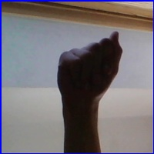
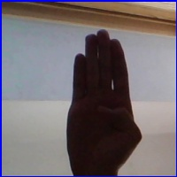
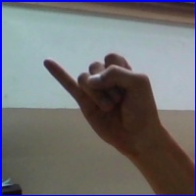
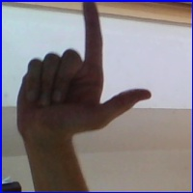
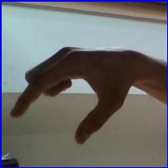
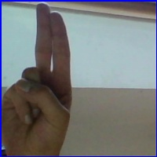
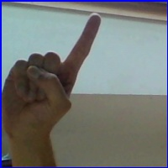
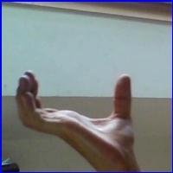
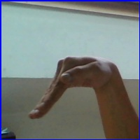

Select Examples from the Dataset
Class 0 - A
Class 1 - B
Class 9 - J
Class 11 - L
Class 16 - Q
Class 20 - U
Class 25 - Z
Class 26 - Space
Class 27 - Delete
Class 28 - Nothing

Slide 7
Preprocessing – Remove Padding
Every image is padded by a blue border.
This provides unneeded information that does not vary with each class
We choose to crop out 8 pixels from every edge of the image
This removes information that is not useful for discriminating classes, and preserves key information in the center of the image
Added benefit of reducing the size of the classifiers input/feature-space
Image size: 200 x 200 x 3 to 184 x 184 x 3
TODO: before & after cropping

Slide 8
Preprocessing – Rescaling
We can further reduce the size of the input space by rescaling each image to a smaller size
Rescaling will allow each sample to retain the key properties that can be used for discerning between classes
By creating a smaller input space, we can also shrink the number of parameters required by the model to classify images
A smaller model width can help mitigate any overfitting problems
Image size: 164 x 164 x 3 to 128 x 128 x 3
TODO: before & after rescaling

Slide 9
Appendex

